Slide 1




WELCOME
TO BRINK,
FUTURE BOBCATS!
New Student Information for 2023-2024 School Year

Slide 2

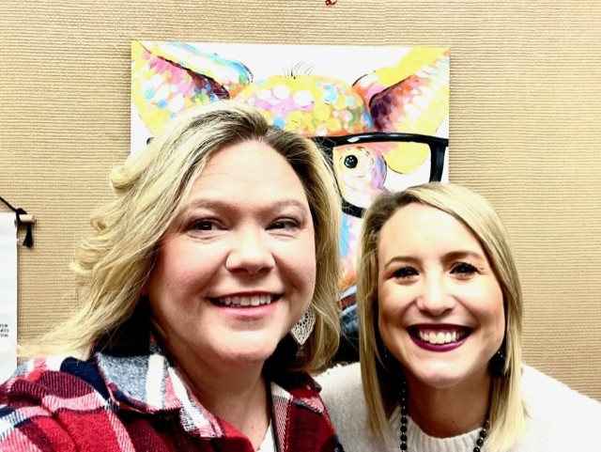
Hello!
Meet Your Brink Counselors!
Mrs. Roberts-7th Grade Counselor
Mrs. Martinez-8th Grade Counselor

Slide 3

Moore Public Schools
Online Registration
Login to Parent Portal account
Look on bottom left side for options and click on “More.”
Then, click on “Online Registration” link.
Visit the MPS Enrollment website for more information by clicking here.
February 27th-March 3rd

Slide 4

Every student will enroll in 5 core courses
English
Math
Reading
Science
Geography
For more information about each course, please review each Course Description by clicking here.

Slide 5
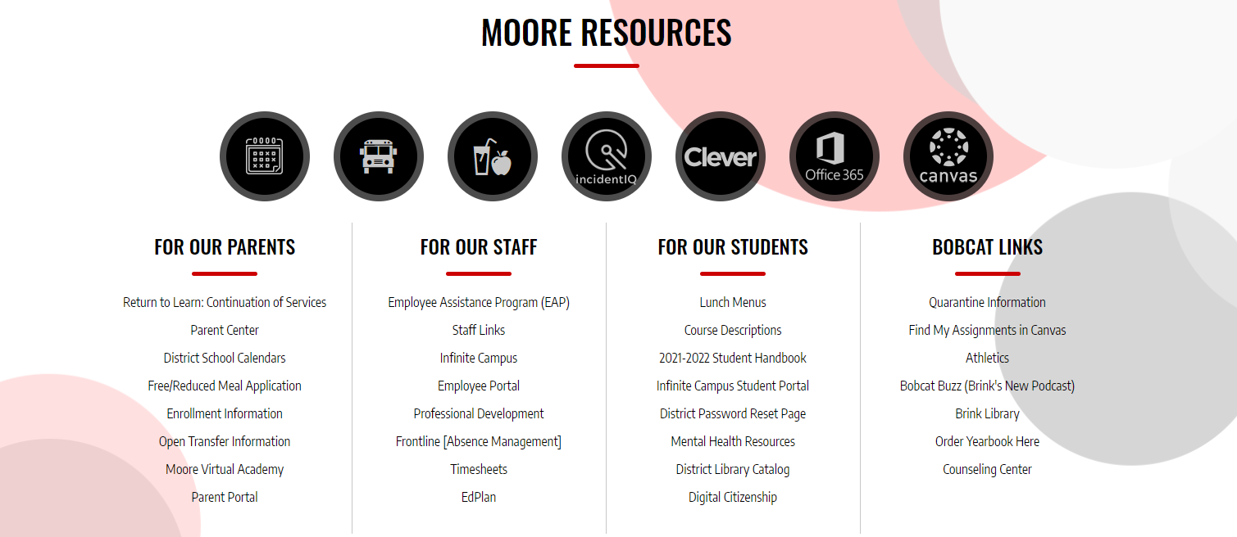
Brink Junior High Website

Slide 6

Available Honors Courses:
English
Math
Reading
Science
Geography
Honors Courses
For more information about Honors Courses, please click here.

Slide 7


Honors Enrollment Guidelines
The Purpose of Honors Courses:
Prepares students for future high school Honors & AP Courses
Provides college and career readiness
Advances higher-level thinking skills

Slide 8
Characteristics of Honors Courses
Moves at an accelerated pace
More time demanding
Requires work outside of class
Independent reading and research
Requires various projects

Slide 9
Rigorous independent work ​
Strong study skills​
Self-motivated​
Read on or above grade level​
Self-disciplined​
Organized​
Turn in assignments on time
Expectations of Honors Students:

Slide 10
Honors Math Specifics
Math Honors Pre-Algebra advances one year ahead and must begin in 7th grade. Algebra I is only available to those who test into it.
3 years of math must still be taken in 9th-12th grade regardless of math taken in junior high.
Except for math, you do not have to be in Honors one year to take it the next year.

Slide 11
Special Education needs will be addressed on an individual basis.​
Your elementary school will forward student information to us. ​
If you have questions, please contact our Special Education Department Chair, Rhonda Pfenning at rhondapfenning@mooreschools.com.
Special Education

Slide 12
Electives
Band
Art
Chorus
2D & 3D art
Art is a 1 or 2 semester course
Additional fee & supplies required
Brass
Woodwind
Percussion
No previous musical experience is required. Click here for a short video!
Additional fee & supplies required
S.T.E.M.
Physical Education
Science, Technology, Engineering, & Math
PE can be a 1 or 2 semester course

Slide 13
Before School Starts in August...
You will need a new current proof of residence to pick up your student’s schedule in August.
Gas Bill
Water Bill
Electric Bill
Lease/Mortgage Contract
Bus Information - bus information will be provided on our Brink Website. Look for the bus icon towards the bottom of our homepage.
All students entering 7th grade are required to have a Tdap vaccination.

Slide 14

BRINK CREW
Creating Relationships through Encouragement & Wisdom
Led by 8th Grade Brink Crew Leaders in August
Creates an easier transition into a new school
Introduces students to their new school, classmates, and 8th grade leaders

Slide 15
Bobcat Lunch Options
Cafeteria:
Traditional hot lunch/sandwich line/salad line​
Snack bar- single items
Student Store:
Cash Only
Eagle One
Taco Bueno
Bring Your Own Lunch:
Students may bring their own lunch and eat in the cafeteria or under our Pavillion.
Breakfast is available at 7:10 a.m.

Slide 16
Clubs and Organizations
Academic Team
Art Club
Band
Choir
FCA
Multicultural Club
National Junior Honor Society
Robotics Club
STUCO
Technology Student Assistance

Slide 17



Brink Athletics
"WE over me"
Considered an after-school activity
Health physical required
Must hold passing grades in all classes to be eligible to participate
Attendance is mandatory
For more information: Please contact James Robb, Brink Athletic Director, at jamesrobb@mooreschools.com.

Slide 18
BRINK ATHLETICS
Archery
Basketball
Cheer
Cross Country
Football
Golf
Pom
Softball- Fastpitch (Fall)
Softball- Slow Pitch (Spring)
Track
Volleyball
Wrestling
WE ARE BRINK!

Slide 19

Brink Communication
FOLLOW US ON INSTAGRAM & TWITTER: @THEBRINKBOBCATS​
LISTEN TO OUR PODCAST: BOBCAT BUZZ- YOU CAN FIND THE LINK TO OUR PODCAST ON THE BRINK WEBSITE UNDER "BOBCAT LINKS".
CHECK OUT OUR CALENDAR ON THE BRINK WEBSITE TO STAY UP-TO-DATE ON ALL OF OUR EVENTS.
LOOK AT THE FLYERS ON PEACHJAR- THESE FLYERS CAN BE FOUND BY CLICKING THE PEACH ICON ON OUR WEBSITE.

Slide 20

We look forward to seeing you soon!
Do you have any questions?
Mary Beth Roberts
Marybethroberts@mooreschools.com
7th Grade Counselor 23-24
Kimberly Martinez
kimberlymartinez@mooreschools.com
8th Grade Counselor 23-24

