Slide 1
OKCareerGuide.org

Slide 2
Students

Slide 3
Using Clever to Login
Go to OKCareerGuide.org
Click ‘Login’
Select ‘Log In with Clever’
Enter your school
365 Login

Slide 4
Creating an Account without Clever
Create an account→ choose the appropriate category (middle or high school student)
Select and Fill in your information
For your username use your 1st & last name
For your password use your student ID number
Click next step
*If at this point is says ‘username already taken’ then add a 1 to the end of your user name
Fill in the remaining information
Click ‘Sign Me up’ one time
*If at this point is says ‘username already taken’ then open okcareerguide.org in a separate browser window and sign in using your newly created log in

Slide 5
If you can’t get logged in DO NOT create a new account
Try logging in with your 1st and last name and then add a 1 to the end
  Example: instead of micahwilleford try micahwilleford1
Didn’t work? Try this:
Try adding a space in your user name
  Example: instead of micahwilleford try micah willeford
Still not working?
  Click forgot username
  and/or
  Click forgot password
STILL not working?
  Ask your teacher to look you up

Slide 6
Student Account Tutorial

Slide 7
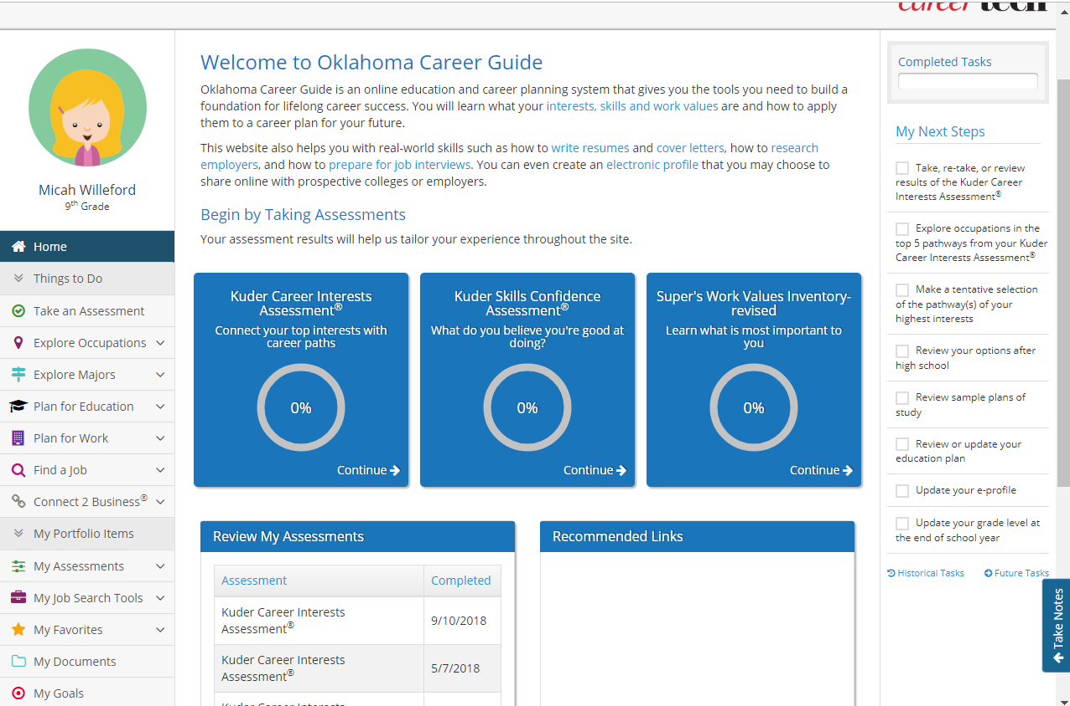
Your Dashboard (Homepage)
My Next Steps
A checklist to keep you on tract.
Updating your grade updates your checklist
Assessments
Navigation Pane & Table of Contents
Assessment Results
‘My Favorites’

Slide 8
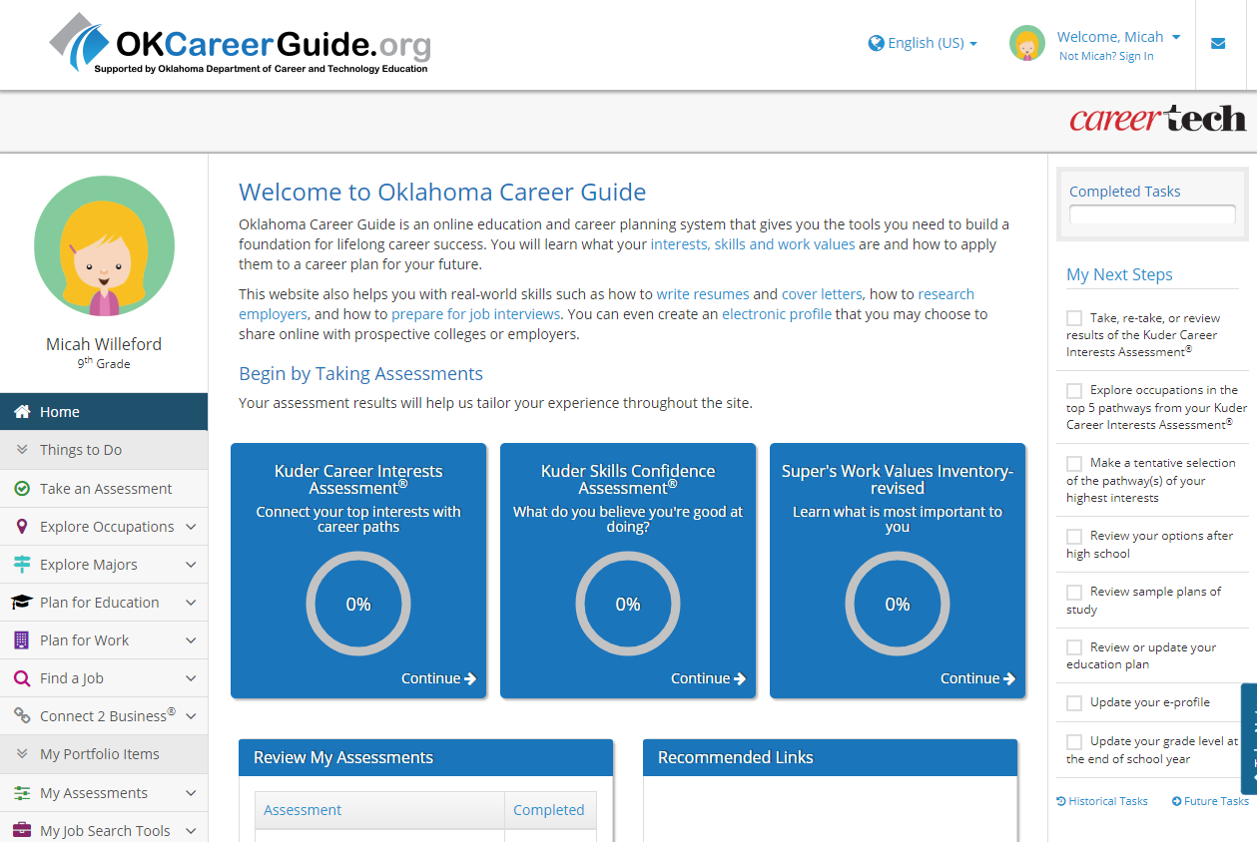
Take an assessment or three!
Once you click on the assessment you want to take, you’ll find the instructions for each assessment located at the top of the page.
7th and 8th grade accounts only show the first 2 assessments

Slide 9
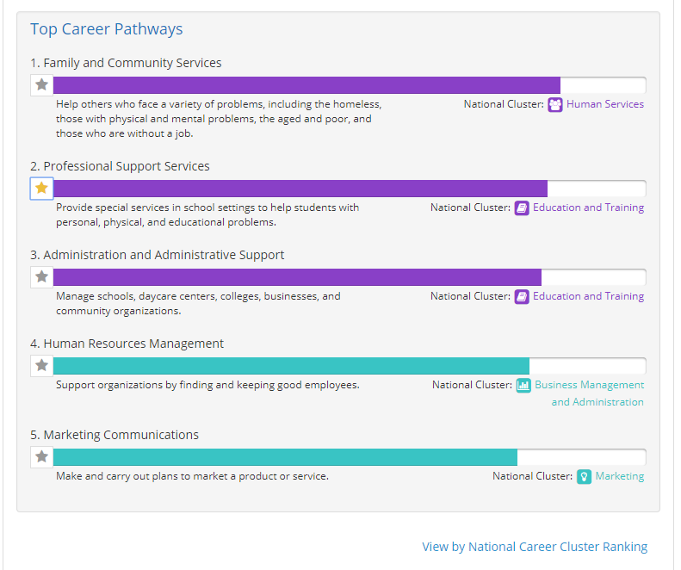
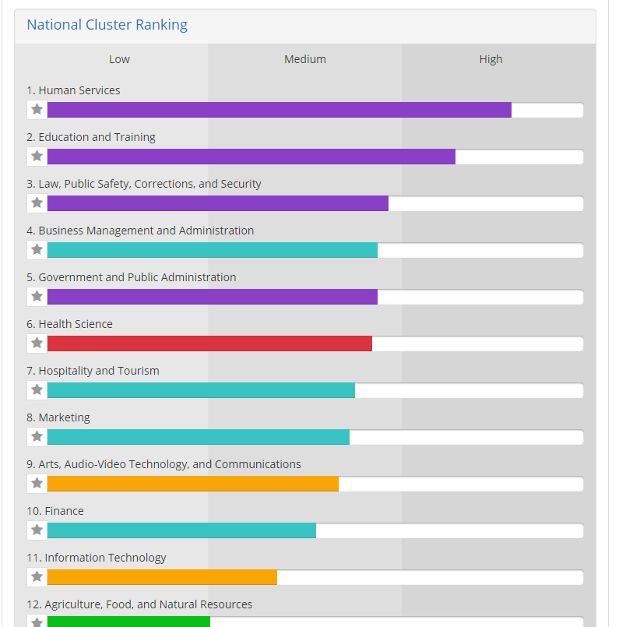
The first assessment looks at your Interests in relation to Careers & reports your top ranking Pathways (categories of occupations) or click ‘view by National Career Cluster ranking’ to see the Cluster Ranking

Slide 10
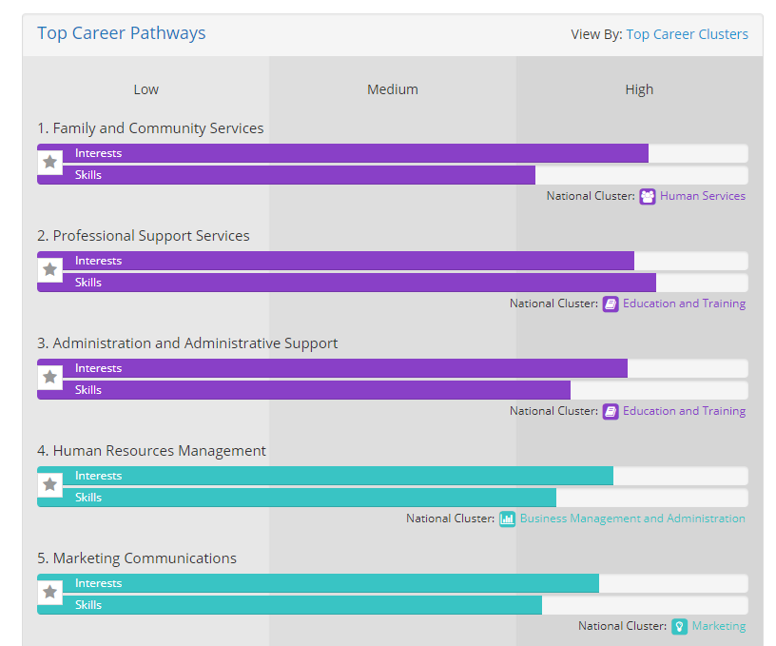
The second assessment looks at your SKILLS in relation to Careers & reports your top ranking Pathways (categories of occupations) and compares them to your interests in those high skill areas

Slide 11
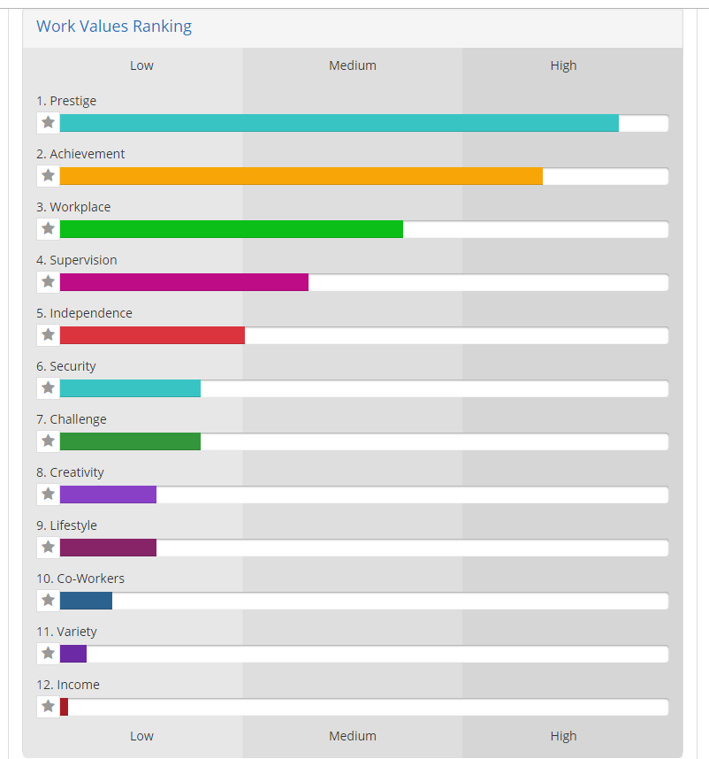
The third assessment looks at your WORK VALUES in relation to Careers & reports your top ranking Values (what’s important to you in a career).

Slide 12
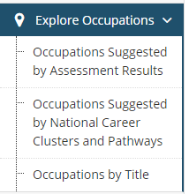
Can’t find an occupation you like?
Look at the left hand navigation bar and click on ‘EXPLORE OCCUPATIONS’
Click through the occupations listed in your results
Search through all the clusters and pathways
Search for a specific occupation by title or key word

Slide 13
An Occupation (Job) you’re interested in!

Slide 14
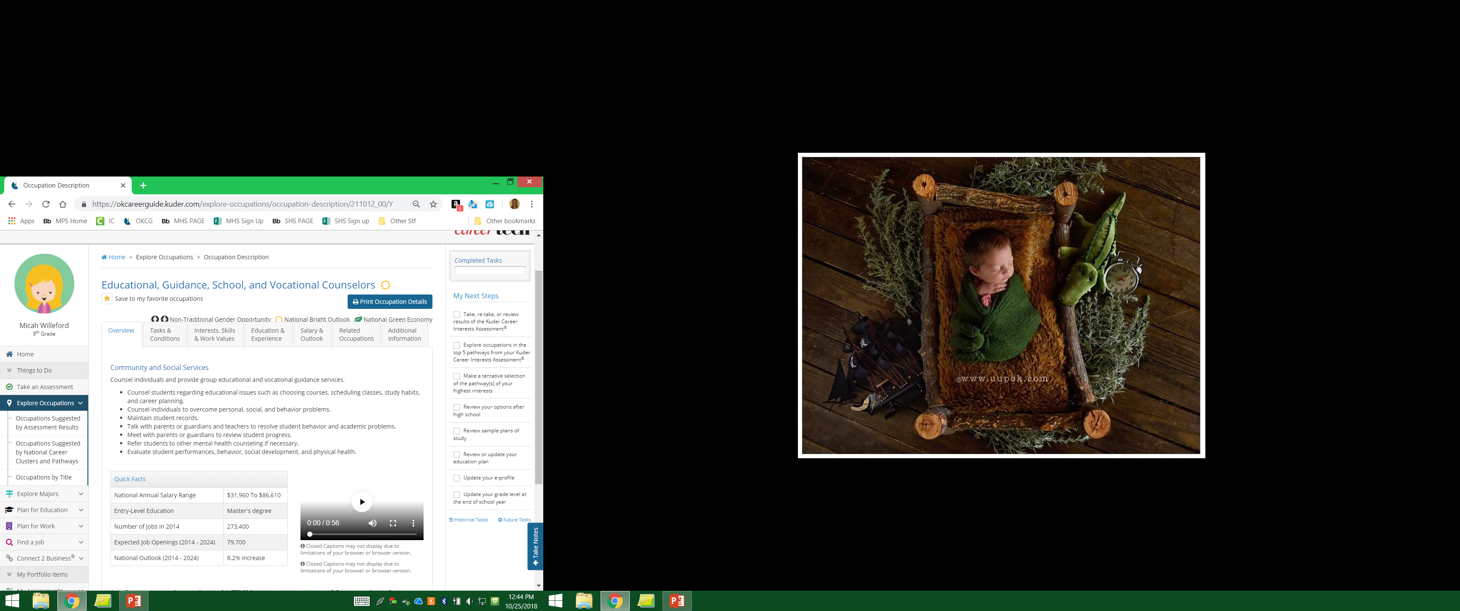
Quick Facts!
7 Tabs of DETAILS
A Video? Watch it!
Like the occupation? Save it to your Favorites by clicking the star!

Slide 15
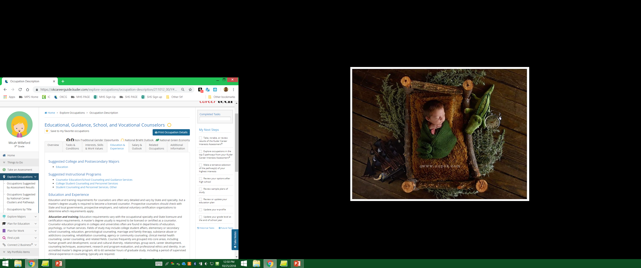
Click the
Education &
Experience
Tab
This page will tell you what levels of Education, Experience, Certifications, Trainings etc. you’ll need
You will also see a list of Majors & Programs you can study to become this occupation

Slide 16
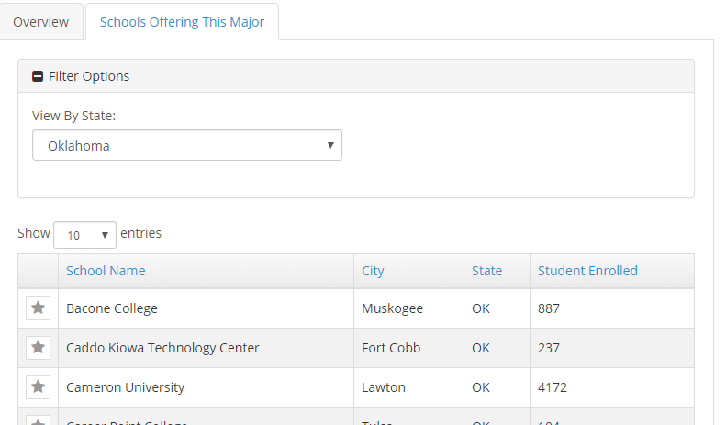
Click on a Major or Program
Here is a list of schools in Oklahoma that offer that Program or Major!
Click on a school for more info

