Slide 1

Welcome Class of 2023
Ms.Shah, Mr. Martin-Fodor, Ms. Weeks, Mrs. Brown
and SCHS student panel

Slide 2
What is AVID?
AVID = “Advancement Via Individual Determination”
SCHS Vision …. We graduate lifelong learners who aspire to improve themselves and the world.
AVID's mission is to close the achievement gap by preparing all students for college readiness and success in a global society.
The AVID program will ….
Prepare your student to be a successful high school student.
Give your student tools to use in all of their classes.
Teach students how to collaborate and how to delegate teamwork.
Learn about college entrance requirements.
Explore colleges based on their interests.
Promoting a COLLEGE going Culture at SCHS.

Slide 3
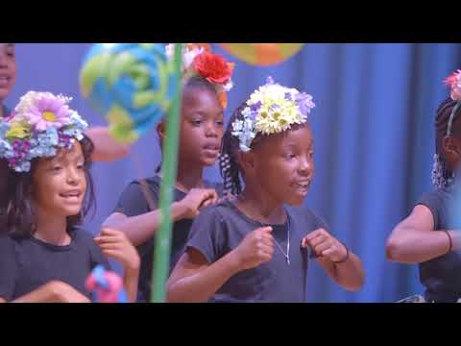
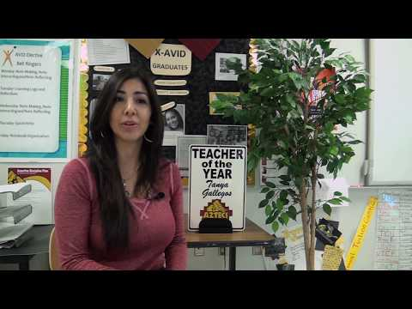

Slide 4

AVID - 4 year commitment
4 year commitment signed on contract
Avid is a process, college will not be achieved overnight
Freshman | Sophomore | Junior | Senior
Organization Time management College Presentations Field trip to local colleges Community Service Public Speaking Getting involved in School Activities Creating a 4 year plan- including courses and tests that need to be taken | College Presentations Field trip to colleges Community Service PSAT practice SAT practice and ACT practice Introducing scholarships/ Financial Aid opportunities Summer internship/ program opportunities Guest Speakers with different career and school backgrounds Mock Job interviews | College Presentations Field trip to colleges Community Service PSAT Test SAT/ACT Test Subject SAT tests College Application Introduction Essay writing for college applications Financial Aid Application Scholarship Applications Narrowing down list of college | Asking teachers for college recommendations Final list of Colleges to Apply too Complete College Application Complete Financial Aid/ Scholarship Applications Lessons on Budgeting and Finance

Slide 5
AVID Elective: Strategies
Tutorials
Binder Checks
eLearning Logs
Cornell Notes
College applications/Financial Aid/Scholarships
Field trips to colleges/ College presentations
WICOR Activities

Slide 6





What do AVID strategies look like in SCHS classrooms? ...“WICOR”
Writing
Inquiry
Collaboration
Organization
Reading

Slide 7
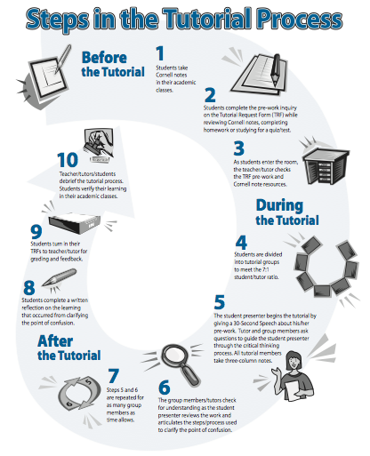
Tutorials
Ask questions based on lowest grade
PSAT questions are used if students do not have questions
Groups with 1 college tutor
Twice a week

Slide 8
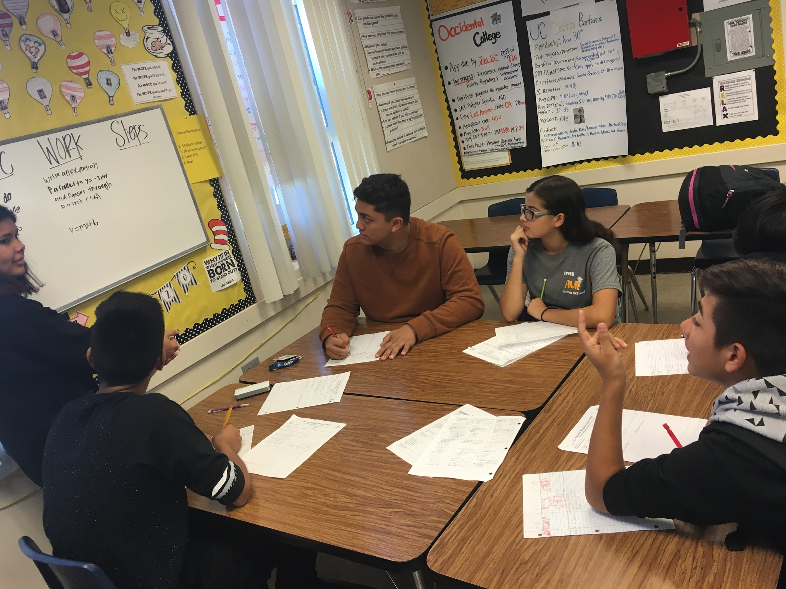
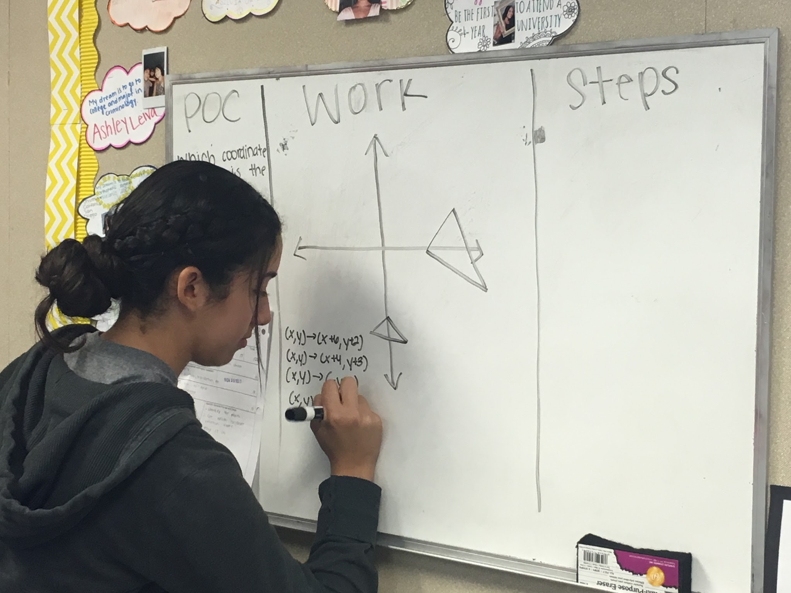
Tutorials

Slide 9

Binder checks
Every SCHS Freshman is given a binder, graded every week
Agenda Check
  Month view
  Week view (HW becomes a to do list)
Cornell Notes
  10 pages
  3 Essential Questions
  3 summaries
2 eLearning Logs per week (completed online)

Slide 10

eLearning Logs
Earn higher grades
Retain learned information
Check spelling & grammar
Practice your typing speed
  Additional practice on www.typing.com

Slide 11
Student Panel
How has AVID helped you succeed at SCHS?
If you could give one suggestion to parents’ of AVID students, what would it be?
What is one AVID strategy that you will use when you go to college?

Slide 12
Parent Commitment
Four Year Program
Keep open communication with student and their teachers. Utilize School Loop.
Weekly check-ins with students.
Encourage students to participate in college visits and fundraising efforts for Spring College Tour their Junior year.
Hold students accountable for their homework and their projects. Responsibilities earn privileges.
Teachers and Counselors at SCHS are here to partner with you to support OUR students.

Slide 13
AVID Contacts
Mr. Martin-Fodor: Class of 2023 Teacher
Ms. Weeks: Class of 2023 Counselor
Ms. Shah: SCHS AVID Site Coordinator
Mrs. Brown: SCHS Vice Principal
Ms. Lamay: SCUSD District Support
Register for Schoolloop: santaclara.schoolloop.com
Best way to communicate with teachers and counselors
View your child’s grades
Stay up to date with upcoming activities

Slide 14

