Slide 1
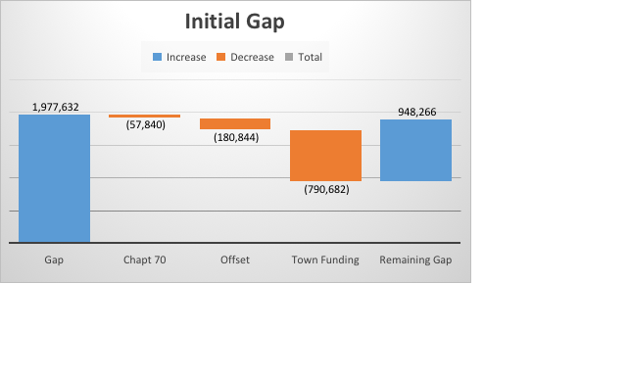
FY19 MOE Budget
Description | Amount
FY19 MOE Budget (12/17) | $34,574,302
Adjustments
Retirements | ($23,000)
Transportation Revolving Offset | ($105,000)
Enrollment Shifts | ($130,000)
FY19 MOE BUDGET as of 1/16/18 | $34,316,302
Resulting Budget Gap | $1,977,632
Additional Revenues
Increase in Chapter 70 (estimate $20/student) | $57,840
Increase in Town Contribution (Town Admin Prelim Budget 1/29) | $790,682
Solar Farm Utility Offset | $180,844
Total | $1,029,366
Remaining Budget Gap | $948,266
Key Gap Drivers:
Vocational tuition $250,000
Special Ed Increases $383,424
Transportation $131,324
Collective Bargaining $972,903

Slide 2
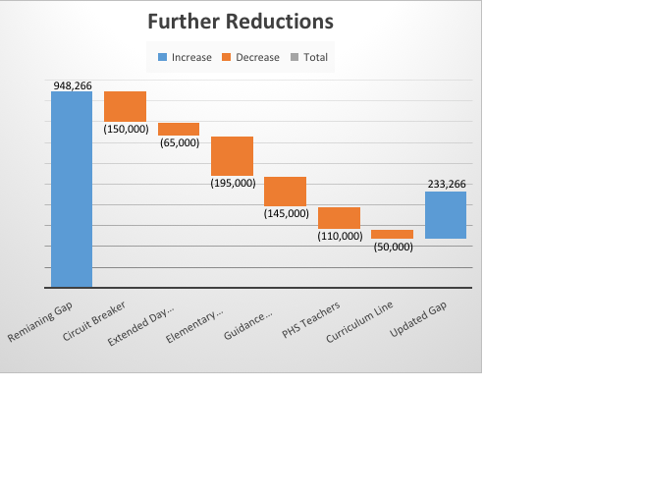
FY19 Budget Balancing…
A little ways to go
Description | Amount | Notes
Remaining Budget Gap | $948,266
Additional Circuit Breaker Offset | ($150,000) | Using reimbursement in same FY that it is received
Extended Day Revolving Offset | ($65,000) | Move 1.0 Teacher to revolving account for FY19
Remaining Gap | $733,266
Additional Reductions
3.0 Elementary Positions | ($195,000) | Enrollment driven (detail in appendix)
7-12 Guidance Restructure | ($145,000) | Enrollment / Change in Program Delivery
1.4 PHS Teachers | ($110,000) | Enrollment Driven
Remaining Gap | $283,266
Reduction in Districtwide Curriculum Line | ($50,000)
Remaining Gap | $233,266

Slide 3
FY19 Budget Balancing…
Description | Amount | Notes
Remaining Budget Gap | $233,266
Additional Reductions:
Reduction in support staff | ($72,000) | Enrollment Driven
Remaining Gap | $161,266
Additional Revenues:
Fees | $0
Chapter 70 Increase | $14,460 | $5/student
Additional Funding from the Town | $80,000 | Health Insurance
Subtotal | $66,806

