Slide 1
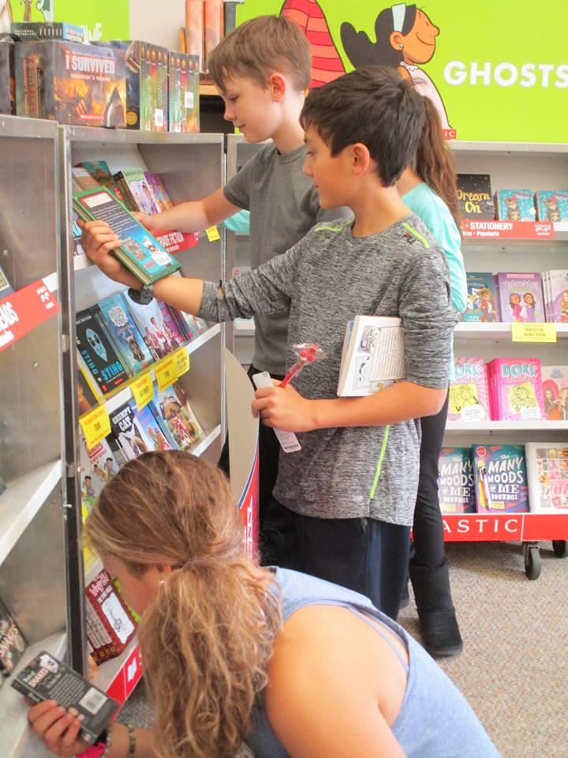
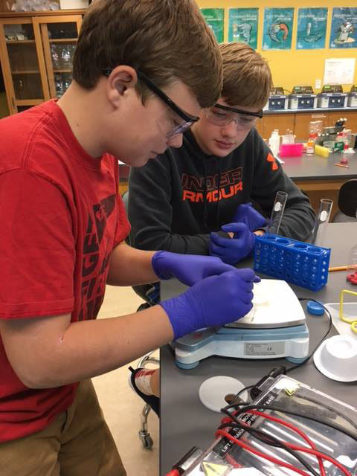
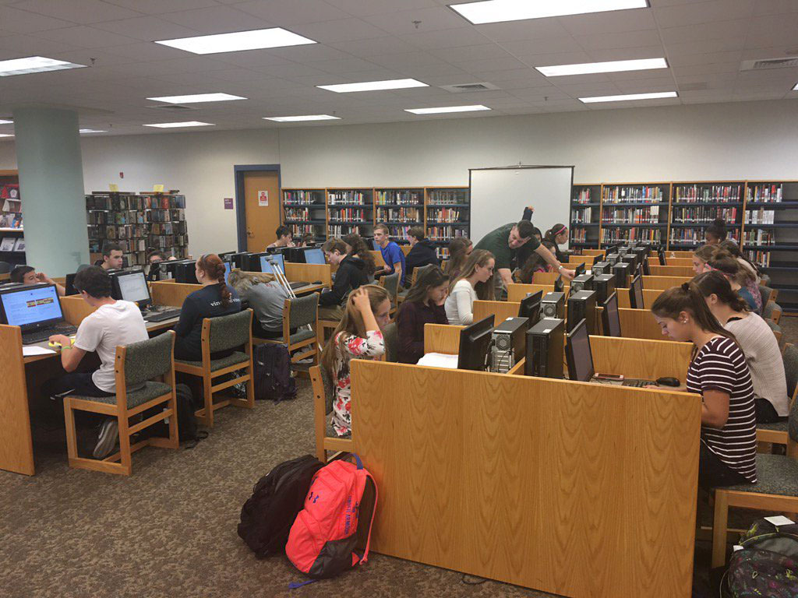

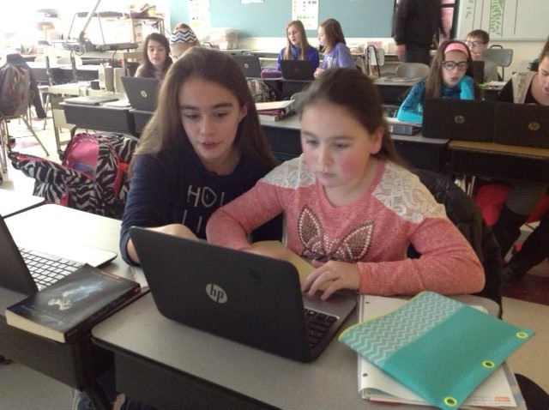
PEMBROKE PUBLIC SCHOOLS
FY19 Budget Presentation
February 6, 2018
OUR MISSION:
To ensure student achievement through excellence in teaching and learning.
72 Pilgrim Road, Pembroke, Massachusetts 02359

Slide 2
Priorities in the FY19 Budget
Achievement – Offering free Full Day Kindergarten for SY18-19
Achievement/Technology – Restructuring Math Apps at PCMS to have a STEM focus with project based learning
Technology – Restructuring of current staff to delineate between Instructional and Informational Technology
Social Emotional Health & Wellness – Investigating various schedule options at the secondary level that would allow for more opportunities for students

Slide 3
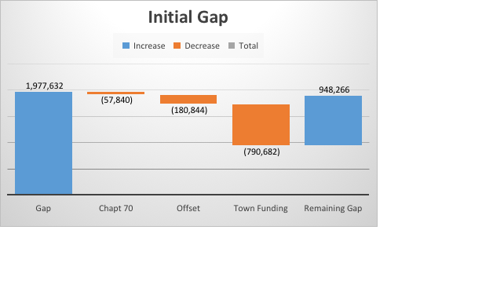
FY19 MOE Budget
Description | Amount
FY19 MOE Budget (12/17) | $34,574,302
Adjustments
Retirements | ($23,000)
Transportation Revolving Offset | ($105,000)
Enrollment Shifts | ($130,000)
FY19 MOE BUDGET as of 1/16/18 | $34,316,302
Resulting Budget Gap | $1,977,632
Additional Revenues
Increase in Chapter 70 (estimate $20/student) | $57,840
Increase in Town Contribution (Town Admin Prelim Budget 1/29) | $790,682
Solar Farm Utility Offset | $180,844
Total | $1,029,366
Remaining Budget Gap | $948,266
Key Gap Drivers:
Vocational tuition $250,000
Special Ed Increases $383,424
Transportation $131,324
Collective Bargaining $972,903

Slide 4
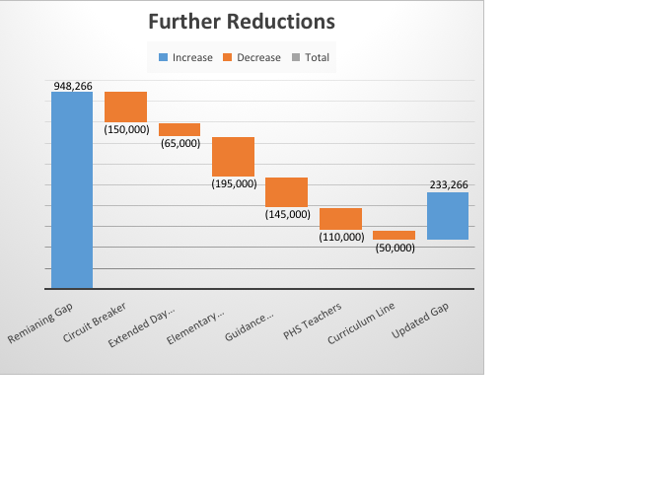
FY19 Budget Balancing…
A little ways to go
Description | Amount | Notes
Remaining Budget Gap | $948,266
Additional Circuit Breaker Offset | ($150,000) | Using reimbursement in same FY that it is received
Extended Day Revolving Offset | ($65,000) | Move 1.0 Teacher to revolving account for FY19
Remaining Gap | $733,266
Additional Reductions
3.0 Elementary Positions | ($195,000) | Enrollment driven (detail in appendix)
7-12 Guidance Restructure | ($145,000) | Enrollment / Change in Program Delivery
1.4 PHS Teachers | ($110,000) | Enrollment Driven
Remaining Gap | $283,266
Reduction in Districtwide Curriculum Line | ($50,000)
Remaining Gap | $233,266

Slide 5
Additional Items for Consideration
Description | Amount | Notes
Remaining Budget Gap | $233,266
1. Elementary Bus Fee | $40,000 | Reinstate fee for students living less than 2 miles
2. Explore Before/After School Care |  | Potential Revenue Generation
3. Additional Elementary Reductions |  | Class sizes over 25

Slide 6
Next Steps
Continue to work with Town Dept. Heads – Next Meeting 2/12/18
Continue to develop reduction scenarios with Administrative Team – 2/15/18
Present budget to Board of Selectmen/Advisory – 2/26/18 -3/12/18
Invite Sen. DeMacedo & Rep. Cutler for Budget Discussion 3/18 (waiting on date confirmation)
Release of House Ways and Means Budget – 4/18

Slide 7
Full Day Kindergarten
Historical Revenue:
Expenditures from Revolving:
Year 1 Costs:
  One Additional Teacher
  Year 2 Gains: Additional $550,000 in Chapter 70
Year | Amount
FY18 | $328,824
FY17 | $289,136
FY16 | $316,556
FY15 | $262,979
Description | Amount
Kindergarten Teachers | $162,512
Kindergarten Paras | $28,902
PreSchool Paras | $137,328
Total | $328,742

