Slide 1
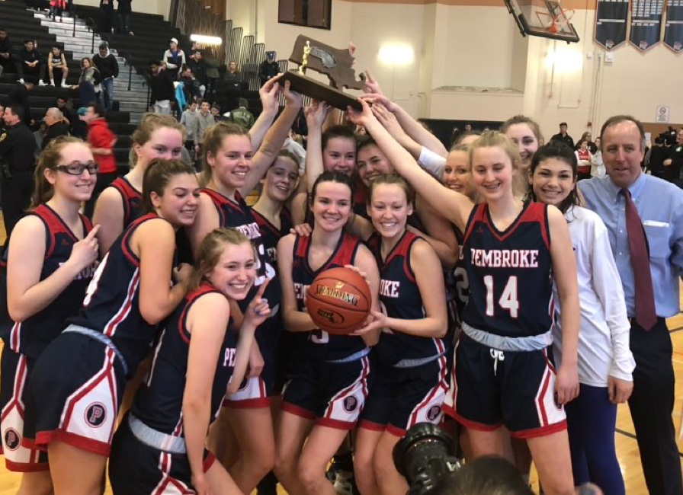
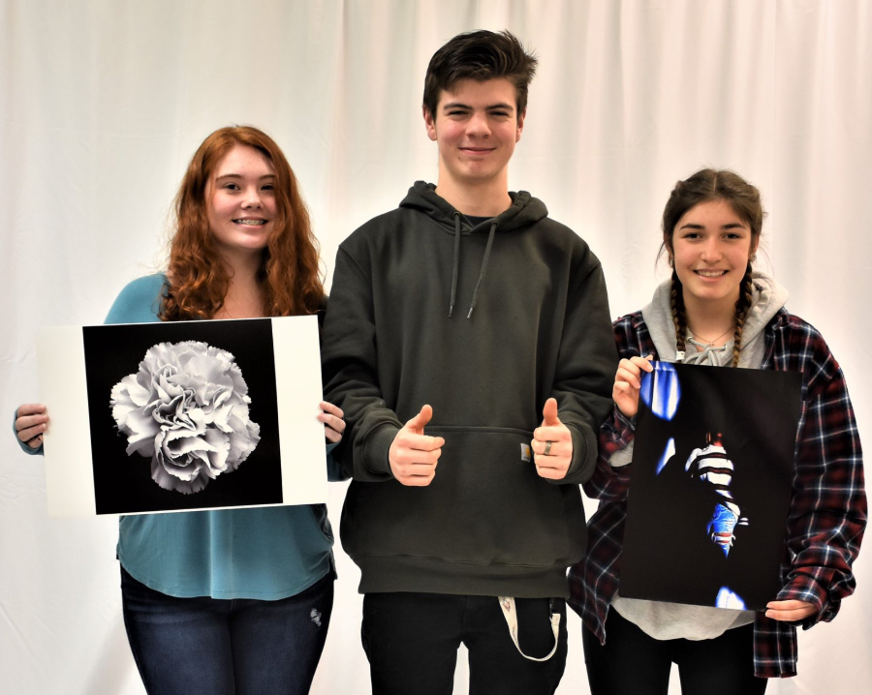
PEMBROKE PUBLIC SCHOOLS
Pembroke High School FY21Budget Presentation
February 4, 2020
OUR MISSION:
To ensure student achievement through excellence in teaching and learning.
72 Pilgrim Road, Pembroke, Massachusetts 02359

Slide 2
Overview
Enrollment and Class Size Data
FY21 Budget Priorities
Rationale

Slide 3
Historical PHS Enrollment
School | 2011-12 | 2012-13 | 2013-14 | 2014-15 | 2015-16 | 2016-17 | 2017-18 | 2018-19 | 2019-20
PHS | 944 | 955 | 984 | 1020 | 1005 | 967 | 916 | 843 | 816

Slide 4
Average Class Sizes FY20
ELA | Math | History | Science | World Language | VPA | PE
18 (+1) | 18.5 (+.7) | 21.4 (E) | 15.8 (E) | 16.9 (+.9) | 19.8 (-2) ------------ M – 20 A – 19.5 | 24.5 (+4)

Slide 5
PHS Priorities for FY21
Category | Description | Cost | Notes
Achievement/Social Emotional | 1.0 Teacher | $65,000 | Assign to Compass Program to assist with instruction and continue growth of program
Technology | 1.0 Educational Technology Integration Specialist | $65,000 | Work with teachers to create lessons that allow students to interact with educational technologies
 | Total | $135,000

Slide 6
Rationale- Teacher
Aligns with district goals of academic achievement and social emotional wellness
Allows for growth of Compass Program to include an instructional component
  Currently staffed by paraprofessional
  Offers tutoring when possible but not able to fill in content gaps due to long-term absence
  Currently reassigning a building substitute teacher to assist
25 students utilized Compass as of Jan 31, 2020
    40% for Mental Health
    60% for other medical needs (concussion, long term illness)
    Almost identical numbers to this time last year (41%-59%)
    Some for overlapping needs
    56% (14) for 10 days or more
      four of those students 30+ days, each of whom will spend a portion of the day there for the rest of the year

Slide 7
Rationale – Ed. Tech. Integration Specialist
Aligns with district goals of achievement and technology
Ample devices
  6 computer labs
  Language lab
  4 laptop carts – 150 brand new Chromebooks
  BYOD network allows for even more devices
Need to “teach teachers” how to integrate this educational technology more readily
For example BYOD underutilized
  Phones are most common device
  Not often used for educational purposes
  Can we create a cultural shift that encourages use of additional devices
New Maker Space in Library
Need to find ways for students to interact with technology (as opposed to staff)

Slide 8
Forecasting FY22 priority
Include offerings/create courses that are more “hands-on” for our students.
Courses that require students to create, design, manufacture finished products
Commitment to recourses and additional staff
Rationale –
  Better service a growing segment of our population looking to explore such programming
  Retain students at PHS that may look to other schools for those experiences
  Deliver a well-rounded education to all students

