Slide 1
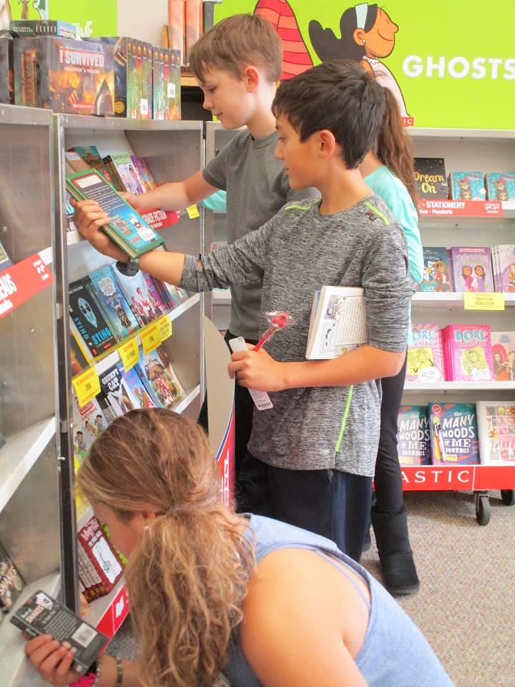
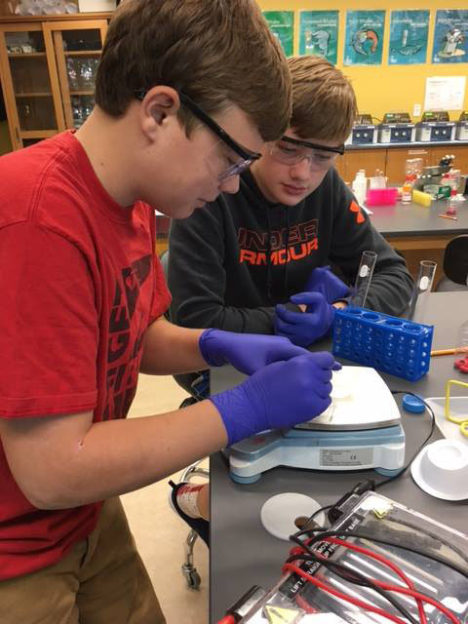
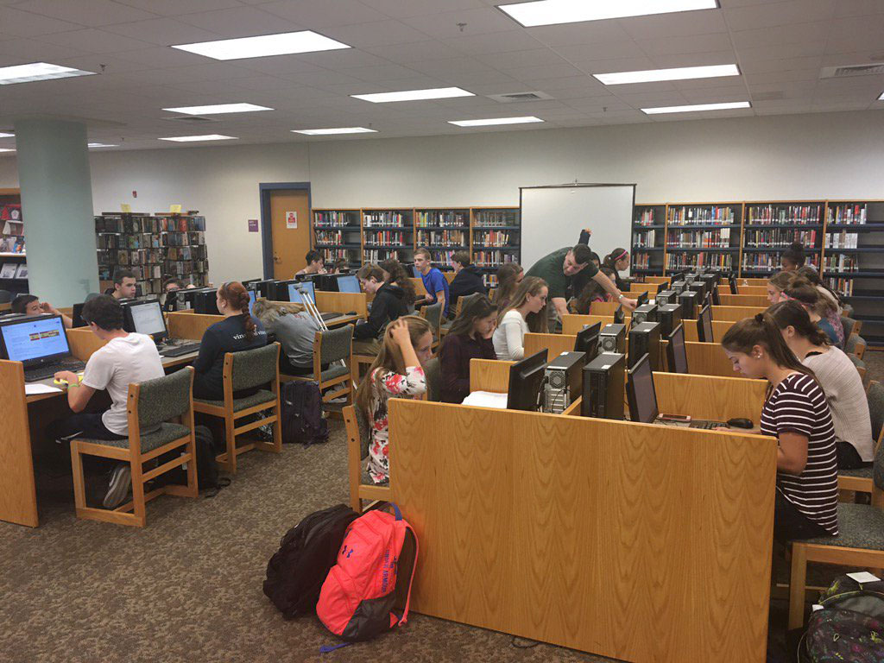
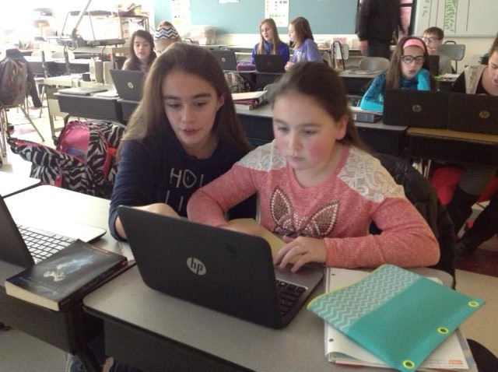
PEMBROKE PUBLIC SCHOOLS
Elementary FY21 Budget Presentation
February 4, 2020
OUR MISSION:
To ensure student achievement through excellence in teaching and learning.
72 Pilgrim Road, Pembroke, Massachusetts 02359

Slide 2
Overview
Historical Information
Data
FY21 Budget Priorities

Slide 3
Historical Elementary Enrollment
School | 2012-13 | 2013-14 | 2014-15 | 2015-16 | 2016-17 | 2017-18 | 2018-19 | 2019-20
Bryantville | 640 | 608 | 606 | 547 | 514 | 502 | 499 | 488
Hobomock | 450 | 473 | 439 | 446 | 435 | 429 | 425 | 403
North | 601 | 626 | 593 | 561 | 520 | 478 | 497 | 485
Total | 1,691 | 1,706 | 1,638 | 1,554 | 1,469 | 1,409 | 1,421 | 1,376

Slide 4
Class Sizes
Bryantville FY20 | K | 1 | 2 | 3 | 4 | 5 | 6
Enrollment | 67 | 77 | 68 | 63 | 70 | 73 | 70
# of Sections | 3 | 4 | 4 | 3 | 3 | 3 | 3
Average class size | 22 | 19 | 17 | 21 | 23 | 24 | 23
FY21 Projected | K | 1 | 2 | 3 | 4 | 5 | 6
Enrollment | 66 | 67 | 77 | 68 | 63 | 70 | 73
# of Sections | 3 | 3 | 4 | 4 | 3 | 3 | 3
Average class size | 22 | 22 | 18 | 20 | 24 | 26 | 22
Hobomock FY20 | K | 1 | 2 | 3 | 4 | 5 | 6
Enrollment | 51 | 53 | 60 | 53 | 72 | 56 | 58
# of Sections | 3 | 3 | 3 | 3 | 3 | 3 | 2
Average class size | 17 | 18 | 20 | 18 | 24 | 19 | 28
FY21 Projected | K | 1 | 2 | 3 | 4 | 5 | 6
Enrollment | 55 | 51 | 53 | 60 | 53 | 72 | 56
# of Sections | 3 | 3 | 3 | 3 | 3 | 3 | 2
Average class size | 19 | 17 | 18 | 20 | 18 | 24 | 28
North Pem FY120 | K | 1 | 2 | 3 | 4 | 5 | 6
Enrollment | 55 | 71 | 63 | 65 | 70 | 87 | 74
# of Sections | 3 | 4 | 3 | 3 | 3 | 4 | 3
Average class size | 18 | 18 | 21 | 22 | 23 | 22 | 25
FY21 Projected | K | 1 | 2 | 3 | 4 | 5 | 6
Enrollment | 66 | 55 | 71 | 63 | 65 | 70 | 87
# of Sections | 3 | 3 | 4 | 3 | 3 | 3 | 4
Average class size | 22 | 18 | 18 | 21 | 22 | 23 | 22

Slide 5
The Story Behind the Numbers
Number of Students with IEPs (Individual Education Plans):
    Bryantville –16%
    Hobomock – 15%
    North – 15%
    Preschool – 42%
Number of Students with 504 plans (Accommodations):
    Bryantville – 6%
    Hobomock – 4%
    North – 3%
    Preschool - <1%

Slide 6
Social Emotional Support
Small Group/Individual Intervention
Classroom-Based Intervention
Daily student check-ins
Morning student support update (DCF updates, family consultation, & assignment of targeted support for dysregulated students
Daily family follow-up
Daily social skills lunch groupings
1:1 crisis management availability
Peer mediation
Building restorative practices in small group setting
Modeling conflict resolution strategies at recess
Classroom social skill lessons
Leading morning meetings
Classroom-based student observation
Providing support for behavior management strategies in classroom setting
Supporting classroom teachers through ongoing professional development

Slide 7
Current Focus
Tier 1, 2 and 3 Social Emotional Support (Previous year addition .5 social worker)
Empowering Writers
Science
Intervention Software for Math and Reading
Trauma Informed Practices
Technology (This year addition of student devices)

Slide 8
In-coming Kindergarten Themes
Readiness inequities of those attending preschool and those not
Increased social emotional support
Increased academic expectations
Increased Title 1/Reading intervention support
Current screening tools do not identify children who need extra support for transition to school

Slide 9
Office Paraprofessional Responsibilities
Special Education Clerical **
504 Clerical
Receptionist **
Meeting Coordination **
Facilities Coordination
Duties and Student Support **
Project Management (i.e. Kindergarten Registration)
Dismissal Coordination

Slide 10
Budget Priorities for FY21
Social Emotional
.5 Social Worker at Hobomock
Social Emotional
Restorative Practices PD & Support
Academic/Social Emotional
Screening Tool for Incoming Kindergarteners
Transition Program for Those Identified
Academic
Grade 6 Science Curriculum Alignment

