Slide 1
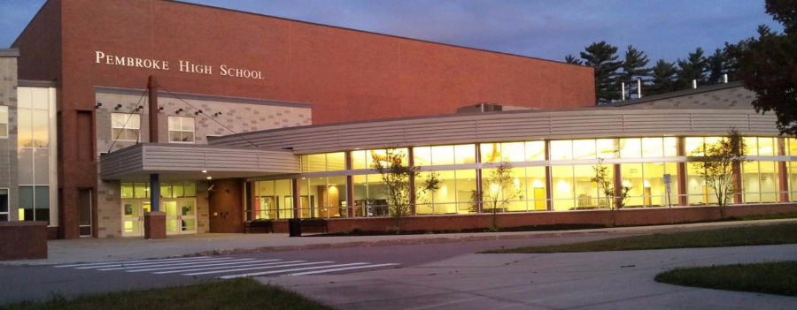
PEMBROKE PUBLIC SCHOOLS
Maintenance Department FY2021 Overview
February 12, 2020
OUR MISSION:
To ensure student achievement through excellence in teaching and learning.
72 Pilgrim Road, Pembroke, Massachusetts 02359

Slide 2
Maintenance Department Goals FY21
Continue Custodial training and certification through Massachusetts Facilities Administrator Association program for each district custodian through FY21
Evaluate and improve districts parking lots and build plan for re-lining & paving
Evaluate & repair Carol Dodge field erosion/drainage problem

Slide 3
Budget Overview
Description | Amount
Facilities Manager | $55,659
Aggregate Custodial Personnel (18.0 FTE) | $1,089,962
Contracted Services | $405,000
Annual Collaborative Buy | $42,000
Substitute coverage | $40,000
Total: $1,632,621

Slide 4
Contracted Services Overview FY2020
Description | Amount
FY2019 | $405,000
Miscellaneous | $23,700
Preventive Maintenance | $19,750
Repairs | $157,050
Service Agreements | $81,000
Custodial Supplies | $21,757
Waste Water Supplies & Services | $33,622

Slide 5
Repairs: $157,050 (7/1/2019 to present)
Vendor Type |  | YTD | Percent
HVAC | Repairs to roof top units, uni-vents in classrooms, HVAC controls. | $87,948 | 56%
Plumbing | Leak repairs; faucet / toilet / shower replacements. | $26,699 | 17%
Electrical | General lighting repairs, outlet repair, exterior lighting repair. | $12,564 | 8%
Phones | General repairs to phone lines, new phone installation, transfer of extensions and VM. | $4,711 | 3%
Equipment | Repairs to custodial equipment: floor machines, vacuums, etc. | $6,282 | 4%
Doors, structures | Repairs to locks, handles, doors and entry ways. | $5,715 | 4%
Alarm Systems | Repairs to fire and burglar alarms | $5,132 | 3%
Roofing | Repairs to Roof | $7,999 | 5%

Slide 6
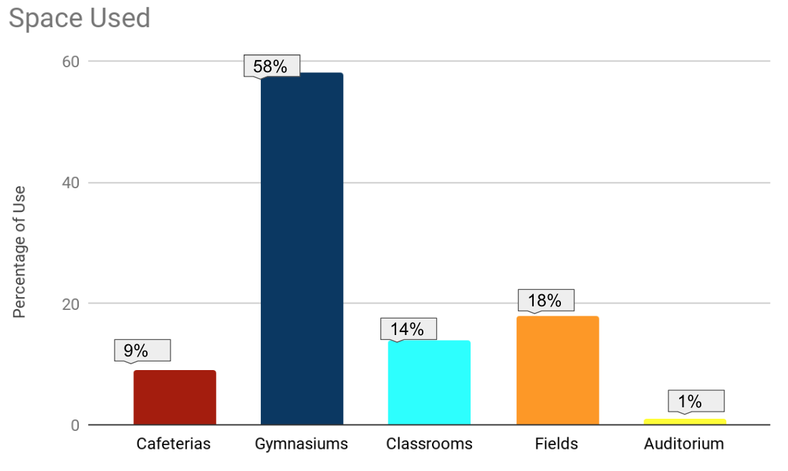
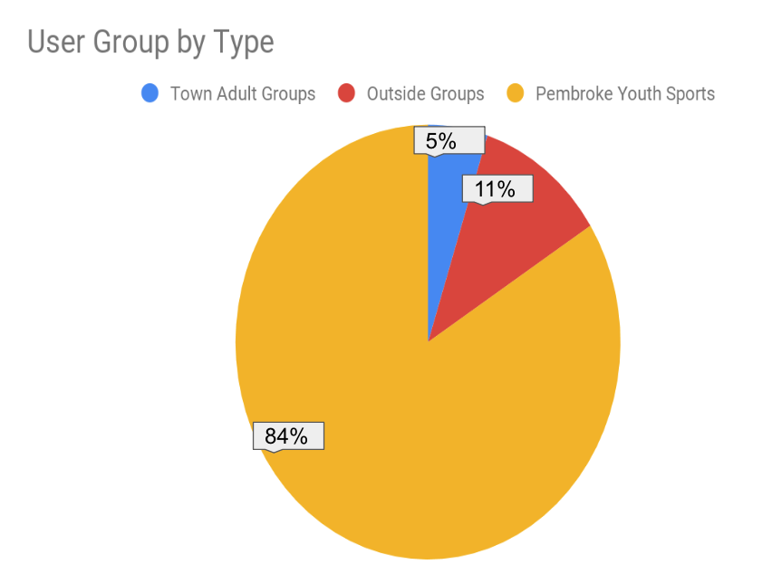
Community Use of District Facilities
Total number of community events hosted by PPS: 1,124 (7/1/2019 to present)

Slide 7
Major Upcoming/Ongoing Project
Finalizing keyless entry project for faculty/staff in all 5 PPS buildings
Irrigation Project at High School & North Pembroke: Irrigation lines in this spring, Fencing for softball field
Continue to evaluate and replace PPS exterior doors

