Slide 1
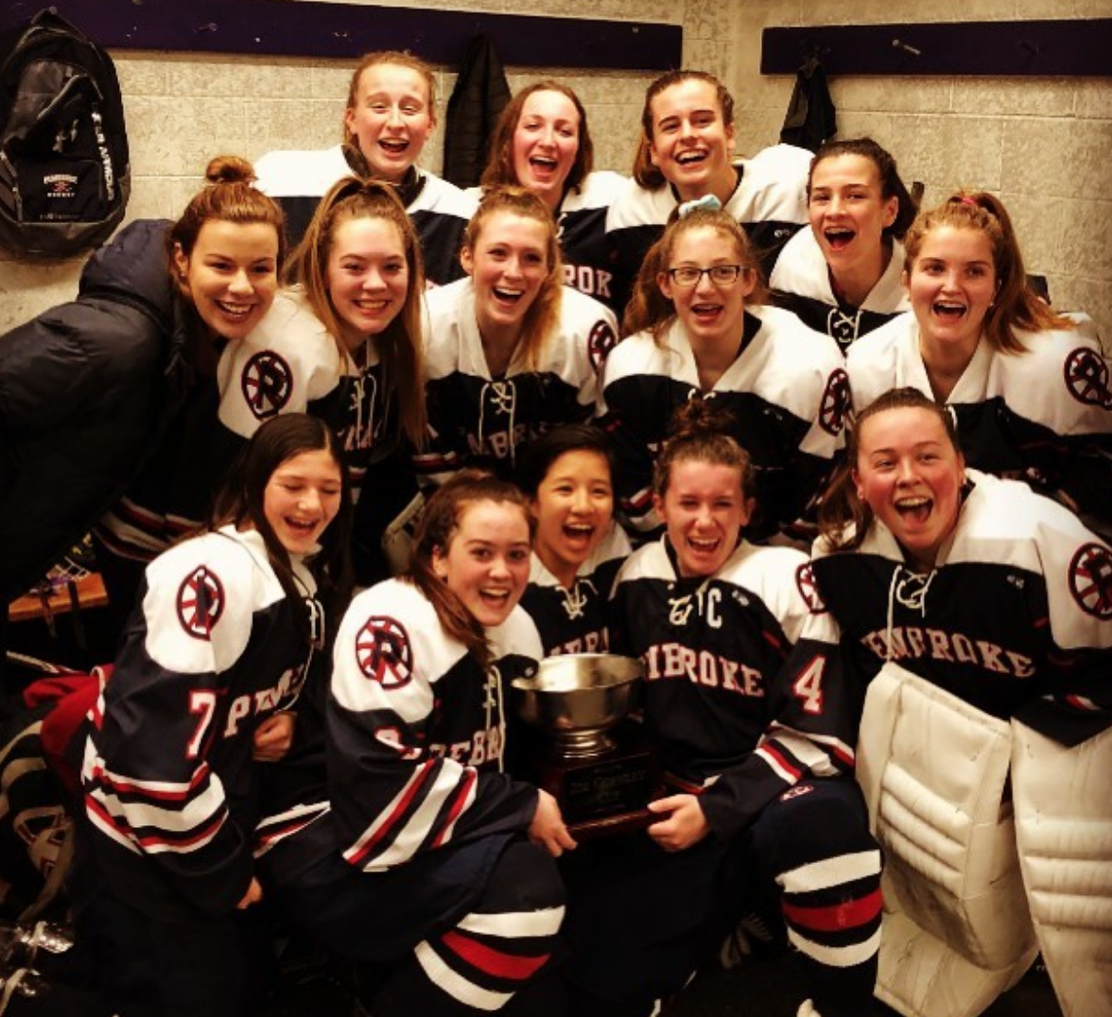
PEMBROKE PUBLIC SCHOOLS
Athletic Department Overview
February 12, 2020
OUR MISSION:
Education Through Athletics
72 Pilgrim Road, Pembroke, Massachusetts 02359

Slide 2
2018-2019 By the Numbers
2019 By the Numbers
97 League All-Stars
23 Patriot Ledger All-Scholastics
1 Boston Globe All-Scholastic
1 Boston Herald All-Scholastic
1 Boston Globe division 2 coach of the year
5 programs qualified for the state tournament
16 individuals qualified for state track & wrestling meets
1 Patriot League Team Sportsmanship Award
6 Patriot League Fisher Division titles
1 MIAA South Sectional Title
1 MIAA state semi-final appearance

Slide 3
Athletic Department Goals FY21
Summer Leadership Program (1 day) for incoming Fall Captains
Provide coaches a professional development opportunity
Continue strong Summer Strength & Conditioning Program in partnership with Marathon Sports
Increase number of teams utilizing strength & conditioning center through PHS coach sports training with Marathon Sports

Slide 4
Athletic Department Budget Overview
Description | Amount
Athletic Director (0.5) | $ 55,659
Pembroke High School Coaching Stipends | $ 283,717
PCMS Coaching Stipends | $ 25,730
Athletic Maintenance Custodian | $ 56,800
Contracted Services | $ 185,000
Officials | $ 45,000
Supplies & Equipment | $ 20,000
Total: $ 671,906

Slide 5
Budget detail
CONTRACTED SERVICES | TOTAL $185,000
Rentals: ice, gym, pool | $60,000
League Dues & Entry Fees | $16,000
Field Maintenance & Operations | $28,000
Athletic Trainer Supplies | $5,500
Football Equipment Reconditioning | $10,000
Police & EMT Details | $5,000
General & Emergent Service Repairs | $15,000
Uniform replacement cycle | $18,500
Transportation (First Student) | $27,000
OFFICIALS | TOTAL $45,000
Game officials and event staff | $45,000
ATHLETIC SUPPLIES & EQUIPMENT | TOTAL $20,000
Consumable supplies | $20,000

Slide 6
Athletic Department Capital Items
Description | Est. Cost
Scoreboard for Softball Field | $6,000-$8,000
New Hurdles for Track & Field & Sand Pit Covers | $5,000
Netting for Hammer Throw Area | $4,000-6,000
New Scoring Table for Gymnasium | $4,000-6,000

Slide 7
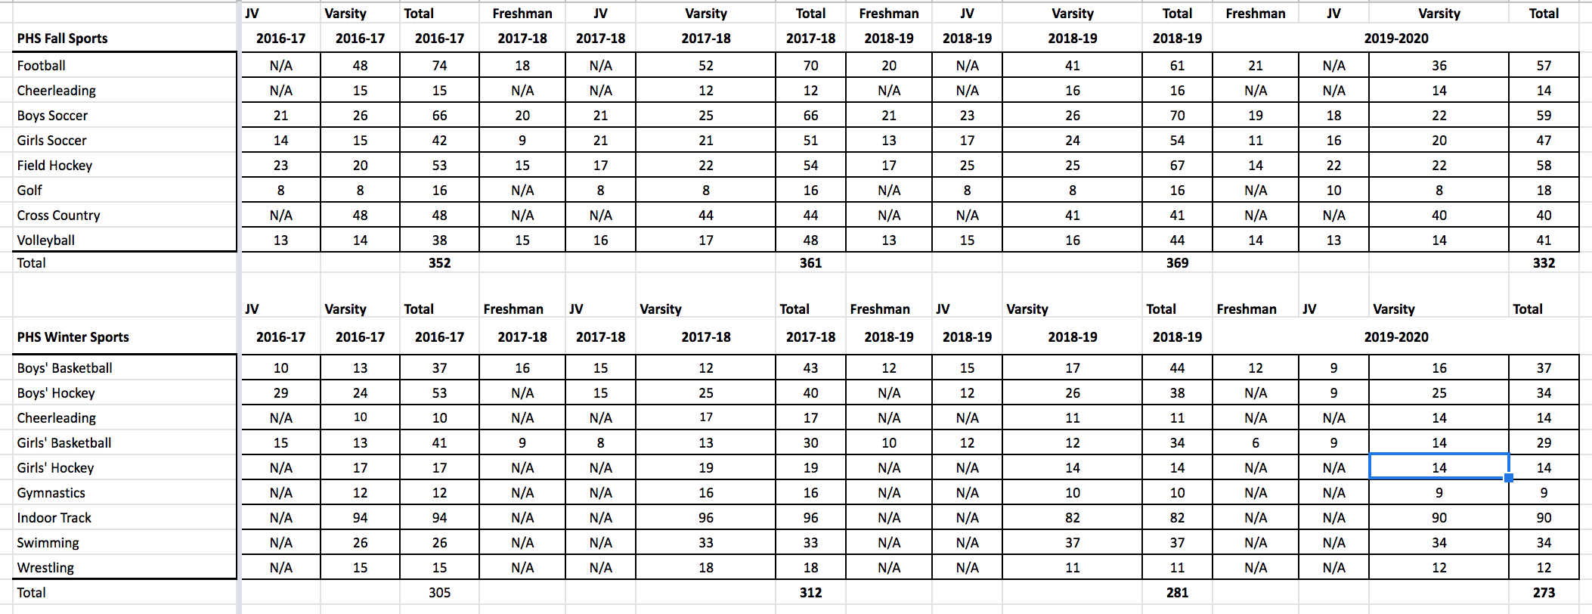
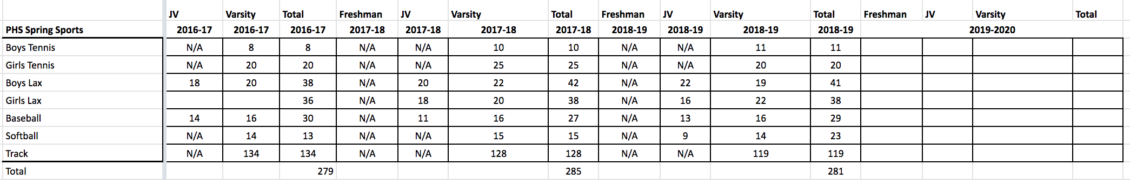
Participation Trends

Slide 8
Community Service & Athletics
Volleyball & Father Bill’s Homeless Shelter lunch bag initiative
Golf Team’s backpack & warm clothing drive
Boys Hockey Team’s Christmas gift buying for local youth
Athletic Department sock drive for homeless shelters
Athletic Department winter Pembroke Fire House Food Pantry drive
Boys/Girls Soccer, Boys/Girls Basketball, Volleyball, Girls Hockey, Girls Lacrosse, Wrestling, Baseball, Softball programs all volunteering at youth clinics and programs in town of Pembroke

