Slide 1
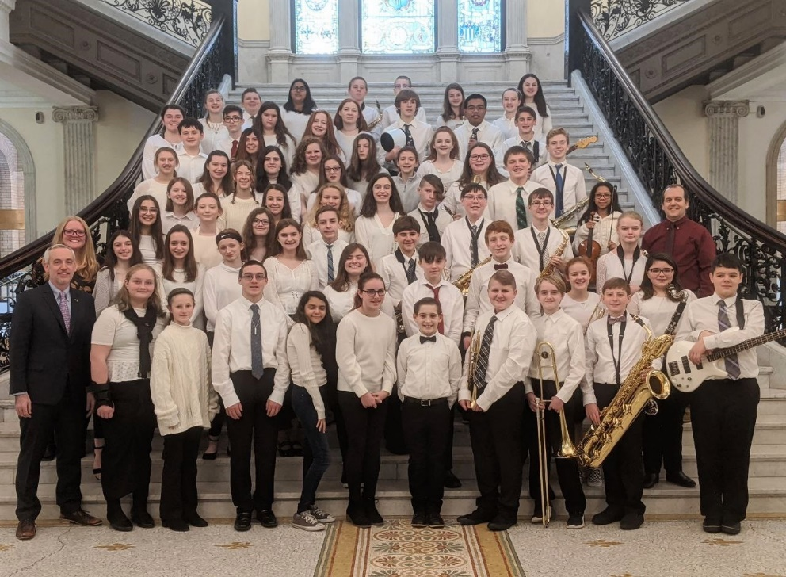
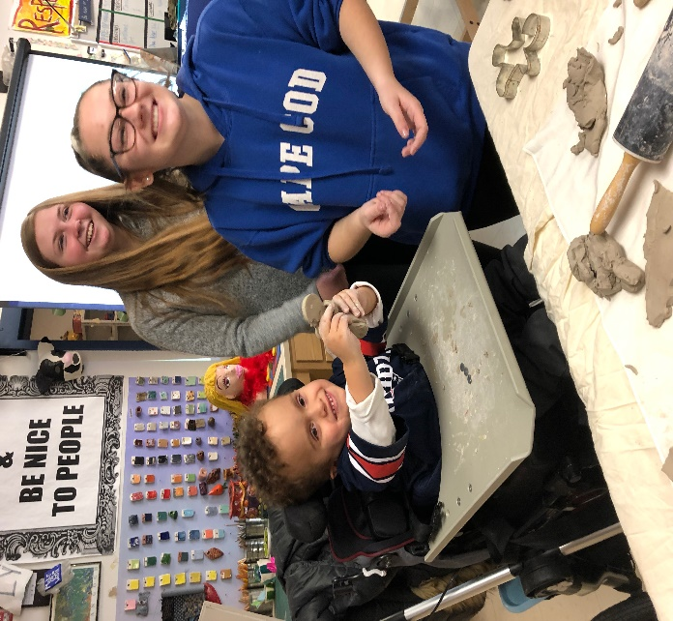

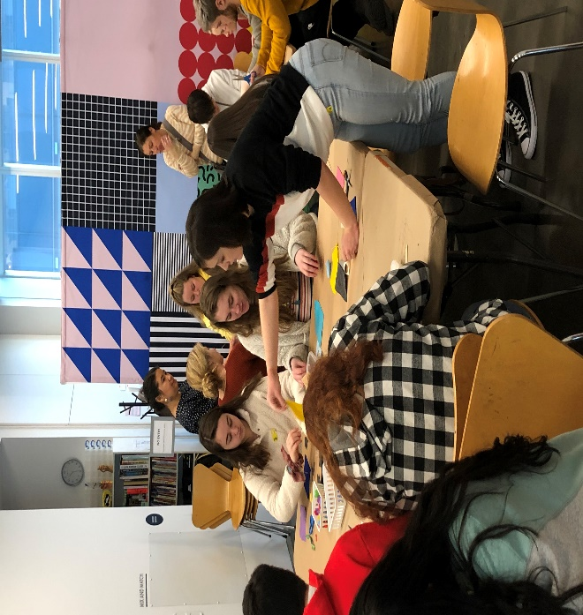
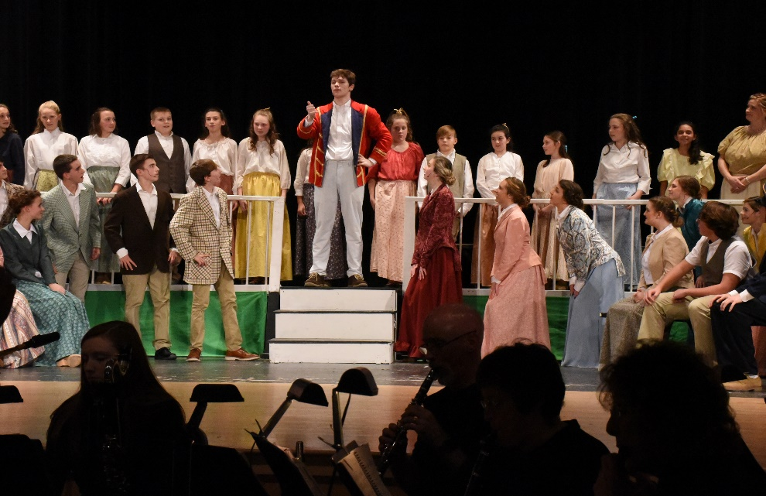
PEMBROKE PUBLIC SCHOOLS
Visual & Performing Arts FY 21 Budget Presentation
February 12, 2020
OUR MISSION:
To ensure student achievement through excellence in teaching and learning.
72 Pilgrim Road, Pembroke, Massachusetts 02359

Slide 2
Visual & Performing Arts Goals 2019-2021
Improve Achievement for all Students
      Continue to provide outstanding performing and artistic opportunities for students both in and out of the classroom: (in-district music concerts - Southeastern MA and State level music festivals: SEMSBA, District, All-State; music competitions, community performances; Art competitions - MA Art All-State and juried art shows – (Boston Globe Scholastics, Emerging Young Artists, Josh Cutler Juried Art Competition, Keating Juried Art Competition).
Support & Develop Excellent Instruction
      Continue to utilize and refine best practices (Google Suite, Responsive Classroom), data review, and peer observation (both in district and out of district).
      Continue to support teacher training on how to collect and analyze data from grade level benchmark assessments.
      Implement new 3D Printing & Product Design curriculum semester 2 of 2019-2020
Develop & Revise Curriculum
      Revise K-12 VPA course curriculum in all courses to align with new Massachusetts Arts Curriculum Frameworks including new standards in Media Arts.

Slide 3
Current VPA Staffing By Building
Location | FTE | Description
Bryantville | 2.0 | One visual art and one music teacher
Hobomock | 2.0 | One visual art and one music teacher
North | 2.0 | One visual art and one music teacher
PCMS | 3.0 | One visual art and two music teachers
PHS | 5.4 | Three visual art and 2.4 music teachers
District wide | 1.2 | Two elementary instrumental music teachers (1.0 Band and .2 String)
Total | 15.6

Slide 4
Elementary Instrumental Enrollment
Building | Full Year Course(s) Band & String | Student Enrollment 2017-2018 | Student Enrollment 2018-2019 | Student Enrollment 2019-2020
Bryantville | 5th grade Instrumental 6th grade Instrumental | 56 33 | 55 43 | 47 48
Hobomock | 5th grade Instrumental 6th grade Instrumental | 48 31 | 38 38 | 31 38
North | 5th grade Instrumental 6th grade Instrumental | 51 37 | 50 42 | 52 46
 | TOTAL STUDENT ENROLLMENT | 256 | 266 | 262

Slide 5
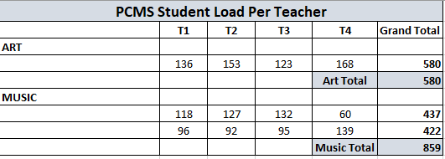
PCMS STUDENT LOAD PER TEACHER

Slide 6
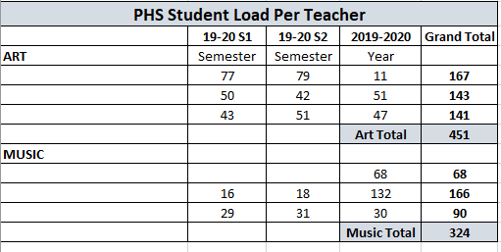
PHS STUDENT LOAD PER TEACHER

Slide 7
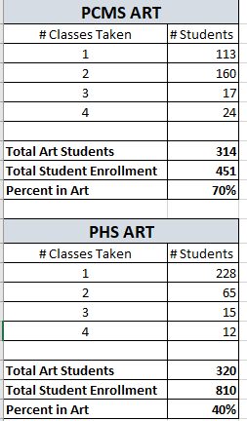
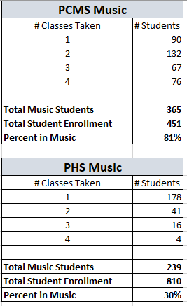
VPA CLASS ENROLLMENT PCMS & PHS

Slide 8
VPA Co-Curricular Enrollment
Building | Activity/Club | Student Enrollment 2019-2020
Bryantville | Chorus Art Club | 78 20
Hobomock | Chorus | 50
North District | Chorus After School String Club | 45 13
PCMS | Art Club Drama Club Jazz Band | 28 62 28
PHS | Art Club Jazz Band Men’s Choir Women’s Choir Thespian Society – Fall Musical Thespian Society – Winter Play Audio Engineering Color Guard TRI-M Music Honor Society (not a stipend position) | 17 24 17 22 72 39 9 15 51
 | TOTAL STUDENT ENROLLMENT IN VPA CO-CURRICULAR | 590 (grades 3-12)

Slide 9
FY 21 Costs for Preserving VPA Programs
Budget Type | Description | Projected Cost
Textbooks | Music for band, orchestra, choral, and general music classroom | $8,000
Instructional Materials & Supplies | All materials needed for teaching and learning- Majority of this cost is art consumables | $36,000
Contracted Services | Accompanists, chair rental, piano tuning, school-owned instrument repair and maintenance, art kiln maintenance | $12,125
Subscription and Dues Renewal | NAfME, NAEA, ACDA, MASSCUE, Music K-8, Music Express, Noteflight, Smart Music | $3,545
Instructional Equipment | Technology, instruments, equipment (Cameras, micron pens, 3D Printer, (2) Choral Rises - replacement ) | $ 11,330
Transportation District-wide | SEMSBA, District, All-State, South Shore Band Exchange Concert, St. Patricks’ Day Parade, UMASS Band Day, elementary concert visit, instrument demo day for 4th graders | $14,000
 | Total VPA Level funded budget K-12 FY’ 21 | $85,000

Slide 10
New Budget Requests – FY ’21
Budget Type | Description | Projected Cost
Level 2 Instructional Equipment | Replace Choral Risers (6) over a 5-year period at 2 per year (cost per is $2,000 riser) Replace Art Kilns over a 5-10 year period (1 per year, 1 kiln per school) | $10,000 $ Quote in progress (Estimate $3,500)
Total | New Budget Requests above current level funding | $13,500

Slide 11
Next Steps
Description
Continue to offer outstanding artistic and musical performance opportunities for all students K-12
Explore additional opportunities to create pathways in the Arts (Theater, Film, Audio/Sound Production, Music Technology)
Continue to strengthen community partnerships
Continue to seek out and apply for grants
72 Pilgrim Road, Pembroke, Massachusetts 02359

