Slide 1
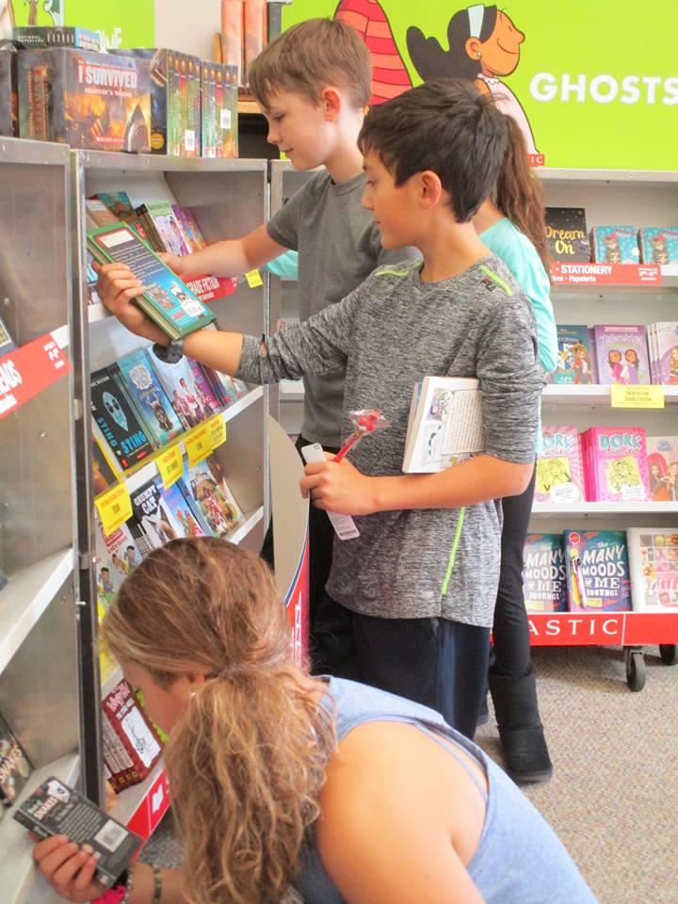
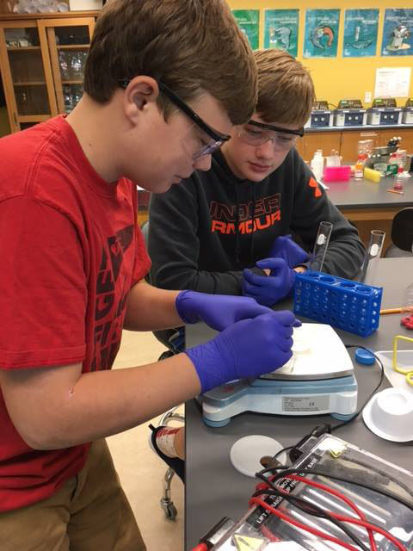
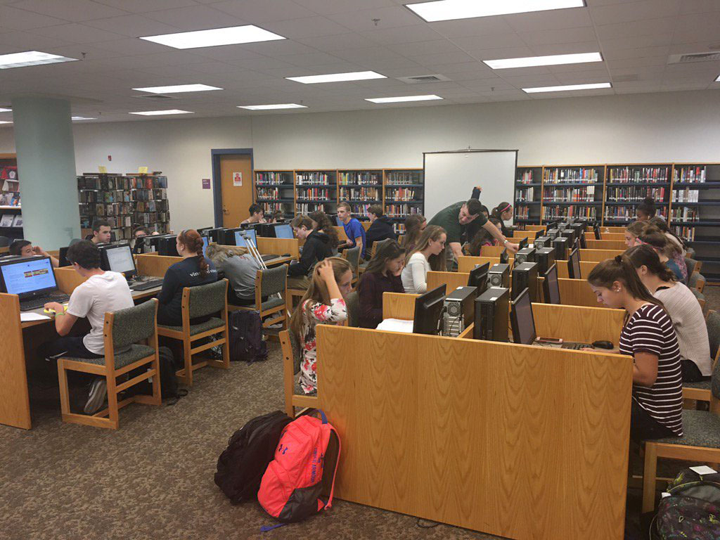

PEMBROKE PUBLIC SCHOOLS
Student Services FY21 Budget Presentation
February 4, 2020
OUR MISSION:
To ensure student achievement through excellence in teaching and learning.
72 Pilgrim Road, Pembroke, Massachusetts 02359

Slide 2
Overview
Data
Goals
FY 21 Budget Priorities

Slide 3
Special Education Enrollment
School Year | Total Enrollment | Special Education Enrollment | Out of District Enrollment
2019-2020 | 2, 757 | 434 ( 15%) | 32 students
2018-2019 | 2, 828 | 431 ( 15%) | 30 students
2017-2018 | 2, 922 | 428 ( 14%) | 31 students
2016-2017 | 3, 041 | 427 ( 14%) | 30 students

Slide 4
Placements

Slide 5
Section 504 Plans
Category | number of students=136
01 Intellectual
02 Sensory/Hard of Hearing or Deaf | 7
03 Communication | 1
04 Sensory/Vision Impairment or Blind | 2
05 Emotional | 9
06 Physical | 3
07 Health | 106
08 Specific Learning Disabilities | 2
09 Sensory/Deafblind
10 Multiple Disabilities
11 Autism | 1
12 Neurological | 5
13 Developmental Delay

Slide 6
English Language Learners
School Year | Number of ELLs
2019-2020 | 60
2018-2019 | 48
2017-2018 | 38
2016-2017 | 29
2015-2016 | 22

Slide 7
Languages Represented

Slide 8
Levels of Need

Slide 9
Special Education Budget

Slide 10
Budget Increase
ODP Special Education Tuition Increases
Transportation Increases (Special Education, Homeless and Foster Care)
Move ins in Special Education ODP
Increased number of supports needed for students presenting with social/emotional and behavioral needs

Slide 11
Department Goals
Increasing and expanding both teachers’ knowledge base and strategies, as well as available resources, as it relates to working with students that present with social/emotional and behavior dysregulation
Create district wide protocols for dealing with behaviors
Explore and provide professional development on Restorative Justice
Align staffing to student needs across levels and departments
Sustaining current level of mental health staff relative to current student need
Continue to seek input from families on their knowledge of the special education process and supports for students; with a focus on engagement and expanding knowledge base through informational student services presentations and use of the website

Slide 12
Budget Priorities FY 21
Category | Description | Cost | Notes
Social/Emotional | 1.00 BCBA | $68, 000 | Expand behaviorist model/supports
Social/Emotional | RBT Training | $8,000 | Behavioral training for paraprofessionals
Social/Emotional | Partnership with Gosnold | $6,000 | Social/Emotional Counseling/Family Needs
Social/Emotional | Kindergarten Transition Program at Each Building | $7,500 | Support At Risk Kindergarten Students
Social/Emotional | Restorative Justice Professional Development | $5,000 | Expand teacher strategies and resources
Nursing | .6 LPN | Cost neutral | Align with level of need at PHS; be in compliance for MED DEL certification
 | Total | $94,500

