Slide 1


Freshmen Course Selection
Presented By:
Angeleena Sim Susan Taiariol
Jessica Muñoz Lori Pellegrino-Jackson

Slide 2



East Union counselors
Mrs. Sim
A-Gom
asim@musd.net
Ms. Muñoz
AVID, CARE, EL, Migrant, Foster
jmunoz@musd.net
Ms. Pellegrino-Jackson
P-Z
lpellegrinojackson@musd.net
Mrs. Taiariol
Gon-O
staiariol@musd.net

Slide 3

Fast forward to after High school!
Career
Major or Specialty
Education or Training

Slide 4
Where to start…
4 year College or University
2 year Community College
Trade or Technical School
Military
Workforce
Unsure? Click here!

Slide 5
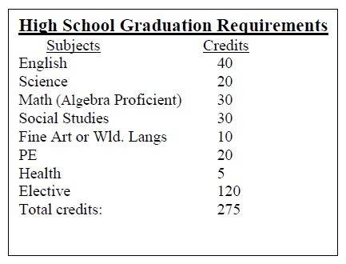
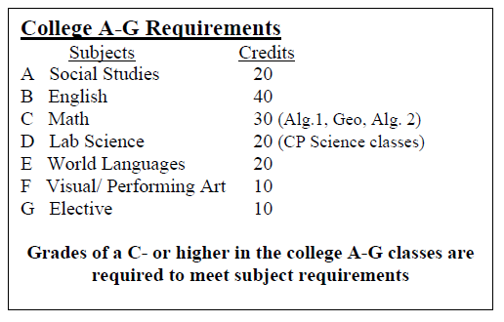
Graduation vs a-g requirements
We always encourage you to go above and beyond
the minimum requirements!

Slide 6
Course selection
What you need for freshmen year…

Slide 7

English
Honors English I
English I

Slide 8
Life Skills
Success 101
Health

Slide 9
Math
Algebra A
Algebra B
Algebra 1
Algebra 1 Robotics

Slide 10
Life Science
The Living Earth
Sustainable Ag Biology
Biology Honors

Slide 11
Physical
Education
Core Physical Education
JROTC 1

Slide 12
World Language
Two years of the same world language is required to be A-G. If you feel you are ready to begin a world language select one on your form.

Slide 13
Visual/
Performing art
At least one year of a visual or performing art is required to be A-G
To graduate you must have one year of a world language or visual/performing art

Slide 14
Elective areas
Math
Social Science
Life or Physical Science
World Language
Visual/Performing Art
Agriculture
Business
CTE
PE
Miscellaneous

Slide 15
Use Electives to….
Go beyond the minimum A-G requirements
Support a career choice
Learn or enhance a skill
Support a hobby or passion

Slide 16

MUSD High school Course catalog
Gives description of classes
Provides prerequisite and A-G information
Please see East Union’s course selection sheet for the classes offered at East Union.

Slide 17
How to complete your course selection form

Slide 18
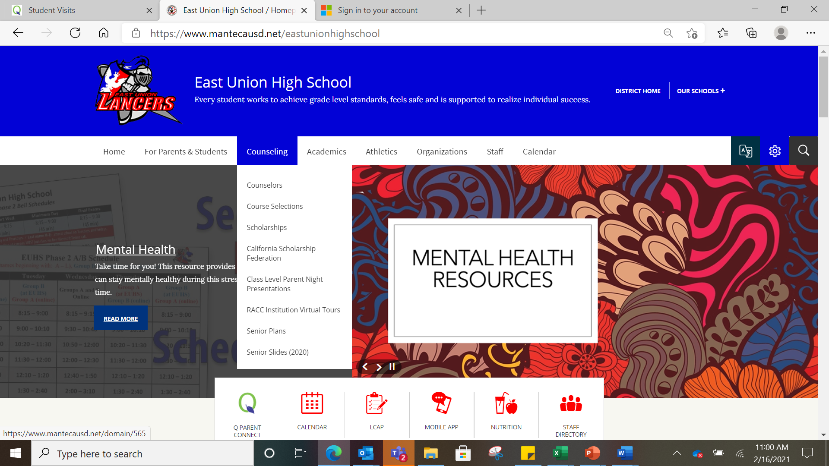
Go to the East Union Website
Click on Counseling
Click on Course Selection

Slide 19
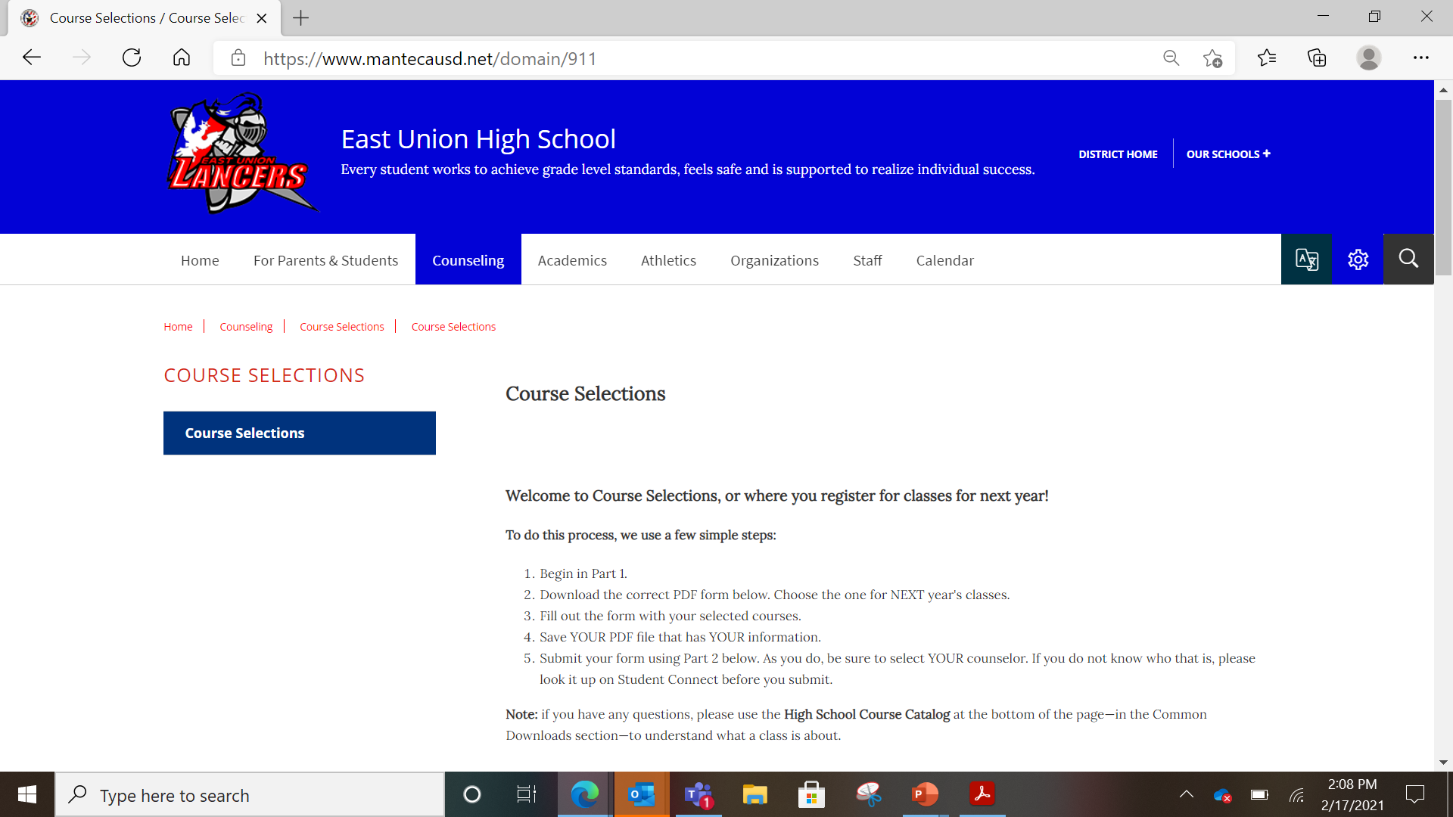
This is the page you will see once you have clicked on “course selection” under the counseling tab
Step by step instructions

Slide 20
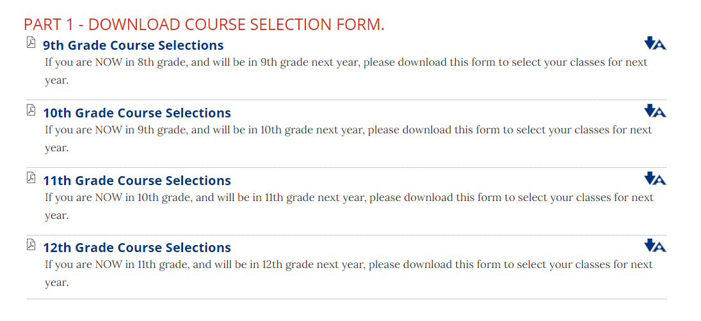
Remember this is for NEXT year. Click on the grade you will be in NEXT year.

Slide 21




2021-2022 EUHS Course Enrollment GRADE 9
Filling out your
course selection form
Name:
ID# Date:
Last Name First Name
Post Grad Plans: Employment Military Trade School Community College 4 - Year College Counselor: Click here
REQUIRED CLASSES:
ELECTIVE CLASSES:
CHOOSE 8 ELECTIVES AND NUMBER 1-8 IN ORDER OF PREFERENCE
PHYSICAL EDUCATION
ENGLISH
SOCIAL SCIENCE
_2750 JROTC 1 CP
VISUAL & PERFORMING ARTS
_6000 INTRO TO ART CP $
_6100 THREE DIMENSIONAL ART CP $
_6115 COMP GRAPHICS & ANIMATION CP $
_6215 DIGITAL PHOTOGRAPHY CP $
_6240 INTRO TO THEATRE CP
_6263 MUSICAL THEATRE 1 CP
_6315 CONCERT BAND CP AY
_6400 CHOIR CP
_6450 GUITAR CP (RC)
_6460 PIANO CP
MISCELLANEOUS
_5500 LIFE MANAGEMENT $
___
1010 ENGLISH HONORS 1 CP (AR)
1110 ENGLISH 1 CP
1362 ENGLISH 1 SH CP (AR)
_1513 WORLD GEOGRAPHY CP
_1740 ETHNIC STUDIES CP
WORLD LANGUAGE
_4110 SPANISH 1 CP
_4120 SPANISH 2 CP *
_4160 SPANISH SPEAKERS 1 CP (AR)
_4170 SPANISH SPEAKERS 2 CP *
_4210 FRENCH 1 CP
_4220 FRENCH 2 CP *
___
___
MATHEMATICS
Make sure to fill out your
  NAME
  ID#
  DATE
  POST GRADUATION PLAN
  COUNSELOR
Please choose 8 ELECTIVE classes and number them 1-8 in order of preference.
___
2120 ALGEBRA A CP (AR)
2125 ALGEBRA B CP (AR)
2130 ALGEBRA 1 CP (AR)
2133 ALGEBRA 1/ Robotics CP (AR)
___
___
___
LIFE SCIENCE
AGRICULTURE
_6500 AG SCIENCE 1 CP
_6700 BASIC AG MECHANICS $
_6765 AG WOOD I $
_6740 ART/HIST FLORICULTURE CP $
BUSINESS
4500 INTRO TO BUSINESS CP
4626 DIGITAL LITERACY CP
___
3012 THE LIVING EARTH CP
6770 SUSTAINABLE AG BIOLOGY CP
XXXX BIOLOGY HONORS CP (AR)
___
___
PHYSICAL EDUCATION
___
2510 CORE PE
2750 JROTC 1 CP
___
LIFE SKILLS
___
5810 SUCCESS 101/ 5902 HEALTH +
RSP/SDC
___
8010 MODIFIED ENGLISH 1
___
8065 MODIFIED PRE-ALGEBRA
A
___
8070 MODIFIED ALGEBRA
___
8200 FUNCTIONAL LANGUAGE ARTS 1
COMMENTS:
___
8276 FUNCTIONAL MATH 1
___
8277 FUNCTIONAL MATH 2
8306 FUNCTIONAL EARTH SCIENCE
___
8325 FUNCTIONAL HEALTH
+
___
8332 FUNCTIONAL SUCCESS 101
+
___
8116 STUDY SKILLS TRANSITION 9
___
LEGEND:
AY = All Year
CP = College prep class
(AR) = Approval required (RC) = Repeatable for credit
$ = Fee required for class ($32 - $42)
* = Pre-requisite required
+ = Semester class
// = You must be able to provide own transportation to job sites.
View course descriptions in the MUSD High School Catalog by
clicking here.

Slide 22

Remember to save your PDF form!
The form must be saved in order to upload it in part 2.

Slide 23
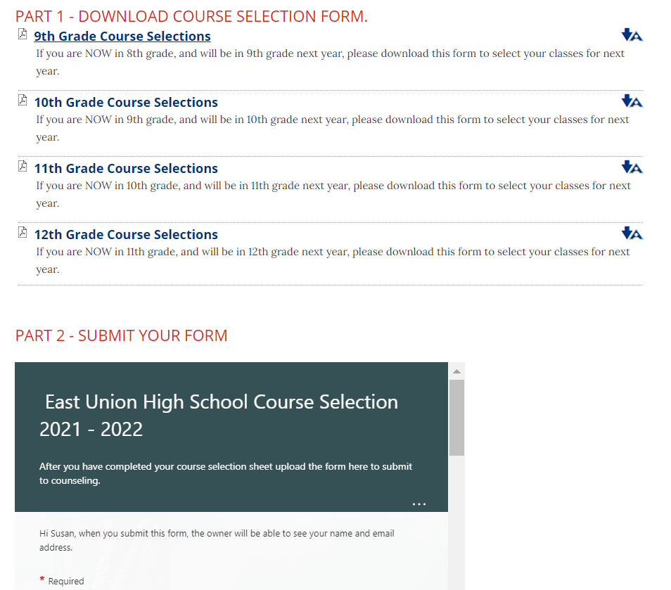


Slide 24
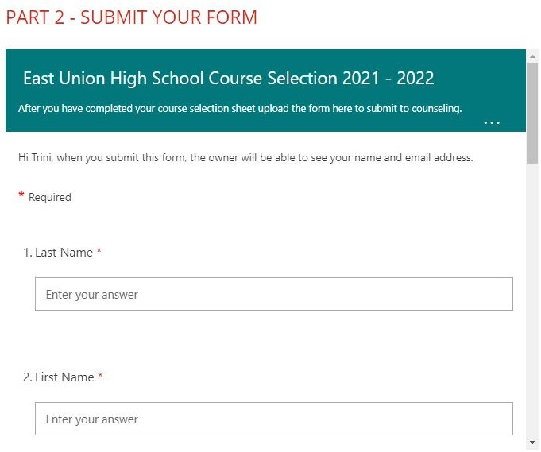
Part 2
Fill in the online form with the required information.
Make sure to use your musd.net email.

Slide 25
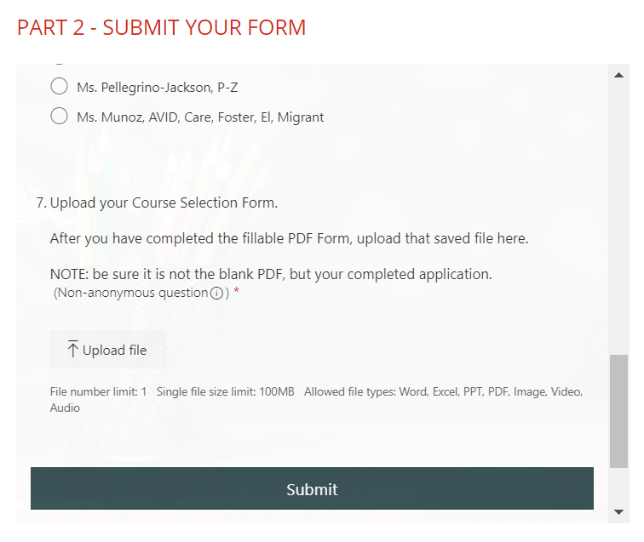
Upload and submit
At the bottom of the online form, upload your saved PDF.
Once your saved PDF has been uploaded click the submit button.

Slide 26
Need more guidance?
Email or send a teams message
French Camp
Jessica Munoz jmunoz@musd.net
McParland
Lori Pellegrino-Jackson lpellegrinojackson@musd.net
Neil Hafley
Susan Taiariol staiariol@musd.net
New Haven
Angeleena Sim asim@musd.net

Slide 27
East Union counselors
Mrs. Sim
New Haven
Ms. Muñoz
French Camp
Ms. Pellegrino-Jackson
McParland
Mrs. Taiariol
Neil Hafley

