Slide 1


Sophomore Course Selection
Presented By:
Angeleena Sim Susan Taiariol
Jessica Muñoz Lori Pellegrino-Jackson

Slide 2
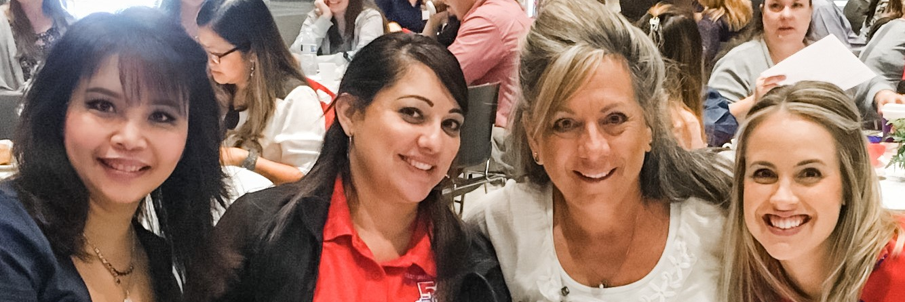


East Union counselors
Mrs. Sim
A-Gom
asim@musd.net
Ms. Muñoz
AVID, CARE, EL, Migrant, Foster
jmunoz@musd.net
Ms. Pellegrino-Jackson
P-Z
lpellegrinojackson@musd.net
Mrs. Taiariol
Gon-O
staiariol@musd.net

Slide 3

What comes after High school?
Career
Major or Specialty
Education or Training

Slide 4
Where to start…
4 year College or University
2 year Community College
Trade or Technical School
Military
Workforce
Unsure? Click here!

Slide 5
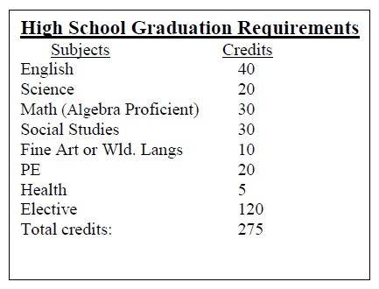
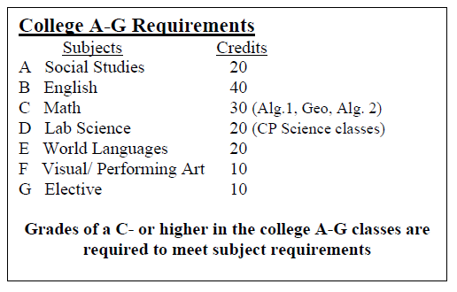
Graduation vs a-g requirements
We always encourage you to go above and beyond
the minimum requirements!

Slide 6
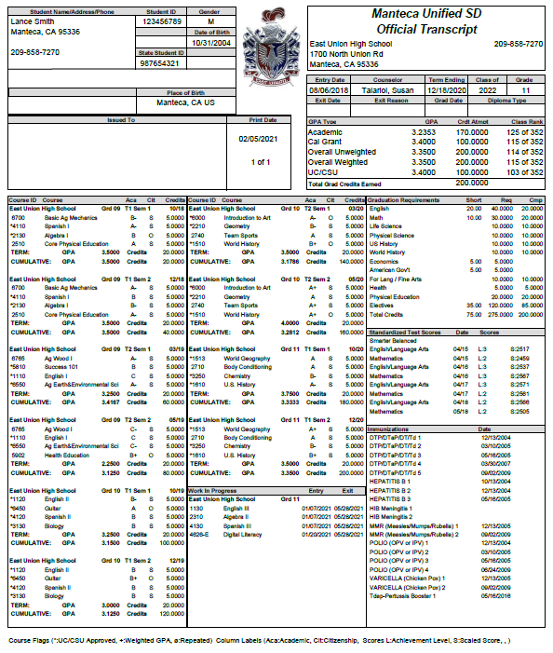
Know your Transcript
  Record of your classes
  Graduation Requirements
  GPA
  Courses in Progress
  Counselor
  Testing

Slide 7
Course selection
What you need for sophomore year…

Slide 8

English
Honors English II
English II

Slide 9
Social Science
World History

Slide 10
Math
Geometry
Algebra II
*If you have not completed the Algebra requirement, your counselor will place you in the appropriate math class.

Slide 11
Life Science
The Living Earth
Sustainable Ag Biology

Slide 12
Physical Science
Chemistry in Earth Systems
Ag and Soil Chemistry
Chemistry Honors

Slide 13
Physical
Education
Body Conditioning
Aerobics
Team Sports
JROTC 1
JROTC 2

Slide 14
Elective
Areas
Math
Social Science
Life or Physical Science
World Language
Visual/Performing Art
Agriculture
Business
PE
Miscellaneous

Slide 15
Use Electives to….
Go beyond the minimum A-G requirements
Support a career choice
Learn or enhance a skill
Support a hobby or passion

Slide 16
How to complete your course selection form

Slide 17
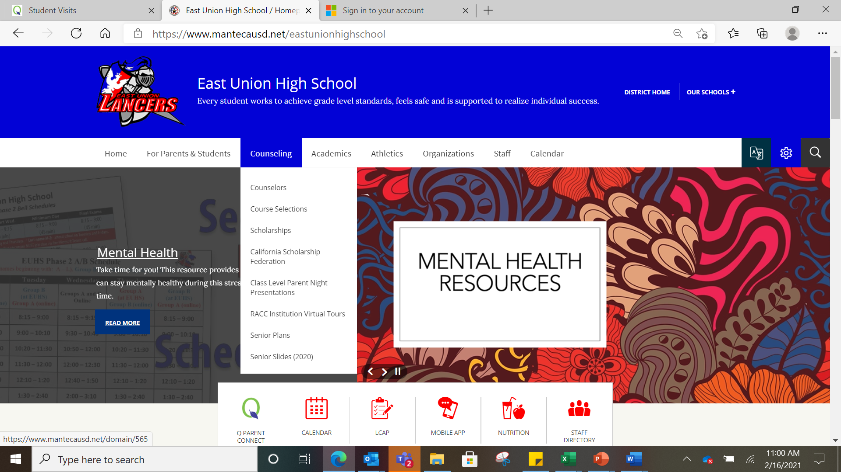
Go to the East Union Website
Click on Counseling
Click on Course Selection

Slide 18
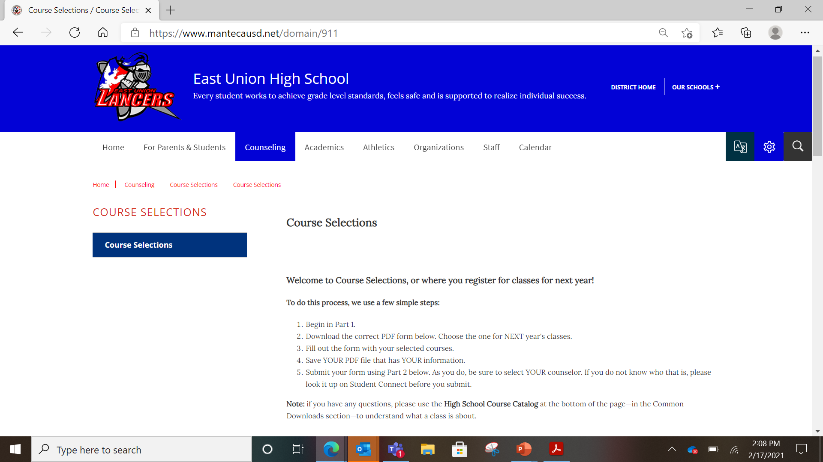
This is the page you will see once you have clicked on “course selection” under the counseling tab
Step by step instructions

Slide 19
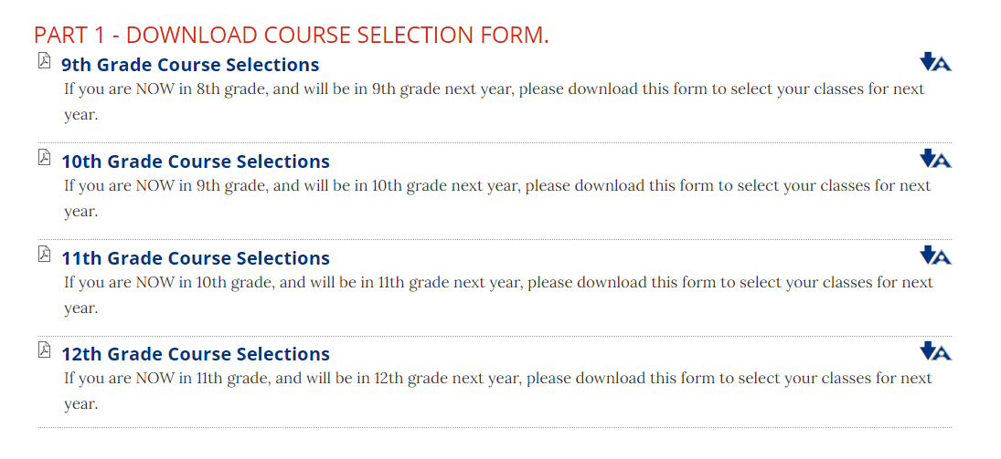
Remember this is for NEXT year. Click on the grade you will be in NEXT year.

Slide 20




Filling out your
course selection form
Name: ID# Date:
Last Name First Name
Post Grad Plans: Employment Military Trade School Community College 4 - Year College Counselor: _{Click Here}
REQUIRED CLASSES:
ELECTIVE CLASSES:
CHOOSE 8 ELECTIVES AND NUMBER 1-8 IN ORDER OF PREFERENCE
PHYSICAL EDUCATION
ENGLISH
1020 ENGLISH HONORS 2 CP (AR)
1120 ENGLISH 2 CP 1122 ENGLISH 2 SH CP (AR)
MATHEMATICS 2210 GEOMETRY CP * 2310 ALGEBRA 2 CP * LIFE SCIENCE 3012 THE LIVING EARTH CP 6770 SUSTAINABLE AG BIOLOGY CP PHYSICAL SCIENCE 3252 CHEMISTRY in EARTH SYSTEMS CP 6555 AG & SOIL CHEMISTRY CP * XXXX CHEMISTRY HONORS CP (AR)
SOCIAL SCIENCE 1510 WORLD HISTORY CP PHYSICAL EDUCATION 2710 BODY CONDITIONING (RC) 2730 AEROBICS (RC) 2740 TEAM SPORTS (RC) 2750 JROTC 1 CP 2760 JROTC 2 CP * RSP/SDC 8015 MODIFIED ENGLISH 2 8065 MODIFIED PRE-ALGEBRA 8070 MODIFIED ALGEBRA A 8075 MODIFIED ALGEBRA B 8205 FUNCTIONAL LANGUAGE ARTS 2 8260 FUNCTIONAL WORLD HISTORY 8277 FUNCTIONAL MATH 2 8300 FUNCTIONAL LIFE SCIENCE 8118 STUDY SKILLS TRANSITION 10
SOCIAL SCIENCE
___
_1513 WORLD GEOGRAPHY CP
_1740 ETHNIC STUDIES CP
LIFE SCIENCE
_3275 ZOOLOGY CP *
_6770 SUSTAINABLE AG BIOLOGY CP
WORLD LANGUAGE
_4110 SPANISH 1 CP
_4120 SPANISH 2 CP *
_4130 SPANISH 3 CP *
_4160 SPANISH SPEAKERS 1 CP (AR)
_4170 SPANISH SPEAKERS 2 CP *
_4210 FRENCH 1 CP
_4220 FRENCH 2 CP *
_4230 FRENCH 3 CP *
AGRICULTURE
_6500 AG SCIENCE 1 CP
_6700 BASIC AG MECHANICS $
_6760 POWER AG MECHANICS $ *
_6765 AG WOOD I $
_6775 ADV AG WOOD $ (RC) *
_6740 ART/HIST FLORICULTURE CP $
_6750 ADV FLORICULTURE (RC) $ *
BUSINESS
_4500 INTRO TO BUSINESS CP
_4626 DIGITAL LITERACY CP
_4630 COMPUTER APPLICATION CP *
_4645 AP COMPUTER SCIENCE CP *
_2710 BODY CONDITIONING (RC)
_2711 BODY CONDITIONING/SPORTS(AR)(RC)
_2730 AEROBICS (RC)
_2740 TEAM SPORTS (RC)
_2750 JROTC 1 CP
_2760 JROTC 2 CP *
VISUAL & PERFORMING ARTS
_6000 INTRO TO ART CP $
_6010 ADV ART CP (RC) $ *
_6100 THREE DIMENSIONAL ART CP $
_6105 COMP ANIMATION & PROD. CP $ *
_6115 COMP GRAPHICS & ANIMATION CP $
_6215 DIGITAL PHOTOGRAPHY CP $
_6220 ADV DIGITAL PHOTO CP $ *
_6240 INTRO TO THEATRE CP
_6250 INTERMEDIATE THEATRE (AR) (RC) CP*
_6263 MUSICAL THEATRE 1 CP
_6264 MUSICAL THEATRE 2 CP
_6315 CONCERT BAND CP AY
_6320 ADV BAND CP AY (RC) *
_6400 CHOIR CP
_6430 ADV CHOIR CP AY (RC) *
_6450 GUITAR CP (RC)
_6460 PIANO CP
_6470 ADV PIANO CP (RC) *
MISCELLANEOUS
_5500 LIFE MANAGEMENT $
_5600 CULINARY $
___
___
Make sure to fill out your
  NAME
  ID#
  DATE
  POST GRADUATION PLAN
  COUNSELOR
Please choose 8 ELECTIVE classes and number them 1-8 in order of preference.
___
___
___
___
___
___
___
___
___
___
___
___
___
___
___
___
___
___
___
___
___
COMMENTS:
___
LEGEND:
AY = All year
CP = College prep class (AR) = Approval required
(RC) = Repeatable for credit
$ = Fee required for class ($32 - $42)
* = Pre-requisite required
+ = Semester class
// = You must be able to provide own transportation to job sites.
View course descriptions in the MUSD High School Catalog by
clicking here.

Slide 21

Remember to save your PDF form!
The form must be saved in order to upload it in part 2.

Slide 22
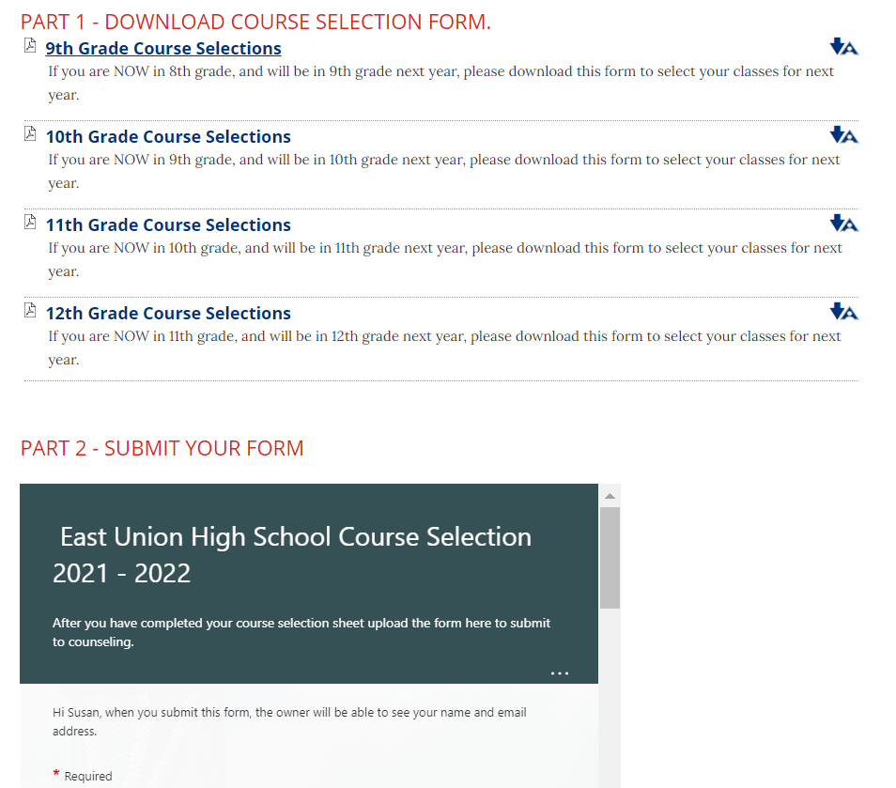


Slide 23
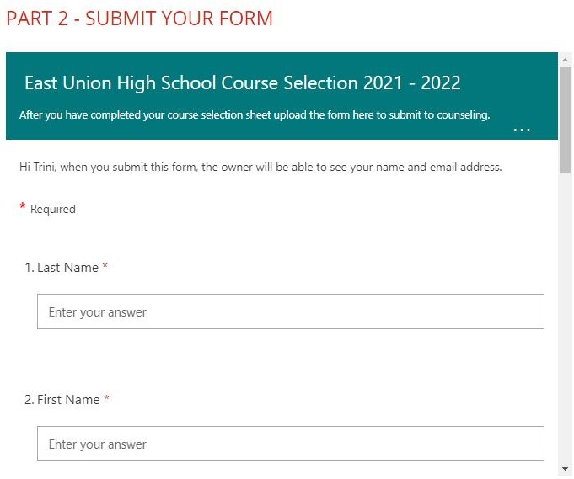
Part 2
Fill in the online form with the required information.
Make sure to use your musd.net email.

Slide 24
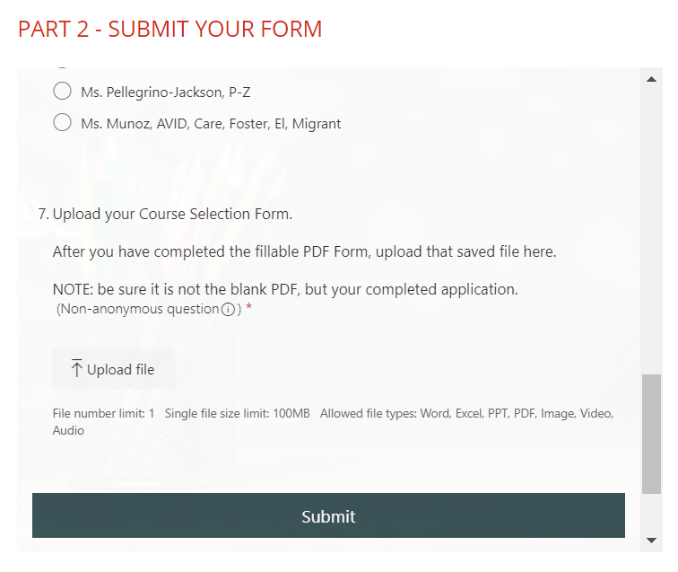
Upload and submit
At the bottom of the online form, upload your saved PDF.
Once your saved PDF has been uploaded click the submit button.

Slide 25

Need
More Guidance?
Please email or send a message through TEAMS.
Contact your counselor if you have questions regarding course selections.

Slide 26
East Union counselors
Mrs. Sim
A-Gom
asim@musd.net
Ms. Muñoz
AVID, CARE, EL, Migrant, Foster
jmunoz@musd.net
Ms. Pellegrino-Jackson
P-Z
lpellegrinojackson@musd.net
Mrs. Taiariol
Gon-O
staiariol@musd.net

