Slide 1


Senior Course Selection
Presented By:
Angeleena Sim Susan Taiariol
Jessica Muñoz Lori Pellegrino-Jackson

Slide 2
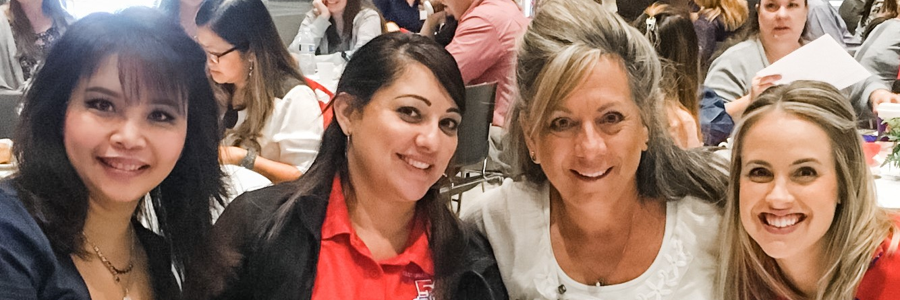


East Union counselors
Mrs. Sim
A-Gom
asim@musd.net
Ms. Muñoz
AVID, CARE, EL, Migrant, Foster
jmunoz@musd.net
Ms. Pellegrino-Jackson
P-Z
lpellegrinojackson@musd.net
Mrs. Taiariol
Gon-O
staiariol@musd.net

Slide 3

What comes after high school?
Career
Major or Specialty
Education or Training

Slide 4
Where to start…
4 year College or University
2 year Community College
Trade or Technical School
Military
Workforce
Unsure? Click here!

Slide 5
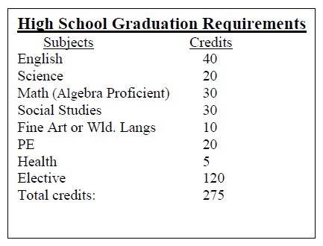
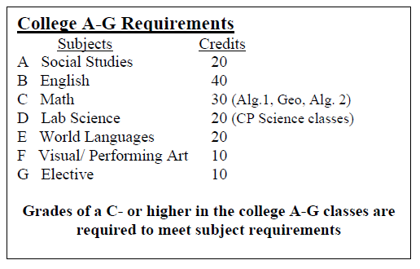
Graduation vs a-g requirements
We always encourage you to go above and beyond
the minimum requirements!

Slide 6
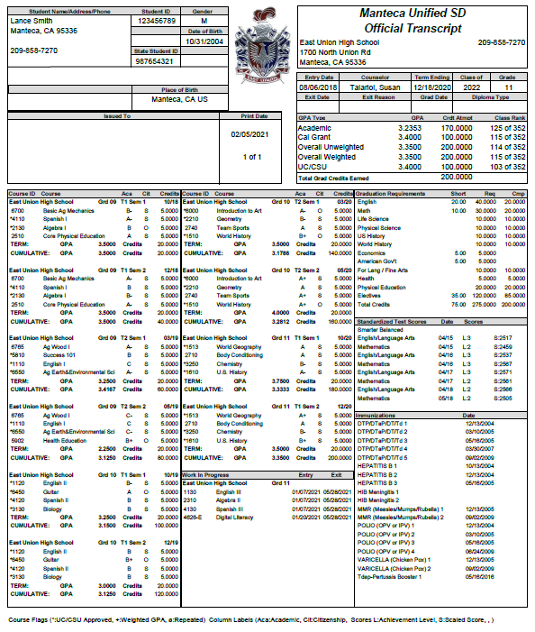
Know your Transcript
  Record of your classes
  Graduation Requirements
  GPA
  Courses in Progress
  Counselor
  Testing

Slide 7
Course selection
What you need for senior year…

Slide 8

English
AP English Literature
English IV
English IV Multicultural

Slide 9
Social Science
Government/Economics
AP American Government
AP Microeconomics

Slide 10
Elective areas
Math
Social Science
Life or Physical Science
World Language
Visual/Performing Art
Agriculture
Business
CTE
PE
Miscellaneous

Slide 11
Use Electives to….
Go beyond the minimum A-G requirements
Support a career choice
Learn or enhance a skill
Support a hobby or passion

Slide 12

MUSD High school Course catalog
Gives description of classes
Provides prerequisite and A-G information
Please see East Union’s course selection sheet for the classes offered at East Union.

Slide 13
How to complete your course selection form

Slide 14
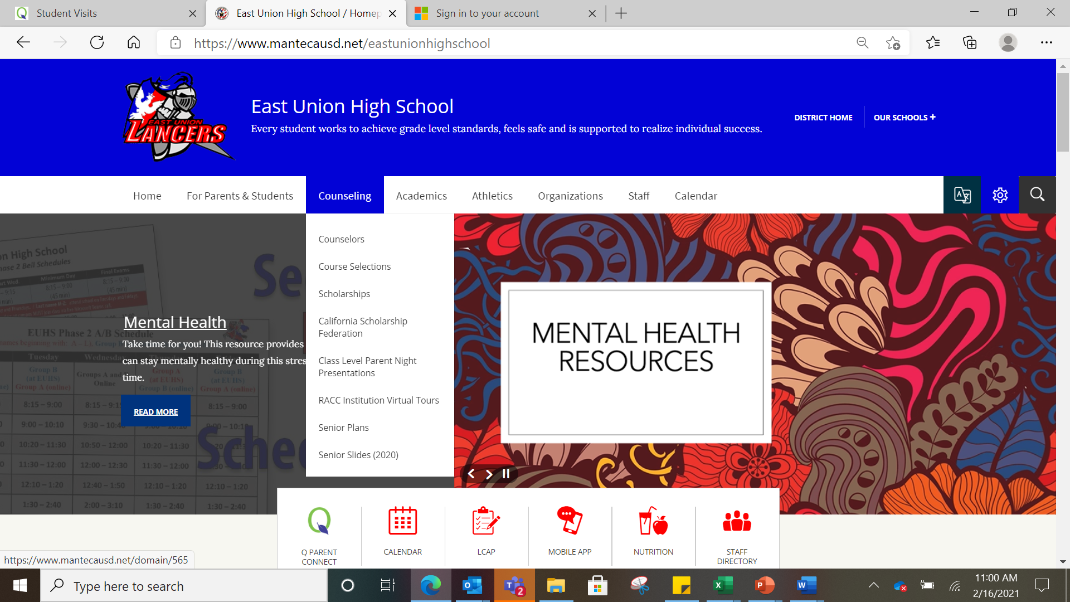
Go to the East Union Website
Click on Counseling
Click on Course Selection

Slide 15
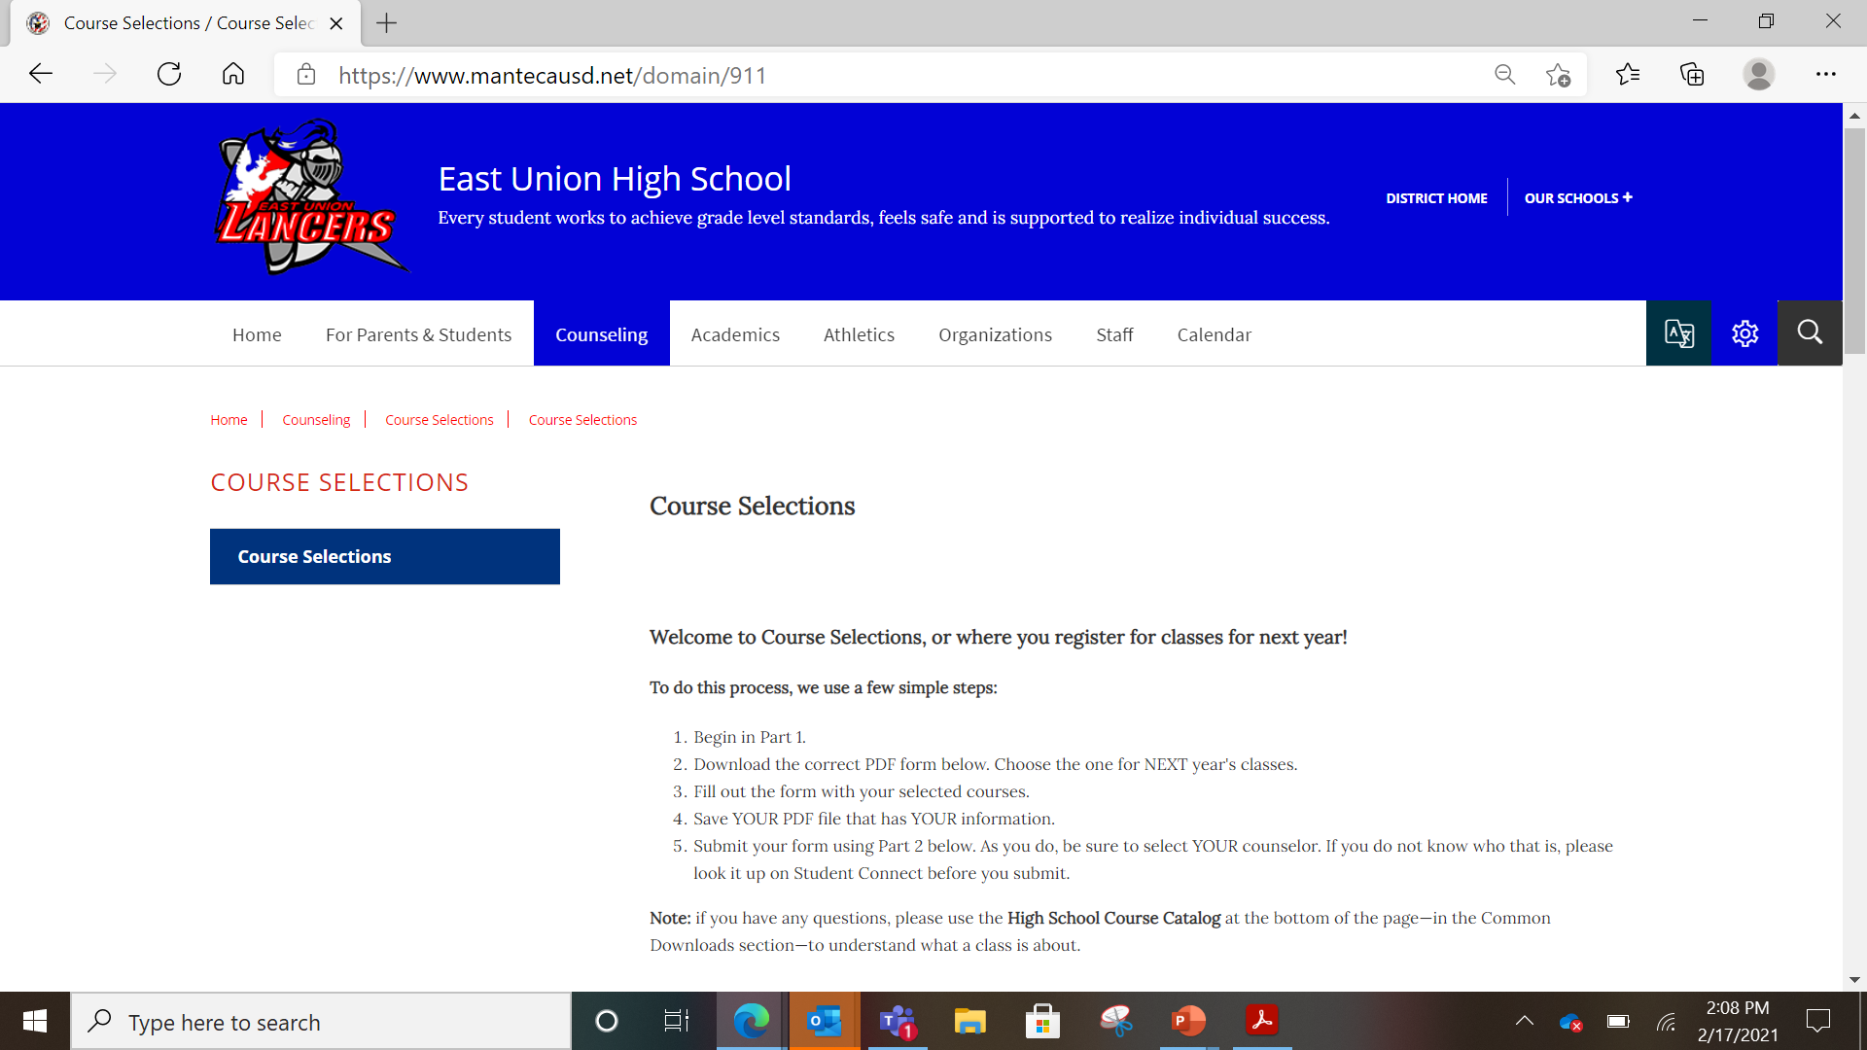
This is the page you will see once you have clicked on “course selection” under the counseling tab
Step by step instructions

Slide 16
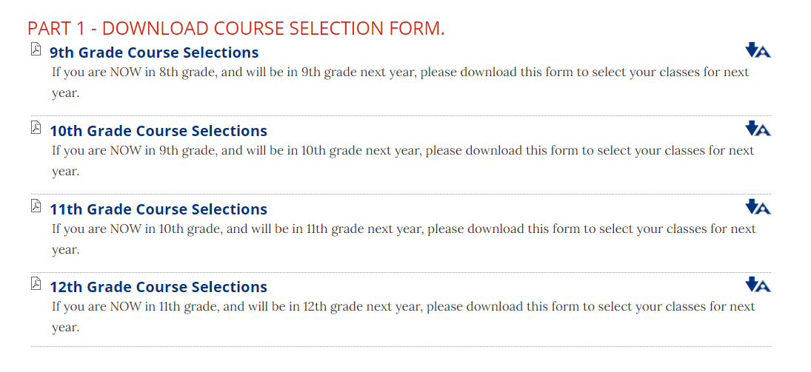
PART 1
Click on the grade you will be in NEXT year.

Slide 17





Name: ID# Date:
Last Name First Name
Post Grad Plans: Employment Military Trade School Community College 4 - Year College
Filling out your
course selection form
Counselor:
Click Here
REQUIRED CLASSES:
ELECTIVE CLASSES: CHOOSE 8 ELECTIVES AND NUMBER 1-8 IN ORDER OF PREFERENCE
ENGLISH
1040 AP ENGLISH LITERATURE CP (AR)
1140 ENGLISH 4 CP
1150 ENGLISH 4 MULTICULTURAL CP
WORLD LANGUAGE
4110 SPANISH 1 CP
4120 SPANISH 2 CP *
4130 SPANISH 3 CP *
4140 SPANISH 4 CP *
4150 AP SPANISH LANG CP *
4160 SPANISH SPEAKERS 1 CP (AR)
4170 SPANISH SPEAKERS 2 CP *
4210 FRENCH 1 CP
4220 FRENCH 2 CP *
4230 FRENCH 3 CP *
4240 FRENCH 4 CP *
AGRICULTURE
6500 AG SCIENCE 1 CP
6700 BASIC AG MECHANICS $
6720 AG EQUIP CONTRUCTION $ *
6760 POWER AG MECHANICS $ *
6765 AG WOOD I $
6775 ADV AG WOOD $ (RC) *
6740 ART/HIST FLORICULTURE CP $
6750 ADV FLORICULTURE (RC) $ *
BUSINESS
4500 INTRO TO BUSINESS CP
4626 DIGITAL LITERACY CP
4630 COMPUTER APPLICATION CP *
4645 AP COMPUTER SCIENCE CP *
4700 BUSINESS & PERSONAL FINANCE CP ^
4725 ACCOUNTING 1 (Automated) CP * ^
PHYSICAL EDUCATION
2710 BODY CONDITIONING (RC)
2711 BODY CONDITIONING/SPORTS (AR)(RC)
2730 AEROBICS (RC)
2740 TEAM SPORTS (RC)
2750 JROTC 1 CP
2760 JROTC 2 CP *
2770 JROTC 3 CP (RC) *
2780 JROTC 4 CP (RC) *
MISCELLANEOUS
5500 LIFE MANAGEMENT $
5600 CULINARY ARTS $
5800 ADULT LIVING *
VISUAL & PERFORMING ARTS
6000 INTRO TO ART CP $
6010 ADV ART CP (RC) $ *
6020 COLOR & DESIGN CP (RC) $ *
6030 CERAMICS CP $
6035 ADV CERAMICS CP (RC) $ *
6055 DIGITAL MEDIA & PRODUCTION CP $*
6100 THREE DIMENSIONAL ART CP $
6120 ADV GRAPHIC DESIGN CP $ *
6105 COMP ANIMATION & PROD. CP $ *
6115 COMP GRAPHICS & ANIMATION CP $
6215 DIGITAL PHOTOGRAPHY CP $
6220 ADV DIGITAL PHOTO CP $ *
6240 INTRO TO THEATRE CP
6250 INTERMEDIATE THEATRE (AR) (RC) CP*
6260 ADV THEATRE CP (AR) (RC) CP *
6263 MUSICAL THEATRE 1 CP
6264 MUSICAL THEATRE 2 CP
6315 CONCERT BAND CP AY
6320 ADV BAND CP AY (RC) *
6400 CHOIR CP
6430 ADV CHOIR CP AY (RC) *
6450 GUITAR CP (RC)
6460 PIANO CP
6470 ADV PIANO CP (RC) *
CTE (YEAR LONG CLASSES OFF CAMPUS.)
___
___
___
SOCIAL SCIENCE
1711 Economics/ 1712 Government CP +
1715 AP ECONOMICS CP
1720 AP GOVERNMENT CP
Make sure to fill out your
  NAME
  ID#
  DATE
  POST GRADUATION PLAN
  COUNSELOR
Please choose 8 ELECTIVE classes and number them 1-8 in order of preference.
___
___
___
RSP/SDC
___
8025 MODIFIED ENGLISH 4
___
8126 STUDY SKILLS TRANSITION 12
___
8215 FUNCTIONAL LANGUAGE ARTS 4
___
8255/8270 FUNCTIONAL ECON/GOV’T+
ELECTIVE CLASSES:
CHOOSE 8 ELECTIVES IN ORDER OF PREFERENCE
MATHEMATICS
2240 AP STATISTICS CP *
2310 ALGEBRA 2 CP *
2318 FINITE MATH CP *
2320 PRE-CALCULUS CP *
2330 AP CALCULUS A/B CP *
2335 AP CALCULUS B/C CP *
SOCIAL SCIENCE
1513 WORLD GEOGRAPHY CP
1740 ETHNIC STUDIES CP
1751 AP PSYCHOLOGY CP
LIFE SCIENCE
3140 AP BIOLOGY CP *
3230 PHYSIOLOGY CP *
3275 ZOOLOGY CP *
6770 SUSTAINABLE AG BIOLOGY CP
P HYSICAL SCIENCE
3032 PHYSICS of the Universe CP *
3145 AP ENVIRONMENTAL SCIENCE CP *
3222 AP PHYSICS CP *
3252 CHEMISTRY in Earth Systems CP *
3211 AP CHEMISTRY CP *
3270 ASTRONOMY CP *
6555 AG & SOIL CHEMISTRY CP *
You must take a bus for all
CTE classes scheduled 2nd- 4th period
1800 ADMINISTRATION OF JUSTICE
4985 CULINARY ARTS/ FOOD SERVICE $*
5015 AUTOMOTIVE TECH 1 (2 periods in 1 term)
5025 AUTOMOTIVE TECH 2 (2 periods in 1 term)
5540 INTERIOR DESIGN //
5855 FASHION MERCHANDISING //
5865 CAREERS W/ CHILDREN //
5875 HEALTH CAREERS //
LEGEND AY =
CP = (AR) =
(RC) =
$ =
All Year
College prep class Approval Required Repeatable for credit
Fee required for class ($32 – $42)
* = Pre-requisite required
+ = Semester class
^ = Counts towards a 3rd year of Math
// = You must provide your own transportation to job sites.
6790 AGRISCIENCE SYSTEMS MANAGEMENT
COMMENTS:
View course descriptions in the MUSD High School Catalog by clicking here.

Slide 18

Remember to save your PDF form!
The form must be saved in order to upload it in part 2.

Slide 19
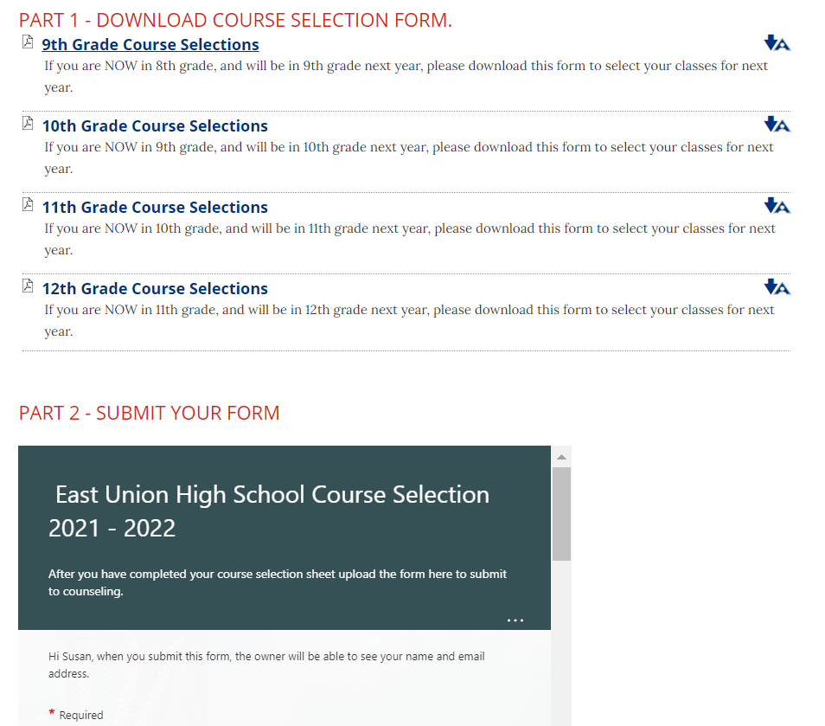


Slide 20
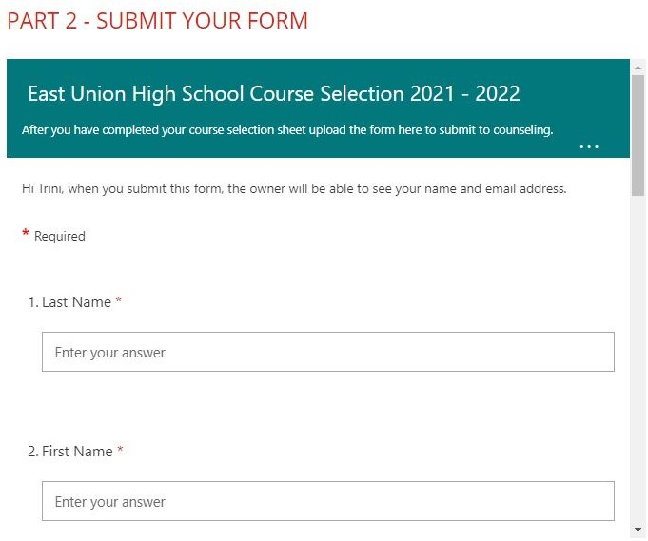
Part 2
Fill in the online form with the required information.
Make sure to use your musd.net email.

Slide 21
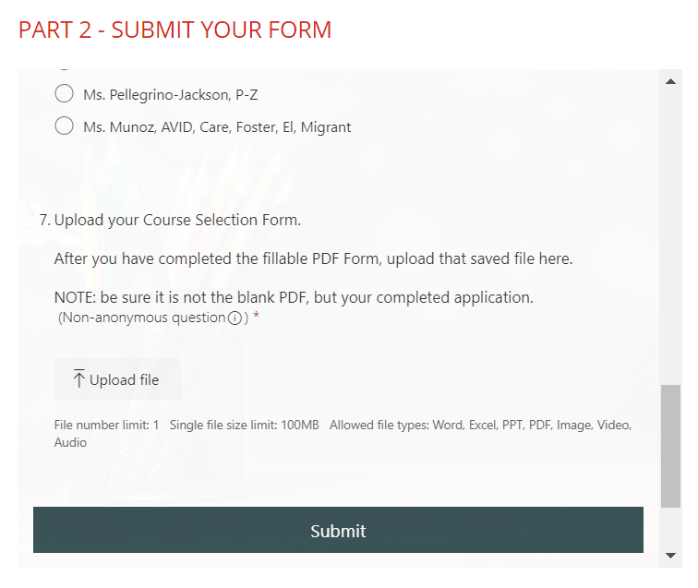
Upload and submit
At the bottom of the online form, upload your saved PDF.
Once your saved PDF has been uploaded click the submit button.

Slide 22

Need
More Guidance?
Please email or send a message through TEAMS.
Contact your counselor if you have questions regarding course selections.

Slide 23
East Union counselors
Mrs. Sim
A-Gom
asim@musd.net
Ms. Muñoz
AVID, CARE, EL, Migrant, Foster
jmunoz@musd.net
Ms. Pellegrino-Jackson
P-Z
lpellegrinojackson@musd.net
Mrs. Taiariol
Gon-O
staiariol@musd.net

