Slide 1
SBCUSD and Smarter Balanced Assessment Consortium Testing
Assessment and Accountability, January 2013

Slide 2
2014-2015
… will be the first school year of full implementation of the new assessment

Slide 3
Computer Adaptive Testing
The Smarter Balanced assessment system will capitalize on the precision and efficiency of computer adaptive testing (CAT) for both the mandatory summative assessment and the optional interim assessments.
    Better information for teachers
    More efficient and more secure
    More accurate
Computerized assessments allow teachers, principals, and parents to receive results in weeks, not months. Faster results mean that teachers can use the information from optional interim assessments throughout the school year to differentiate instruction and better meet the unique needs of their students
Notes:
Based on student responses, the computer program adjusts the difficulty of questions throughout the assessment. For example, a student who answers a question correctly will receive a more challenging item, while an incorrect answer generates an easier question. By adapting to the student as the assessment is taking place, these assessments present an individually tailored set of questions to each student and can quickly identify which skills students have mastered. This approach represents a significant improvement over traditional paper-and-pencil assessments used in many states today, providing more accurate scores for all students across the full range of the achievement continuum.
Better information for teachers: Optional computer adaptive interim assessments will provide a more detailed picture of where students excel or need additional support, helping teachers to differentiate instruction. The interim assessments will be reported on the same scale as the summative assessment, and schools will have the flexibility to assess small elements of content or the full breadth of the Common Core State Standards at locally-determined times throughout the year.
More efficient and more secure: Computer adaptive tests are typically shorter than paper-and-pencil assessments because fewer questions are required to accurately determine each student’s achievement level. The assessments draw from a large bank of questions, and since students receive different questions based on their responses, test items are more secure and can be used for a longer period of time.
More accurate: CAT offers teachers and schools a more accurate way to evaluate student achievement, readiness for college and careers, and to measure growth over time.

Slide 4
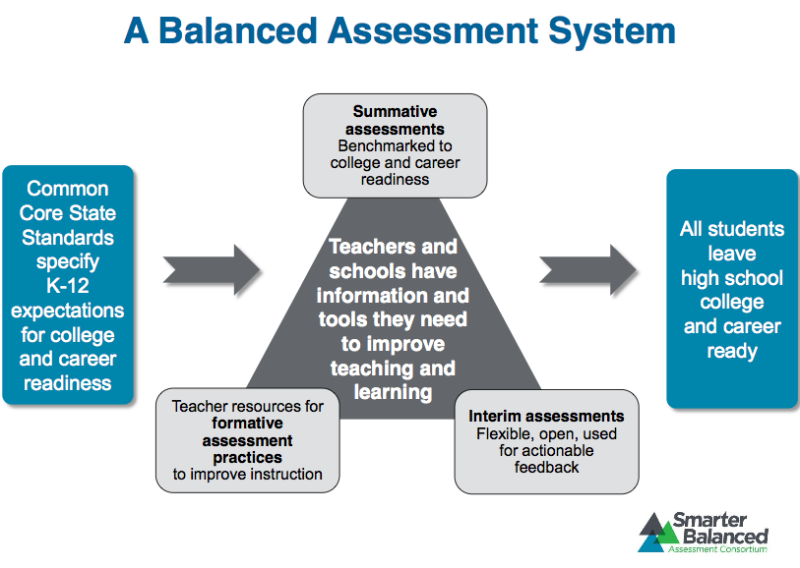

Slide 5
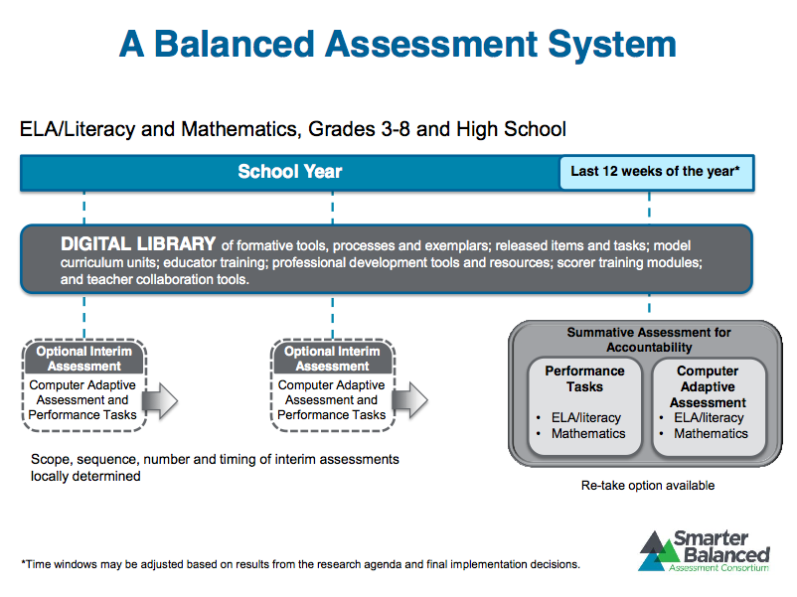

Slide 6
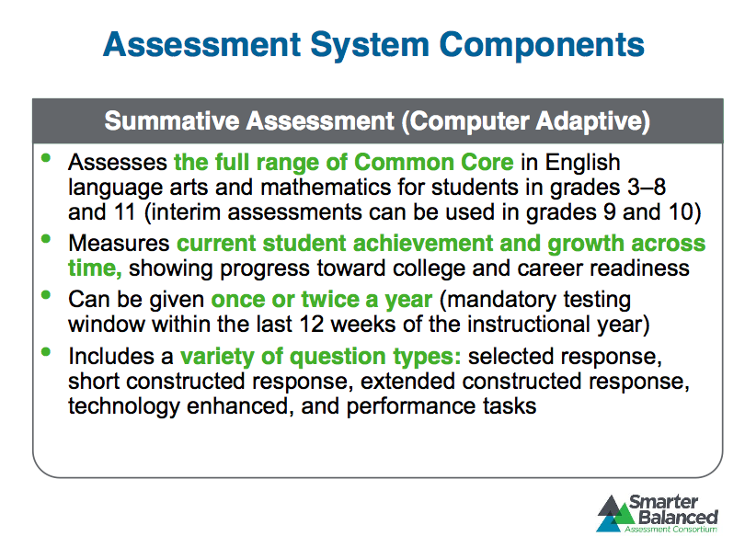
Summative Assessments

Slide 7
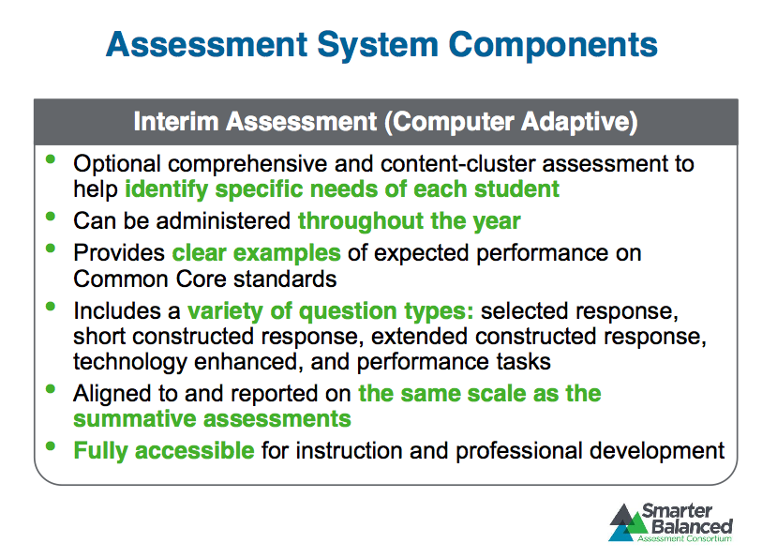
Interim Assessment

Slide 8
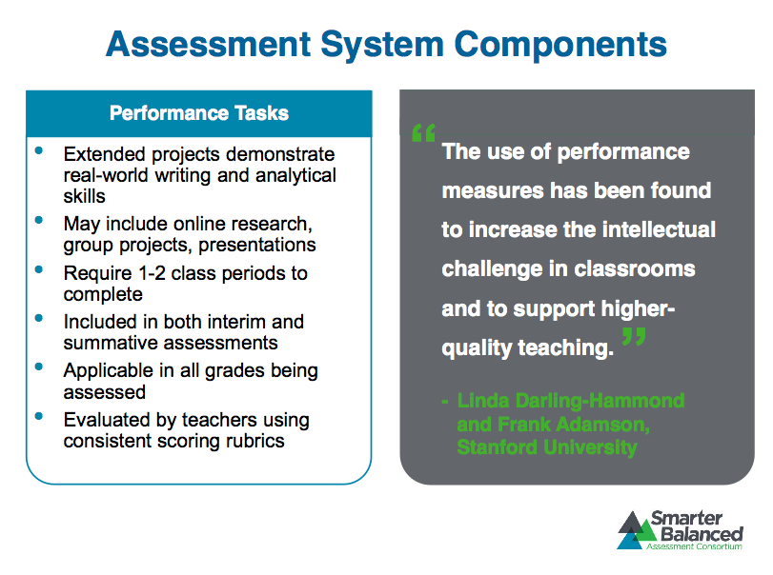
Performance Tasks

Slide 9
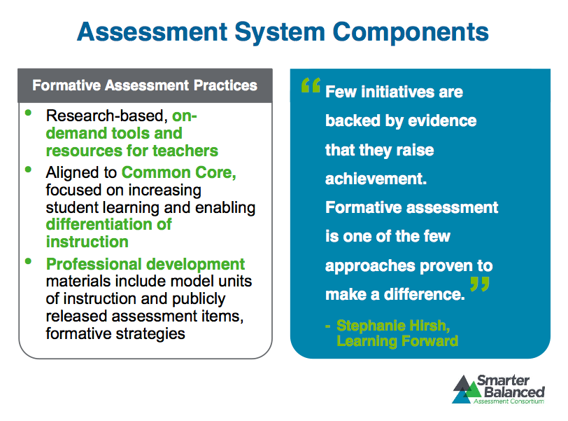
Formative Assessments

Slide 10
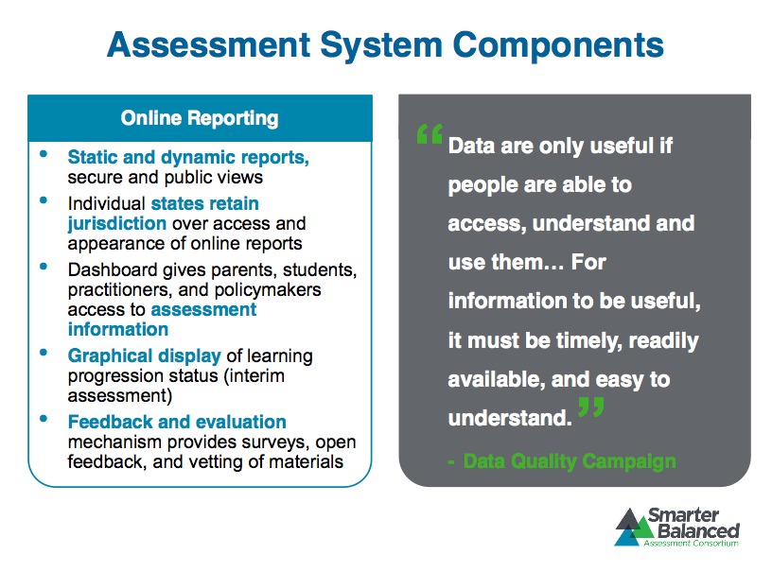
Online Reporting

Slide 11
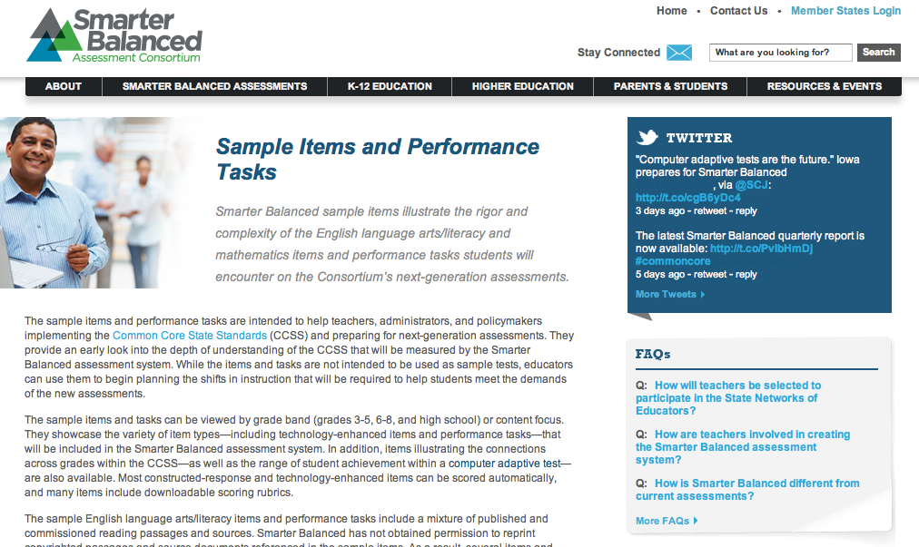
Sample ELA and Math SBAC Items
Smarter Balanced Sample Items

Slide 12
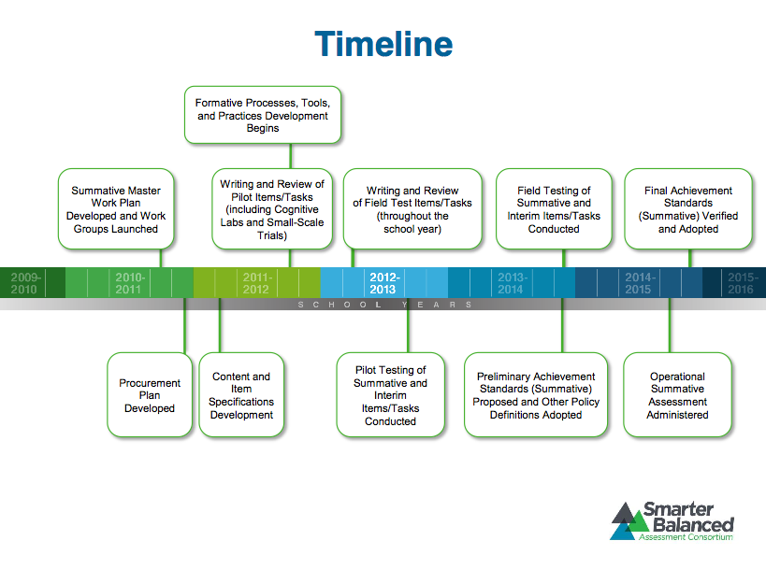

Slide 13
SBCUSD Preparation for Transition to SBAC Assessment System

Slide 14
Strategies for Ensuring Success in 2014-2015
Gathering and dissemination of Technology Readiness site and district survey data
Participation in SBAC Testing Pilots
Identification of technology purchasing models that support classroom instruction and SBAC testing
Implementation of state approved SBCUSD Technology Plan
SBCUSD Technology Committee for guidance in making district decisions, coordination of district technology efforts, and increased communication
Development of district 1 to 1 iPad initiative (iSeek) for technology integration
Participation in county and state SBAC assessment updates and meetings
Collaboration and coordination between district stakeholder groups
Communication with school administrators
Support of site purchasing and implementation of student technologies
  Purchasing models
  Site set-up support
  Technology training for administrators, teachers and Student Technology Leaders
Notes:
Gathering and Use of Technology Readiness Survey Data
Identification of technology purchasing models that support classroom instruction and SBAC testing
Implementation of state approved SBCUSD Technology Plan
Technology Committee for decision making, coordination of district technology efforts, and increased communication
1 to 1 iPad Initiative (iSeek)
Participation in county and state SBAC assessment updates and meetings
Collaboration between Assessment and Accountability, Purchasing, Sites, Elementary Instruction, Secondary Education, Information Technology, Superintendent and Cabinet and SBCUSD Technology Committee and Facilities
Communication with sites on updates, site needs and district support
Support of site purchasing and implementation of student technology
Purchasing models
Technology Training
Illuminate, Aeries, Parent Portal, SAP, Financial 2000, Word, etc
iSeek iPad Training
Administrative Technology Walkthroughs
Technology Saturday Training (Discovery Ed, iPad, Applications, document management, Smart Board Technology, InterWrite technology, Pages, iMovie, iBooks, Teacher Best Technology Practices
Discovery Education weeknight training

Slide 15
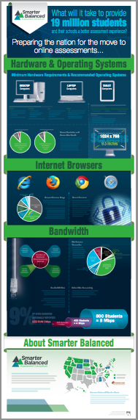
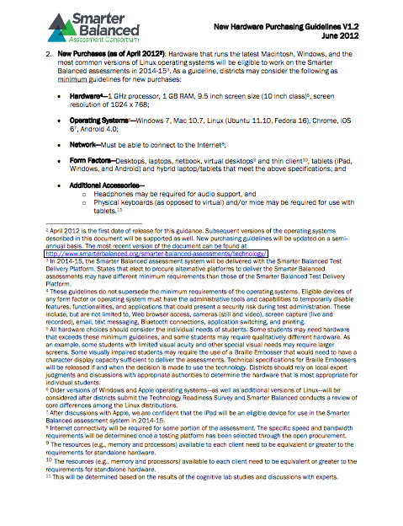
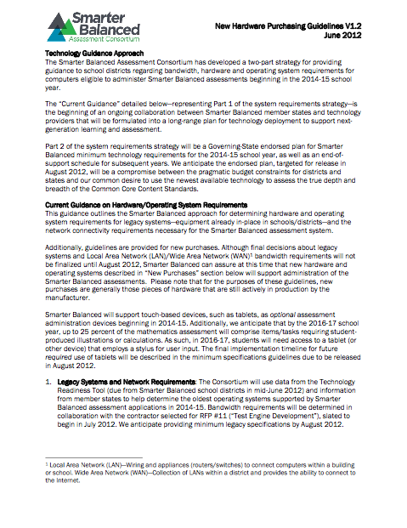
Technology Readiness Guidelines
Hardware and Operating Systems
Internet Browsers
Bandwidth

Slide 16
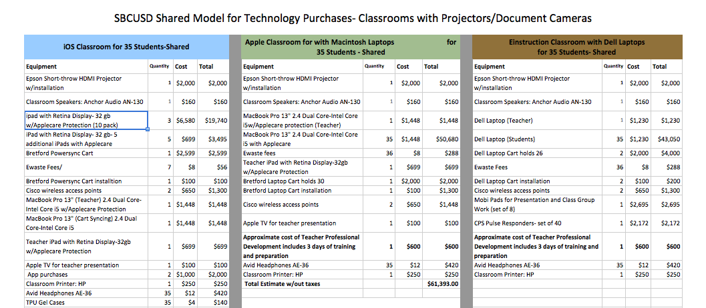
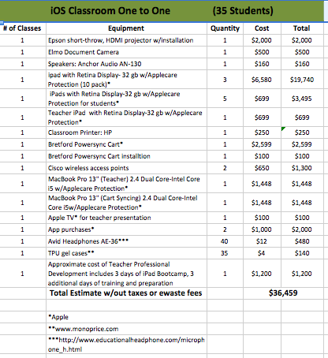
SBCUSD Technology Purchasing Guidelines

Slide 17
CBT and SBAC Pilot Participation
SBCUSD 2012

Slide 18
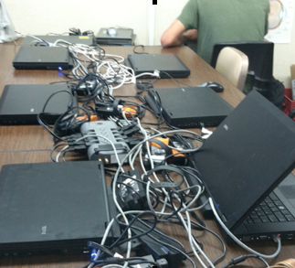
Computer Based Testing Pilot 1
Sierra High School and Middle College
Schools are in desperate need of current computer equipment
Site support for technology infrastructure and hardware must be equitably established to ensure student access to equipment that works
Roles for providing district support to sites for computer based testing must be established
Computer labs are one solution but may be insufficient in number to meet student testing needs
Mobile devices are another solution but hardwiring the mobile devices is cumbersome and creates safety issues
Our school site wireless will need enough capacity to support student use for testing

Slide 19
Computer Based Testing Pilot 2
“Scientific” Component Two-week period to test no more than 2 grades in their school – one grade and one subject area
“Volunteer Component” will ensure all schools have the opportunity to experience the basic functionality of the test administration system
February 20-May 10, 2013
Scientific-District Schools:
Del Rosa, Golden Valley, Hillside, Kimbark, Parkside, Ramona Alessandro, Roosevelt, San Andreas High, San Bernardino High, Sierra High, Urbita, Wlison
Scientific-Charters:
Carden
New Vision Middle
Volunteer:
Pacific

Slide 20
Most Recent Updates from California Department of Education

Slide 21
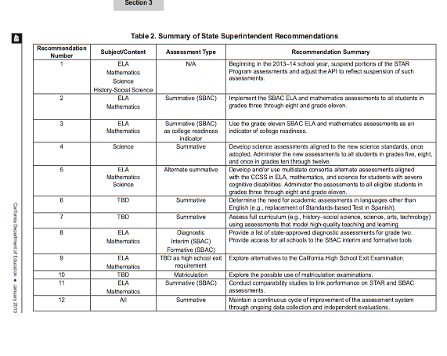
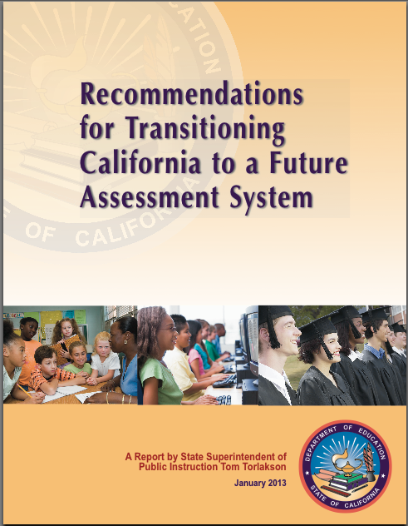
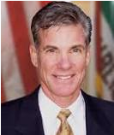
January 2013- Report by Superintendent Tom Torlakson

Slide 22
Next Steps in Transition to SBAC Assessment System
Provide guidance and assistance in gathering needed data on site and district readiness
Help sites determine needed resources
Provide ongoing informational updates
Develop district models for effective site testing environments
Identify and train personnel for technical and academic testing support of students
Develop district capacities necessary for effective integration of student technology use in daily learning

Slide 23

Questions or Comments…

