Slide 1


Slide 2

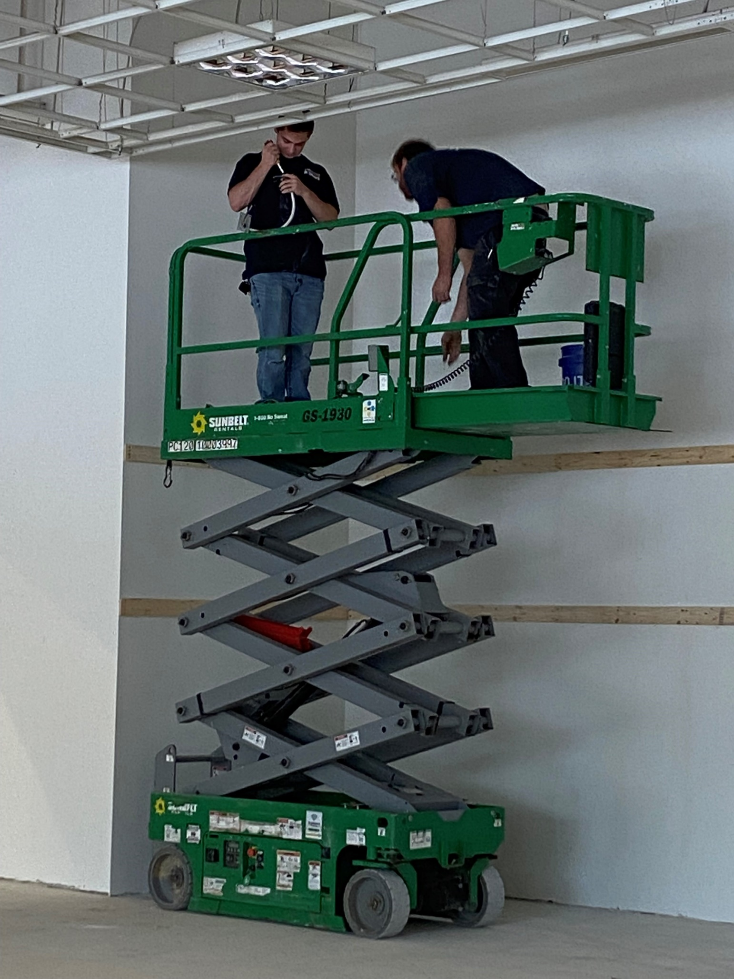
ELECTRICIAN
Typical day:
Arrive at the job site
  Job sites can change weekly or monthly
Check in with the job foreman
Learn and assist the foreman or other technicians
Pack up and head home

Slide 3
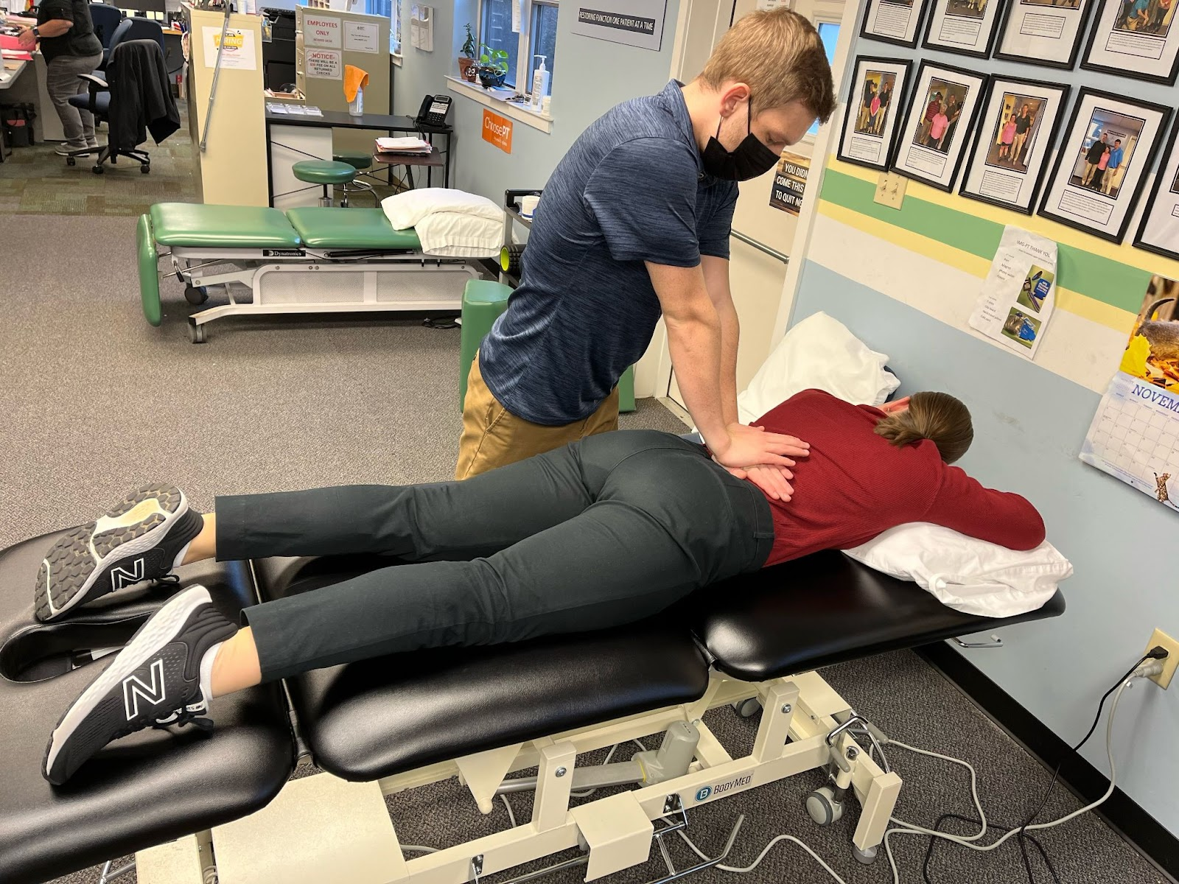
PHYSICAL THERAPY
Job Responsibilities:
Assist patients and students with exercises, ice, and STEM
Clean tables and equipment
Changing, washing, and drying linens
Paperwork
  Configuring charts
  Creating workshop packets
Notes:
How My Internship is Helping Me Prepare for the Future
Exposed Me to an Outpatient Physical Therapy Setting
Helped Confirm Physical Therapy as a Career
Introduced Me to the Actual Work of a Physical Therapist

Slide 4
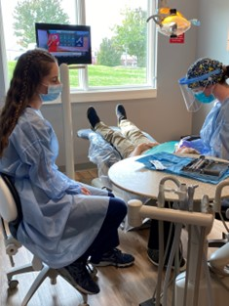
DENTISTRY
Typical day includes:
Change into scrubs upon arrival
Observe hygienists as they work
Resetting / changing rooms between patients
Pulling charts for upcoming patients
Check in patients when they arrive
Daily chores around the office

Slide 5
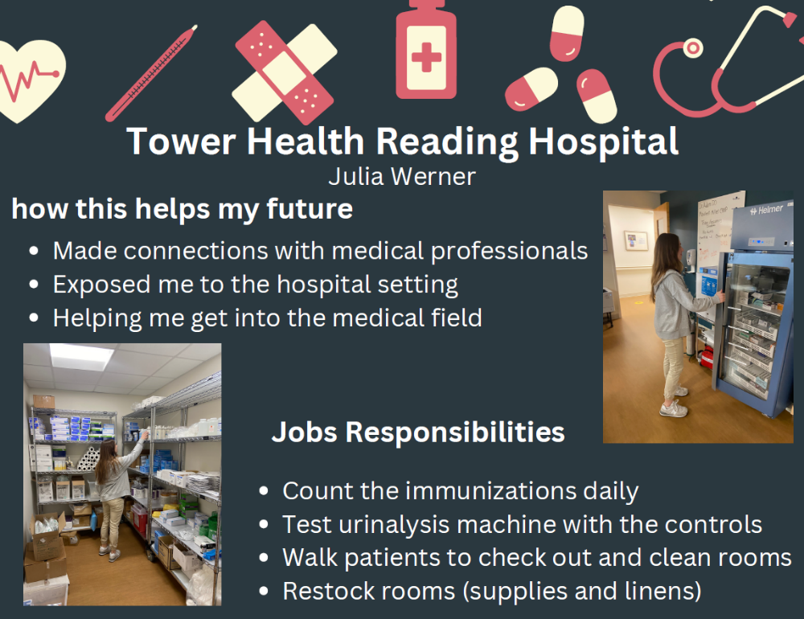
HOSPITAL
How this helps my future:
I made connections with medical professionals
Exposed me to a hospital setting
Helps me get into the medical field

Slide 6
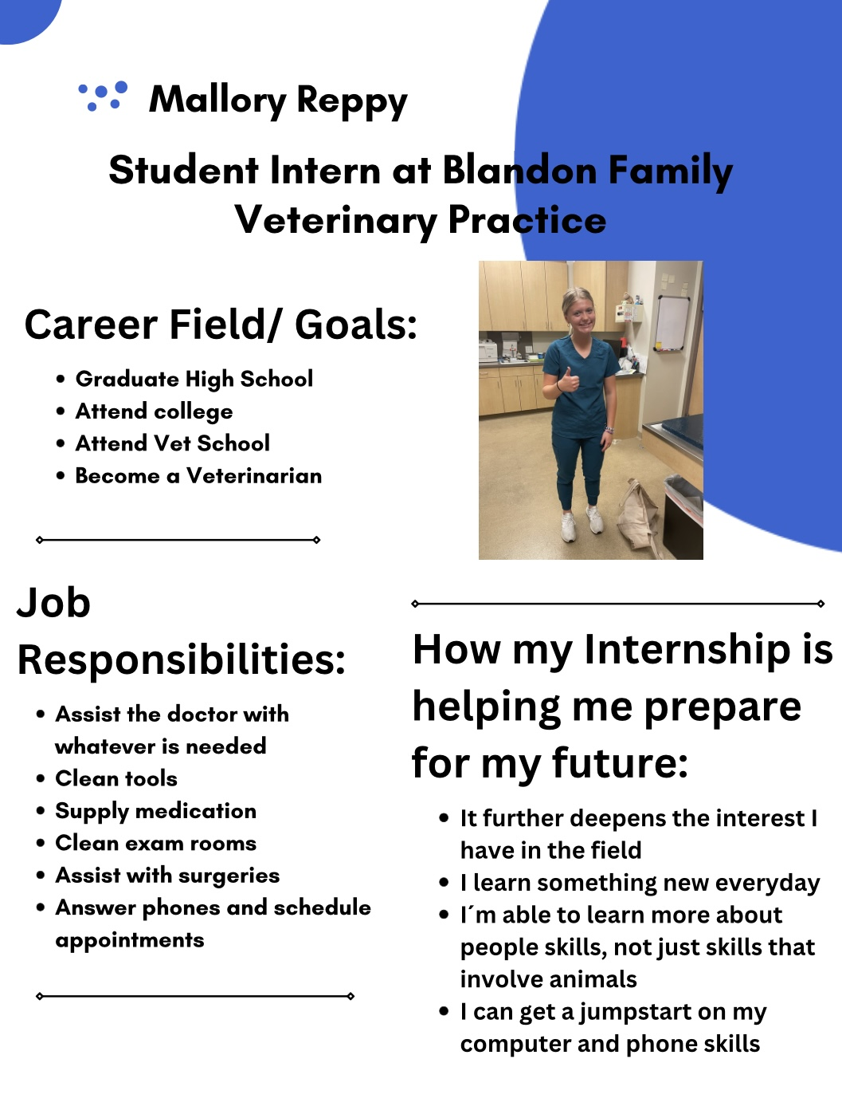
VETERINARIAN
Responsibilities:
Assist the doctor with needed tasks
Clean tools
Supply medication
Clean exam rooms
Assist with surgeries
Answer phones and schedule appointments

Slide 7
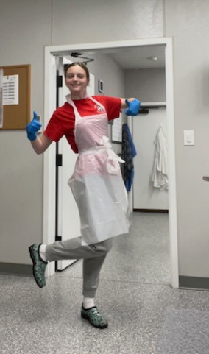
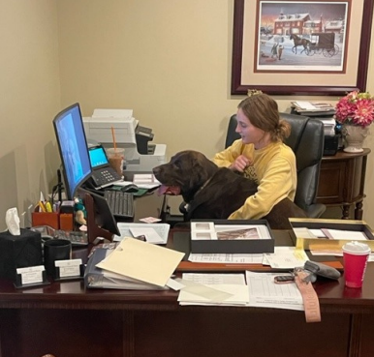
FUNERAL HOME
Career Goals:
Attend a 4 year university
Attend mortuary school
Obtain a funeral director’s license
Help the community through my work

Slide 8
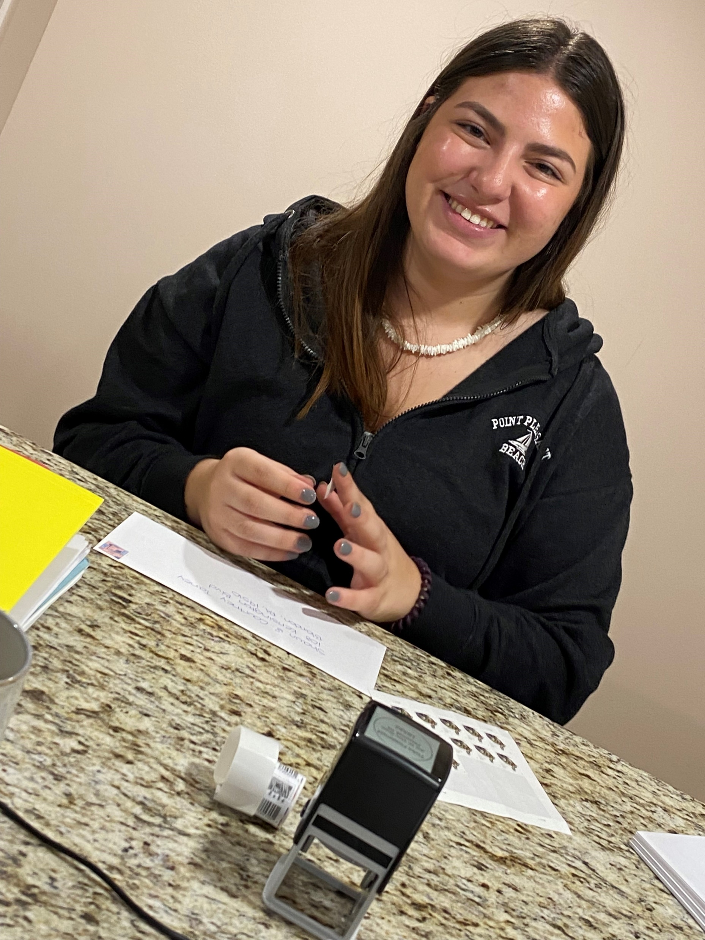
REAL ESTATE
Skills learned:
Typing business documents on a computer
Add numbers quickly and accurately
Properly write business letters
Address envelopes
Prepare portfolios for open house

Slide 9
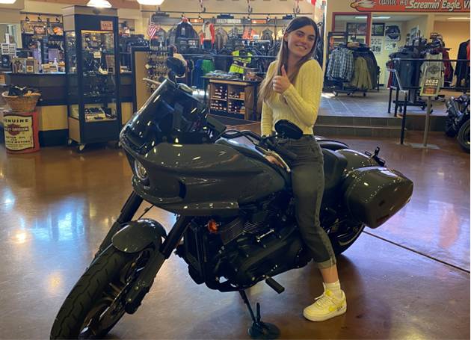
BUSINESS
Area of Interest:
Business
Finance
Risk Management

Slide 10
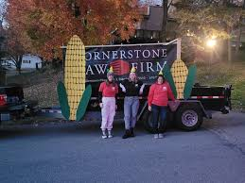
LAW FIRM
Tasks:
Organize legal documents
Experience day-to-day work in a law firm
Provide service to the community by promoting the law firm in a parade

Slide 11
ATHLETIC TRAINER
Typical day:
Arrive at 2:25 p.m.
Go to the athletic training room
Learn about students that I can help during that day
Get informed on sports practices taking place that day
Help students with rehab
Watch paperwork being completed

Slide 12
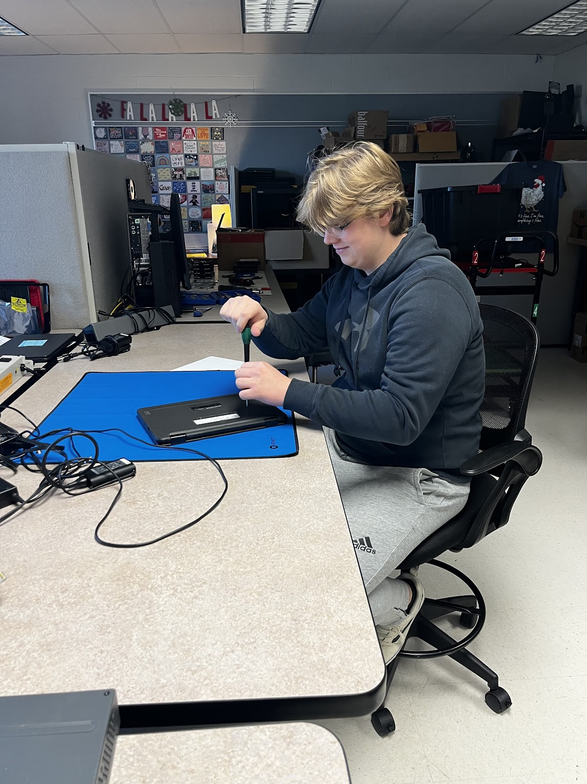
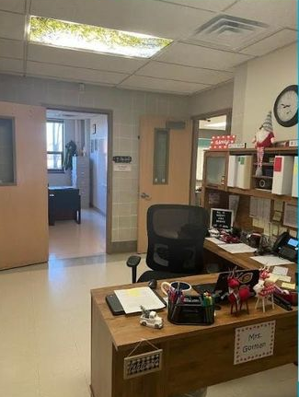
LOGAN & MICHAEL
FAHS IT Department
How we are preparing for our future:
Learning basic repair skills
Networking skills
Telecommunication skills
Teaming skills
Communication skills

Slide 13
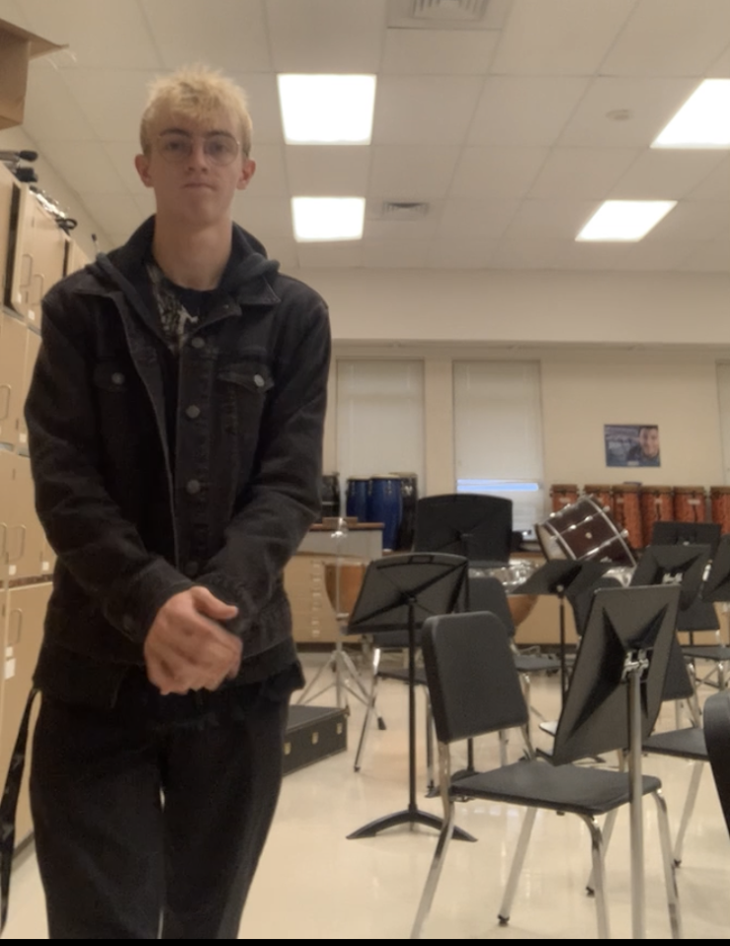
MUSIC EDUCATION
Job Responsibilities:
Keep students on task and engaged
Help clean up around the classroom
Teach students new material

Slide 14

INTERNSHIP REQUIREMENTS
1) Hours (120 per semester)
2) Weekly Time Sheets
3) Quarterly Assignments
4) Mentor Evaluation

Slide 15






HOW DO I GET AN INTERNSHIP?

Slide 16

Fill out the survey in Google Classroom to express an internship
01
Read over the information in Google Classroom
02
Talk to potential internship sites
03
Share information with Mrs. Ackerman
04
A meeting is held with student & parent(s) to go over requirements
05
Internship Site Agreement must be filled out
06
First-day orientation is held
07
You are off to your internship and learning about a career
08

Slide 17

QUESTIONS?
EMAIL
kackerman@fleetwoodasd.org

Slide 18
GOOGLE CLASSROOM
CODE
bp4uv5v

