Slide 1


Language Education Network
Virtual Meeting
March 3, 2023
1:00 – 2:30 PM
Facilitators:
Carlos Pagán, Director, Literacy and Language Support
Melissa Garcia, Coordinator, Language Education Services

Slide 2
WELCOME & INTRODUCTIONS

Slide 3

2022-23 Meeting Dates

Slide 4
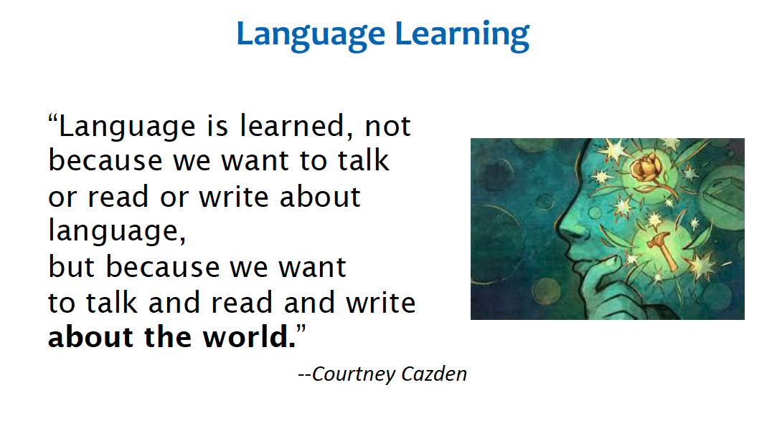

Slide 5
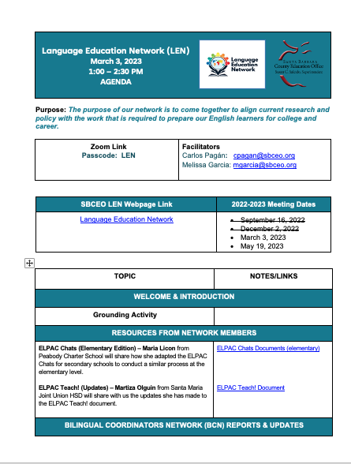
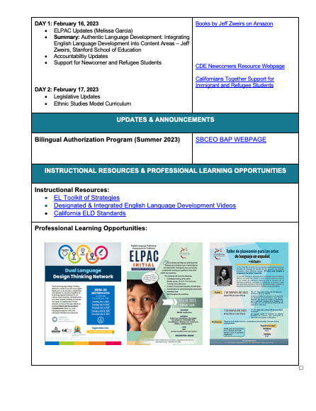

Slide 6
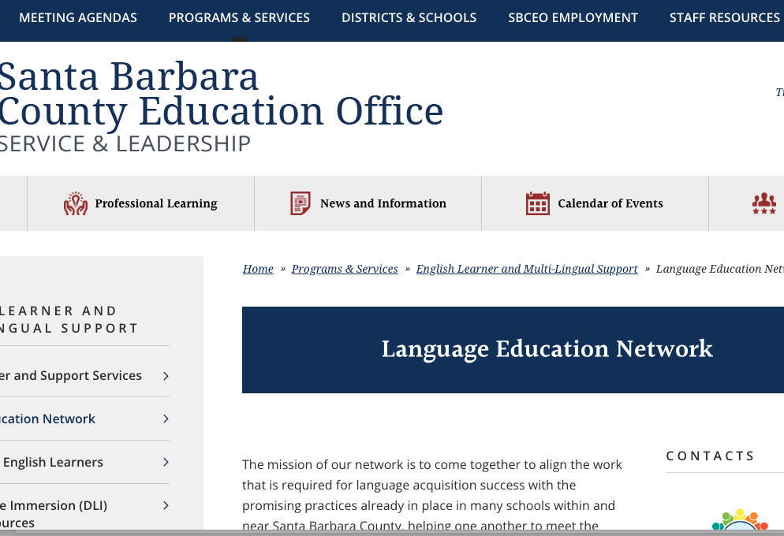
SBCEO LEN RESOURCES

Slide 7
RESOURCES FROM NETWORK MEMBERS

Slide 8
ELPAC CHATS – Elementary Edition

Slide 9
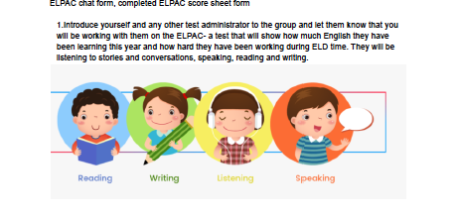

Slide 10
ELPAC TEACH!

Slide 11


Slide 12
BILINGUAL COORDINATORS NETWORK (BCN) REPORTS & UPDATES

Slide 13

ELPAC UPDATES

Slide 14
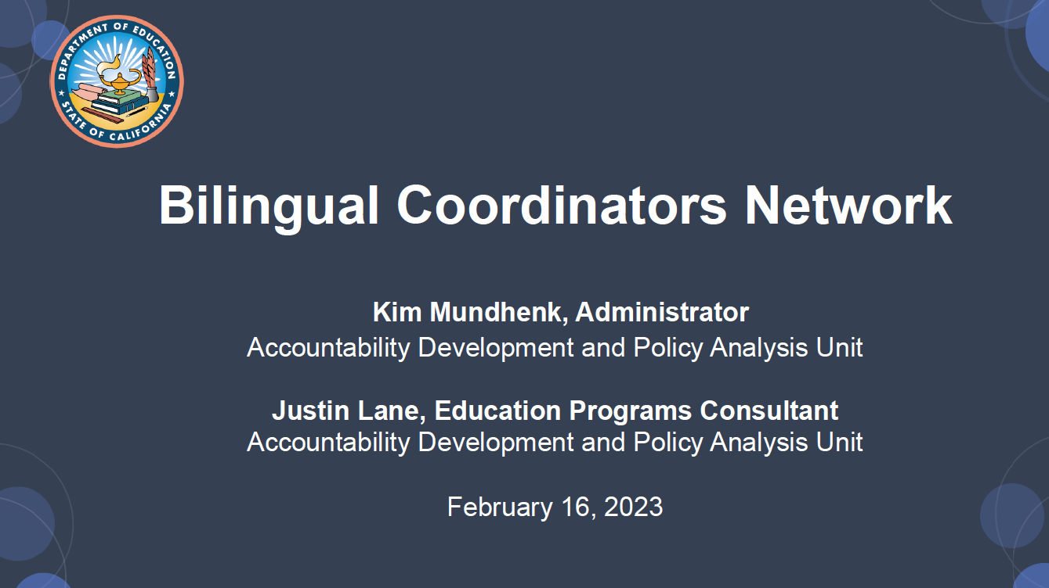

Slide 15


Slide 16
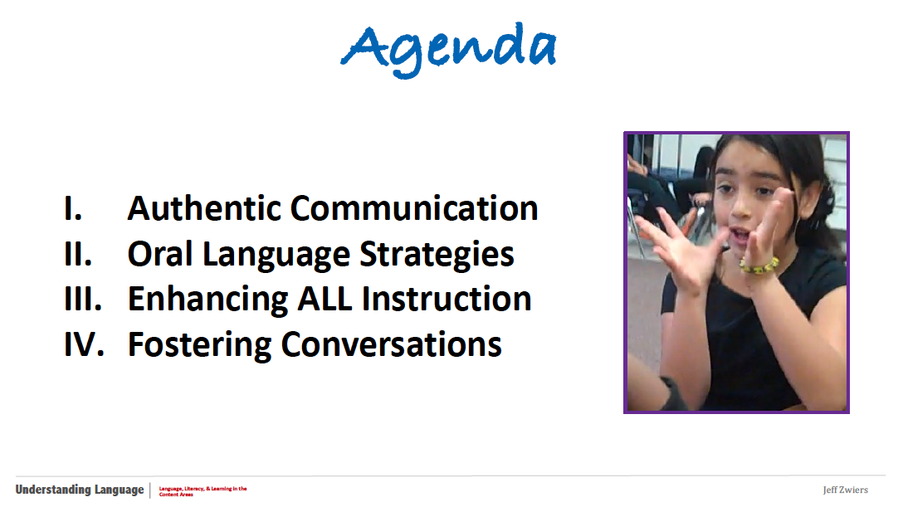

Slide 17
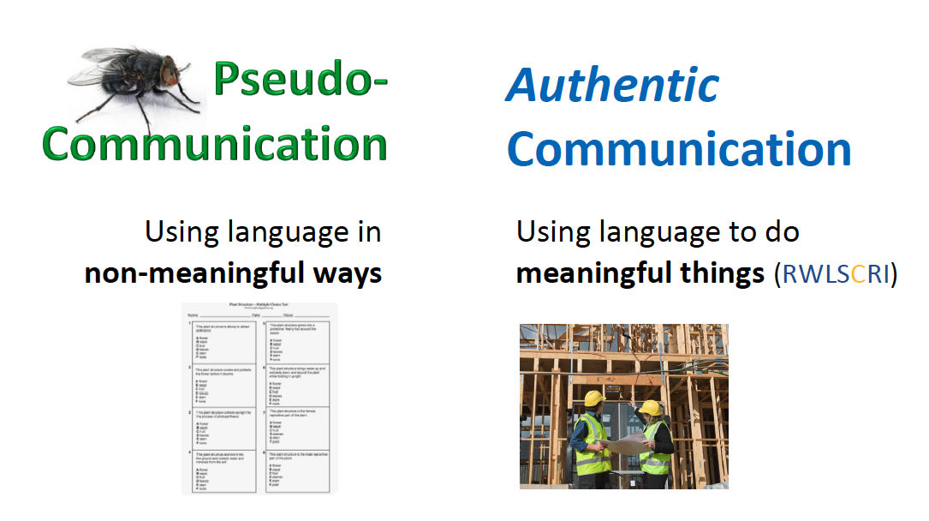

Slide 18
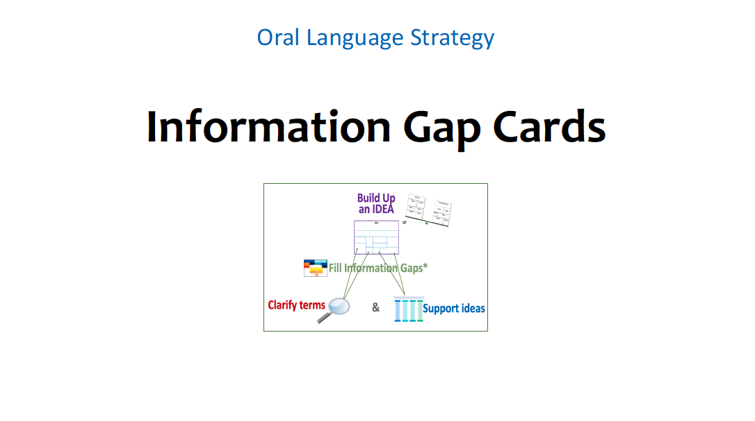

Slide 19
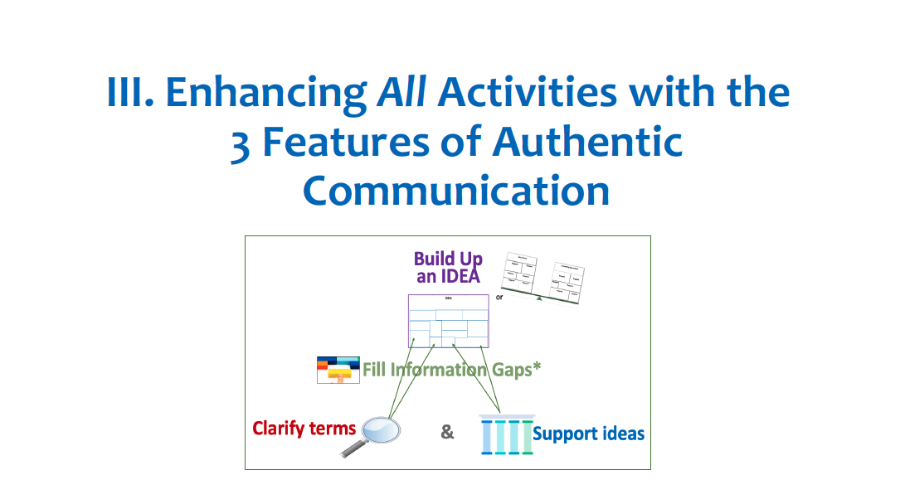

Slide 20
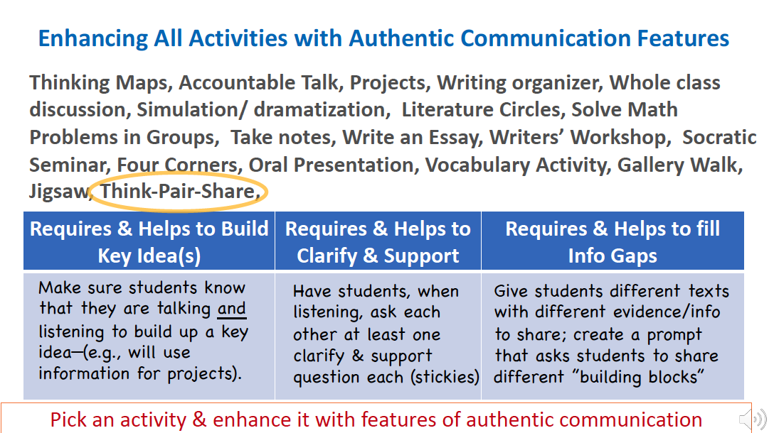

Slide 21
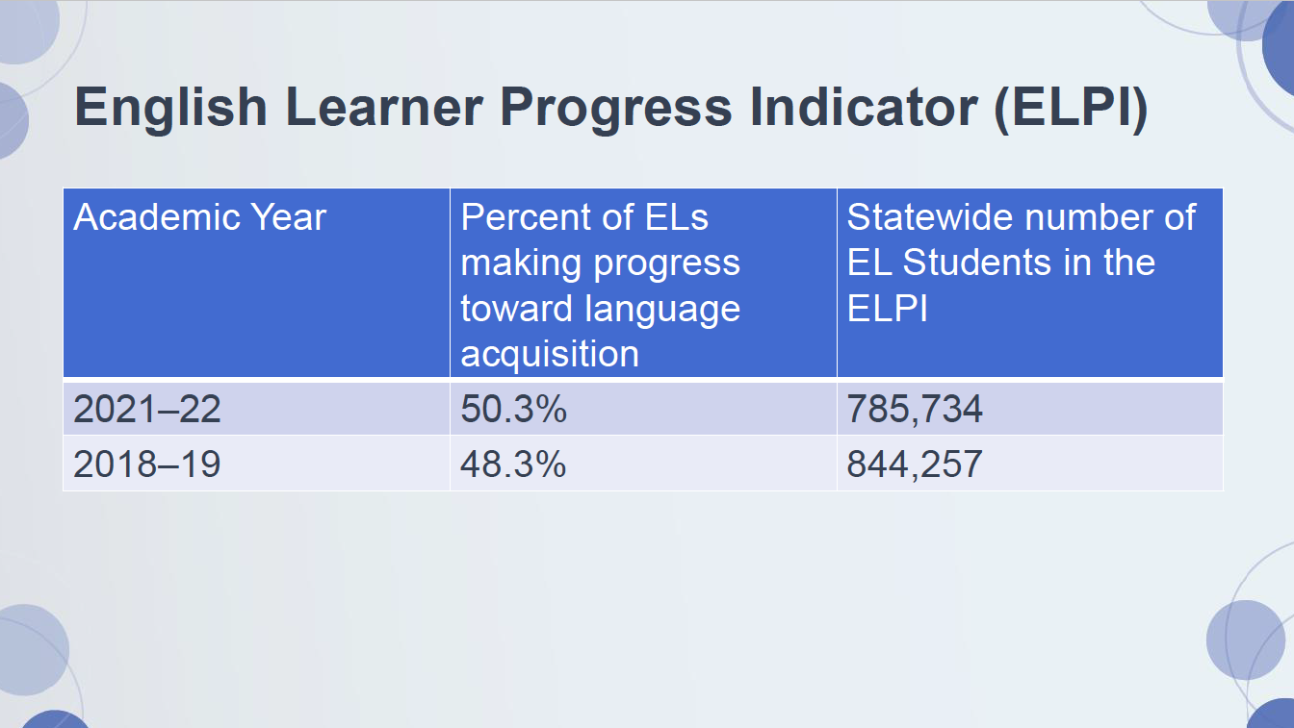

Slide 22
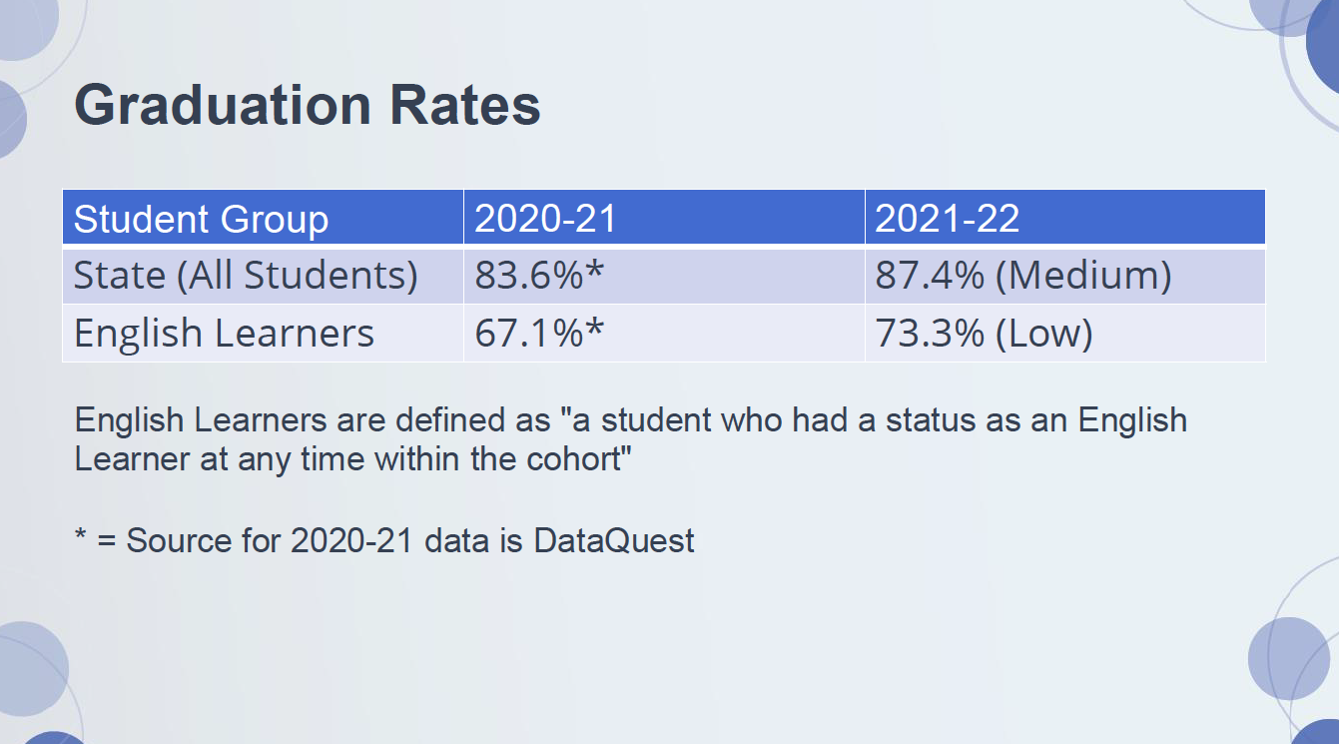

Slide 23
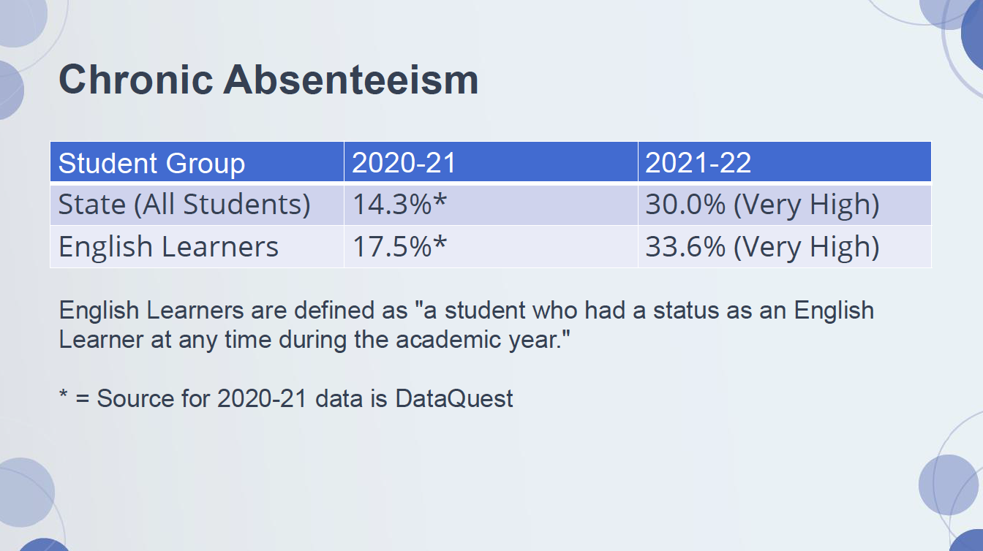

Slide 24
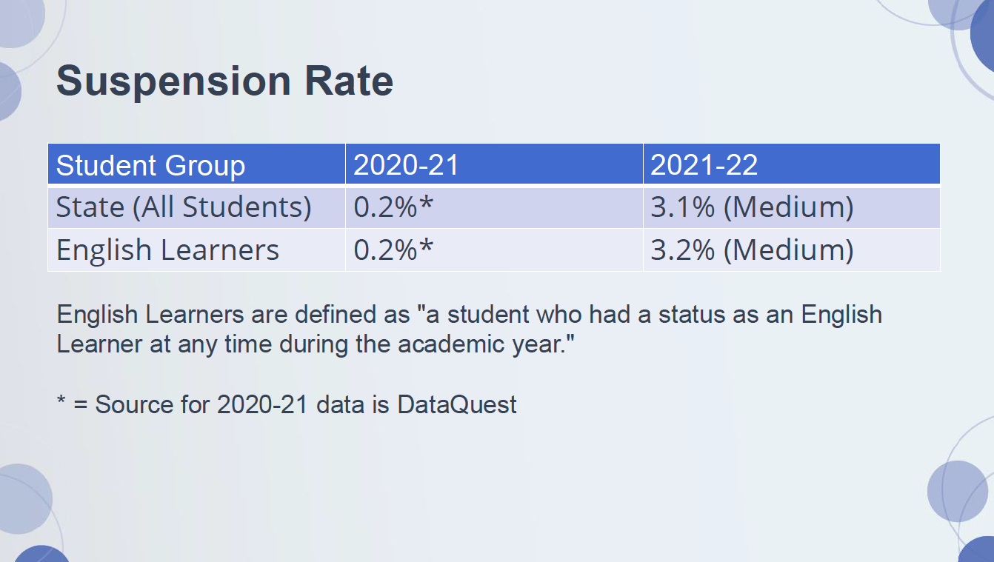

Slide 25
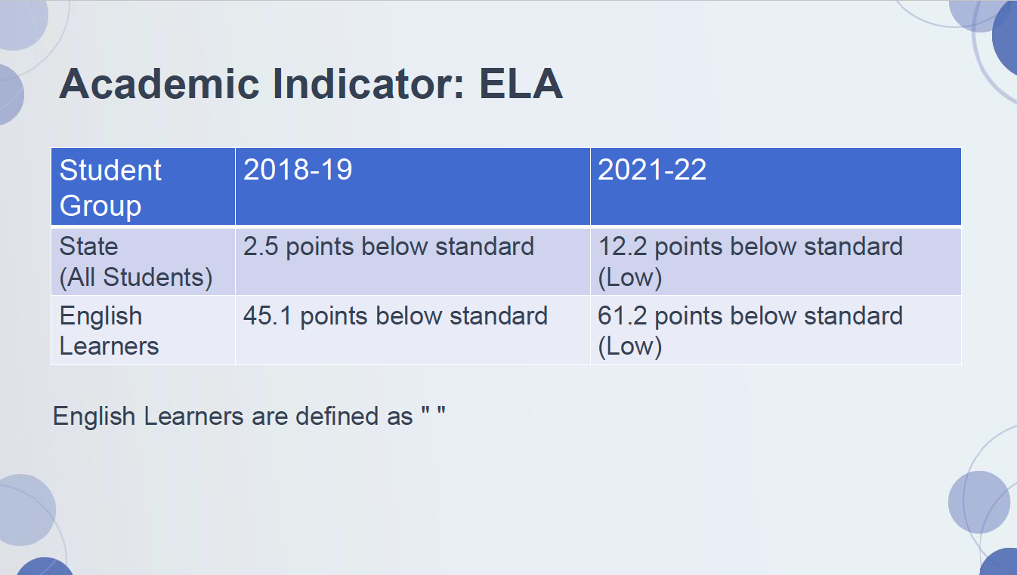

Slide 26
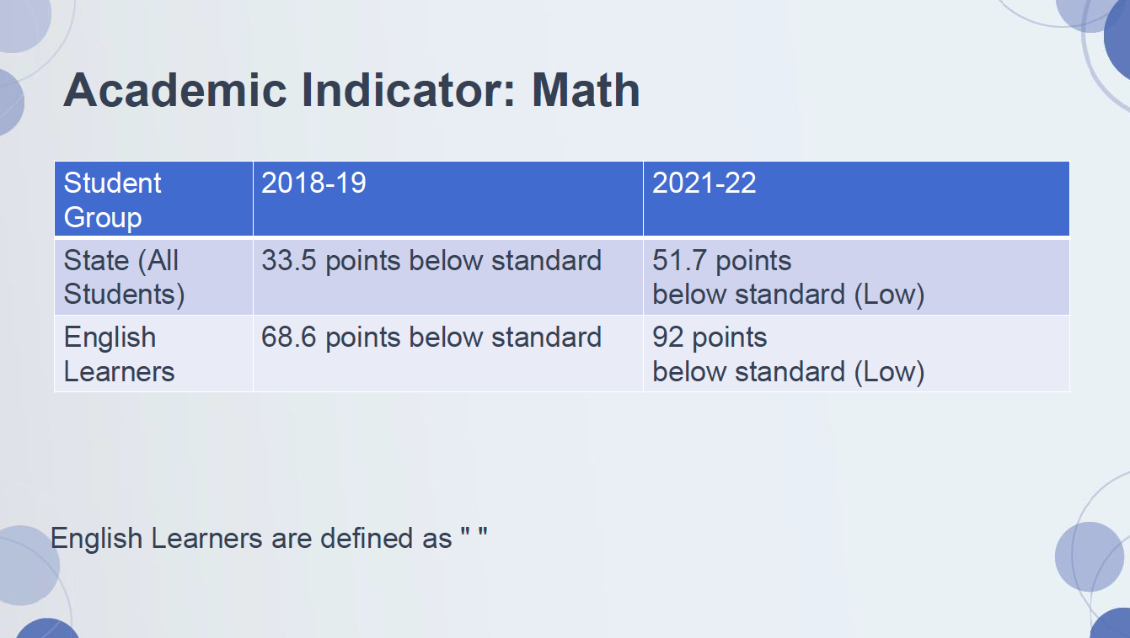

Slide 27
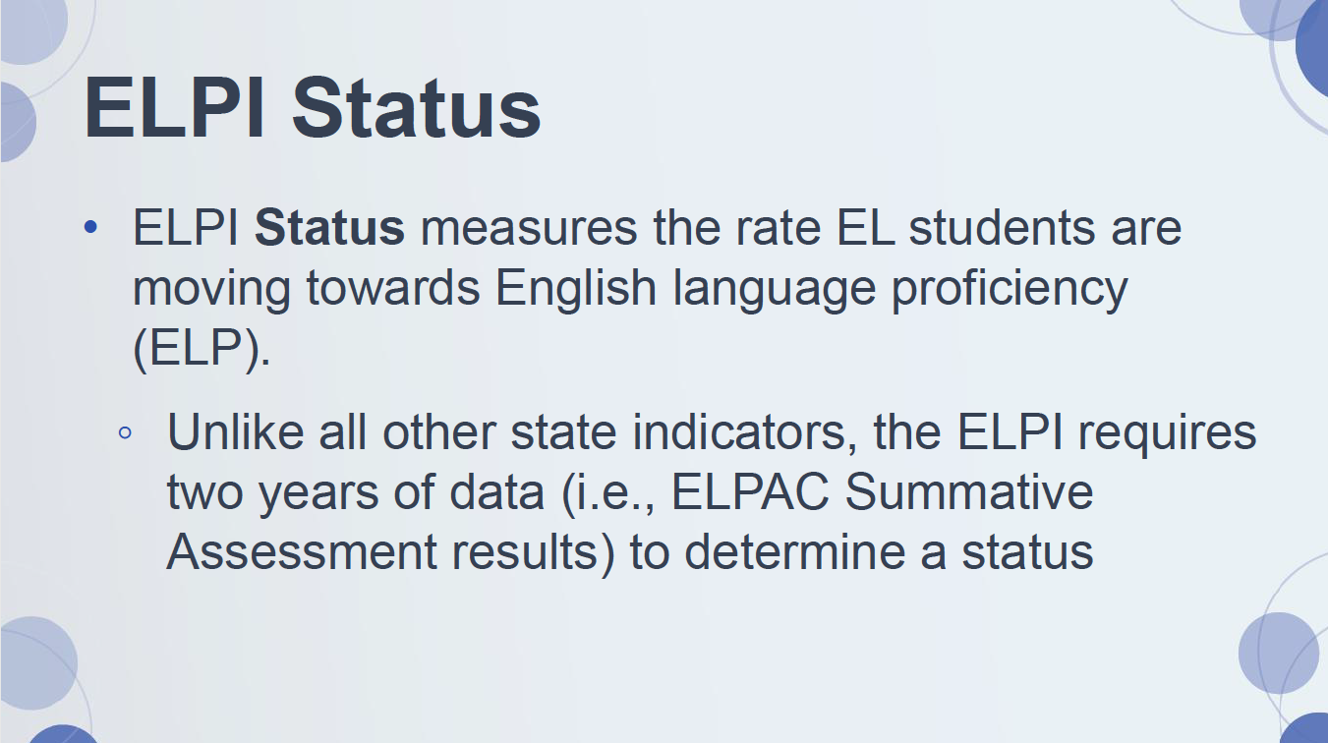

Slide 28
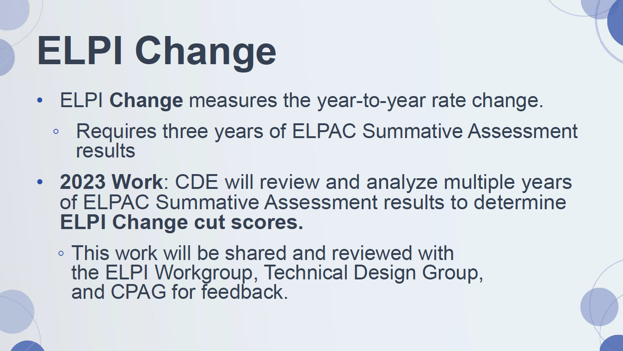

Slide 29
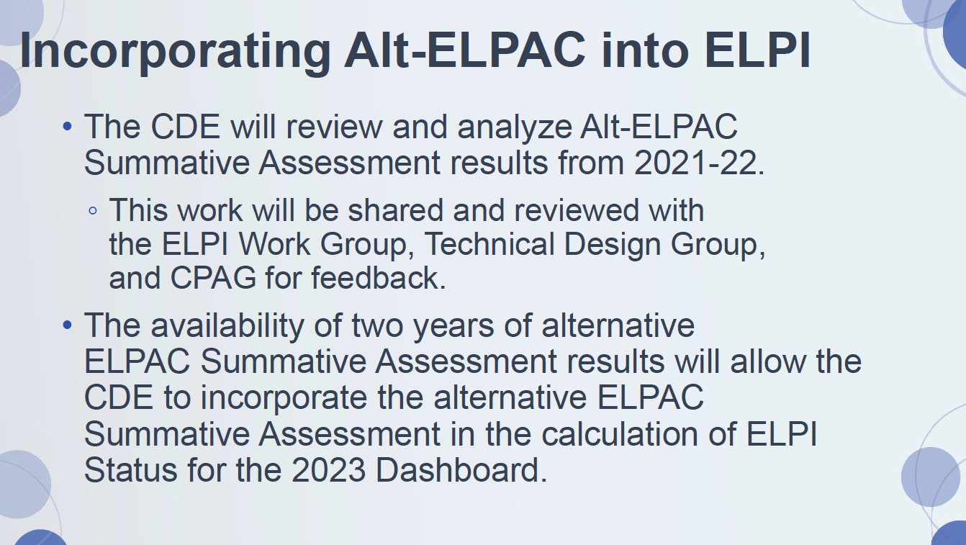

Slide 30

Observation Protocol for Teachers of English Learners (OPTEL)
If you would like to participate, please sign up at:
https://tinyurl.com/OPTEL2023FieldTestSignUp

Slide 31


Slide 32
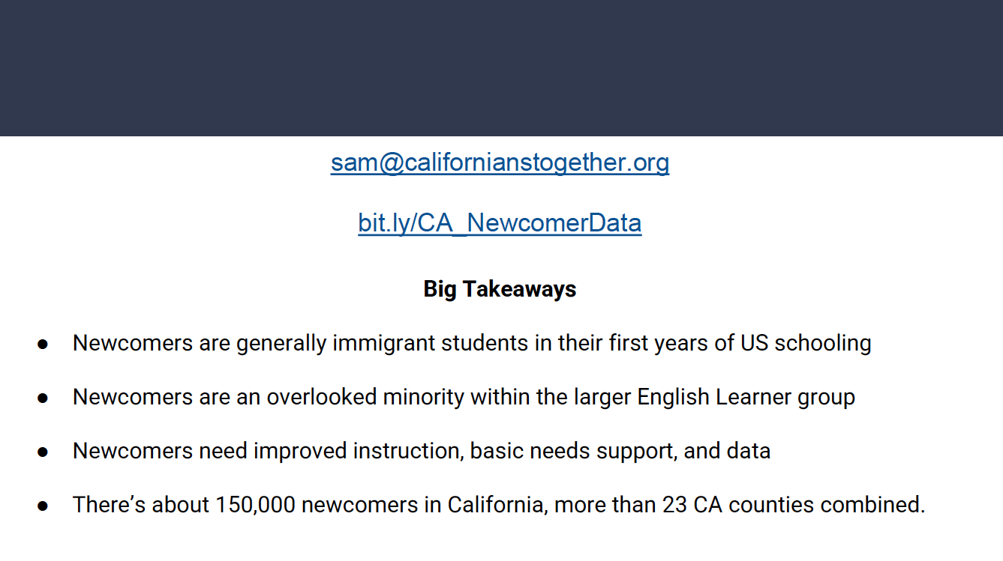

Slide 33


Slide 34
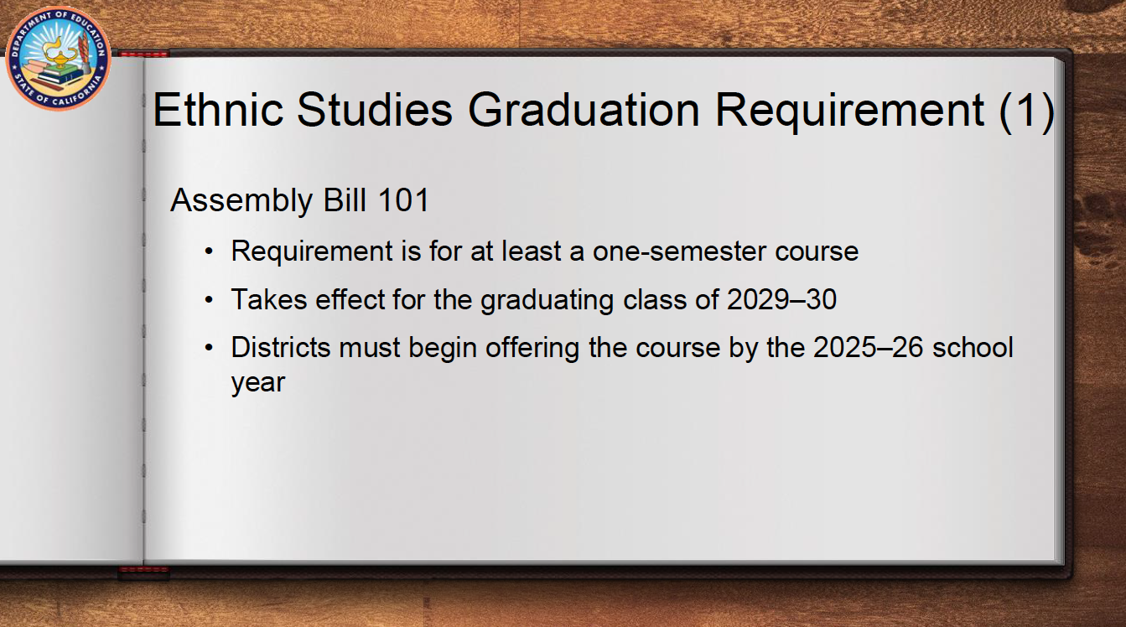

Slide 35
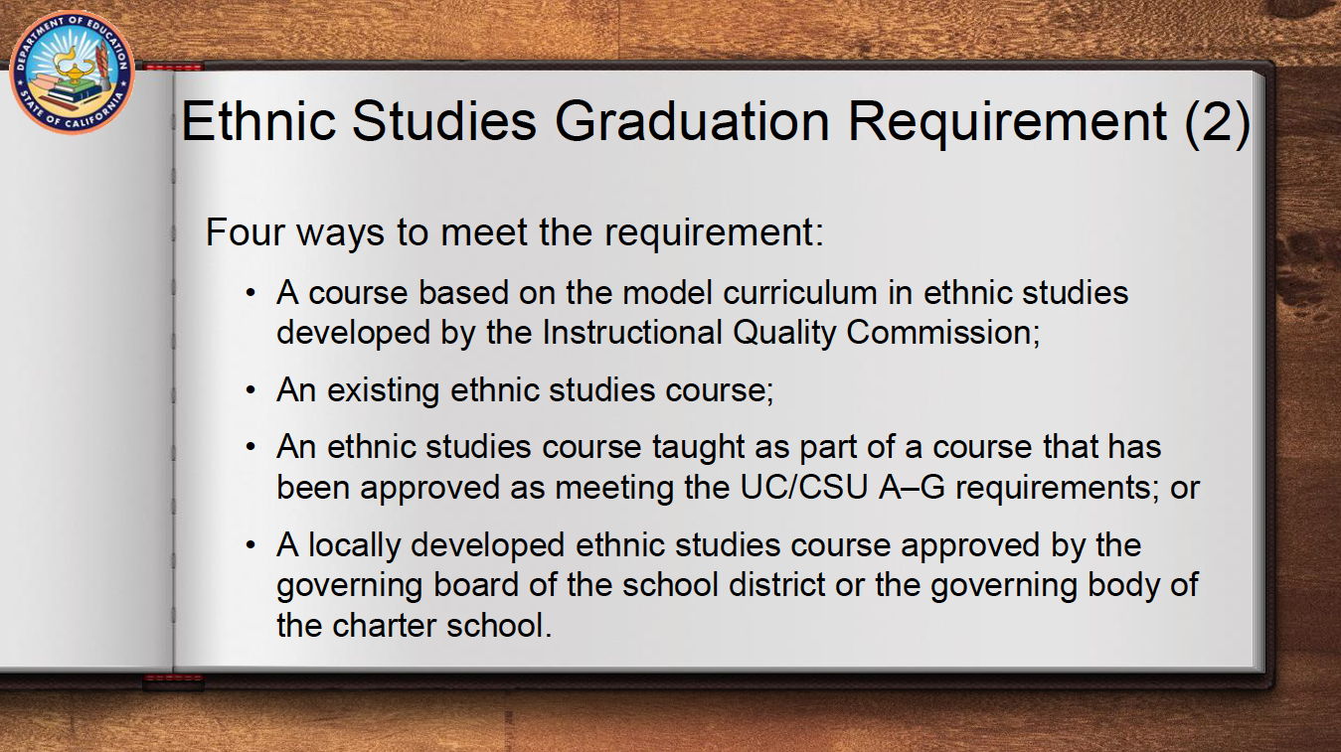

Slide 36
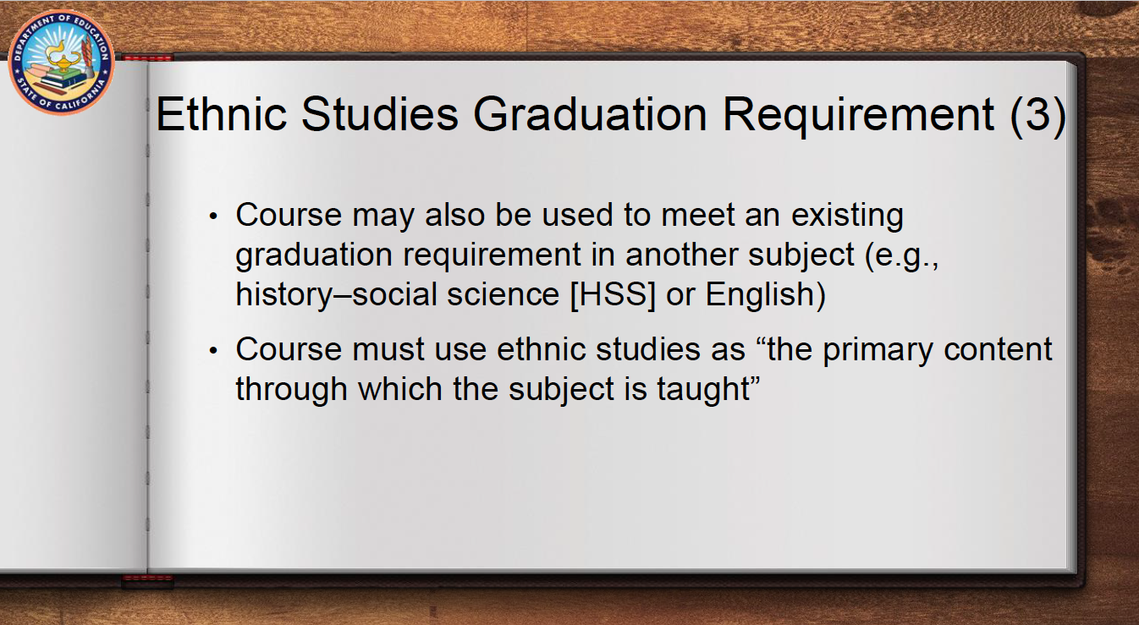

Slide 37
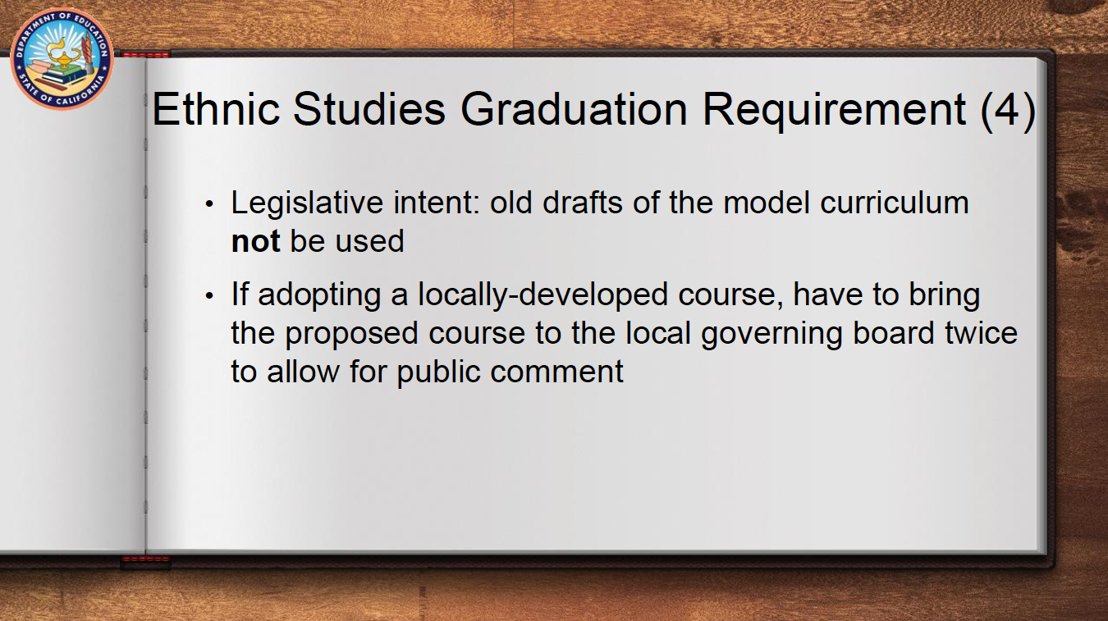

Slide 38
UPDATES & ANNOUNCEMENTS

Slide 39


Slide 40
PROFESSIONAL LEARNING OPPORTUNITIES

Slide 41

MAY 18, 2023
8:30 AM – 3:00 PM

Slide 42

MARCH 7, 2023
3:00 – 4:30 PM

Slide 43


Slide 44

Thank you!

