Slide 1

Superintendent Search Input Survey
Tuesday, February 28, 2023

Slide 2



1,671
Total Responses
Date Opened: Tuesday, February 7, 2023
Date Closed: Thursday, February 23, 2023
Complete Responses: 1,671

Slide 3
Q1: What is your role in the Ascension Parish school system? (select all that apply)
Answered: 1,663

Slide 4
Q1: What is your role in the Ascension Parish school system? (select all that apply)
Answered: 1,663
ANSWER CHOICES | RESPONSES
Alumni | 10.94% | 182
Business Owner | 2.35% | 39
Community Member | 13.17% | 219
Current Student | 25.32% | 421
Employee | 36.26% | 603
Parent/Guardian | 45.58% | 758
Other (please specify) | 2.89% | 48
TOTAL |  | 2270

Slide 5
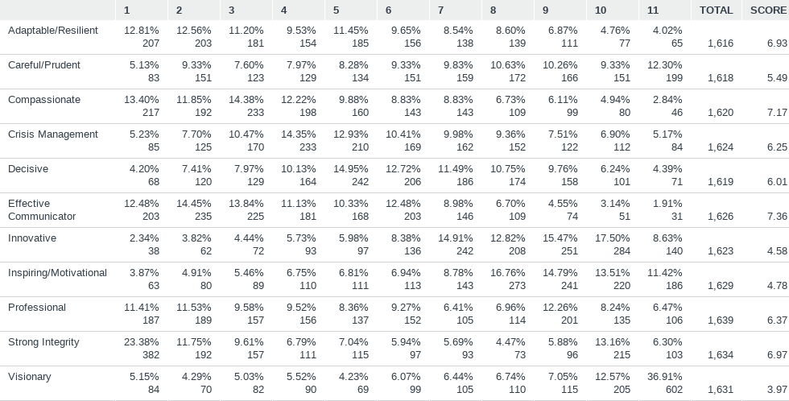
Q2: Please rank the leadership qualities you feel are most important in a superintendent.
Answered: 1,658

Slide 6
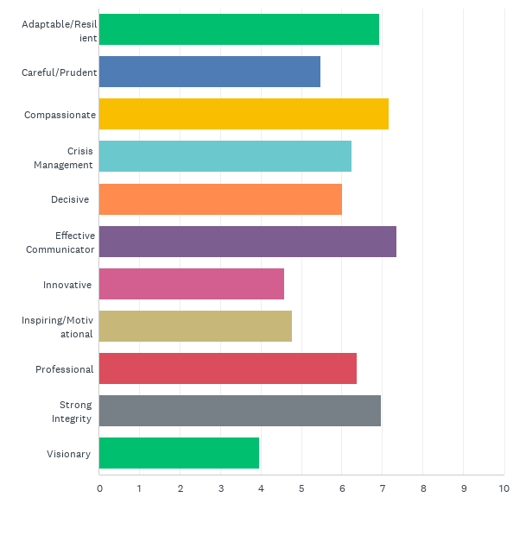
Q2: Please rank the leadership qualities you feel are most important in a superintendent.
Answered: 1,658
4
2
1
5
3

Slide 7
Top 5 Leadership Qualities by Respondent Group
 | ALL | BUSINESS OWNERS | COMMUNITY, EMPLOYEES, & PARENTS | STUDENTS
1 | Effective Communicator | Strong Integrity | Strong Integrity | Adaptable
2 | Compassionate | Effective Communicator | Effective Communicator | Careful/Prudent
3 | Strong Integrity | Professional | Compassionate | Compassionate
4 | Adaptable | Adaptable | Adaptable | Crisis Management
5 | Professional | Compassionate | Professional | Effective Communicator

Slide 8
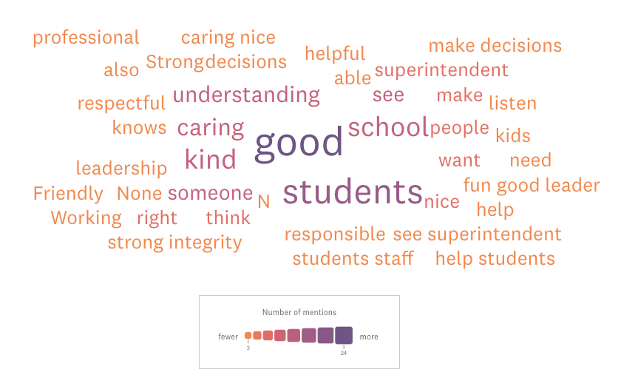
Word Cloud of Student Written Responses on Leadership

Slide 9
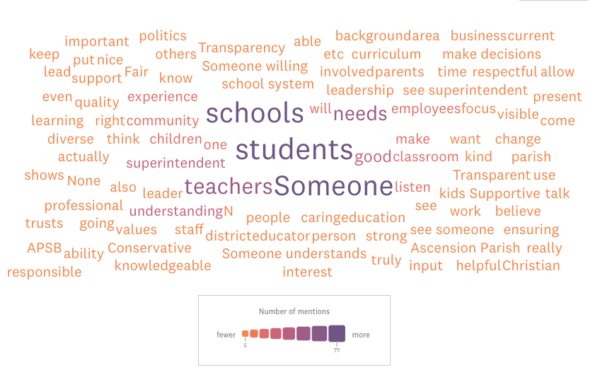
Word Cloud of All Written Responses on Leadership

Slide 10
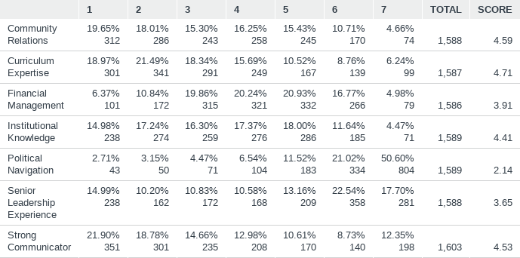
Q4: Please rank the skills and experience you feel are most important in a superintendent.
Answered: 1619 ,: 52

Slide 11
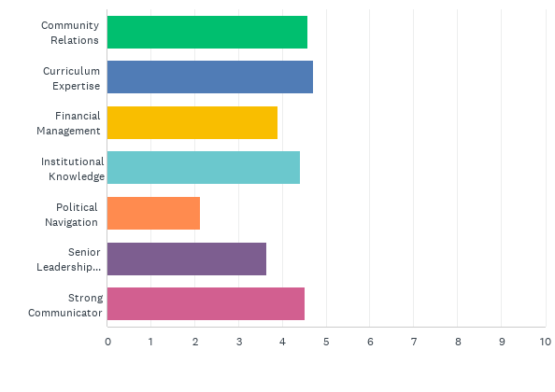
Q4: Please rank the skills and experience you feel are most important in a superintendent.
Answered: 1,619
2
1
5
4
3

Slide 12
Top 5 Skills & Experience by Respondent Group
 | ALL | BUSINESS OWNERS | COMMUNITY | EMPLOYEES | PARENTS | STUDENTS
1 | Curriculum Expertise | Curriculum Expertise | Curriculum Expertise | Strong Communicator | Curriculum Expertise | Community Relations
2 | Community Relations | Community Relations | Institutional Knowledge & Community Relations | Institutional Knowledge | Strong Communicator | Curriculum Expertise
3 | Strong Communicator | Strong Communicator | Community Relations | Curriculum Expertise | Institutional Knowledge | Strong Communicator
4 | Institutional Knowledge | Senior Leadership | Senior Leadership | Community Relations | Community Relations | Institutional Knowledge
5 | Financial Management | Institutional Knowledge | Professional | Financial Management | Financial Management | Financial Management

Slide 13
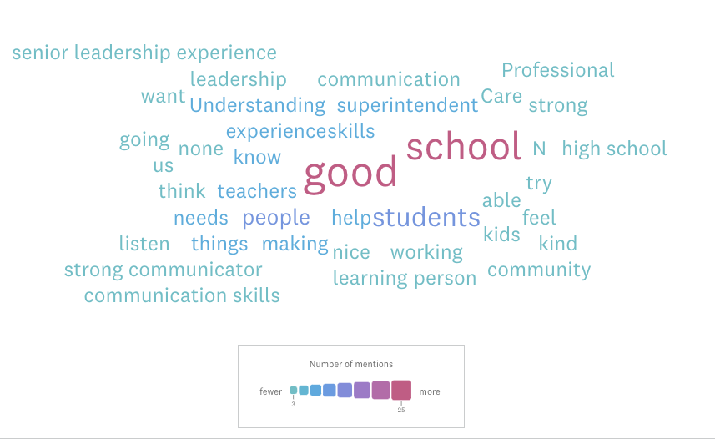
Word Cloud of Student Written Responses on Skills

Slide 14
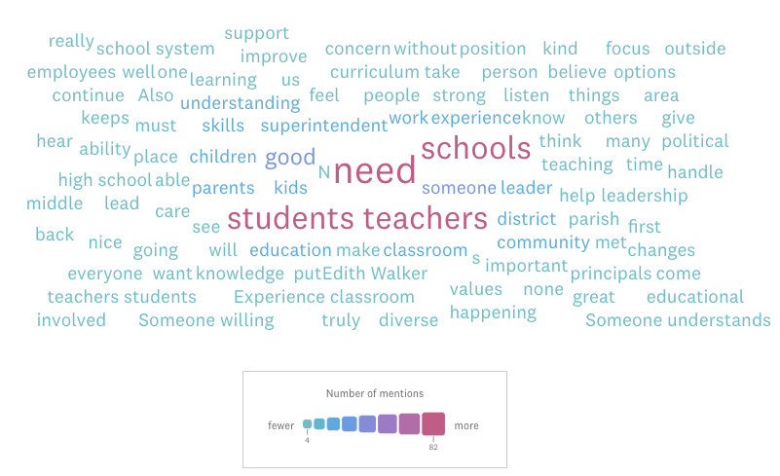
Word Cloud of All Written Responses on Skills

