Slide 1


Navigating the Transition to College: How to have a successful first year of college
Melinda S. Harper, Ph.D.
Queens University of Charlotte
Charlotte Psychotherapy & Consultation Group

Slide 2
Topics Covered
What to expect during this transition
Key factors of a successful transition
Myths vs. Realities
Distinguish between “red flags” of difficulty and normal adjustment reactions
Homesickness and what to advise
Know when to "step in" and when to "step back"
Proprietary & Confidential

Slide 3

Why This Transition Matters
An opportunity for growing intellectually and personally, creating new social connections, and establishing a sense of community within a new environment.
Significant shift in:
  Academics or Professional Demands
  Social landscape
  Independent Living
  Orientation towards future
Proprietary & Confidential

Slide 4
What can happen during this transition?
Approximately 75% of students reported difficulty maintaining a healthy diet.
Approximately 60% of all college students reported inadequate sleep.
Three in five students reported feeling isolated from campus life.
Of those who frequently felt isolated, more than half (53%) frequently felt depressed.
Students also expressed high rates of anxiety, with half reporting occasionally (50.3%) .
About half (49.4%) of respondents found it somewhat or very difficult to manage their time effectively.
Handout: First Year in Stages
SOURCE: Romo & Jacobo, 2020. 2019 Your First College Year Survey. CIRP at the Higher Education Research Institute at UCLA (N = 6,263 1st year students from 23 4-year colleges/universities in U.S.)
Notes:
During this transition, young adults are particularly susceptible to both psychological and physical symptoms of stress:
Loneliness
Depression
Homesickness
Health concerns and problematic use of substances

Slide 5
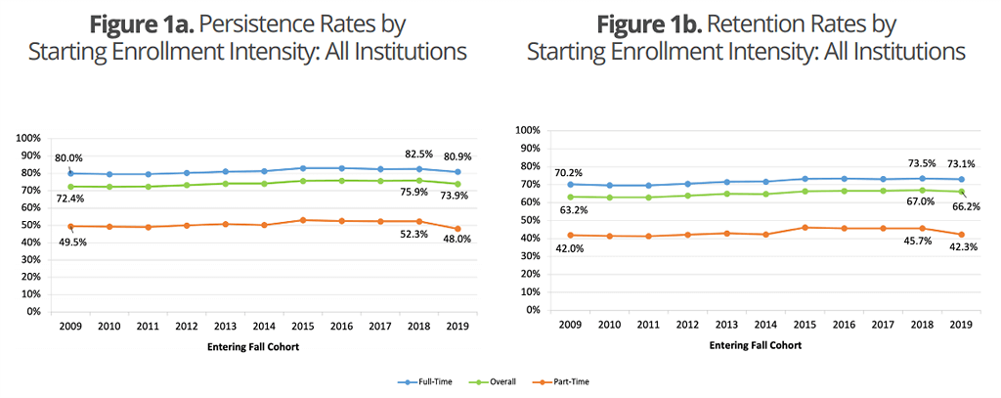
What can happen during this transition?
In Fall 2019, 73.9% persisted at any U.S. institution by Fall 2020 (Figure 1a), while 66.2% were retained at their starting institution (Figure 1b) (N = 2.6 mil).
An average of 9.2 percent of first-year students, in any fall term between 2009 and 2019, transferred to a different institution by the following fall.
Notes:
The Persistence and Retention report series examines first-year persistence and retention rates for beginning postsecondary students. Persistence rate is measured by the percentage of students who return to college at any institution for their second year, while retention rate is by the percentage of students who return to the same institution. Students attaining a credential in their first year are accounted for in persistence and retention rates. The report is designed to help institutions understand trends and patterns in this important early success indicator, and identify disparities by institutional type, degree level, starting enrollment intensity, state, and student demographic factors such as age, gender, and race/ethnicity.

Slide 6
“Why do young adults fail at college?”
Not Ready or Prepared:
  “Mismatch” between high school and college/”young adulthood”
  Poor Lifestyle & Study Habits
Low Motivation or Lack of Effort
Take-away: Young adults recognize the reason they may not succeed is within their control and responsibility
Handout: University vs High School
Proprietary & Confidential
Notes:
For faculty, the number one reason (37% - 40%) for college student failure was "Not Ready for College" followed by Lack of Effort (11-13%).
For students, the number one reason (34.6%) for college student failure was “Motivation” followed by Study Habits (17.3%).
In survey of over 170,000 American students, results indicated a serious ‘‘mismatch’’ between high school students’ learning habits and the habits expected of them at university.

Slide 7

What do I need to succeed?
Key factors for success are:
  Balanced lifestyle for physical/emotional health
  Time management
  Motivation
  Sense of Belonging
SOURCES: Brooks & DuBois, 1995; Gerdes & Mallinckrodt, 1994; Pritchard & Wilson, 2003; Rickinson & Rutherford, 1995
Proprietary & Confidential

Slide 8


Key Factors: Balance & Time Management
Balance:
  Physical & Emotional Health (eat, sleep, exercise)
  Work (or being productive)
  Social
Ask Your Young Adult/Yourself:
  When is the last time you ate/slept well?
  When is the last time you connected with friends?
  When is the last time you “moved”? (Small vs Large moves)
Handouts: Time Management Schedule
Course Load Formulas
Proprietary & Confidential

Slide 9
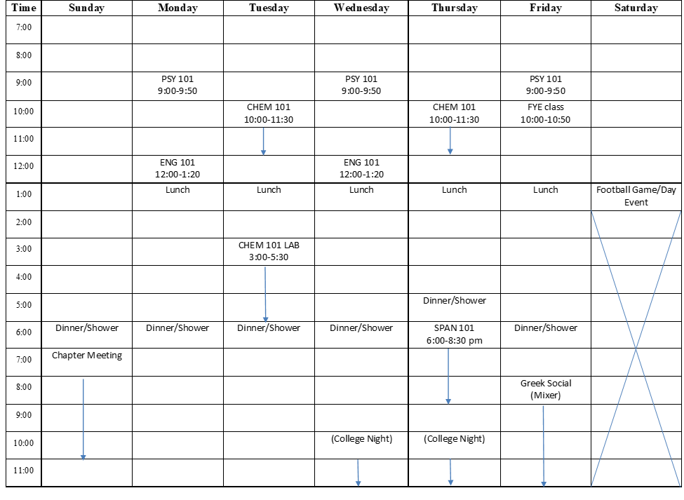

Slide 10

Key Factor: Motivation
Your ability to self-control and motivate is 2x more predictive of health, academic performance, income levels and relationship stability in adulthood compared to IQ and SAT scores (Duckworth & Seligman, 2005).
Tips to increase motivation and effort:
  Rest & Eat!
  Meditate (“working” on self-control)
  Consistency and structure
  Remember: It’s the process, not the person
    Key Strategy: Distributive Practice!
Proprietary & Confidential

Slide 11


Key Factor: Sense of Belonging
The degree to which they “fit in” and perceive their university as a match is predictive of college success and retention (Wintre et al., 2008)
Proximity is huge contributor to making friends
Two essential variables: regularity and familiarity
Quality over Quantity: requires one-on-one time
Prioritize close friendships!
Paradox: Technology/social media is surface connection (not depth).
“These [early relationships] are precursors for how they will function in life socially for the rest of their lives. How well you do [with peers] tells us a whole lot about how you manage in a lot of different ways as an adult.”
SOURCES: Narr et al., 2017

Slide 12
Common Myths vs Reality

Slide 13

MYTH: “EVERYONE” Finishes “On-Time”
For the starting cohort of 2013, 63% of students had completed a bachelor’s degree at the same institution where they started by 2019 (within 6-year graduation rate).
For the starting cohort of 2015, the national 6-year completion rate reached 62.2%.
As of 2020-21, only 41% of American college students graduate from college in four years (may be as low as 33.3%).
As many as 33% to 75% of all undergraduate students change majors at least one time before earning a degree.

Slide 14

Myth: College is the “best four years of your life”
Fact: Homesickness is normal…and temporary!
Over 95% first-year students report homesickness in the first semester
Homesickness stems from two factors:
  a lack of security and familiarity
  A sense of distress caused by separation.
“High demand” and “Low control”
Notes:
Most experience “homesick separation” vs “homesick distress”
Variables that can predict, impact, or worsen homesickness, including:
A lack of experience with living away from home.
Control over the transition.
Attitude toward the transition.
Response from the family.

Slide 15
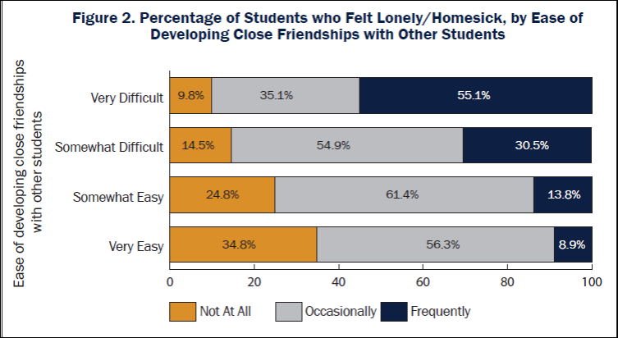
SOURCE: Romo & Jacobo, 2020. 2019 Your First College Year Survey. CIRP at the Higher Education Research Institute at UCLA (N = 6,263 1st year students from 23 4-year colleges/universities in U.S.)
Notes:
Our findings show that how students perceived the ease of making friends related to how often they felt lonely or homesick. Figure 2 shows the easier it was for students to develop friendships, the less they felt lonely or homesick. For example, 55.1% of students who found it very difficult to make friends on campus frequently felt lonely or homesick. By contrast, just 8.9% of students who found making friends very easy felt frequently lonely or homesick during the first year of college

Slide 16


What can parents do for “homesickness?”

Slide 17
Early Red Flags
Communication noticeably drops (or increases)
Skipping classes or work
Having several “late nights” (or naps) in a row
Multiple requests for money
Drop in social connection
Loss of interest in pleasurable activities
Written report/early academic warning
Proprietary & Confidential

Slide 18
When to Step Back vs. Step In
STEP BACK by:
Saying less and listening more
Asking clarifying questions
Validating experience
Offering support by asking “What can I do to support you?”
Anticipate residual consequences for “unloading”.
Availability as an Emotion Coach
STEP IN when you hear:
Loss of interest in activities
Lack of energy and motivation to “keep up”
Lack of interest in goals
Proprietary & Confidential

Slide 19
Strategies to Support
  If feeling socially disconnected:
    Scroll through your phone/email/Facebook list of contact. Make a list of people you haven’t seen or spoken to for a while. Reach out via social media and say hello! Anticipate feeling anxious or awkward, but you can do it! And it’s not “weird”!
  If feeling emotionally disconnected:
    Reach out to one of your social supports.
    Try a meditation or mindfulness practice.
    Journal and offer self-compassion
  If feeling physically “off”:
    Break a sweat and raise serotonin!
    Commit to some form of movement (moderate walk, exercise class) for at least 30 minutes.
    Eat a quality meal; get a good night’s rest
  Check in using “HALT”
  Change one (or all!) of your FIVE senses!

Slide 20
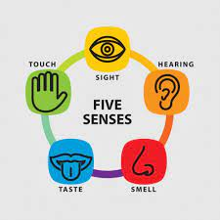
1. Notice 5 things that you can see. Look around you and become aware of your environment. Try to pick out something that you don’t usually notice.
2. Notice 4 things you can feel. Bring attention to the things that you’re currently feeling, such as the texture of your clothing or the smooth surface of the table you’re resting your hands on.
3. Notice 3 things that you can hear. Listen for and notice things in the background that you don’t normally notice. It could be the birds chirping outside or an appliance humming in the next room.
4. Notice 2 things you can smell. Bring attention to scents that you usually filter out, either pleasant or unpleasant. Catch a whiff of the pine trees outside or food cooking in the kitchen.
5. Notice 1 thing you can taste. Take a sip of a drink, chew gum, or notice the current taste in your mouth.

Slide 21

What can parents do?
Be prepared to:
  Normalize mistakes: College is a “safe” place to learn
Be informed about:
  Big 3
  Important Dates (D/A & W)
Plan ahead:
  Handouts: Parent-Young Adult Contract and Checklist
Proprietary & Confidential

Slide 22

THANK YOU!

