Slide 1
Finance Advisory Committee
2023-24 Finance Advisory Committee
Budget and Fiscal Recommendations to Superintendent Osei
Patricia Magnuson, Director of Business Services
Shanique Williams, Asst. Director of Business Services
Meshach Mandel, Student Finance Intern
Alicia Margalli, Student Finance Intern
Julian Roweder, Student Finance Intern
Jacey Cassem, Community Member
Robert Grommesh, Parent/Community member
Valerie Jensen, Parent/Community member
Lisa Walhstrom, Parent/Community member
Prepared for 2.28.2023 School Board Meeting
Notes:
Patricia

Slide 2
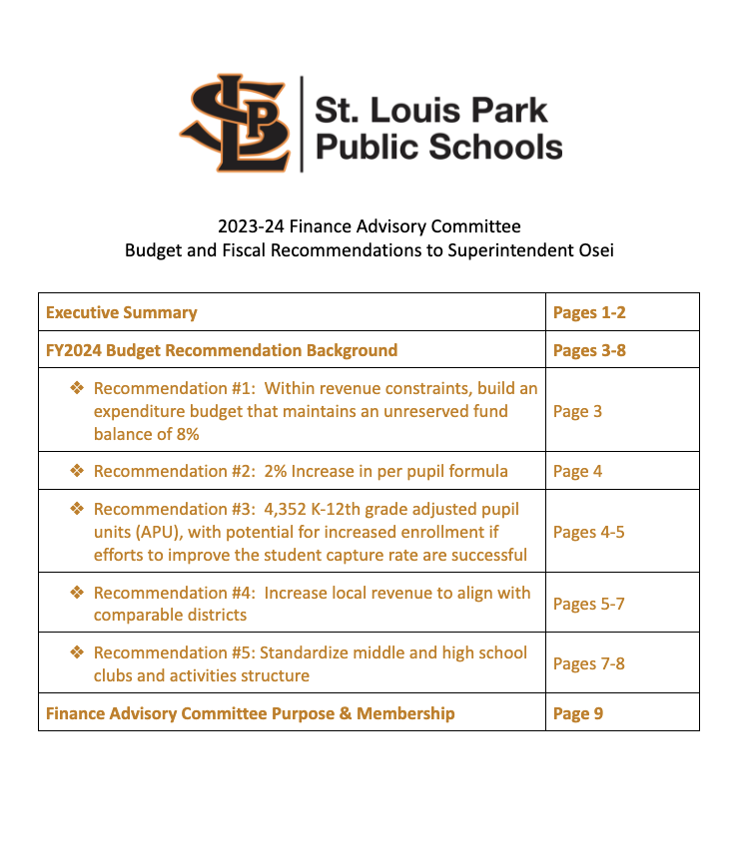
Notes:
Patricia

Slide 3
FAC Purpose
Advise administration and the SLP School Board on
economic and school finance issues, and
build community trust in district finances.
Prepared for 2.28.2023 School Board Meeting
Notes:
Patricia

Slide 4
FAC Members
Community Members
1 | Carlee | Bendickson | high school parent
2 | Julia | Beverly | Peter Hobart parent
3 | Sue | Cantor | community member
4 | Jacey | Cassem | Aquila parent
5 | Barry | Fitzpatrick | middle and high school parent
6 | Andy | Gilles | PSI parent
7 | Angel | Glass | Susan Lindgren parent
8 | Robert | Grommesh | High School & private school parent
9 | Katherine | Heyerdahl | PSI parent
10 | Brice | Hogan | Peter Hobart and PK parent
11 | Valerie | Jensen | Aquila parent
12 | Drew | McGovern | Susan Lindgren parent
13 | Michael | Ness | PSI parent
14 | Lisa | Wahlstrom | Susan Lindgren parent
15 | Meta | Webb | PSI and middle school parent
16 | MIchael | Wells | community member
Students
1 | Meshach | Mandel | new; high school senior
2 | Alicia | Margalli | new; high school junior
3 | Julian | Rohweder | new; high school senior
Staff/School Board
1 | Jennifer | Jerulle | Controller
2 | Virginia | Mancini | School Board Member
3 | Patricia | Magnuson | Director of Business Services
4 | Shanique | Williams | Assistant Director of Business Services
Prepared for 2.28.2023 School Board Meeting
Notes:
Patricia

Slide 5
Primary Factors Discussed and Considered
Declining Fund Balance
Enrollment Projections
Expenditure Trends
Prepared for 2.28.2023 School Board Meeting
Notes:
Shanique

Slide 6
Budget Recommendations
Fund Balance Minimum
General Education Funding Formula
Student Enrollment Projection
Local Revenue
Prepared for 2.28.2023 School Board Meeting
Notes:
Shanique

Slide 7
Recommendation 1: Fund Balance Minimum
Within revenue constraints, build an expenditure budget that maintains an unreserved fund balance of 8%
Prepared for 2.28.2023 School Board Meeting
Notes:
Patricia

Slide 8
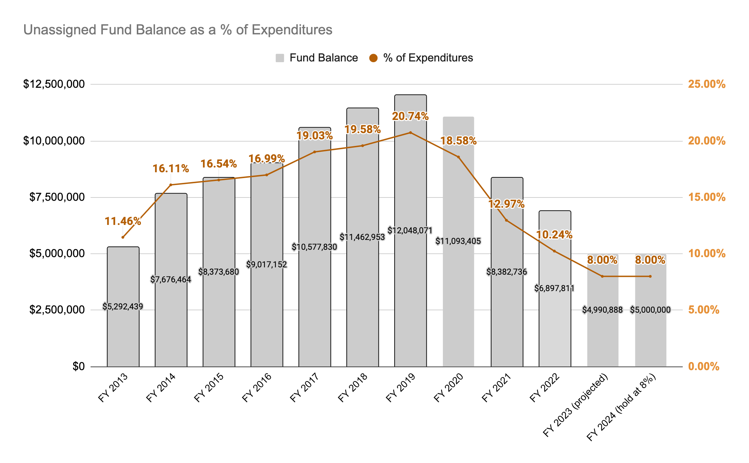
Recommendation 1: Fund Balance Minimum
Prepared for 2.28.2023 School Board Meeting
Notes:
Patricia

Slide 9
Recommendation 2: General Education Funding Formula
2% increase in per pupil formula
Utilize any additional funding from the 2023 session to bolster reserves
Prepared for 2.28.2023 School Board Meeting
Notes:
Patricia

Slide 10
Recommendation 2: General Education Funding Formula
Year | Amount | Explanation
2013-14 | $5,302 | 1.5% increase
2014-15 | $5,831 | 1.5% increase + $25
2015-16 | $5,948 | 2.0% increase
2016-17 | $6,067 | 2.0% increase
2017-18 | $6,188 | 2.0% increase
2018-19 | $6,312 | 2.0% increase
2019-20 | $6,438 | 2.0% increase
2020-21 | $6,567 | 2.0% increase
2021-22 | $6,728 | 2.45% increase
2022-23 | $6,863 | 2.0% increase
2023-24 | $7,000 | 2% increase (assumption)
Prepared for 2.28.2023 School Board Meeting
Notes:
Patricia

Slide 11
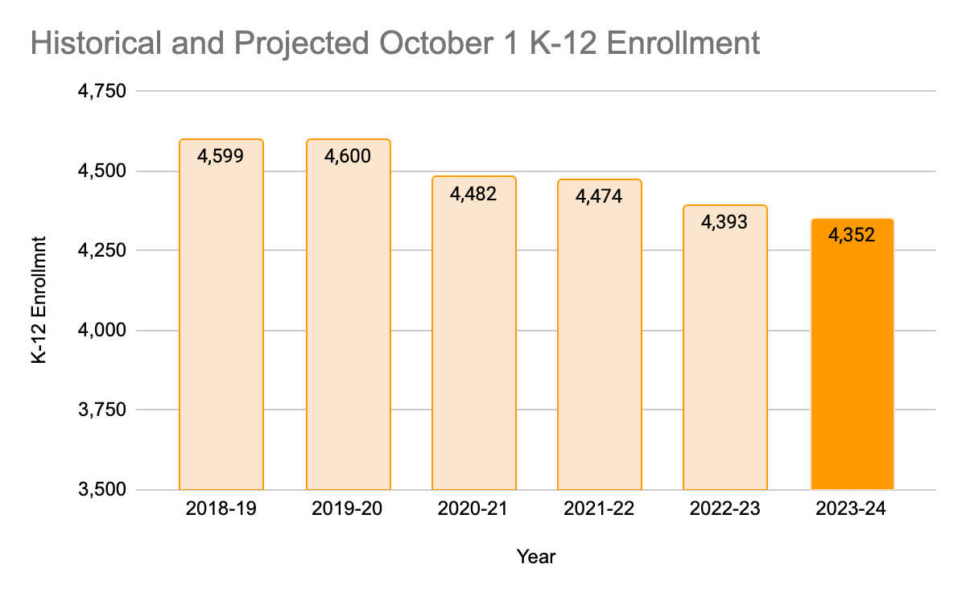
Recommendation 3: Student Enrollment
Prepared for 2.28.2023 School Board Meeting
Notes:
Patricia

Slide 12
Recommendation 3: Student Enrollment
 | Historical Fall Actual |  |  |  | Projected | Prelim. | Variance | Projected
 | 2018-19 | 2019-20 | 2020-21 | 2021-22 | 2022-23 |  |  | 2023-24
K | 332 | 391 | 302 | 351 | 345 | 296 | -49 | 330
1 | 351 | 329 | 384 | 309 | 362 | 345 | -17 | 295
2 | 333 | 338 | 319 | 365 | 309 | 293 | -16 | 327
3 | 355 | 334 | 325 | 319 | 366 | 365 | -1 | 293
4 | 357 | 346 | 322 | 315 | 310 | 319 | 9 | 361
5 | 359 | 347 | 345 | 312 | 318 | 306 | -12 | 310
6 | 356 | 358 | 323 | 330 | 310 | 326 | 16 | 311
7 | 323 | 357 | 340 | 331 | 333 | 330 | -3 | 329
8 | 340 | 333 | 338 | 331 | 329 | 320 | -9 | 320
9 | 392 | 370 | 374 | 399 | 378 | 354 | -24 | 354
10 | 390 | 380 | 366 | 383 | 387 | 397 | 10 | 356
11 | 337 | 378 | 356 | 352 | 367 | 364 | -3 | 379
12 | 374 | 339 | 388 | 377 | 363 | 378 | 15 | 389
K-12 | 4,599 | 4,600 | 4,482 | 4,474 | 4,477 | 4,393 | -84 | 4,352
Year over Year Change |  | 1 | -118 | -8 | 3 | -81 |  | -41
 |  | 0.02% | -2.57% | -0.18% | 0.07% | -1.81% |  | -0.93%
Prepared for 2.28.2023 School Board Meeting
Notes:
Patricia

Slide 13
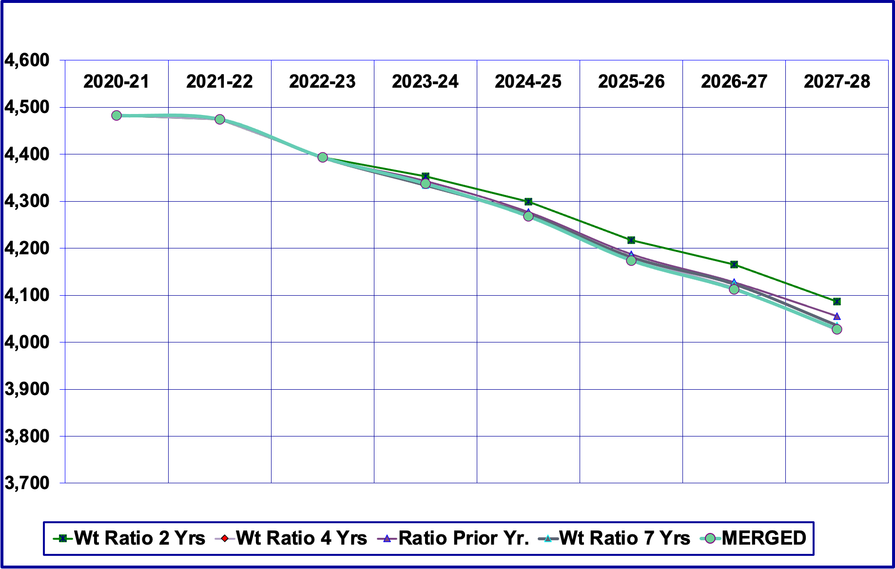
Recommendation 3: Student Enrollment
Projection Method
Chose 2-year weighted ratio
Diminishes impact of pandemic and recovery years
Prepared for 2.28.2023 School Board Meeting
Notes:
Patricia

Slide 14
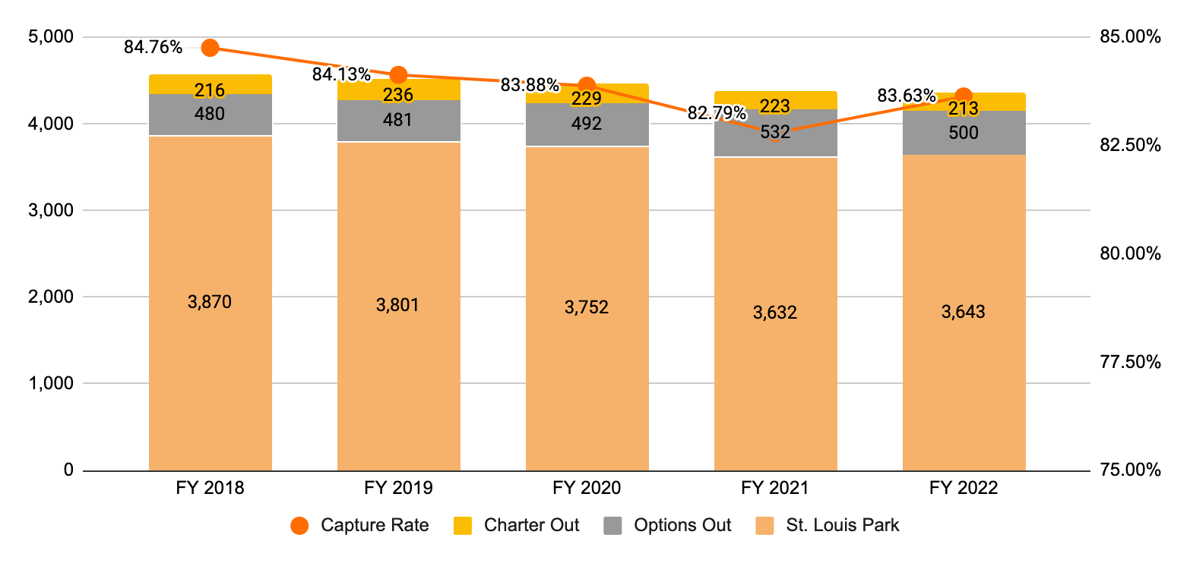
Recommendation 3: Student Enrollment
Focus significant effort to recruit and retain resident students to increase capture rate
Prepared for 2.28.2023 School Board Meeting
Notes:
Patricia

Slide 15
Recommendation 4: Increase Local Revenue
Increase student activity fees and meal prices to align with comparative district averages
Maintain high school student parking fees at current rate
Prepared for 2.28.2023 School Board Meeting
Notes:
Shanique

Slide 16
Recommendation 4: Local Revenue
Proposed fees reflect comparative district averages
Increase HS Student Activity Fees (+$14,000)
Increase MS Student Activity Fees from $105 to $110 (+$1,400)
Students who qualify for educational benefits (Lunch is reduced pay half fee or lunch is free pay $25)
 | 2023-24 Recommendation | Comparison District Average | FY2022 and 2023 Fee | $ Change | % Change
Cross Country | $210 | $209 | $205 | $5 | 2.44%
Swimming | $210 | $215 | $205 | $5 | 2.44%
Synchronized Swimming | $210 | $190 | $205 | $5 | 2.44%
Tennis | $210 | $206 | $205 | $5 | 2.44%
Baseball | $220 | $221 | $205 | $15 | 7.32%
Golf | $220 | $213 | $205 | $15 | 7.32%
Nordic Ski | $220 | $218 | $205 | $15 | 7.32%
Soccer | $220 | $218 | $205 | $15 | 7.32%
Softball | $220 | $221 | $205 | $15 | 7.32%
Track & Field | $220 | $221 | $205 | $15 | 7.32%
Volleyball | $220 | $219 | $205 | $15 | 7.32%
Basketball | $230 | $232 | $205 | $25 | 12.20%
Gymnastics | $230 | $230 | $205 | $25 | 12.20%
Lacrosse | $230 | $230 | $205 | $25 | 12.20%
Football | $250 | $250 | $205 | $45 | 21.95%
Hockey | $270 | $276 | $250 | $20 | 8.00%
Prepared for 2.28.2023 School Board Meeting
Notes:
Shanique

Slide 17
Recommendation 4: Standardize middle and high school clubs and activities structure
Two Tier system:
Service Club (no fee): Activity to do or bring awareness of service/social justice issues (i.e. gals and pals, SOAR, GSA, environmental club)
Interest Club ($25 fee): A club that seeks to know or learn more about activity or an enrichment opportunity (i.e. art, dungeons and dragons, quiz bowl, math team)
Prepared for 2.28.2023 School Board Meeting
Notes:
Shanique
Service Club:
No fee
must generate outside dollars to cover costs beyond the cost of the club advisor (schedule C of teacher contract)
Interest Club:
$25 fee; to offset cost of the club advisor (schedule C of teacher contract), supplies, transportation, tournaments

Slide 18
Recommendation 4: Increase Local Revenue
Recommended meal prices reflect comparative district averages.
Breakfast
 | Proposed | Current | $ Increase | % increase
Elementary | $1.70 | $1.50 | $0.20 | 13.33%
Middle School | $1.80 | $1.50 | $0.30 | 20.00%
High School | $1.90 | $1.50 | $0.40 | 26.67%
Adults/Guests | $2.50 | $2.50 | $0.00 | 0.00%
Lunch
Elementary | $2.95 | $2.90 | $0.05 | 1.72%
Middle School | $3.15 | $3.15 | $0.00 | 0.00%
High School | $3.30 | $3.15 | $0.15 | 4.76%
Adults/Guests | $4.95 | $4.95 | $0.00 | 0.00%
Prepared for 2.28.2023 School Board Meeting
Notes:
Shanique

Slide 19
Budget Recommendations
Fund Balance Minimum
General Education Funding Formula
Student Enrollment Projection
Local Revenue
Prepared for 2.28.2023 School Board Meeting
Notes:
Patricia

Slide 20
FAC Committee Member Reflections
Parents/Community Members:
Jacey Cassem
Robert Grommesh
Valerie Jensen
Lisa Walhstrom
Students:
Meshach Mandel
Alicia Margalli
Julian Roweder
Prepared for 2.28.2023 School Board Meeting
Notes:
Patricia

Slide 21
Questions
Prepared for 2.28.2023 School Board Meeting
Notes:
all

