Slide 2
Background Information
  The CCSSM were a result of a state-led initiative in June 2009 by the Council of Chief State School Officers and the National Governor’s Association Center for Best Practices
  Released on June 2, 2010
  Adopted by California SBE on August 2, 2010
  www.corestandards.org
Notes:
APPROXIMATE TIME: 1 minutes Running Time: 1 minutes
INTENT: To give participants a brief background on California’s adoption of Common Core State Standards.
Talking point:
The CCSSM are a result of a state-led initiative.
In August of 2010, the California State Board of Education determined these standards to be at least as rigorous and the 1997 Mathematics standards.
The information on these slides can be found on the Common Core State Standards website at www.corestandards.org
A copy of the California Common Core State Standards can be found at www.cde.ca.gov

Slide 3
Background Information
“ The Standards are not intended to be a new name for old ways of business. They are a call to take the next step. It is time for states to work together to build on lessons learned from two decades of standards based reform. It is time to recognize that standards are not just promises to our children, but promises we intend to keep.”
Common Core State Standards for Mathematics
Notes:
APPROXIMATE TIME: 1 minute Running Time: 2 minutes
INTENT: To have participants understand that the Common Core State Standards have expectations of reforming mathematics education.

Slide 4
Common Core State Standards
Underlying Characteristics
The standards are:
Aligned with college and work expectations
Fewer but more focused
Coherence and consistency
Based on rigorous content and application of knowledge through high-order skills
Informed by other top performing countries
Notes:
APPROXIMATE TIME: 1 minutes Running Time: 3 minutes
INTENT: To share the focus of the CCSS
These talking points are directly from the introduction from the Common Core State Standards website listed on the previous page.
Many have heard of the complaint that our curriculum is “a mile wide and an inch deep.” These Standards are a substantial answer to that problem.
It is important to note that “fewer” is no substitute for focused standards. Fewer standards would be easy to do by resorting to broad general statements. Instead, these standards aim for clarity and coherence. Schmidt and Houang* (2002) say that standards are coherent if they are:
Articulated over time
Reflect the hierarchical nature of the content
Evolve from particulars to deeper structures
Development of the standards began with research-based learning progressions detailing what is known today about how students’ math knowledge, skill and understanding develop over time.
Citation: Schmidt, W.H., and Houang, R.t., “Lack of Focus in the Intended Mathematics Curriculum: Symptom or Cause?” in Loveless (ed.), Lessons Learned: What International Assessments Tell Us About Math Achievement. Washington, D.C.: Brookings Institution Press, 2007

Slide 5
Common Core State Standards
Shifts in Instruction
Focus
Coherence
Rigor
Notes:
APPROXIMATE TIME: 3 minutes (Slide 1 of 4) Running Time: 6 minutes
Intent: Discuss the key ideas that are contain in the rigor shift within the Common Core State Standards.
Here are talking points but each shift is discussed in the next 3 slides
Focus implies that instruction should focus deeply on only those concepts that are emphasized in the standard. The result is that students can gain strong foundational conceptual understanding, a high degree of procedural skill and fluency, and the ability to apply the mathematics they know to solve problems inside and outside the mathematics classroom.
Coherence arises from mathematical connections. Some of the connections in the standards knit topics together at a single grade level. Most connections are vertical, as the strands support a progression of increasing knowledge, skill, and sophistication across grade levels.
Rigor requires that conceptual understanding, procedural skill and fluency, and application be approached with equal intensity.
(Source: Prepublication version of the Common Core State Standards for Mathematics for California Public Schools, California Department of Education, April 2013)

Slide 6
Focus
The standards call for a greater focus in mathematics. Rather than racing to cover topics in the “mile wide and inch deep” curriculum, teachers narrow and deepen the way time and energy in the classroom is spent.
They focus on the major “work” of the grade level so students can build a solid foundation, conceptual understanding, a high degree of procedural and skill fluency, and the ability to apply the math to solve problems inside and outside of the math classroom.
Notes:
APPROXIMATE TIME: Time continued (Slide 2 of 4) Running Time: 6 minutes
Intent: Discuss the key ideas that are contain in the rigor shift within the Common Core State Standards.
Focus implies that instruction should focus deeply on only those concepts that are emphasized in the standards. The result is that students can gain strong foundational conceptual understanding, a high degree of procedural skill and fluency, and the ability to apply the mathematics they know to solve problems inside and outside the mathematics classroom.
(Source: Prepublication version of the Common Core State Standards for Mathematics for California Public Schools, California Department of Education, April 2013)

Slide 7
Coherence
The standards are designed around coherent progressions from grade to grade. Each standard is not a new event but an extension of previous learning.
Instead of allowing additional or supporting topics to detract from the focus of the grade, these topics can serve the grade level focus.
Notes:
APPROXIMATE TIME: Time continued (Slide 3 of 4) Running Time: 6 minutes
Intent: Discuss the key ideas that are contain in the rigor shift within the Common Core State Standards.
Coherence arises from mathematical connections. Some of the connections in the standards knit topics together at a single grade level. Most connections are vertical, as the strands support a progression of increasing knowledge, skill, and sophistication across grade levels.
(Source: Prepublication version of the Common Core State Standards for Mathematics for California Public Schools, California Department of Education, April 2013)

Slide 8
Rigor
The major topics at each grade level pursue, with the same intensity,
  Conceptual understanding
  Procedure skill and fluency
  Application
Notes:
APPROXIMATE TIME: Time continued (Slide 4 of 4) Running Time: 6 minutes
Intent: Discuss the key ideas that are contain in the rigor shift within the Common Core State Standards.
Rigor requires that conceptual understanding, procedural skill and fluency, and application be approached with equal intensity
(Source: Prepublication version of the Common Core State Standards for Mathematics for California Public Schools, California Department of Education, April 2013)

Slide 9
Two Types of Standards
Standards for Mathematical Content
  K-8 grade level standards
  9-12 conceptual catagories
Standards for Mathematical Practice
  Describe varieties of expertise that educators should seek to develop in their students
  Identify “processes and proficiencies” that are hallmarks of “mathematically proficient students”
  Remain the same throughout all grades
Notes:
APPROXIMATE TIME: 2 minutes Running Time: 8 minutes
INTENT: To introduce the two types of standards found in the Common Core Standards for mathematics.
There are content standards and practice standards.
K-8 content standards are organized by grade.
9-12 standards are organized by conceptual categories. The draft mathematics framework has organized these standards into high school courses.
The other set is the Standards for Mathematical Practice. This set is the same across all grade levels.

Slide 10
Standards for Mathematical Practice
“ …describe ways in which developing student practitioners of the discipline of mathematics increasingly ought to engage with the subject matter as they grow in mathematical maturity and expertise throughout the elementary, middle and high schools years.”
Common Core State Standards for Mathematical Practice, p.2
Notes:
APPROXIMATE TIME: 1 minutes Running Time: 9 minutes
INTENT: To introduce the Standards for Mathematical Practice in the Common Core Standards for mathematics.

Slide 11
Standards for Mathematical Practice
Mathematically Proficient Students
1. Make sense of problems and persevere in solving them
…start by explaining to themselves the meaning of a problem and looking for entry points to its solution
2. Reason abstractly and quantitatively
…make sense of quantities and their relationships to problem situations
3. Construct viable arguments and critique the reasoning of others
…understand and use stated assumptions, definitions, and previously established results in constructing arguments
4. Model with mathematics
…can apply the mathematics they know to solve problems arising in everyday life, society, and the workplace
Notes:
APPROXIMATE TIME: 3 minutes (Slide 1 of 2) Running Time: 12 minutes
Intent: The intent of this slide is to describe the Standards for Mathematical Practice.
Talking points:
The mathematical practices are on slides 11 and 12.
Underneath is a short statement highlighting some of the information from the paragraph that describes each practice. Explain that there is a strong emphasis on student problem solving, reasoning and “practicing” mathematics.

Slide 12
Standards for Mathematical Practice
Mathematically Proficient Students
5. Use appropriate tools strategically
…consider the available tools when solving a mathematical problem
6. Attend to precision
…calculate accurately and efficiently
7. Look for and make use of structure
…look closely to discern a pattern or structure
8. Look for and express regularity in repeated reasoning
…notice if calculations are repeated and look for both general methods and for shortcuts
Notes:
APPROXIMATE TIME: 3 minutes (Slide 2 of 2) Running Time: 12 minutes
Intent: The intent of this slide is to describe the Standards for Mathematical Practice.
Talking points:
See notes on slide 11
The tools listed under # 5 practice include: paper and pencil, concrete models, ruler, protractor, calculator, spreadsheet, computer algebra system, statistical package, dynamic geometry software and digital content located on a website.

Slide 13
Mathematics Content Standards
Grades K–8
  The Mathematical Content Standards for Grades K-8 provide:
Students with a solid foundation in whole numbers arithmetic (addition, subtraction, multiplication and division), fractions, and decimals.
A clear direction for numerical fluency, including the development of conceptual understandings. By the time students exit Grade 5, they should be using algorithms to manipulate numbers fluently.
A clear and articulated sequence for the development of fractions. Student mastery of the conceptual and procedural knowledge about fractions are essential to success in algebra.
A clear and articulated sequence for the development of proportional reasoning in Grades six and seven.
Notes:
APPROXIMATE TIME: 2 minutes Running Time: 14 minutes
INTENT: To share some specifics about the CCSS grades K-8
Talking points:
It is important to reiterate the CCSS focus on arithmetic and fluency with whole numbers in the early grades.
The kindergarten through grade five standards provide students with a solid foundation in whole numbers arithmetic (addition, subtraction, multiplication and division), fractions, and decimals.
Mastery of these skills prepares students for learning more advanced concepts and procedures in later grades.
There is also a clear direction for numerical fluency in the CCSS.
By the time students exit grade 5, they should be using algorithms to manipulate numbers fluently.
The CCSS build upon practices of countries with high achievement in mathematics
The CCSS is a clear and articulated sequence for the development of fractions.
Student mastery of the conceptual and procedural knowledge about fractions are essential to success in algebra.

Slide 14
Mathematics Content Standards
High School
  The Mathematical Content Standards for high school:
Specify the math that all students should study to be college and career ready.
Identify additional math standards that students should learn in order to take advanced courses such as calculus, advanced statistics, or discrete mathematics. These are indicated by (+).
Include the addition of two courses from California.
    Calculus
    Advanced Placement Statistics and Probability
Notes:
APPROXIMATE TIME: 2 minutes Running Time: 16 minutes
INTENT: To share some specifics about the CCSS for high school
Talking points:
Explain that the high school standards specify the math that all students should study to be college and career ready.
The standards also identify additional standards that students should learn in order to take advanced courses such as calculus, advanced statistics and discrete mathematics. These are indicated by (+).
The standards commission added two California courses, Calculus and Advanced Placement Statistics and Probability, to the CCS.

Slide 15
8th Grade Options
In the Common Core State Standards for Mathematics, there are two possible mathematics courses for an eighth grade student to take:
  1. Grade 8 Common Core Mathematics
  ^{2. Algebra I or Mathematics I}
Notes:
APPROXIMATE TIME: 1 minutes Running Time: 17 minutes
INTENT: To share the course options for 8th grade students.
Talking points:
Algebra I or Mathematics I will be determined by the district. Each school district will determine which pathway their high schools will follow.
This slided can be edited to included either Algebra I or Mathematics I based on district decision.

Slide 16
8th grade Options
Course sequence 8-12
Grade 8 | Grade 9 | Grade 10 | Grade 11 | Grade 12
8th Grade Common Core Standards for Mathematics | Algebra I or Mathematics I | Geometry or Mathematics II | Algebra II or Mathematics III | PreCalculus
Algebra I | Geometry | Algebra II | PreCalculus | AP Calculus
Mathematics I | Mathematics II | Mathematics III | PreCalculus | AP Calculus
Notes:
APPROXIMATE TIME: 2 minutes Running Time: 19 minutes
INTENT: To share some specifics about the CCSS for high school
Talking points:
This chart shows the sequence of course a student will take based on the course completed in 8th grade.
A student can take Calculus in 12th grade, if Algebra I or Mathematics I is the 8th grade course.
If a student take 8th grade CCSS in grade eight, it is still possible to take Calculus in high school. For this to occur, acceleration needs to happen in high school.

Slide 17
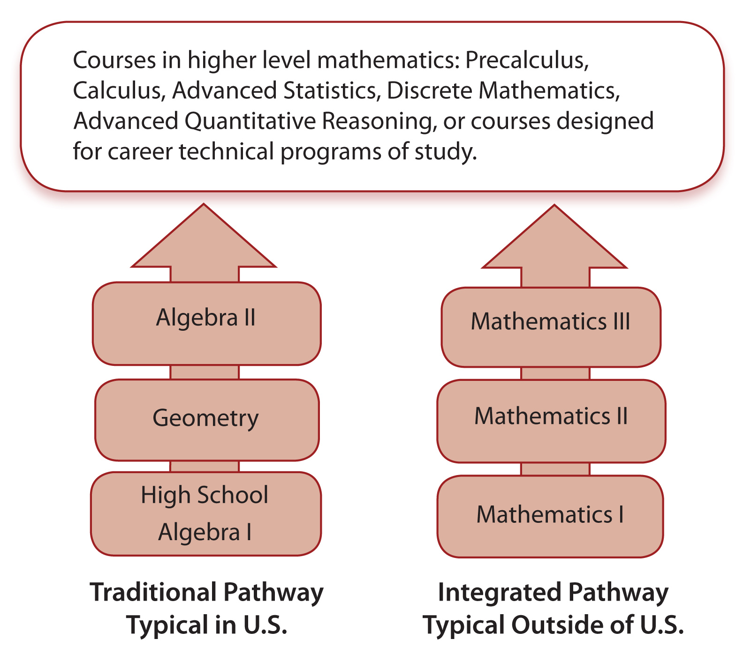
High School Pathways
Notes:
APPROXIMATE TIME: 2 minutes Running Time: 21 minutes
INTENT: To show the options for high school course pathways
For more information, see the Common Core State Standards, Appendix A

Slide 18
Acceleration
Previous method of acceleration
New options for acceleration
  Middle school
  High school
Notes:
APPROXIMATE TIME: 1 minutes Running Time: 22 minutes
INTENT: The intent of these slide is to explain how students who are ready can accelerate the CCSSM.
Talking points:
Under the former 1997 mathematics standards, a previous method of acceleration were to skip grade in mathematics. Another option would be for students to take 7th grade math in 7th grade and Algebra I in 8th grade with no course in-between.
In CCSSM there are three middle school course for grades 6-8. It is not recommended to skip any of the content in these course.
The new options would be for students to either accelerate in middle school or high school.

Slide 19
Draft Mathematics Framework
Acceleration Options
Middle School
  Compacting
High School
  Accelerated Integrated Pathway
  Doubling Up
  Enhanced Pathway
  Summer Bridge Pathway
Notes:
APPROXIMATE TIME: 2 minutes Running Time: 24 minutes
INTENT: The intent of this slide is to explain some options for acceleration.
Talking points:
Compacting in middle school is the completing all of the math content for grades 6-8 in two year.
High school options:
Accelerated Integrated Pathway – If a district has chosen and integrated pathway, three years of mathematics (Mathematics I,II, and III) are covered in two years.
Doubling Up – In a block schedule, a student might be able to take two math course in one year.
Enhanced Pathway – Precalculus is combined with Algebra II or Mathematics III to create a hybrid course. A student would take this course their 11th grade year to take Calculus in 12th grade.
Summer Bridge Pathway – Summer school course to provide Precalcus for a student to be able to take Calculus.

Slide 20
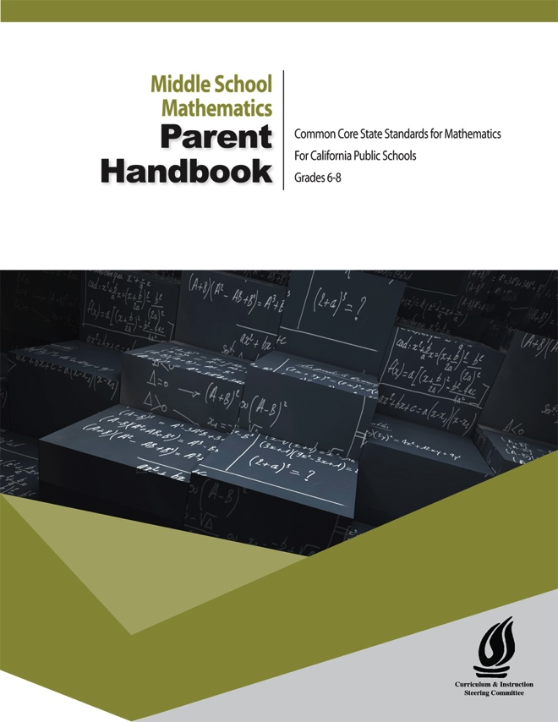
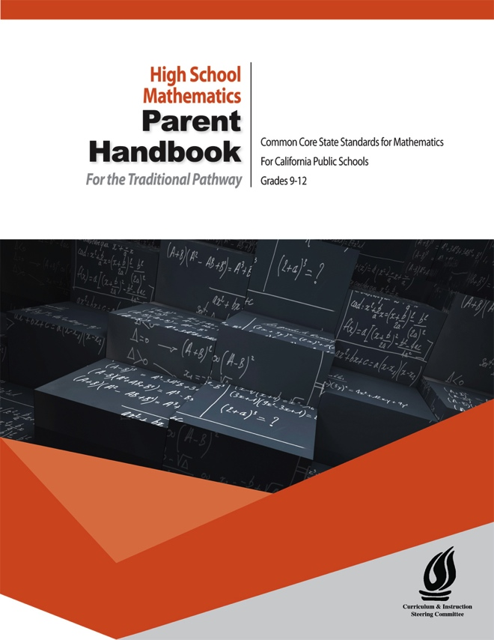
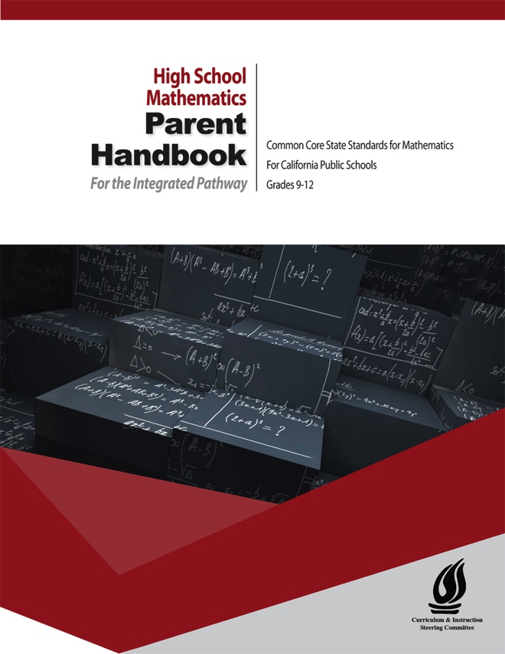
More Information
See the Parent Handbook
  For middle school (grades 6-8)
  For high school (grades 9-12)
    Traditional or integrated pathway
Notes:
APPROXIMATE TIME: 1 minutes Running Time: 25 minutes
INTENT: The intent of this slide is to introduce the CCSSM Parent Handbooks.
Talking points:
There are three Parent Handbooks:
Middle School – grades 6-8
High School for Traditional pathway
High School for Integrated pathway

