Slide 1

November Paper 2 Exam

Slide 2
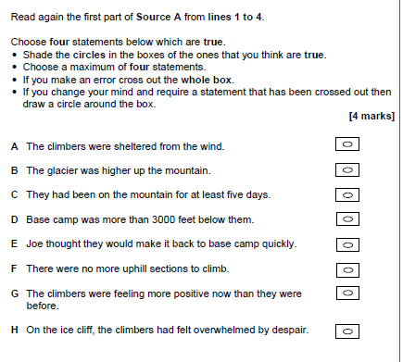
Question 1
On average is got 3/4 marks on this question.

Slide 3

Question 1
Positives (WWW)
Question 1 was attempted by all students… the majority scored 3 marks or more BUT
Students who did less well (EBI)
Less than half achieved the full 4 marks, as opposed to over three-quarters in June 2019.
The reason for the reduction in students achieving full marks is one particular statement (D) which the majority of students who scored 3 selected in error.
Students misread the opening line of Source A: ‘Directly beneath us the glacier we had walked up five days ago curved away towards the crevasses which led to base camp, nearly 3 000 feet below us.
The base camp was 3 000 feet below them 5 days previously. Selecting the wrong answer here, meant that students could not select the right 4.
Top Tips
Students should read both the extract and the statements slowly and carefully before making a selection
Students should be prepared to make a correction if necessary

Slide 4
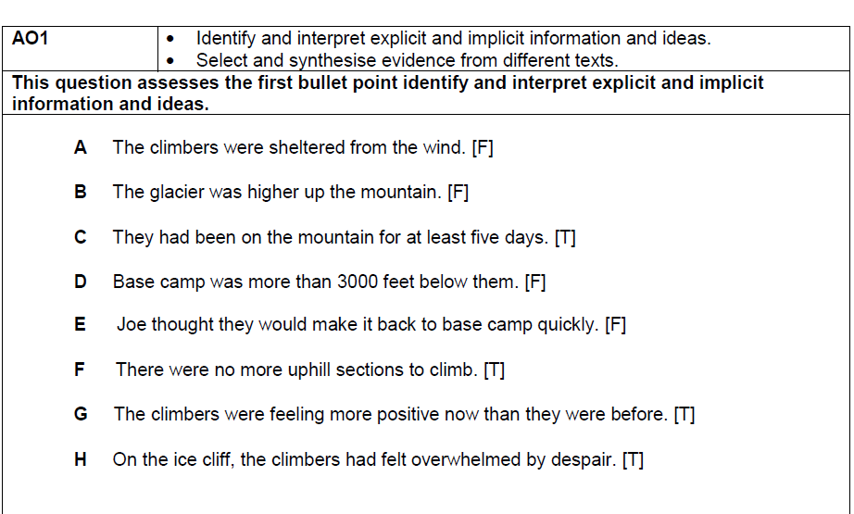
Answers

Slide 5

Question 2

Slide 6
Question 2
On average people in this class got between 3/4 marks!
You need to refer to Source A and Source B for this question.
Both sources describe the similar ways in which drivers behave.
Use details from both sources to write a summary of what you understand about the similar behaviour of the drivers. [8 marks]

Slide 7
Question 2
Positives
This was not the first series where students were asked to explore differences rather than similarities in the two texts. This does not appear to have presented significant issues… Students had been well-prepared by centres to address both possibilities.
Although the focus of the question was on differences, comments on similarities were also rewarded by examiners where they were appropriate to the focus of the question.
Students who did less well
Students tended to mistake the focus of the task and wrote that the climbers were going up and not down.
Some students focused on how ‘uncaring’ Joe’s climbing partner seemed, even though he had ‘carefully weighed up the risks’ and was ‘positive’ for his partner and friend.
Other students struggled to understand the basic differences between friend/partner and experience v strangers and a business transaction.
Top Tips
Interpretation of information and ideas is the key to accessing the higher levels
This means phrases such as ‘which suggests’, ‘which implies’ and ‘and’ to develop.

Slide 8
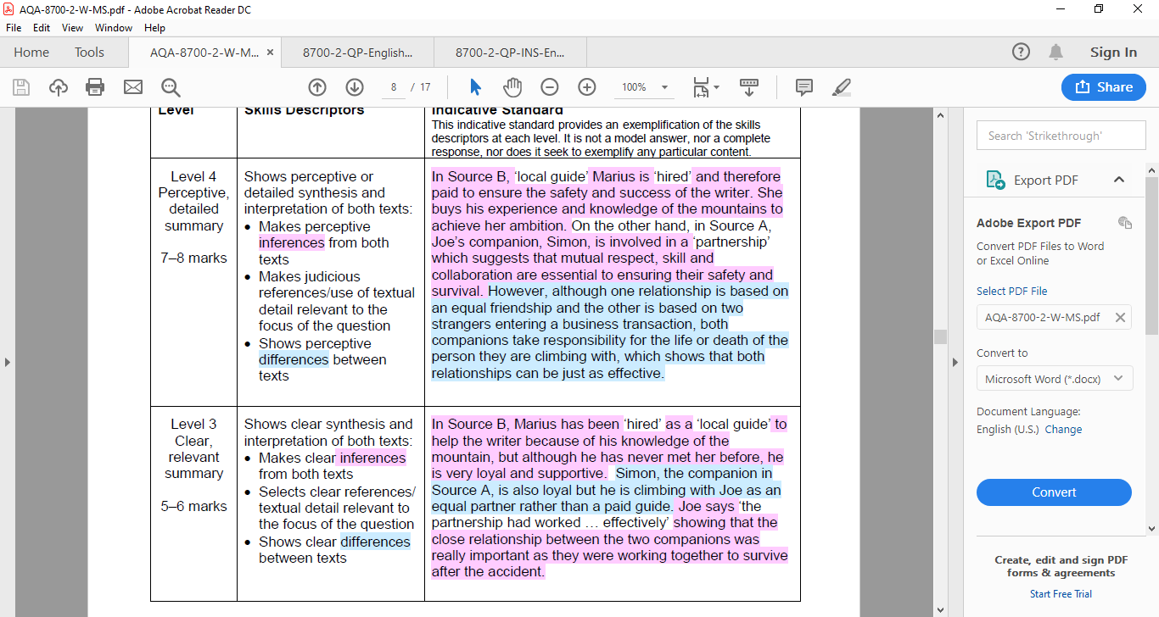
Question 2
On average people in this class got 4.5 marks!
Use details from both sources to write a summary of what you understand about the differences between the two companions, Simon and Marius.
How would we answer this differently the 2nd time around? How can we get out of level 3 and into level 4?

Slide 9
What’s the difference between Band 3 and 4?

Slide 10

Question 2
Examiner Report
How marks were gained:
There was a comparison and understanding of a ‘local guide’ and a ‘partner’ with exploration of what was implied and how the behaviour of the two may be different respectively.
Equality as a comparison between the two characters was bought up – one was a ‘stranger’ who had undergone a ‘business transaction’ and the other a ‘friend’, the way they spoke to each other was commented on.
There was also successful comparison of the knowledge and skills base, with lots of comments about Marius being ‘as strong as a bear’ and always in total control which his companion liked, compared with Simon who was in control, perhaps masking his fear with ‘infectious optimism’ to keep Joe calm and rapid decision making to get Joe help as soon as possible and ensuring their survival by descending quickly.

Slide 11
Question 3

Slide 12
Question 3
On average people in this class was 8 marks.
You now need to refer only to Source A from lines 23 to 31.
How does the writer use language to describe how he feels?
[12 marks]

Slide 13
Question 3
Positive
Most students commented on the focus of the question (Joe’s feelings) with some success.
Students who did less well
Some students used little or inaccurate subject terminology and couldn’t get into a Band 2.
Students struggled where they made poor choices, and commented on the weather as pathetic fallacy as an indicator ‘something bad was going to happen’ and were often left with little to comment on other than the meanings of the words.
A few students commented on sentence lengths and how tension was reduced near the end of the extract as he was getting over his pain.
Some students selected the quotation ‘A wave of nausea and pain swept over me’ and commented once on the metaphor, without commenting that the metaphor was extended and linking ‘wave’ and ‘swept’ to the power of nature.
Students often need to write in more depth about a particular image, returning to the central comparison in a metaphor or simile and explicitly linking it to what is happening in the text, in order to move into Level 3.
Top Tips
Students need to write more fully and in more detail about individual images
Students need to recognise semantic fields and patterns in texts.
It is important to contextualise comments on language effects to attain a mark in Level 3

Slide 14
Class Analysis
“A wave of nausea and pain swept over me.”
Notes:
Analyse the quotation – which other words are linked? Does the image get stronger or weaker? What wider theme can this be linked to?

Slide 15
How does the writer use language to describe how he feels?
The terrible sliding stopped, and I hung silently against the slope. Three faint tugs trembled the taut rope, and I hopped up on to my leg. A wave of nausea and pain swept over me. I was glad of the freezing blasts of snow biting into my face. My head cleared as I waited for the burning to subside from my knee. Several times I had felt it twist sideways when my boot snagged. There would be a flare of agony as the knee kinked back, and parts within the joint seemed to shear past each other with a sickening gristly crunch. I had barely ceased sobbing before my boot snagged again. At the end my leg shook uncontrollably. I tried to stop it shaking, but the harder I tried, the more it shook. I pressed my face into the snow, gritted my teeth, and waited. At last it eased.
Notes:
Which other quotations could we pick?

Slide 16
How does the writer use language to describe how he feels?
The terrible sliding stopped, and I hung silently against the slope. Three faint tugs trembled the taut rope, and I hopped up on to my leg. A wave of nausea and pain swept over me. I was glad of the freezing blasts of snow biting into my face. My head cleared as I waited for the burning to subside from my knee. Several times I had felt it twist sideways when my boot snagged. There would be a flare of agony as the knee kinked back, and parts within the joint seemed to shear past each other with a sickening gristly crunch. I had barely ceased sobbing before my boot snagged again. At the end my leg shook uncontrollably. I tried to stop it shaking, but the harder I tried, the more it shook. I pressed my face into the snow, gritted my teeth, and waited. At last it eased.
Notes:
Which other quotations could we pick?

Slide 17
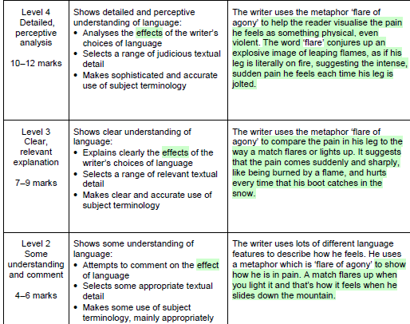
Which is your answer most like? How has it improved from your exam?
What do you still need to do?
Write one more paragraph at your target level.

Slide 18
Question 3
How marks were gained:
There were metaphors, personification, violent verbs, onomatopoeia, repetition, rule of three, adverbs that students selected. Most students selected 3 quotations that were relevant.
Only a few able to clearly identify the comparison between the writer’s feelings of being in hell as they linked ‘burning’ and ‘flare’ with others – they developed comments and were able to make more than one interpretation..
The metaphor of the ‘wave of nausea’ was also a favourite… students were able to explore how this metaphor offered a comparison of the danger and power of nature and humans being helpless in relation to the unpredictability and mayhem of the sea, just as the men were at the mercy of the mountain and elements.
It is the ability to contextualise the image and, crucially, to bring together both parts of the image and relate them back to the text which is rewarded by marks in Level 3 and above.
The choice of language examples is the key to success in Question 3, and for the most part students made sensible and helpful choices.

Slide 19
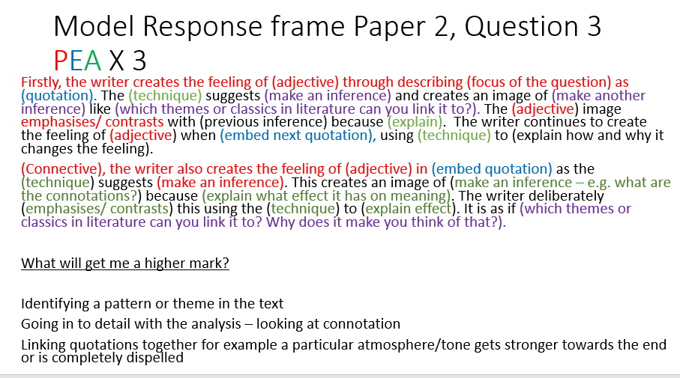
Now write up your response in a paragraph

Slide 20
Question 4

Slide 21
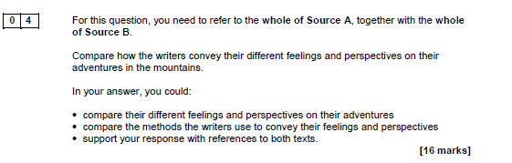
Question 4
On average people in this class got 9 marks.

Slide 22
Question 4
Top Tips
Even the simplest response to Question 4 is rewarded so it is better to try than leave it blank.
Students need to respond directly to the focus of the task and evaluate writer’s purpose – in this question, it was prudent to consider form and audience.
The focus on different perspectives appeared to encourage more widespread comparison of methods
Students who did less well
One of the most obvious observations about responses to Question 4 was how short they were (often less than what they wrote for Q2).
However, a significant minority of students did not attempt Question 4 at all.
Where students struggled, they often failed to focus on the writer’s feelings beyond was stated and didn’t comment at all on the effect on the reader.
Some students repeated words from the quotation they had selected – this is not explaining.
Some students made no references to methods or terminology throughout their response; this hindered them in moving up from Band 1 or 2.
Positive (WWW)
There were a reassuring number of students commenting on methods, a central expectation of this task and one of the key skills, and doing so with some confidence and success.
The focus again was on similarities, for the first time on Question 4 in a live series, and again it did not appear to distract or confuse students in the slightest.
Notes:
It is worth reinforcing that although all evaluations and interpretations can be valid, they must be rooted in the text.

Slide 23
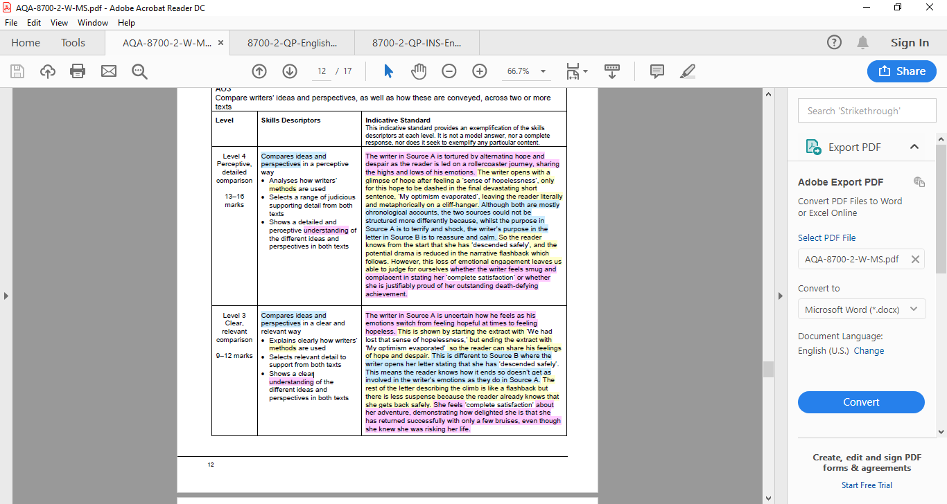
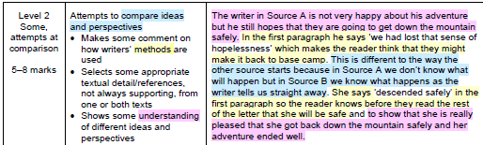
Question 3
Level Marked on Model Answer
Compare how the writers convey their different perspectives and feelings on their adventures in the mountains.
How would we answer this differently the 2nd time around? How can we top of level 2 or level 3?

Slide 24
What’s the difference between Band 3 and 4?

Slide 25
Question 4
How marks were gained:
Students who did attempt the question were often able to comment on the differences between the two writers’ perspectives on their adventures in the mountains.
Some students developed their response by exploring differences in their attitudes too, in that the writer of Source A took it very seriously, whilst the writer in Source B seemed to make light of her experiences.
Students progressed naturally from an identification of the writers’ similar perspectives to explore the different purposes and audiences the writers used and what their intended effect of their form was.
You could have compared:
• Their previous experience
• Their enjoyment
• Their suffering
• Their success
• Their gender
• Their expectations
• Their purpose in writing
methods such as:
• Structural shifts – highly detailed focus in Source A; episodic shifts in Source B
• Structural viewpoint – first person narratives; descriptive in Source A, reflective in Source B
• Whole text structure – mostly chronological in both sources but openings very different
• Tone – dramatic and distressed in Source A; cheerful and ironic in Source B
• Language features – figurative language in Source A; understatement and hyperbole in Source B
• Word choice.

Slide 26
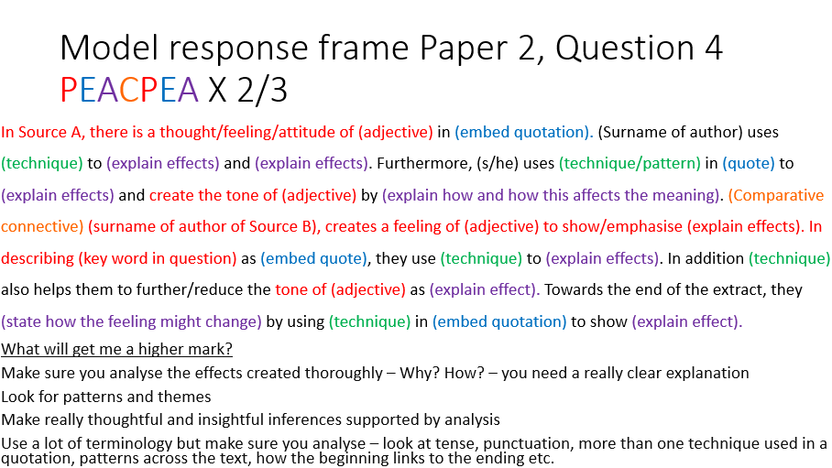
Your turn!

Slide 27
Question 5

Slide 28
Question 5
On average people in this class got:
AO5: 17
AO6: 9
‘People have become obsessed with travelling ever further and faster. However, travel is expensive, dangerous, damaging and a foolish waste of time!’
Write an article for a news website in which you argue your point of view on this statement.
(24 marks for content and organisation and
16 marks for technical accuracy)
[40 marks]

Slide 29
Question 5
Positive
The article form was picked up by almost all students, and there were varying degrees of formality in the layout of the addresses, dates and salutations. *An article will be on the exam in summer.*
The vast majority of students appeared to find this an accessible and engaging task.
Where students performed well on Content and Organisation, they produced coherent arguments either for or against the statement.
There was some pleasing evidence of sentence forms being more varied and being used to create effects.
Students who did less well (EBI)
A few students limited their responses by limiting ‘travelling’ to cars as a mode of transport rather than commenting on the reach of travel – e.g. a recreational trip to space is now possible.
Students whose central argument was unclear or muddled often gave level 2 or below as students who mishandled the inclusion of a counter-argument often sabotaged the clarity of their own argument by flipping between sides and thus risked leaving the reader confused.
Students were often unable to vary their vocabulary and raise it to a more sophisticated level; they frequently used ‘also’ and listed reasons without using any anecdotes or examples.
A few students did not understand that the purpose of the text is to inform and entertain rather than just inform.
Unfortunately, inaccurate use of commas and punctuation marks really hindered the marks available for SPAG.
Top Tips
A counter-argument can be counter-productive when mishandled as it jeopardises the overall clarity of communication.
What can be linked to world wide media here?

Slide 30
Question 5
Replanning the question – to inform and entertain:
‘People have become obsessed with travelling ever further and faster. However, travel is expensive, dangerous, damaging and a foolish waste of time!’
Notes:
What are the key words of the question? How does this link to you, your local community, the country, the world? What examples/ anecdotes can you use for each?

Slide 31
DIRT
Task:
Now, working on your targets, write your introduction, paragraph 1 and 2.
Underline where you have worked on your targets.

