Slide 1
Grade boundaries Nov 2020
 | 9 | 8 | 7 | 6 | 5 | 4 | 3 | 2 | 1
Paper 1 | 66 | 61 | 55 | 48 | 44 | 40 | 25 | 16 | 7
Paper 2 | 66 | 60 | 54 | 48 | 44 | 40 | 24 | 16 | 7
Overall | 132 | 121 | 109 | 96 | 88 | 80 | 49 | 32 | 14

Slide 2

November 2020 Paper 1 Exam

Slide 3
Question 1
Read again the first part of the source from lines 1 to 4.
List four things about Rosie from this part of the source. [4 marks]
1.
2.
3.
4.
Everyone but 2 of us got full marks for this question!!!

Slide 4
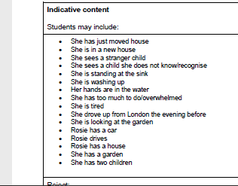
Answers

Slide 5

Question 2

Slide 6

Question 2
Examiner Report
Top Tips
Make sure students are aware they don’t have to talk about every bullet point (sentence forms was not a particular feature in this extract).
Don’t leave hanging quotations.
Students who did less well
Identified and labelled language techniques but these were inaccurate. E.g. this is a verb for an adjective.
Some identified techniques but failed to comment on effect/explain reason. Some also offered a basic, generic comment e.g. ‘creates a picture in our heads’.
Others tried to look at connotations of words without consideration of context e.g. ‘ancient’ suggests ‘old’. Old is what ancient means, so it is not a connotation.
Selected quotations that were very limiting.
Positives
On a whole, students made appropriate selections of language to analyse; they employed subject terminology to enhance; they did not write at unnecessary length; and they focused on the effects of the writer’s choice of specific words and phrases and analysed to the best of their ability.

Slide 7
Question 2
On average people in this class got between ….. marks!
How does the writer use language here to describe the garden?
Getting the quotations right – which quotation could you say the most about out of these 3?
“Ancient”
“Overgrown mess”
“Its knuckles in the earth like a gigantic malformed hand”
Notes:
Students discuss and select quotation

Slide 8
How does the writer use language here to describe the garden?
Rosie had made a quick check of the unfamiliar garden before letting the children go out to play. The bottom half of the garden was an overgrown mess, a muddle of trees and shrubs. An ancient mulberry tree stood at the centre. Its massive twisted branches drooped to the ground in places, its knuckles in the earth like a gigantic malformed hand. The wintry sun hung low in the sky and the gnarled growth threw long twisted shadows across the undergrowth within its cage. The trunk of the tree was snarled with the tangled ivy that grew up through the broken bricks and chunks of cement, choking it. The path that led down towards the fence at the bottom, which marked the garden off from an orchard beyond, disappeared into a mass of nettles and brambles before it reached the padlocked door.
Notes:
Which three quotations would be good to select? (please adapt for your group – for 11A1 we’ll look at patterns/ semantic fields)

Slide 9
Question 2
On average people in this class got 5 marks!
How does the writer use language here to describe the garden?
The writer develops the image of the mulberry tree as a dominating and supernatural force in the garden. Adjectives like ‘massive’ and ‘twisted’ establish the authoritative size and complexity of the tree and this is further developed with the simile ‘like a gigantic malformed hand’. This personifies the tree and gives it a sense of deliberate intent, as if it rules over the elements of the garden around it. The ‘hand’ could imply a supernatural power that has a sinister influence over the rest of the garden.
The writer emphasises the way in which the mulberry tree commands the rest of the garden. The adjectives ‘massive’ and ‘twisted’ create the idea that this is a huge and misshapen tree. By comparing its branches to stretched out fingers in using the simile ‘like a gigantic malformed hand’ it gives the impression of a mysterious presence that takes over parts of the garden.
Notes:
Which is better? What’s the difference? (Spot the difference?)

Slide 10
Success criteria for Question 2:
1)
2)
3)
4)
5)
Phrases to avoid in your answer:
This creates an image in the reader’s mind.
The writer does this to engage us.
It is what the writer wants to achieve.
This makes us want to read on.
This floods our imagination.

Slide 11

Question 2
Examiner Report
How marks were gained:
One of the most popular comments was about how the mulberry tree seemed to dominate the garden, taking ‘centre’ stage and this was enhanced by comments on the simile, personification and adjectives.
The simile ‘like a gigantic malformed hand’ was frequently selected, with the effect of conveying how this mighty tree was like a king with a hold over the garden implying it was completely powerful, its size indicating it was inescapable and ‘malformed’ suggesting it was unnatural; its hold was sinister.
There was also successful analysis of ‘gnarled’ and ‘snarled’’ from the most able students, who were able to examine the paradox of an evil internal rhyme mimicking a children’s innocent nursery song with a paranormal being who seemed malevolent, perhaps foreshadowing a sinister ending and creating a foreboding atmosphere.

Slide 12
Question 3

Slide 13
Question 3
On average people in this class got between 0 and 8 marks.
You now need to think about the whole of the source.
This text is from the beginning of a novel.
How has the writer structured the text to interest you as a reader?
You could write about:
• what the writer focuses your attention on at the beginning of the source
• how and why the writer changes this focus as the source develops
• any other structural features that interest you.
[8 marks]

Slide 14
Question 3
Students who did less well
Used phrases such as 'at the beginning', 'in the middle' and 'at the end' but then narrated too much of the story, rather than considering not only what is happening where but the reasons why, and how reading about this at this point added to their understanding of the text as a whole.
Some of the less able students dealt only with the opening few lines, even though the question instructs them to ‘think about the whole of the source’. Students need to focus on the whole text in order to explore the development of character or events or themes and achieve Level 3 and above.
Positive
Most students now understand that the key skill, the analysis of structure, is a matter of looking at what happens where and why, and what impact this has on the reader’s understanding of the text as a whole.
There was evidence from this series that students are beginning to recognise structural patterns that are significant to the development of the plot and link them together effectively.
Some students are beginning to write about conventions of genre and cyclical structures explaining what effect is created.

Slide 15
Question 3
On average people in this class got between 0 and 8 marks.
How has the writer structured the text to interest you as a reader?
At the very beginning of the extract the writer creates an intriguing hook by immediately introducing the ‘stranger child’. Straight away this makes us wonder who this child is and where they have come from. The reference to it being the ‘first day at the house’ in the same sentence provides a further mysterious element to the story as we start to question whether the unfamiliar house and the unknown child are linked. By the end when the child disappears the mystery only deepens.
From the very first sentence, the writer carefully builds up the references to the ‘stranger child’ that run throughout the text. By introducing this unexplained element straight away, it immediately establishes the mysterious atmosphere of the extract. When we learn at the same time that this is the ‘first day at the house’, the combination of these structural features is a narrative convention for creating a sense of the unfamiliar within the supernatural genre. When at the end it is suddenly revealed that she has ‘gone’, it completes a circular structure that deepens our understanding that this is a mystery narrative.
Notes:
Which is a Band 3 and which a Band 4?

Slide 16
Question 3
On average people in this class got between 0 and 8 marks.
How has the writer structured the text to interest you as a reader?
At the very beginning of the extract the writer creates an intriguing hook by immediately introducing the ‘stranger child’. Straight away this makes us wonder who this child is and where they have come from. The reference to it being the ‘first day at the house’ in the same sentence provides a further mysterious element to the story as we start to question whether the unfamiliar house and the unknown child are linked. By the end when the child disappears the mystery only deepens.
From the very first sentence, the writer carefully builds up the references to the ‘stranger child’ that run throughout the text. By introducing this unexplained element straight away, it immediately establishes the mysterious atmosphere of the extract. When we learn at the same time that this is the ‘first day at the house’, the combination of these structural features is a narrative convention for creating a sense of the unfamiliar within the supernatural genre. When at the end it is suddenly revealed that she has ‘gone’, it completes a circular structure that deepens our understanding that this is a mystery narrative.
Notes:
What do you notice about the ‘why’?

Slide 17
Success criteria for Question 3:
1)
2)
3)
4)
5)
Top tips:
Use ‘to’ and ‘because’ to comment on the effect.
Phrases to avoid in your answer:
This interests the reader.

Slide 18
Question 3
How marks were gained:
Some recognised that the effect of describing ‘it was their first day at the house’ at the beginning, was a deliberate ploy to create the feeling of mystery which develops as we read.
Others examined the ending suddenly reveals that she has ‘gone’, completing a circular structure that deepens our understanding that this is a mystery narrative.
Better students were able to explain how the writer used a narrative convention for developing the mystery and supernatural elements of the tree coupled with the cyclical narrative of the girl ‘disappearing’ to deepen our understanding that the two elements are linked.

Slide 19
Question 4

Slide 20
Question 4
On average people in this class got …… marks.
Focus this part of your answer on the second part of the source, from line 24 to the end.
A student said, ‘I wasn’t at all surprised by the disappearance of the stranger child at the end of the extract. The writer has left us in no doubt that she is just part of Rosie’s imagination.’
To what extent do you agree?
In your response, you could:
• consider the disappearance of the stranger child
• evaluate how the writer presents the stranger child
• support your response with references to the text.
[20 marks]
Notes:
What are the two parts of the question here?

Slide 21
Question 4
Students who did less well
Some students did not answer the question.
Some students wrote about what they would have done if they were Rosie – this is unhelpful as it does not answer the question.
Some students relied on only one piece of evidence – this question does require a range – between 3 and 5 pieces is appropriate.
Some students did not use any terminology – this questions ask about methods used and so terminology, structural or language is needed.
Top Tips
It is worth reinforcing that although all evaluations and interpretations can be valid, they must be rooted in the text.
Positive
The key skill for Question 4 is evaluation, both of the ideas in the source in relation to the given statement, and also of the methods used by the writer to convey these ideas. The question was generally answered well across the ability range.
Notes:
It is worth reinforcing that although all evaluations and interpretations can be valid, they must be rooted in the text.

Slide 22
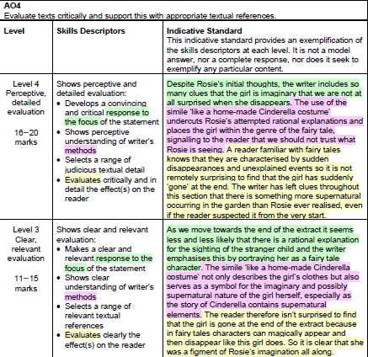
Question 4
A student said, ‘I wasn’t at all surprised by the disappearance of the stranger child at the end of the extract. The writer has left us in no doubt that she is just part of Rosie’s imagination.’
To what extent do you agree?
How might we answer this the second time around?

Slide 23
Question 4
How each level gained marks:
Level 1
students were able to comment on the simile of the ‘Cinderella costume’ and deuce she was imaginary from tge beginning.
Level 2
attempted to evaluate by recognising that the simile was a link to the world of imagination and responded to both parts of the question.
Level 3
Some students achieved Level 3 by linking together Rosie’s rational clues and commenting on the writer’s emphasis of the simile ‘like a home made Cinderella costume’ like a symbol for imagination and supernatural elements in the extract.
Another typical Level 3 evaluation was in relation to fairy tales characters who can magically appear and then disappear like this girl does. So it is clear that she was a figment of Rosie’s imagination all along.
Level 4
Evaluated the concept and genre of fairy tales.
Others evaluated that although the idea the writer’s use of foreshadowing deliberately leads readers the conclusion that she is a figment of Rosie’s imagination, there is something more supernatural occurring in the garden than Rosie ever realised, even if the reader suspected it from the very start.

Slide 24
Question 5

Slide 25
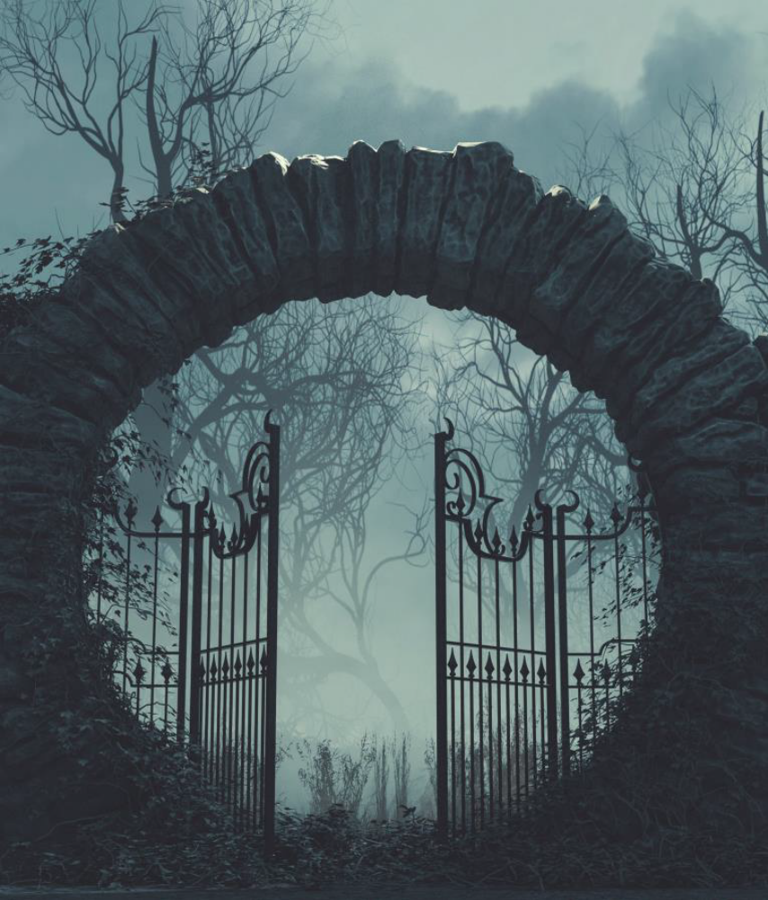
Question 5
On average people in this class got:
AO5: ….
AO6: …
………..
Write a description of a mysterious place, as suggested by this picture:
Or
Write a story about an event that cannot be explained.

Slide 26
Question 5
Positive
The quality of responses ranged mostly across Level 3 and 4.
Students are beginning to understand the need to plan their writing, meaning fewer responses were unnecessarily lengthy.
In terms of AO6, schools and colleges continue to emphasise the importance of varying sentence forms and encourage students to use a variety of punctuation.
Students who did less well
Some of the less able students forgot to describe and listed events characterised by ‘then’ and repetition of clauses joined with ‘and’, ‘but’ and ‘so’.
There were also fewer formulaic descriptions this series, possibly due to the nature of the descriptive option, although some students still managed to include a contrived use of senses, describing what they could see, hear and smell the minute in a mysterious setting..
Lack of capital letters, comma splicing, punctuation of dialogue and the use of apostrophes continue to be matters of concern.

Slide 27
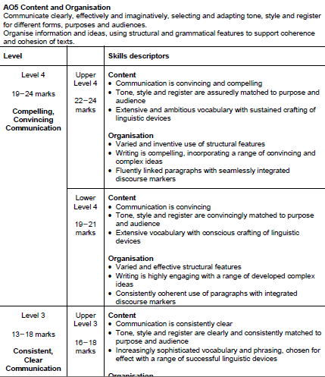
Question 5
How would we answer this differently the 2nd time around?
How can we get into upper level 4?

Slide 28
Question 5
Success criteria:
1)
2)
3)
4)
5)

