Slide 1





College Athletic Eligibility
Who?, What?, Why?, How?
Your questions answered
6:oopm
UHS Auditorium
Tuesday February 21, 2023

Slide 2
Objective
As a student-athlete or parent I will better understand the academic requirements necessary to continue participating in an athletic program at the college level.

Slide 3
Not all colleges are the same!
National Collegiate Athletic Association (NCAA)
Division I
Division II
Division III
National Association of Interscholastic Athletics (NAIA)
National Junior College Athletic Association (NJCAA)
National Christian College Athletic Association (NCCAA)
Visit each associations eligibility page for specific eligibility rules and certification processes.

Slide 4
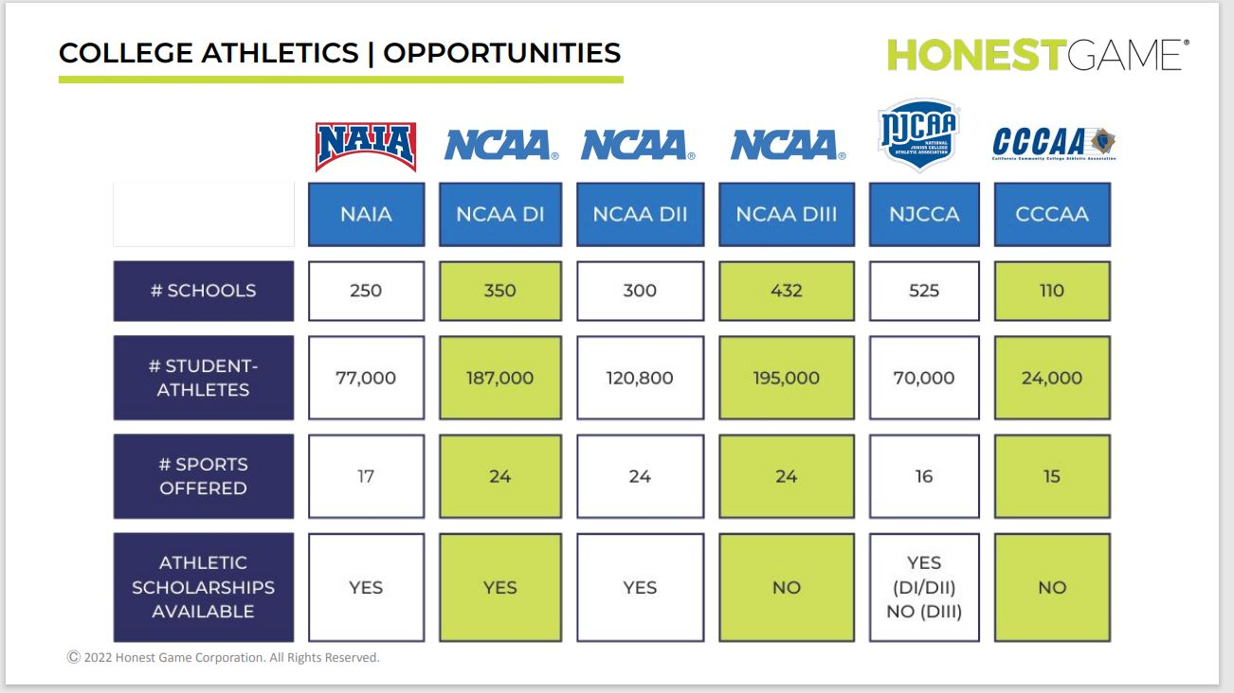

Slide 5
Not all college programs are the same!
Different college divisions and governing body offer a variety of sport offerings and national championships.
The “NCAA” is the governing body that most people think about when they think about college athletics.
The NCAA functions similarly to FHSAA – it is a member school run organization and governing body. They don’t make the rules, they enforce the rules that their member school presidents/representatives implement.

Slide 6
NCAA
This presentation will focus on NCAA as they have the most stringent and in-depth certification process.

Slide 7
NCAA Fast Facts
1,100+ member colleges and universities
98 voting athletic conferences
39 affiliated organizations
More than 500,00 student-athletes
19,500 teams
90 championship each year
24 sport offered
3 divisions/levels of competition offered

Slide 8

What is the NCAA Eligibility Center?
A specific area of the NCAA that focuses on evaluating and certifying college-bound student-athletes for collegiate athletics.
You only need to be evaluated and certified if you are participating at Division I or Division II schools.
They certify a potential student-athlete in two areas
  Academic eligibility
  Amateurism eligibility
www.eligibilitycenter.org

Slide 9

Where do I start????
NCAA offers 2 different accounts a student-athlete can register for.
  Profile Page account
  Certification account
What’s the difference?

Slide 10

Profile Page Account
Any student-athlete can create a profile page account for free.
No Cost
Who should create this type of account
8th grade, freshman, sophomores
Those who are only looking at Division III schools
Those who are just starting to look at playing sports in college
You can transition to a Certification Account at any time.

Slide 11
Certification Account
There is a registration fee. $100 for domestic students.
Who should create a Certification Account
If you wish or need to be certified to play Division I or Division II.
Must register with a certification account before being allowed to take “official” college visits or signing a National Letter of Intent.
Juniors, Seniors, select sophomores
If you are on a college’s Institutional Request List (IRL)

Slide 12
Certification Account
When students register for a certification account, they must:
Select the sport(s) they would like to play in college.
Update their information frequently if they play for multiple teams or attend events outside the traditional high school setting.
Request final amateurism certification before they enroll full time at a Division I or Division II school

Slide 13
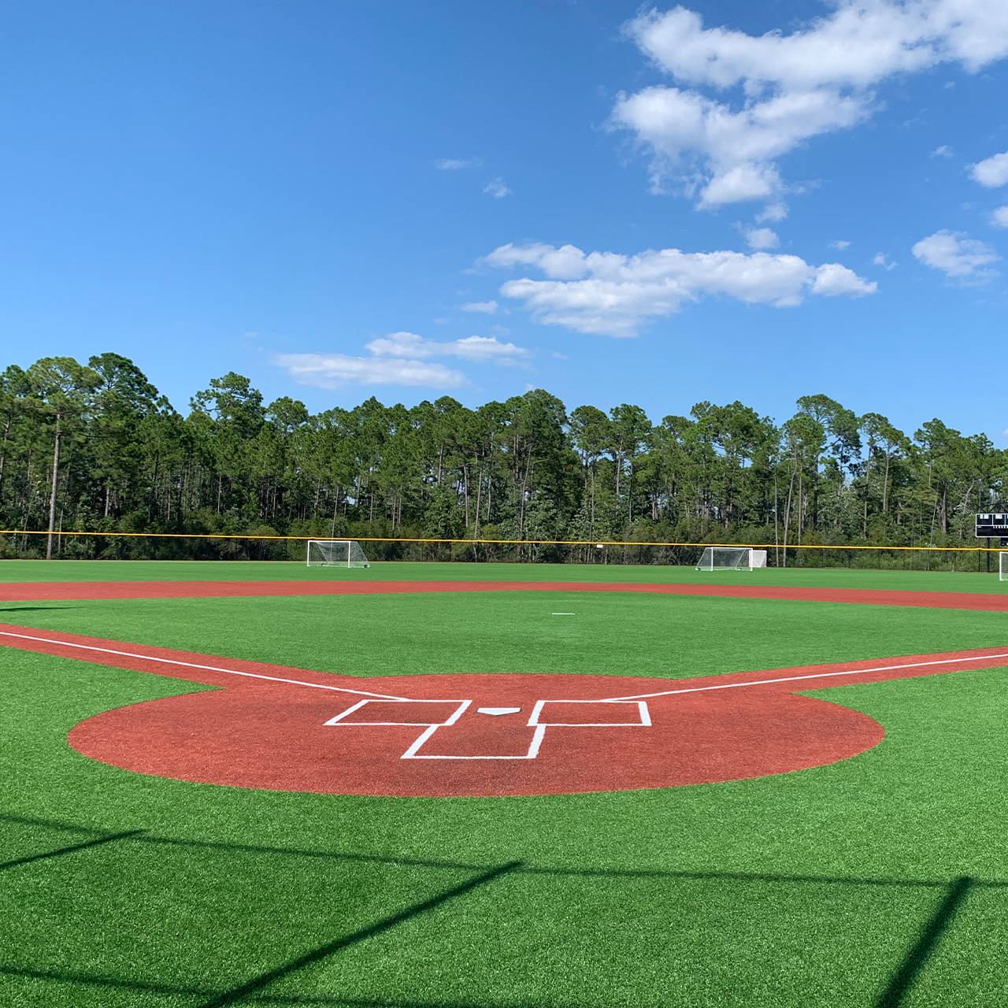
How do I know if I am actually being recruited?
Ask if you are on a college’s institutional request list. (IRL)
The NCAA will not actually begin or complete the certification process unless you are on someone’s IRL.
Just because you receive mail from a school, does not mean you are on their IRL!
A college is offering you to come on an “official” visit. That means the college is paying for much of your trip.

Slide 14
So what classes do I need to take to be “certified”?
Academic requirements for Division I and Division II schools are different.
Division III schools do not have specific NCAA academic requirements beyond what it takes to be admitted into the actual school itself.
Your “Core” classes are the ones that count for certification. Not your electives.

Slide 15

So what are “core” courses?
Typically, they are your English, Math, Science and Social Studies classes.
Select academic electives such as foreign language.
Each high school must submit the courses they offer to NCAA and they will decide which classes we offer will count as a “Core” course.
Not all English, Math, Science, and Social Studies classes count.
“Core” courses are reviewed each year and thus may change from year to year.

Slide 16

How do I know what courses are approved?

Slide 17
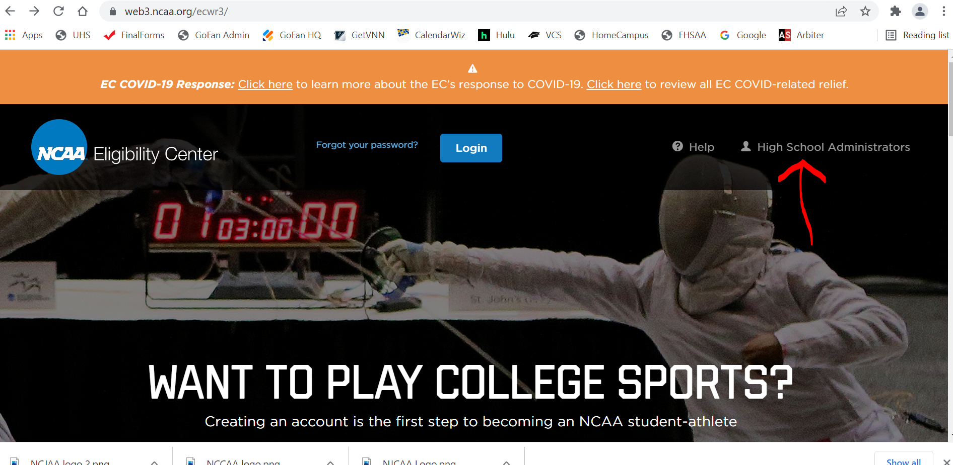
www.eligibilitycenter.org

Slide 18
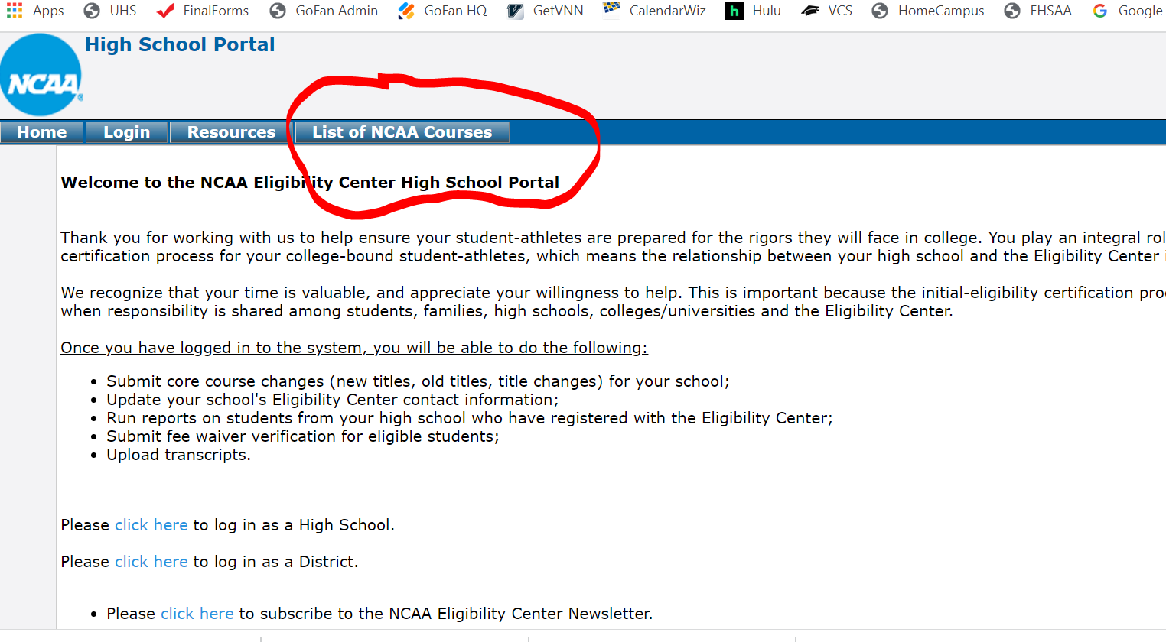
www.eligibilitycenter.org

Slide 19
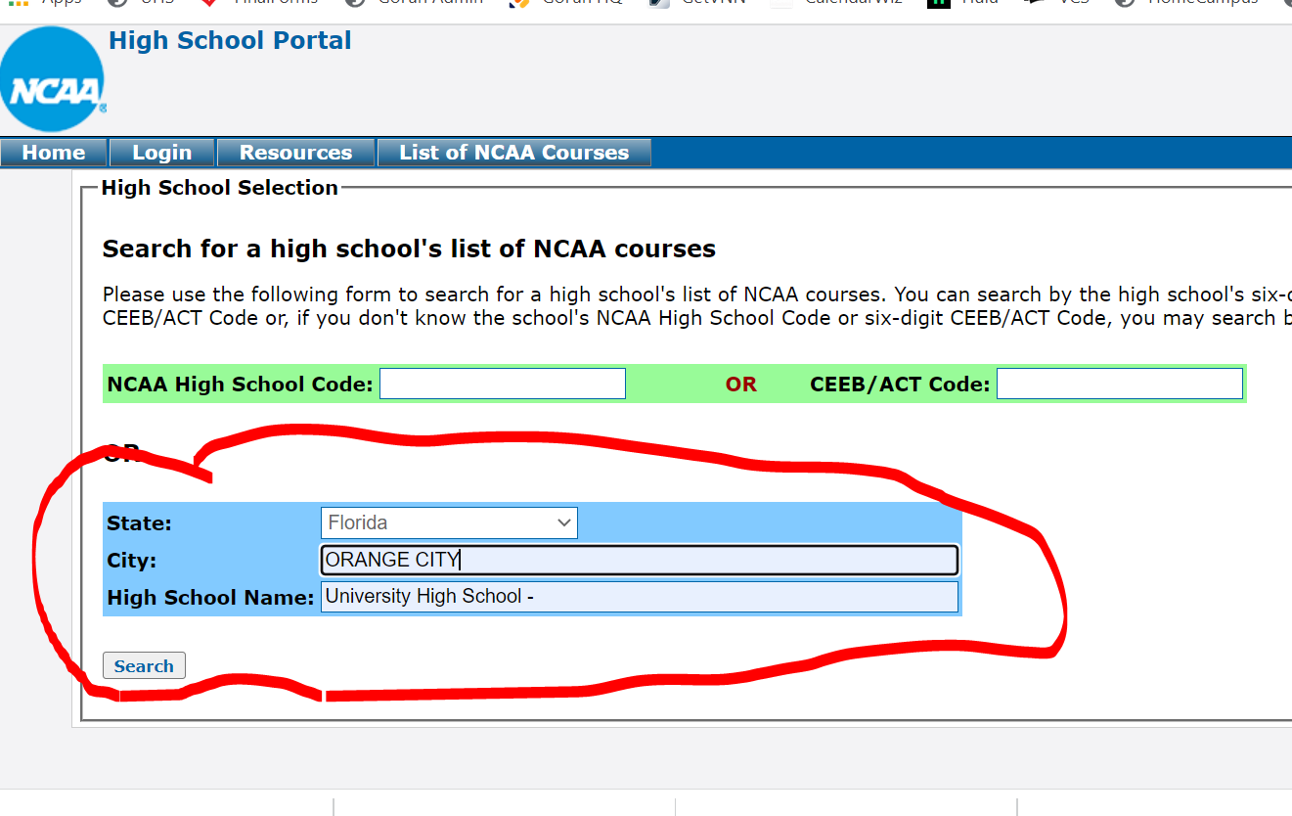
www.eligibilitycenter.org

Slide 20
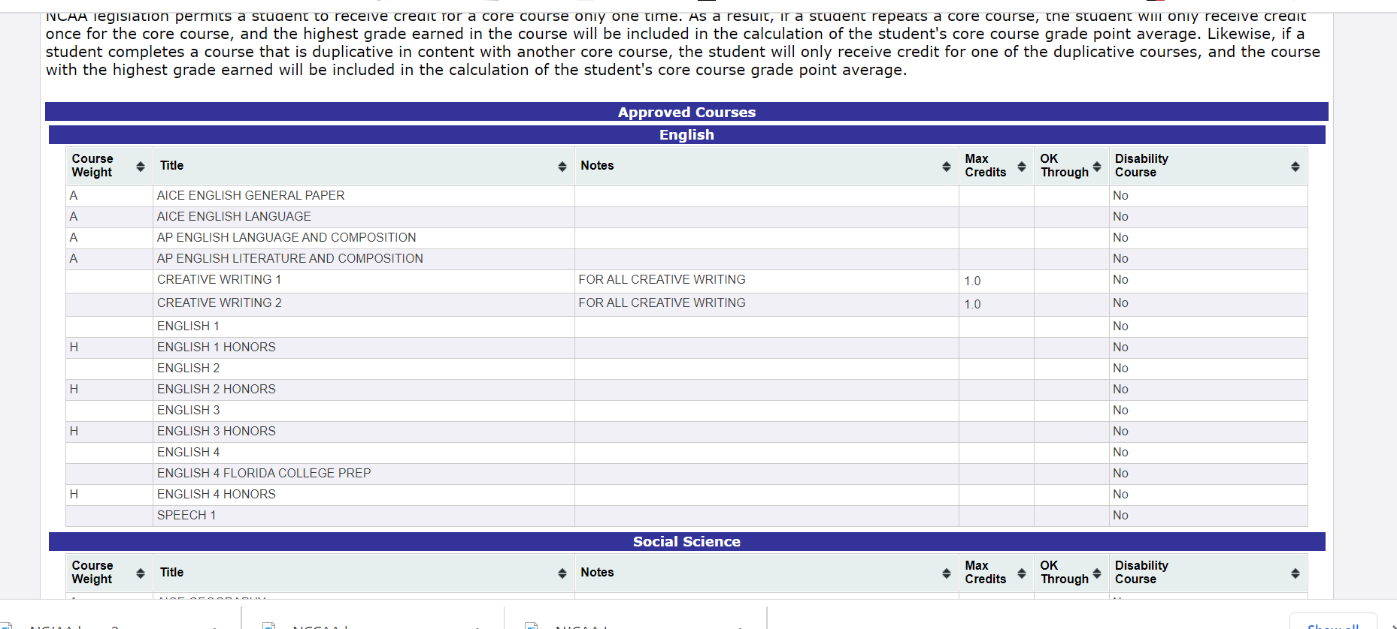

Slide 21
What do I need to take – Division I?
16 total credits
English
4 years
Math
4 years (Algebra I or higher)
Natural/Physical Science
2 years (including at least 1 lab course)
Social Science
2 years
Additional Course
at least 1 additional year of English, Math or Science)
Additional Courses
4 additional credits of either English, Match, Science, Social Science, approved foreign language

Slide 22

Additional “Core” course Notes
Division I
When students enter 9th grade the first time, they have four years (8 consecutive semesters) to complete core-course requirements.
10 of the 16 core courses must be completed and are locked in before starting your seventh semester (end of your junior year)
Of the 10 courses you have “locked in”, 7 of them must be in English, Math, and Science. (Called the 10/7 rule) That means if you “retake” a class for credit it won’t count for NCAA purposes.
Students must graduate on time with their cohort class.

Slide 23

Division I Certification
Students applying for NCAA Division I certification will receive 1 of 4 possible outcomes
Early Academic Qualifier
Qualifier
Academic Redshirt
Nonqualifier

Slide 24
Early Academic Qualifier
Division I
Based on student’s pre-seventh semester academic year. (What you have done by the end of your junior year.)
You must have completed 14 of the core course requirements.
You must have a core course GPA greater than 3.00.
Early Academic Qualifiers can: receive athletic aid, practice and compete

Slide 25
“Regular” Qualifier – Division I
Based on all four years of high school academic progress.
Must meet the 10/7 rule.
Must complete all 16 core courses
Must earn a core-course GPA greater than 2.30
Submit proof of graduation
Qualifiers can receive athletic aid, practice and compete.

Slide 26
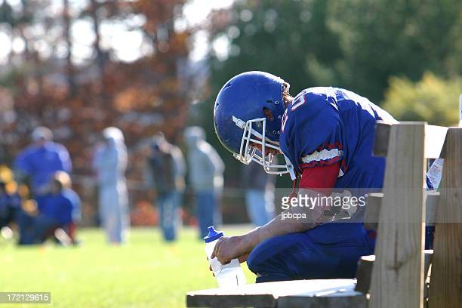
Academic Redshirt Division I
Based on all four years of high school academic progress.
Must complete all 16 core-course requirements
Must earn a core course GPA greater than 2.00
Submit proof of graduation
Academic Redshirts may: receive athletic aid during their freshman year, practice.
They are not eligible to compete.
Students who are non-qualifiers would need to contact their college to determine next steps for potentially earning eligibility status beyond their freshman year.

Slide 27

Nonqualifier – Division I
Students who are certified as nonqualifiers are not allowed to receive athletic aid, practice or compete at their school.
Students who are non-qualifiers would need to contact their college to determine next steps for potentially earning eligibility status beyond their freshman year.

Slide 28

NCAA “CORE” GPA
Please note the school district does not calculate an NCAA Core GPA
Be careful not to assume the GPA you see in Focus is your NCAA GPA.
Your Focus GPA includes any and all of your credits, not just your core classes.

Slide 29

What about test scores?
NCAA Eligibility no longer requires an SAT or ACT test score to determine academic eligibility.
A Note about test scores! While the NCAA may not require them for eligibility purposes, your specific school may still require them for admittance into the school.

Slide 30
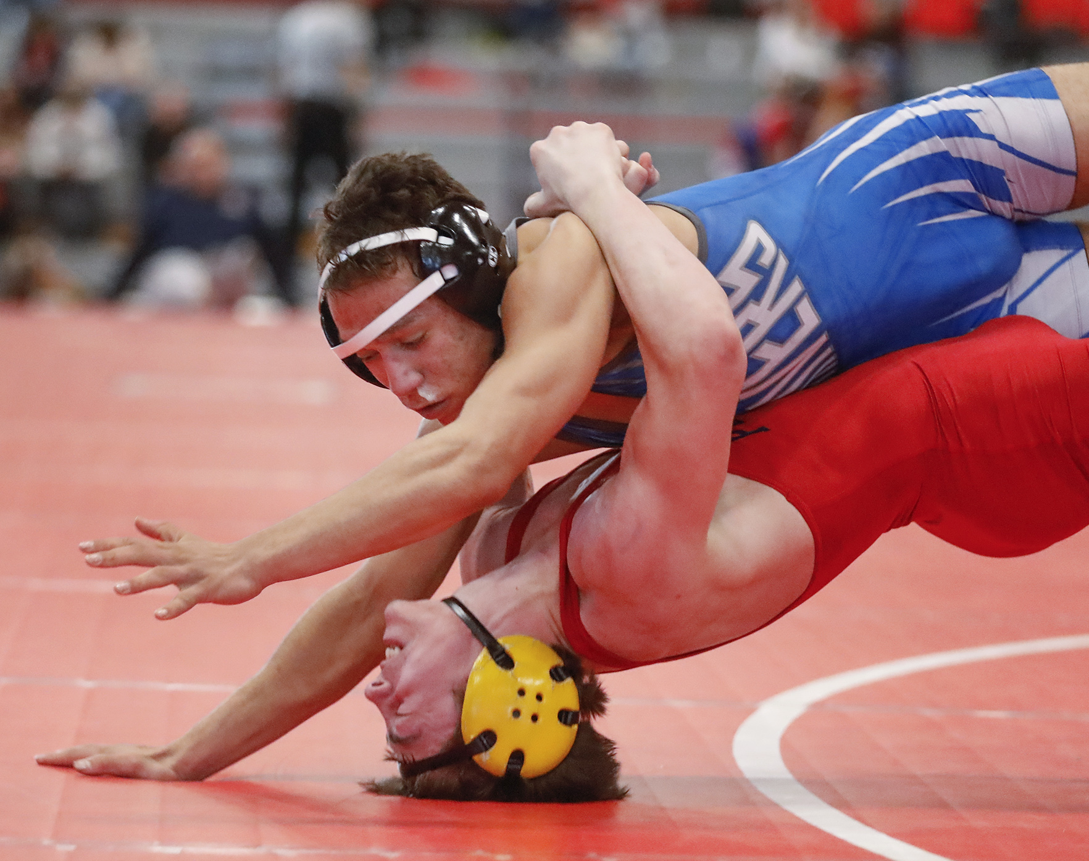
Division II Certification
Students applying for NCAA Division II certification will receive 1 of 3 possible outcomes
Early Academic Qualifier
Qualifier
Partial Qualifier

Slide 31
Early Academic Qualifier requirements – Division II
14 credits
English – 3 years
Math – 3 years (Algebra I or higher)
Natural/Physical Science – 2 years (including at least 1 lab course)
Additional Courses – 6 additional credits of NCAA approved core courses

Slide 32
Early Academic Qualifier – Division II
Based on student’s pre-seventh semester academic year. (What you have done by the end of your junior year.)
You must have completed 14 of the core course requirements.
You must have a core course GPA greater than 2.50.
Early Academic Qualifiers can: receive athletic aid, practice and complete

Slide 33
What do I need to take – Division II?
16 total credits
English – 3 years
Math – 2 years (Algebra I or higher)
Natural/Physical Science – 2 years (including at least 1 lab course)
Social Science – 2 years
Additional Course – at least 3 additional years of English, Math or Science)
Additional Courses – 4 additional credits of either English, Match, Science, Social Science, approved foreign language

Slide 34

“Regular” Qualifier – Division II
Based on all four years of high school academic progress.
Must complete all 16 core courses
Must earn a core-course GPA greater than 2.20
Submit proof of graduation
Qualifiers can receive athletic aid, practice and compete.

Slide 35
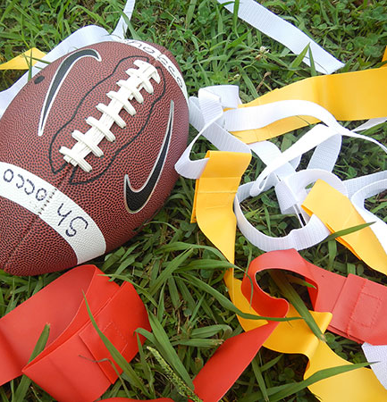
Partial Qualifier – Division II
Students that do not meet Division II qualifier standards will be deemed a partial qualifier.
They must still provide proof of graduation.
Partial Qualifiers may receive athletic aid and may practice. They may not compete.
Students who are non-qualifiers would need to contact their college to determine next steps for potentially earning eligibility status beyond their freshman year.

Slide 36
How should I plan my course load?
The NCAA recommends taking the following each year:
1 English
1 Math
1 Science
1 Social Science or Foreign Language course
PASS your core classes the first time!!!!

Slide 37

Division III requirements
Each Division III school determines its own eligibility for:
  Admission
  Financial Aid
  Practice and competition
The NCAA Eligibility Center does not perform certifications for Division III student-athletes
Division III institutions do not provide any athletic financial aide or National Letters of Intent
Division III college-bound student-athletes may register for the free “Profile Page” account but it is not required.

Slide 38

Distance or E-Learning
The Eligibility Center will not require a separate review of distance or e-learning programs used during the Spring 2020, SY 2020-2021 or SY 2021-2022 used by individual school districts in response to Covid-19.
This does not pertain to distance or e-learning used for credit retrieval purposes or courses taken via computer class for first time credit.
Volusia Online Learning and Florida Virtual School are considered separate high schools for those attending them full-time. Please look for their approved core courses with the NCAA.

Slide 39

Amateur Certification
You may not have earned money or goods for your participation on a team. Prize winnings, substantial gifts may render you a professional athlete.
This includes new Name, Image, and Likeness regulations.
All three divisions have adopted a uniform, interim policy suspending NIL rules for all incoming and current student-athletes in all sports.
For more information visit www.ncaa.org/nil

Slide 40
Covid 19 Impact
At this time, modifications to eligibility rules due to Covid 19 are due to expire beginning with student enrolling in Fall 2023.

Slide 41
Have more Questions?
NCAA College-bound student-athlete support line
877-262-1492
Monday – Friday – 9:00am – 5:00pm
Follow the Eligibility Center on Social Media
Twitter @NCAAEC
Instagram @playcollegesports
Facebook @NCAAEC

Slide 42
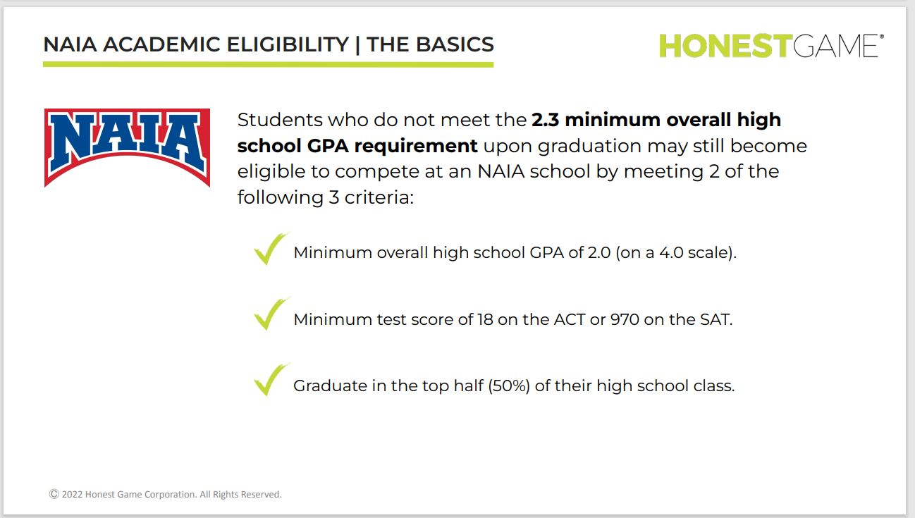
www.playnaia.org

Slide 43
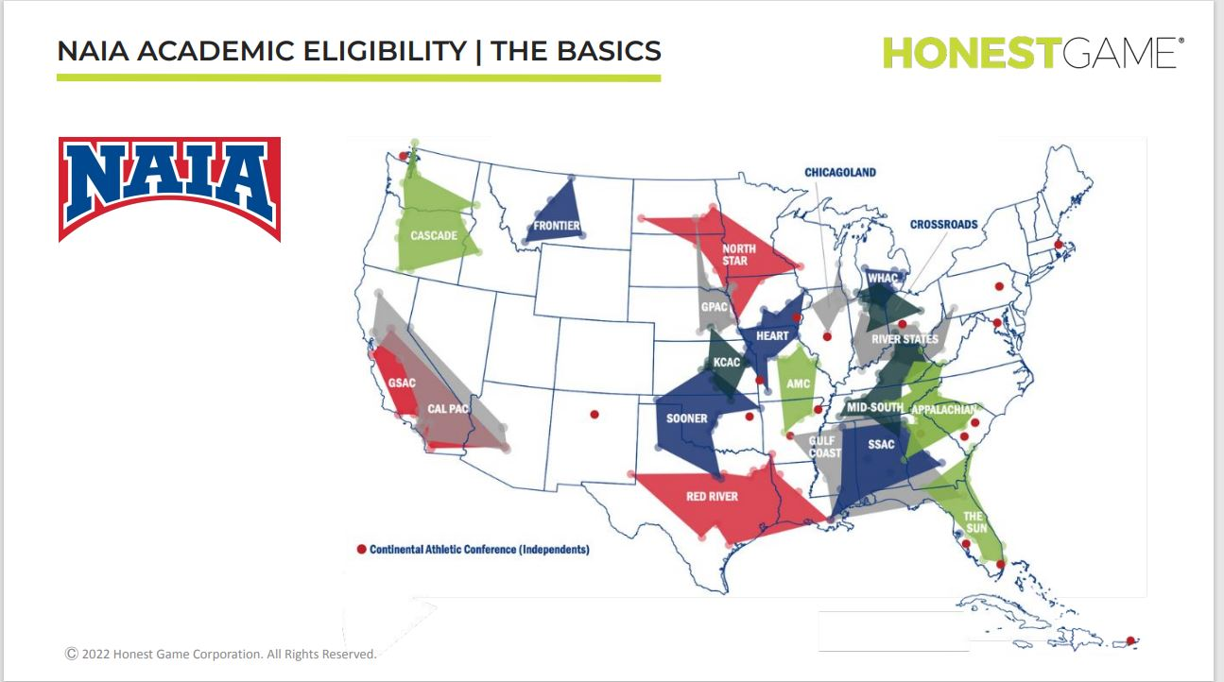
www.playnaia.org

Slide 44
Junior College Basics
JUCOs are able to set their own academic standards
Usually, you need to have earned a HS Diploma, GED or other high school equivalency test.
Once you attend a JUCO, academic requirements for NCAA eligibility are different than attending right out of high school. You will want to talk to both NCAA and your JUCO college about your college classes if you are planning to transfer.

Slide 45

Final Tips
Inform your coach, the athletic director and YOUR GUIDANCE COUNSELOR if you are a student-athlete and are considering trying to participate in college athletics.
Take your academic work seriously. Pass all of your courses the first time you take them, with a C or better.
When taking SAT/ACT, send scores to your desired institution but also to NCAA. Their code is 9999.
The guidance office has separate transcript request forms for the NCAA Eligibility Center.

Slide 46
Final Tips
A parent (or student if they are 18 years or older) must request transcripts to be sent to individual institutions and the eligibility center. This is not automatic! A coach or Athletic Department cannot do it on your behalf. It must be the parent. This includes sending your final transcript after graduation.
Remember that attaining NCAA certification is not the same as admittance into an institution. You must still apply and be accepted into your desired institution even if you are being recruited by that school.
Don’t wait until your senior year to begin thinking about college.

Slide 47
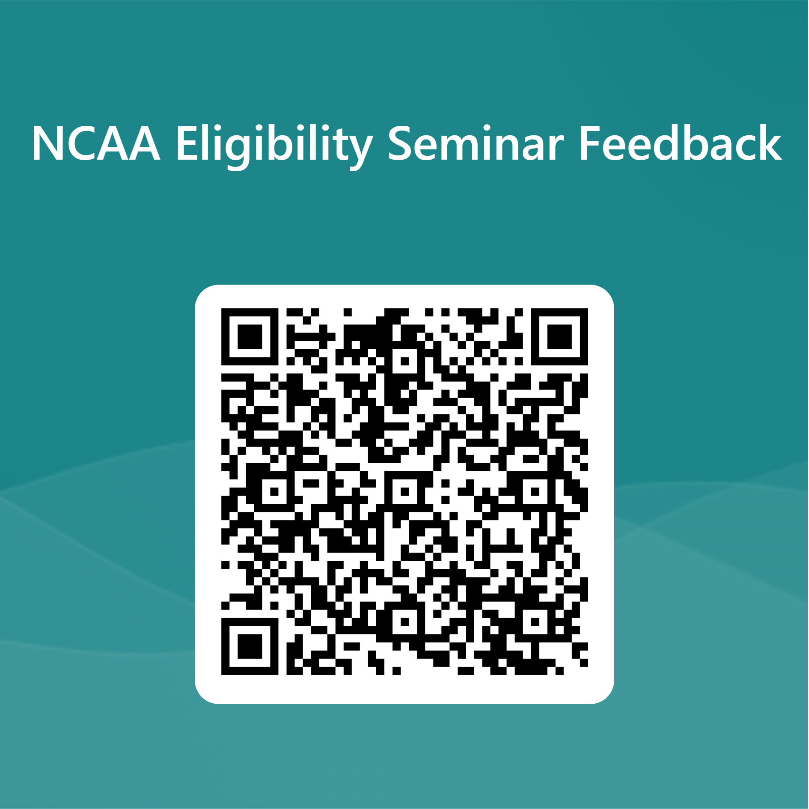
Help us improve this presentation and plan for future presentations.

