Slide 1
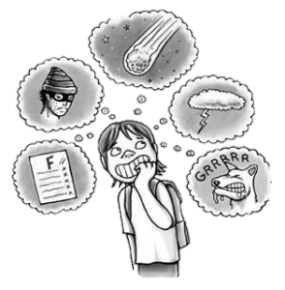
Worried Kids:
What can we do to support anxious children?

Slide 2
General anxiety - Usually something that has been learned in childhood and becomes part of one’s lifestyle
Situational anxiety - Related to a specific event or activity

Slide 3
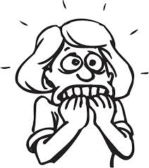
Possible Sources of Anxiety
Traumatic experience
Physiological – central nervous system highly reactive
Inconsistent or confusing environment
Personality– Introverted or perfectionistic children
Family issues- financial, divorce, stepparents, separation, illness, homelessness, etc.
School issues- grades, expectations, peer interactions, bullying, etc.

Slide 4
Symptoms
Excessive anxiety, worry or fear
Physical Symptoms
  Rapid heartbeat, shortness of breath, dizziness, blurred vision, headaches, tense muscles, back pain, cold hands and feet, chest pain, dry mouth, stomach aches, digestive problems
Emotional and behavioral changes
  Changes in sleeping and eating patterns, nightmares and fatigue
  Loss of interest in normal activities
  Poor self-esteem, poor self-efficacy
  Difficulty concentrating, feeling of irritability, withdrawn, self-medicating (drug or alcohol abuse), poor school performance, hyperactivity
  Repetitive reassurance questions, "what if" concerns, inconsolable, won't respond to logical arguments
  Perfectionism, self-critical, very high standards that make nothing good enough
  Overly-responsible, people pleasing, excessive concern that others are upset with him or her, unnecessary apologizing
  Demonstrating excessive avoidance, refuses to participate in expected activities, refusal to attend school
Disruption of child or family functioning, difficulty with going to school, friend's houses, religious activities, family gatherings, errands, vacations

Slide 5
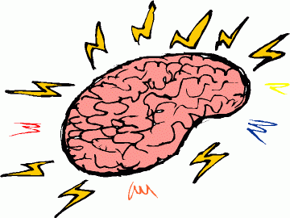
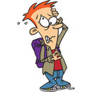

The Cycle of Anxiety
Worried Thoughts
Trigger
Anxious Feelings
Brain Response
Body Response

Slide 6
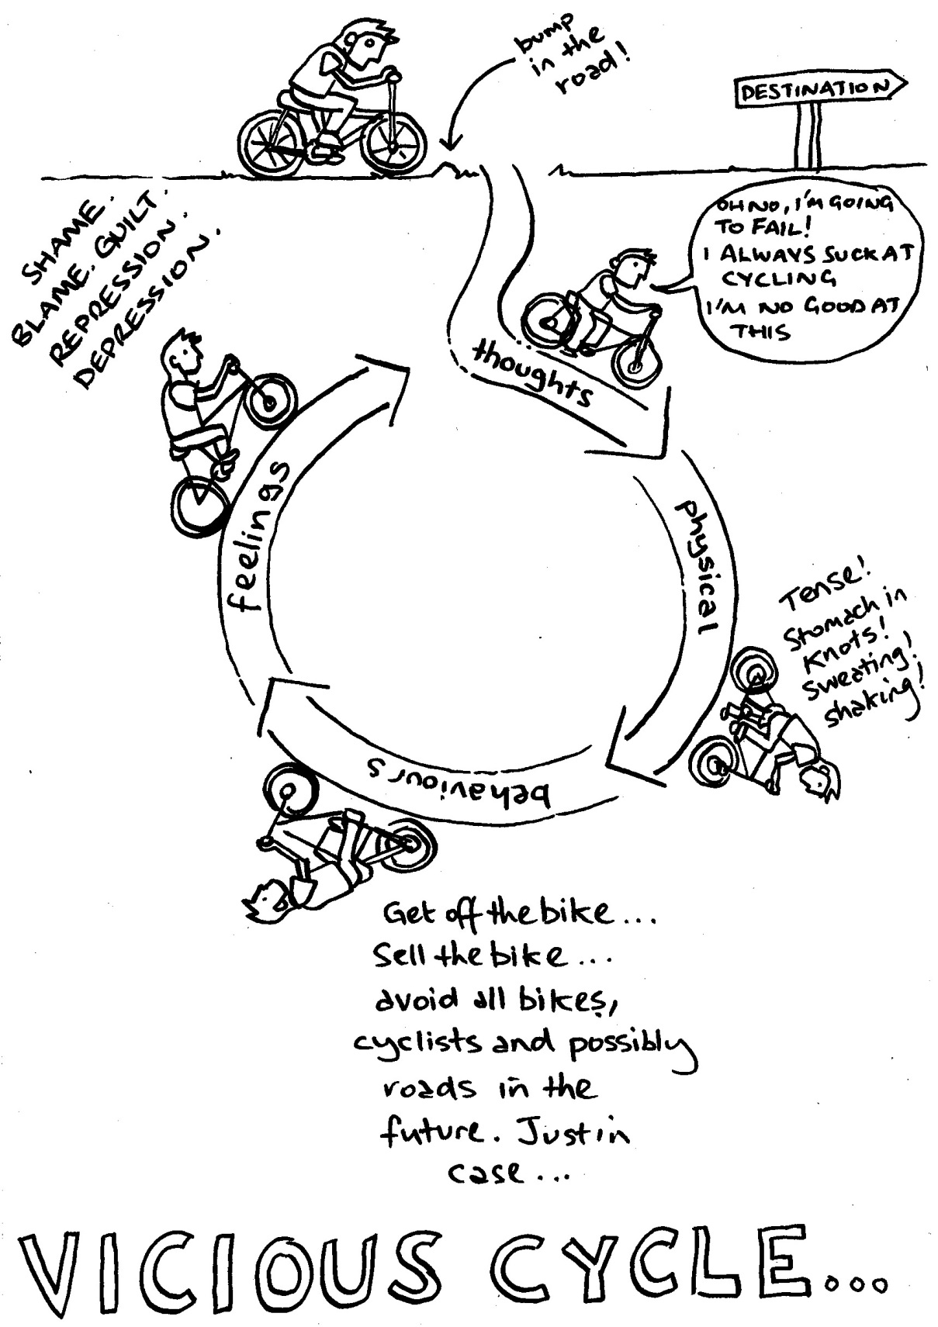

Slide 7
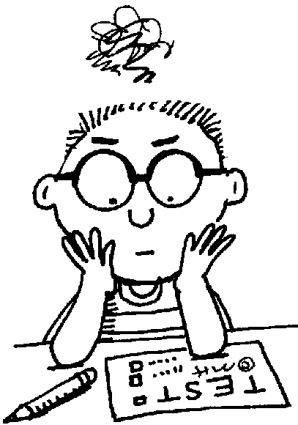
Anxiety at School
Anxiety can be seen as a cause and effect of poor school performance. Students can be overwhelmed which causes anxiety, and then in turn their poor performance can produce more anxiety .
  Anxiety can interfere with focusing attention, learning and test taking
  Highly anxious students feel the need to divide their attention between learning the new information being presented while worrying about the evaluation of the information being taught.
  Poor study skills - If the information being presented is not done so in a well-organized manner the anxiety levels in these students may increase
When it comes to testing, many students find it hard to demonstrate the knowledge, due to “freezing-up” or lacking the skills necessary for effective test-taking

Slide 8
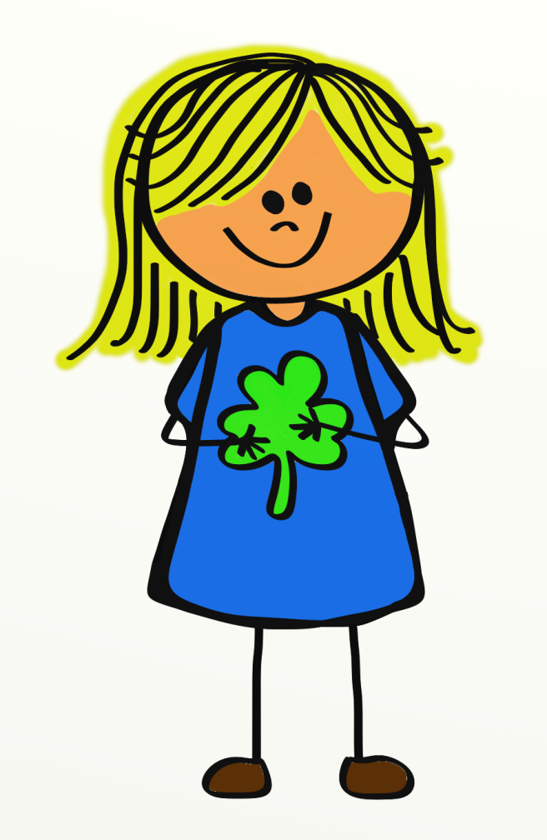
Goals
1. Verbally identify specific worries, fears and anxieties
2. Develop coping skills - Implement relaxation and defensive thinking strategies to decrease the level of anxiety.
3. Reduce anxiety so that daily functioning is not impaired.

Slide 9
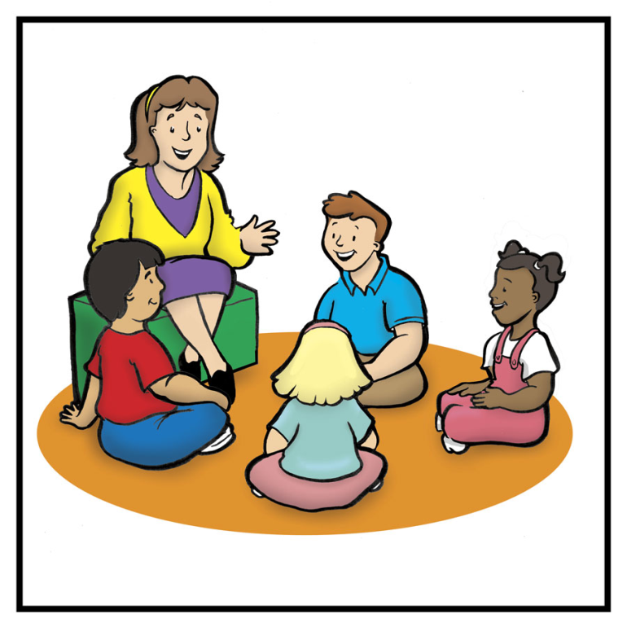
How We Can Help
Small group counseling
Crisis support
Classroom lessons
  Test Anxiety, specifically
Consultation with classroom teachers

Slide 10
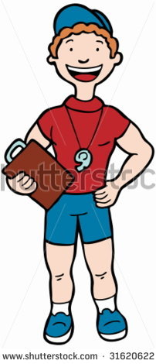
How You can Help!
Identify specific worries, fears and anxieties
  Worry Monster
Be firm, encouraging and compassionate.
Promote security – provide a consistent and caring environment
Encourage the expression of feelings
  Journaling can help stressed and anxious children express themselves without being put in an even more stressful position. Place the students in extracurricular activities that involve exercise and foster friendships
Develop a list of relaxation strategies to use in moments of anxiousness
  Breathing Buddies
  Muscle Relaxation
  Music, play dough, watching a movie, etc.
Coach your child in positive thinking!
  When they are facing something that makes them feel anxious, ask them to imagine themselves being successful performing that task (i.e. What is it going to feel like when you rock that test?!)

