Slide 1
Infection Prevention & Control
Prevention Strategies
Virginia Department of Health (VDH)
Healthcare-Associated Infections Program

Slide 2
Objectives
Review standard and transmission-based precautions
  Discuss hand hygiene strategies and how to measure compliance
  Review respiratory etiquette and safe injection practices
Review the OSHA Bloodborne Pathogens Standard and best practices for blood glucose monitoring
Discuss the role of environmental cleaning in infection prevention and how to measure compliance
Describe the importance of vaccination

Slide 3
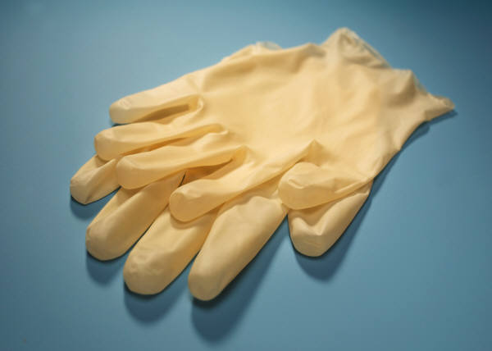
Isolation Precautions
Used to reduce transmission of microorganisms
Designed to protect both staff
and patients from contact with infectious agents
Includes:
  Standard precautions
  Transmission-based precautions
.
Notes:
Isolation Precautions can also be known as “infection prevention precautions”

Slide 4
Standard Precautions
Because it is not always possible to tell who is infected, these practices should be the approach for the care of all patients all the time
Formerly known as “universal precautions”
Notes:
Standard Precautions combine the major features of Universal Precautions and Body Substance Isolation and are based on the principle that all blood, body fluids, secretions, excretions except sweat, nonintact skin, and mucous membranes may contain transmissible infectious agents.
Standard Precautions include a group of infection prevention practices that apply to all patients, regardless of suspected or confirmed infection status, in any setting in which healthcare is delivered

Slide 5
Sharps Injury Prevention
Hand Hygiene
Personal Protective Equipment
Special Lumbar Puncture Procedures
Textiles and Laundry
Standard
Precautions
Cleaning of Care Equipment Between Patients
Patient Placement
Respiratory Hygiene /
Cough Etiquette
Safe Injection
Practices
Care of Environment
Notes:
Hand hygiene before and after contact with the patient and /or objects/surfaces around the patient that may be contaminated with bacteria or viruses
PPE (personal protective equipment)
Use gloves when care provider anticipates contact with blood, feces, urine or other body fluids
Wear a gown to prevent soiling of providers clothing
Additional PPE such as face mask, shield, or goggles when splashing or spraying of blood/body fluids may occur
Use mouthpiece, resuscitation bag, other ventilation devices to prevent contact with mouth and oral secretions
Special Lumbar Puncture Procedures - use of masks for insertion of catheters or injection of material into spinal or epidural spaces via lumbar puncture procedures (e.g., myelogram, spinal or epidural anesthesia).
Patient placement - Prioritize for single-patient room if patient is at increased risk of transmission, is likely to contaminate the environment, does not maintain appropriate hygiene, or is at increased risk of acquiring infection or developing adverse outcome following infection.
Safe injection practices
Care of environment - Develop procedures for routine care, cleaning, and disinfection of environmental surfaces, especially frequently touched surfaces in patient-care areas.
Respiratory hygiene/cough etiquette
Clean equipment between patients; handle in a manner that prevents transfer of microorganisms to others and to the environment
Textiles and laundry - Handle in a manner that prevents transfer of microorganisms to others and to the environment. Also want to handle regulated waste in the same manner…
11. Sharps injury prevention - Do not recap, bend, break, or hand-manipulate used needles; if recapping is required, use a one-handed scoop technique only; use safety features when available; place used sharps in puncture-resistant container

Slide 6
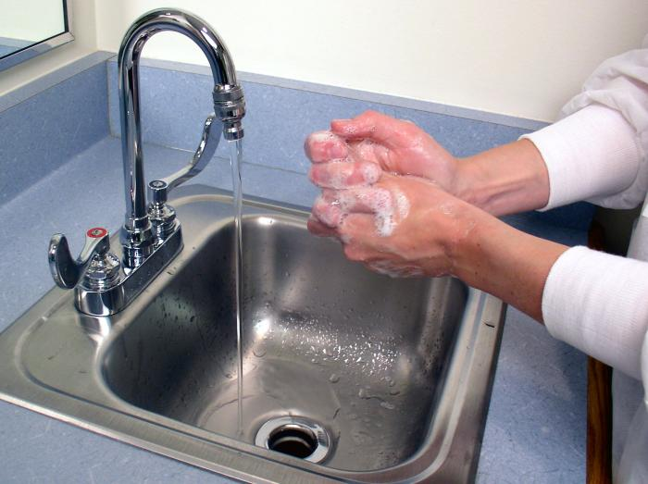
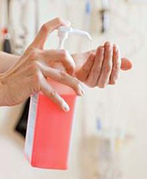
Hand Hygiene: How and When
 | Soap and water | Alcohol-based hand rub
When to use | Use when hands are visibly dirty, contaminated, or soiled | Use for routinely decontaminating hands if hands are not visibly soiled
How to use (properly) | Wet hands with water, apply soap, rub hands together for at least 15 seconds Rinse and dry with disposable towel Use towel to turn off faucet | Apply to palm of one hand, rub hands together covering all surfaces until dry Manufacturer will instruct how much to use
Guideline for Hand Hygiene in Health-care Settings. MMWR 2002; vol. 51, no. RR-16.
Notes:
When hands are visibly dirty, contaminated, or soiled, wash with soap and water. This includes after using the restroom and before eating or preparing food.
If hands are not visibly soiled, use an alcohol-based handrub for routinely decontaminating hands.

Slide 7

Hand Hygiene: Why and When
Clean hands are the most important factor in preventing the spread of disease and antibiotic resistance in settings across the continuum of health care.
Before and after:
  Contact with a patient
  Treating a cut or wound
  (Ex: changing dressings or bandages)
Guideline for Hand Hygiene in Health-care Settings. MMWR 2002; vol. 51, no. RR-16.
Notes:
Hand hygiene is indicated before and after: contact with a patient and changing wound dressings or bandages (treating a cut or wound)
Gloves should be used when a healthcare worker has potential for contact with blood or other body fluids in accordance with standard precautions
Be sure to perform hand hygiene before preparing or eating food, touching one’s eyes, nose, or mouth, administering medication, or inserting invasive devices such as catheters (regardless of glove use)
NOTE: Hand hygiene before handling medication is a recommendation of the World Health Organization.

Slide 8
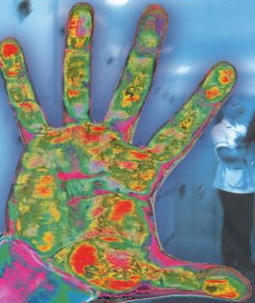
Hand Hygiene: When
Before:
  Putting on gloves
  Preparing or eating food*
  Touching your eyes, nose, or mouth
  Handling/administering medication
  Insertion of invasive devices
After:
  Contact with blood, body fluids, mucous membranes, secretions, excretions, or non-intact skin
  Removing gloves
  Touching surfaces or objects in the patient’s environment that may be contaminated (bed rails, bedside tables, light switches, etc.)
  Handling garbage
  Using the restroom*
  Blowing your nose, coughing, or sneezing
* Wash hands with
soap and water
Notes:
Hand hygiene is also indicated after contact with a patient’s blood, body fluids, mucous membranes, secretions (except sweat), excretions, or non-intact skin, after removing gloves, after touching surfaces or objects in the patient’s environment that may be contaminated with bacteria or viruses, such as bed rails, bedside tables, light switches, and patient care equipment, and after handling garbage.
All persons, not just care providers, should always perform hand hygiene after using the rest room and blowing their nose, coughing, or sneezing.

Slide 9
Hand Hygiene: Monitoring Compliance
On a regular basis, observe different types of staff to make sure they are complying with recommended practices for hand hygiene
  What type of hand hygiene is done? (soap and water vs. alcohol-based hand rub)
  Is hand hygiene done before patient contact? After patient contact?
  If gloves are used, is hand hygiene done before the gloves are put on and after the gloves are taken off?
Analyze the data to identify gaps in compliance and provide additional training as necessary

Slide 10
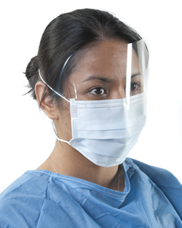

Personal Protective Equipment:
Standard Precautions
Gloves:
If contact with blood or body fluids may occur
Face mask / eye protection:
If contact with blood or body fluids may occur
Gown:
If contact with blood or body fluids may occur
Notes:
Patient signs and symptoms will determine what personal protective equipment (PPE) is necessary.
The task being performed also will determine what PPE is necessary
**During resuscitation, use mouthpiece, resuscitation bag, other ventilation devices to prevent contact with mouth and oral secretions

Slide 11








Sequence of Putting on PPE (“Donning”)
Notes:
Like for hand hygiene, you can do observations to look at compliance for appropriate PPE use. This is especially useful if you have patients who are on different types of isolation precautions (contact precautions, droplet precautions) to make sure the correct types of PPE are being worn during the right times.

Slide 12
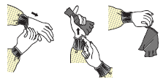
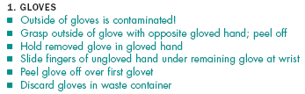


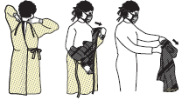



Sequence of Taking off PPE (“Doffing”)
Notes:
Except for respirator, remove PPE at doorway or in anteroom. Remove respirator after leaving patient’s room and closing door.

Slide 13
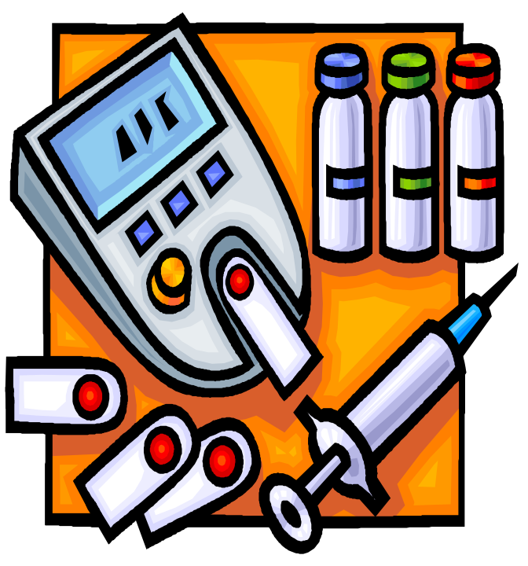
Safe Injection Practices: Why
Safe injection practices are intended to prevent transmission of infectious diseases between individuals AND to prevent injuries such as needlesticks
Notes:
A safe injection does not harm the recipient, does not expose the care provider to any avoidable risks, and does not result in waste that is dangerous for the community.

Slide 14
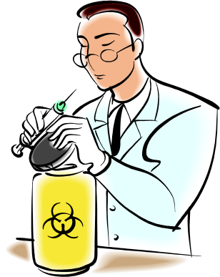
Safe Injection Practices Include:
Aseptic technique
Using a single syringe and fluid infusion sets ONLY once (changing the needle is not sufficient)
Using single-dose vials when possible
If multi-dose vials must be used, then use & store them according to manufacturer's recommendation
Notes:
Use aseptic technique to prevent contamination of sterile injection equipment
Do not administer medications from a single syringe to multiple patients. Changing the needle is not sufficient.
Use fluid infusion and administration sets (i.e., intravenous bags, tubing, and connectors) for one patient only, and discard immediately after use
Use single dose vials for injectible medications whenever possible
If multidose vials must be used, use and store them in accordance with the manufacturer’s instructions

Slide 15
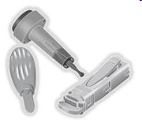

Safe Injection Practices: Fingerstick Devices
Single-use devices
  Disposable
  Prevent reuse through an auto-disabling feature
  Appropriate for settings where assisted monitoring
  of blood glucose is performed
Reusable devices
Often resemble a pen (“penlet”)
Use not recommended due to problems that have been observed, including:
  Failure to change disposable pieces
  Failure to clean and disinfect properly
  Links to multiple outbreaks of hepatitis B
  Risk for occupational needlestick
Only appropriate for people who do not require assistance with blood glucose monitoring (BGM)
Single-Use Fingerstick Device
Source: CDC
Reusable Fingerstick Device
Source: CDC
Notes:
The most important message here is that reusable devices are only to be used for persons who DO NOT require assistance with their blood glucose monitoring. Otherwise, single-use devices should be used.
Penlets pose a risk for occupational needlesticks. This is because you have to remove the lancet after sticking the patient and some of the models have a dangerous design – for example, in a “flip-top” model, you can easily cut your thumb on the lancet when you flip it open to remove the lancet.

Slide 16

Blood Glucose Monitoring Best Practices
Fingerstick devices should never be used for more than one person
  Select single-use devices that permanently retract upon puncture
Dedicate blood glucose meters to a single patient, one person, if possible
  If shared, the device should be cleaned and disinfected after every use, per manufacturer’s instructions
Insulin pens and other medication cartridges and syringes are for single-use only and should never be used for more than one person
Notes:
Restrict use of fingerstick devices to individual persons. Never share between persons.
Any fingerstick devices designed for reuse on a single person must be clearly labeled with the individual patient’s name and stored in a secure area such as a locked cabinet or medication cart.
Select single-use devices that permanently retract upon puncture.
Dispose of used lancets at the point of use in an approved sharps container.

Slide 17
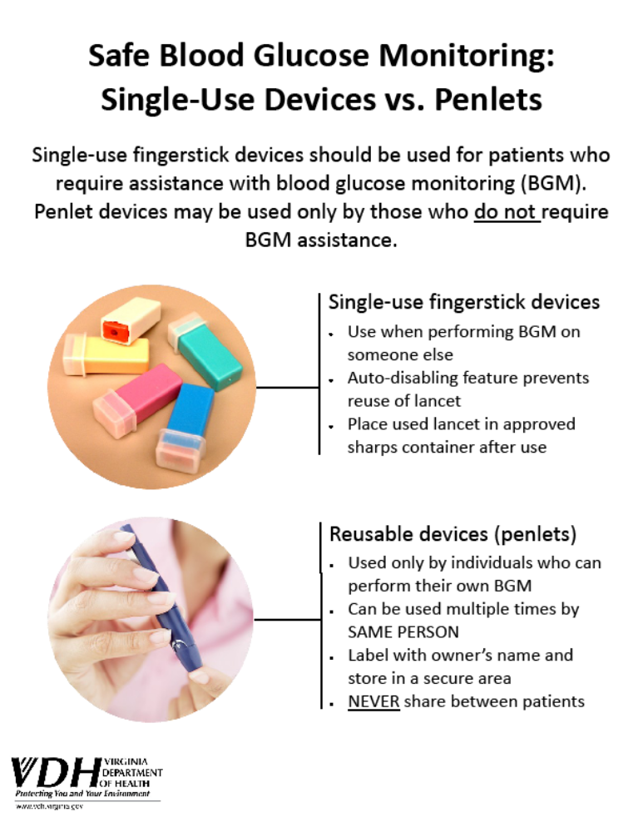
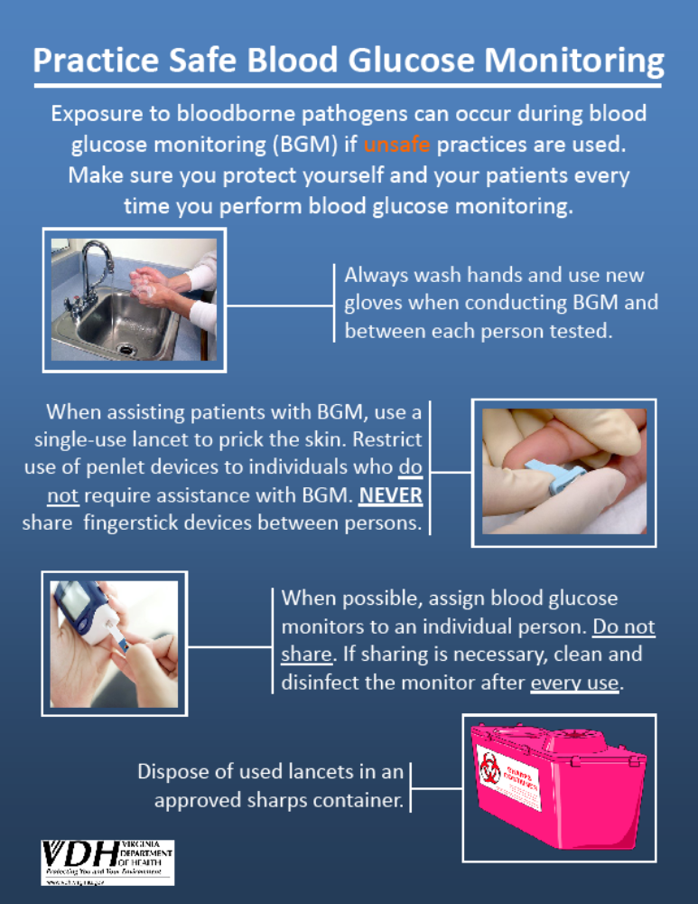
Notes:
This slide has two signs/posters that address blood glucose monitoring. The poster on the left explains the difference between single-use devices (for use with assisted blood glucose monitoring) and reusable devices (only used for persons who DO NOT require assistance with their blood glucose monitoring). The poster on the right walks through the best practices of safe blood glucose monitoring – hand hygiene, use of a single-use fingerstick device, use of an individually-assigned blood glucose meter, and appropriate disposal of the used lancet in a sharps container. Both posters are available on the VDH HAI website.

Slide 18

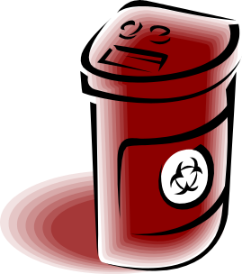
OSHA Bloodborne Pathogens Standard
The Occupational Safety and Health Administration
(OSHA) Bloodborne Pathogens (BBP) Standard
describes important strategies that can reduce the
risk of infection on the job.
Exposure Control Plan
Engineering Controls
Work Practice Controls
Standard Precautions / Personal Protective Equipment
Housekeeping
Hepatitis B Vaccine
Occupational Exposure Follow-up
Training and Recordkeeping
Notes:
The Bloodborne Pathogens Standard is divided in sections that address the following topics; the exposure control plan, engineering controls, work practice controls, standard precautions and personal protective equipment, housekeeping, hepatitis B vaccine, occupational exposures, education, and recordkeeping. A copy should be located in your facility and made available to you.

Slide 19
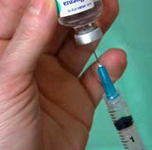
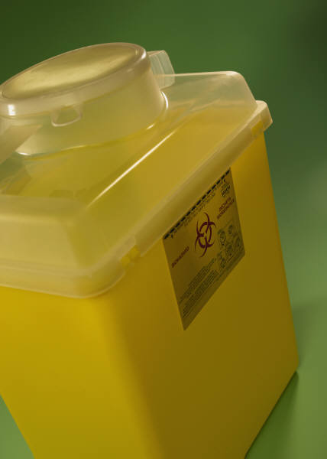
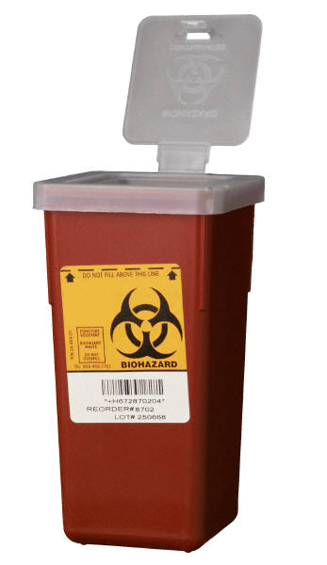
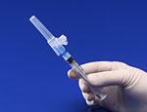
Engineering Controls: Handling Sharps
Use needles with safety devices
Never recap, break, or bend needles
Never leave needles unattended
Never reuse disposable sharps
Dispose of all needles in a regulated, color-coded, labeled sharps container
Sharps containers should be changed when 1/2-3/4 full.
Notes:
Engineering controls (part of OSHA BBP Standard) include certain safety rules that should be followed when handling sharps. Safe practices include never reusing disposable needles, syringes, lancets or sharps of any kind and never breaking bending or recapping needles. If recapping is necessary, those situations should be described in the exposure control plan. The single handed “scoop technique” should always be used. Used needles should be disposed of in a regulated, color-coded, labeled sharps container as described in Virginia Regulated Medical Waste regulation. Sharps containers should be puncture proof with a lid that prevents retrieval of the disposed medical waste.
The sharps container should be changed when it is ½-3/4 full to avoid contact with discarded sharps. Sharps containers should be placed in locations accessible to staff but not to patients.

Slide 20
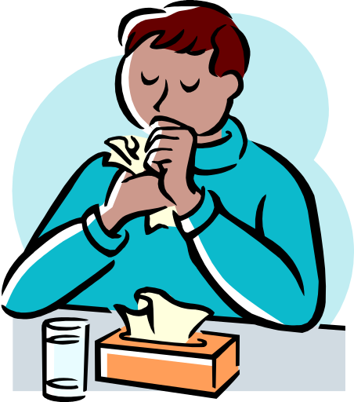
Respiratory Hygiene/ Cough Etiquette
Is used to decrease the transmission of respiratory illness such as influenza & colds by:
Education regarding how respiratory illnesses spread and prevention practices including how to “cover your cough” and proper hand hygiene methods
Availability and use of tissues and hand hygiene products
Use of mask for person who is coughing
Spatial separation of the person with a respiratory illness
Notes:
Education of patients, visitors, and care providers about how respiratory infections are transmitted and respiratory illness can be prevented. This includes asking visitors, and care providers to stay home if they are sick.
Use of posted signs (in languages appropriate to the population served) with instructions and pictures about how to cover your cough and wash your hands.
Availability and use of disposal tissues when coughing and sneezing, and reminders to dispose of used tissues properly.
Use of a mask for a person who is coughing. A mask should only be used if the resident can tolerate the mask and until the person can be placed in a location where risks to others are minimized.
Spatial separation of the person with a respiratory infection from others. Since droplets travel through the air for 3-6 feet, separating an ill person from others by more than 3 feet decreases risk of transmission. If a patient is ill and shares a room, the use of curtains or screens between beds can limit dispersal of droplets.
Stressing hand hygiene after contact with respiratory secretions. This applies to everyone.

Slide 21
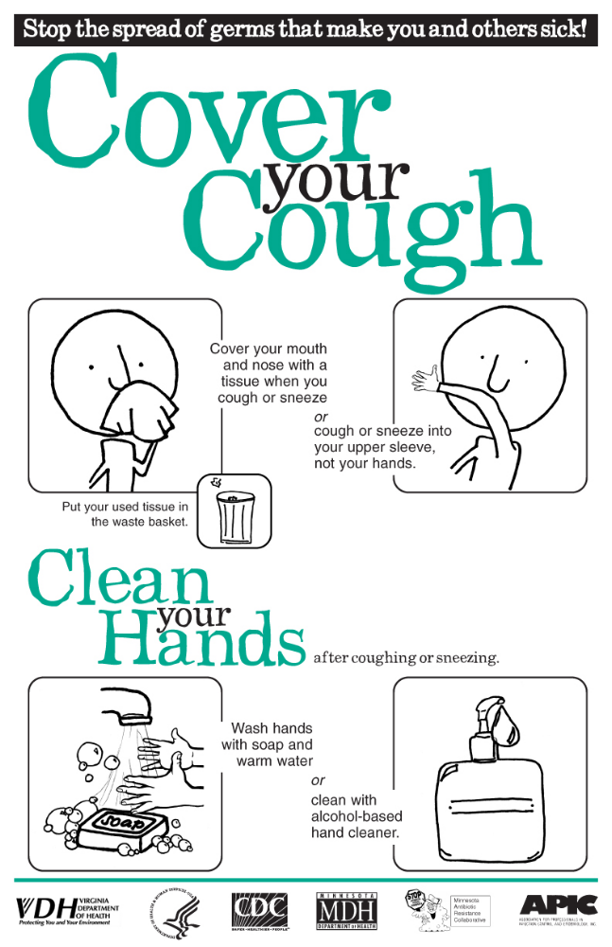
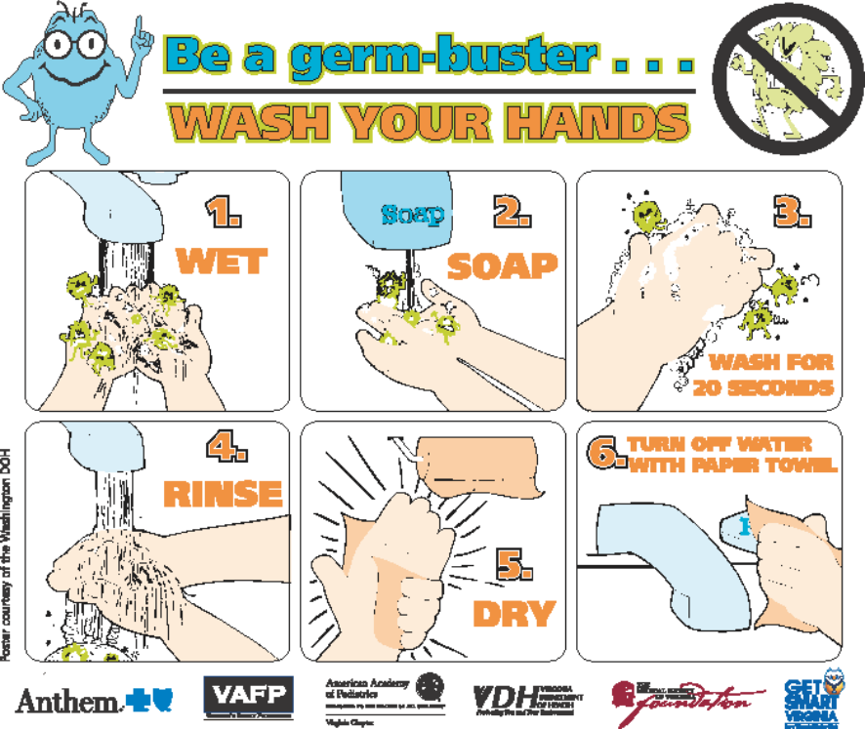
Notes:
This slide has pictures of two posters relevant to respiratory hygiene that are available on the VDH HAI website. The sign on the left instructs people to cover their cough and clean their hands to stop the spread of germs. The sign on the right demonstrates how to wash your hands with soap and water.

Slide 22
Contact Precautions
Are used in addition to standard precautions
Designed to reduce the risk of transmission of microorganisms by direct or indirect contact
  Examples: Clostridium difficile, scabies, multidrug-resistant organisms
Utilize wearing of gown and gloves for all activities that may involve contact with the patient or potentially contaminated areas/objects in the patient’s environment
Dedicate use of noncritical care equipment (e.g., blood pressure cuffs) to a single patient or use single-use disposable noncritical care equipment
Recommend private room or cohorting of patients with same bacteria or virus

Slide 23
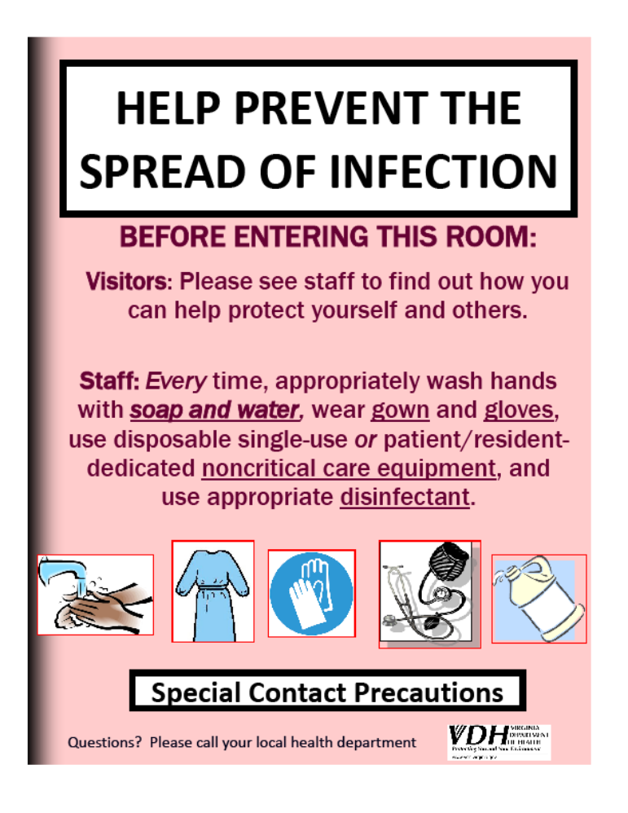
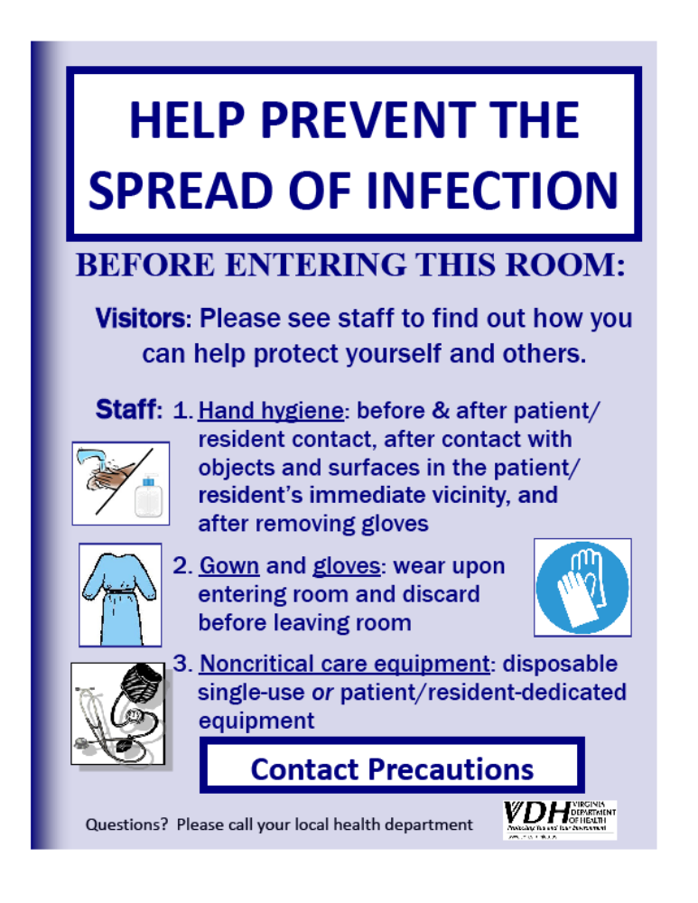
Notes:
This slide shows two signs that can be used to remind staff and visitors to appropriately implement contact precautions in a patient’s room. The picture on the left is for regular contact precautions and the sign on the right is for diseases like C. difficile that need “special” contact precautions that involve the use a different disinfectant (usually a bleach solution) and soap and water for hand hygiene.

Slide 24
Droplet Precautions
Are used in addition to standard precautions.
Used for illnesses that can be spread to others by speaking, sneezing, or coughing.
  Examples: influenza, the common cold
These germs may through the air for approximately 3-6 feet and can be breathed into the nose or mouth of another person.
A mask is used by staff or visitors upon entering the room of a patient on droplet precautions.
Hand hygiene is essential to avoid the spreading of germs.

Slide 25
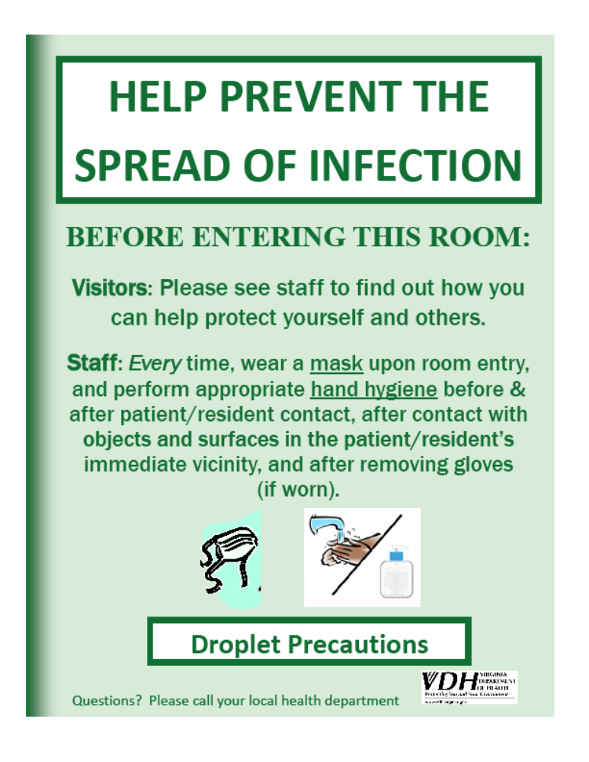
Notes:
This picture shows a sign that can be used to remind staff and visitors to appropriately implement droplet precautions in a patient’s room. This sign is available on the VDH HAI website.

Slide 26
Airborne Precautions
Are used in addition to standard precautions.
Used for illnesses that can be transmitted by small particles in the air.
  Example: tuberculosis
An airborne infection isolation (AII) room with negative pressure is preferred.
  If AII room not available, place in private room with door closed.
Use N95 respirator (or higher) when entering room.
Notes:
In settings where Airborne Precautions cannot be implemented due to limited engineering resources (e.g., physician offices), masking the patient, placing the patient in a private room (e.g., office examination room) with the door closed,

Slide 27
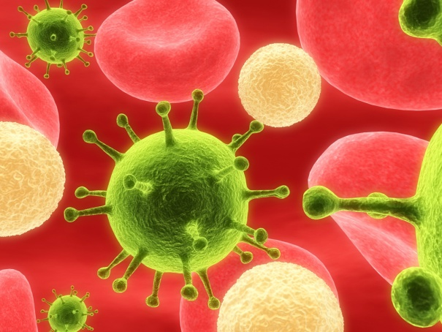
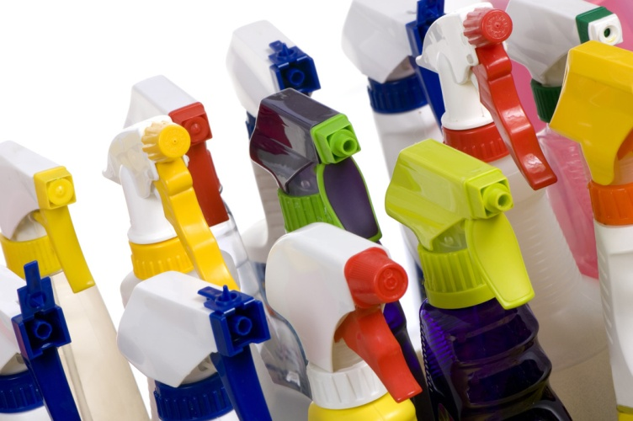
Cleaning of the Environment
Our environment contains
microorganisms that can
cause infection.
Cleaning and disinfecting surfaces and objects such as medical equipment can decrease the spread of these organisms to people.
Notes:
When cleaning and disinfecting the environment it is important to include flat surfaces such as sink counters, and frequently touched items such as bedrails, light switches, call buttons, and bedside tables.

Slide 28
Common Terms
Clean = remove all visible dust, soil, and any other foreign material
Decontaminate = remove disease-producing microbes to make safe for handling
Disinfect= kill or destroy nearly all disease-producing organisms, except spores using a chemical or physical agent
Sterilize = destroy microorganisms and spores
Adapted from the APIC, 2009 Infection Prevention Manual for Long-Term Care Facilities
Notes:
Disinfection is used on inanimate objects

Slide 29

Breakdown of Cleaning
Cleaning is the physical removal of all visible soil and other foreign material (such as dirt, dust bunnies, and body fluids) so you can get to the microbes underneath. You can’t kill microbes if you don’t clean first.
One can clean without disinfecting, but one can not disinfect without cleaning, therefore, one must clean first to remove the materials.
Transmission of infection may not be a failure of the cleaning and disinfecting agents but rather a failure to completely follow the cleaning and disinfecting process.
Notes:
An important step in infection prevention and control is cleaning

Slide 30

Cleaning Process
Environmental Services should approach cleaning in a orderly, regularly scheduled method.
  Clockwise or counter-clockwise
  Working from top to bottom
  Cleanest to the dirtiest
Notes:
Housekeeping surfaces and environmental surfaces should be cleaned on a routine schedule, when visibly soiled and according to manufacturer's recommendations

Slide 31
Sample Cleaning Schedule
Equipment | Who is Responsible | Frequency | Cleaning Process
Blood pressure cuff | Nursing | Between patients | EPA-registered disinfectant
Call button | Environmental Services | Between patients | EPA-registered disinfectant
Bed rails | Environmental Services | Daily | EPA-registered disinfectant
*Adapted from New York City Department of Mental Health and Hygiene, 2010, available at: http://www.nyc.gov/html/doh/downloads/pdf/bhpp/ped_ltcf_conf/peds_conf_clones.pdf
Notes:
Housekeeping surfaces (e.g., floors, table tops) and other environmental surfaces should be cleaned and disinfected regularly, when spills occur, and when these surfaces are visibly dirty. Follow your facility’s schedules for routine cleaning and disinfection and for terminal cleaning of rooms when preparing the room for the next patient. If you don’t have a schedule, you can make one using the example below. Medical equipment that is shared between patients (e.g., blood pressure cuffs) should be disinfected between patients.

Slide 32
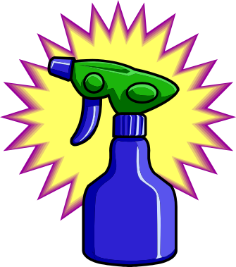
Disinfecting Agents
Only use disinfectants registered with the U.S. Environmental Protection Agency (EPA)
Cleaners and disinfectants should be reviewed for use, dilution, contact time, and shelf life
  Contact time: amount of time needed for the chemical to come in contact with the microorganism so that a significant number of organisms are killed.
Use appropriate disinfectant for situation
  For example: areas contaminated with C. difficile or norovirus may need different cleaners and disinfectants

Slide 33
Classification Chart
Critical items
Semicritical items
Noncritical items
Enter sterile body tissues, sterile body fluids, or vascular system
Contact with mucous membranes or non-intact skin
Contact with intact skin, not mucous membranes
High-level disinfectant
Low-level disinfectant
Sterilization
Notes:
Items such as medical care equipment and/or patient care equipment should be cleaned, disinfected, or sterilized according to three classifications
Critical items are items that enter normally sterile tissue or the vascular system or through which a sterile body fluid (e.g., blood) flows. These items are associated with high risk of infection if they are contaminated with any microorganism and must be sterilized before using. Examples include surgical instruments, cardiac and urinary catheters, and implants.
Semicritical items are items that contact mucous membranes (e.g., eyes, nose, or mouth) or non-intact skin. At a minimum, semicritical items require high-level disinfection using chemical disinfectants and rinsing with sterile water. Examples include respiratory therapy and anesthesia equipment, some endoscopes, cystoscopes, and laryngoscope blades.
Noncritical items are items that have contact with intact skin but not mucous membranes and are associated with little risk of spreading germs. Noncritical items require at least low-level disinfection. Noncritical resident care items include bedpans, blood pressure cuffs, blood glucometers, crutches, and computers. Noncritical environmental surfaces include bed rails, tray tables, bedside tables, walls, floors, toilets, sinks, and furniture.

Slide 34


Preparing a Bleach Solution
1:10 Dilution
  1 part bleach to 9 parts water
  1 ½ cups bleach in 1 gallon water
1:100 Dilution
  1 part bleach to 99 parts water
  1/4 cup bleach in 1 gallon water

Slide 35
Environmental Cleaning: Measuring Compliance
Environmental Checklist
Location/Unit:__________________ Date:__________ Person Monitoring: _______________
Cleaning Tasks (*= high touch areas frequently contaminated) | Cleaned | Not cleaned | Not Applicable
Patient Rooms and Shared Areas - use appropriate disinfectant
Bed - thoroughly during terminal cleaning and allow to dry completely
Bedside commode and its its cleaning brush*
Call box / button and controls*
Door, handles, and bed rails*
Floor - sweep, use wet mop starting farthest from door
IV pole - grab area*
Light switches*
Medical equipment - per facility policy and manufacturer instructions
Phone*
Remote control*
Room furniture - bed, chairs, sofa, table, etc.*
Bathroom - all surfaces with appropriate disinfectant
Door handles, bathroom handrails, and light switches*
Floor: sweep, use wet mop starting farthest from door
Mirrors
Shower stall / bathtub
Sink and faucet handles*
Toilet including surface, seat, lever / flush*
Medication Room
Area secure and clean without items stored on the floor
Medications clearly identified, dated, discarded after expiration date
Refrigerator: no food, clean, temperature between 36-46°F
Laundry
Appropriate personal protective equipment worn by laundry personnel
Clean and soiled laundry separated appropriately
Clean and soiled linen covered while stored and transported
Wash temperature appropriate
Replace As Needed
Curtains - if soiled
Hand sanitizer
Sharps containers - replace if 1/2 to 3/4 full and properly dispose
Other personal protective equipment (gloves, gowns, face masks, etc.)
Paper towels
Red bag waste - close, transport, and dispose appropriately
Soap
Waste basket - close bag before removing; clean and disinfect if soiled
° Use proper personal protective equipment depending on chemicals used and isolation precautions. ° Use Environmental Protection Agency (EPA) standards and published guidelines to choose chemicals specific to the organism and situation. For example, a 10% sodium hypochlorite disinfectant is recommended for norovirus. ° No food should be eaten/stored in designated laundry, medication, or chemical areas. ° Pay attention to isolation precaution signs and do not remove until terminal cleaning is completed.
Environmental Checklist Cleaning and Disinfection of Blood Spills or Other Potentially Infectious Bodily Fluids
Location/Unit:__________________ Date:__________ Observer: ______________________ Room Number:_________________ (Optional) Person Monitored:_______________
Step | Performed | Not Performed | Not Applicable
Use gloves appropriately
Use other PPE as necessary (may include gown, mask, and/or eye protection)
Collect any sharp materials with dustpan, forceps, or other tools. DO NOT use hands, even when wearing gloves
Discard any sharps in appropriate puncture-resistant container
Apply appropriate disinfectant to all reusable equipment (including used dustpan/forceps) and environmental surfaces Option 1: Use an EPA-registered tuberculocidal agent (EPA lists D and E)* Option 2: Use freshly diluted bleach (sodium hypochlorite) solution**
If the spill involves large amounts of blood or body fluids, clean with disposable absorbent material
Discard any appropriate waste into red biohazard waste bag
* Environmental Protection Agency (EPA) Office of Pesticide Programs List D: EPA's Registered Antimicrobial Products Effective Against Human HIV-1 and Hepatitis B Virus List E: EPA's Registered Antimicrobial Products Effective against Mycobacterium tuberculosis, Human HIV- 1 and Hepatitis B Virus **Use a 1:10-1:100 dilution of 5.25%-6.15% sodium hypochlorite (bleach) for decontaminating blood spills. 1:100 dilution used for small spills of blood (i.e., drops of blood) on noncritical surfaces. 1:10 dilution used for large spills of blood because hypochlorites and other germicides are substantially inactivated in the presence of blood. 1:10 dilution used if a sharps injury is possible. Additional information available in the Healthcare Infection Control Practices Advisory Committee (HICPAC) Guideline for Disinfection and Sterilization in Healthcare Facilities, 2008.
IMPORTANT: If you believe you have been exposed to any blood or other potentially infectious body fluids (e.g., skin puncture or splash to eyes/mucous membranes), wash the area properly and seek follow-up medical attention by contacting your supervisor.
Notes:
Two examples showing how to measure compliance with environmental cleaning practices are shown here. The picture on the left is a tool to monitor how spills of blood or other potentially infectious bodily fluids are cleaned and disinfected. The checklist on the right is a tool used to log if “high touch” areas in the patient’s room or on the unit are cleaned appropriately. These tools are available as spreadsheets on the VDH HAI website.

Slide 36
Vaccinations
A vaccine is a preparation that improves immunity to a particular disease.
  Examples: influenza, tetanus, or pneumonia
The vaccine typically contains an agent that resembles a disease-causing microorganism.
The vaccine stimulates the body’s immune response to recognize the foreign invader, destroy it, and "remember" it, so that the immune system can more easily recognize and destroy any of these microorganisms that may be encountered later.

Slide 37
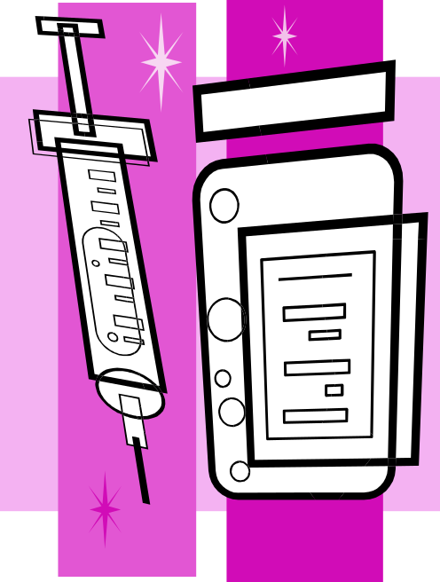
Why Vaccinate?
Vaccines can help prevent some diseases
  Save costs (resource reallocation)
    Lost time from work
    Treatment expenses
  Save lives
Long-term protection in the individual
Help prevent outbreaks from occurring
Notes:
Other benefits:
May assist herd immunity
May lead to the elimination of diseases (example smallpox)

Slide 38
Vaccination Recommendations
May vary based on underlying medical conditions, occupation, and age
  Special vaccination recommendations apply to healthcare personnel to protect themselves and their patients against disease
Even if you were vaccinated as a child, you may need to get vaccinated as an adult for certain diseases
  For example, it is recommended that you get a vaccination for influenza every year
Recommendations are updated and published every year
CDC website for immunization schedules: http://www.cdc.gov/vaccines/schedules/index.html
Notes:
Familiarize yourself with the adult vaccination schedule recommendations and procedures for administration.
Vaccine recommendations change every year.
Learn about the different vaccines recommended for care providers in your setting

Slide 39
Successful Vaccination Strategies
Stress benefits of vaccination.
Allay fears and misconceptions.
  Vaccines are safe!
  Can’t “catch” the disease from the vaccine
  Minimal side effects
  Benefits outweigh the risks
Find creative ways to increase staff influenza vaccination rates.
Notes:
Maintain your own individual vaccination record
Understand the associated side effects with each vaccine

Slide 40
Staff Members and Illness
Staff sick leave policies should allow and encourage those who are ill to stay home
  Consistent with public health guidance
  Non-punitive and as flexible as possible
Keep track of illness in staff via surveillance logs
After returning to work, remind staff to practice good hand hygiene and respiratory etiquette

Slide 41
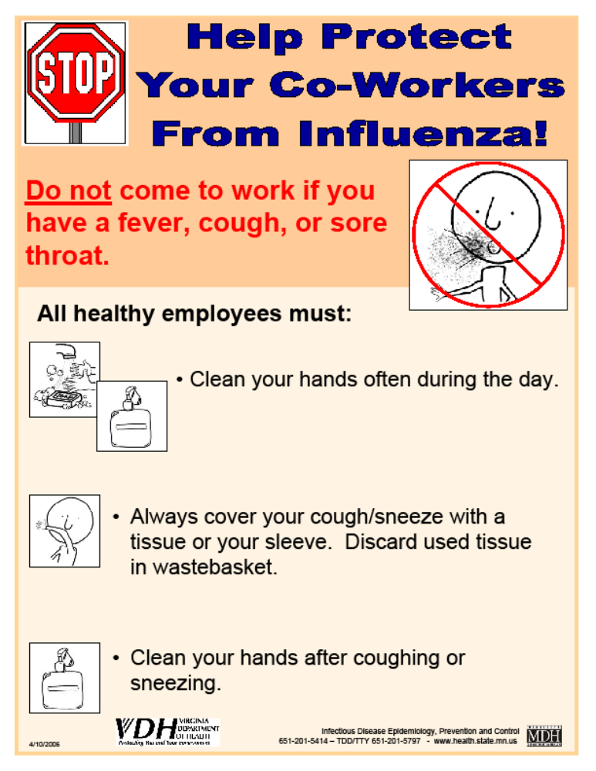

Slide 42
Staff Members and Illness
If sick with a communicable disease or skin lesion, do not report to work.
  Remain home for at least 24 hours after symptoms resolve, without the use of medicines that treat the symptoms.
  If you have a skin lesion or weeping dermatitis above the elbow or below the collarbone, you are able to continue to work provided the affected area is bandaged and the drainage is contained.
  Other communicable diseases may have different work restrictions or recommended lengths of exclusion from work. Your facility should consult with the local health department as necessary to prevent the spread of infection.
If at work, stop patient care and/or food service activities, promptly notify your supervisor, and leave work as soon as possible.
Notes:
Staff members with symptoms of a communicable disease, such as a fever, cough, or diarrhea, should be excluded from work until at least 24 hours after symptoms resolve, without the use of medicines that treat the symptoms.

Slide 43

Education is Prevention!
Share information and strategies with staff
  Upon hire
  Annually
  As needed
Use effective teaching tools
  Address the adult learning principles
  Engage, involve, interact
    Case studies Group discussion
    Group exercises Applied practice
    Role playing Interviews
  Use assessments before and after training to see if training was successful

Slide 44
Thank you!
VDH Healthcare-Associated Infection Program
Main line: 804-864-8141

