Slide 1
Pre-Algebra

Slide 2
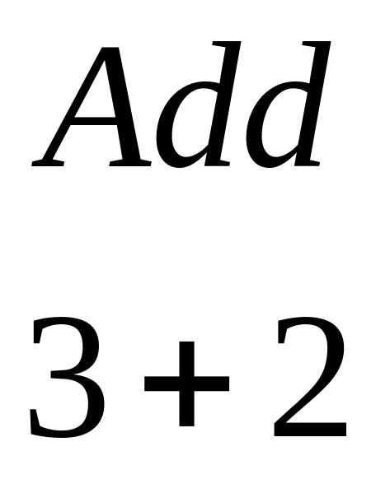
Practice

Slide 3
Practice Answer
5

Slide 4
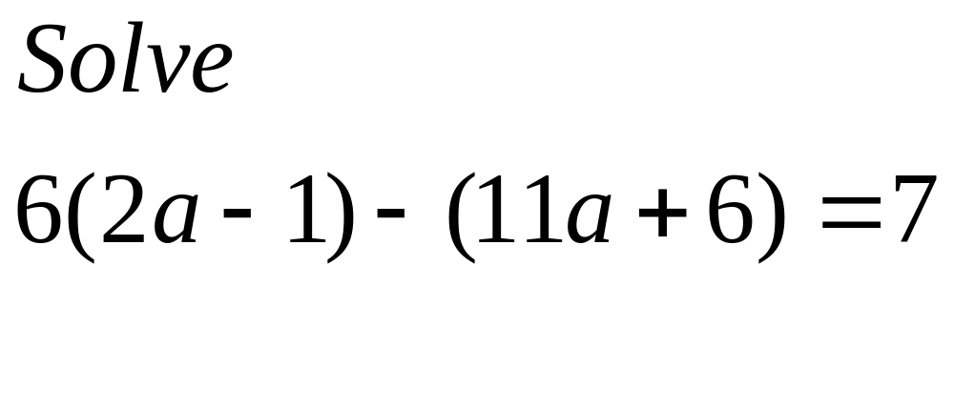
Question 1.1

Slide 5
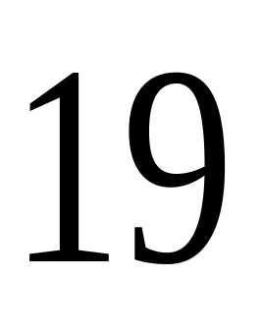
Answer 1.1

Slide 6
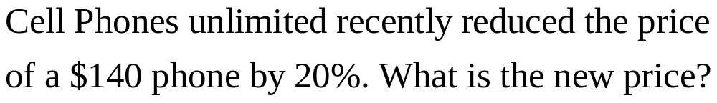
Question 1.2

Slide 7
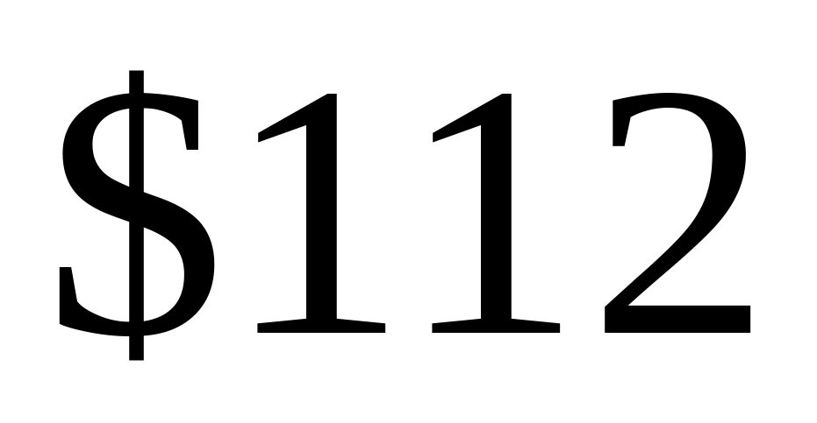
Question 1.2 Answer

Slide 8
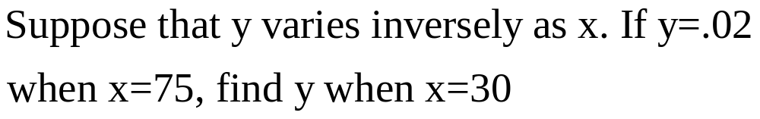
Question 1.3

Slide 9
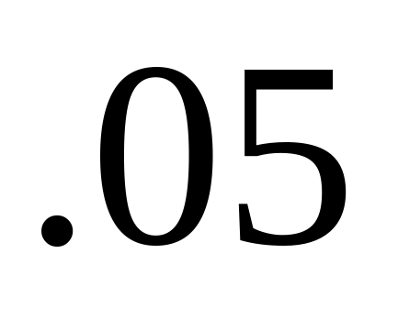
Question 1.3 Answer

Slide 10
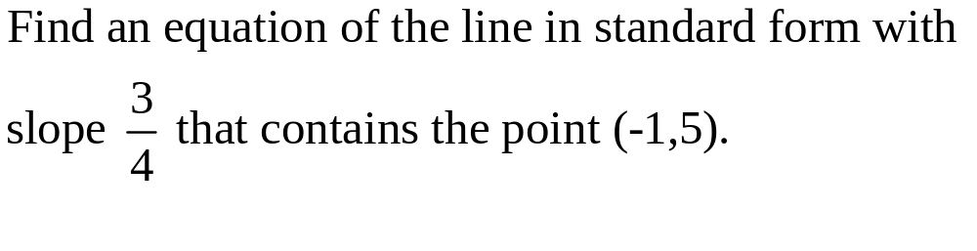
Question 1.4

Slide 11
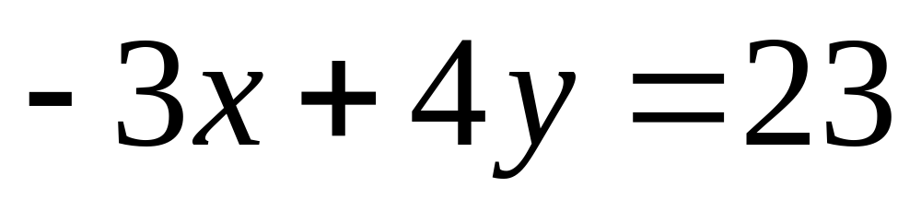
Question 1.4 Answer

Slide 12
Round 2

Slide 13
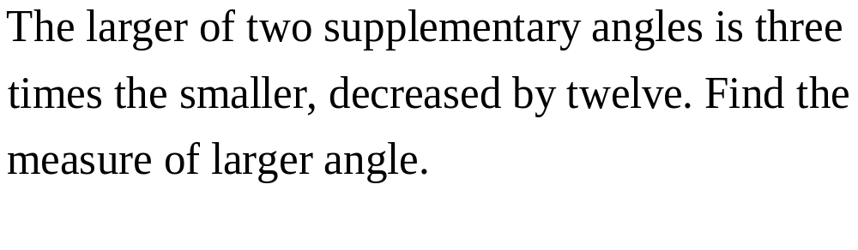
Question 2.1

Slide 14
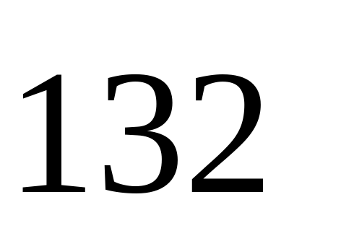
Question 2.1 Answer

Slide 15
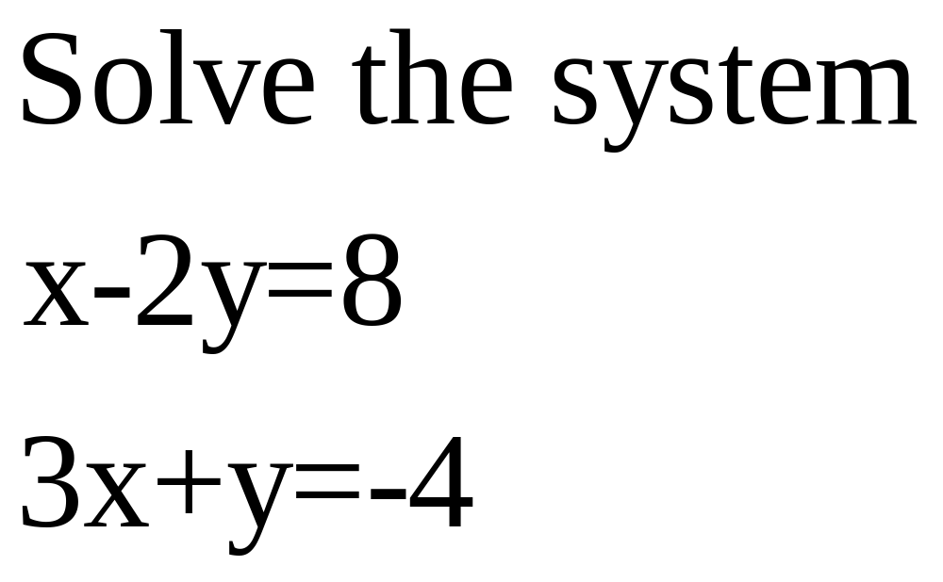
Question 2.2

Slide 16
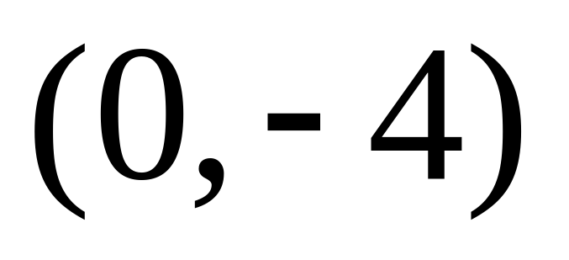
Question 2.2 Answer

Slide 17
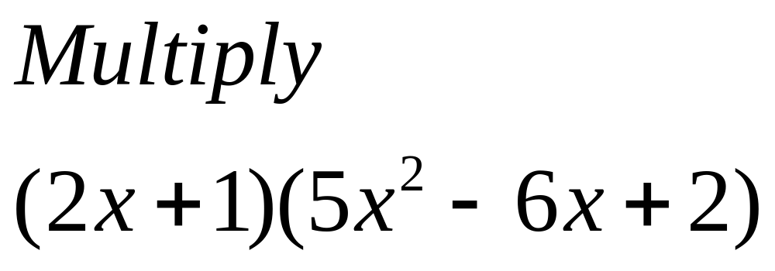
Question 2.3

Slide 18
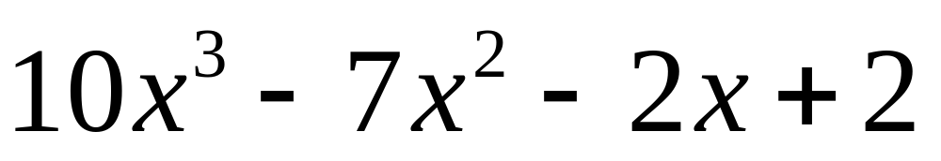
Question 2.3 Answer

Slide 19
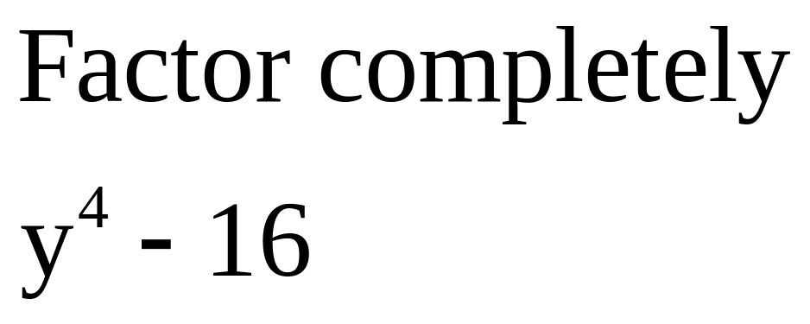
Question 2.4

Slide 20
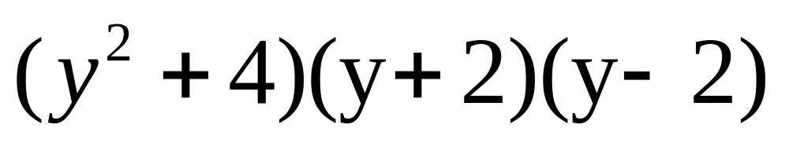
Question 2.4 Answer

Slide 21
Round 3

Slide 22
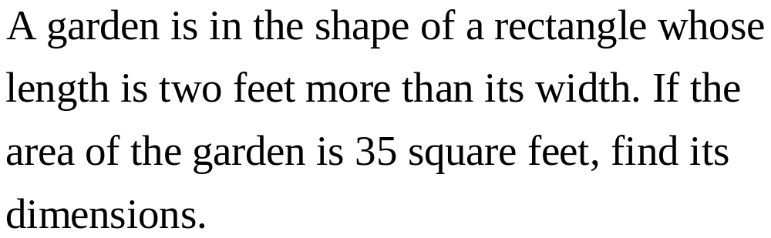
Question 3.1

Slide 23
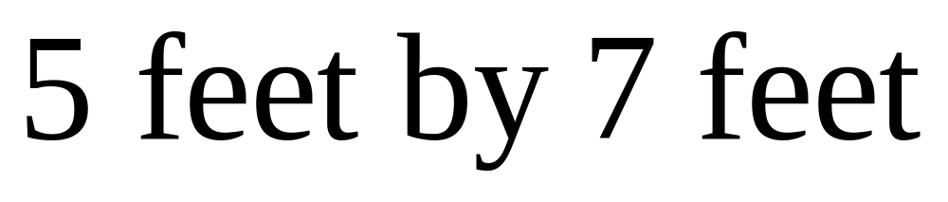
Question 3.1 Answer

Slide 24
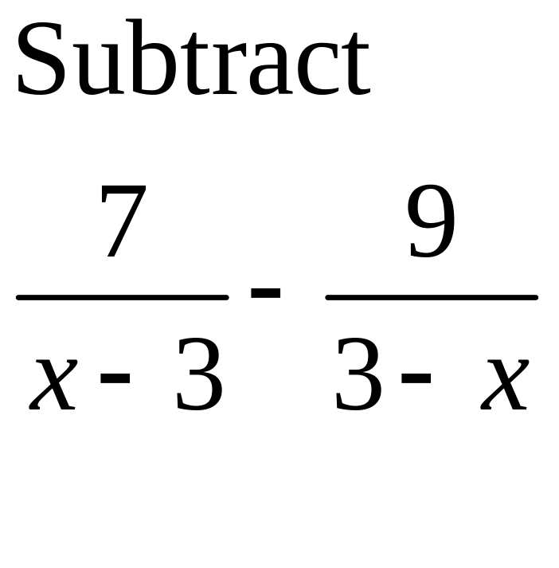
Question 3.2

Slide 25
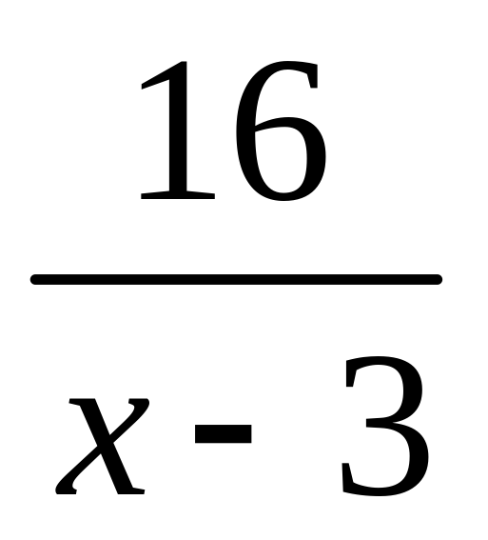
Question 3.2 Answer

Slide 26
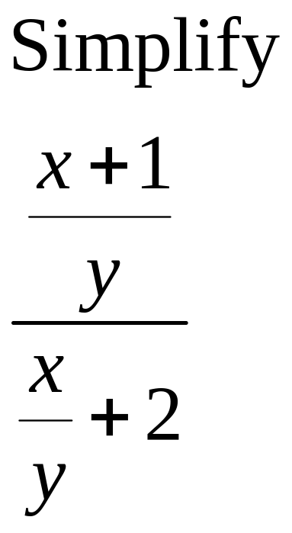
Question 3.3

Slide 27
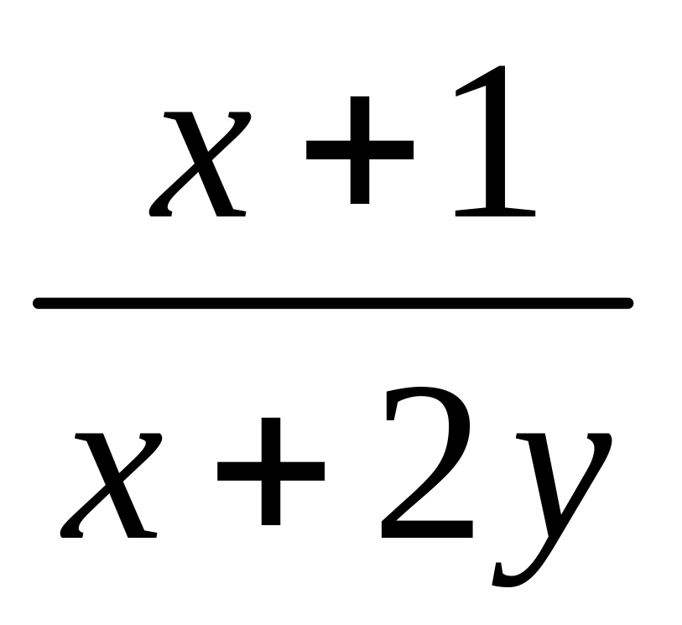
Question 3.3 Answer

Slide 28
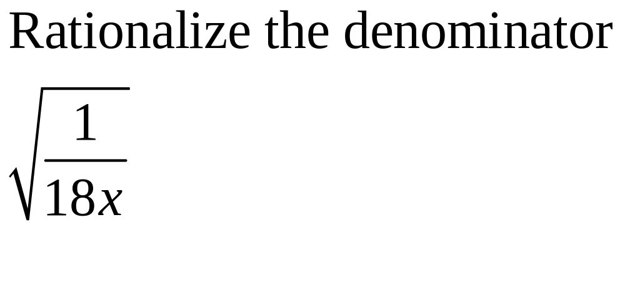
Question 3.4

Slide 29
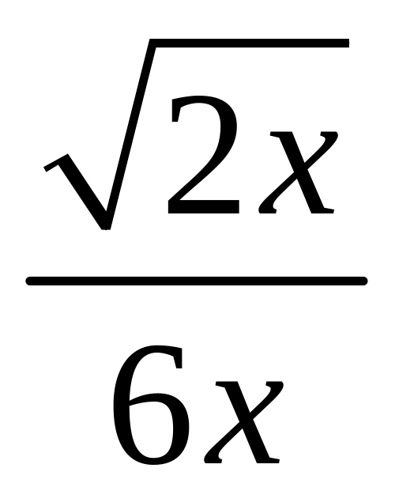
Question 3.4 Answer

Slide 30
Round 4

Slide 31
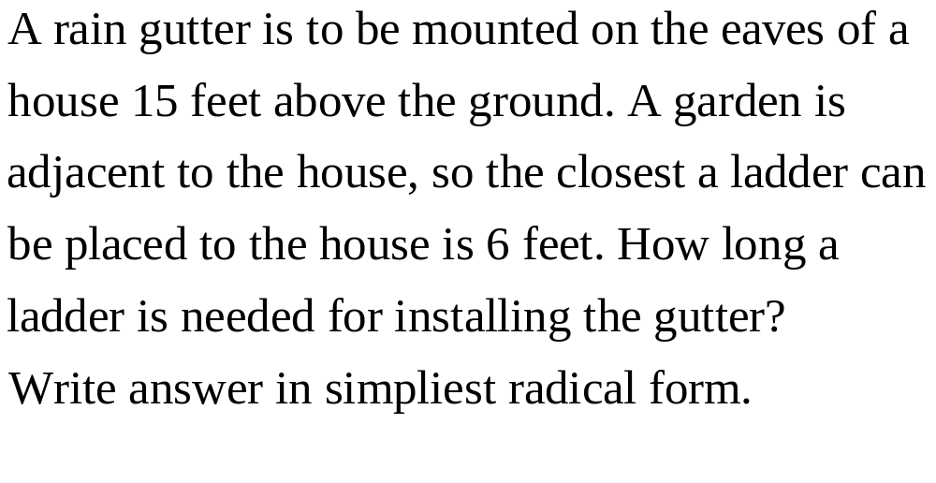
Question 4.1

Slide 32
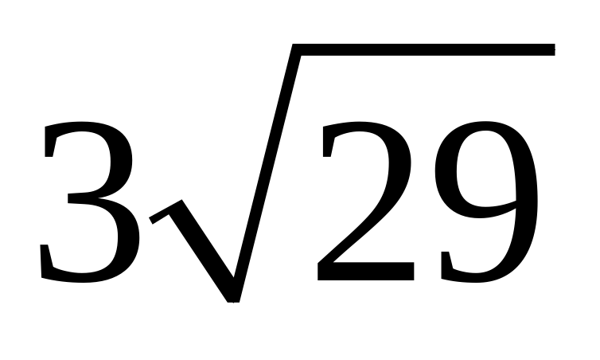
Question 4.1 Answer

Slide 33
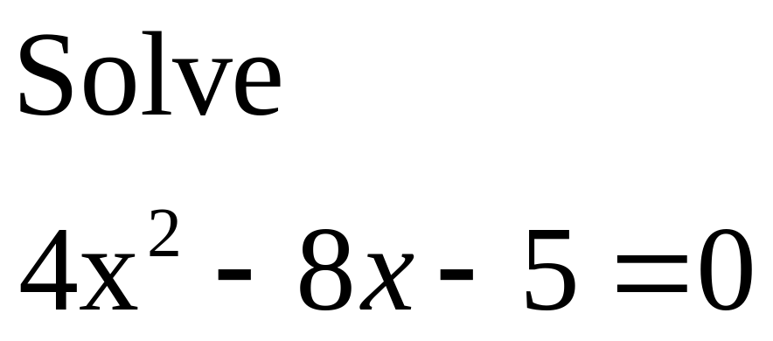
Question 4.2

Slide 34
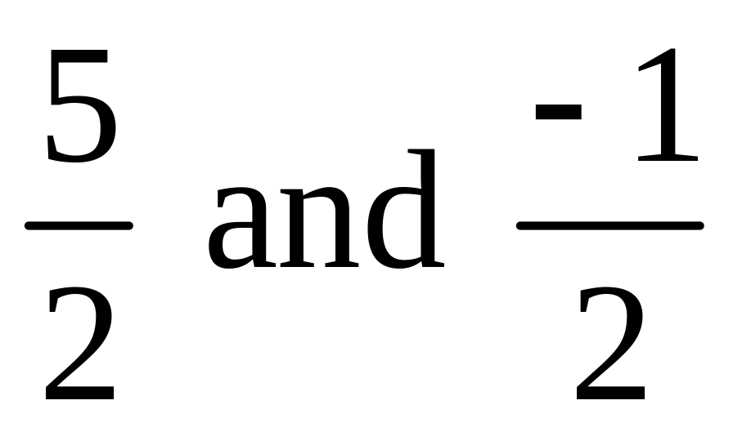
Question 4.2 Answer

Slide 35
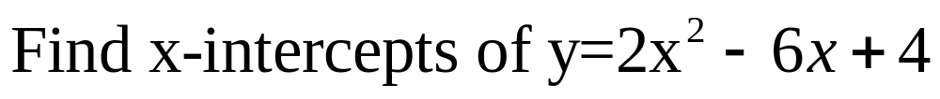
Question 4.3

Slide 36
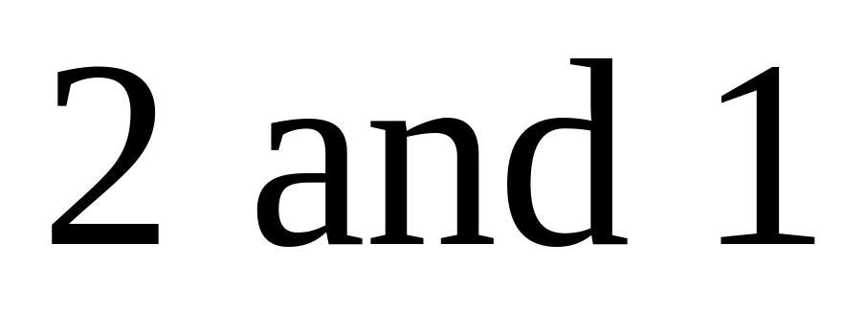
Question 4.3 Answer

Slide 37
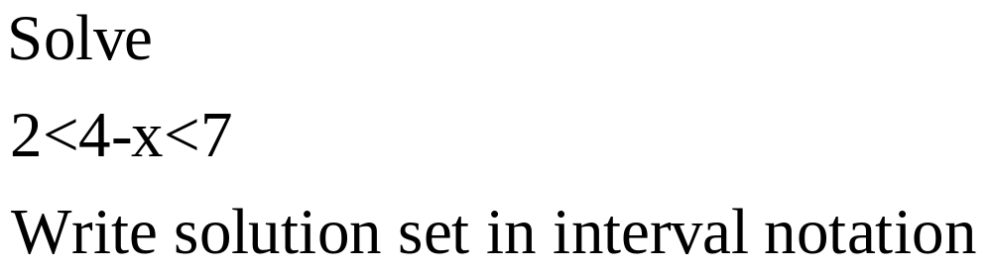
Question 4.4

Slide 38
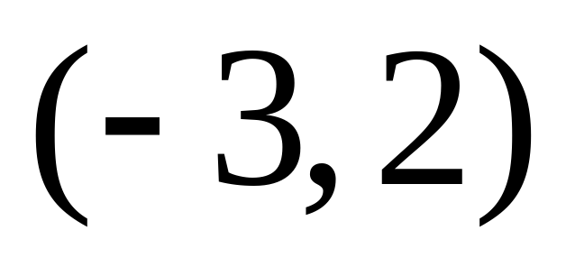
Question 4.4 Answer

Slide 39
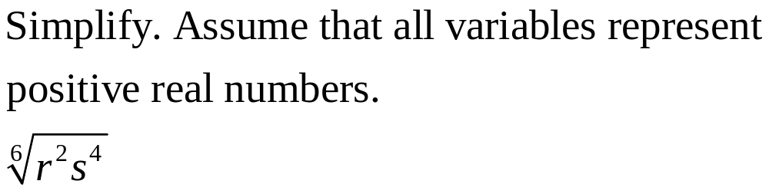
Extra 1

Slide 40
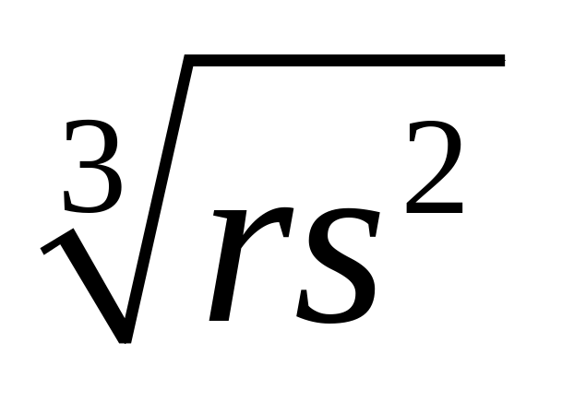
Extra 1 Answer

Slide 41
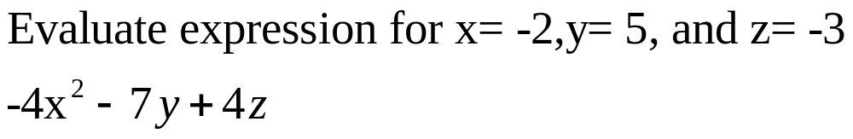
Extra 2

Slide 42
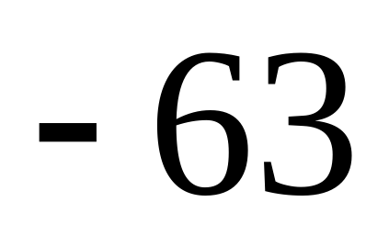
Extra 2 Answer

