Slide 1
6th Grade

Slide 2
Practice

Slide 3
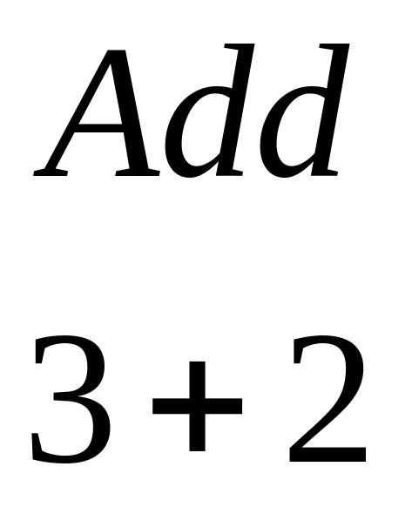
Practice

Slide 4
Practice Answer
5

Slide 5
Question 1.1

Slide 6
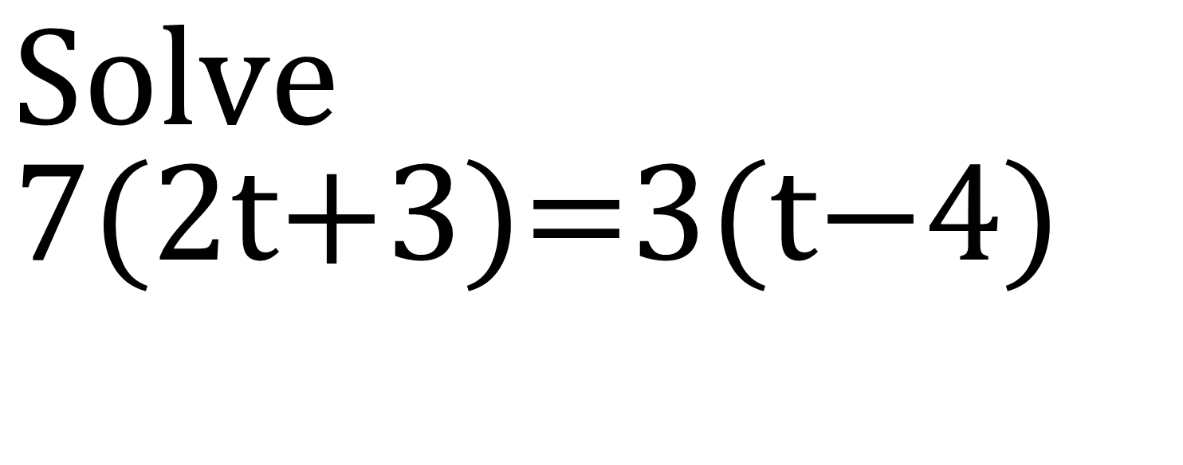
Question 1.1
$$\text{Solve} \\ 7(\text{2}\text{t}\text{+3})\text{=3}(\text{t}\text{−4})$$

Slide 7
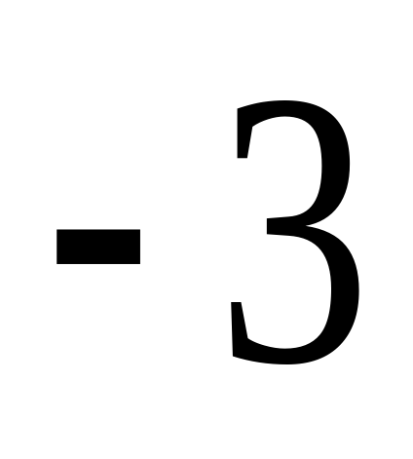
Answer 1.1

Slide 8
Question 1.2

Slide 9
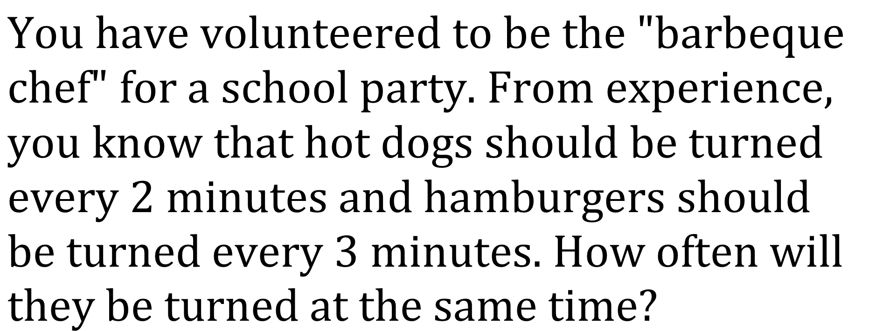
Question 1.2
$$\text{You} \text{have} \text{volunteered} \text{to} \text{be} \text{the}\text{ "}\text{barbeque} \text{chef}\text{" }\text{for} \text{a} \text{school} \text{party}\text{. }\text{From} \text{experience}\text{, }\text{you} \text{know} \text{that} \text{hot} \text{dogs} \text{should} \text{be} \text{turned} \text{every}\text{ 2 }\text{minutes} \text{and} \text{hamburgers} \text{should} \text{be} \text{turned} \text{every}\text{ 3 }\text{minutes}\text{. }\text{How} \text{often} \text{will} \text{they} \text{be} \text{turned} \text{at} \text{the} \text{same} \text{time}\text{?}$$

Slide 10
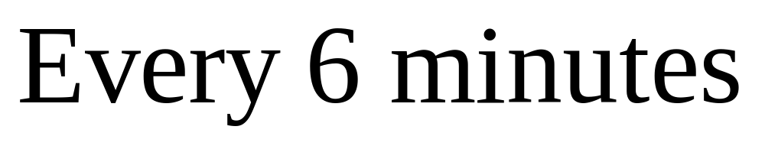
Question 1.2 Answer

Slide 11
Question 1.3

Slide 12
Question 1.3

Slide 13
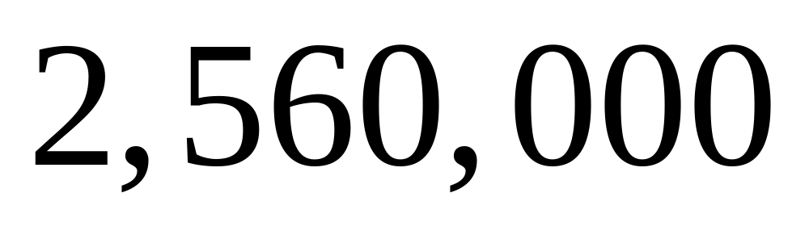
Question 1.3 Answer

Slide 14
Question 1.4

Slide 15
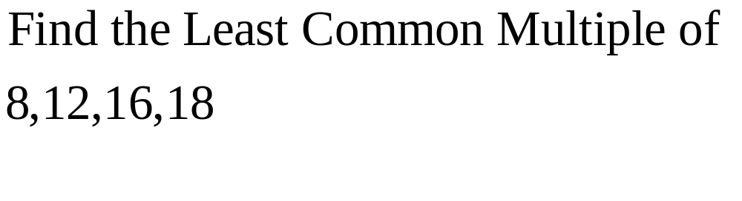
Question 1.4

Slide 16
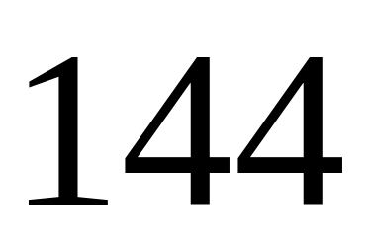
Question 1.4 Answer

Slide 17
Question 1.5

Slide 18
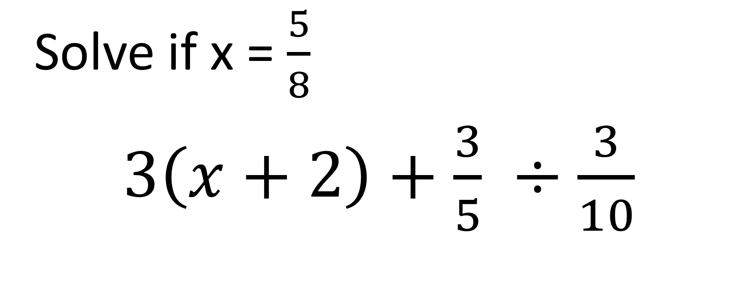
Question 1.5
Solve if x = $\frac{5}{8}$
$3\left(x+2\right)+\frac{3}{5} ÷\frac{3}{10}$

Slide 19
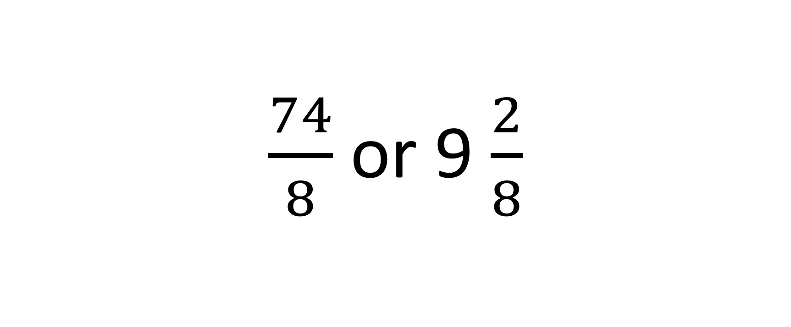
Question 1.5 Answer
$\frac{74}{8}$ or 9 $\frac{2}{8}$

Slide 20
Round 2

Slide 21
Question 2.1

Slide 22
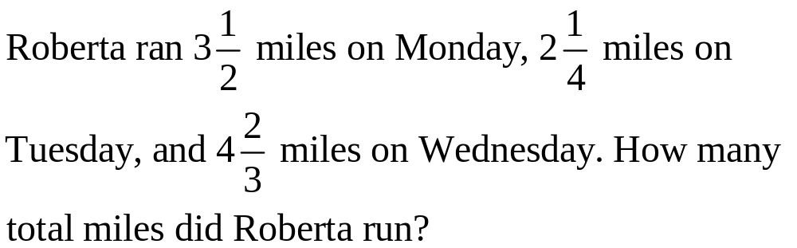
Question 2.1

Slide 23
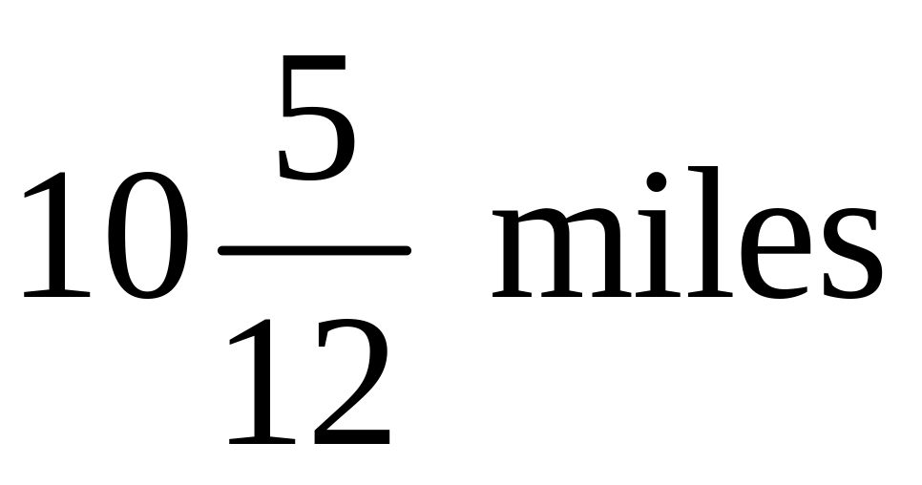
Question 2.1 Answer

Slide 24
Question 2.2

Slide 25
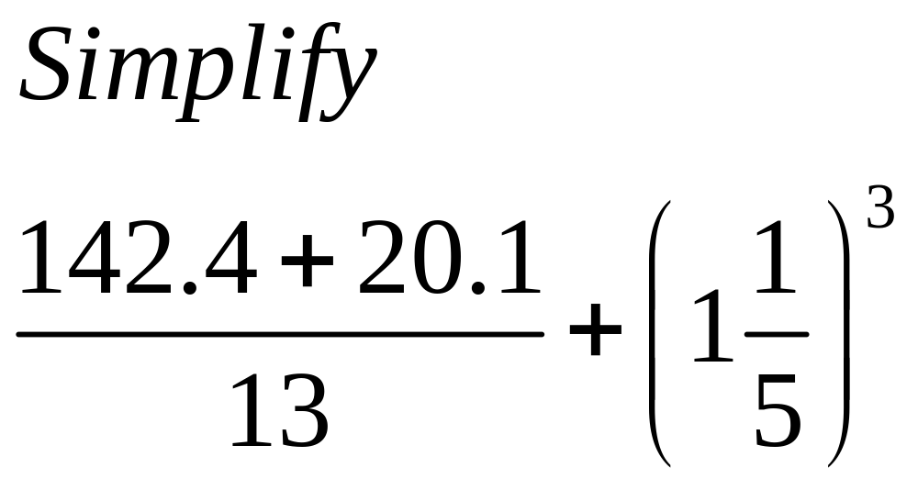
Question 2.2

Slide 26
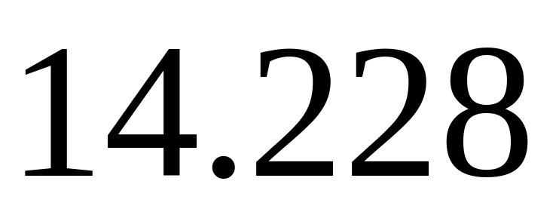
Question 2.2 Answer

Slide 27
Question 2.3

Slide 28
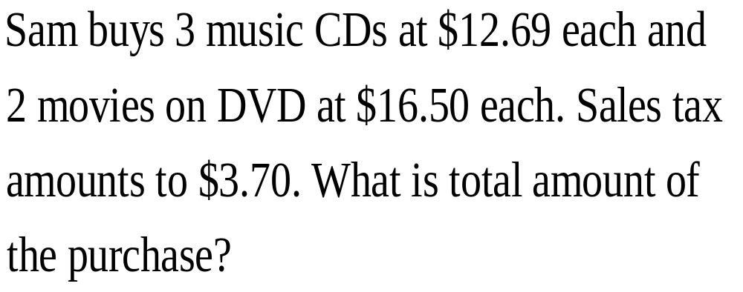
Question 2.3

Slide 29
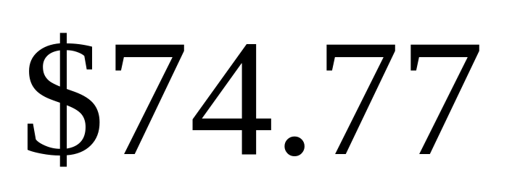
Question 2.3 Answer

Slide 30
Question 2.4

Slide 31
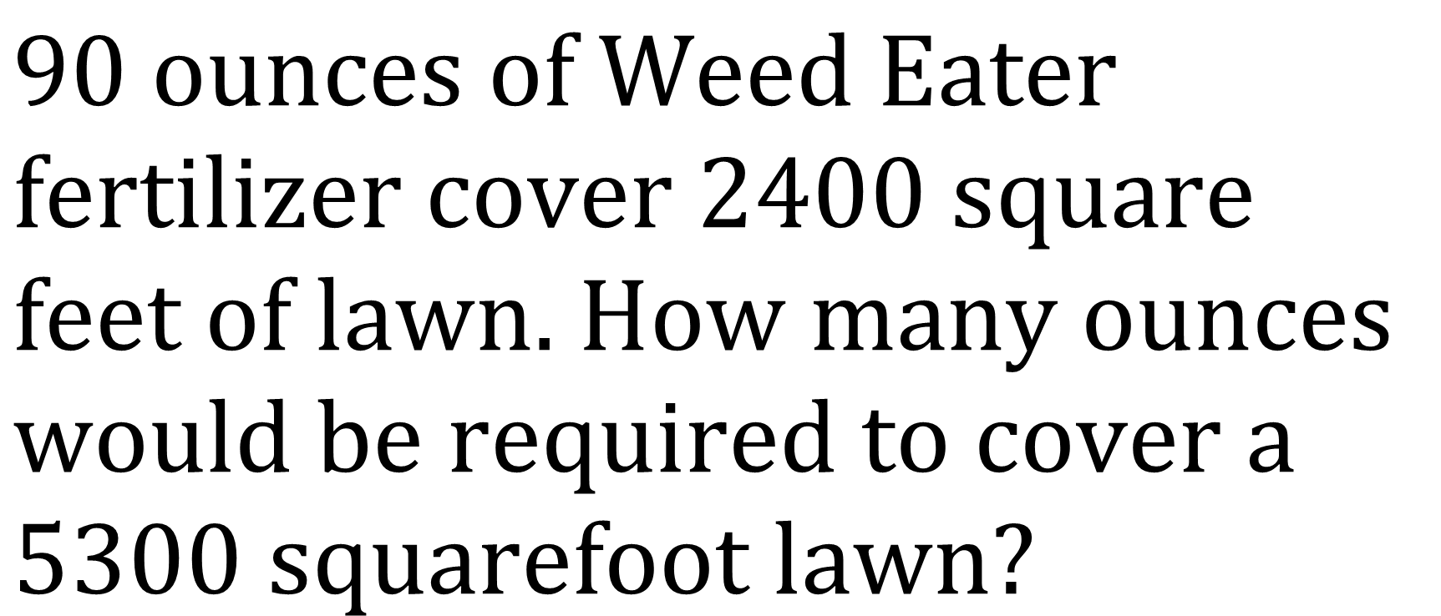
Question 2.4
$$90 \text{ounces} \text{of} \text{Weed} \text{Eater} \text{fertilizer} \text{cover}\text{ 2400 }\text{square} \text{feet} \text{of} \text{lawn}\text{. }\text{How} \text{many} \text{ounces} \text{would} \text{be} \text{required} \text{to} \text{cover} \text{a}\text{ 5300 }\text{squarefoot} \text{lawn}\text{?}$$

Slide 32
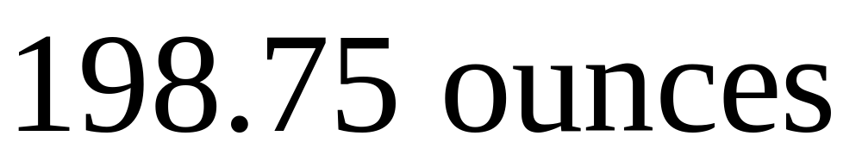
Question 2.4 Answer

Slide 33
Question 2.5

Slide 34
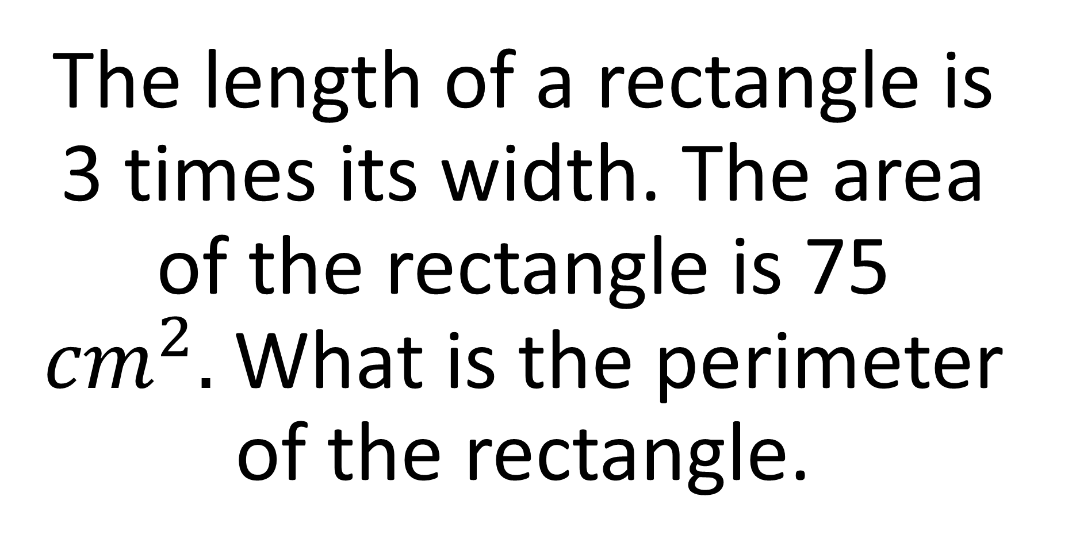
Question 2.5
The length of a rectangle is 3 times its width. The area of the rectangle is 75 ${cm}^{2}.$What is the perimeter of the rectangle.

Slide 35
Question 2.5 Answer
40 cm

Slide 36
Round 3

Slide 37
Question 3.1

Slide 38
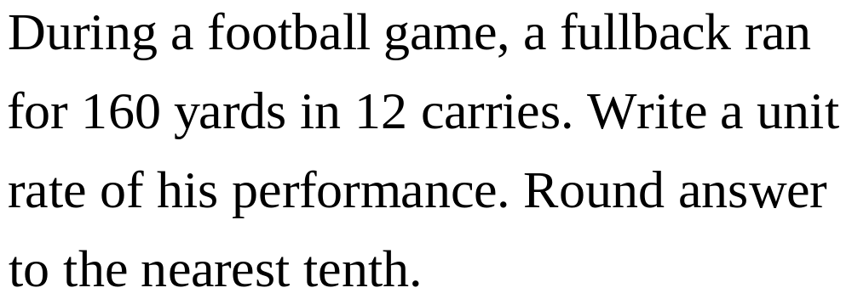
Question 3.1

Slide 39
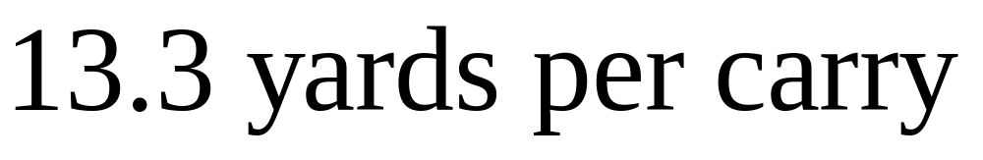
Question 3.1 Answer

Slide 40
Question 3.2

Slide 41
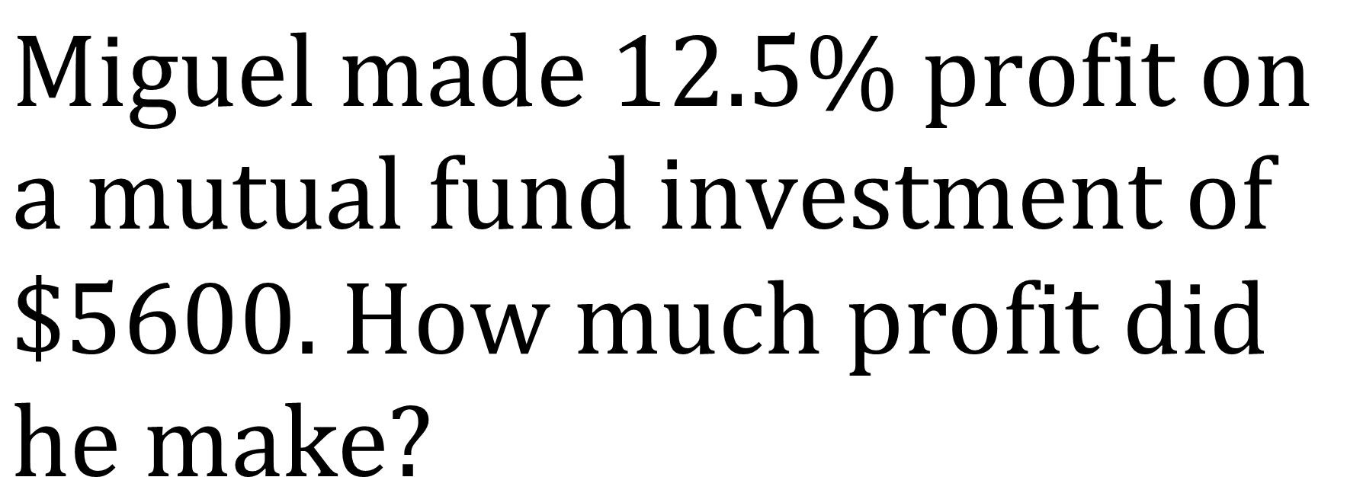
Question 3.2
$$\text{Miguel} \text{made}\text{ 12.5\% }\text{profit} \text{on} \text{a} \text{mutual} \text{fund} \text{investment} \text{of}\text{ \$5600. }\text{How} \text{much} \text{profit} \text{did} \\ \text{he} \text{make}\text{?}$$

Slide 42
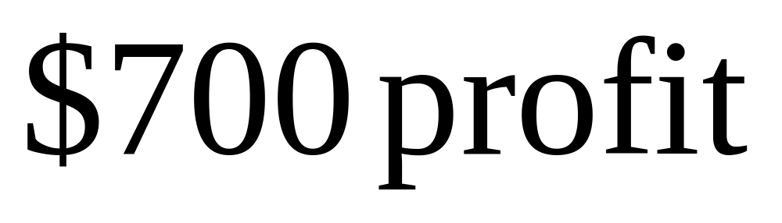
Question 3.2 Answer

Slide 43
Question 3.3

Slide 44
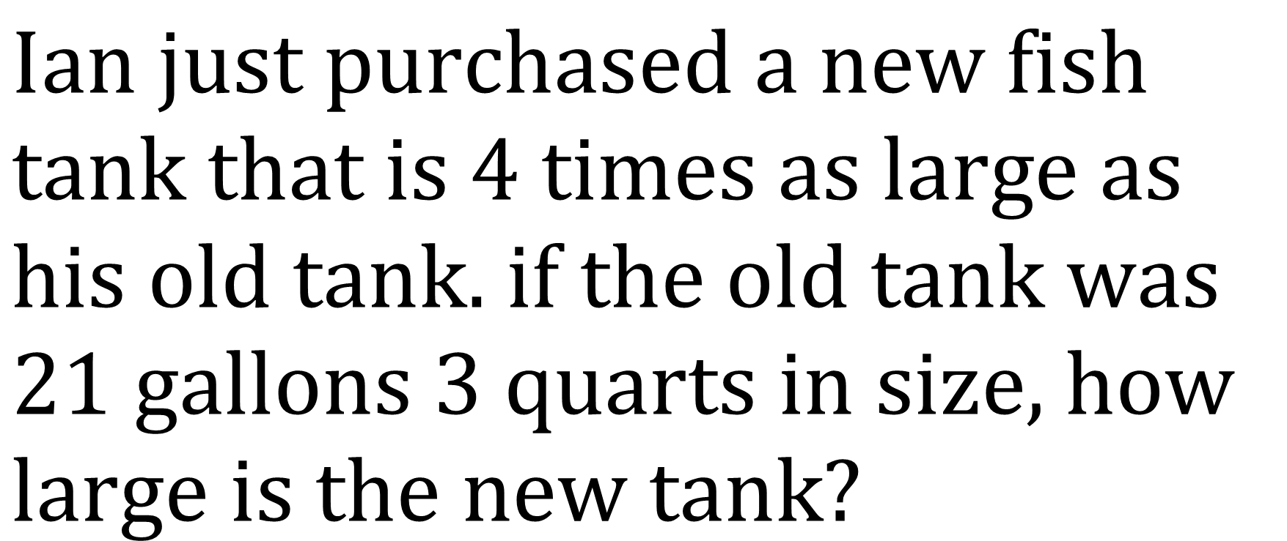
Question 3.3
$$\text{Ian} \text{just} \text{purchased} \text{a} \text{new} \text{fish} \text{tank} \text{that} \text{is}\text{ 4 }\text{times} \text{as} \text{large} \text{as} \text{his} \text{old} \text{tank}\text{. }\text{if} \text{the} \text{old} \text{tank} \text{was}\text{ 21 }\text{gallons}\text{ 3 }\text{quarts} \text{in} \text{size}\text{, }\text{how} \text{large} \text{is} \text{the} \text{new} \text{tank}\text{?}$$

Slide 45
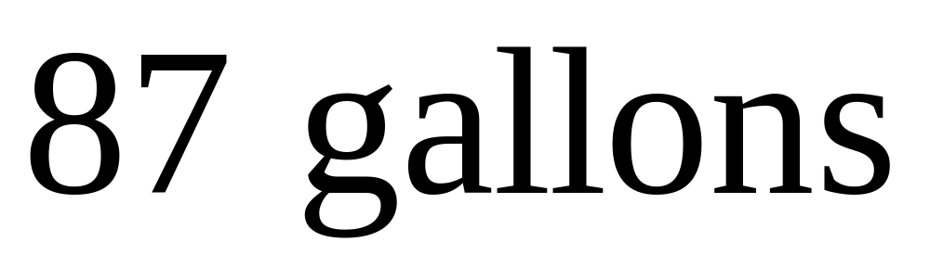
Question 3.3 Answer

Slide 46
Question 3.4

Slide 47
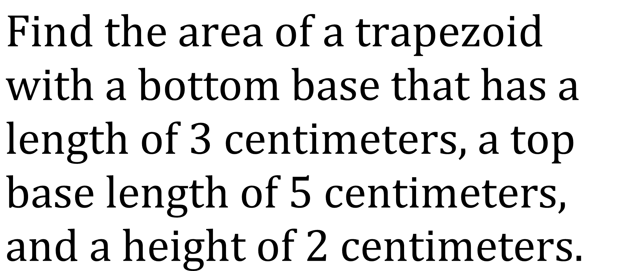
Question 3.4
$$\text{Find} \text{the} \text{area} \text{of} \text{a} \text{trapezoid} \text{with} \text{a} \text{bottom} \text{base} \text{that} \text{has} \text{a} \text{length} \text{of}\text{ 3 }\text{centimeters}\text{, }\text{a} \text{top} \text{base} \text{length} \text{of}\text{ 5 }\text{centimeters}\text{, }\text{and} \text{a} \text{height} \text{of}\text{ 2 }\text{centimeters}\text{.}$$

Slide 48
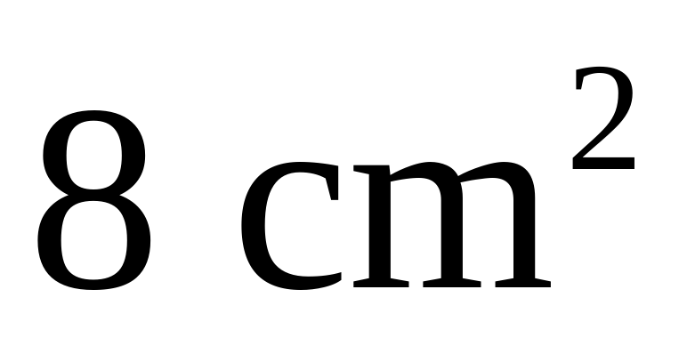
Question 3.4 Answer

Slide 49
Question 3.5

Slide 50
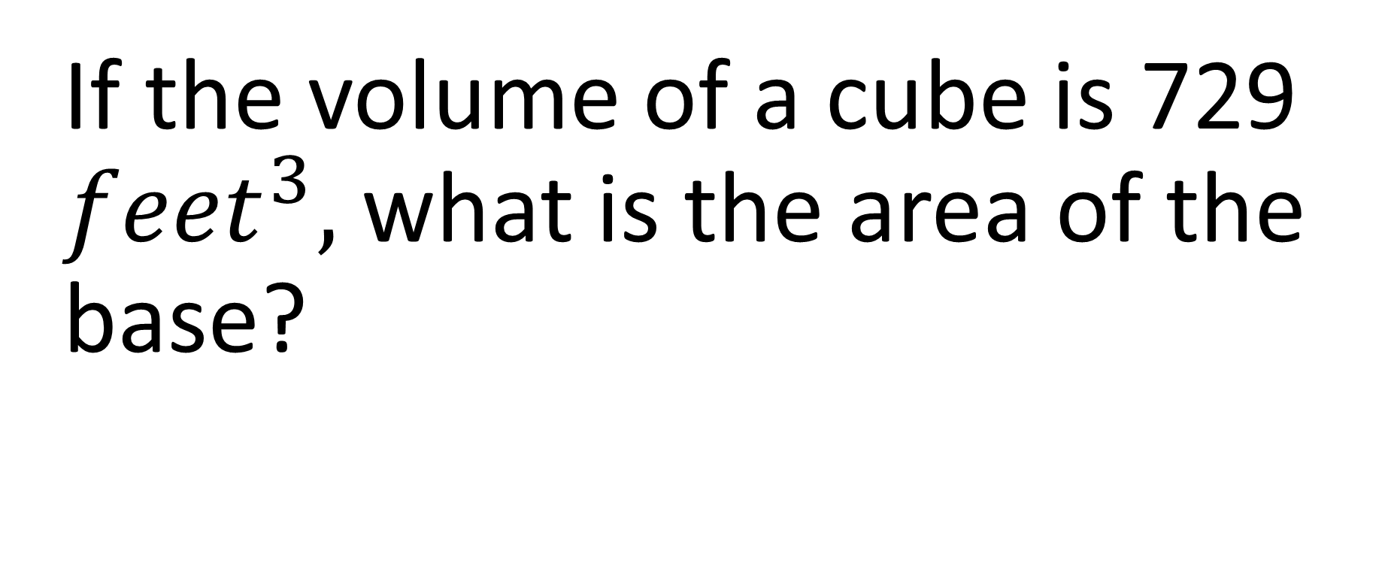
Question 3.5
If the volume of a cube is 729 ${feet}^{3},$ what is the area of the base?

Slide 51
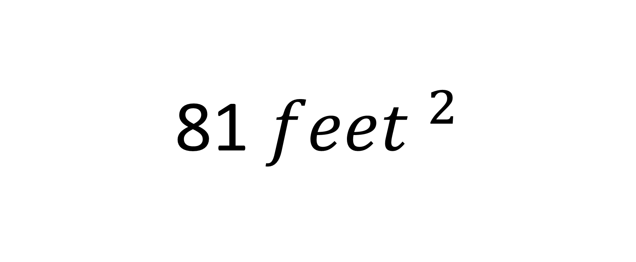
Question 3.5 Answer
81 ${feet }^{2}$

Slide 52
Round 4

Slide 53
Question 4.1

Slide 54
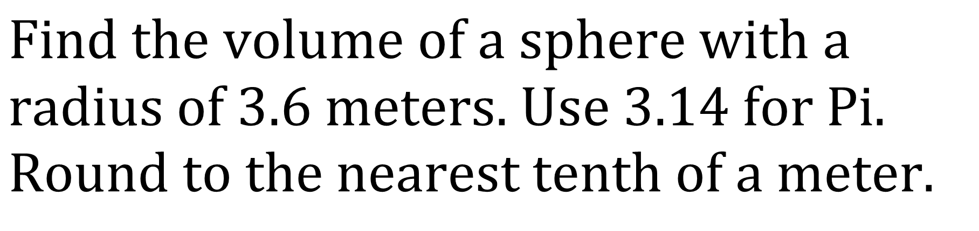
Question 4.1
$$\text{Find} \text{the} \text{volume} \text{of} \text{a} \text{sphere} \text{with} \text{a} \text{radius} \text{of}\text{ 3.6 }\text{meters}\text{. }\text{Use}\text{ 3.14 }\text{for} \text{Pi}\text{. }\text{Round} \text{to} \text{the} \text{nearest} \text{tenth} \text{of} \text{a} \text{meter}\text{.}$$

Slide 55
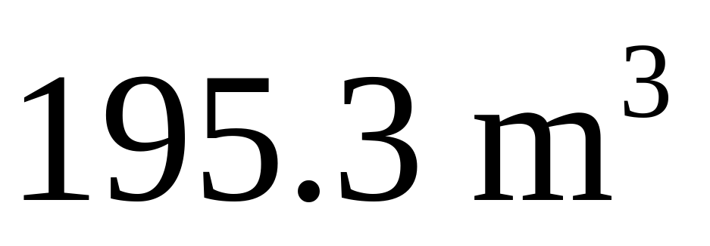
Question 4.1 Answer

Slide 56
Question 4.2

Slide 57
Question 4.2

Slide 58
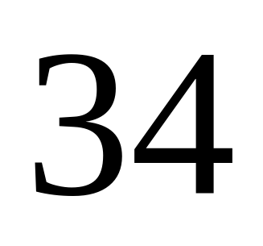
Question 4.2 Answer

Slide 59
Question 4.3

Slide 60
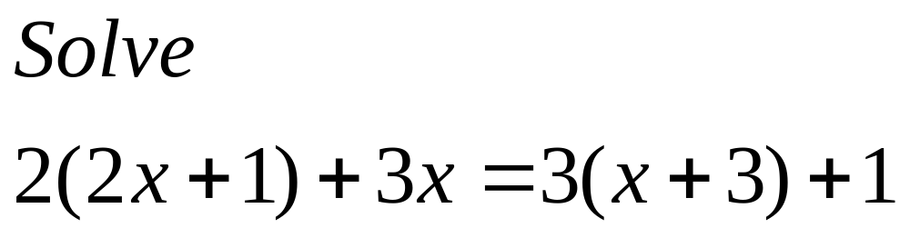
Question 4.3

Slide 61
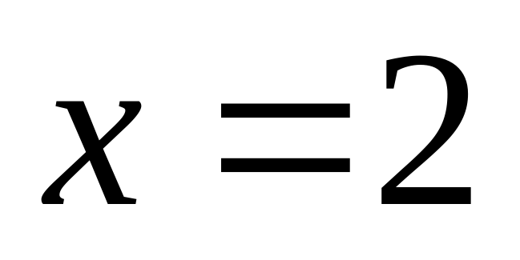
Question 4.3 Answer

Slide 62
Question 4.4

Slide 63
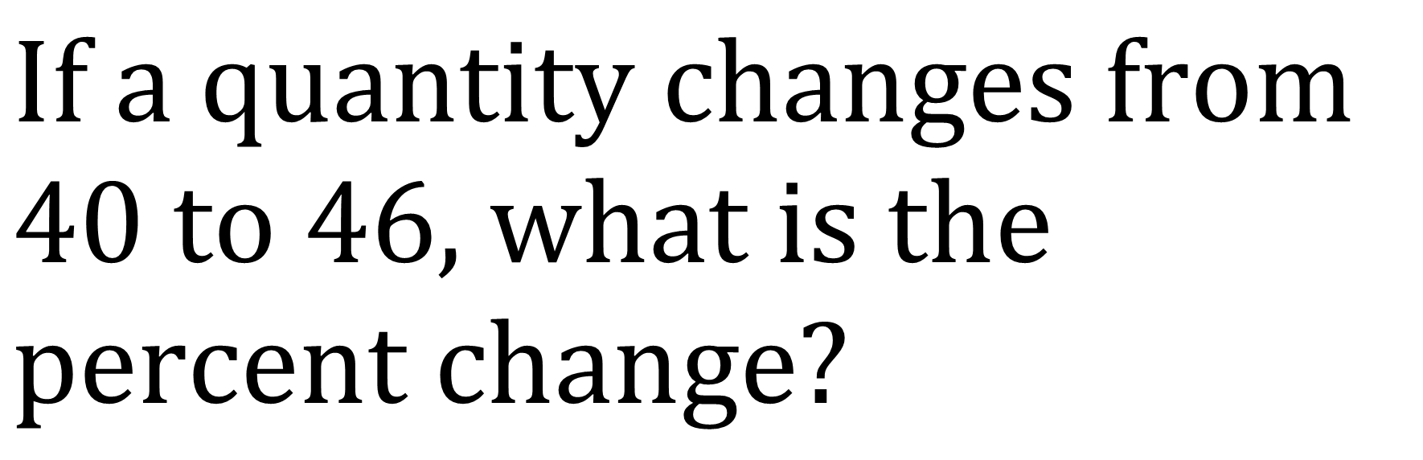
Question 4.4
$$\text{If} \text{a} \text{quantity} \text{changes} \text{from}\text{ 40 }\text{to}\text{ 46, }\text{what} \text{is} \text{the} \text{percent} \text{change}\text{?}$$

Slide 64
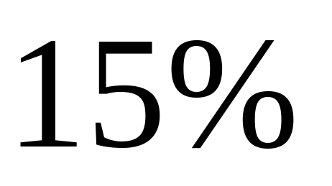
Question 4.4 Answer

Slide 65
Question 4.5

Slide 66
Question 4.5
The coach is choosing players to participate in a fundraiser. There are 23 players on the team. 5 of them are pitchers, 8 are catchers, 7 are infielders and the rest are outfielders. What is the probability that he will choose a pitcher and a catcher to participate?

Slide 67

Question 4.5 Answer
$$\frac{15}{506}$$

Slide 68
Extra 1

Slide 69
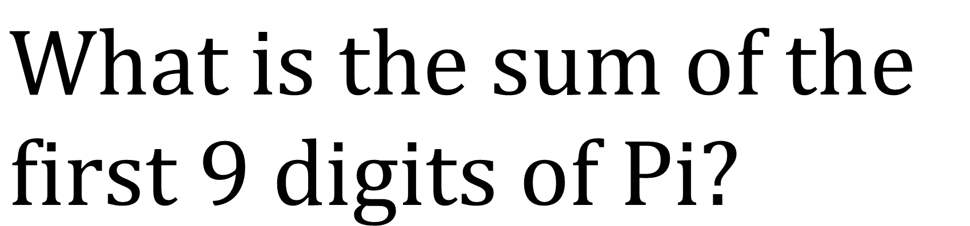
Extra 1
$$\text{What} \text{is} \text{the} \text{sum} \text{of} \text{the} \text{first}\text{ 9 }\text{digits} \text{of} \text{Pi}\text{?}$$

Slide 70
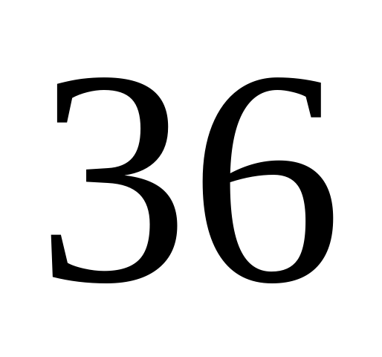
Extra 1 Answer

Slide 71
Extra 2

Slide 72
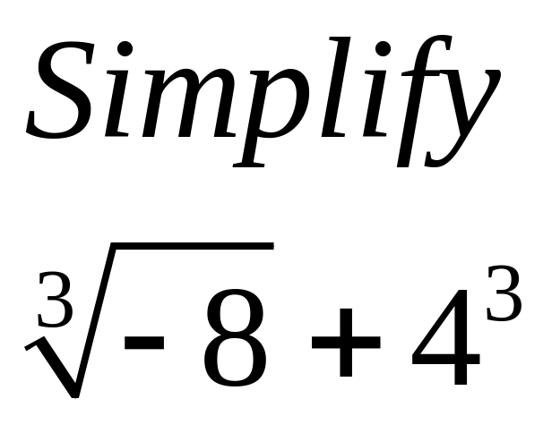
Extra 2

Slide 73
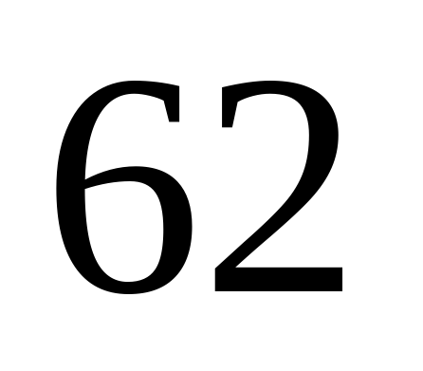
Extra 2 Answer

