Slide 1

AREAS OF SCHOOL OPERATIONS IMPACTED BY TITLE IX
January 22, 2021
Walter | Haverfield

Slide 2

Applicability of Title IX
Applicability of Title IX
Title IX impacts many aspects of school district operations
  Not limited to athletics (although this is the context in which most people think of the regulations)
Also has applicability to:
  Recruitment, admissions and counseling
  Funding (including booster groups)
  Athletics and extra-curricular activities
  Pregnant and parenting students
  Discipline

Slide 3

Recruitment, Admissions and Counseling
Recruitment, Admissions and Counseling
School districts must be on the lookout for issues related to:
  vocational schools
  STEM schools
  open enrollment
  assignment of guidance counselors
  content of counseling (schools, career options)

Slide 4
Funding
Funding
School districts are responsible to ensure
  “that benefits, services, treatment and opportunities overall, regardless of funding sources, are equivalent for male and female athletes.”
This is true even if the funds are raised by the student-athletes themselves or by a booster club and then “donated” to the school district.
“Equivalent” does not mean “identical” per Regulations and OCR Policy Interpretation. Comparable standard.

Slide 5

Funding from Booster Groups
Booster group donations may result in Title IX liability for a district if the funds are not equally distributed among boys’ and girls’ teams
Booster groups often generate and designate money for a specific sport, which leads to an imbalance among sexes
It is the responsibility of the BOE to correct any imbalance, which may entail allocating its own resources

Slide 6


OCR states in the Title IX Athletics Investigator’s Manual:
  Where booster clubs provide benefits and services that assist only teams of one sex, the institution shall ensure that teams of the other sex receive equivalent benefits and services. If booster clubs provide benefits and services to athletes of one sex that are greater than what the institution is capable of providing to athletes of the other sex, then the institution shall take action to ensure that benefits and services are equivalent for both sexes

Slide 7
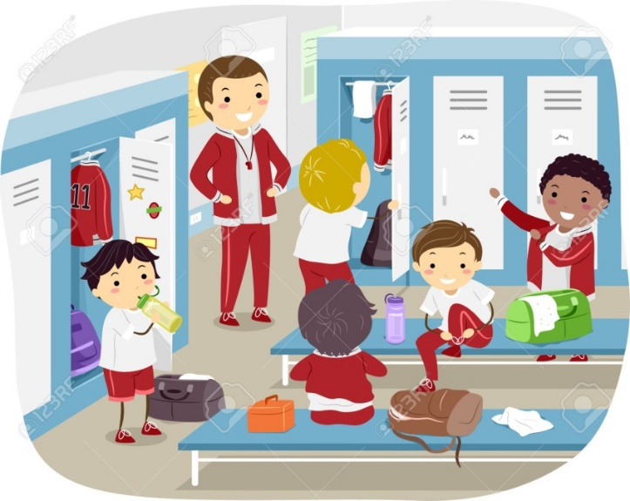
Funding and Facilities
Locker number, size, and quality relative to team size
Number, size and quality of shower stalls, restroom facilities, mirrors, chairs, benches.
Material, paint
Team rooms- size and
amenities, including
entertainment

Slide 8

Funding and Facilities (Quality)
Location
Aesthetics: appearance should be similar in quality from the outside, dimensions
Playing surface quality, turf, materials used in infields and warning tracks, field surface uniformity.
Weather related concerns. E.g. did seasonal flooding affect mostly one group?
Age
Lighting
General conditions
Restroom facilities
Coaching evaluation locations
Videotaping locations
Quality and capacity of score boards, spectator seating, spectator restrooms, concessions, public address systems, press boxes, and media.

Slide 9
Facilities and Facilities (Availability)
Is there any limit in using the field that applies more to girls than boys? For example, are the boys able to use their field more often and more freely because it is on campus?
Does the district provide transportation to both teams? Neither?
Consider the proximity of practice or work out areas- if any - to the fields. Is shelter available at only one field?
Do summer camps have equal access?
In general, compare teams’ seasons, schedules, and practice times

Slide 10

Athletics and Extracurricular Activities
Sex discrimination prohibited on basis of:
  student interests and abilities, and
  benefits and opportunities.
Standard for non-discrimination based on interests and abilities: equal athletic opportunities for members of both sexes, effectively accommodating interests and abilities.

Slide 11
Athletics and Extracurricular Activities
OCR 3-part test for assessing nondiscriminatory athletic participation based on interests and abilities:
  Participation opportunities substantially proportionate to respective enrollments;
  Members of one sex underrepresented, district show history and continuing practice of program expansion which is demonstrable responsive to developing interests;
  Members of one sex underrepresented, if continuing practice not established, district show interests and abilities fully and effectively accommodated by present program.

Slide 12

Athletics and Extracurricular Activities
OCR factors for determining non-discrimination based on benefits and opportunities:
  Equipment and supplies
  Scheduling of games and practice times
  Travel and per diem allowances
  Coaching and tutoring
  Compensation of coaches and tutors
  Locker rooms
  Practice facilities and training facilities
  Publicity

Slide 13
Pregnant and Parenting Students
Discriminating against any student on the basis of pregnancy, child birth, termination of pregnancy or recovery therefore is prohibited
  This includes EXCLUDING any student from an education program (including vocational education) or ACTIVITY (including extra-curricular activity)

Slide 14
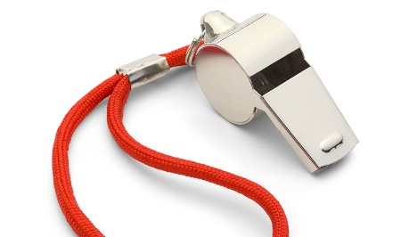
Discipline
Separate or different rules of behavior, sanctions, or other treatment based on sex prohibited.
  Includes: no discipline based on gender identity, or failure to conform to stereotypical notions of masculinity or femininity in behavior OR appearance (dress codes)
Recommendation: record review for disproportionality, disparate impact, systemic problems/trends.

Slide 15
Classes and Extracurricular Activities
Narrow categories where intentional separation based on sex is permitted under Title IX:
  Contact sports in PE class
  Classes or portions of classes on human sexuality
  Other miscellaneous catch-all category: class/activity based on one of two important objectives, 1) to improve students’ educational achievement, or 2) to meet the particular, identified educational needs of students

Slide 16

Employment (Including Student Employment)
Applies to the following activities:
  Recruitment
  Selection
  Promotion
  Job classification/structure
  Compensation
  Granting of leave
  Benefits
  Pregnancy
  Marital or parental status

Slide 17


Slide 18


