Slide 1

THE FUNDAMENTALS OF TITLE IX
January 22, 2021
Walter | Haverfield

Slide 2
What is Title IX?
Title IX of the Education Amendments Act of 1972 is a federal law that states:
    "No person in the United States shall, on the basis of sex, be excluded from participation in, be denied the benefits of, or be subjected to discrimination under any education program or activity receiving Federal financial assistance.”
  Title IX prohibits sex-based discrimination in educational programs and activities.

Slide 3

Discrimination
Discrimination is the act of treating people differently based on a protected characteristic (or stereotypes based on that characteristic)
  Focus on access to education opportunities, resources, programs;
  Disparate treatment in the
  workplace/school;
  Disparate impact claims (neutral
  policies that have discriminatory
  impacts)

Slide 4
Common Types of Protected Traits
Race
Color
Religion
Sex (gender)
Military status
National origin
Disability
Age
Ancestry
Marital status
Pregnancy or
Genetic information

Slide 5
Title IX – Examples of Discrimination
Treat one person differently from another in determining whether such person satisfies any requirement or condition for the provision of such aid, benefit, or service
  “You can’t do that because you’re a man”
Provide different aid, benefits, or services or provide aid, benefits or services in a different manner
Deny any person any such aid, benefit, or service
  “Only men can do that”
Subject any person to separate or different rules of behavior, sanctions, or other treatment
  “Women have to…but men don’t”

Slide 6

Sexual Harassment
Any unwelcome sexual advance, request for sexual favors, or other unwanted verbal or physical conduct of a sexual nature when one or more of the following conditions are present
  Quid pro quo
  Hostile environment

Slide 7

Categories of Harassment
Quid Pro Quo Harassment
Hostile Environment Harassment
  Both are prohibited under the law

Slide 8
Quid Pro Quo
Quid Pro Quo (this for that) Harassment occurs when submission to OR rejection of sexual advances/requests is used as the basis for participation in an activity or class
Example: Teacher pressures a student into an intimate relationship by suggesting acquiescence will result in good grades. When teacher’s advances are spurned, she issues an “F.”
Example: Superintendent requests sexual attention from elementary school principal with a promise that if she goes out with him, he will recommend the issuance of a new employment contract.

Slide 9

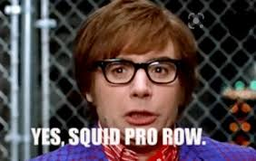
Quid Pro Quo
They do/won’t do this, so…
They will/won’t put up with this, so…
If you do/don’t…I will/won’t…

Slide 10

Quid Pro Quo
May involve a power differential between parties
Voluntary conduct between some may put observers in the position of believing that something sexual is necessary to get something favorable

Slide 11
Hostile Work Environment
To establish unlawful harassment, one must show that the harassment was:
  Based on his/her sex;
  Unwelcome; and
  Sufficiently severe or pervasive to alter the conditions of employment or education or creates an abusive, intimidating, hostile or offensive working or school environment.

Slide 12
Sexual Harassment
  Example: Teacher routinely tells sexual jokes in class, has a reputation for cornering female students and purposefully brushes up against and touches female students in a sexual manner
  Example: A male high school principal routinely inquires about the new female science teacher’s “chemistry” with her husband, comments about her appearance and how lucky her husband is to be married to her, shares explicit details regarding his own marriage, and asks her to do the same

Slide 13
Hostile Environment
  A. Based on protected class status or lack thereof
    Must be based on protected class, i.e. sex.
      If a principal is mean to a teacher because he does not like the teacher’s pink clothes, this is not unlawful harassment under the anti-harassment laws.
    Can be the protected class of either the victim or the harasser.
    Verbally harassing conduct need not explicitly mention the protected class status, i.e. jokes may be chauvinist even if they do not mention “women” (or men) specifically.

Slide 14
Hostile Environment
B. Unwelcome
  Person did not solicit or invite the conduct and regards it as offensive.
  District must evaluate all surrounding circumstances to determine if conduct is unwelcome, i.e. a consensual conversation.
  If the victim complains, that’s an obvious indication the conduct is unwelcome, but the district should not wait for a complaint to investigate potentially prohibited conduct.

Slide 15
“Welcomeness” of Conduct
In order for conduct of a sexual nature to constitute sexual harassment, it must be “unwelcome.”
  OCR always views sexual conduct between an adult and an elementary student as unwelcome and OCR strongly presumes that sexual conduct between an adult and secondary student is unwelcome.
  Whether student-to-student sexual conduct is welcome or unwelcome must be determined on a case-by-case basis.

Slide 16
C. “Severe or Pervasive”
  Generally, a single or isolated incident is not enough to create a hostile environment.
  However, a single incident of harassment which is egregious or unusually severe may be sufficient to create a hostile work environment, particularly when the harassment is physical.
    E.g. Assault.

Slide 17

“Severe or Pervasive” (cont’d)
  Factors to consider include whether the conduct was: abusive, derogatory, frequent, humiliating, or physically threatening.
  Severe or pervasive prong is met if the conditions of an individual’s employment or education are altered.
    E.g. student’s semester grade hinges on the submission to a sexual advance by a teacher.

Slide 18

Harassment
The intent of a harasser does not matter – the test for harassment is from the viewpoint of a reasonable person and victim – it is an objective standard.
The prohibition against sexual harassment does not extend to legitimate, non-sexual touching (such as a kindergarten teacher’s consoling hug for a child with a skinned knee).

Slide 19
Other Violations of Anti-Harassment Laws
  Retaliating against a person who has made a report or filed a complaint alleging harassment, or who has participated as a witness in a harassment investigation;
  Filing a malicious or knowingly false report or complaint of harassment;
  Disregarding, failing to investigate adequately, or delaying investigation of allegations of harassment, when responsibility for reporting and/or investigating harassment charges comprises part of one’s supervisory duties.

Slide 20
Policy Requirements
Statement prohibiting harassment, intimidation, or bullying
Suspension possible for harassment, intimidation, or bullying by electronic act
Definition of harassment, intimidation, or bullying (at least as broad as the statute)
Procedure to be used for reporting incidents
Procedure for responding and investigating reports

Slide 21
Policy Requirements
Strategy for protecting victim or other person from new or additional harassment
Strategy for protecting from retaliation following a report
Personnel must report incidents
Parent/guardian must be notified to the extent permitted
Procedure for documentation
Means by which a person may report anonymously

Slide 22

Policy Requirements
Disciplinary procedure for students found “guilty” of harassment, intimidation, or bullying
Prohibiting deliberately false reports of these actions and the disciplinary procedures that would follow
Semiannual reports to Board and on website

Slide 23

Notice of Policy
The policy must be put in:
  Student handbooks
  Any publications that set forth comprehensive rules, procedures, and standards of conduct for schools and students in the district
Train employees
Train students annually
Notify parents annually

Slide 24
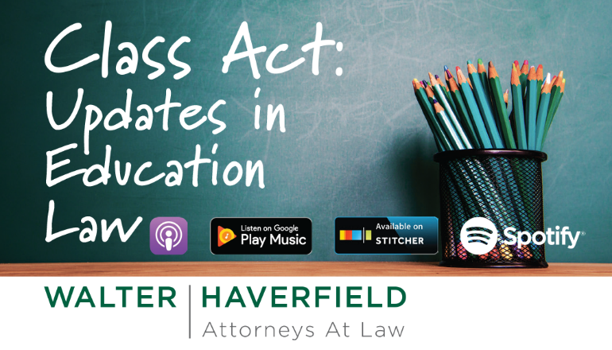

Slide 25


