Slide 1

DUTIES OF A TITLE IX
COMPLIANCE OFFICER
January 22, 2021
Walter | Haverfield

Slide 2
Title IX Coordinator
Each school must designate and authorize at least one employee to coordinate its efforts to comply with its Title IX responsibilities.
  Must be known as the “Title IX Coordinator”
  Not a Compliance Officer anymore
Add “Title IX Coordinator” to existing job title of person in the role
Stated duties must specifically reflect “Title IX Coordinator” responsibilities
Be sure those responsibilities give Title IX coordinator sufficient authority to perform the required tasks

Slide 3

Title IX Coordinator cont’d
At least 1 person must be designated and actually serving as the Title IX coordinator at all times
Make sure the person has time to fulfill this role
If someone is not designated the Title IX Coordinator, and that person’s job title does not reflect that fact, then do so ASAP

Slide 4
Considerations
Title IX coordinator’s role should be independent and should report directly to the senior leadership
Designating a full-time Title IX coordinator will minimize risk of conflict of interest and ensure sufficient time is available to perform all the responsibilities
Although not required by Title IX, multiple coordinators may be good practice for larger school districts
  If there are multiple Title IX coordinators, one should be designated as the “lead” Title IX coordinator who will have ultimate oversight responsibility

Slide 5

Responsibilities and Authority
Coordinate the school’s compliance with Title IX
  This includes grievance procedures for resolving Title IX complaints
Coordinate and oversee the school’s responses to all complaints and reports involving possible sex discrimination
Obtain knowledge of school policies and procedures on sex discrimination
  Should be involved in the drafting and revision of such policies and procedures

Slide 6
Responsibilities cont’d
Provide or facilitate ongoing training, consultation, and technical assistance on Title for all students, faculty, and staff
Explain complaint procedures to complainants and respondents
Oversee investigations of reports and complaints of sexual misconduct
  Recommends on whether report/complaint constitutes sexual misconduct
  Appoint an investigative team
  Ensure complaints are handled properly
  Inform all parties of grievance process
  Maintain information and documentation related to investigation in a secure manner
  Monitor compliance with timeframes

Slide 7

Responsibilities cont’d
Recognize the Coordinator is not the Decisionmaker
Monitor and advise in ways such as:
  Regularly reviewing all reports and complaints
  Conducting an annual climate survey
  Organize and maintain files
  Regularly assess the school’s compliance with Title IX
  Regularly consult with the senior leadership to promote awareness and discussion

Slide 8
Responsibilities cont’d
Other Coordinator responsibilities:
  Identify and address any patterns and/or systemic problems
  Provide training on policies and procedures on sex discrimination & harassment
  Conduct constituent surveys for analysis and consideration
  Monitor students’ participation in athletics & extra-curricular activities for disproportionate impact
  Monitor students’ participation in academic programs for disproportionate impact

Slide 9

Visibility of Title IX Coordinator
Must be visible in the school community
  Notice of nondiscrimination posted
    Note that questions should be directed to the Title IX coordinator
    Via bulletins, announcements, application forms etc.
  Students and employees must be notified of the name, office address, telephone number, and email address of the current Title IX coordinator
    Contact information must be widely distributed and easily found on the website or in various publications

Slide 10
Interim Measures
Consider & coordinate interim measures during the investigation of a complaint
Contact complainant confidentially to discuss availability of supportive measures
Interim measures should be individualized and appropriate based on the information gathered by the Title IX Coordinator, making every effort to avoid depriving any student of her or his education
  The measures needed by each student may change over time, and the Title IX Coordinator should communicate with each student throughout the investigation to ensure that any interim measures are necessary and effective based on the students’ evolving needs

Slide 11
Interim Measures cont’d
Explain to complainant that a formal complaint is not necessary in order to implement supportive measures
Supportive or interim measures should be designed to preserve or restore a student's access to the school's education program or activity, regardless of the type of complaint.
Supportive measures may include the following:
  Academic course adjustments -No contact orders
  Counseling -Schedule changes

Slide 12

Interim Measures cont’d
Consider the complainant’s wishes
Be sure measures are:
  Non-punitive
  Non-disciplinary
  Not unreasonably burdensome to the respondent
Goal is to promote:
  Equal access to educational opportunities
  Protect safety
  Deter sexual harassment

Slide 13

Investigation
A complainant’s wishes with respect to whether the school investigates should be respected unless the Title IX Coordinator determines that signing a formal complaint to initiate an investigation over the wishes of the complainant is not clearly unreasonable in light of the known circumstances
Keep investigations equitable

Slide 14
What constitutes an “equitable” investigation?
Burden is on the school, not the parties, to gather sufficient evidence to reach a fair, impartial determination as to whether sexual misconduct has occurred and whether a hostile environment has been created and must be redressed
Investigator must be a person without any perceived conflicts of interests and biases for or against any party
  Institutional interests should not interfere with impartiality
Title IX Coordinator is not the complainant, even if she signs a formal complaint

Slide 15

What constitutes an “equitable” investigation? cont’d
Requires a trained investigator to:
  analyze and document the available evidence to support reliable decisions,
  objectively evaluate the credibility of parties and witnesses,
  synthesize all available evidence, and
  take into account the individual circumstances of each case
Allow parties to be represented, even if not by an attorney

Slide 16
What constitutes an “equitable” investigation? cont’d
School should provide written notice to the responding party of the allegations constituting a potential violation of the school’s sexual misconduct policy, including sufficient details and sufficient time to prepare a response before any initial interview
  Sufficient details include:
    Identities of parties involved, the specific section of the code of conduct allegedly violated, the precise conduct that allegedly occurred, the date and location of the alleged incident
Each party should receive written notice in advance of any interview or hearing
Cannot implement gag orders or stop a party from discussing allegations or gathering evidence

Slide 17
What constitutes an “equitable” investigation? cont’d
The investigation should result in a written report summarizing the relevant exculpatory and inculpatory evidence
Reporting and responding parties and appropriate officials must have timely and equal access to any information that will be used during informal and formal disciplinary meetings and hearings
Send parties and their advisors evidence directly related to their allegations, in electronic or hardcopy format, with at least 10 days to inspect, review and respond to the evidence
Give parties and advisors a copy of the investigative report summarizing the relevant evidence, in electronic or hardcopy format, with at least 10 days to respond

Slide 18

Informal Investigations
A school may facilitate an informal resolution (including mediation) to assist the parties in reaching a voluntary resolution if:
  If all parties voluntarily agree to participate in an informal resolution that does not involve a full investigation after receiving a full disclosure of the allegations and their options for formal resolution and,
  if a school determines that the particular Title IX complaint is appropriate for such a process

Slide 19

Investigation Dos and Don’ts

Slide 20
Investigator Dos
Be open and receptive to the complaint.
Take the complaint seriously even if it sounds far-fetched or frivolous.
Reserve judgment on whether you believe the complainant.
Follow Board procedures for gathering evidence and conducting interviews.
Respond promptly. Do not wait to undertake an investigation.
Take steps to prevent threats or acts of violence even if the investigation is pending.

Slide 21

Investigator Don’ts
Make light of a complaint.
Show bias when conducting witness interviews.
Promise that all information will be kept confidential. It is appropriate to state that information will be kept as confidential as possible given the obligation to respond to the complaint.
Discuss the investigation with individuals who do not have a “need to know”.

Slide 22
Dismissal
Schools must dismiss allegations of conduct that do not meet the Final Rule’s definition of sexual harassment or did not occur in a school’s education program or activity against a person in the U.S.
  Such dismissal is only for Title IX purposes and does not preclude the school from addressing the conduct in any manner the school deems appropriate.
Schools may, in their discretion, dismiss a formal complaint or allegations if: 1) the complainant informs the Title IX Coordinator in writing that the complainant desires to withdraw the formal complaint or allegations; 2) the respondent is no longer enrolled or employed by the school; or 3) if specific circumstances prevent the school from gathering sufficient evidence to reach a determination.
Schools must give the parties written notice of a dismissal (mandatory or discretionary) and the reasons for the dismissal.

Slide 23
Hearings
K-12 schools are not required to conduct live hearings.
Determine whether a live hearing is necessary on a case-by-case basis.
Perhaps a live hearing is acceptable for high school students or students over a certain age.
Regardless of having a hearing, provide each party the opportunity after the completion of the investigative report to submit written, relevant questions that the party wants asked of another party or witness, provide each party with the answers, and provide for limited follow-up questions.

Slide 24
General Principles
Respond meaningfully to every known report of sexual harassment and investigate every formal complaint.
Promote and apply basic due process protections for students, including:
  a presumption of innocence throughout the process
  written notice of allegations and any investigative interview, meeting or hearing
  opportunity to review all evidence collected
  a right to respond
  the right to cross- examination, subject to "rape shield" protections

Slide 25
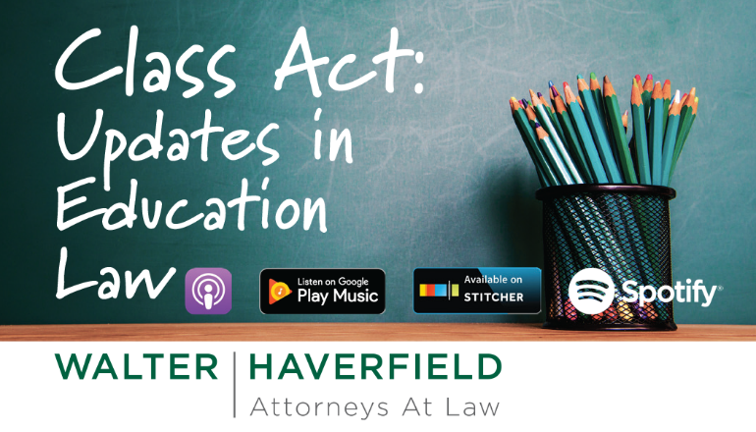

Slide 26


