Slide 1

TITLE IX DISCIPLINE AND ITS IMPACT ON STUDENT DUE PROCESS RIGHTS
January 22, 2021
Walter | Haverfield

Slide 2

TOPICS
Overview of Substantive and Procedural Due Process
New Grievance Process
Emergency Removal
First Amendment Issues
Questions

Slide 3

SUBSTANTIVE AND PROCEDURAL
DUE PROCESS: AN OVERVIEW

Slide 4
STUDENT RIGHTS- GENERALLY
Complainant (victim) has right to attend school without being subjected to unwelcome sexual conduct, especially conduct so severe, pervasive, and objectively offensive that it denies equal access to education.
Respondent (alleged perpetrator) has right to due process before discipline is imposed and right not to be disciplined at all for activities protected by First Amendment.

Slide 5
RESPONDENT’S DUE PROCESS RIGHTS
Students accused of misconduct are entitled to substantive and procedural due process.
Substantive: District cannot arbitrarily or unreasonably deprive students of education. Discipline must be supported by substantial, reliable, and probative evidence in the record. Typically “preponderance of the evidence” standard used for most disciplinary issues.
Procedural: In deciding whether discipline is warranted, students are entitled to fair procedures. More procedures required for more significant discipline.

Slide 6
STUDENT DUE PROCESS RIGHTS
Students are entitled to substantive and procedural due process.
Substantive: Does the evidence prove that the alleged perpetrator (respondent) sexually harass / sexually assault the victim (complainant)?
Procedural: In answering the above question, did the district provide a fair chance for the alleged perpetrator to prove his or her innocence and respond to the allegations?

Slide 7

WHAT CHANGED AND WHY?
New regulations prompted by parent and student concerns that alleged perpetrators were not given fair chance to prove their innocence and that “preponderance of the evidence” standard was too low to expel a student from university or school.
New regulations attempt to address both substantive and procedural issues.

Slide 8
CHANGES TO SUBSTANTIVE
DUE PROCESS RIGHTS
The district must now presume innocence throughout the process.
The burden is on the district to show that discipline is warranted.
Schools may apply either “preponderance of the evidence” or “clear and convincing” standard, but must be consistent.

Slide 9
EVIDENTIARY STANDARDS
Preponderance of the Evidence: It is “more likely than not” that the perpetrator committed the action. Used in civil context. Also known as 51% rule.
Clear and Convincing: It is “substantially more likely to be true that the perpetrator committed the act.”
Beyond a Reasonable Doubt: The only logical explanation is that the perpetrator committed the act/crime, no other logical explanation exists. This is used in the criminal context because a high standard is needed to deprive someone of freedom.

Slide 10

CHANGES TO PROCEDURAL
DUE PROCESS RIGHTS
Single investigator and decision-maker no longer allowed.
Detailed grievance process with a focus on:
  Notice of allegations
  Cross examination
  Opportunity to review and response to evidence
Explicit prohibition on conflicted or biased coordinators, investigators, decision-makers.
Emphasis on equal opportunities for both complainants and respondents to participate in the process.

Slide 11

NEW GRIEVANCE PROCESS

Slide 12

GRIEVANCE PROCESS
  General Emphasis
  Notice of Allegations
  Investigation
  Determination of Responsibility
  Appeals

Slide 13
GRIEVANCE PROCESS –
GENERAL EMPHASIS
Complainants and respondents must be treated equitably.
Objective evaluation of all relevant evidence
All decision makers and investigators must be free of conflict or bias
Presumption that respondent not responsible for alleged conduct until decision is made.

Slide 14
NOTICE OF ALLEGATIONS
Both respondent and complainant must receive notice of grievance process – explaining the process and the district’s policy.
Notice must include statement that respondent is presumed not responsible until final decision is made.
Notice must be given with sufficient time to prepare response before any initial interview.
Notice must be provided again if new allegations come to light during investigation.

Slide 15

NOTICE CONT.
Notice must include details known at the time:
  Date and location of alleged incident
  Identities of the parties
Notice must also include:
  Right to have advisor, may be attorney
  Right to inspect and review evidence
  Prohibition on knowingly making false statements/submitting false information

Slide 16
GRIEVANCE PROCESS- INVESTIGATION OVERVIEW
  Investigative interviews
  Time to review and respond to evidence
  Investigative Report
  Time to review and respond to Report
  Hearing (optional for K-12)
  Determination regarding responsibility
  Appeals

Slide 17
GRIEVANCE PROCESS- INVESTIGATIVE INTERVIEWS
District must provide equal opportunity for both parties to:
  present witnesses and evidence at interviews/meetings.
  Have advisor present (restrictions on advisor’s participation ok as long as apply to both sides)for any interviews, meetings.
  Written notice of date/time/location/participants/purpose for all hearings, interviews, meetings with sufficient time to prepare.

Slide 18
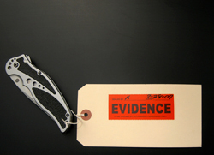
INVESTIGATIVE INTERVIEWS Cont.
  District may not:
  Restrict either party from discussing allegations, gathering, or presenting relevant evidence.
  Access, consider, or disclose medical/psychological records without that party’s voluntary consent.

Slide 19
RESPONDING TO EVIDENCE
  After the interviews are completed and evidence has been gathered, District must send the evidence to each party in electronic or hard copy.
  Then the parties have 10 days to submit written response.
  Investigator will consider responses prior to completing investigation report.

Slide 20
INVESTIGATIVE REPORT
After parties submit their responses, the District creates an investigative report fairly summarizing the evidence.
Report must be sent to parties 10 days before hearing or other time to decide.
Parties must be allowed time to review and respond, including asking written, relevant questions.

Slide 21
HEARING /QUESTIONING
Live hearing is optional for K-12, but required for post-secondary schools.
Party’s advisor (not party) must be allowed to cross examine other party and witnesses directly, orally, and in real time.
District must – upon request – provide for live hearing in two separate rooms or virtually.
District must provide advisor free of charge to conduct cross examination if party does not have advisor.
Cross examination questions have to be relevant and can only concern sexual predisposition or prior sexual behavior in limited circumstances.
District must create hearing audio recording or transcript and make it available for both parties.

Slide 22

HEARING /QUESTIONING
Because hearing is optional and involves many additional regulations, we recommend against it.
Even if there is no hearing, districts must allow each side to question the other, in written form.

Slide 23

HEARING /QUESTIONING Cont.
Questioning in written form must include opportunity for:
Written relevant questions
Providing each party with answers
Allowing for additional, limited follow up questions.

Slide 24
HEARING /QUESTIONING Cont.
Questioning in written form may not include:
Questions /evidence about complainant’s sexual predisposition
Questions/evidence about complainant’s prior sexual behavior. (Exception: Prior sexual behavior ok to show someone else committed the conduct or to prove consent.)
Decision-maker must explain why question is excluded.

Slide 25

DETERMINATION
Decision-maker (not Title IX coordinator or investigator) must issue written determination regarding responsibility.
Apply either “preponderance of the evidence” standard or “clear and convincing evidence” standard depending on District’s policy.

Slide 26
DETERMINATION Cont.
Written Determination must include:
Allegations of sexual harassment
Description of procedural steps (notification, interview, site visits, evidence gathering methods, hearing)
Findings of fact
Conclusions re: applying code of conduct to facts
Statement & rationale for results for each allegation, including: responsibility determination, disciplinary sanctions for respondent, remedies to restore or preserve equal access for complainant
Procedures and bases for appeals.

Slide 27

DETERMINATION Cont.
Must be provided to both simultaneously;
Becomes final after appeal time has passed or when appeal result is provided.
Title IX Coordinator responsible for implementing remedies.

Slide 28
APPEALS
District must allow appeal if either party alleges:
  Procedural irregularity affecting outcome
  New evidence nor reasonably available by determination date affecting outcome
  Title IX coordinator, investigator, or decision maker had a conflict of interest or bias affecting outcome.
District may allow appeal for other reasons or not, as long as opportunity is equal for both sides.

Slide 29

APPEALS Cont.
District must:
Notify other side if appeal filed.
Implement appeal procedures equally.
Appoint new and trained decision maker without conflict of interest or bias (cannot be Title IX coordinator, investigator, or previous decision maker).
Afford both sides reasonable and equal opportunity to submit written statement challenging outcome.
Issue written decision with result and rationale, provide simultaneously to both parties.

Slide 30
INFORMAL RESOLUTIONS
District may not:
  require informal resolution
  offer informal resolution until a formal complaint is filed.
  facilitate informal resolution where allegations are by student against employee.

Slide 31
INFORMAL RESOLUTIONS
District may facilitate informal resolution after formal complaint filed, but must:
Provide written notice to both parties with:
  Allegations
  Informal resolution process including any provisions that after agreeing to a resolution, party cannot withdraw and resume formal grievance process.
  Consequences of participating including records maintained or shared.
Obtain both parties’ written and voluntary consent to informal resolution

Slide 32

EMERGENCY REMOVALS

Slide 33
EMERGENCY REMOVAL
Districts may emergency remove student if individualized safety and risk analysis determines that sexual harassment allegations pose immediate threat to student physical health or safety such that removal is justified.
Notice and opportunity to challenge the decision must be provided immediately after removal.
Comply with all laws and regulations (federal and state) related to emergency removals and students with IEPs and 504 Plans.

Slide 34
EMERGENCY REMOVAL: EXAMPLE
Susie tells a teacher that Robert sexually assaulted her in the bathroom.
If the administrator’s individualized safety and risk analysis shows that Robert’s continued attendance creates immediate threat to student health or safety, administrator may:
  Issue notice of intent to suspend and then provide opportunity to appear in informal hearing to challenge suspension or otherwise explain actions.
  Issue notice of suspension with intent to expel, plus notice of opportunity to appear to challenge the reason for expulsion w time and place btw 3-5 days. Follow standard procedures for hearing, appeals etc.
  Don’t forget MDR for students with IEP or 504 plans before expulsion hearing or within 10 days of decision to suspend resulting in over10 cumulative days out of school (change in placement)

Slide 35

FIRST AMENDMENT

Slide 36
FIRST AMENDMENT
Sometimes sexual harassment complaints are outside the disciplinary process because the alleged conduct is protected by the First Amendment.
  Ex. Off-campus and using his own equipment, Robert creates a Tiktok page with disrespectful content about Susie. There is no substantial disruption to the school environment as a result, but Susie files a complaint.
Disciplining Robert may be prohibited by the First Amendment, and the district would need to dismiss any formal complaints against him.

Slide 37
FIRST AMENDMENT
However, the district can and should take non-disciplinary action:
  offering both parties counseling, evaluation where appropriate
  Implementing monitoring, additional supervision
  Changing alleged perpetrator’s class schedule, other separation approaches
  Anti-harassment speakers, programming, education.
Consulting with counsel is usually a good idea for any First Amendment issues because the decisions can be very fact-specific.

Slide 38
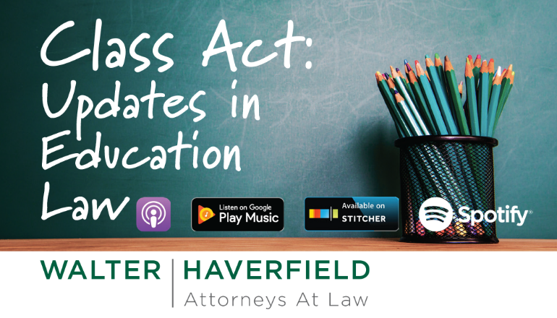

Slide 39


