Slide 1



Ohio’s Next Generation Assessments
Canfield Local School District
Notes:
John Tullio - Introduction

Slide 2

and
Commonly Confused
Notes:
Dave

Slide 3
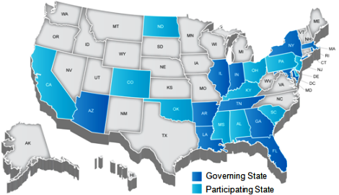
PARCC
Notes:
Dave

Slide 4

Most Significant Changes
More tests in more grades
Tests will now be administered in multiple sessions
Computer-based administration
Question format
Writing/typing demand
Testing windows
Notes:
Dave

Slide 5


Performance Based & End of Course (Year)
Performance Based (PBA)
Intended to be administered approximately ¾ of the way through the course (year)
Writing intensive assessments
End of Course (EOC)
End of Year (EOY)
Intended to be administered as close to the conclusion of the course/year as possible
Objective format assessments
Notes:
Dave

Slide 6
Next Generation Assessment Format
English Language Arts & Math
Developed by PARCC
PBA: February 16- March 20
  3 sessions ELA
  2 sessions math
  computer administered
EOY/EOC: April 13 - May 15
  2 sessions ELA
  2 sessions math
  computer administered
Science/Social Studies
developed by AIR/ODE
PBA: March 2-13
  1 session science
  1 session social studies
  computer administered
EOY/EOC: May 4-15
  1 session science
  1 session social studies
  computer administered
Notes:
Dave

Slide 7

Windows are the same for all Ohio districts
School start dates and holiday breaks
Testing Windows
Notes:
Dave

Slide 8
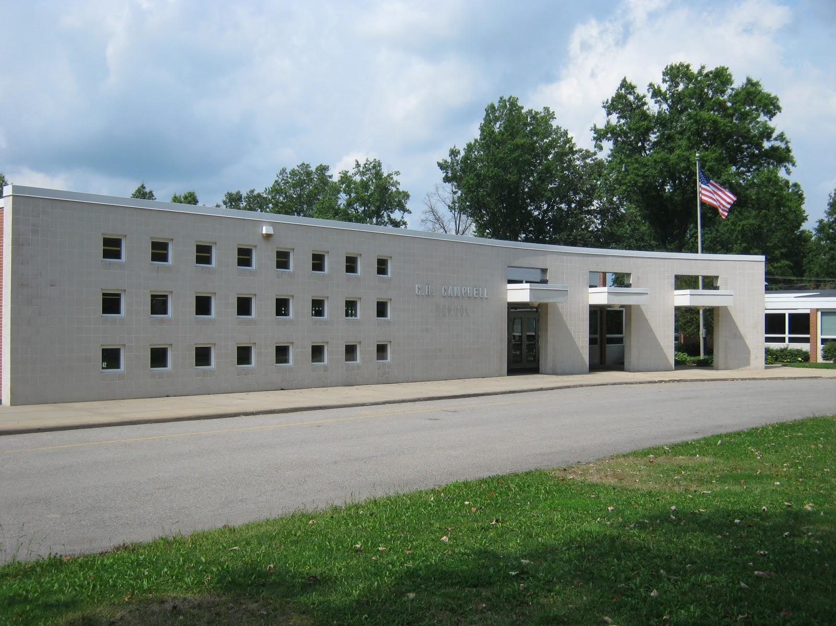
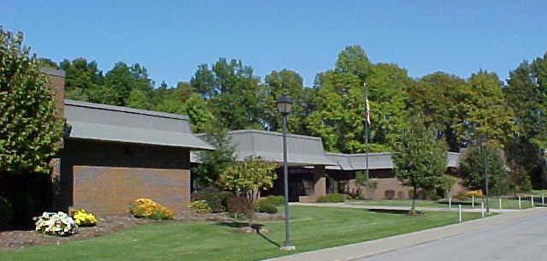
C. H. Campbell Elementary School
and
Hilltop Elementary School
Next Generation Assessments for 2014-2015

Slide 9
Assessments at a Glance
Previous Years:
Ohio Achievement Assessments (OAA)
Grade 3 (7.5 hours total)
  Fall reading assessment
  Spring reading and math assessments
Grade 4 (5 hours total)
  Spring reading and math assessments
Now:
PARCC and AIR
Grade 3 (9.25 hours total)
  Fall reading OAA
  Spring reading OAA if scoring below proficient in the fall OAA
  Spring PARCC ELA if scoring proficient or above in the fall OAA
  PARCC Math
Grade 4 (12.5 hours total)
  PARCC ELA
  PARCC Math
  AIR Social Studies

Slide 10
PARCC Testing Sessions
Performance-based Assessment End of Year Assessment
Grade 3
ELA Performance-based Assessment
  3 testing sessions (3.5 hours total)
  February 17-19
Math Performance-based Assessment
  2 testing sessions (2.5 hours total)
  March 3-4
Grade 4
ELA Performance-based Assessment
  3 testing sessions (4.25 hours total)
  February 23-25
Math Performance-based Assessment
  2 testing sessions (2.5 hours total)
  March 10-11
Social Studies Performance-based Assessment
  1 testing session (1.25 hours)
  March 5
Grade 3
ELA End of Year Assessment
  1 testing session (1.25 hours)
  April 20
Math End of Year Assessment
  2 testing sessions (2.5 hours total)
  April 22-23
Grade 4
ELA End of Year Assessment
  1 testing session (1.25 hours total)
  April 28
Math End of Year Assessment
  2 testing sessions (2.5 hours total)
  April 29-30
Social Studies End of Year Assessment
  1 testing session (1.25 hours)
  May 5
Notes:
I wouldn’t discuss every test with the public but instead just have them read the slides while we elaborate on what the tests will be like.

Slide 11
How are we preparing students?
Chromebooks in the classroom
  1:2 Student/Chromebook ratio in grades 3-4
Professional development for teachers by the Mahoning County Educational Service Center (MCESC)
Curriculum alignment to the Common Core Standards
Online assessments using Scootpad, TenMarks, Wowzers, and other tools.
Typing being taught in grades 2-3
Online practice testing with all students before the assessment
Developing assessments to mirror the next generation assessments

Slide 12
Third Grade Reading Guarantee
Students who score below a 394 on both the fall and spring Ohio Achievement Assessment qualify for retention in reading for fourth grade
These students will be given multiple opportunities in addition to the OAA to demonstrate reading proficiency before the start of the school year (Summer OAA and other approved assessments)
Reading intervention is provided to students in all grade levels who are “off track” based upon reading benchmark assessments
Last year, Canfield Local Schools had zero students retained due to the Third Grade Reading Guarantee
Next year, reading proficiency will be based upon the PARCC assessments instead of the OAA

Slide 13
How are the new assessments different?

Slide 14
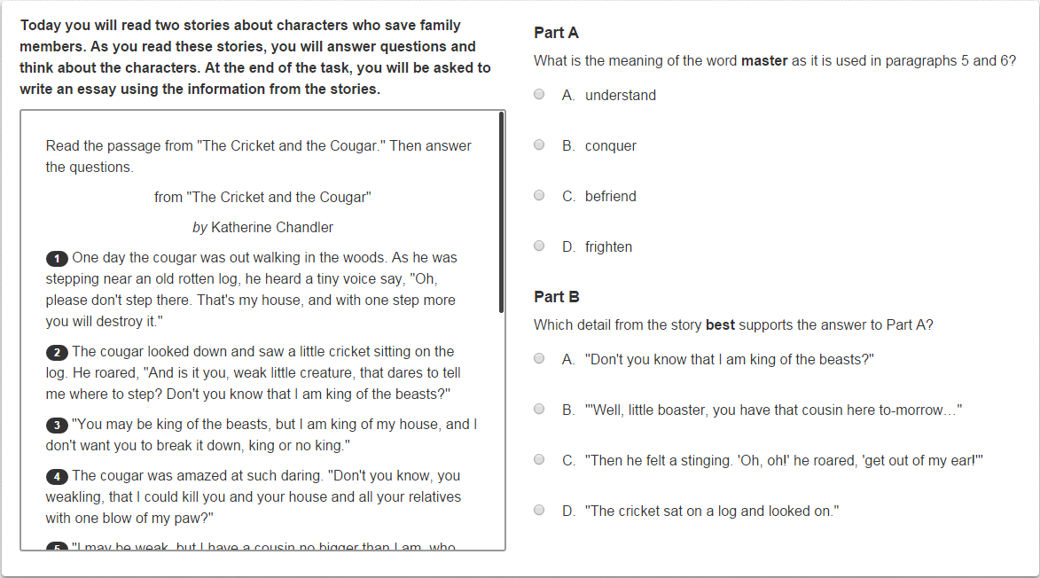
Part A and Part B Questions

Slide 15
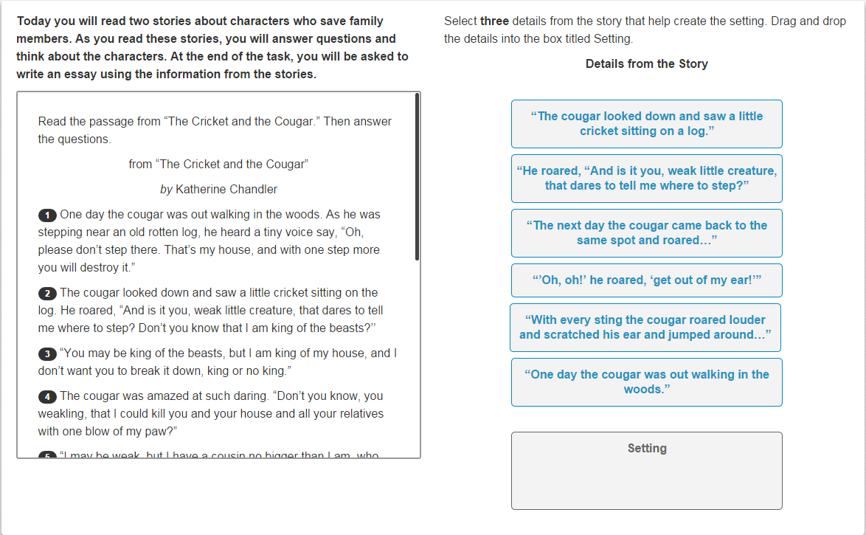
Drag and Drop Questions

Slide 16
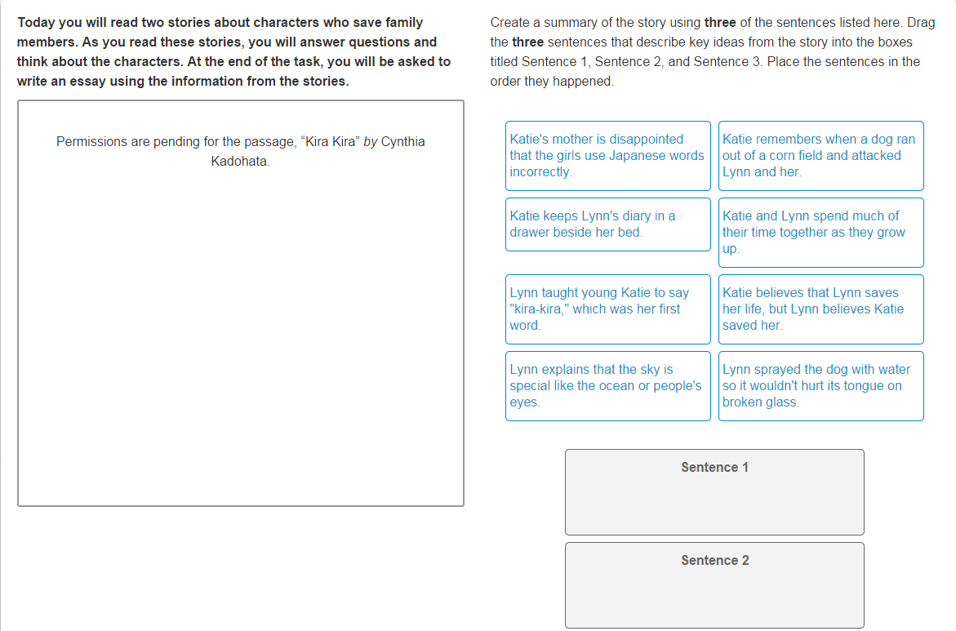

Slide 17
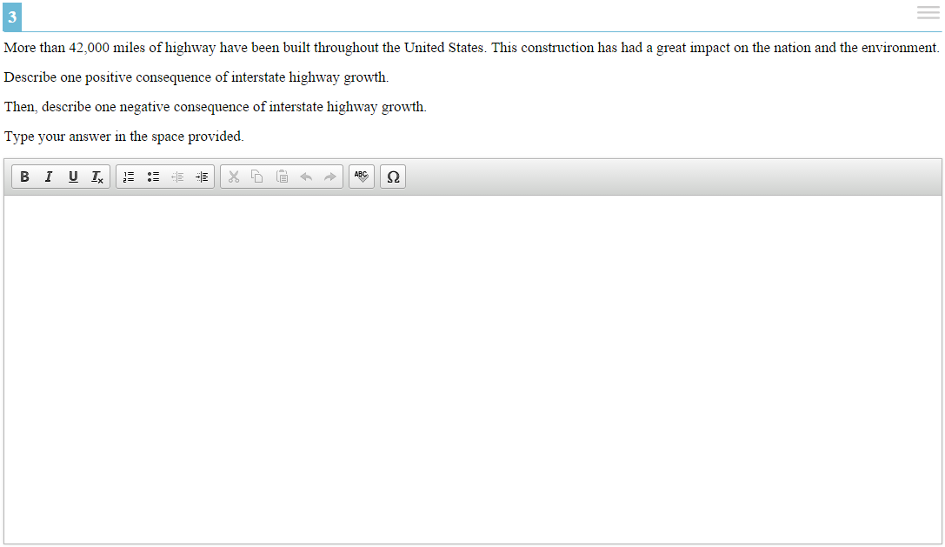
Essay Questions
Notes:
AIR Social Studies Example

Slide 18
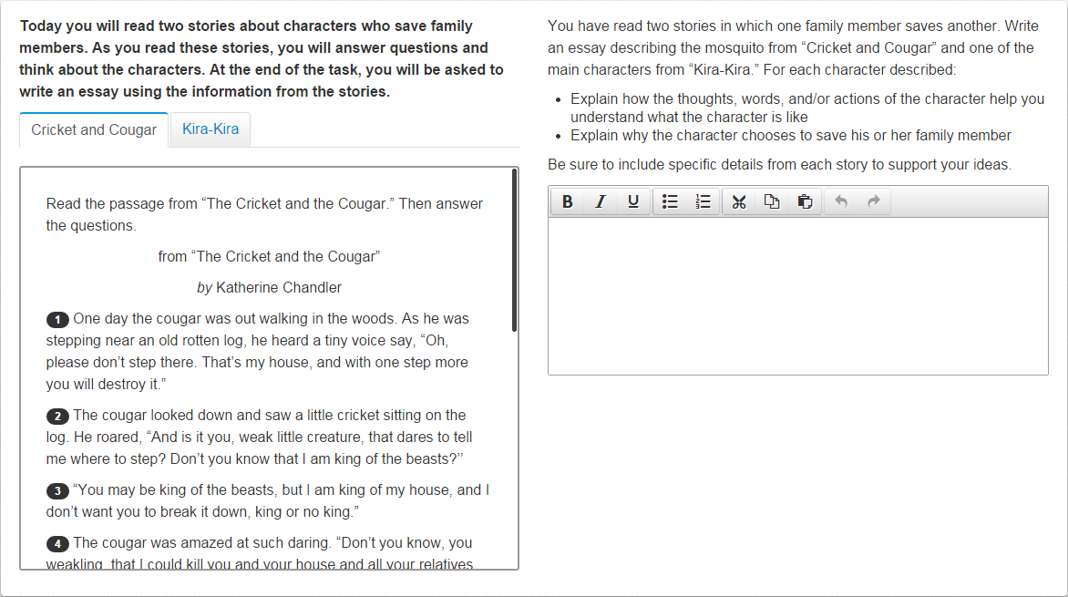
Essay evaluating multiple passages

Slide 19
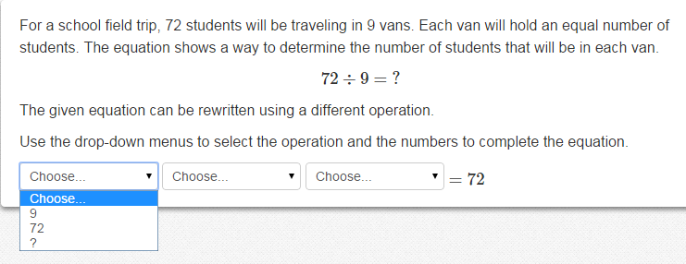
Building equations

Slide 20
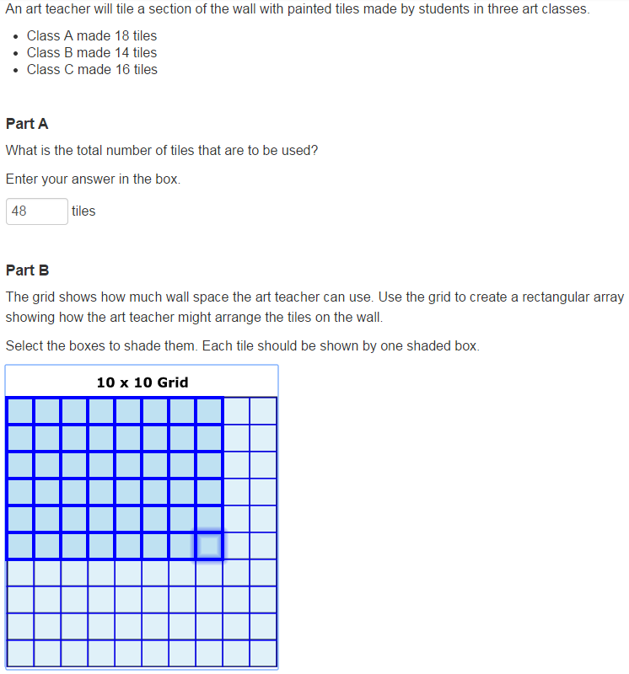
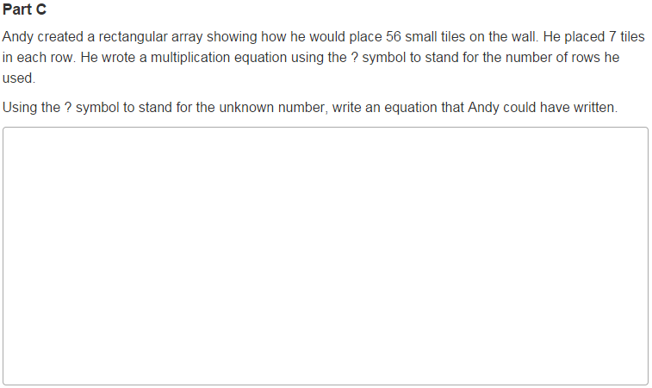
Multi-Step Questions
Students must solve Part A correctly to get credit for Part B
Part C can receive credit in this example if the student misses Part A or Part B

Slide 21
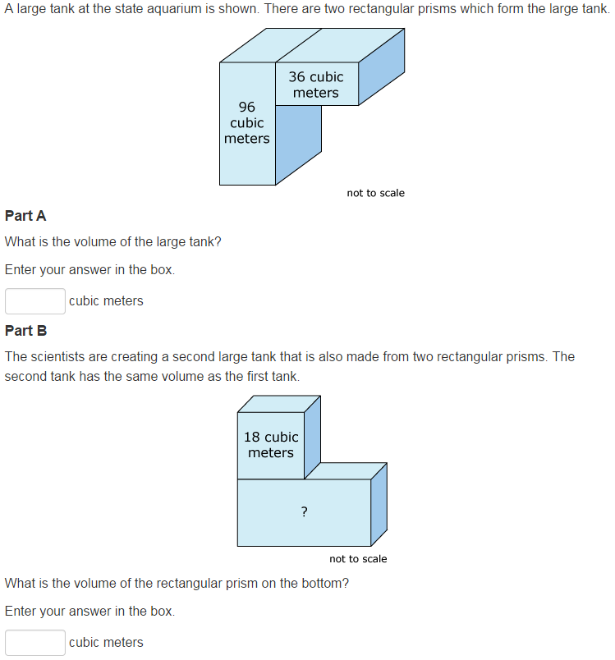
Multi-Step Questions

Slide 22
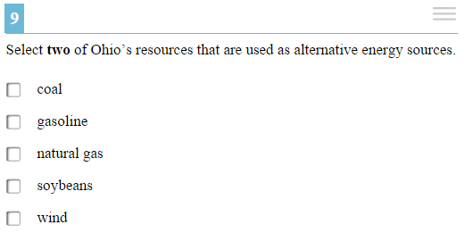
Multiple Selection Questions
Notes:
AIR Social Studies Example

Slide 23

Canfield Village Middle School
Grades 5-8
Next Generation Assessments for 2014-2015

Slide 24
Question formats-skills required at all grades
Part A and B Questions
Drag and Drop Questions
Essay Questions
Essays Evaluating Multiple Passages
Building Equations
Multi-step Questions
Multiple Selection

Slide 25
Assessments at a Glance
Now:
PARCC and AIR
Grade 5
  PARCC ELA- 3 Parts PBA; 2 Parts EOY (6.25 hours total)
  PARCC Math- 2 parts PBA; 2 parts EOY (5 hours total)
  AIR Science- 1 part PBA; 1 part EOY (2.5 hours total)
GRADE 5 TOTAL HOURS: 13.75
Grade 6
  PARCC ELA- 3 Parts PBA; 2 Parts EOY (6.25 hours total)
  PARCC Math- 2 parts PBA; 2 parts EOY (5 hours total)
  AIR Social Studies –
  1 part PBA; 1 part EOY (2.5 hours total)
GRADE 6 TOTAL HOURS: 13.75
Previous Years:
Ohio Achievement Assessments (OAA)
Grade 5: Science, Math and Reading (6 hours total)
Grade 6: Reading and Math (4 hours total)
Grade 7: Reading and Math (4 hours total)
Grade 8: Science, Math and Reading (6 hours total)
_________________________________
20 total hours for OAA

Slide 26
Assessments at a Glance-Now
Grade 7
  PARCC ELA- 3 Parts PBA; 2 Parts EOY (6.25 hours total)
  PARCC Math- 2 parts PBA; 2 parts EOY (5 hours total)
GRADE 7 TOTAL HOURS 11.25
Grade 8
  PARCC ELA- 3 Parts PBA; 2 Parts EOY (6.25 hours total)
  PARCC Math- 2 parts PBA; 2 parts EOY (5 hours total)
  AIR Science- 1 part PBA; 1 part EOY (2.5 hours total)
GRADE 8 TOTAL HOURS: 13.75

Slide 27
OAA (Then): 20 Hours Grades 5-8
(10 instructional days affected)
Next Generation Assessments (Now) : 52.5 Hours total Grades 5-8
(24 instructional days affected)
THEN AND NOW

Slide 28
How are the new assessments different, and how does this affect classroom instructional practices?

Slide 29
Rigor, Depth, Cognitive Skills!!
Teaching aligned to rigor of standards, from which the assessments are generated
Emphasis on critical thinking and process, rather than memorization and recall
Students required to problem solve and collaborate
The means to getting to end/answer(s) is just as important as the “final answer”

Slide 30
How are we at CVMS preparing students?
Chromebooks in the classroom
  1:2 Student/Chromebook ratio in grades 5-8
Professional development for teachers by the Mahoning County Educational Service Center (MCESC)
Curriculum alignment to the Common Core Standards
Online assessments using various programs to allow students to familiarize themselves with online testing nuances
Typing emphasized in all grades as part of all curriculum as a cross-curriculum skill
Emphasizing problem solving and critical thinking in all grades
Online practice testing with all students before the assessment.
Developing assessments to mirror the next generation assessments that are rigorous, and aligned to standards

Slide 31

Canfield High School
Next Generation Assessments for 2014-2015

Slide 32

Assessments at a Glance
Before 2014-15:
The Ohio Graduation Test
  Reading - 2.5 hours
  Writing - 2.5 hours
  Math - 2.5 hours
  Science - 2.5 hours
  Social Studies - 2.5 hours
Total testing days = 5
Instructional days impacted = 5
Administered in the 10th Grade.

Slide 33
Assessments at a Glance
In 2014-15:
Sophomores take the OGT Assessments (Final Year).
Students in Grade 9 take the following:
  PARCC/AIR Assessments
    5 Sessions for English 9 (PBA/EOC).
    4 Sessions for Alegbra I/Geometry (PBA/EOC).
    2 Sessions for Physical Science (PBA/EOC).
    2 Sessions for American History (PBA/EOC).
Total testing days = 13
Instructional days impacted = 23
Notes:
Dave

Slide 34

Comparison
Prior to 2014-15
Total testing days = 5
Instructional days impacted = 5
2014-15
Total testing days = 13
Instructional days impacted = 23

Slide 35

Additional Details
Any student taking American Government will be required to take the new assessment this year (grade level does not matter).
The answers have been unclear regarding the usage of this data.

Slide 36

What is coming in 2015-16?
Freshman
  5 Sessions of PARCC for ELA
  4 Sessions of PARCC for Alegbra I/Geometry (when taken)
  2 Sessions of AIR for Physical Science
  2 Sessions of AIR for American Government
Sophomores
  5 Sessions of PARCC for ELA
  4 Sessions of PARCC for Geometry (when taken)
American Government (when taken)

Slide 37

New Graduation Requirements
Earn a cumulative passing score (currently 18) on seven end-of-course exams:
Algebra 1
Geometry
English I
English II
Physical Science (currently)
American History
American Government

Slide 38

What is being done in preparation?
Standards Alignment
Assessment Blueprints Alignment
Laptop Cart Deployment
Practice Tests Online (Second Semester)

Slide 39
Resources
Student Practice Test Portal - Science and Social Studies
https://login1.cloud2.tds.airast.org/student/V58/Pages/LoginShell.aspx?c=Ohio_PT
Student Tools and Tutorials - Science and Social Studies
http://oh.portal.airast.org/ocba/resources/
PARCC Sample Test Items
http://www.parcconline.org/samples/item-task-prototypes
Scalise Matrix - Question Prototypes
http://pages.uoregon.edu/kscalise/taxonomy/taxonomy.html

Slide 40
Questions
Contact:
Alex Geordan, Superintendent
ageordan@canfieldschools.net

