Slide 1

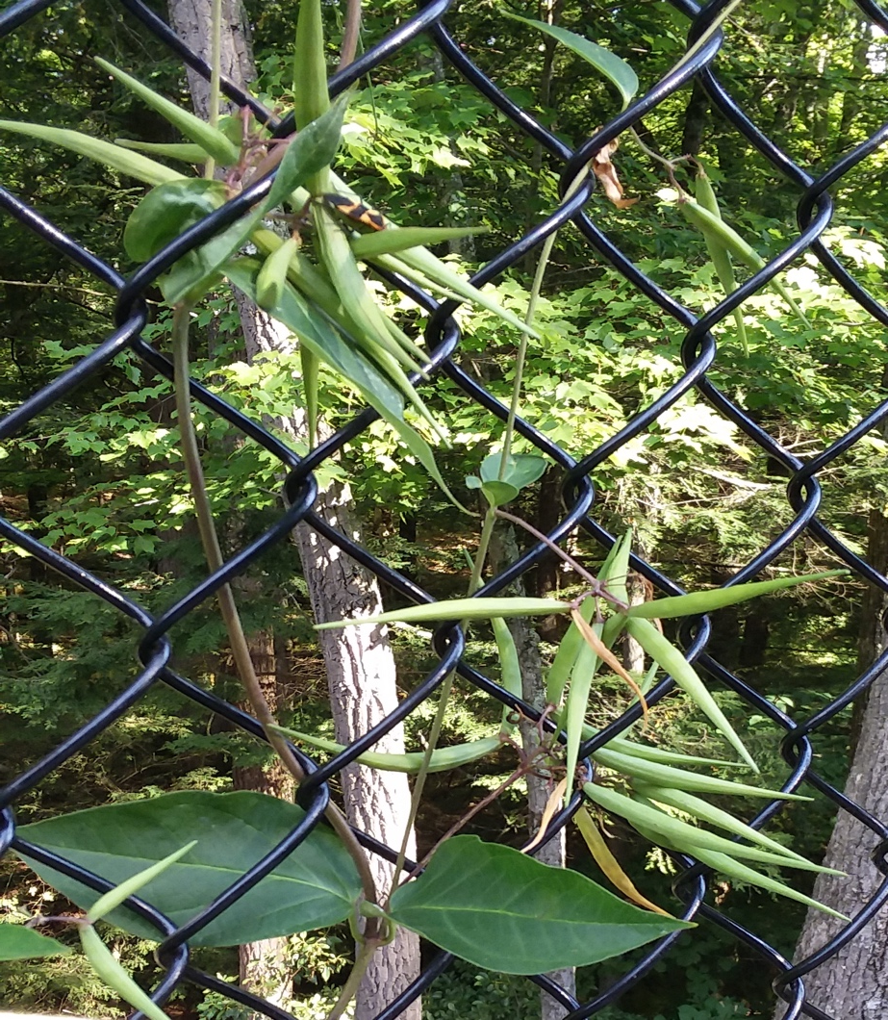
WANTED
For crimes against Southampton wildlife and landscapes:
Swallow-wort
The Problem
Black Swallow-wort (purple flowers) and Pale Swallow-wort (pinkish flowers) invade fields, field edges, and woodlands. Close relatives of milkweed, these species may interfere with monarch butterfly reproduction.
The Solution
Hand-pull seedlings and young plants and dig up mature plants. Pods should be bagged and thrown away. Follow-up control of seedlings will likely be needed in subsequent years.
www.massaudubon.org/learn/nature-wildlife/invasive-plants

Slide 2
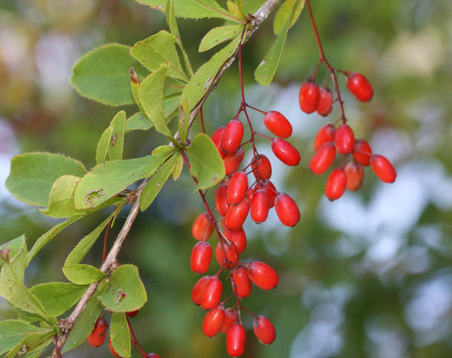
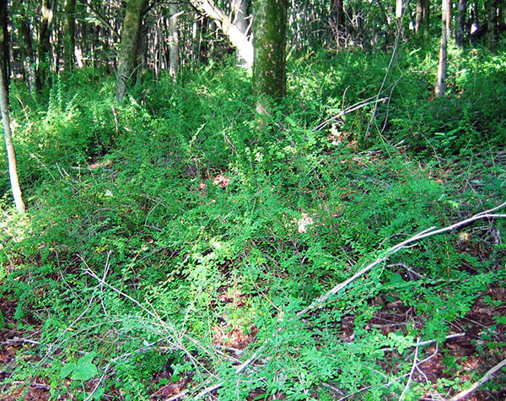
WANTED
For crimes against Southampton wildlife and landscapes:
Barberry
The Problem
Common Barberry, with three-part thorns and Japanese Barberry with its thorny twigs, both have attractive red berries in the summer and fall. Birds eat the berries and then disperse the seeds broadly where the plant can take over fields, forests, and wetlands.
The Solution
Remove the plants by hand. Wear gloves to protect yourself from the thorns. The use of pesticides is prohibited in wetlands without a special license.
www.massaudubon.org/learn/nature-wildlife/invasive-plants

Slide 3
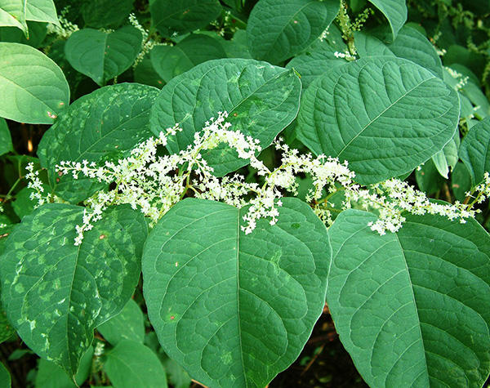
WANTED
For crimes against Southampton wildlife and landscapes:
Knotweed
The Problem
Japanese Knotweed has heart-shaped leaves and thick hollow stems. It can grow 10 feet tall in thick clumps that crowd out all other plants.
The Solution
Pull young plants by hand before they are established. Mature plants should be cut down or pulled in June or July. The use of pesticides is prohibited in wetlands without a special license.
www.massaudubon.org/learn/nature-wildlife/invasive-plants

Slide 4
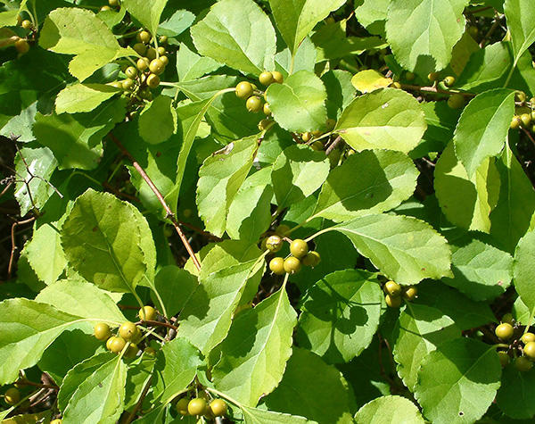
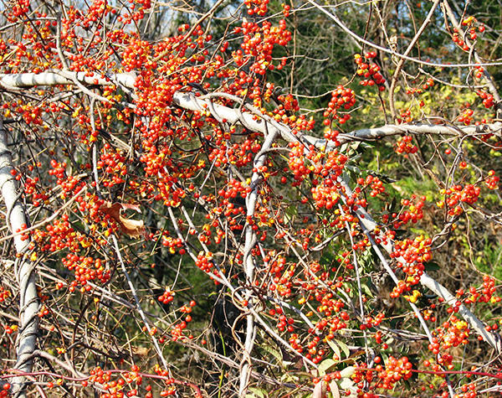
WANTED
For crimes against Southampton wildlife and landscapes:
Bittersweet
The Problem
Oriental Bittersweet, a think woody vine with red berries covered in a yellow shell in the fall, can grow to be 60 ft long. It wraps around tress and smothers surrounding vegetation.
The Solution
Pull young plants by hand before they are established. A 4-foot section of the climbing vine can be cut from the ground level to kill the plant in tall trees. Leave the remaining plant to decay because pulling it could damage the tree.
www.massaudubon.org/learn/nature-wildlife/invasive-plants

Slide 5
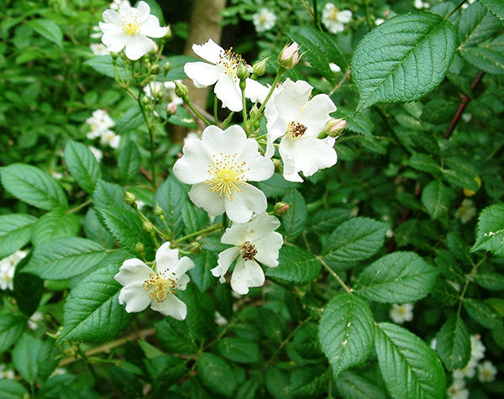
WANTED
For crimes against Southampton wildlife and landscapes:
Multiflora Rose
The Problem
Multiflora Rose is a shrub with white flowers, red fruits, and sharp thorns. It grows in dense stands, taking over field edges, forest openings, and wetlands.
The Solution
Mow or hand prune 3-6 times a year for several years in a row. Wear gloves to protect yourself from the thorns. The use of pesticides is prohibited in wetlands without a special license.
www.massaudubon.org/learn/nature-wildlife/invasive-plants

