Slide 1
Self Service Password Reset Instructions
For staff members who have forgotten their password or would like to change their password, they can reset it themselves.
(This was another feature of the MFA(Multi-factor Authentication) setup.
To change the password, staff can visit: http://aka.ms/sspr or https://passwordreset.microsoftonline.com/
(This can or will have to be done on another user's login.)

Slide 2
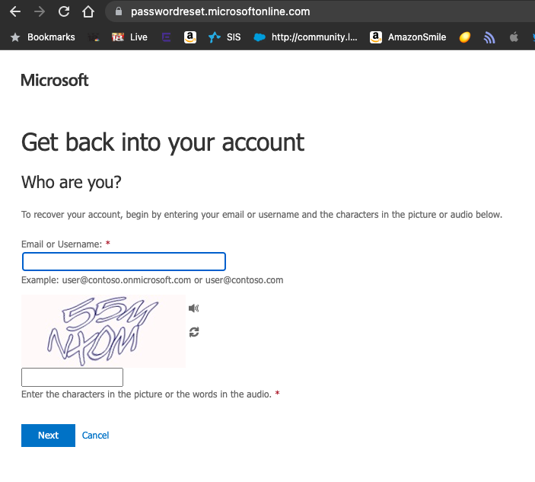
Once there, you will enter your email address and will complete the characters listed below the email to prove you are a person. Then click next.

Slide 3
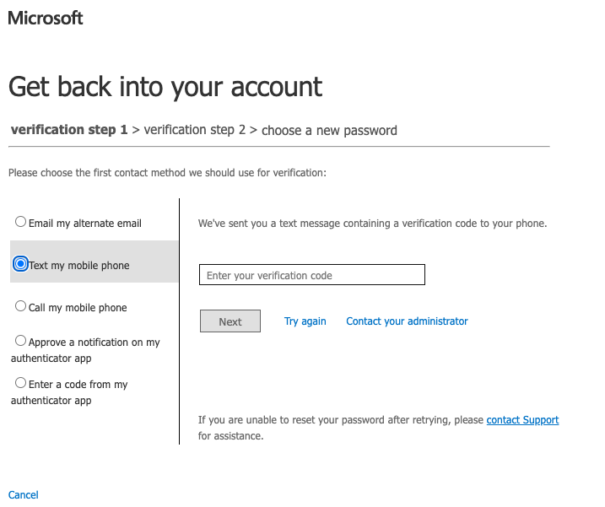
You will then be asked for your phone number that you used to set up MFA. Enter the number and click next.

Slide 4
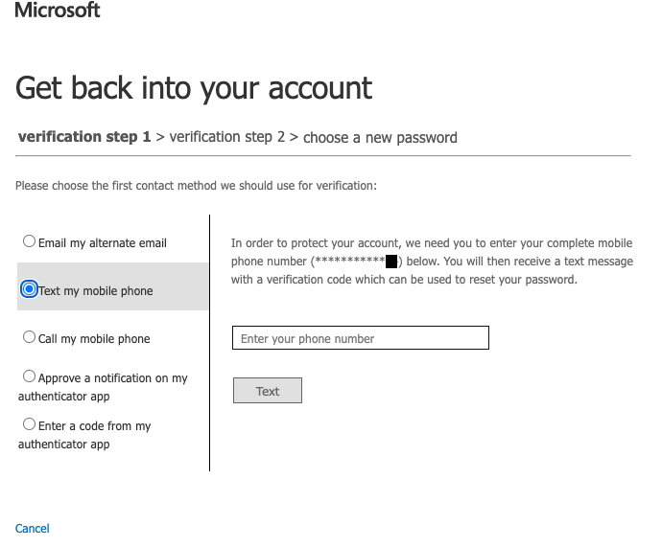
You will receive a text with a security code that you will enter. Then you will be able to reset your password.

