Slide 1
Sophomore Presentation
Planning for the Future

Slide 2
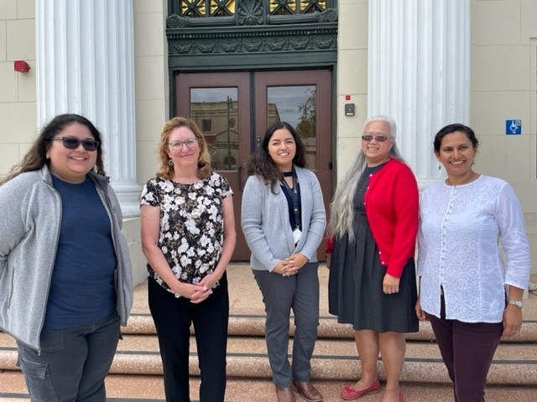
Hello Class of 2025!
The Counselors welcome you to your Sophomore Presentation!
Ms. Perez, Ms. D’Ambrosio, Ms. Albor, Ms. Loy, Ms. Patil

Slide 3
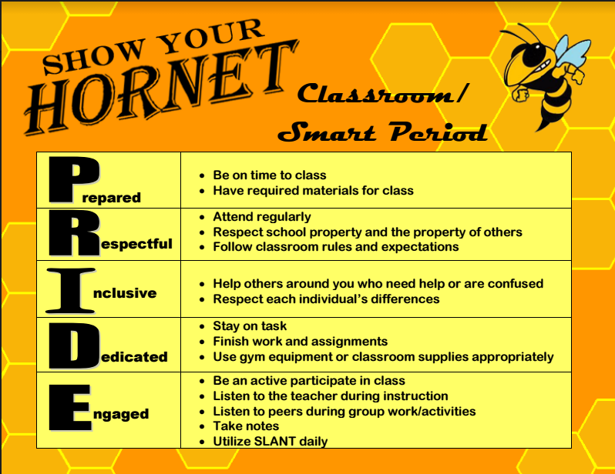

Slide 4
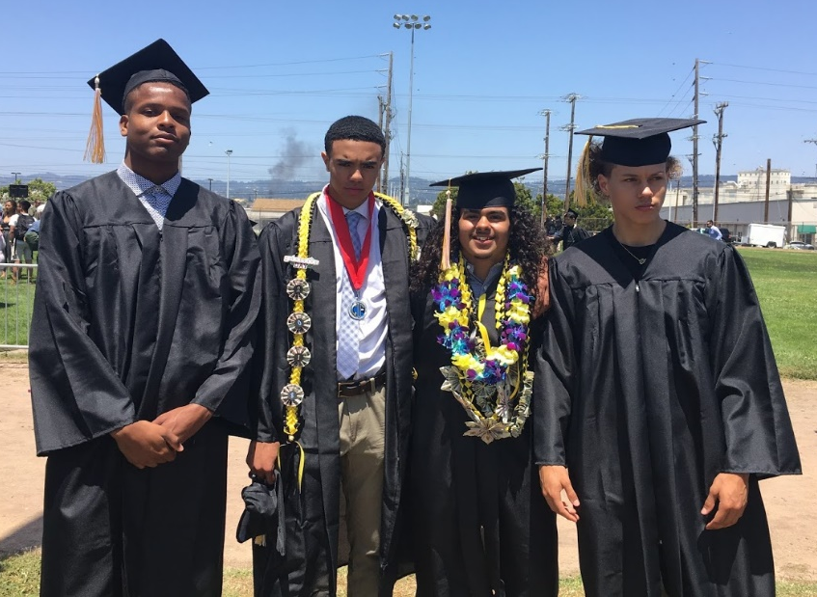
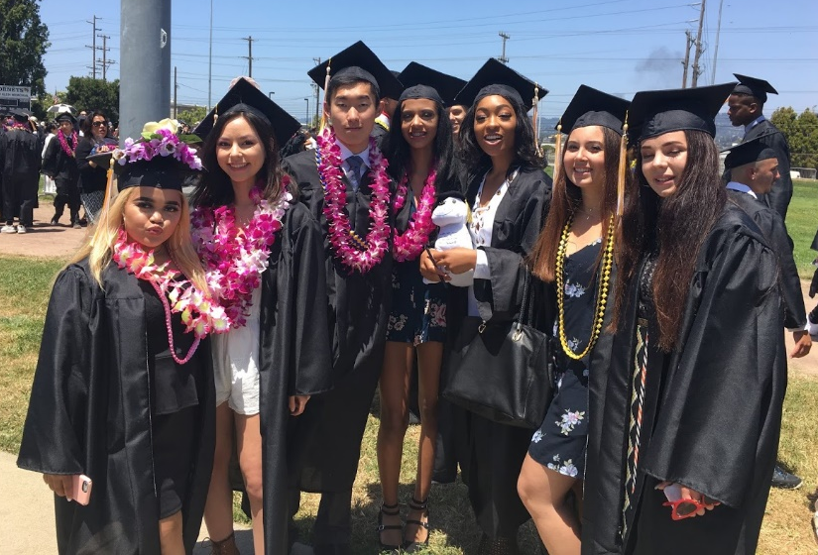
Objective
To provide 10th graders with information about graduation requirements, and post-secondary options so students can start creating their 4-year Academic Plans.

Slide 5
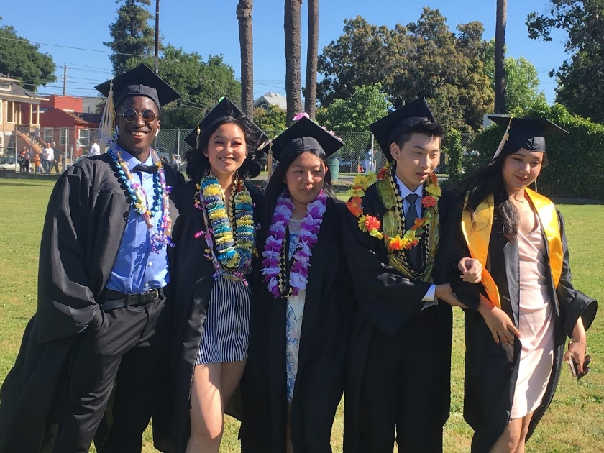
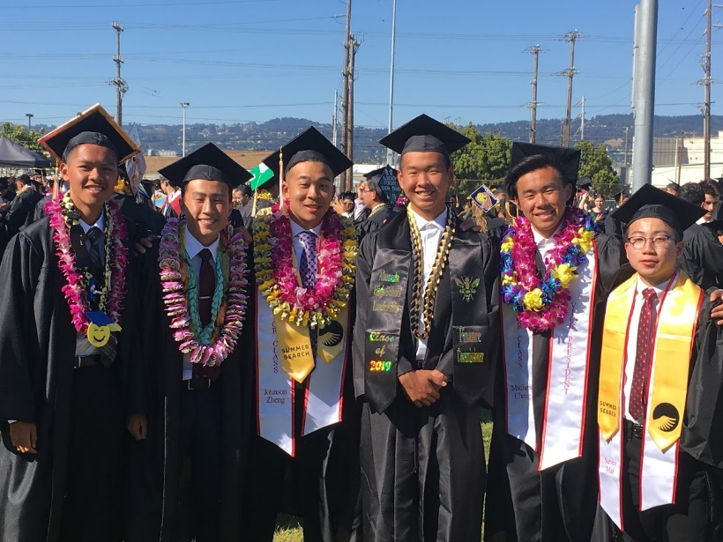
Rationale
To ensure that all sophomores understand the graduation and college requirements so they can best plan for their post-secondary goals.

Slide 6
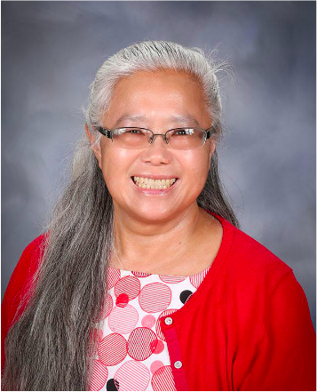
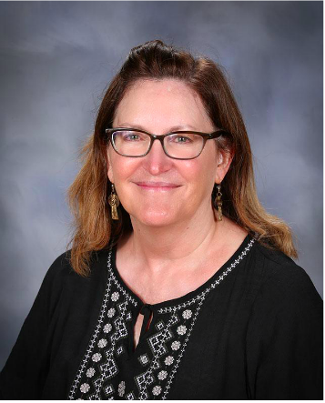
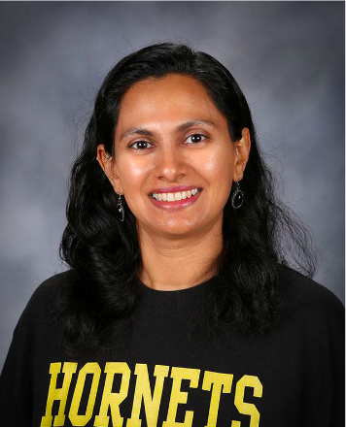
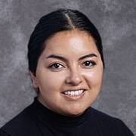

Sophomore Counselors
Counseling Office C132
Ms. Loy A - F
Ms. D’Ambrosio G - Le
Ms. Patil Lea - Sa
Ms. Albor
Sch - Z
College & Career Specialist RM E128
Ms. Gwen

Slide 7


Graduation Requirements
220 Credits
Subject requirements
Graduation!
Minimum GPA of 1.75
20 Hours of Community Service

Slide 8

Subject Requirements for Graduation
English | 40 Credits |  | Navigating Life | 5 Credits
Social Studies | 30 Credits |  | Ethnic Studies | 5 Credits
Math | 20 Credits |  | Visual Perf. Art / CTE | 10 Credits
Science (Lab) 1yr Bio. Life 1 yr. Physical | 20 Credits |  | World Language / CTE | 10 Credits
Physical Education | 20 Credits |  | Electives | 60 Credits
 |  |  | Total Credits Needed | 220

Slide 9

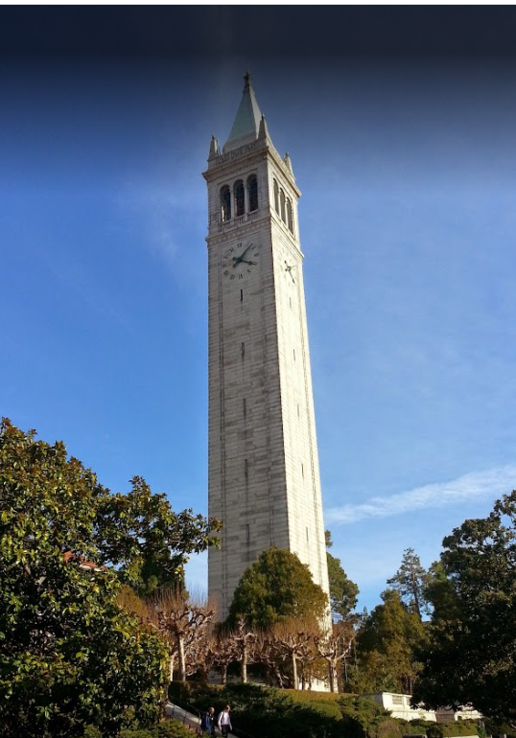
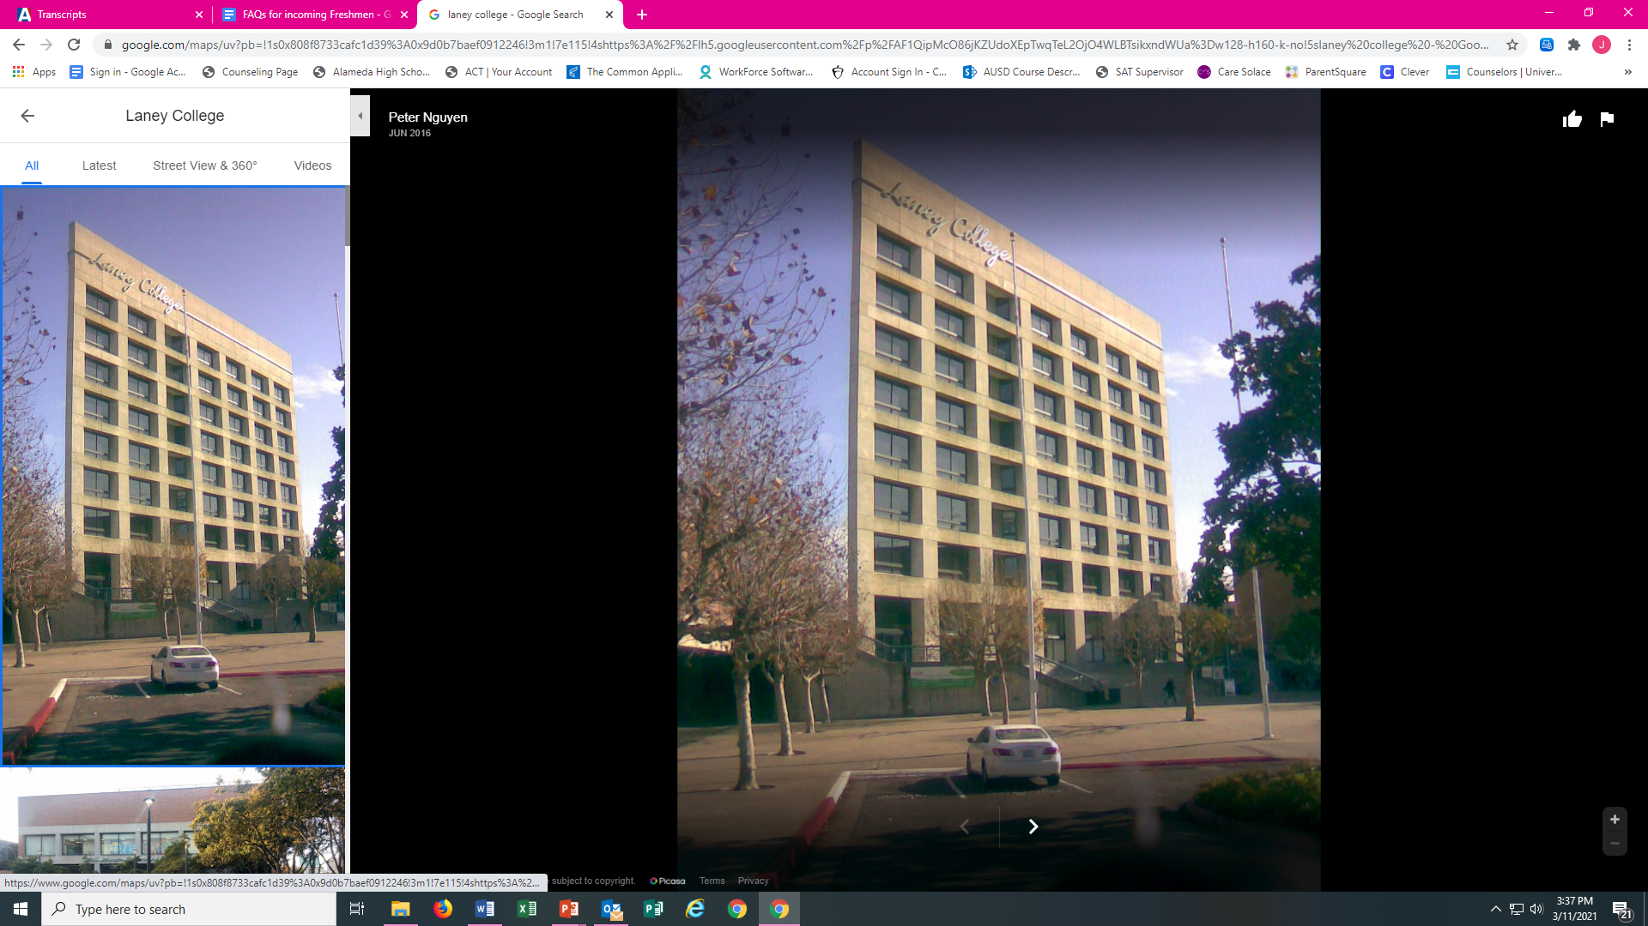

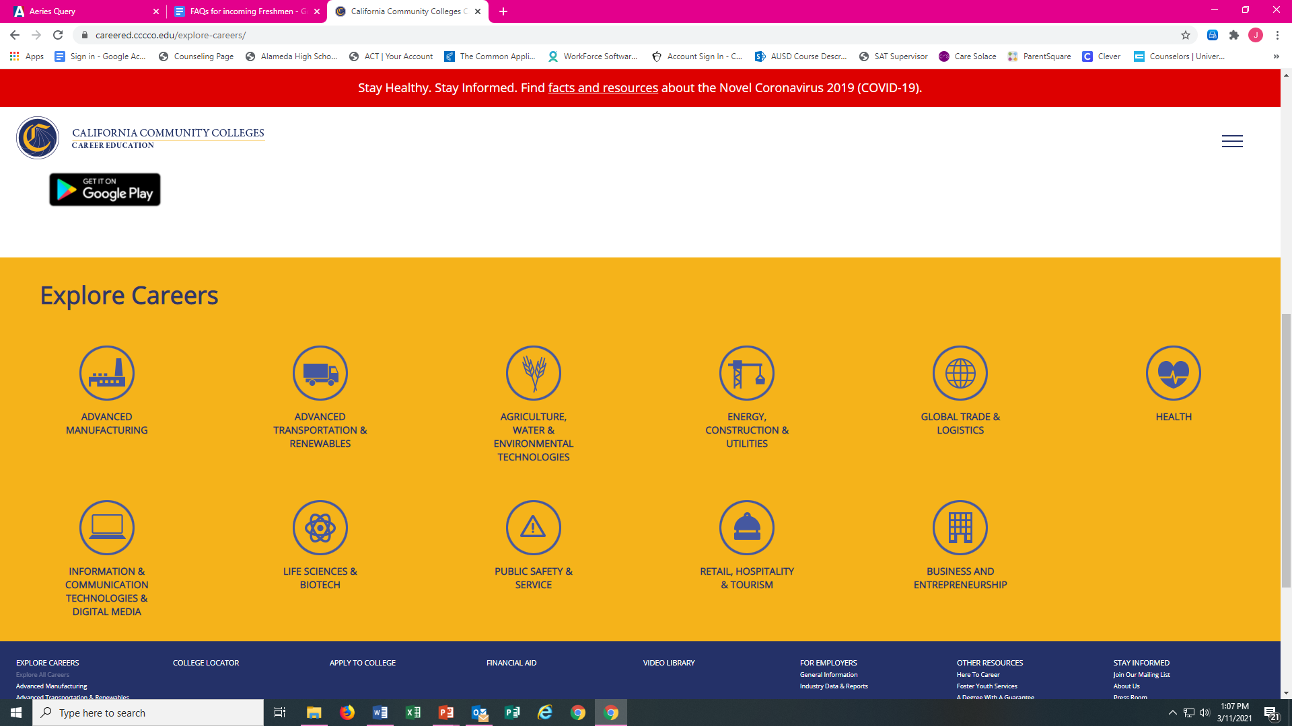
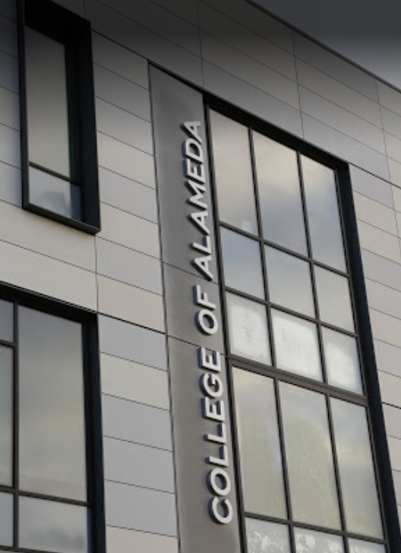

Post Secondary Plans
4-year college
Community college options:
- Transfer to a 4-year college
- Complete an Associates degree in a
Vocational program to prepare for the world of work.
Military
Apprenticeship programs
Employment

Slide 10
A) History
2 years
G) College Prep Elective
1 Year
B) English
4 Years
UC/CSU
A-G
Minimum Course Requirements
Grades of C or better required.
F) Visual/ Performing Art
1 Year
C) Math
3 Years
(Alg.1, Geom., Alg. 2)
4 Recommended
E) Foreign Language
2 Years
3 Recommended
D) Science
2 Years Lab Science
3 Recommended

Slide 11




Testing For College Admission
If you plan to apply to 4-year colleges, testing may be required.
PSAT- A standardized test to help prepare for taking the SAT. When taken as a junior, students with high scores could qualify for the National Merit Scholarship Program. The test is offered each October at AHS.
SAT or ACT- Standardized tests that some colleges may require for college admission. Students generally test junior year if needed. Register online
    SAT: www.sat.org/register
    ACT: www.actstudent.org
Starting in 2023-24, the SAT and PSAT will be digital tests.

Slide 12


Slide 13

Academic
4-year Planning

Slide 14


Planning
It is important to be Prepared.
All students will create an Academic Plan in Aeries to help them map out their High School journey and prepare for their post-secondary goals.
Once created, students will have the opportunity to update their plan each year during Course Selection.

Slide 15

Developing your 4-year Plan
Students need to make sure that they take the classes required for graduation.
Students need to make sure they are meeting all requirements necessary for their post-high school goals (e.g. meeting the A-G requirements for college admissions).
AP/honors classes are advanced classes. Before signing up for an advanced class, make sure you understand the rigor and commitment you are making by choosing it. Students can take a maximum of 4 AP/honors classes each year.
Students are allowed to take only 1 math class and 1 science class each year.

Slide 16
Math Sequence
Students must select the correct math course in sequence
Class Completed Enroll in: Next Class
Algebra 1 (passed with a grade of C or higher)
Geometry (required for 4-year college admissions)
Algebra 2
or
Advanced Algebra 2 (fast paced class recommended for strong math students who received B’s or higher in both Algebra 1 and Geometry)
(Either class required for 4-year college admission)
Geometry (passed with a grade of C or higher)
Algebra 2 or Adv. Algebra 2 (passed with a grade of C or higher)
Precalculus or Honors Precalculus (rec. for students who received a C or higher in Advanced Algebra 2)
or
Statistics (11th-12th grade only)
Precalculus or PreCalculus HP or Statistics (passed with a grade of C or higher)
Calculus, AP Calculus AB, AP Statistics or AP Calculus BC upon completion of AP Calculus AB. See Course Catalog for prerequisite details

Slide 17
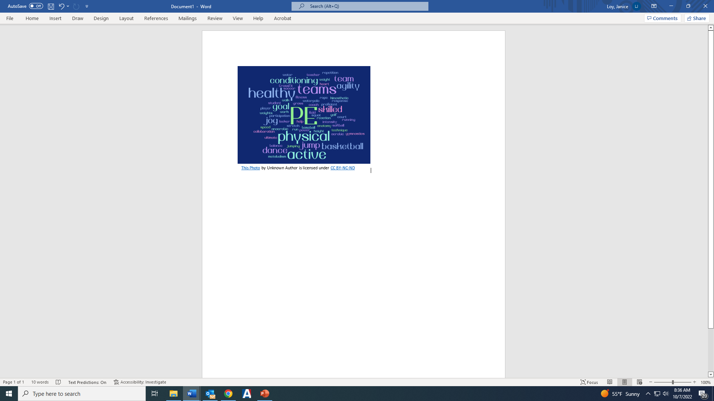
PE Requirement
Two years of PE are required for graduation.
Options for the 2nd year of PE: PE, Dance, Jujitsu
A student may qualify for a PE Exemption for the 2nd year of PE based on successful participation on school sports teams.
Completion of two seasons on a school athletic team will exemption one year of PE. One season will exempt one semester of PE.
To receive a PE Exemption, you must submit the PE Exemption Application.
If your PE Exemption is approved, you will be able to take another class instead of PE.
.

Slide 18
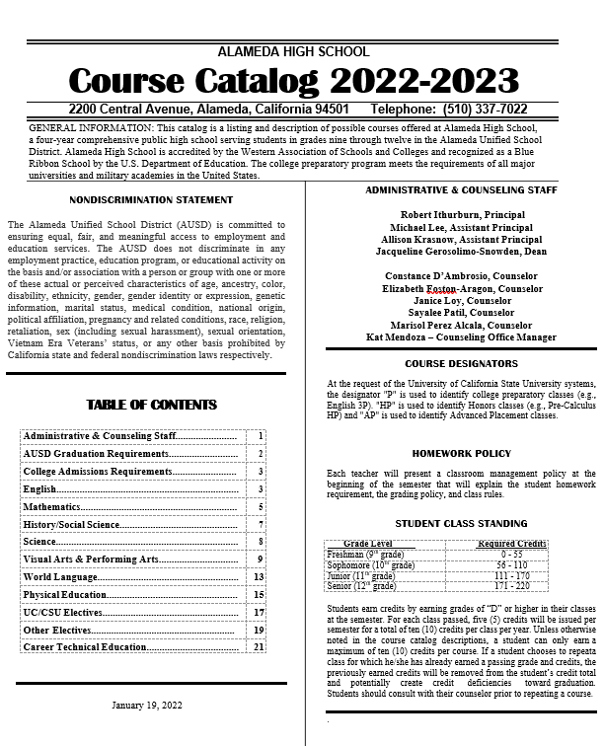
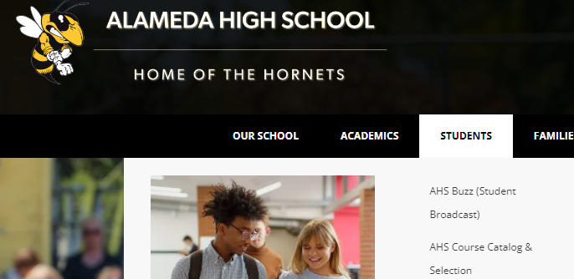
Course Catalog
Refer to the AHS Course Catalog for details and questions about the class offerings.
The Catalog is available on the website under “Students”.
.

Slide 19

Junior Course Requirements
Juniors are required to take 6 classes.
English 3 – Choose between English 3 P and AP English 3
US History– Choose between US History P or AP US History
Math or Elective
Science or Elective
Elective
Elective

Slide 20

Senior Course Requirements
Seniors are required to take a minimum of 5 classes. Students may only have a free period if they will have a minimum of 180 by the end of your junior year.
English: Choose between English 4 P & AP English 4
Government (semester) + Economics (semester) or AP Government (year) + Economics (semester) * note if you choose AP Government, the semester of Economics may be 0 period.
Elective
Elective
Elective
Elective or free period

Slide 21

Reminders
Create your Academic Plan with care. Make sure you have chosen classes that will meet your requirements for graduation and your post-secondary plans.
Aim for a balanced 4-year plan where you meet all requirements plus have time to enjoy your non-academic related interests.
Make sure you have met all prerequisites as listed in the Catalog.
Make sure you understand what category each of your classes is counting for towards graduation purposes as listed in the Catalog.
The Plan you are creating is a plan. Adding a class to your Plan does not guarantee that you will get into that class in the future.
Hornet Pride!

Slide 22

Creating your own 4-year Plan
Step 1.
Complete your 4-year plan worksheet

Slide 23
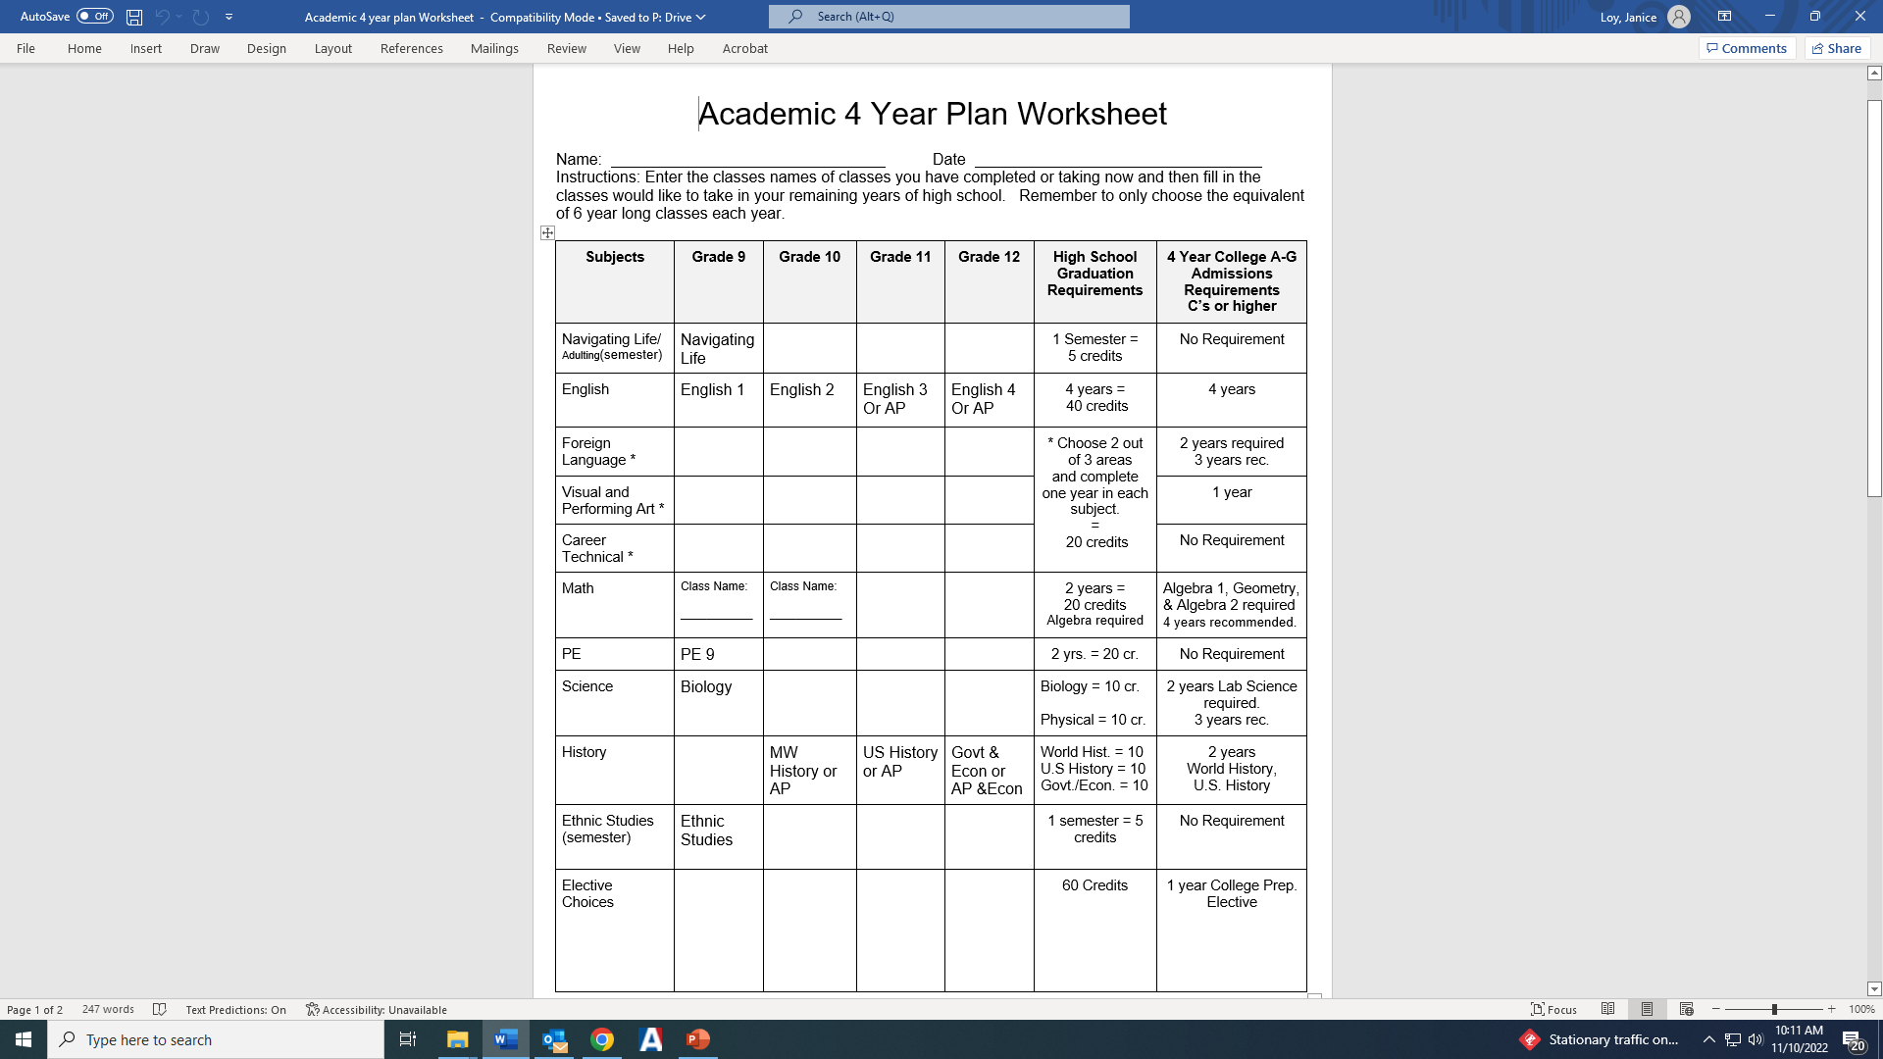

Slide 24
Creating your own 4-year Plan
Step 2.
In Aeries, go to Classes and select Academic Plan
Your 9-10th grade classes are already entered so you just need to plan for 11-12th grades.

Slide 25
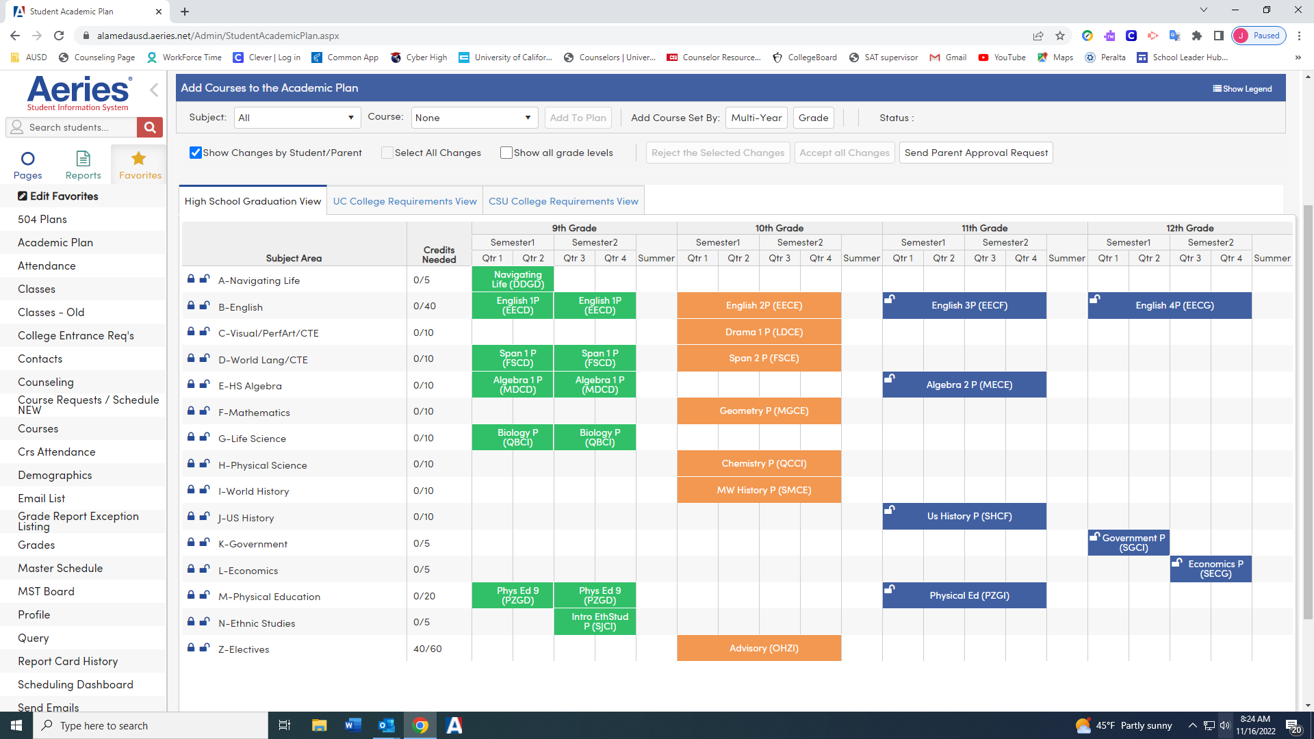
Academic Plan in Aeries
Notes:
Green= classes completed
Orange = classes currently enrolled
Blue = planned classes
Some classes needed for graduation have been prepopulated. Students can change those.
Point out the graduation requirement tracker

Slide 26
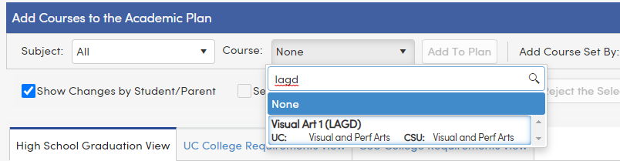
How to Add a Class
1.
3.
1. Type in the code for the class you would like to add.
Select the class.
Click on the “Add to Plan” button
2.

Slide 27
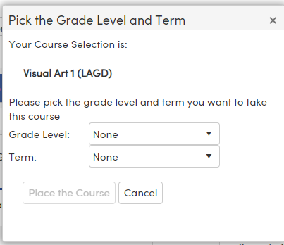
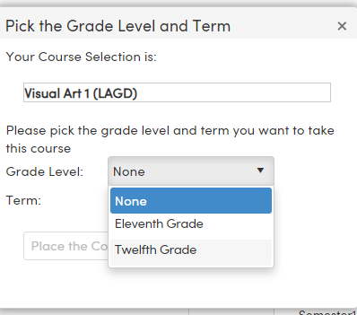
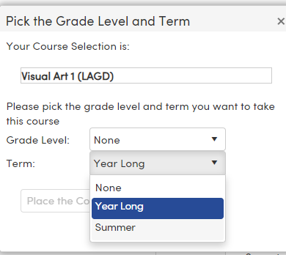
1. After you choose “add” you get this screen
2. Choose what grade level you want to take the class.
3. Choose “Year Long” for the term
Do NOT Choose Summer for the Term!

Slide 28
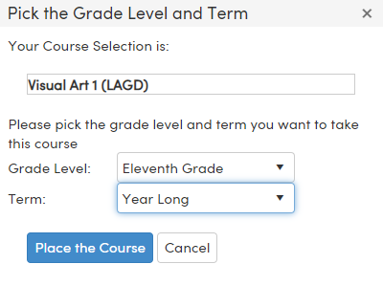
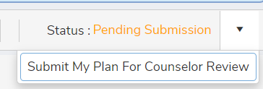
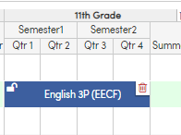
4. Select “Place the Course.
5. Continue adding classes until you have entered all of your selections for each grade level.
6. When you are done, Submit your Plan.
7. If you make a mistake or want to change a class that has been pre-populated, use the trashcan to delete the class.

Slide 29

Reminder: Do NOT choose SUMMER for the term!
Summer Term

Slide 30
Creating your own 4-year Plan
Follow the printed instructions if you need more detailed help.
Your 4-year plan must be in entered in Aeries by December 5.
You will have the opportunity to update your 4-year plan again during Course Selection.

Slide 31
Grade Level Requirements
 | 9th | 10th | 11th | 12th
English | English 1 | English 2 | English 3 | English 4
Math | X | X
Science | Biology
Social Studies |  | World History | US History | Government & Economics
PE | PE 9
Navigating Life | Navigating Life
Ethnic Studies | Ethnic Studies
VPA/CTE
WL/CTE
Electives

