Slide 1
Alameda High
Course Selection 2023-24
Presentation for Rising Seniors

Slide 2
Course Selection Steps
Students will complete their Course Selection Form. Distributed in US History classes during Course Selection Presentations or available in the Counseling Office or on the website.
Students will enter their selections in Aeries between January 24 and February 1.
Students will return their completed course selection form by February 3 to their history teacher.

Slide 3
Graduation Requirements
English | 40 Credits |  | Current Life/Adulting | 5 Credits
Social Studies | 30 Credits |  | Visual / Perf. Art / CTE | 10 Credits
Math | 20 Credits |  | World Lang/CTE | 10 Credits
Science (Lab) 1 Yr. Biological 1 Yr. Physical | 20 Credits |  | Electives | 65 Credits
Physical Education | 20 Credits |  | Total Credits Needed: | 220

Slide 4
A-G Eligibility Requirements
Note: only semester grades of A, B, or C count toward A-G eligibility requirements
A. History: 2 years required | E. Foreign Language: 2 years required. 3 years recommended
B. English: 4 years required | F. Visual Performing Arts: 1 year required
C. Math: 3 years required(Algebra 1, Geometry, Algebra 2) 4 years recommended | G. College Prep Elective: 1 year required
D. Lab Science: 2 years required (1 Biological & 1 Physical) 3 years recommended | UC Minimum Academic 10th and 11th GPA for Admission = 3.0 CSU Minimum Academic 10th and 11th GPA for Admission = 2.0

Slide 5
Choosing Your Senior Schedule
Students need to make sure that they are meeting all of the requirements needed for graduation.
Students need to make sure they are meeting all of the requirements necessary for their post-high school goals (e.g. meeting the A-G requirements for college admissions).
Seniors have the option of taking 5 classes (free period) instead of 6 with parent approval.
Students can ONLY have a free period their senior year if they will have a minimum of 170 credits at the end of junior year. You cannot have failed any classes (no F’s or NM’s on your transcript). Please review your transcript in Aeries to verify.
Students applying to 4-year colleges should consider taking 6 classes as seniors.
Students applying to 4-year colleges should consider continuing with math, science, and foreign language for their senior year.

Slide 6
Senior Course Requirements
Seniors are required to take a minimum of 5 classes. Students may only have a free period if they will have a minimum of 170 by the end of your junior year.
1. English 4– Choose between English 4 P and AP English 4
2. Government (semester) + Economics (semester) or AP Government (year) + Economics (semester) * note if you choose AP Government, the semester of Economics may be 0 period.
3. Elective
4. Elective
5. Elective
6. Elective or free period

Slide 7
0 period
The only 0 period currently planned is 0 period Economics for students taking AP Government.
Students who select AP Government will potentially be assigned 0 period Economics.
0 period will start at 7:30 a.m.
Students do not have a choice about which semester they may be assigned 0 period.

Slide 8
Adulting
Adulting (or Navigating Life) is a 1 semester class required for graduation.
If you have not met this requirement previously, you need to sign up for Adulting.
Students who request Adulting will be assigned another semester long class to pair up with it if those additional credits are required for graduation.
Seniors can have a free period paired with Adulting as long as they have a minimum of 5 classes each semester.

Slide 9
PE Requirement
Two years of PE are required for graduation.
A student may apply for a PE Exemption for that 2nd year of PE if they complete 2 seasons of a school sport. An application for the Exemption must be submitted upon completion of the 2nd season of sports.
PE Exemption paperwork is available on the website.

Slide 10
AP/Honors Policy
AP classes are the equivalent to college courses. Please remember that when selecting your AP/Honors courses.
Students may only take a maximum of four AP/Honors classes during the course of one school year.
Once students have registered for the following year’s classes, they may drop any AP/Honors class up to May 12, 2023, with no reason or approval process necessary. Drop requests must be made in writing to the counselor by submitting a completed Course Change Request form.
After May 12, 2023, all AP/Honors drop requests will be reviewed by the counselor and Administrative representative. These drops are not guaranteed and the student may need to remain in their originally chosen class.
Students interested in taking more than four AP/Honors courses at one time must petition in writing (with a parent signature). The Petition will be available on the website. Petitions must be turned in to your counselor via email by February 17, 2023 of the current school year. Students whose petitions are granted still may drop any of their AP/Honors classes up to the final drop date of May 12, 2023.
Students must have submitted their completed, signed Course Selection Sheet to the Counseling Office. Otherwise, students will not be enrolled in any AP/Honors courses.
Please note that signing up for an AP/Honors class is signing on to a commitment. DO NOT sign up for an AP class if you are not sure, as we may not be able to release you from the class due to seat availability in other classes. Also note, seat availability includes the planning for new students not yet enrolled.

Slide 11
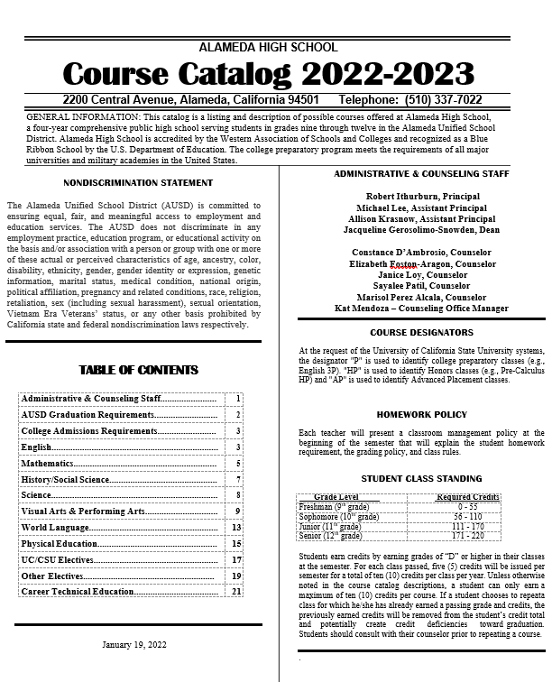
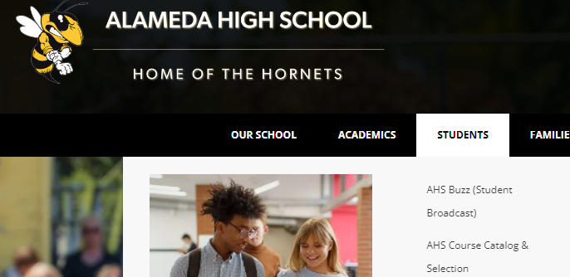
Course Catalog
Refer to the AHS Course Catalog for details and questions about the class offerings.
The Catalog is available on the website under “Students”.
.

Slide 12
Repeatable Classes
A student can only earn a maximum of ten (10) credits per course. If a student chooses to repeat a class for which he/she has already earned a passing grade and credits, the previously earned credits will be removed from the student’s credit total and potentially create credit deficiencies toward graduation. The only exceptions are listed below. The following classes may be repeated for credit towards graduation.
• Academic Strategies
• Advanced Projects Multi-Media Art with prior teacher approval
• Concert Band
• Contemporary Dance 2/3
• Creative Writing
• Digital Filmmaking 2
• Drama 3
• ELD Classes
• Jazz Band
• Journalism 2
• Jujitsu
• Leadership
• Musical Theater
• Orchestra
• PE 2
• Sports Medicine 2
• Strength & Conditioning
• Symphonic Band
• Theater Tech
• Yearbook

Slide 13
Reminders
Make your choices wisely. The master schedule is created based on your choices. You many not be able change your mind in the future.
If you have questions about specific classes, refer to the Course Catalog, watch the available class information videos, talk to your teachers about recommendations.
Make sure you have met all of the prerequisites as listed in the Catalog.
You are only allowed to choose 1 math and 1 science class during course selection. If you sign up for 2 math or 2 science classes, you will be dropped from one of those.
An “elective” means that you get to choose the subject and it is not required for the year. So after you’ve met the minimum requirement in a subject category for graduation any additional years will count as elective credit.
Some classes could count for credit in different categories. For example, Digital Film could count as a Visual Performing Art or CTE.

Slide 14
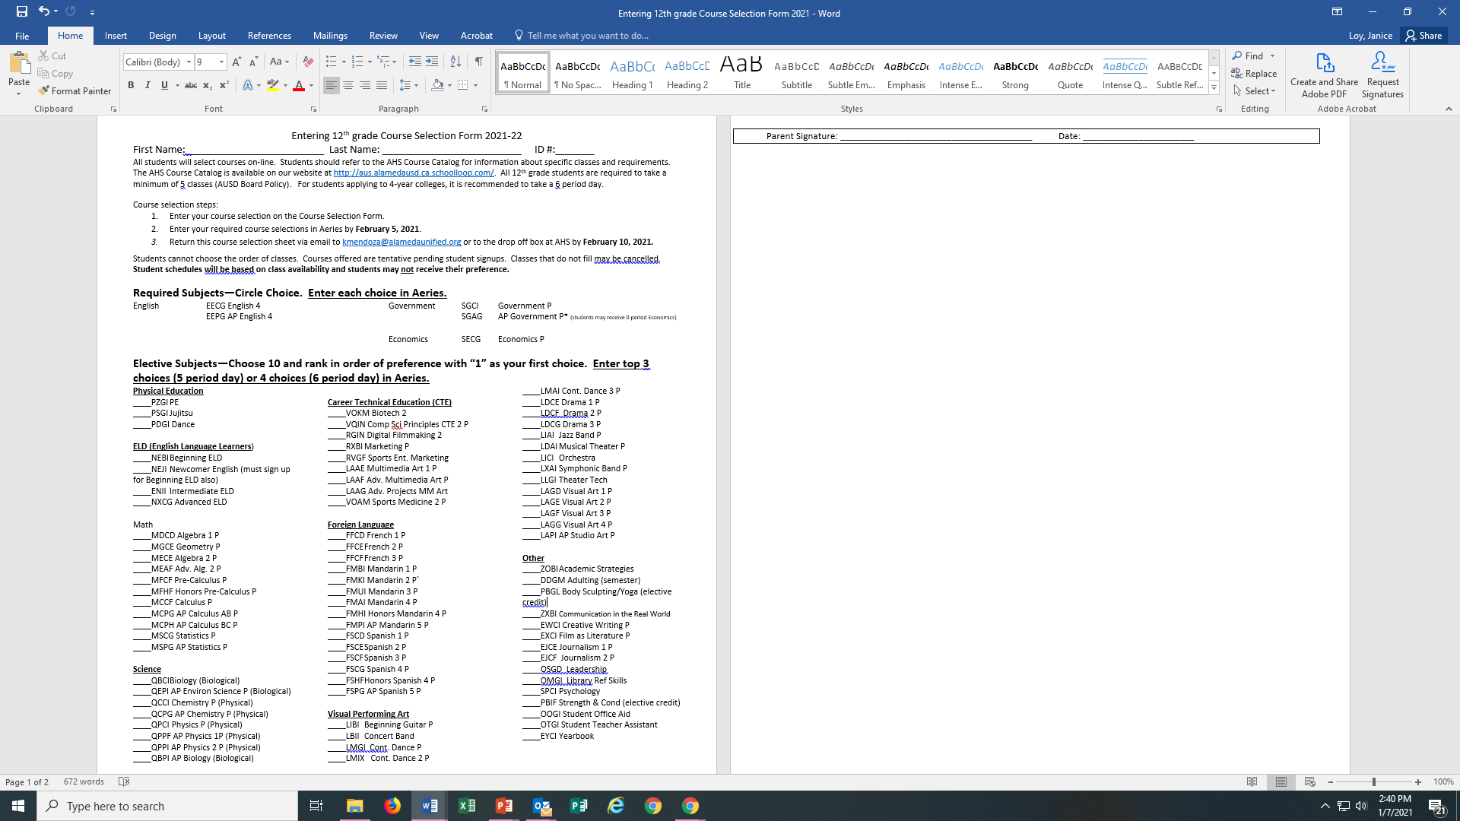
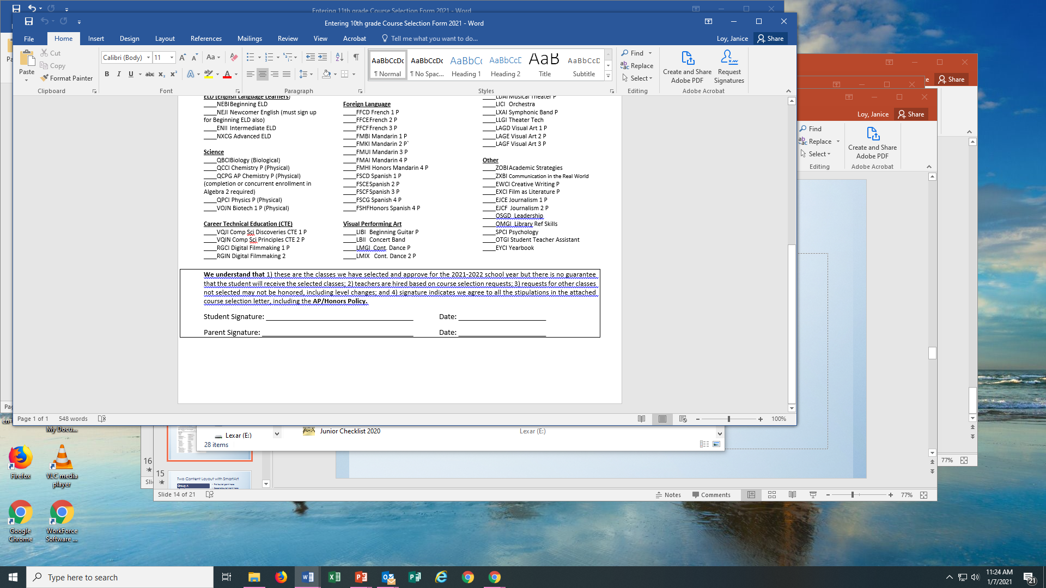
Course Selection Sheet
Circle your choice for the Required Subjects. (3 classes total)
Rank order your other choices 1-10 with “1” being your first choice. Your top 3 - 4 choices will be entered into Aeries as part of your Primary Request. Choices 4 or 5 – 10 will be alternate choices (not entered in Aeries).
Read and Sign your Course Selection Sheet.
Return your Course Selection Sheet
1
2
3

Slide 15

Enter Your Choices into Aeries
In Aeries, go to Classes and select Academic Plan
The next slide shows what you will see. Classes you have already completed are in green. Classes you are currently taking are orange. Some classes like English and social studies are pre-populated in blue. Your selections will be teal.
Add/Update your choices for your senior year. English, Government, and Economics are already added for you.

Slide 16
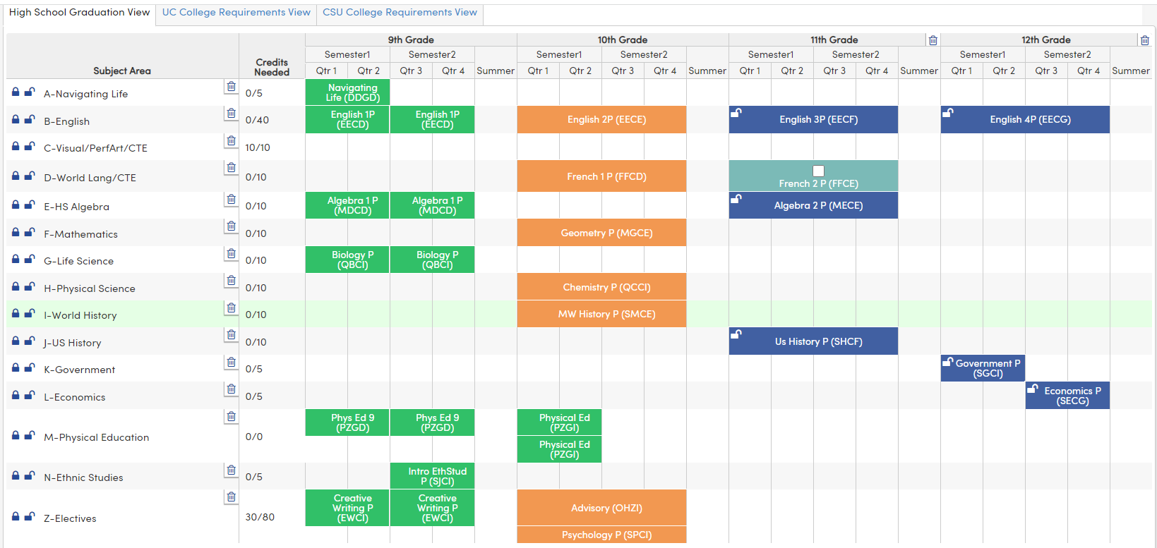
Academic Plan in Aeries
Shows if you still need credit in this area!
Notes:
Green= classes completed
Orange = classes currently enrolled
Blue = planned classes
Some classes needed for graduation have been prepopulated. Students can change those.
Point out the graduation requirement tracker

Slide 17
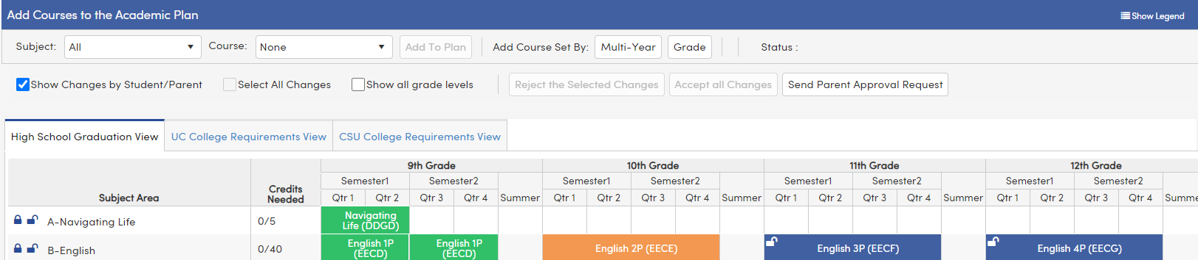
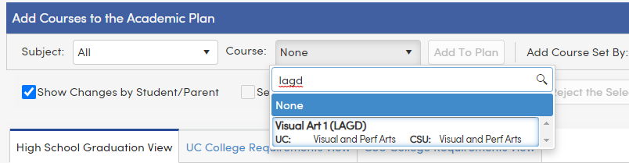
How to Add a Class
1.
3.
1. Type in the code or name for the class you would like to add.
Select the class.
Click on the “Add to Plan” button
2.

Slide 18
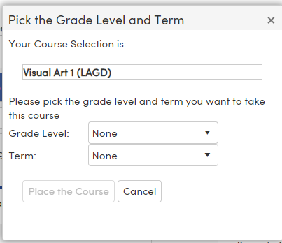
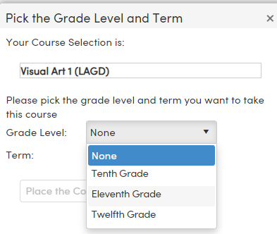
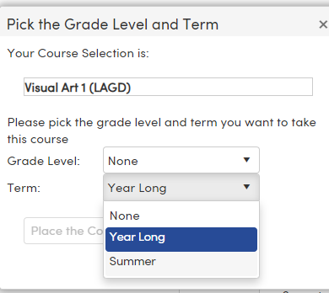
4. After you choose “add” you get this screen
5. Choose which grade level you want to take the class.
6. Choose “Year Long” for the term
Do NOT Choose Summer for the Term!

Slide 19
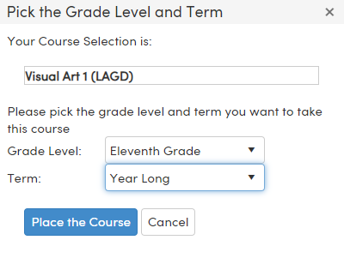
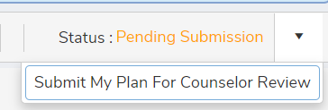
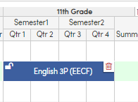
7. Select “Place the Course.
8. Continue adding classes until you have entered all of your selections for each grade level.
9. When you are done, Submit your Plan.
10. If you make a mistake or want to change a class that has been pre-populated, use the trashcan to delete the class.

Slide 20

Reminder: Do NOT choose SUMMER for the term!
Summer Term

Slide 21
Returning your Course Selection Sheet
Students must return their completed Course Selection Sheets which includes a parent/guardian signature.
Students will not be allowed to take an AP/Honors class unless the form is returned and signed. If a course selection sheet is not received, the student will be dropped from that specific AP/Honors class.
Turn your form into your history teacher by February 3, 2023.

Slide 22
Final Reminders
Enter your selections in Aeries by February 1.
If you are requesting a free period, select “Open Period” as one of your 7 primary choices entered into Aeries.
You can only select your classes, not the periods or teachers.
Students who do not complete their course selection process will have their schedules created by their counselor.
Only sign up for 1 math and 1 science class.
Turn in your course selection sheet by the deadline, February 10.

Slide 23
Questions?
Contact your Counselor
A- C Ms. Loy jloy@alamedaunified.org
D - Law Ms. D’Ambrosio cdambrosio@alamedaunified.org
Le – P Ms. Patil spatil@alamedaunified.org
Q – Z Ms. Albor malborrueda@alamedaunified.org

