Slide 1
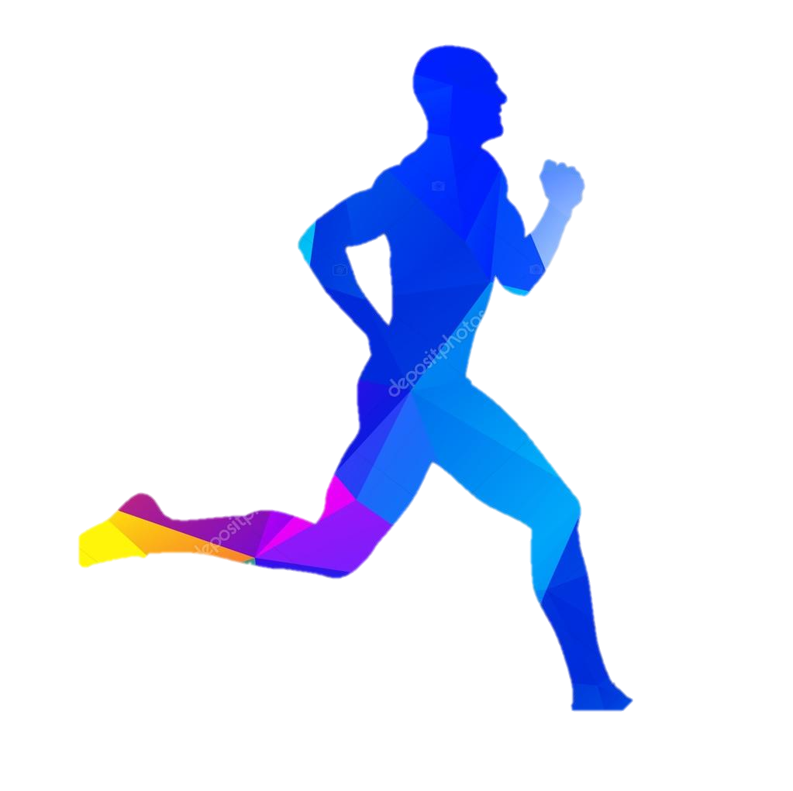
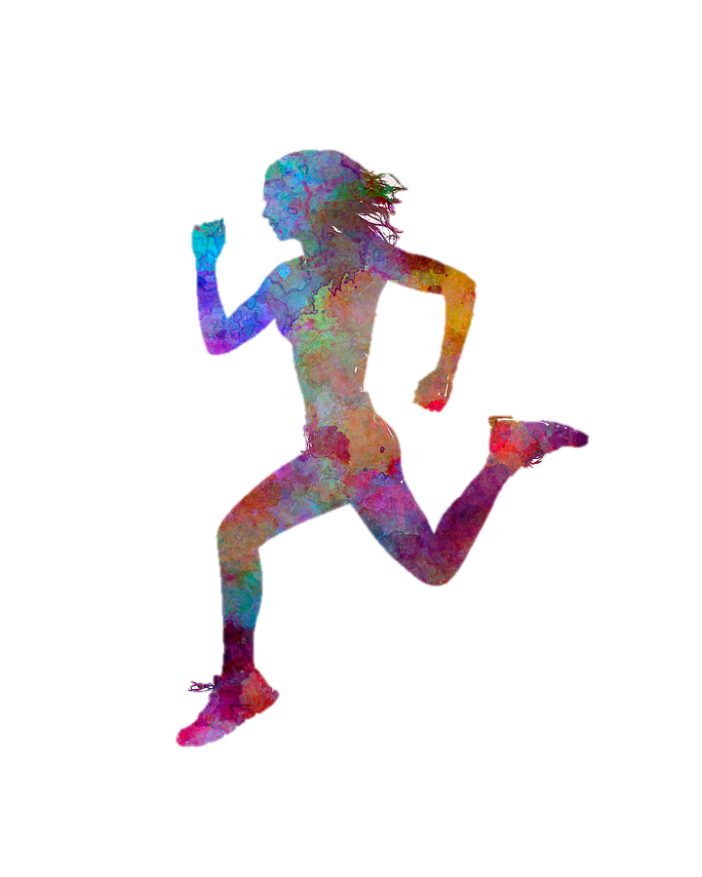

CC & Track Preseason
Readiness to Run Program
Avoiding accommodation adaptation injuries by being prepared to run

Slide 2
ADAPTATION TO RUNNING TAKES TIME
It take a minimum of 4-6 weeks of a gradual progression to be ready for your competitive season. Individuals MUST prepare before training with the competition coach.
Listen to your body.
Bones respond with mineralization
Tendons respond by increasing tensile strength
Muscle response by fibers increasing in strength and power

Slide 3
Principles of Training for Adaptation
Frequency : How often you work out
Intensity: How hard you work out
Time: Duration and distance of the work out

Slide 4
Principles of Training for FREQUENCY
Frequency or the how often variable; should be every other day for 3 weeks, on week four, add another day, on week five or 6, add another day so by the 6th week you can train for at least 5 consecutive days. Listen to you body. Keep a log
Examples: MWF. MWFsat or sun. MTWF sun
The intensity is easy. Nothing explosive or hard
The time or distance is still short. 30 minutes

Slide 5
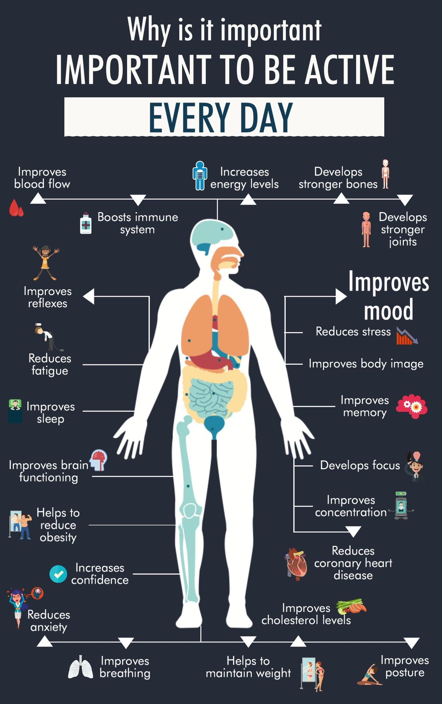
Regular exercise

Slide 6


Progression
What next?
Once we are training on a regular basis with no injury or complaints of discomfort or pain, we can begin to focus on the other variables of Intensity and Time.
Distance runners will want to focus on gradually increasing ( 5% wk) on running longer with respect to time and/or distance.
Sprinter and jumpers will start gradually progressing on Intensity. How fast, how hard, how high, instead of distance.

Slide 7
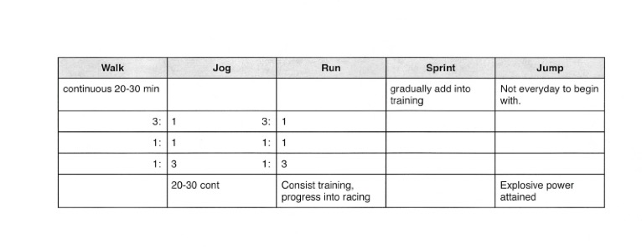
WALK JOG RUN SPRINT JUMP

Slide 8
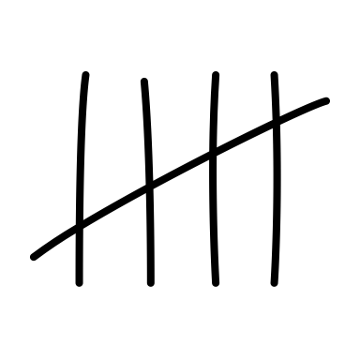





Journal log with reflections
Keep a log of your milage, intensity and time of each workout.
Make a notation of how you felt during the workout with reflection on the previous day or days training.
Note any soreness, fatigue, ease of session, sleep, sickness or any other variables influencing your wellness.

Slide 9


Optimize training. Two ways
PEAK PERFORMANCE
Diminished returned
PRE should be not be increased
until adapted
F.I.T. are held or decreased
Slower, weaker, short tolerance
Energy is down
Overall wellness is decreased
Performing declining
Apathy, irritable
Illness
Injury, Pain
set backs
PRE Increasing F.I.T.
Fast, stronger, longer
Energy is up
Sleep improved
Overall wellness is improved
Performing better
Focused
Making gains

Slide 10

Recovery Importance
Destructive mindset: No pain no gain. Pain weakness leaving your body.
Difference pushing to failure, working into pain. Making it worse.
Do not check out from your body. Listen to your body,
get in tune with it. Honor it, respect it.
Use your brain when you train.
Recovery is as important as the stimulus.
Needs the time to adapt. Many over train.
Keep in mind the purpose of practice. End of each day is to improve.
If you are going to robotically, mindlessly practice, Sometime
what is needed to do to get better is rest, sometimes to push.

Slide 11

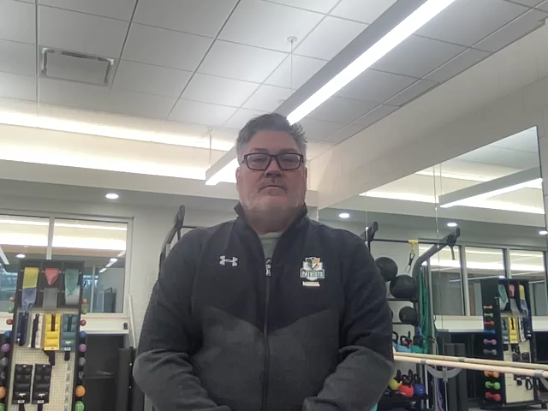
Recovery
After strenuous muscle glycogen exercise, it takes 48 hours w/ rest to replenish stores.
Sleep is among the factors that elevate growth hormone, a natural chemical that makes cells multiply faster and is a factor in muscle building. Studies show that when athletes get too little sleep, they can't train as long as they normally do, and their aerobic performance is impaired.
Prevention of Pediatric Overuse Injuries
Management of Individuals With Patellofemoral Pain
PREVENTING SPORTS-RELATED INJURIES
Preventing Chronic Overuse Sports Injuries
Stress Fractures
Stress Fractures in the Female Athlete
Stress Fracture Treatment and Prevention
Don’t Miss the Signs of a Stress Fracture
Click on Image for for closing remarks

Slide 12
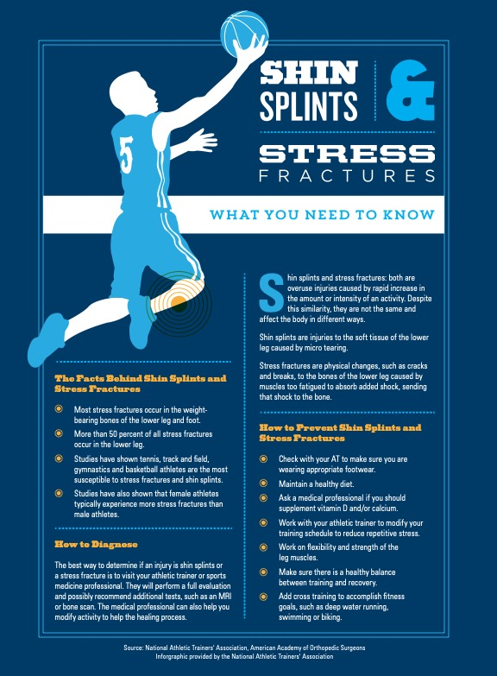
Understanding Stress Fractures
Click for larger infographic

Slide 13
Preparation
Proper attire/Shoes/clothes
What are the best new running shoes of 2022 according to Runners World?
Nutrition Pre and Post training/ Injury Nutrition
Here is a good article from Johns Hopkins about a Runner's based diet. Gives a good summary about runners should eat during their season
https://www.hopkinsmedicine.org/health/wellness-and-prevention/runners-diet
National Athletic Trainers’ Association Position Statement: Evaluation of Dietary Supplements for Performance Nutrition
Fluid Replacement for the Physically Active

Slide 14
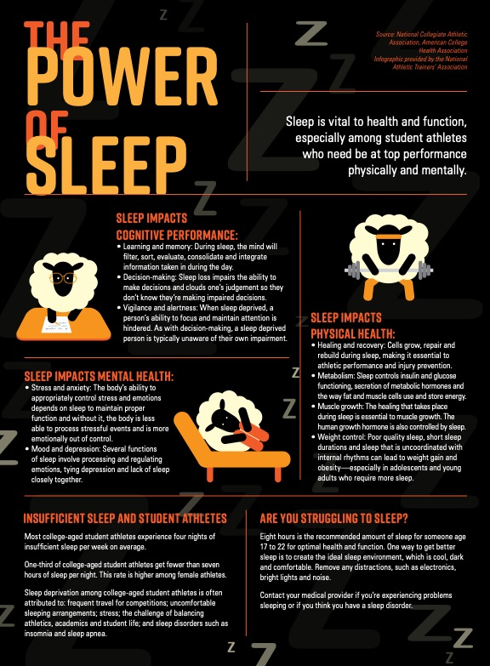
Power of Sleep
Click for larger infographic
Sleep: An Underrated Player in Athletic Performance

Slide 15
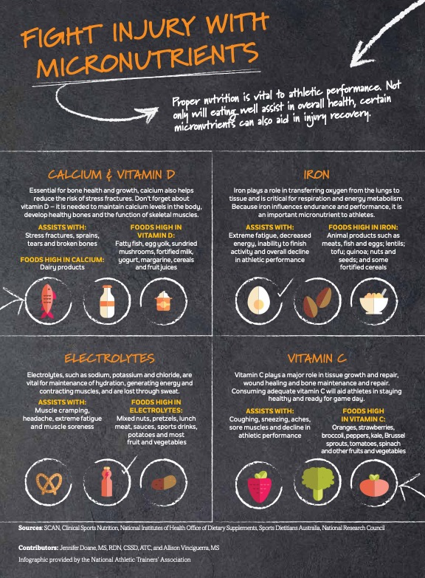
Fight injury with Micronutrients
Click to enlarge infographic

Slide 16
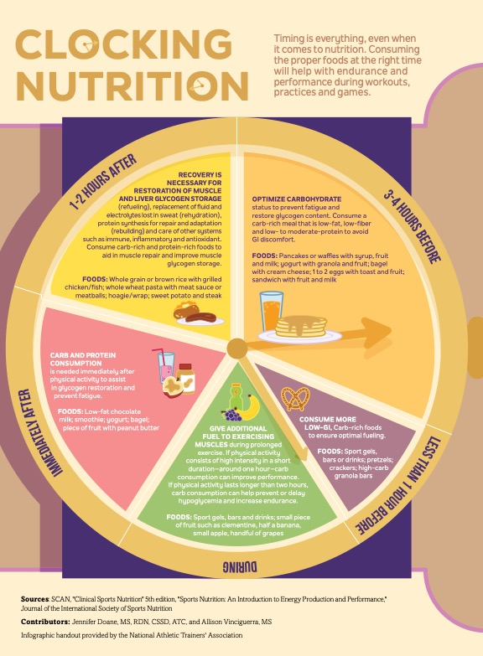
Clocking Nutrition
Click to enlarge infographic

Slide 17
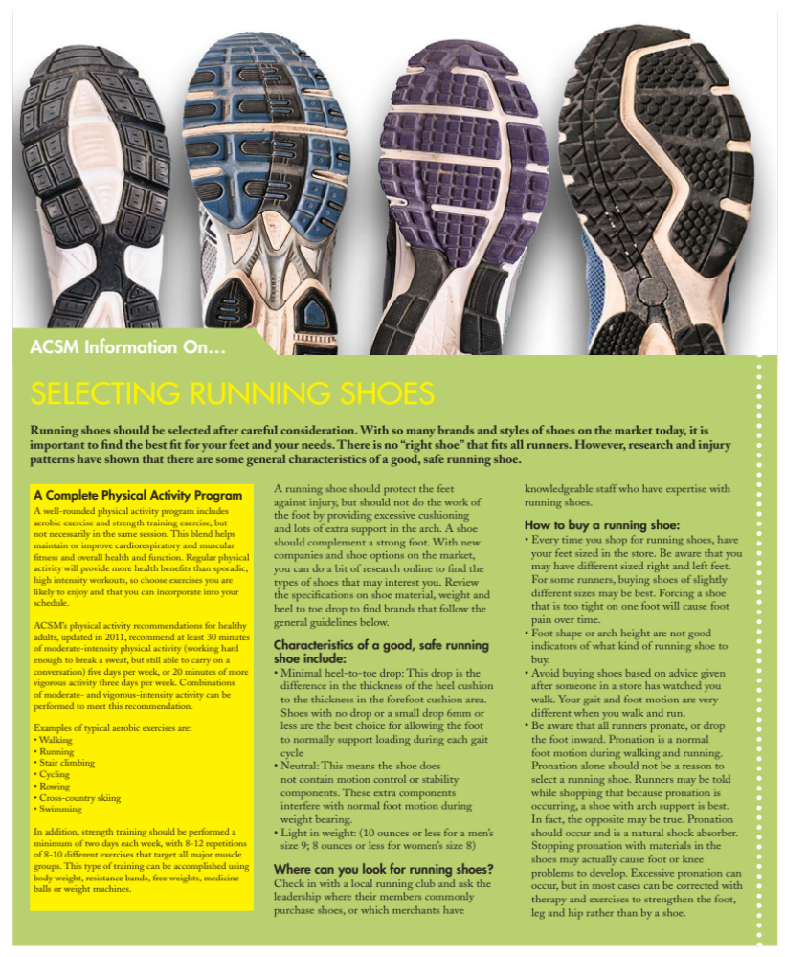
RUNNING SHOES
ACSM Information On… Selecting Running Shoes
3 key factors to consider when choosing your running shoes
Choosing the most suitable running shoes for your sport activity.
Choosing the right running shoes based on your goals.
Choosing shoes that are suitable for your gait and body type.
How to Choose Running Shoes
Consider where you're planning to run. Do you mostly hit the road? ...
Decide if you want more or less cushioning underfoot. ...
Understand whether you need a specific type of support for your gait. ...
Make sure the shoe fits.

Slide 18
Running Shoe selection
There are many good brands such as Brooks, Hoka, Karhu, New Balance, Saucony. Not all running shoes fit the same, it depends on on the individuals foot. The width, length and arch height decides what type of shoe is best for a runner. It is always a good idea to get a gait analysis (Perhaps by a coach or use the slow motion feature on most SMART phones)
to see how one naturally walks/runs to learn how your foot moves. Some might have more of a neutral movement, and other might fall in more more or roll out more. By knowing this information, certain shoes may be better than others. It is always good to try on different shoes at a store and run in them to see how they feel and fit before purchasing. It is always best to go to a running store that offers those trained in gait analysis to help figure out your foot motion and have the knowledge of the types of shoes they offer. A good example of this is Fleet Feet. It is best to not pick a shoe based on what it looks like even some shoes may be trendy, they unfortunately may not be built the best for support and can break down pretty fast.
Shoes can be expensive, but in the end that running shoe that fits and feels good could be the difference to keep yourself injury free. Shoes do not last forever! All shoes should be tracked. As soon as you start running in them, mileage should be tracked. Shoes need to be replaced anywhere from 300-400 miles max. Most smart/ fit watches have the availability to track this mileage, if not make a journal of your mileage in your shoes. I should mention running shoes should never be slipped on, they should be tied and untied, every time you use them. Shoes are part of a strong foundation in runners.

Slide 19
The 3 Principles of Running – What and How to Do Them
The 3 Principles of Running – What and How to Do Them
These foundational principles in running are the pose, the fall, and the pull. The better you can do these 3 principles of running, the better runner you will be.

