Slide 1
Energy
By Hannah Tatman

Slide 2
Energy
Energy cannot be created or destroyed.
There are 8 types of energy:
Chemical
Mechanical
Nuclear
Thermal “Heat”
Sound
Electrical
Gravitational
Radiant
All forms of energy fall under 2 categories, potential and kinetic.

Slide 3
Potential Kinetic
Potential energy is Kinetic energy is
stored energy. motion.
Chemical * Radiant
Nuclear * Thermal
Mechanical * Motion
Gravitational * Sound
* Electrical

Slide 4
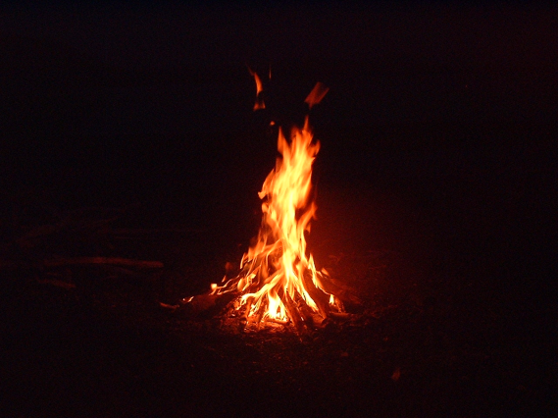

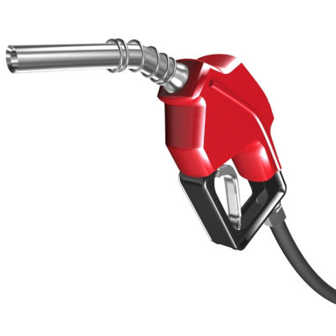
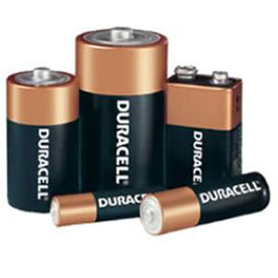
Chemical energy
Chemical Energy is a form of potential energy possessed by food and fuels. Some examples are:
  Burning Wood
  Food
  Oil
  Batteries

Slide 5
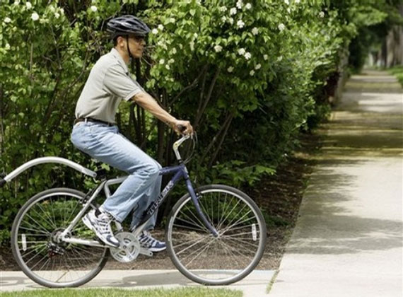

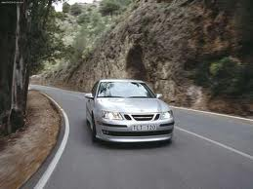
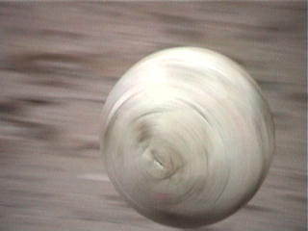
Mechanical Energy
Mechanical energy is energy created by movement. Some examples are:
  Riding a bike
  Running or walking
  A moving car
  Any moving object

Slide 6
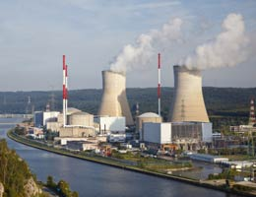
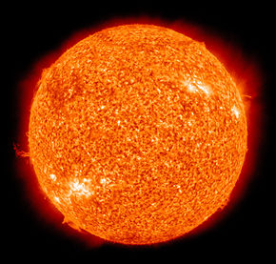
Nuclear Energy
Nuclear energy is a way of creating heat through the fission process of atoms. Some Examples are:
  Nuclear Power Plant
  The Sun (Can be other forms of energy as well.)

Slide 7
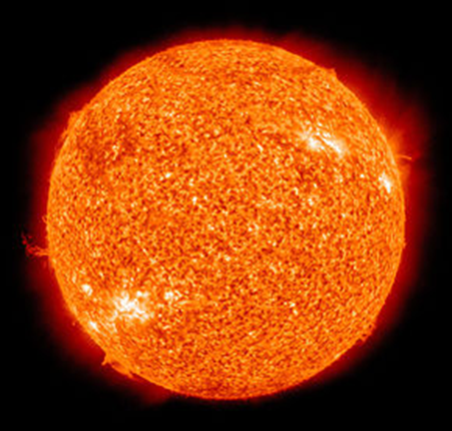

Thermal Energy (Heat)
Thermal Energy is a form of energy that causes a rise in temperature. Some examples are:
  The sun
  Fire

Slide 8



Sound energy
Sound energy is anything that causes sound. Some examples are:
  2 People talking
  Music
  A door slamming

Slide 9
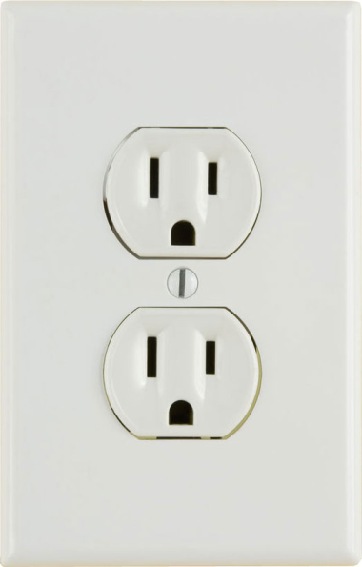
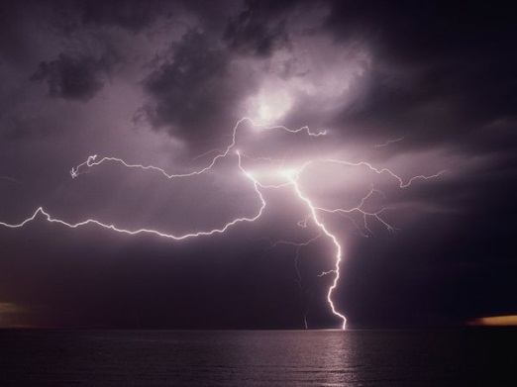


Electrical Energy
Electrical energy is the movement of electrons. Some examples are:
  Lightning
  Plug-In
  Computers
  TV’s

Slide 10

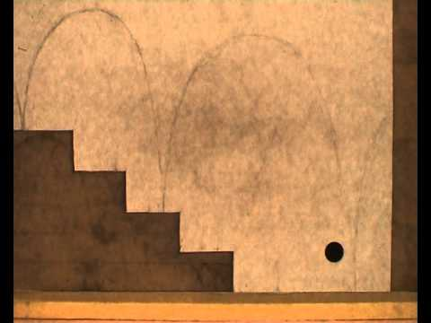
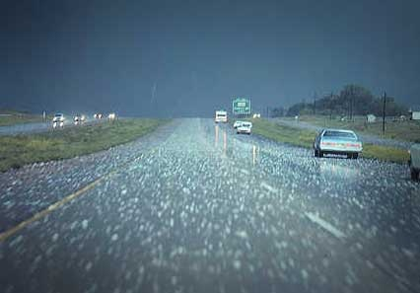
Gravitational Energy
Gravitational energy is energy released by a falling object. Some examples are:
  A ball falling down steps
  Apple falling from a tree
  Hail falling from the sky

Slide 11
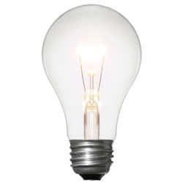
Radiant energy
Radiant Energy is energy that is transmitted in the form of electromagnetic radiation. Some examples are:
The Sun
Light Bulbs

Slide 12
Energy Transfers
An energy transfer is 1 type of energy causing another type of energy. For example:
Electrical Outlet Stove
(Electrical Energy) (Thermal Energy)
Gas Pump Car
(Chemical) (Mechanical)

Slide 13
Energy Transfers (Cont.)
Here are some more examples:
The Sun Plant
(Nuclear/Thermal/Radiant) (Chemical)
Battery Flashlight
(Chemical) ( Radiant)
Outlet Light Bulb
(Electrical) (Radiant)

Slide 14
Quiz
1. What are 4 out of the 8 types of energy?
2. Give me 2 examples of chemical energy? (Does not have to be the same as what I had in the Power Point)
3. What are 2 examples of light energy?
4. Is nuclear energy kinetic or potential energy?
5. Is an electrical outlet electrical energy or chemical energy?

Slide 15
Thank you for watching!!

