Slide 1
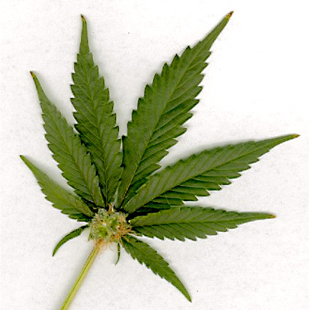
Marijuana
By : C.W.

Slide 2
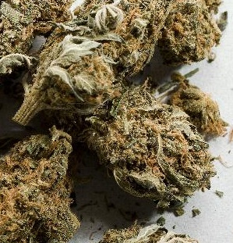
What is Marijuana?
Marijuana is an illegal drug made from the dried leaves, stems, and flower tops of a plant called the Cannabis Sativa, which is a member of the hemp family.

Slide 3
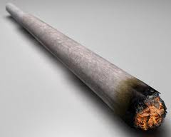
How is Marijuana Used?
Smoking it
Drinking it
Eating it
Most common way is smoking it. The user rolls it up like a cigarette and inhales the vapor.

Slide 4
Effects of Marijuana

Slide 5
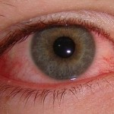

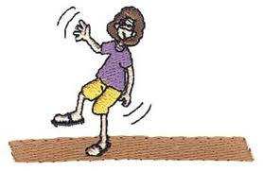
Short Term Effects
The strong feeling of euphoria, or “getting high”.
Redness of eyes
Rapid heartbeat
Change in judgment
Bad coordination

Slide 6
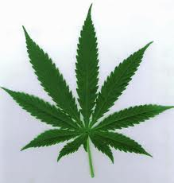
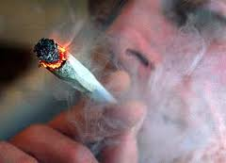
Why Do People Use Marijuana?
Many people use marijuana out of curiosity. They think it can improve their talents and capabilities. But actually, it impairs all abilities.

Slide 7
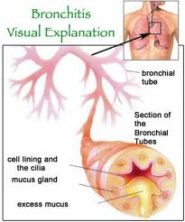
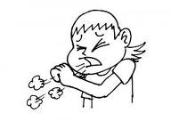

Long Term Effects
Loss of short term memory
Shortened attention span
Interference with learning
Bronchitis
Coughing
Chest pains
Higher risk of cancer
(Withdrawal symptoms from stopping use- irritability, anxiety, sleeplessness, aggression, and impaired appetite.)
In males, it can lower the production sperm.
In females, it can cause menstrual irregularity and reduced fertility.

Slide 8
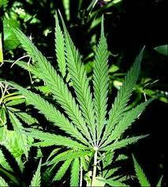
Statistics
Marijuana is the most commonly abused illegal drug in the U.S.
A 2005 survey shows that at least 97 million people have tried marijuana, and 14.5 million are regular users.
100,000 plants have been removed from California’s National Parks.
In 2002, 420,000 marijuana plants with a street value of $1.5 billion dollars were eradicated from California’s forests alone.
The cultivation of marijuana in California is a multi-billion dollar industry.

Slide 9
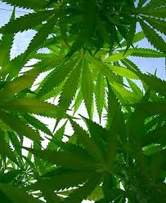

Statistics (cont.)
In Kentucky, marijuana is the most available and frequently abused drug.
Marijuana is usually cultivated outdoors in Kentucky, but more and more people are beginning to grow it inside their homes to avoid detection.
Kentucky ranked in the top three states in the nation for the number of cannabis plants eradicated each year.
In 2000, over 460,000 marijuana plants were eradicated in Kentucky. Kentucky ranked 3rd behind California and Hawaii.
According to studies by YRBS, 46% of high school students said they had tried marijuana at least once in their lifetime.

Slide 10
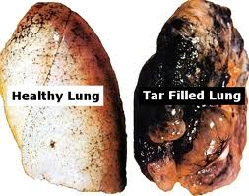
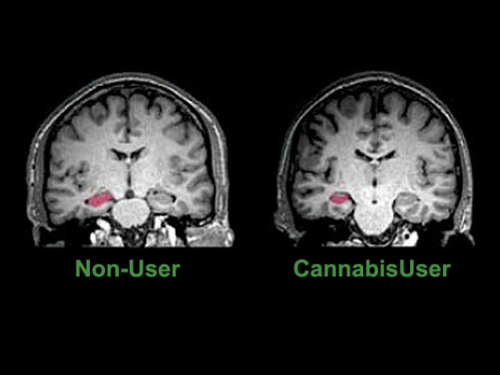
Your Body (cont.)
Blood is also affected Smokers have trouble getting enough blood to their brains.
Parts of the brain that control memory and decision making don’t get enough oxygen.
Regular smokers’ blood flow never returns back to normal.
Marijuana damages your lungs. The smoke is considered an irritant because it irritates the lungs.
When the lungs are being harmed by the smoke, they release your body’s natural substances that fight the toxins. But, it also harms the healthy tissues of the lungs.
The most common cause of death from a respiratory disease in the U.S.A. is emphysema. And it is the 4th most common cause of death overall.
According to most studies, the heart may beat 20-100 percent faster.

Slide 11
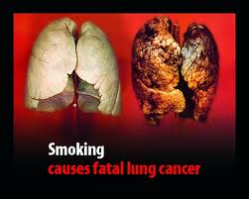

Not So Fun Facts…
Tar is the harmful resin produced by burning plants.
One marijuana joint has the same amount of tar as four cigarettes.
The tar in marijuana smoke is high in carcinogens. Carcinogens are chemicals that cause cancer.
Most studies show that smoking marijuana may increase your risk of having head, neck , and lung cancer.
Teens who use marijuana weekly have double the risk of depression in later life.

Slide 12
Your Body
THC in the plant gets into your bloodstream and travels to your brain.
Tissues, organs, and fat can absorb the THC.
Traces of the chemical can still be found in your body up to a month after the last use of it.
Also, after the initial effects of the marijuana, the users tend to get sleepy, lethargic, and lazy.
They’re body temperature may have lowered, colors and sounds may seem more intense, may become depressed, and paranoid.

Slide 13
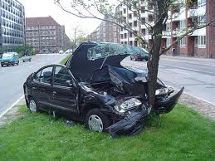
Behavior
When using marijuana, it clouds your thinking.
Statistics show that people who smoke marijuana before getting behind the wheel are less likely to be responsible drivers.
After the euphoria, lethargy sets in. Lethargy is a state of physical slowness and mental dullness.

Slide 14
Do you want your lungs to look like this?!
They will if you do marijuana!

Slide 15

Consequences of Marijuana
http://player.discoveryeducation.com/index.cfm?guidAssetId=C36D6B66-E175-4372-95AD-07BEE2B06AA2&blnFromSearch=1&productcode=US

Slide 16
Sources
http://web.ebscohost.com/src/detail?vid=10&hid=126&sid=195209df-5767-4803-b272-c80cbe984e35%40sessionmgr112&bdata=JnNpdGU9c3JjLWxpdmU%3d#db=mih&AN=32Y0261015581
http://worldbookonline.com/student/article?id=ar344500&st=marijuana
http://abovetheinfluence.com/facts/drugsmarijuana/
Marijuana By : Jeanne Nagle
Pictures of marijuana : science.howstuffworks.com dcist.com blog.bioethics.net
Pictures on slides 5& 6 : eyecare.ygoy.com iknow2.net logosoftwear.com parkerdonat.wordpress.com sfist.com parentsconnect.com
Pictures on slides 7 & 8 : umsl.edu serenityacres.wordpress.com goldsteinlawgroup.com
Pictures on slide 9 : locallender.info thefastertimes.com
Pictures on slides 11 & 12 : godandscience.org quit-weed.com seerpress.com cancertypes.tk
http://www.justice.gov/ndic/pubs1/1540/marijuan.htm

