Slide 1

CRYSTAL METH
BY: BW

Slide 2


What is crystal meth
Crystal meth is a form of methamphetamine. It has many different nicknames
( ice, glass, crank, and Tina. )

Slide 3
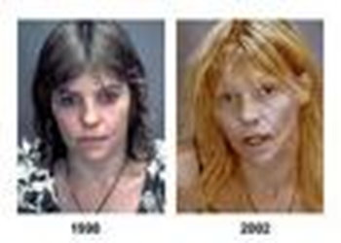

how can crystal meth harm you
CRYSTAL METH IS THE MOST DANGEROUS DRUG IN THE WORLD. ITS DANGEROUS USE, TO BE AROUND, and TO MAKE.

Slide 4

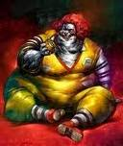
How does it affect you
Chrystal meth won’t just change your attitude it will change the way you look. You can go from beautiful to ugly within a year.

Slide 5
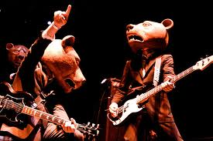
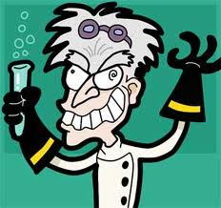
Where does your body get hurt the most?
Nowhere is the the damage worse than the brain. Meth
can make you feel incredible and dynamic ,but that’s only a temporary sensation. Its a short way up but a long way down. Feelings of pleasure and power are replaced with severe depression, insomnia, and hallucinations.

Slide 6
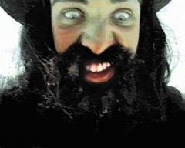
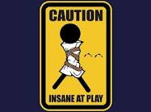
Why do people do it
Chrystal meth may be the most addictive drug on the planet because it causes the brain to release much more dopamine than other drugs. Users feel so much pleasure that they want to keep reliving the experience , they crave it more than anything.

Slide 7
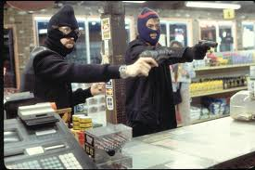
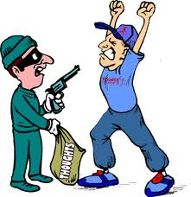
What happens when you’re on meth?
Its possible to become a criminal when you become a meth addict. As with most drugs, it’s a crime to possess, sell, or make meth. However there are other crimes related to meth like stealing , abusing, killing, or mabe just hurting somebody.

Slide 8
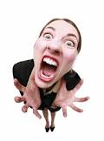

How does Meth effect behavior?
(abuse and violence) Chrystal meth makes people’s behaviors very unpredictable. It interferes with all the parts of the brain that control emotions and good judgment. The line between right and wrong is blurred and this causes addicts to attack quicker if they lose their temper. They can physically and verbally abuse someone, this can happen at home or even out in public.

Slide 9
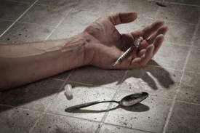
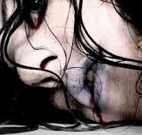
Is it fatal?
  Yes, Chrystal Meth is extremely fatal. It can kill you. After doing it for a while your body gets hurt so much your body can’t function right and you can die. The word for this is overdose. Many people die each year because of this but still others don’t take caution!

Slide 10
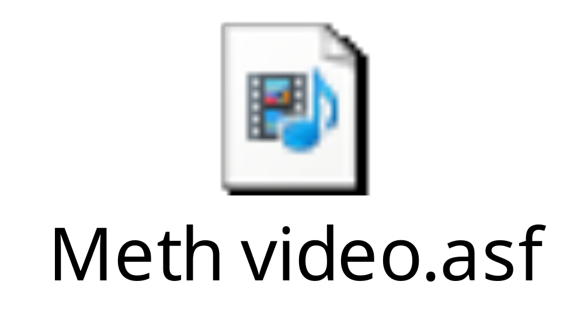
Crystal meth video

Slide 11
Sources
www.Addiction,narcononrehab
www.cyprusupdates.com/../
www.telegraph.co.uk/health/healthpictureg
www.12steptreatmentcenters.com/articles.asp
www.flicker.com/photos/rabidnouaracer/3506644196
www.irleo.worldpress.com/.../
www.findingthin.wordpress.com./.../
www.moheak.com/.../
www.spectronresowcer.com/crazy-science-profresser.com
www.rollitup.org/.../230264-chrystalmeth.html.com
www.wallpaperstag.com
www.Ipstenu.org
www.availibleimages.com
www.chattahbox.com
www.calibansrevenge.blogspot.com
www.Inspringgenerations.org
www.Brainstunts.blogspot.com
www.gaurdian.co.uk
www.Care-mates.com
www.drugfreehomes.org
www.trialx.com

