Slide 1

TOBACCO
By: HGT

Slide 2


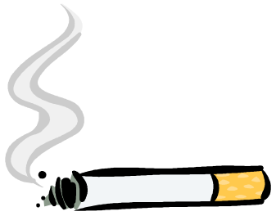
What is tobacco?
Tobacco is a plant with leaves that are used to make smoking tobacco- used in cigarettes, cigars, and pipes, as well as chewing tobacco and snuff.

Slide 3
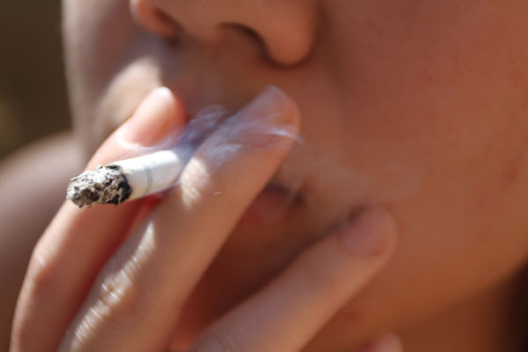
Who uses tobacco?
People have used tobacco for thousands of years. Teens, adults, elderly, and even children that aren’t supposed to. People have smoked it, snorted it, chewed it, and even drank it’s juice.

Slide 4
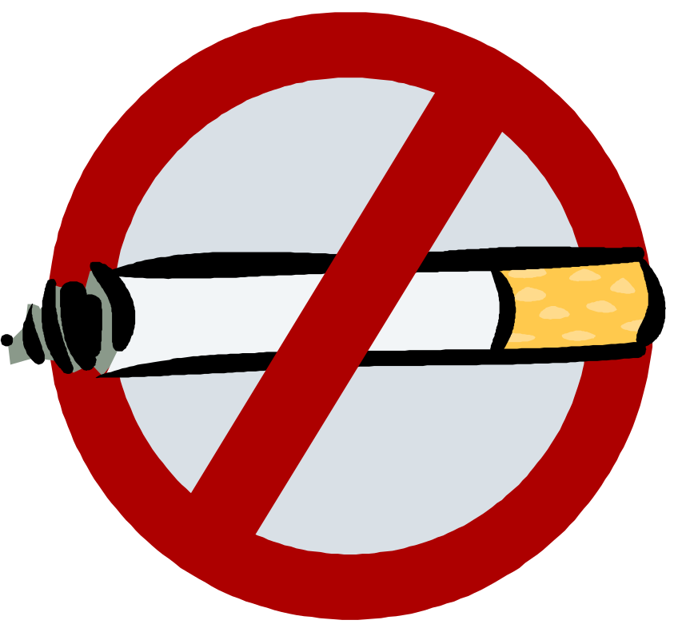
How can tobacco harm you?
Tobacco is the leading preventable cause of disease, disability, and death in the United States. Tobacco can cause lung cancer, mouth cancer, cardiovascular diseases, and even death.

Slide 5
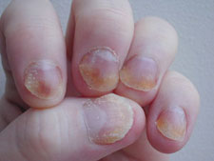
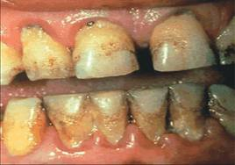
How can tobacco affect your appearance?
Using tobacco can affect your outside appearance just as well as it can your inside appearance . Heavy tobacco users have yellowish teeth and yellow fingernails. Using tobacco can also cause bad breath. It can also cause “early aging” by which you might get wrinkles earlier then you usually would.

Slide 6
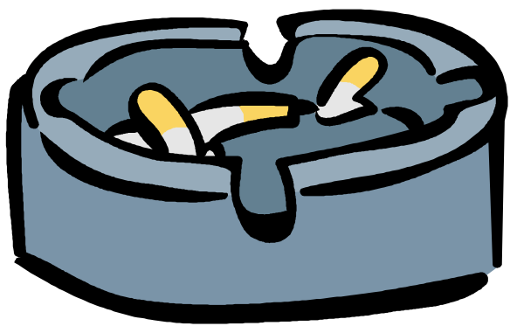
Short term affects
Some short term affects from using tobacco are: your heart rate may go up, as well as your blood pressure. You may experience dizziness, irritation of the eyes and throat, and bad breath. Your physical endurance will go down; the acid in your stomach will increase, and you will not be able to taste and smell things you usually do.

Slide 7
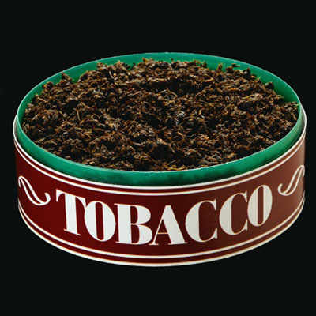
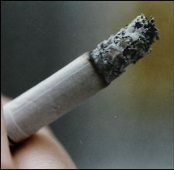
Long term effects
Some long term affects of using tobacco are: cancer in the lungs, emphysema, chronic bronchitis, shortness of breath, and stomach ulcers. You may also have cancer of the mouth, esophagus, and pancreas.

Slide 8
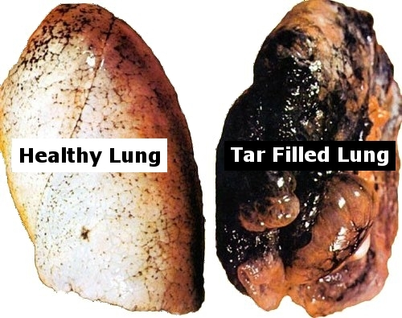
Lungs before and after using tobacco.

Slide 9


Why do people use tobacco?
Many People use tobacco because they are pressured into it, or might use it because everyone else does, so why not? Others may use tobacco because they think it looks cool. Some people use it because they think it feels good, or calms them down.

Slide 10
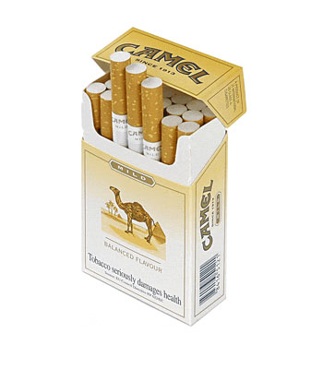

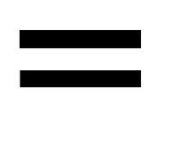
How can tobacco harm you financially?
Many people waste their time and money on tobacco. Cigarettes these days can cost about $5.25 per pack. That could add up to about $1500 a year!

Slide 11


The lure of tobacco
Tobacco users often have trouble remembering how they started, even if they can easily recall how sick their first cigarette or chew made them. If the user has been smoking for a long time, they may not even remember what it feels like to breath with undamaged lungs.

Slide 12
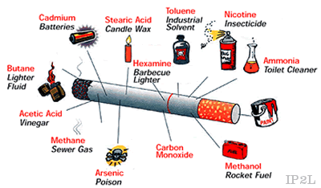
What Is In Tobacco

Slide 13

Facts About Tobacco
People who use tobacco have 10 times the risk of developing lung cancer, than a normal non-smoker.
Tobacco ruins your looks and your health, and it’s a killer.
Using chew tobacco can cause your teeth to fall out.
The more you smoke, the shorter you live.
Just because you use tobacco doesn’t mean that it just harms you, It can also harm the people around you.

Slide 14
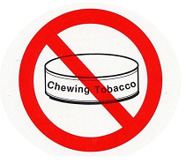
Do Not Use Tobacco!

Slide 15
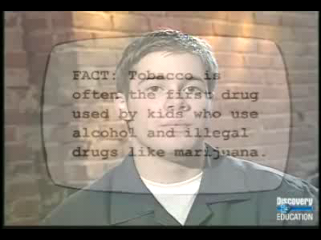
Video

Slide 16
Sources
http://kvl.com/
http://worldbookonline.com/student/article?id=ar559860&st=tobacco
http://abovetheinfluence.com/facts/drugstobacco/
Tobacco By: Jason Porterfield
http://buysmokelesstobaccocompany.com/rooster_smokeless_tobacco.php
http://www.drugnet.net/gallery/view_photo/chewing-tobacco-77
http://www.metrolic.com/the-benefits-of-smoking-174065/
http://vanessaemananasofia.glogster.com/no-smoking/
http://www.cure-nailfungus.com/fungus-of-the-fingernails.jpg
http://www.drugnet.net/resources/gallery_photo/chewing-tobacco77.jpg
http://www.popularemails.com/whatisinacigarette.htm
http://www.lungdetoxification.com/
http://www.ocularharmony.com/blog/great-cigarette-package-design/137/
http://donaldsonville.org/wp-content/uploads/2011/08/head_question_mark.jpg
http://www.clker.com/clipart-no-smoking-sign.html

