Slide 1
The Dangers of
COCAINE
☺By : J. C.

Slide 2
Cocaine Adversities
      Abusing cocaine has a variety of adverse effects on the body:
Cocaine constricts blood vessels
Dilates pupils, and increases body temperature

Slide 3
What is Cocaine
Cocaine is a powerfully addictive stimulant that directly affects the brain or nervous structure. Once injected, cocaine users can not predict what will happen next.

Slide 4
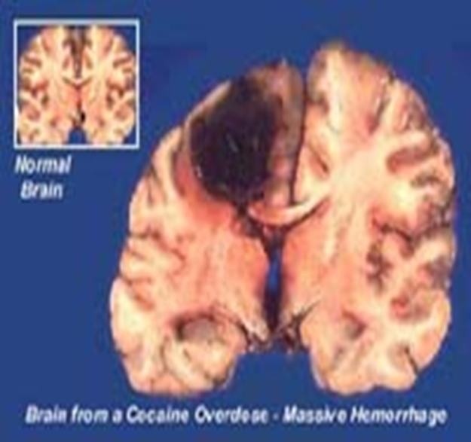
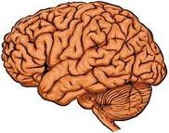
The Comparison of COCAINE On Your Brain
With cocaine
Without Cocaine

Slide 5
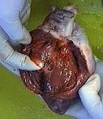
Cocaine And Your HEART
Myocarditis, or heart muscle damage leading to heart failure
Endocarditis, or inflammation of the heart lining
Vascular thrombosis, or clots in the coronary arteries
Pulmonary edema, or fluid in the lungs
Dilated cardiomyopathy, or enlarged heart

Slide 6
Mixing Cocaine With Heroin
MIXING COCAINE WITH HERION
One of the more famed cocaine cocktails is the blend of coke and heroin. The two drugs swell each other. The cocaine drug, can deeply increase heartbeat. Heroin is a central nervous system drug and it will slow the heart down. The effects of the cocaine wear off quickly, but heroin is a longer-acting drug. This blend can cause the heart to lose pace.

Slide 7
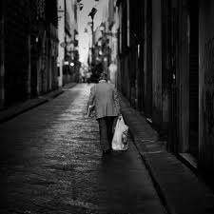
Can Cocaine Cause Cancer?
No cocaine can not cause cancer but the disease it carries on the street can.

Slide 8
How to Tell Usage
To tell usage of cocaine this is what you need to look for:
Bloodshot eyes
Frequent nose-bleeds
Sudden weight loss
Rapid speech
These are just some things to look for.

Slide 9
Making a Bad Situation Worse
Mixing cocaine and smoking each worsen the other's ability to elevate the heart rate and shrink blood vessels. Cocaine paired with alcohol lets the liver make a substance that steps up cocaine's potential to cause death.

Slide 10
Street Names for Cocaine
Blow, Stash, Girl, Snow, Star, Stardust.

Slide 11
Where Did Cocaine Originate?
Pure cocaine was first extracted from the leaf of the Erythroxylon cocoa bush, which grows primarily in Peru and Bolivia, in the mid-19th .

Slide 12
Cocaine Prices
$215.5 per gram
in the U.S.

Slide 13
How to Treat Cocaine Usage
Cocaine usage is not a joking matter, and needs to be taken seriously. Ways to treat cocaine is by contacting a drug counselor. They will take care of your situation.

Slide 14

My Recourses
www.GOOGLE.com
www.worldbookonline.com
www.kvl.com

Slide 15

Do Not Become A Cocaine Addict
It Kills

