Slide 1



Automotive Technology
Mr. Terry “Bubba” Lewis, Instructor
Notes:
To change the image on this slide, select the picture and delete it. Then click the Pictures icon in the placeholder to insert your own image.

Slide 2
Transportation, Distribution, and Logistics
Foundational Skills such as:
  Locating information in technical manuals
  Practicing technical writing skills
  Solving mathematics problems to complete technical applications
  Work orders
  Technical service bulletins
  Interpretation of technical information relating to job performance
  Communication skills
  Leadership and teamwork skills
Demonstrate use of various types of tools and equipment

Slide 3
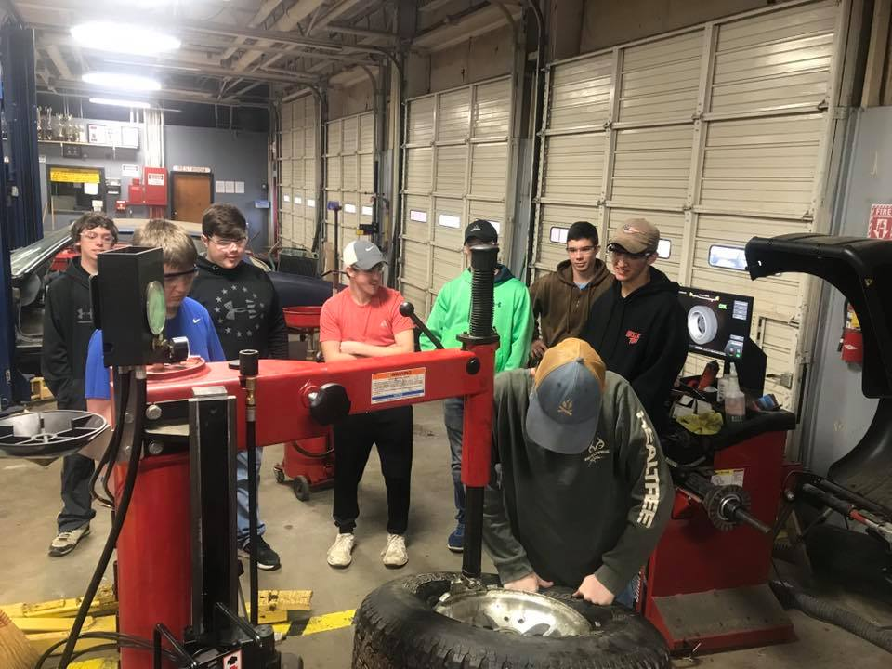

Automotive Mechanical Technology
Exploration of career opportunities
Transportation service skills and workplace success skills
Safety
Tools
Equipment
Shop operations
Basic engine fundamentals
Automotive general electrical systems
Batteries
Lighting
Electrical accessories
Suspension and steering
Brake Systems

Slide 4
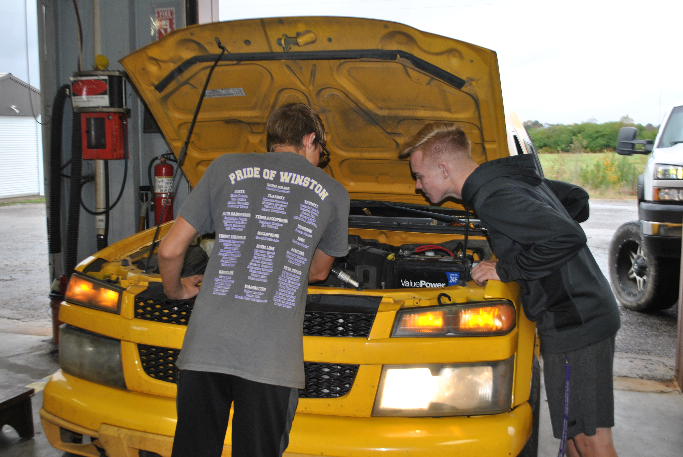

Slide 5
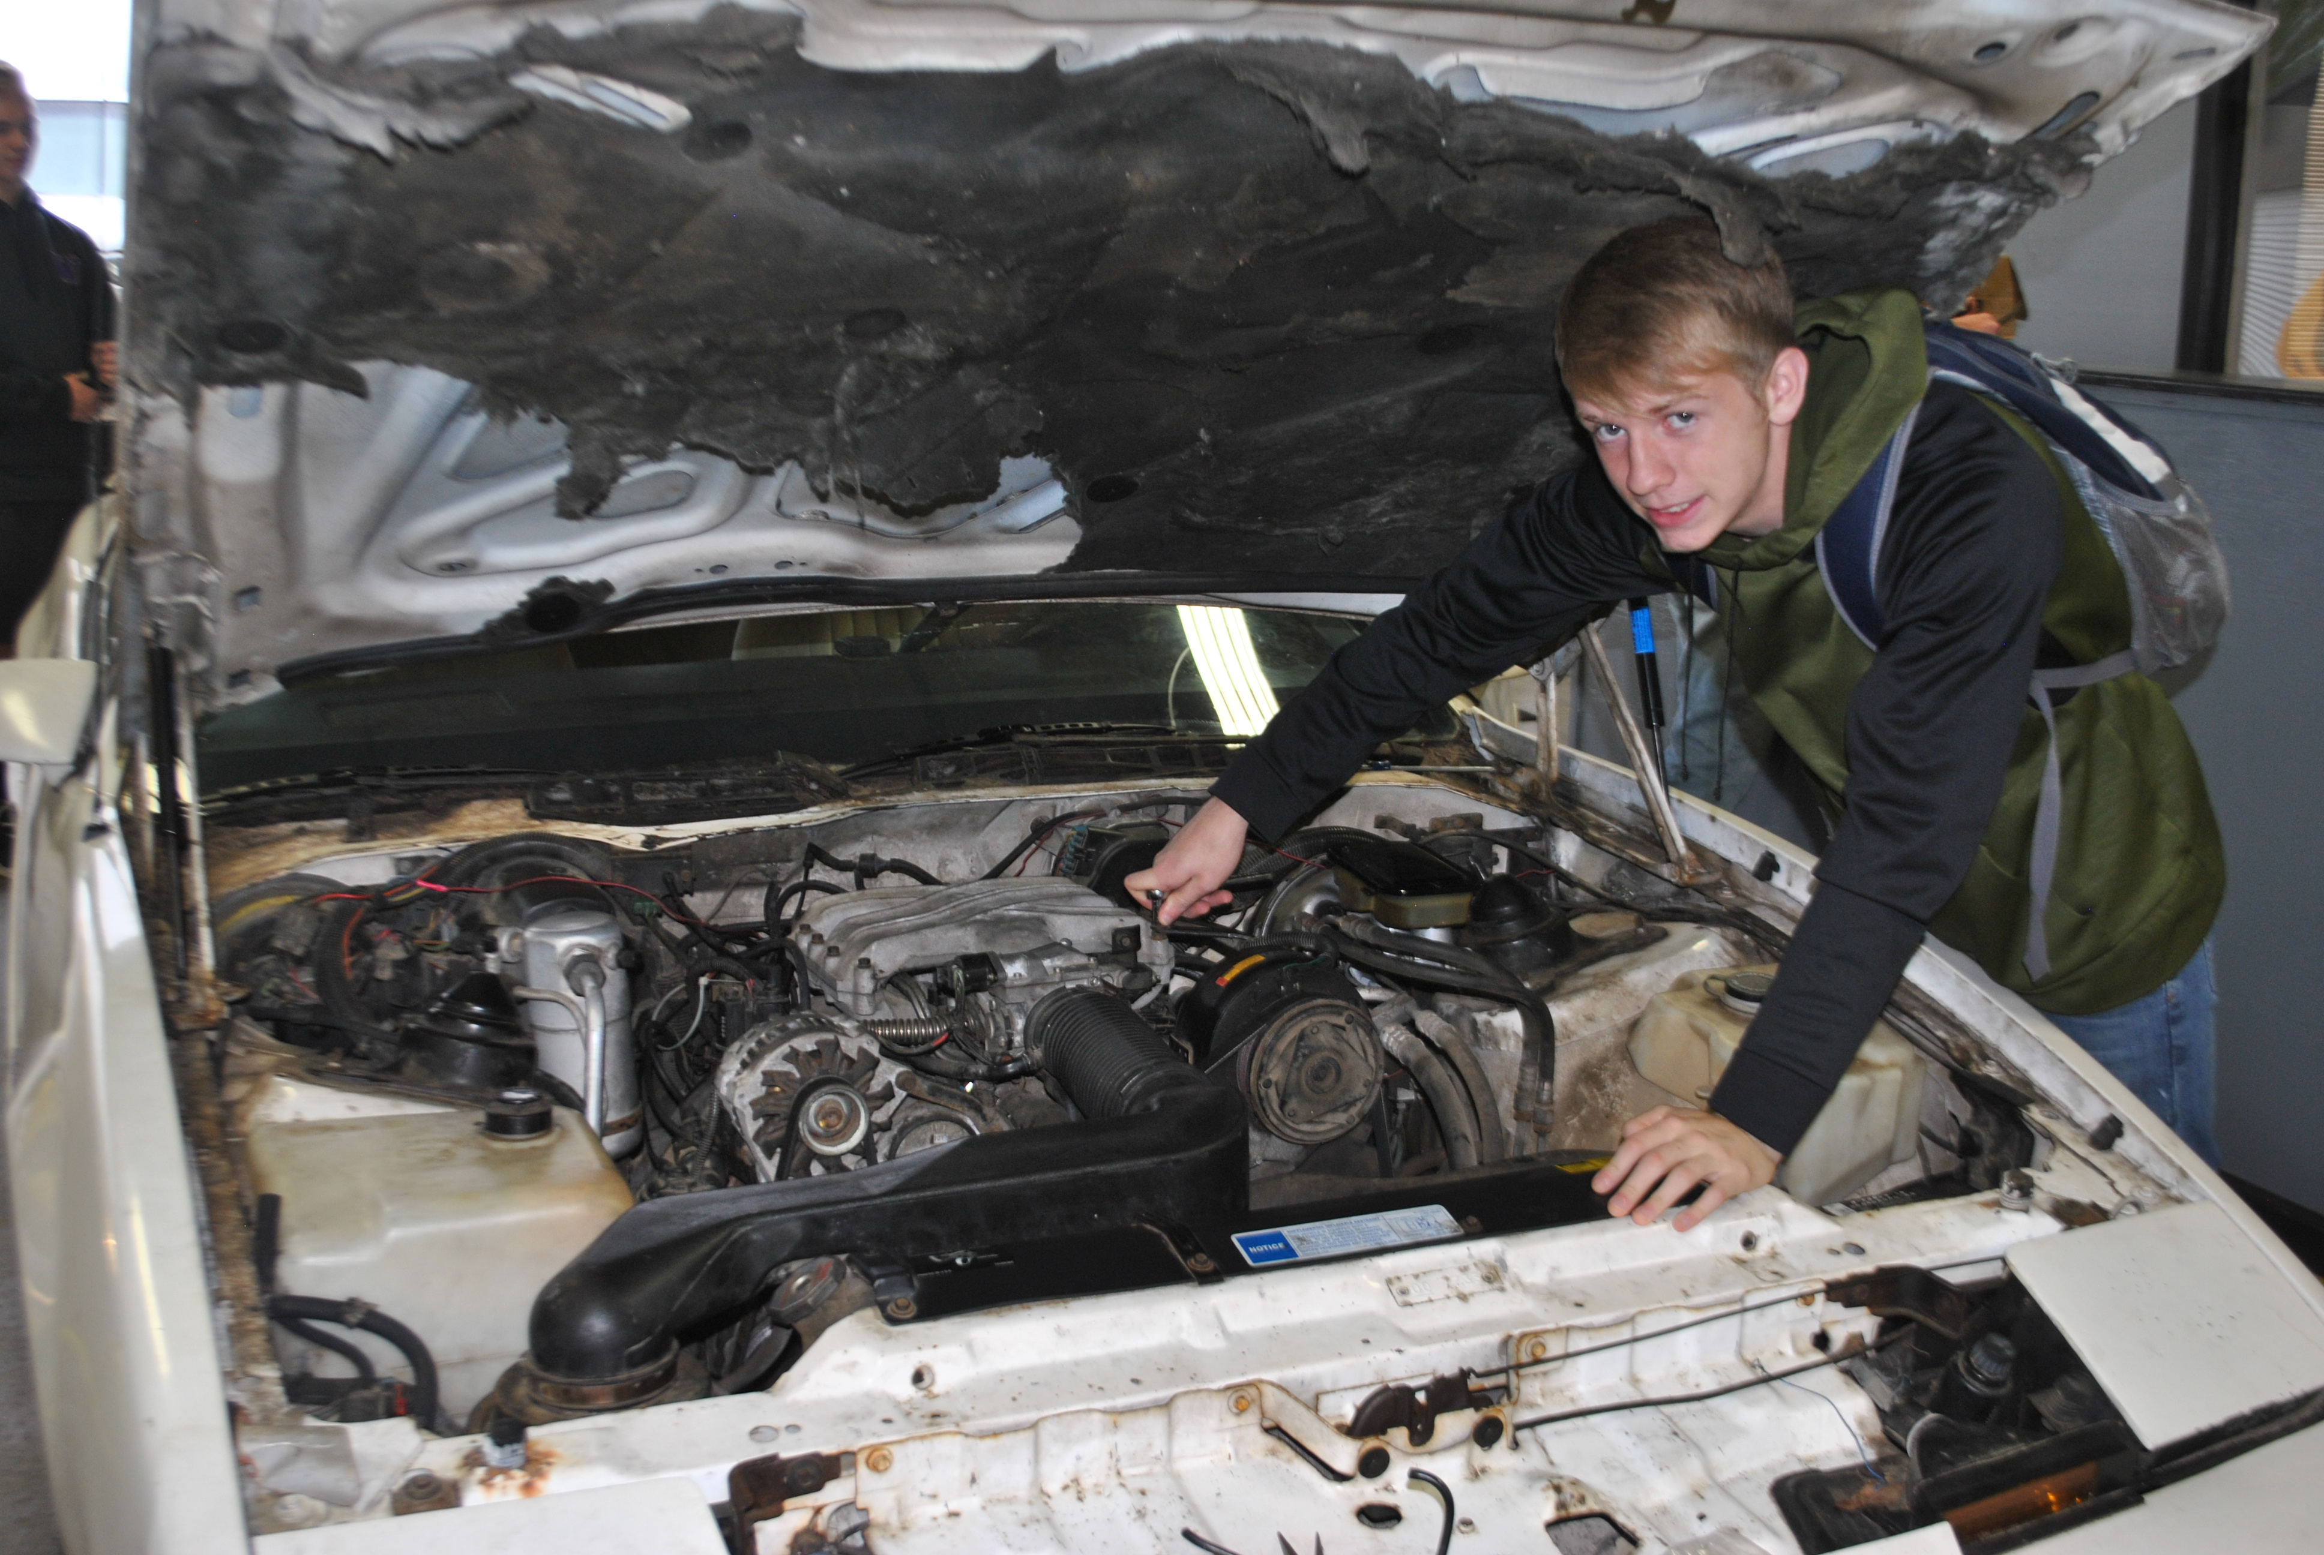

Slide 6
