Slide 1

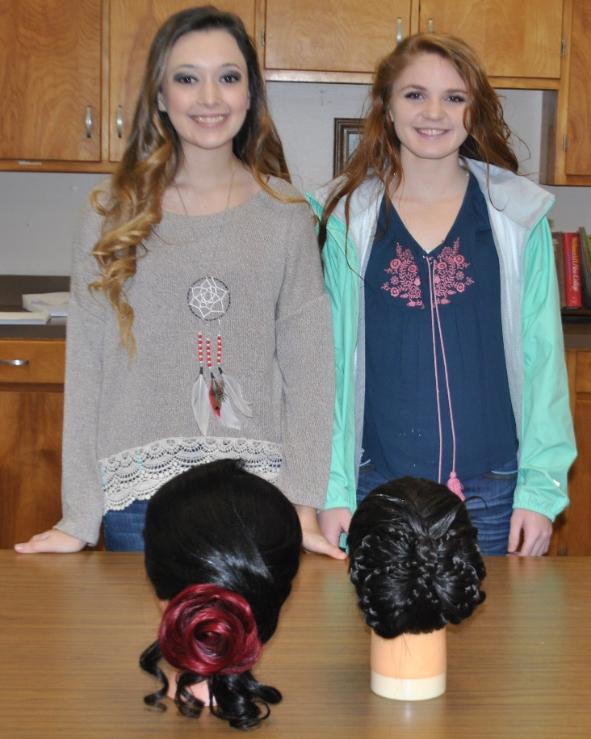
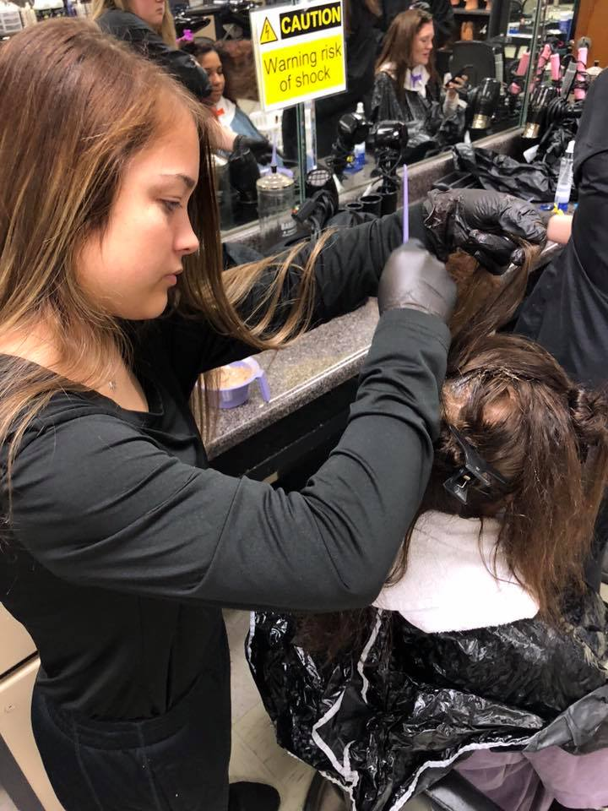
Cosmetology Department
Cali Alexander, Instructor

Slide 2
Introduction to Cosmetology
This is a one-credit course that provides students with a study of concepts related to the cosmetology profession.
Cosmetology history and opportunities, professional image, infection control, and basic fundamentals and principles of hair care and design are specific topics covered in instruction.
Students gain initial practical experience in sanitation, shampooing, hair shaping, and hairstyling.
Introduction to Cosmetology is the prerequisite to:
  Chemical Services
  Hair Coloring
  Introduction to Spa Techniques
  Advanced Spa Technique Applications
  Salon Practices and Management
  State Board Practicum

Slide 3

Learning objectives from Cosmetology
Principles of Hair Design
  Applying techniques for hair shaping and design
  Methods of haircutting
  Hairstyling techniques
Salon Safety and Sanitation
Application of mathematical, reading, writing, critical-thinking, decision-making, and problem-solving skills for performance of work in the cosmetology industry

Slide 4
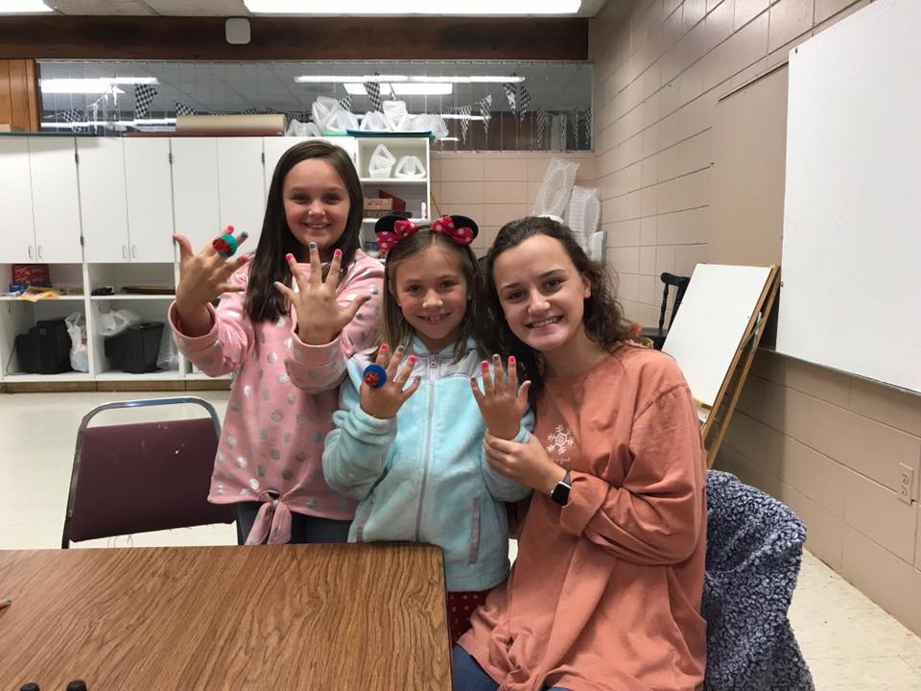

Slide 5
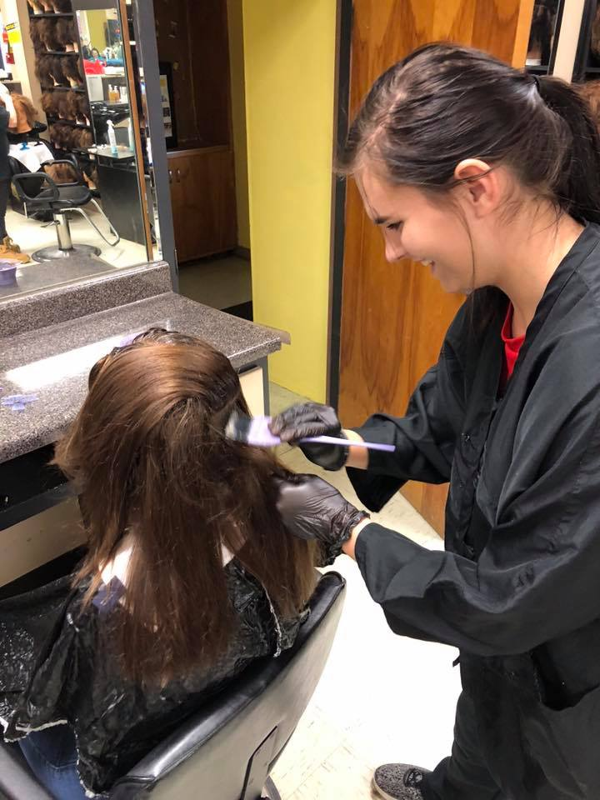

Slide 6
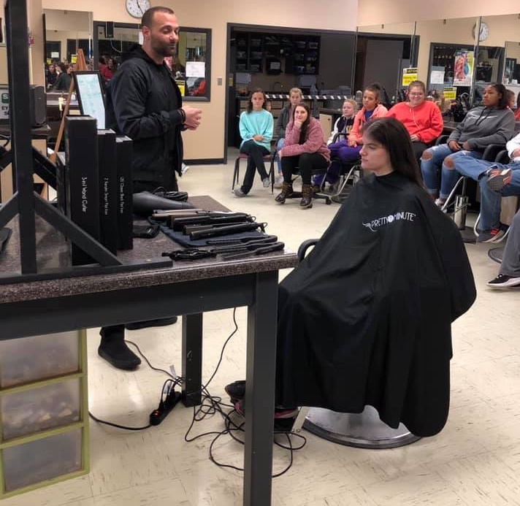

Slide 7
