Slide 1
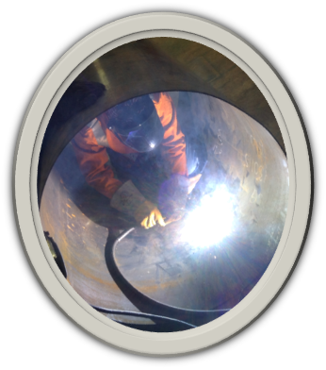
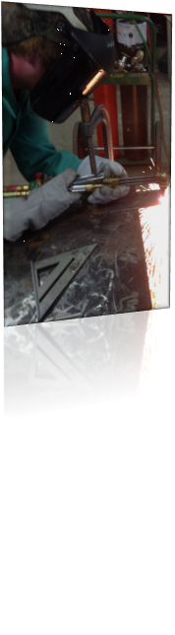

Welding
Winston Career Academy
Winston Career Academy
Bryan Woods, Instructor
10th, 11th, & 12th
Welding Technology

Slide 2


Architecture and Construction
NCCER Welding I
Click on the image for NCCER video
NCCER is a not for profit 501(c) (3) education foundation created in 1996 as The National Center for Construction Education and Research. NCCER was developed to revolutionize training for the construction industry.
Architecture and Construction is a one-credit course in the Welding Technologies Pathway. It is designed for NCCER Core Credentialing, providing students with fundamental knowledge and skills emphasizing use of hand tools, power tools, welding theory, and practices which are utilized in manufacturing and construction industry. This entry-level course is required for NCCER Welding Level I Credentialing and may be taken as one of the optional technical courses with credit applied to the Industrial Maintenance Technology area.

Slide 3

SkillsUSA Leadership Development
Students will participate in project based learning and perform skill objectives of this course.
These projects will simulate on-the-job experiences that include problem solving, estimating, researching/referencing, and hands-on practice.
SkillsUSA provides opportunities that help students develop their potential for premier leadership, personal growth, employability, and career success.

Slide 4
Welding Skill Learning objectives
Welding is a high-tech industry that can take you places all over the world. Welds are everywhere, just look around. From ladders to aircraft carriers, from NASCAR to national defense, and from the laboratory to sales and repair, the varied welding industry impacts virtually every industry.
Areas taught in Welding Technology are:
Welding Safety
Oxyfuel Cutting
Plasma Arc Cutting
Air Carbon Arc Cutting and Gouging
Base Metal Preparation
Weld Quality
SMAW-Equipment and Setup
Shielded Metal Arc Electrodes
SMAW-Beads and Fillet Welds
Joint Fit-Up and Alignment
SMAW Groove Welds with Backing
SMAW- Open V-Groove Welds

Slide 5
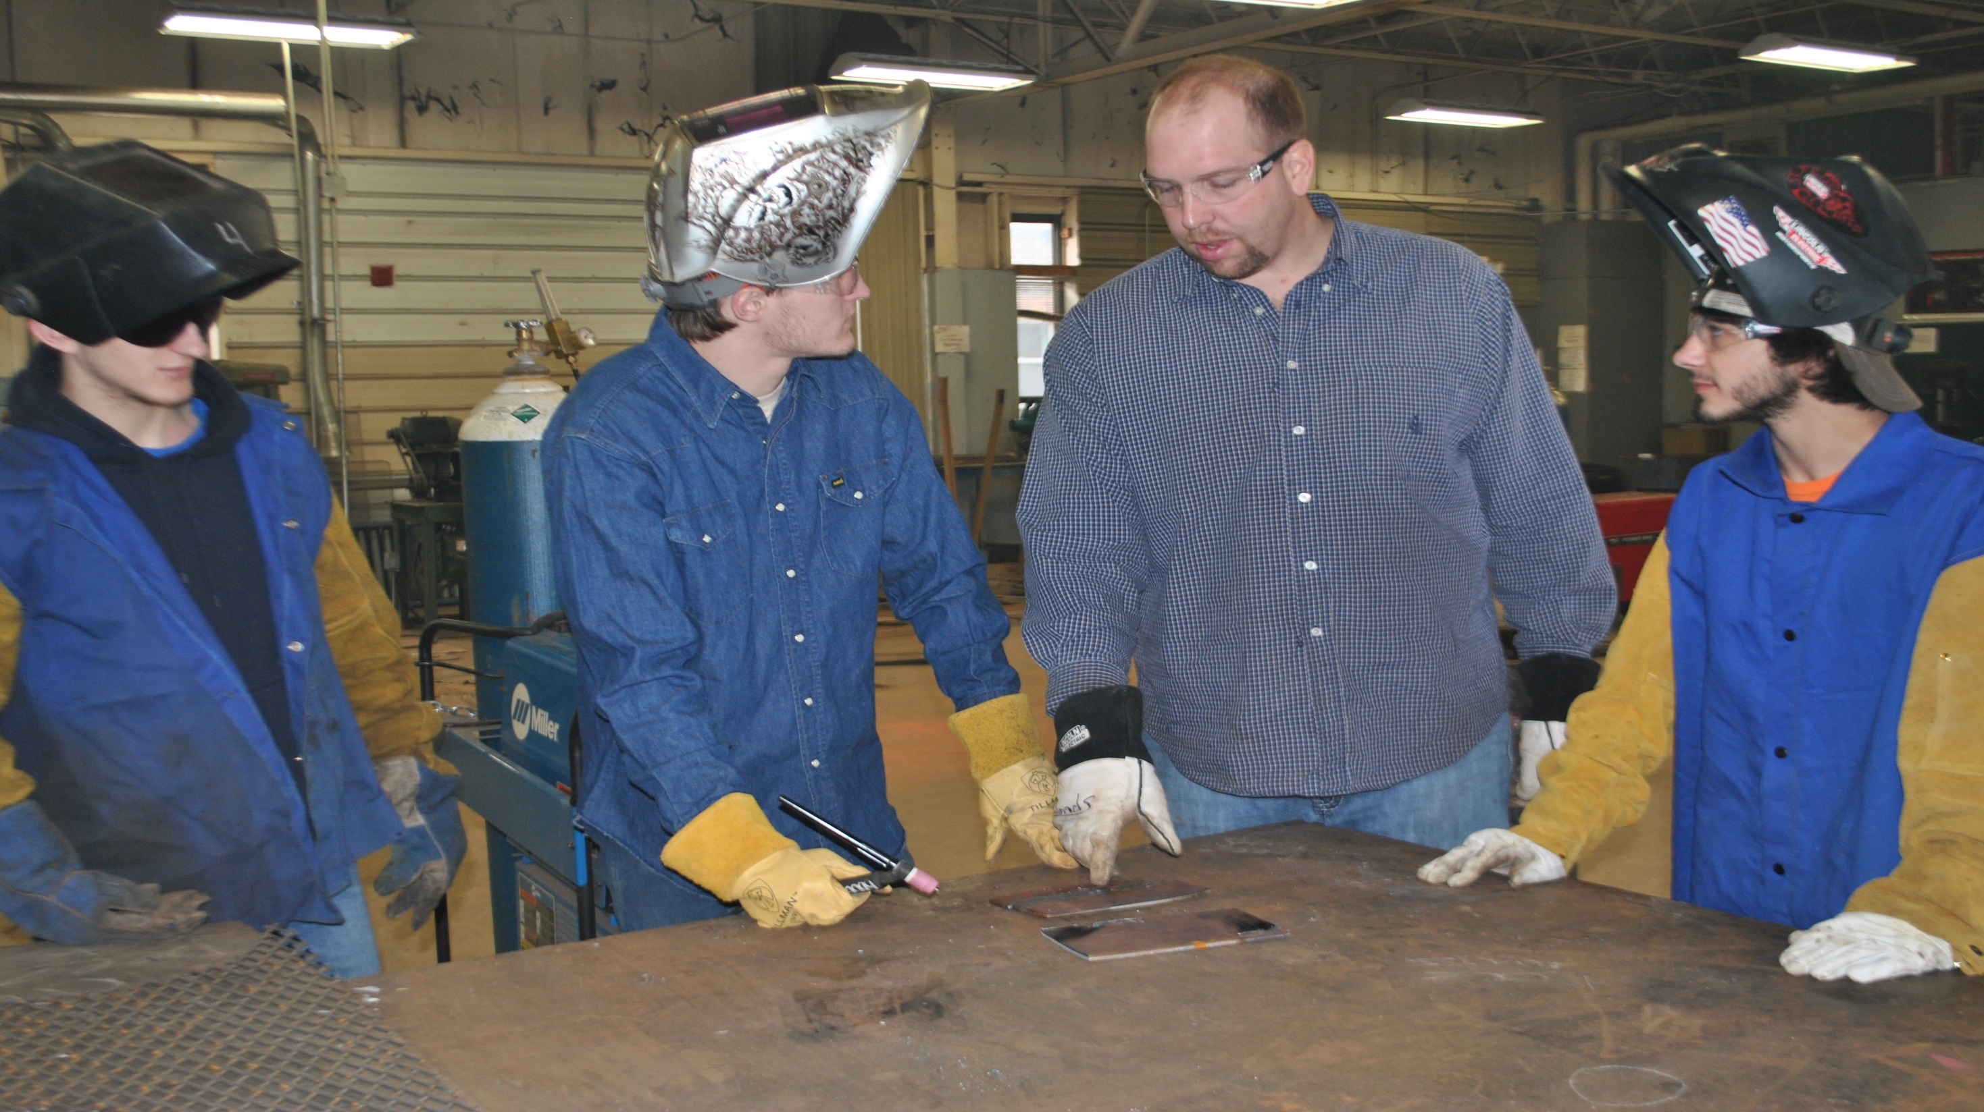

Slide 6
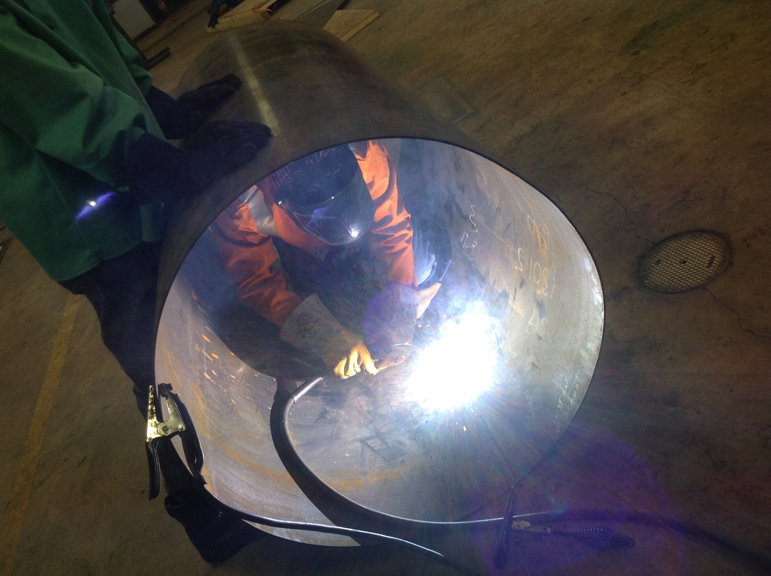

Slide 7
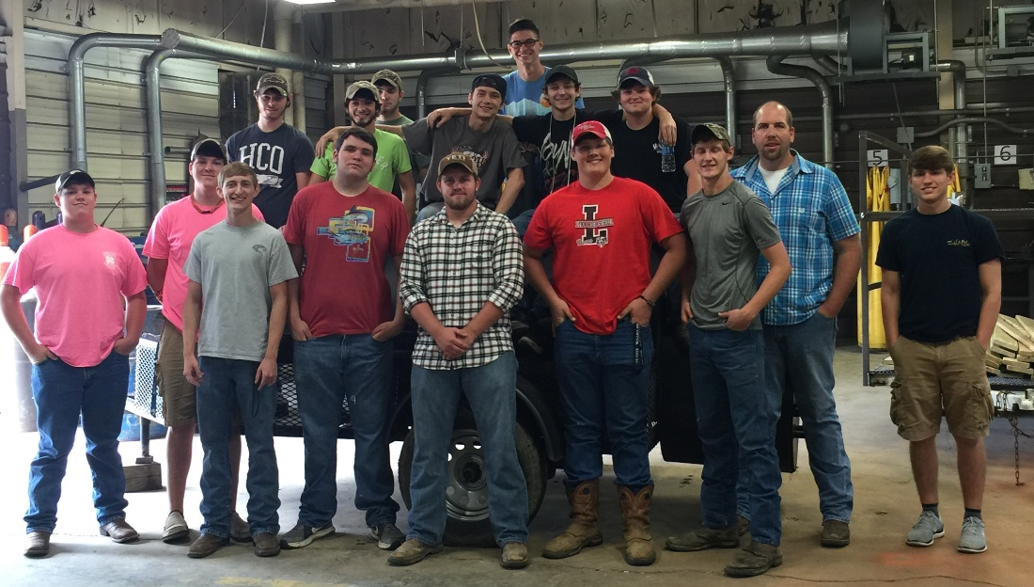

Slide 8
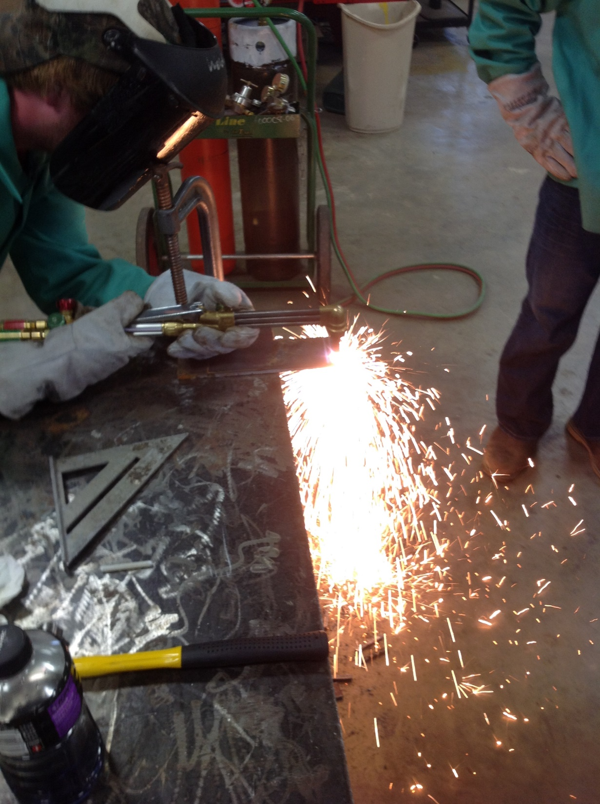

Slide 9
