Slide 1

Electrical Technology
Danny Snoddy, Instructor

Slide 2
Architecture and Construction
This is the 1st of 3 required one-credit courses in the Electrical Technologies Pathway.
Electrical Technologies provides students with fundamental knowledge and skills emphasizing use of hand tools, power tools, and electrical theory which are utilized in the construction industry and required for NCCER Electrical Level I Credentialing.
SkillsUSA Leadership Development and Technical Development is a component of this course providing opportunities helping students develop their potential for premier leadership, personal growth, employability, and career success.

Slide 3

Project-Based Learning
These projects will simulate on-the-job experiences that include problem solving, estimating, researching/referencing, and hands-on practice.
Upon successful completion of this course, students may combine with other specified courses in the Electrical program to earn college credit at Bevill State Community College.
Click on the image above for Electrical Technology informative video.

Slide 4

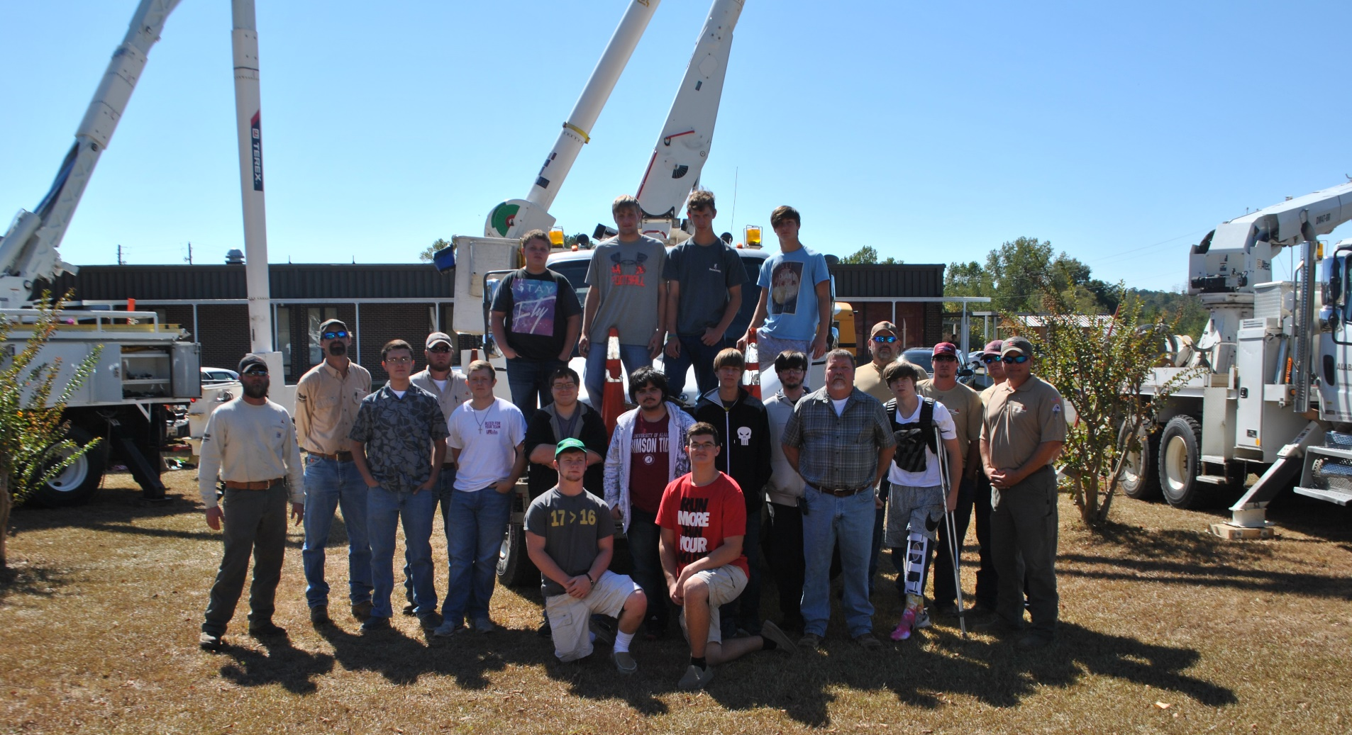
Bevill State Electrical Video (Click on Image for BSCC Video)

Slide 5
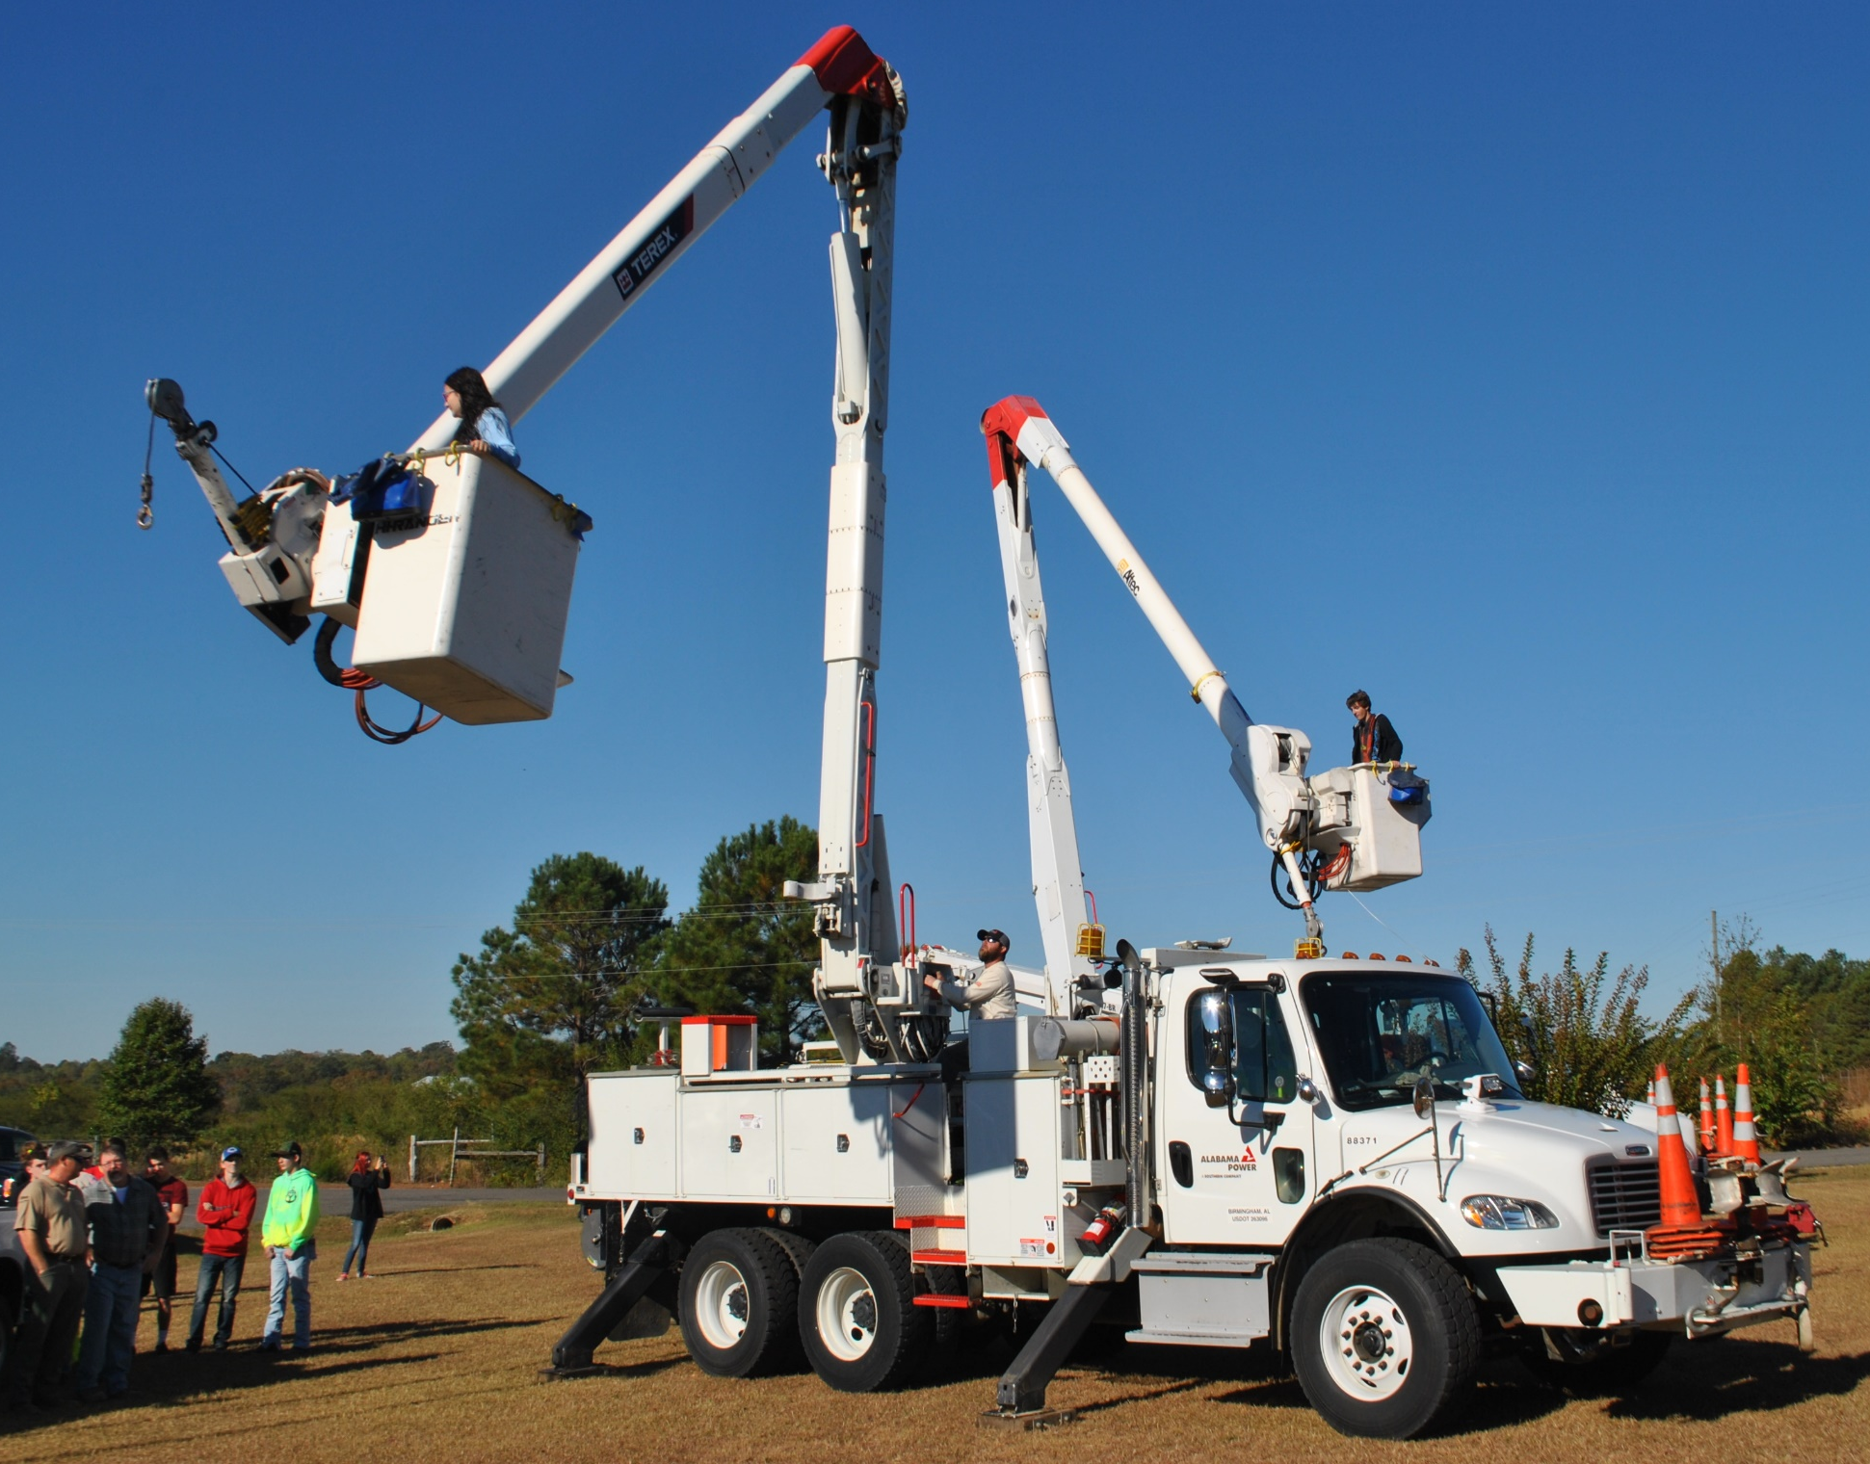

Slide 6
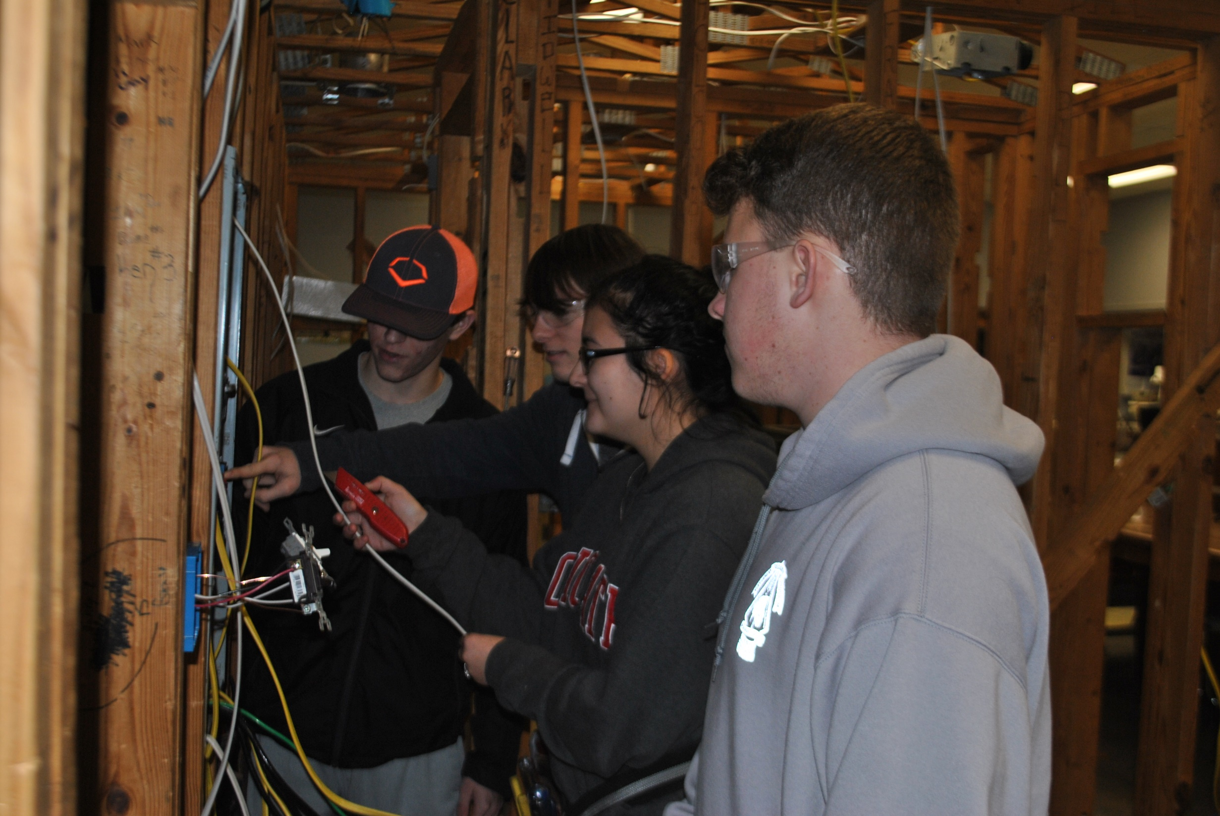

Slide 7
Electrical Technology Learning Objectives
Basic Safety (Construction Site Safety Orientation)
Introduction to Construction Math
Introduction to Hand Tools
Introduction to Power Tools
Introduction to Construction Drawings
Introduction to Basic Rigging
Introduction to Material Handling

Slide 8
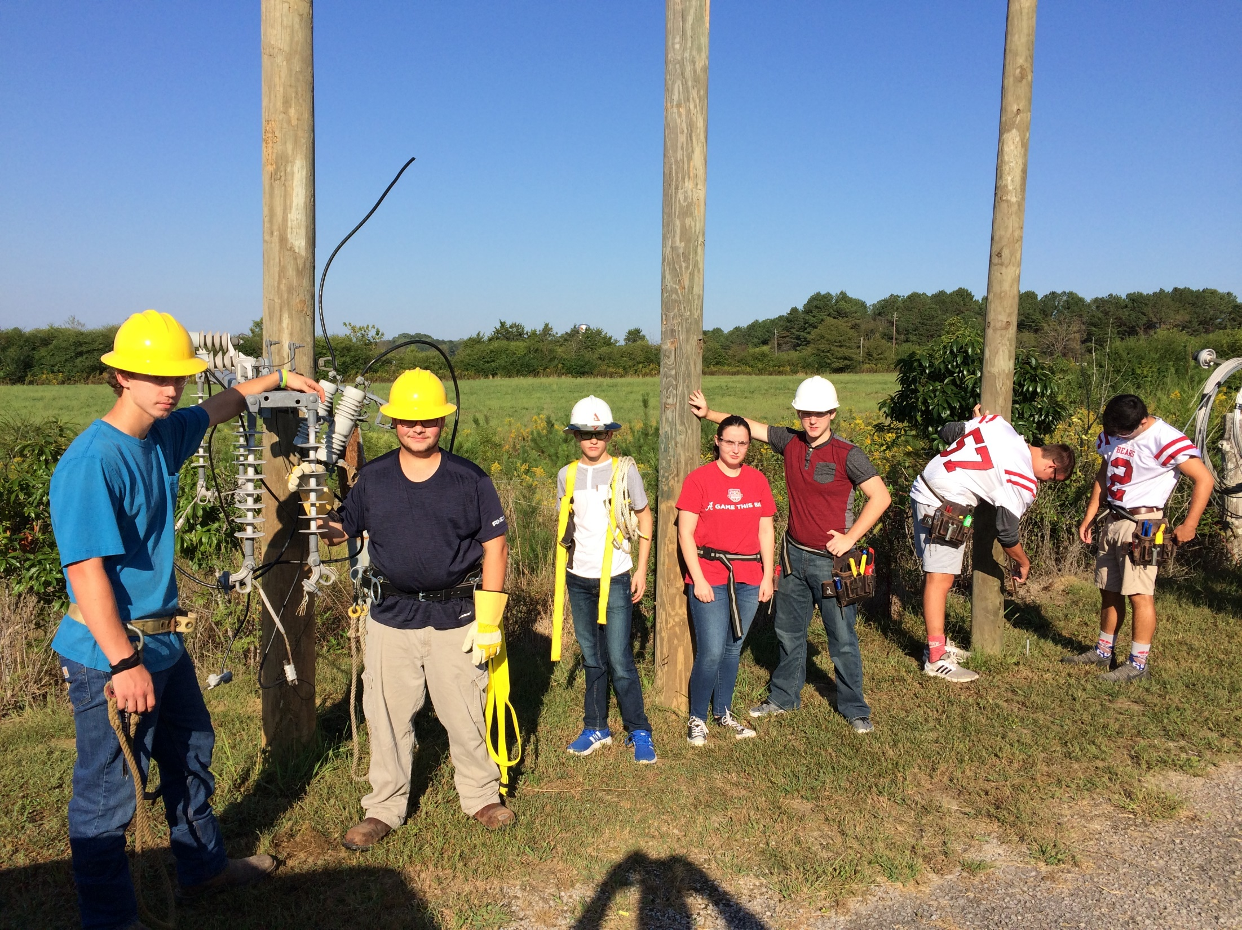

Slide 9
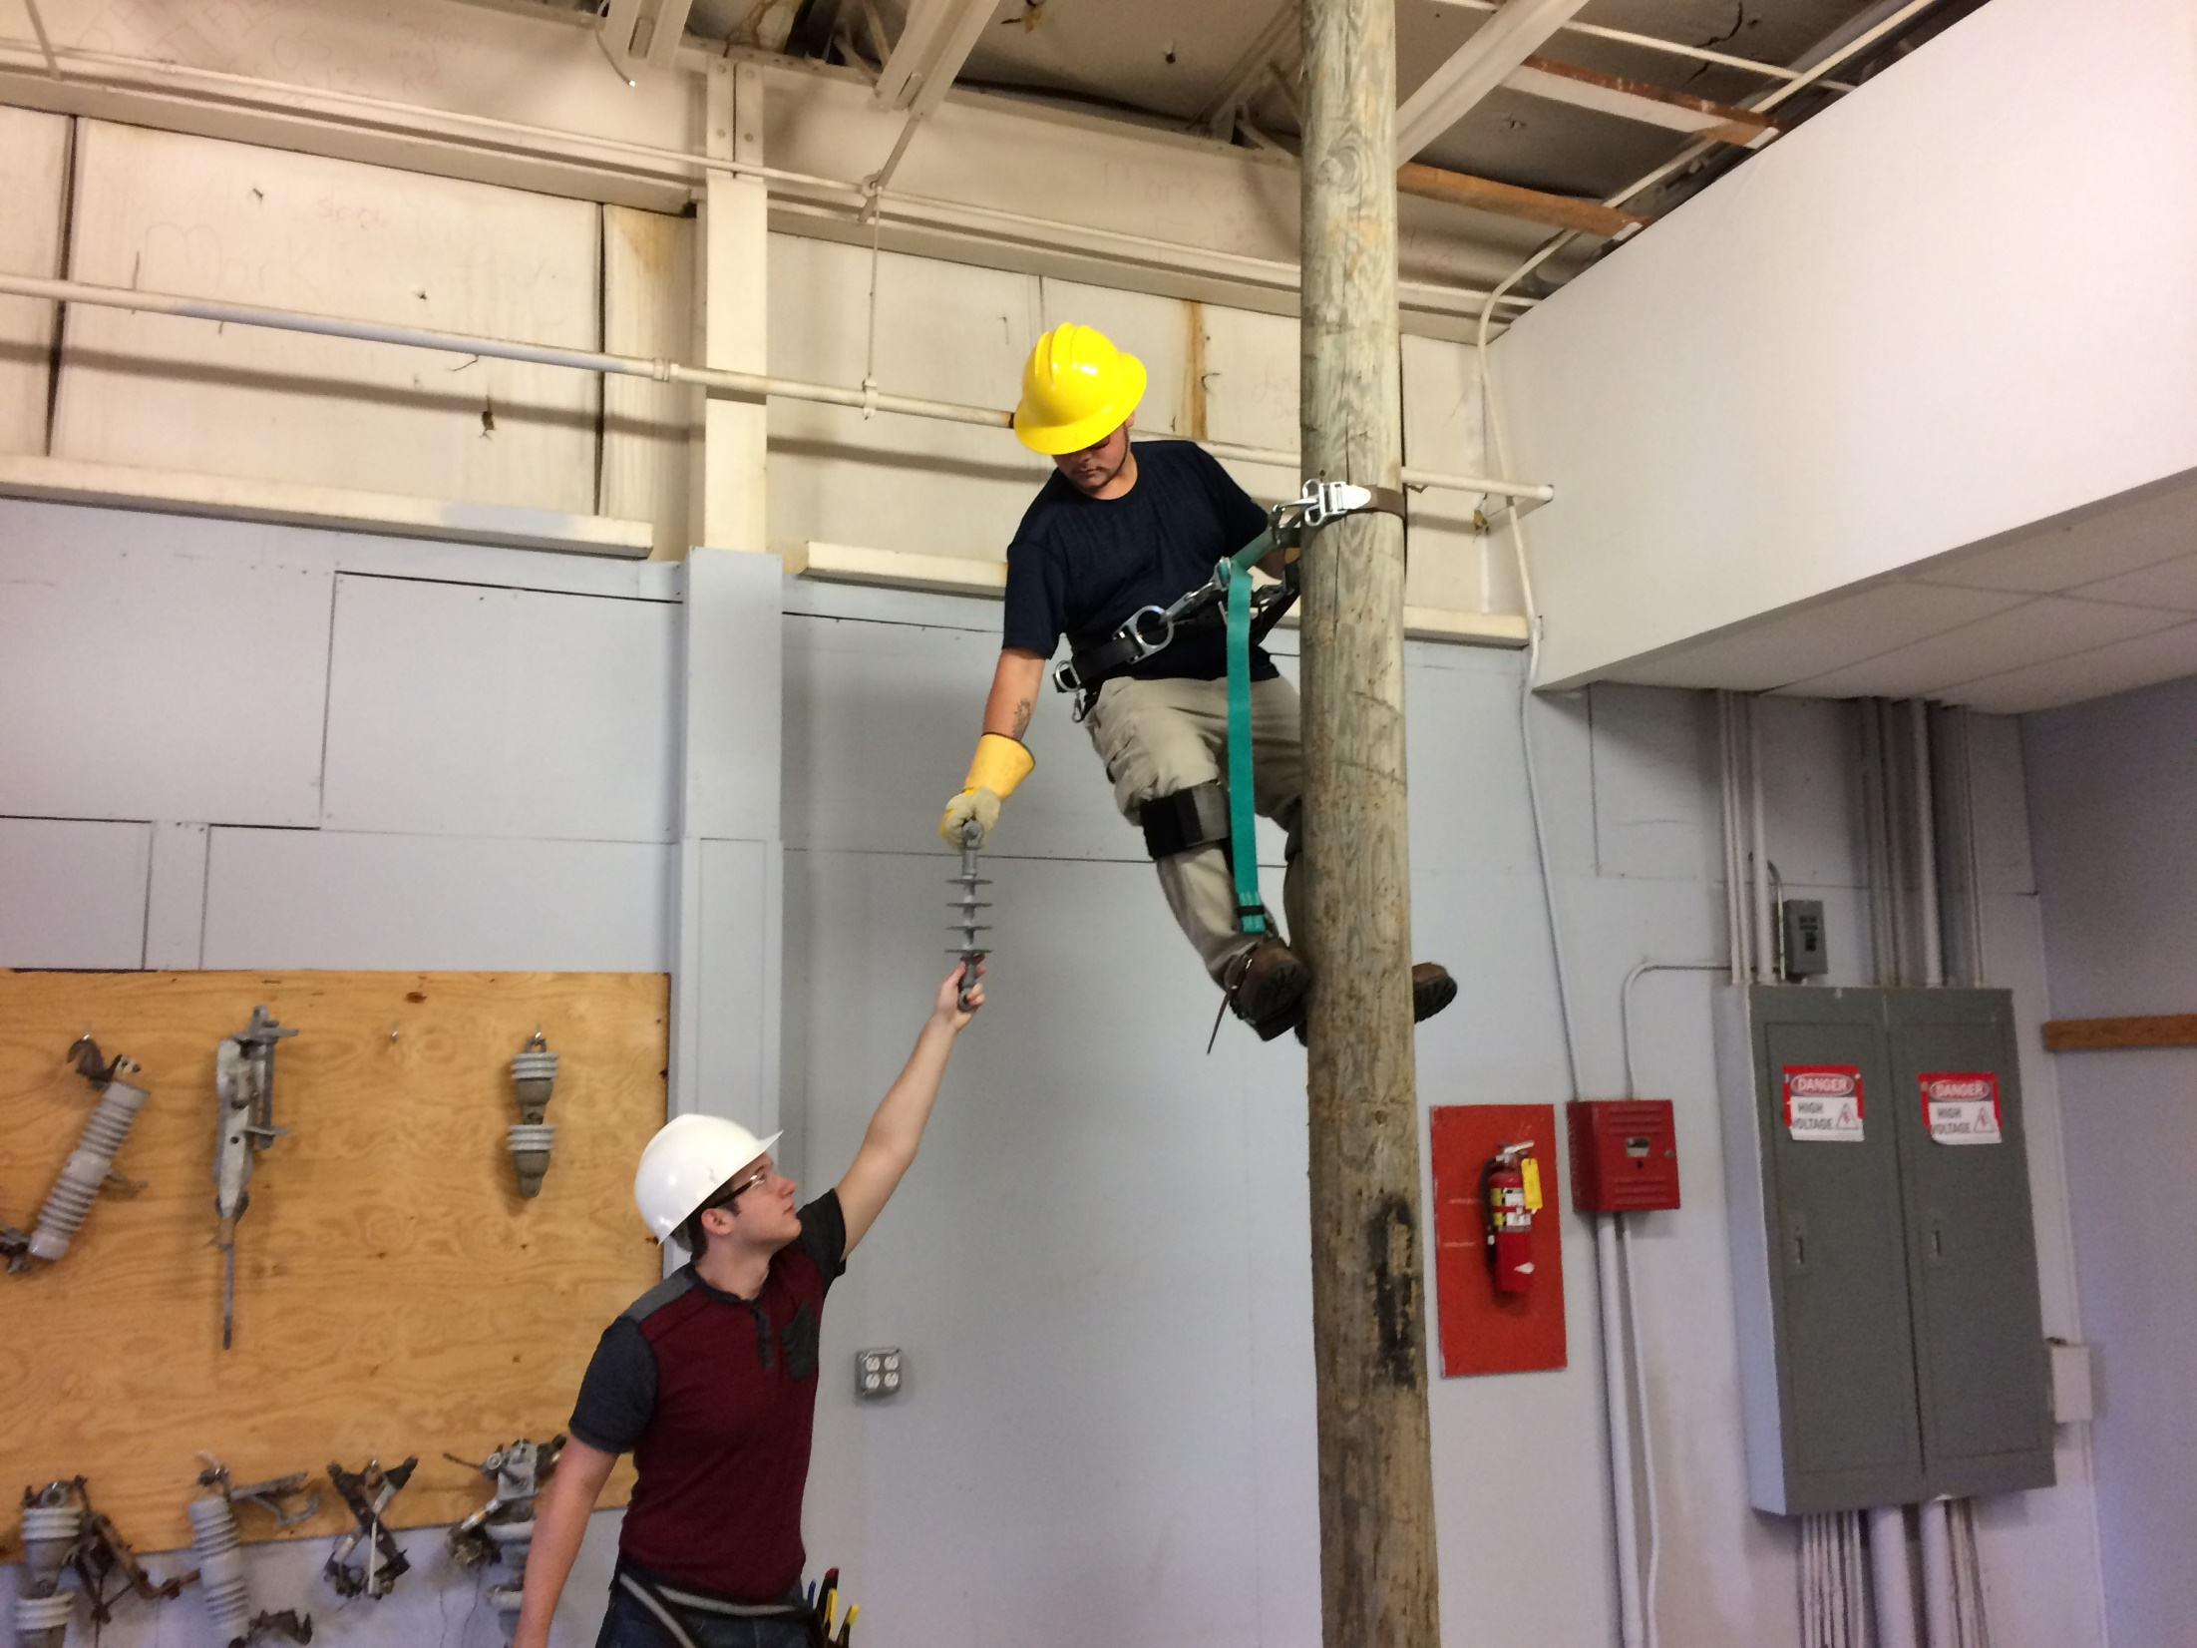

Slide 10
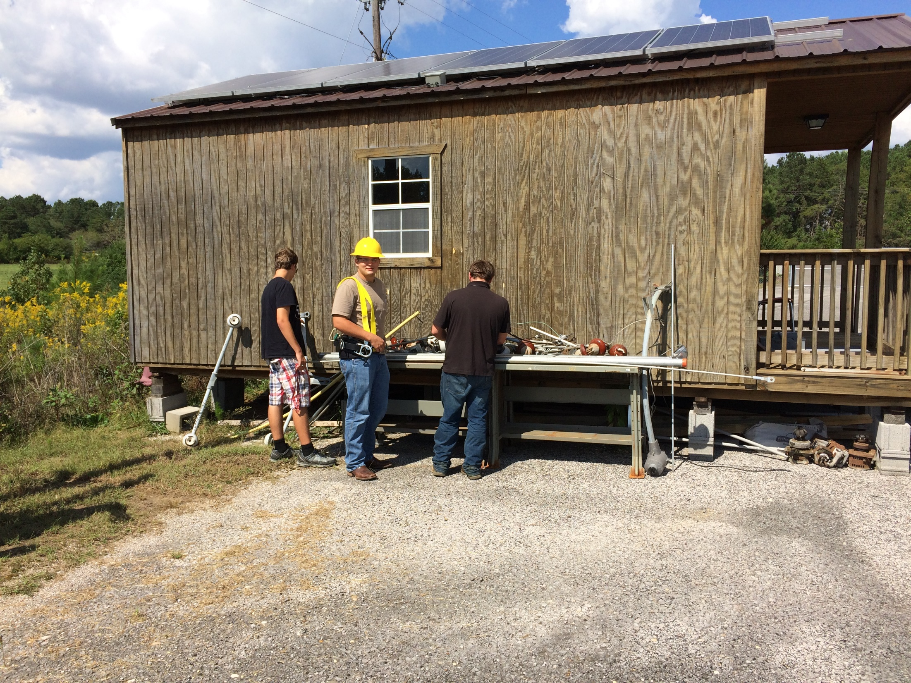

Slide 11
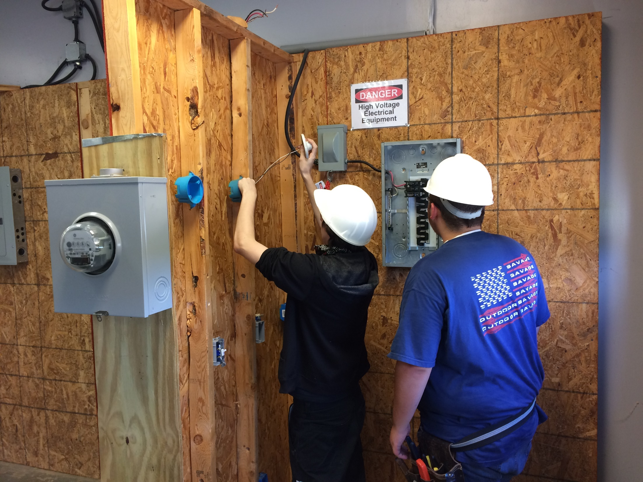

Slide 12
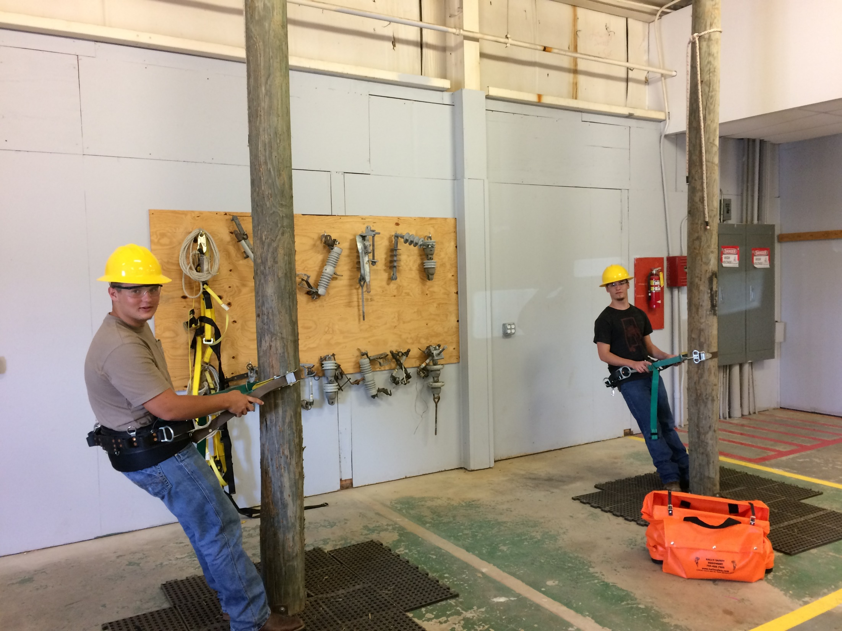

Slide 13
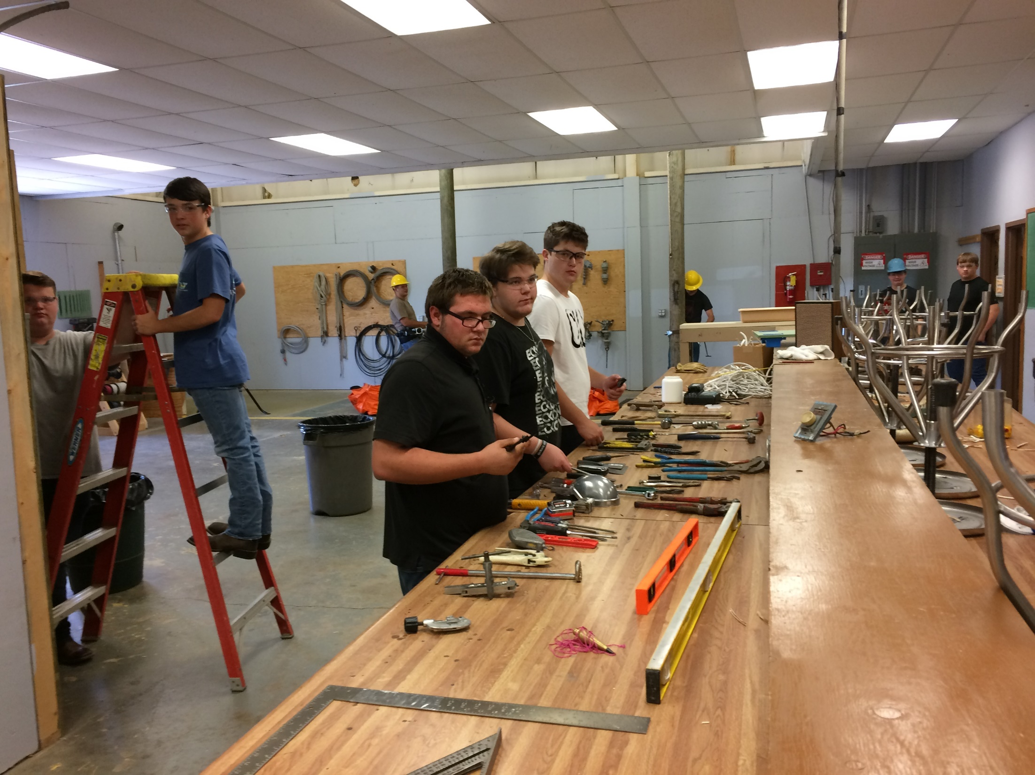

Slide 14
