Slide 1
Employee Self Service
Instructions to view check stub:
Log onto www.winstonk12.org
Click on Employees (right side of screen).
Click on Employee Paystub.
  The first screen that appears is to verify employee status for security purposes. Please enter the user name and passcode below to proceed to the ESS website.
      User Name: Winston67
      Password: $winston

Slide 2
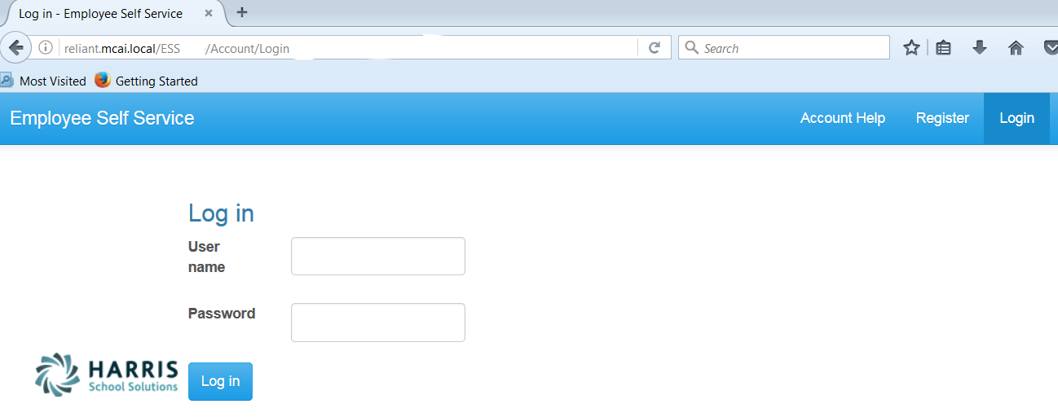
Registration on Log In screen
Employee Self Service – Register
Everyone must register as a user for ESS using their social security number and employee number.
NOTE: Internet Explorer version 9 and below are not supported in ESS. The Internet Explorer browser must be version 10 or above.

Slide 3
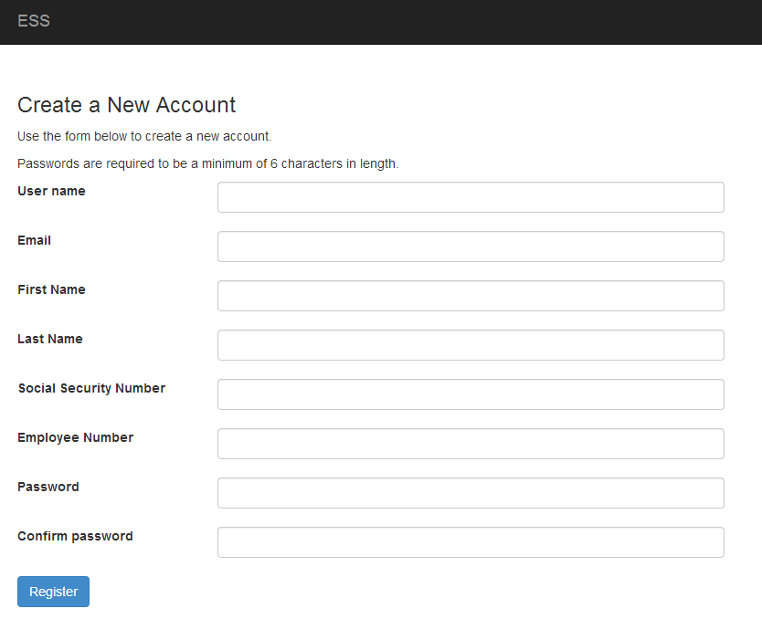
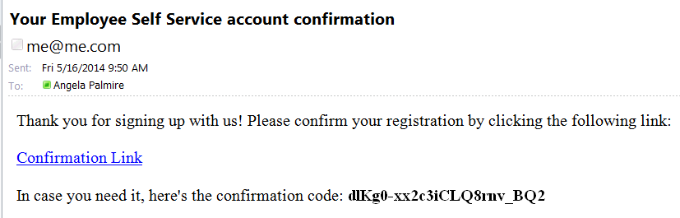
Employee Self Service - Register
Employee chooses their own User Name and Password. User name should not contain any special characters or spaces.
The email address does NOT have to be a school district assigned email address. It may be an employee’s personal email address.
Please contact Nikki Shipman or your local school bookkeeper for your employee number.
An email, with a confirmation link, will be sent to the email address the user provided when creating their account. User must use the confirmation link in the email to be confirmed as an authorized user for ESS. If link does not appear, view as an html.

Slide 4
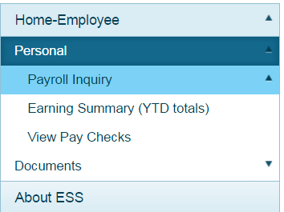
The Personal menu contains the sub-menu for Payroll Inquiry which includes the Inquiries available for the employee.
Employee Self Service–Personal/Payroll Inquiry

Slide 5
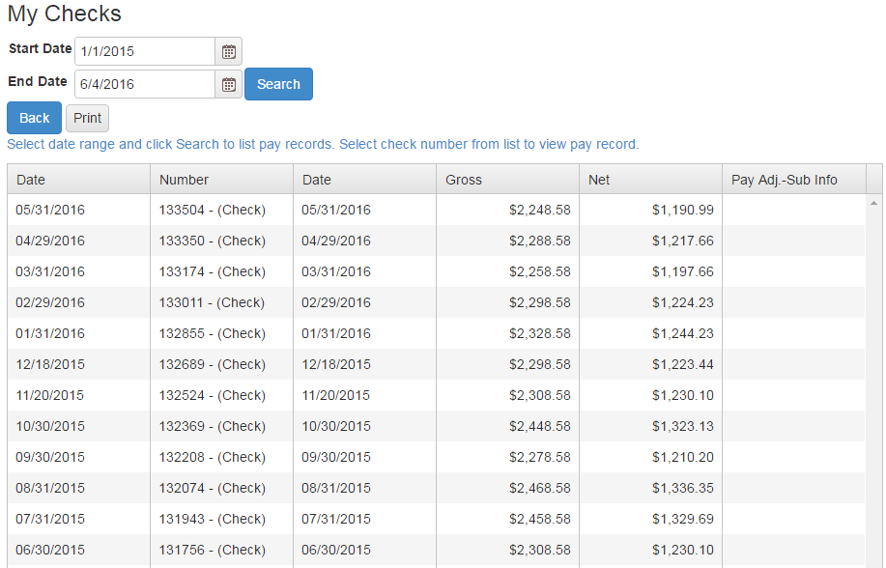
Employee can view and print check/statement summary for a specific check date range. The employee can view check detail by clicking on a particular check.
Employee Self Service – View Pay Checks

Slide 6
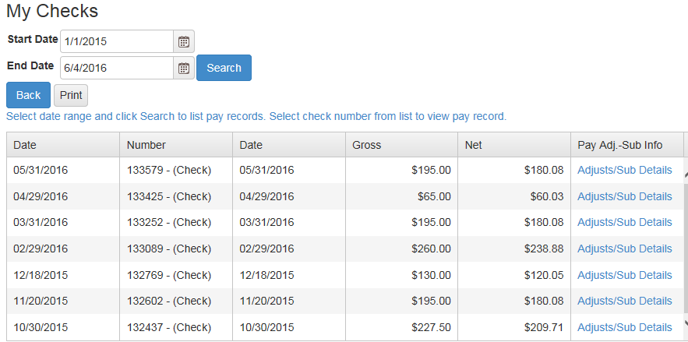
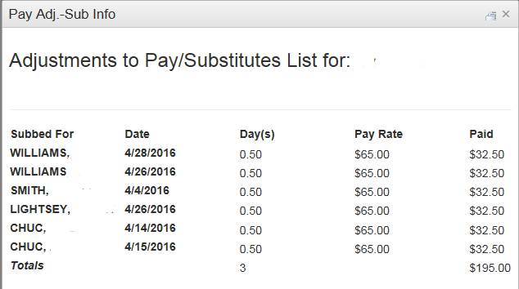
If an employee has extra pay, pay adjustments or substitute pay for a specific check, they can view detail information about the pay by clicking on Adjusts/Sub Details link.
Employee Self Service – View Pay Checks

