Slide 1


July 1, 2021
BENEFITS
OPEN ENROLLMENT
May 12, 2021 – May 28, 2021

Slide 2

AGENDA
Welcome
What’s New
What’s Changing
Eligibility & Enrollment
Review of 2021 Benefits
How to Enroll
Questions

Slide 3
WHAT’S CHANGING
Dental
New Carrier - BCBSIL
  More robust PPO plan
  DHMO plan option
Vision
New Carrier - EyeMed
Basic Life/AD&D
New Carrier - BCBSIL
Medical
No changes

Slide 4
WHAT’S NEW
Short Term Disability
Offered through BCBSIL
100% employee paid
Identity Theft
Offered through LifeLock
  100% employee paid
  2 Plan options:
      Benefit Essential
      Benefit Premier

Slide 5

ELIGIBILITY
Who can enroll?
  Employees working at least 25 hours/week
  Legal spouse
  Children under the age of 26
When can you enroll?
  Within 60 days of your date of hire
  During annual open enrollment
  Within 31 days of a Qualifying Event

Slide 6

MEDICAL
MEDICAL COVERAGE

Slide 7
Medical Plan Comparison
Key Medical Benefits | BCBSIL PPO |  | BCBSIL Blue Choice Select PPO |  | BCBSIL HMOI / BAHMO
 | In-Network | Out-of-network | In-Network | Out-of-network | In-Network Only
Deductible (Individual/Family) | $1,000 / $2,000 |  | $400 / $800 |  | $0 / $0
Out-of-Pocket Maximum (Individual/Family) | $2,500 / $6,250 | $5,400 / $10,800 | $1,500 / $3,750 | $4,400 / $8,800 | $1,500 / $3,000
Covered Services
Office Visit (Physician/Specialist) | $20 / $40 copay | Plan pays 80% after deductible is met | $20 / $20 copay | Plan pays 80% after deductible is met | $20 / $20 copay
Routine Preventive Care | Plan pays 100%; no deductible | Plan pays 80% after deductible is met | Plan pays 100%; no deductible | Plan pays 80% after deductible is met | Plan pays 100%; no deductible
Inpatient Hospital Stay | Plan pays 90% after deductible is met | $300 copay, then plan pays 80% after deductible is met | Plan pays 90% after deductible is met | $300 copay, then plan pays 80% after deductible is met | $250 copay
Emergency Room (copay waived if admitted) | $200 copay |  | $200 copay |  | $200 copay
Urgent Care Facility | Plan pays 90% after deductible is met | Plan pays 80% after deductible is met | Plan pays 90% after deductible is met | Plan pays 80% after deductible is met | $20 copay
Prescription Drugs (Tier 1/Tier 2/Tier 3)
Retail Pharmacy (30-day supply) | $10/$40/$60 copay |  | $10/$20/$40 copay |  | $10/$20/$40 copay
Mail Order (90-day supply) | $20/$80/$120 copay | N/A | $20/$40/$80 copay | N/A | $20/$40/$80 copay

Slide 8

Dental Coverage

Slide 9

Dental Plan Comparison
Key Dental Benefits | BCBSIL PPO |  | BCBSIL DHMO
 | In-Network | Out-of-network | In-Network Only
Deductible (Individual/Family) | $75 / $225 | $100 / $300 | $0 / $0
Benefit Maximum (per Individual) | $2,000 | $2,000 | Unlimited
Covered Services
Preventive Services (Cleanings, Topical fluoride applications) | 100% | 100% | See Schedule
Basic Services (Basic Restorative, Non-surgical extractions) | 80% | 80% | See Schedule
Major Services (Endodontic services, Surgical periodontal services, Major restorative) | 50% | 50% | See Schedule
Orthodontia (Children under 19) | 50% $1,500 LTM | 50% $1,500 LTM | See Schedule

Slide 10
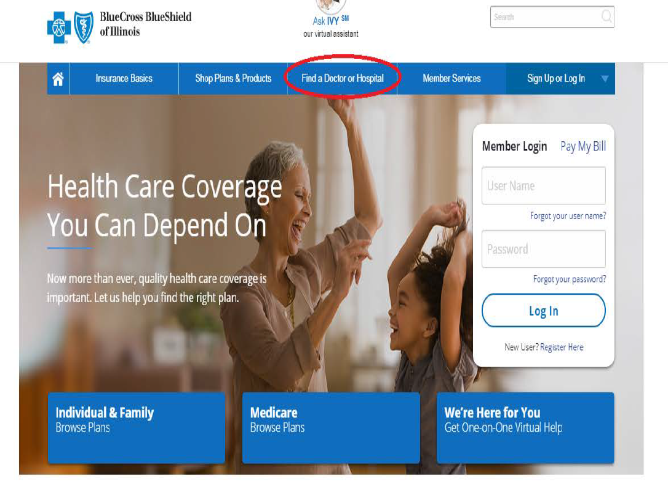
Finding a BCBSIL Network Dentist
Go to: https://www.bcbsil.com

Slide 11
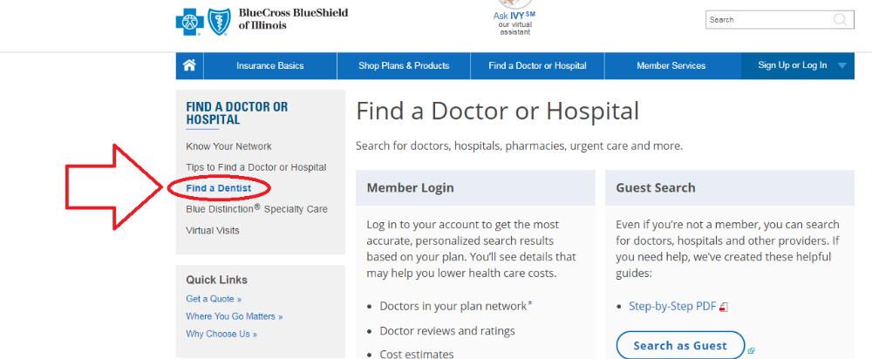
Finding a BCBSIL Network Dentist

Slide 12
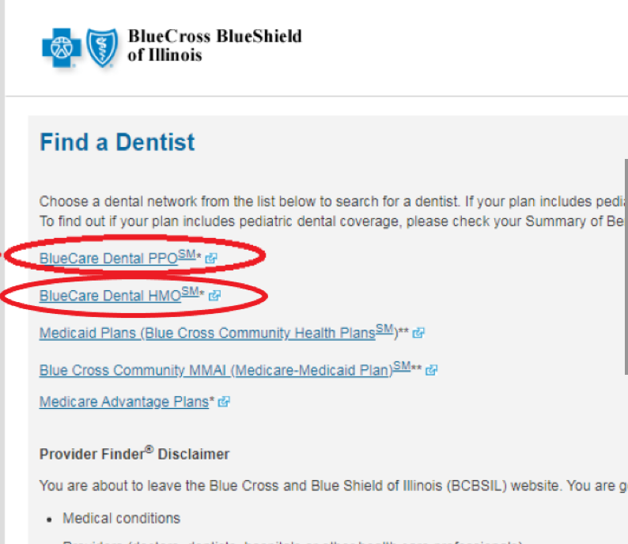
Finding a BCBSIL Network Dentist

Slide 13
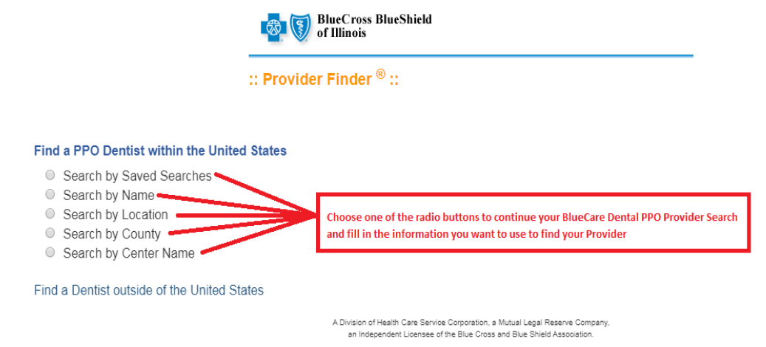
Finding a BCBSIL Network Dentist

Slide 14
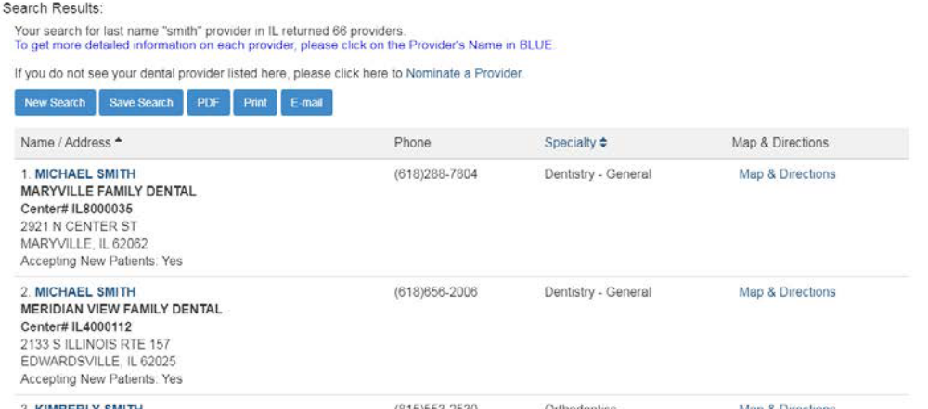
Finding a BCBSIL Network Dentist

Slide 15

Vision coverage

Slide 16


WELCOME TO EYEMED
Vision benefits
for every set
of eyes
Berwyn North Public School District #98

Slide 17



We’ve got you covered:
Your vision benefits at-a-glance
Eye exam every 12 months,
covered with $10 copay – PLUS…
$100 frame allowance every 24 months
$10 lens copay plus fixed pricing on options, every 12 months
$100 contact lens allowance, with coverage for fit and follow-up every 12 months

Slide 18

A few more benefit basics
Your frequency is based on: Plan Year
So, if you receive an exam 7/9/21, you are eligible again 7/1/22.
Contacts are in lieu of lenses only
That means you are entitled to a full pair of glasses (frame & lenses) OR contacts and frames (you would then receive a 20% discount on your lenses).

Slide 19


Find your best fit
You’re on EyeMed’s Insight network,
so you’ve got choices — lots of them
More than 105,000 provider access points at 26,000 locations, including:
Plus, your local retailers:
MyEyeDr, America’s Best and ForEyes
Plus, online options:

Slide 20




How to find an eye doctor
Use the Provider Locator
at eyemed.com
Download and use the EyeMed Members App
(available in the App Store or Google Play)
Check the listing of the closest
eye doctors from your Welcome Kit (you’ll get this after you enroll)

Slide 21






Enjoy more extras:
Member-only savings & discounts
40% off
additional pair of glasses
15% off
standard LASIK prices or
5% off the promotional price
20% off
any remaining balance
over the frame allowance
15% off
any balance over the conventional contact lens allowance
20% off
any non-covered items, including non-prescription sunglasses
up to 40% off
hearing exams and discounted, set pricing on hearing aids
At participating in-network providers. Some exclusions may apply. Log into Member Web for details.

Slide 22


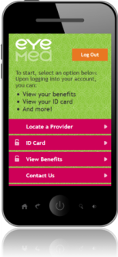
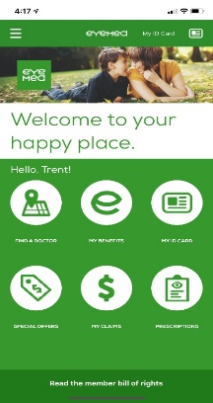
Experience more with member tools
You’ll receive an in-home Welcome Kit detailing your new vision benefits and the closest eye doctors. And using your benefits couldn’t be easier with access to convenient digital tools.
EyeMed Members App
  Benefits, eligibility and claims at-a-glance
  Find an eye doctor and get door-to-door directions
  Grab special offers
  Load and save prescriptions
  Set exam and contact lens reminders
  Pull up ID card and add to your wallet (for iOS only)
Member Web
See benefits and eligibility status*
View Savings Dashboard
Estimate out-of-pocket costs before your visit to the eye doctor
Download ID cards and EOBs
Find an eye doctor
Check claim status
Get special offers
*Due to HIPAA regulations, members will not be able to view dependents over the age of 18

Slide 23

Life/AD&D and
Disability Insurance

Slide 24
Life Insurance

Slide 25

If something were to happen to you tomorrow, would your loved ones be able to...
Pay the rent or mortgage?
Pay your debts?
Provide for themselves?
Pay your funeral and medical costs?
We don’t like to talk about life insurance, but the fact is most people need it to financially protect their family in case of premature death.

Slide 26

Included with your Life Insurance Plan:
Beneficiary Resource Services™:
Benefits Beyond a Check
Employee
Online will preparation: create, modify and store a last will and
testament online
Online pre-planning for funeral and services
Beneficiaries
Unlimited telephonic grief counseling for beneficiary and family members
Up to 5 sessions for legal, financial or grief counseling
Grief and legal counseling offered face-to-face using expansive network of professional resources
Online funeral planning
Program provides wellness services
for you and your loved ones (beneficiaries)
Beneficiary Resource Services is provided by Morneau Shepell. Morneau Shepell is an independent organization that does not provide Blue Cross and Blue Shield of Illinois or Dearborn Life Insurance Company products or services.

Slide 27

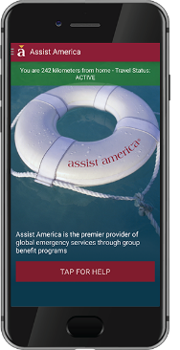
Included with your Life Insurance Plan:
Travel Resource Services™:
Services include but are not limited to:
Medical search referrals
Medical evacuation
Monitoring of medical condition
Travel companion assistance
Return of mortal remains
Dependent children assistance
Advance of medical expenses
Replacement of medicine/eyeglasses
Provides medical and travel assistance
for you and your family traveling for
business or pleasure 100 or more
miles from home (includes travel
within United States)
Access Services with a Mobile App!
A wide range of global emergency assistance services can be accessed from a phone by downloading the FREE Assist America Mobile App.
Travel Resource Services is administered by Assist America. Assist America is an independent organization that does not provide Blue Cross and Blue Shield of Illinois or Dearborn Life Insurance Company products or services. Assist America is solely responsible for the products and services associated with Travel Resource Services. Usage of the Assist America mobile app may be subject to additional terms and conditions.

Slide 28

Included with your Life Insurance Plan:
Solutions for Education Professionals
College & University Employees
Campus Violence Benefit
Due to the growing concern of school violence, we offer a Campus Violence Benefit as part of our Accidental Death & Dismemberment (AD&D) coverage.²
Disability Coverage During School Breaks
We include specific contract language designed for educators and staff that
treats all disabilities the same, regardless of whether they occur while school
is in session or not. This language is standard on all of our Short-Term Disability and Long-Term Disability contracts for education-related groups.
ER visits spike
15-27%
during the summer months.¹
¹Baker, Dr. James. “ER Visits Peak during the Summer Months.” Kaiser Permanente. https://share.kaiserpermanente.org/article/er-visits-peak-during-the-summer-months/.
Published July 2, 2014. Accessed September 7, 2017. ² Not available in all states. ³Exclusions and restrictions do apply.

Slide 29

Included with your Life Insurance Plan:
Solutions for Education Professionals
K-12 School Employees
Campus Violence Benefit
Due to the growing concern of school violence, we offer a Campus Violence Benefit as part of our Accidental Death & Dismemberment (AD&D) coverage.²
College Assistance Plan (K-12)
Figuring out how to pay for college can be overwhelming. To help alleviate this concern, we provide access to the College Assistance Plan (CAP), an online resource dedicated to helping people plan for, pay for, and reduce the cost of college. This secure online portal includes checklists, a negotiation toolkit, pricing calculators, a college search function, and funding and financial aid information. This resource is available to employees of the school district, as well as students and their parents/guardians in the school district. This program is only offered to school districts that include high school.
Office Depot® Discount Program
For our education customers, Office Depot offers a 10% discount on most of their office supplies. This discount is available online through a special website and in stores.³
On Average
Teachers Spend
$500
of their own money each year
to pay for school supplies.¹
¹Jennifer Calfas “7 Big Things You Should Understand About Teacher Pay, According to Teachers” Money.com https://money.com/teacher-pay-big-misconceptions/.
Published September 10, 2018. Accessed July 23, 2020. ² Not available in all states. ³ Exclusions and restrictions apply.

Slide 30

DearbornCares
SM
Payment Now, Paperwork Later
Losing a loved one can be emotionally and
financially overwhelming.
DearbornCares provides an advance payment of the life insurance benefit to help beneficiaries cover their immediate expenses, such as funeral costs and medical bills.
What is it?
Pays up to a total of $50,000 of employer-paid basic life insurance claims
Available for covered employees and retirees
Available on claims with 1, 2 or 3 named beneficiaries
No death certificate required
*Pays up to a total of $50,000 to beneficiaries (maximum 3) of employer-paid basic life insurance benefits in 48 hours of confirmation of eligibility. The advance payment is either distributed to 1 beneficiary or divided up between 2 or 3 beneficiaries, as designated by the insured.

Slide 31


Who are you protecting?
Life insurance is the tool most people use to financially protect their families from premature death.
Who are you protecting?
Do you have a beneficiary?
When you designate a beneficiary, YOU control who receives your life insurance benefits—and whose financial future you protect.
Make your intentions clear and fill out the Beneficiary Designation Form.

Slide 32
Disability Insurance

Slide 33
What is Disability Insurance?
Group Short-Term Disability
Group Short- and Long-Term Disability Insurance pays a percentage of your salary when you are unable to work full time because of a non-work-related illness or injury.
These benefits can be used to pay your everyday expenses when you are without a paycheck. And your premiums can conveniently be paid through a payroll deduction.

Slide 34


Do you have less than 6 months of living expenses—mortgage/rent, insurance (medical, homeowners, auto), utilities (cable, gas, electric, water), food, cell phone, internet and loan payments—in savings?
If you were unable to work due to a disability:
  Would your family’s financial lifestyle have to change?
  If you could borrow money from family or friends, would you have to pay them back?
Are you prepared to live without
your paycheck?
If you answered
YES
to any of these, it’s time to review your Disability Insurance protection.

Slide 35
Voluntary Short-Term Disability Benefits
Benefit Percentage:
60% of weekly earnings, not to exceed $1,500
Weekly earnings as indicated on your W-2 form for the calendar year prior to the date of disability.
Benefit Elimination Period:
Injury 7 days
Sickness 7 days
Benefit Begin:
Injury 8 days
Sickness 8 days
Benefit Maximum Benefit Period:
12 weeks
Pre-existing Condition Exclusion Benefits will not be paid for:
A condition which was caused by, or result from, a sickness or injury for which you received medical treatment; or advice was rendered, prescribed or recommended whether or not the sickness was diagnosed at all or was misdiagnosed within 12 months prior to your effective date.
A condition which was caused by, or results in a disability which begins in the first 12 months after your effective date.

Slide 36

No one is immune from experiencing a disability.
It doesn’t affect just older people.
The Social Security Administration estimates that
25% of 20-year-olds
in the workforce today will
suffer a disability before
they retire.*
*Council for Disability Awareness. “The State of Disability Coverage in America.” https://disabilitycanhappen.org/wp-content/uploads/2019/05/DIAM2019_Facts.pdf. Accessed June 20, 2020.

Slide 37
NORTONLIFELOCK BENEFIT PLANS OVERVIEW
Berwyn north sd #98

Slide 38




OUR CORE ID THEFT PROTECTION
LIFELOCK IDENTITY THEFT PROTECTION
LifeLock Identity Alert System
Monitoring for fraudulent use of your Social Security number, name, address, or date of birth in applications for credit and services. The patented system sends alerts by text, phone, email, or mobile app.
Credit Monitoring + Application Alerts
We monitor key changes to your credit file and alert you to help detect fraud.
Dark Web Monitoring
Identity thieves can sell your personal information on hard-to-find dark web sites and forums. LifeLock patrols the dark web and notifies you if we find your information.
U.S.-Based Identity Restoration Specialists
If your identity is compromised, an Identity Restoration Specialist will personally handle your case and help restore your identity.

Slide 39
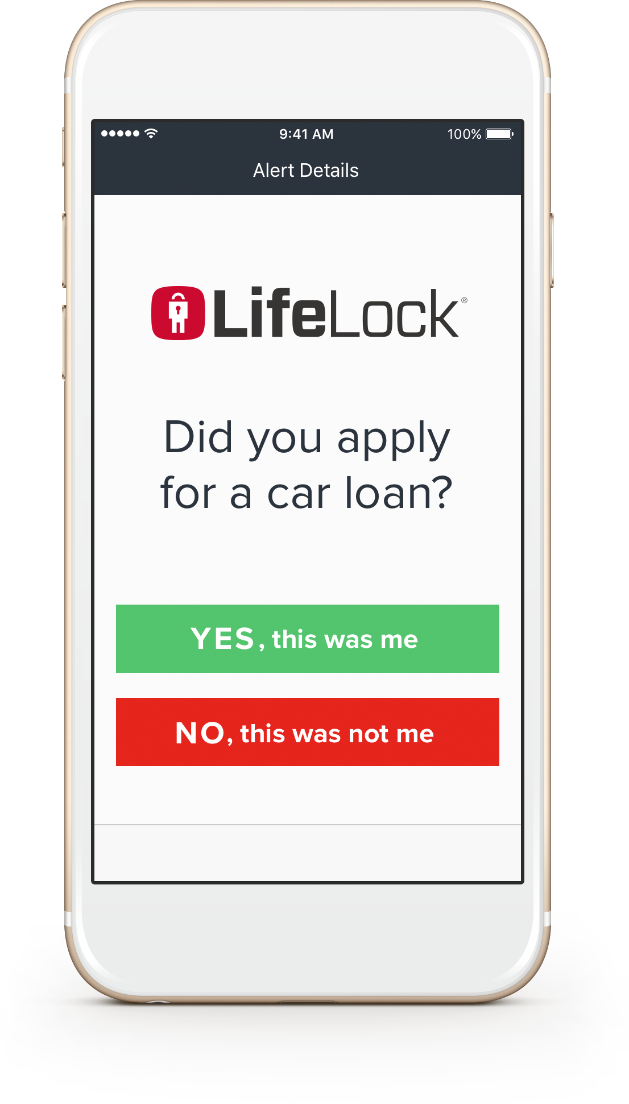
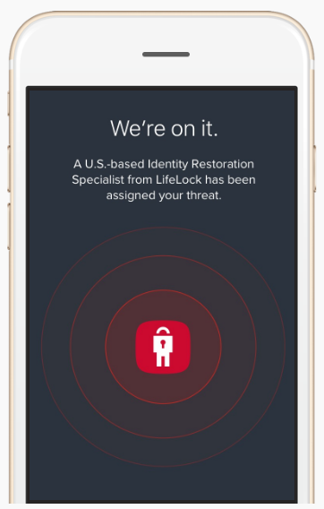
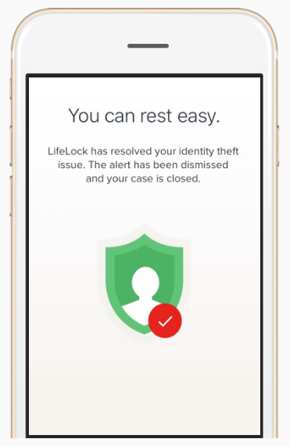
HOW WE HELP PROTECT EMPLOYEES
LIFELOCK IDENTITY THEFT PROTECTION
WE SCAN
We look for threats to your identity.
WE ALERT†
We alert you of suspicious threats by text, email, or phone. ‡‡
WE RESTORE
If your identity is stolen, our U.S. based team will work to fix it.
WE REIMBURSE
We’ll reimburse funds stolen due to identity theft up to the limit of your plan.†††
No one can prevent all identity theft or all cybercrime.
† We do not monitor all transactions at all businesses.
‡‡ Phone alerts made during normal business hours.
††† Reimbursement and Expense Compensation, each with limits of up to $1 million for LifeLock Benefit Elite and LifeLock Ultimate Plus. And up to $1 million for coverage for lawyers and experts if needed.
Benefits provided by Master Policy issued by United Specialty Insurance Company (State National Insurance Company, Inc. for NY State members). Policy terms, conditions and exclusions at: LifeLock.com/legal

Slide 40





ADDITIONAL KEY FEATURES
AWARD-WINNING DEVICE SECURITY FROM NORTON
Online Threat Protection for your Devices**
Multi-layered, advanced security helps protect against existing and emerging malware threats to your devices and help protect your private and financial information when you go online.
Norton Family Parental Controls^{3**}
Help your kids explore, learn and enjoy their connected world safely on their PCs, smartphones, and tablets
Password Manager**
Norton Password Manager provides the tools you need to create, store, and manage every password, your credit card information and other credentials online – safely and securely in your very own encrypted, cloud-based vault.
Secure Cloud Backup^{1**}
Store and protect important files and documents on your PC as a preventative measure to data loss due to hard drive failures, stolen devices and even ransomware

Slide 41

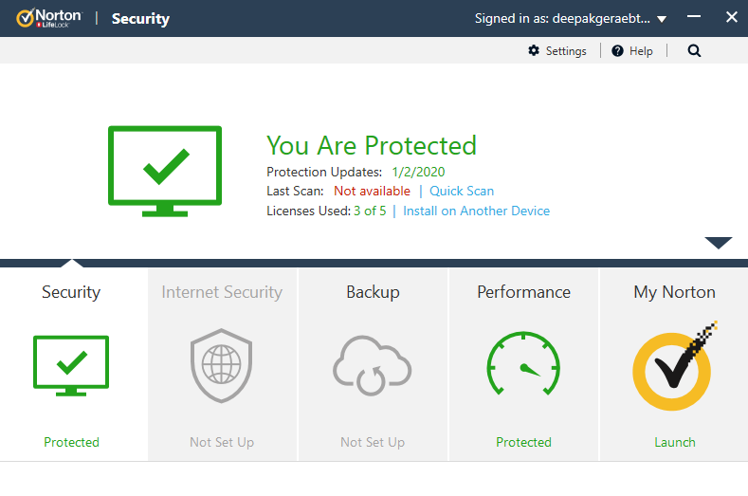


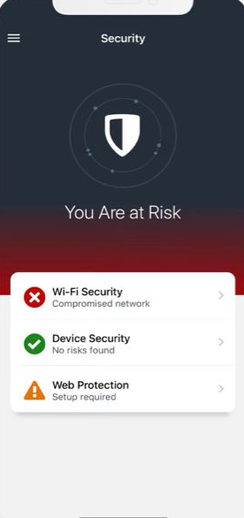
NORTON DEVICE SECURITY
the “must have” protection for your computer can also protect your phone and tablet:
ANTIVIRUS + ANTI-MALWARE: Blocks malicious software from stealing sensitive information.
WI-FI SECURITY: Warns you of public Wi-fi that is compromised and directs you to connect to a secure Wi-fi.
LINK GUARD + SAFE WEB BROWSING: Alerts you when a link or website you are trying to access may compromised.
ISOLATION MODE: Detects when users have accessed an unsafe site by displaying the pages in read only mode.
SMART FIREWALL: Protects your computer from unauthorized access.
SAFECAM: Helps avoid unauthorized access to your PC webcam.

Slide 42


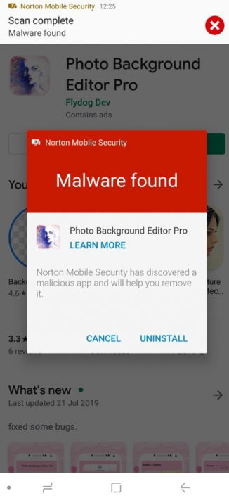
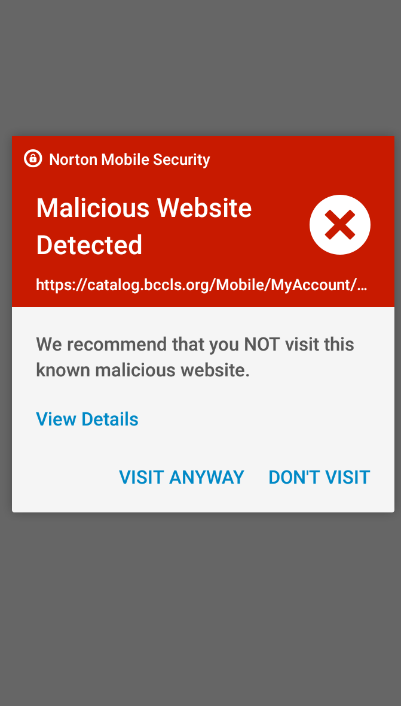
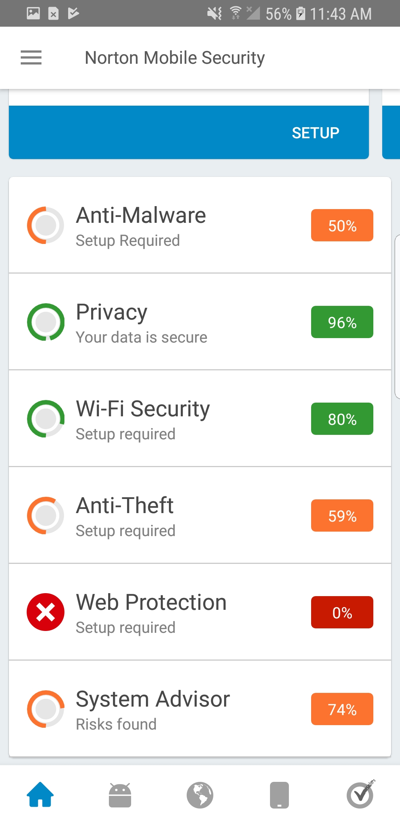
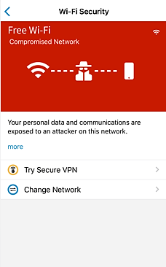
DEVICE PROTECTION IN ACTION
DON’T ASSUME THAT YOUR DEVICE IS NOT AT RISK. You can see our

Slide 43

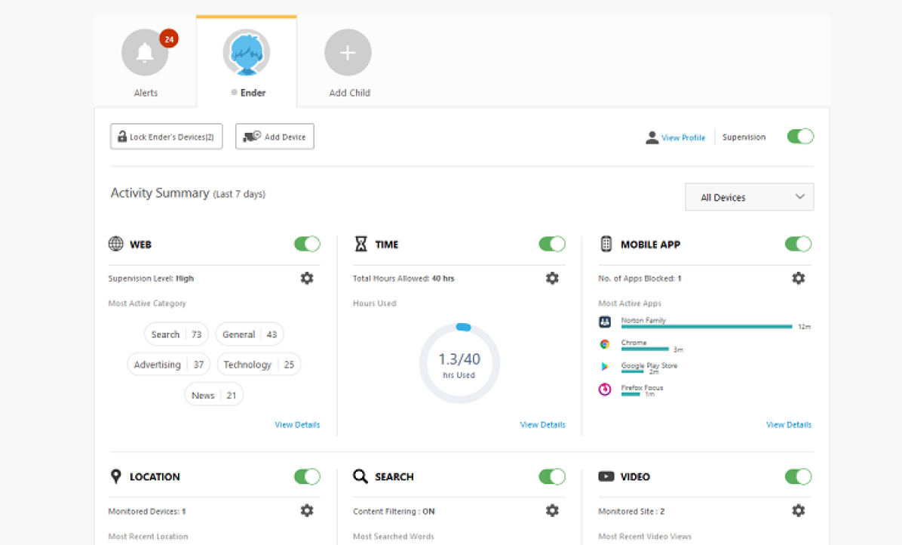

NORTON FAMILY PARENTAL CONTROLS
Encourage important CONVERSATIONS ABOUT HOW KIDS CAN safely EXPLORE ONLINE WITH
WEB SUPERVISION: Makes the web safer for kids to explore by keeping parents informed of which sites kids are visiting and letting them block harmful or inappropriate sites.
My.Norton.com
TIME SUPERVISION: Helps kids balance time spent online by scheduling screen time limits for their device usage.
SEARCH SUPERVISION: Provides insights into the search terms and videos that kids are interested in and flags unsafe behavior.
PARENT REPORTING: Get detailed reports on what kids are doing online, right to the Parent Portal or emailed to their inbox.

Slide 44
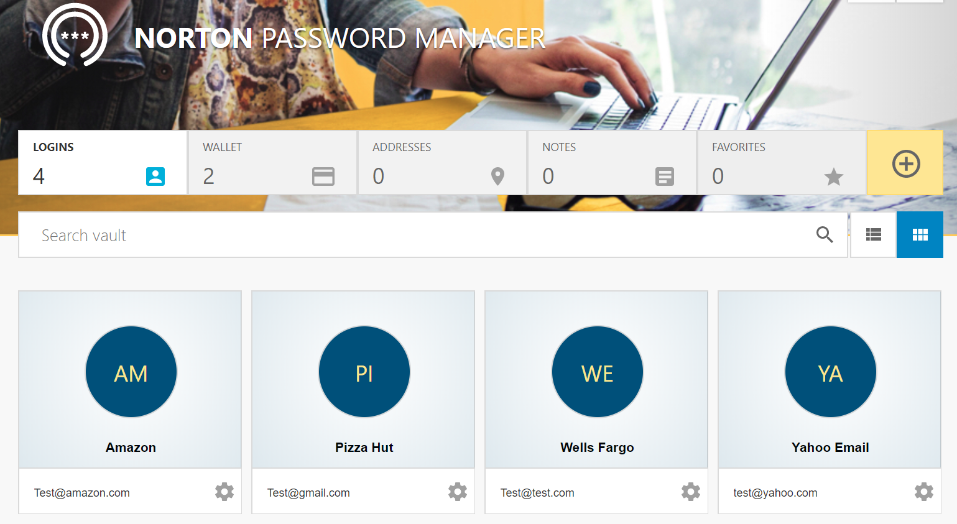
NORTON PASSWORD MANAGER
8 out of 10 people use the same password on multiple sites. Let us help support strong passwords with
Assistance Creating Unique + Complex Passwords
Passwords are hard to remember, and so we tend to rely on the same ones across multiple sites – and when one is compromised, criminals can quickly access multiple accounts.. Norton Password Manager enables you to generate unique and complex passwords and store them in a secure online vault.
Simple to Access + Quickly Update Passwords
Your online vault provides you quick access to your stored passwords with your master password. Find out that one of your passwords had been compromised? You can easily manage your passwords from our mobile app. Your vault syncs across all your devices and can be accessed quickly with Touch ID/Face ID or Android biometrics on your mobile devices.

Slide 45


MEMBERSHIP PLANS & PRICING
ENJOY Comprehensive identity theft and device protection
LifeLock Identity Protection
LifeLock Identity Alert System
Prior ID Theft Remediation
*Privacy Monitor
Dark Web Monitoring
$1m Guarantee(s)
Financial Account Activity Alerts
ID Verification Alerts
Lost Wallet Protection
Credit Freeze/Lock
Norton
Norton Device/Online Security
Norton Parental Controls
Norton Password Manager
Safecam
Social Media Monitoring - NEW 1/2021
VPN - NEW 3/1/2021
$11.49/per employee $21.98/per family
3B Credit Monitoring
3B Credit Reports + Scores
Monthly Credit Score Tracking
5 EE / 10 FAM Norton Device Protection
50GB Online Backup
Home Title Monitoring
New Checking & Savings Application Alerts
Bank Account Takeover Alerts
$7.99/per employee $15.98/per family
1B Credit Monitoring
1B Credit Application Alerts
3 EE / 6 FAM Norton Device Protection
10GB Online Backup

Slide 46
HOW TO ENROLL IN
NORTONLIFELOCK BENEFIT

Slide 47
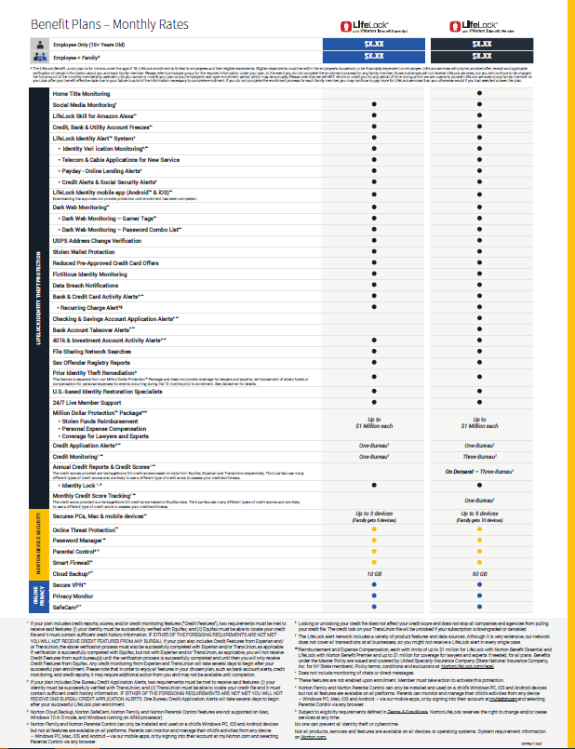
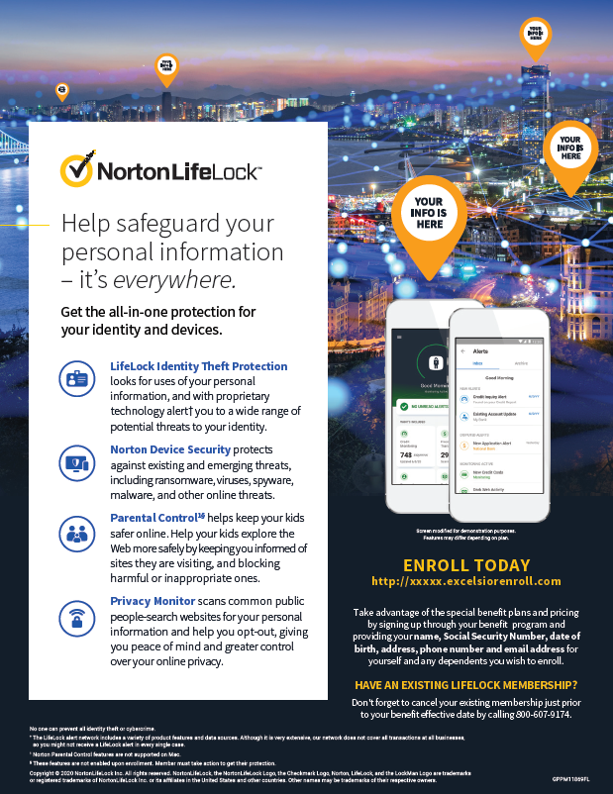
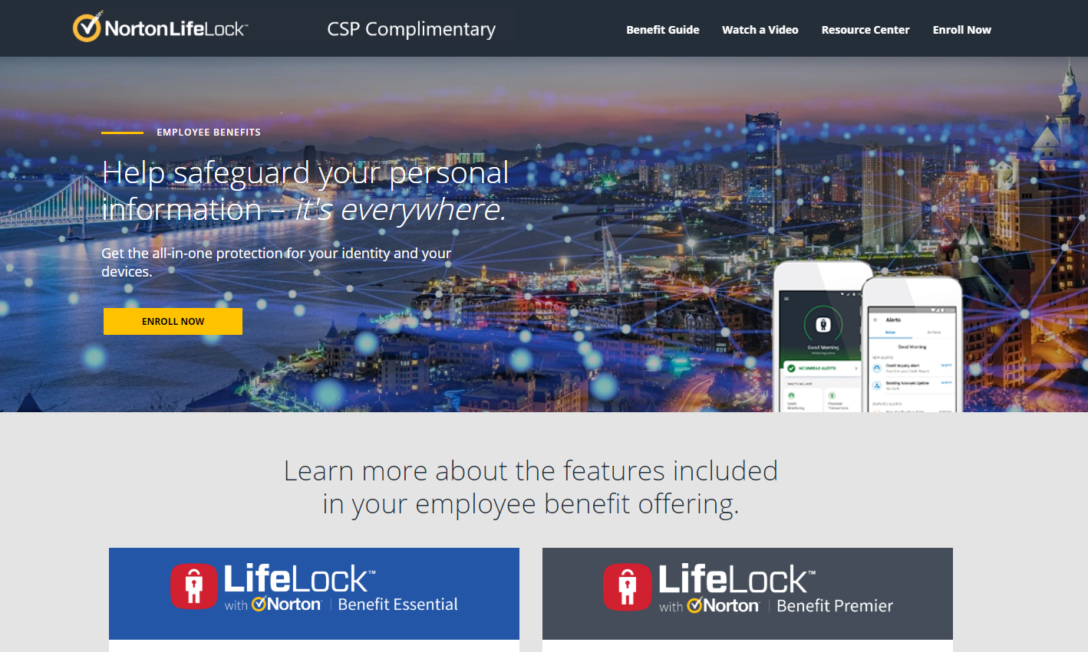
HOW TO ENROLL
BERWYN NORTH SD #98

Slide 48
POST-ENROLLMENT
MEMBER EXPERIENCE

Slide 49
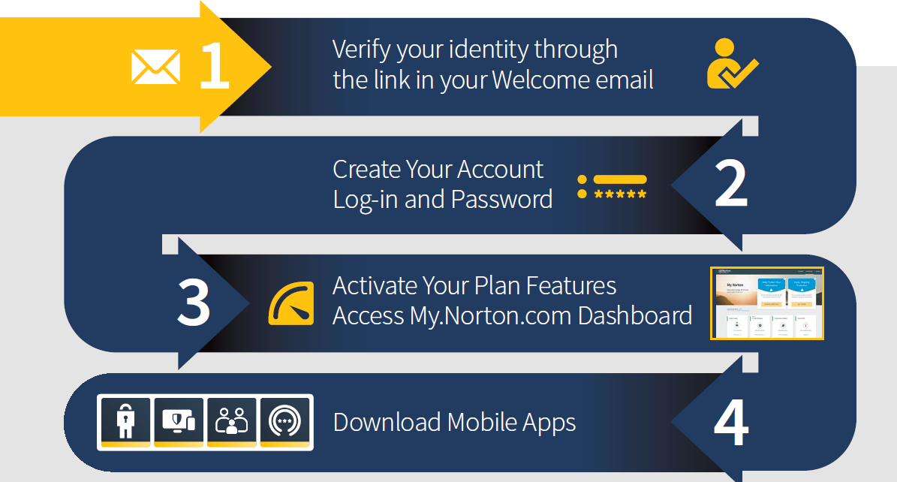
HOW TO SET UP YOUR MEMBER ACCOUNT
NEW & EXISTING MEMBERS

Slide 50
AUTOMATIC-ON FEATURES
ENROLLED MEMBERS RECEIVE MANY
LifeLock Identity Alerts
Home Title Monitoring*
Dark Web Monitoring
Lost Wallet Protection
It’s the foundation for all LifeLock services. We monitor for fraudulent use of your Social Security number, name, address, or date of birth in applications for credit and services. The patented system sends alerts by text, phone, email, or mobile app.
We will monitor and notify you if we detect changes made at the county recorder’s office related to your home’s title so you can take necessary action to protect your home. We actively monitor for change of ownership, change in financing, addition of new lender, and notice of default.
*Premier Plan Only
Identity thieves can sell your personal information on hard-to-find dark web sites and forums. LifeLock patrols the dark web and notifies you if we find your information. We will start monitoring your enrollment information from the moment you are enrolled, and you can add even more information for additional monitoring through your member portal.
A lost wallet can mean a lost identity. Call us if your wallet is lost or stolen and we’ll help cancel or replace credit cards, driver’s licenses, Social Security cards, insurance cards and more.

Slide 51
AUTOMATIC-ON FEATURES
ENROLLED MEMBERS RECEIVE MANY
24/7 Live Member Support
Dedicated Restoration Agents
$1M Protection Package
We have live Identity Protection Agents available to answer your questions 24/7.
If you become a victim of identity theft, an Identity Restoration Specialist will personally handle your case and help restore your identity.
We help protect you with our Million Dollar Protection Package. This includes reimbursement for stolen funds and coverage for personal expenses, each with limits up to $1 million, and coverage for lawyers and experts if needed up to $1 million, to help resolve your case.

Slide 52
WELCOME EMAIL
WELCOME TO YOUR LIFELOCK WITH NORTON BENEFIT PLAN
IF YOU CANNOT FIND
YOUR WELCOME EMAIL,
YOU CAN VISIT:
Norton.com/EBsetup to start
the onboarding process
Start by Clicking Here

Slide 53
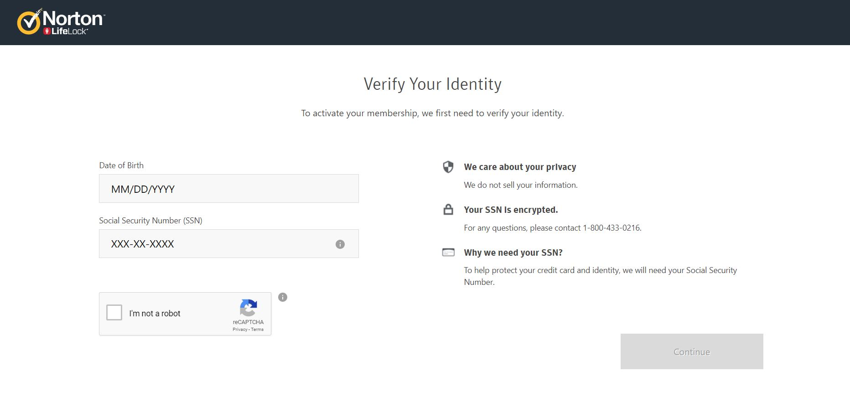
IDENTITY VERIFICATION
WELCOME TO YOUR LIFELOCK WITH NORTON BENEFIT PLAN

Slide 54
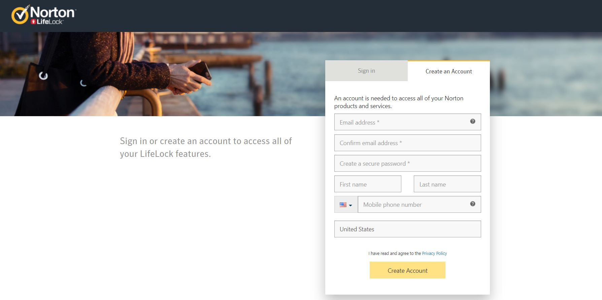
CREATE AN ACCOUNT
WELCOME TO YOUR LIFELOCK WITH NORTON BENEFIT PLAN

Slide 55
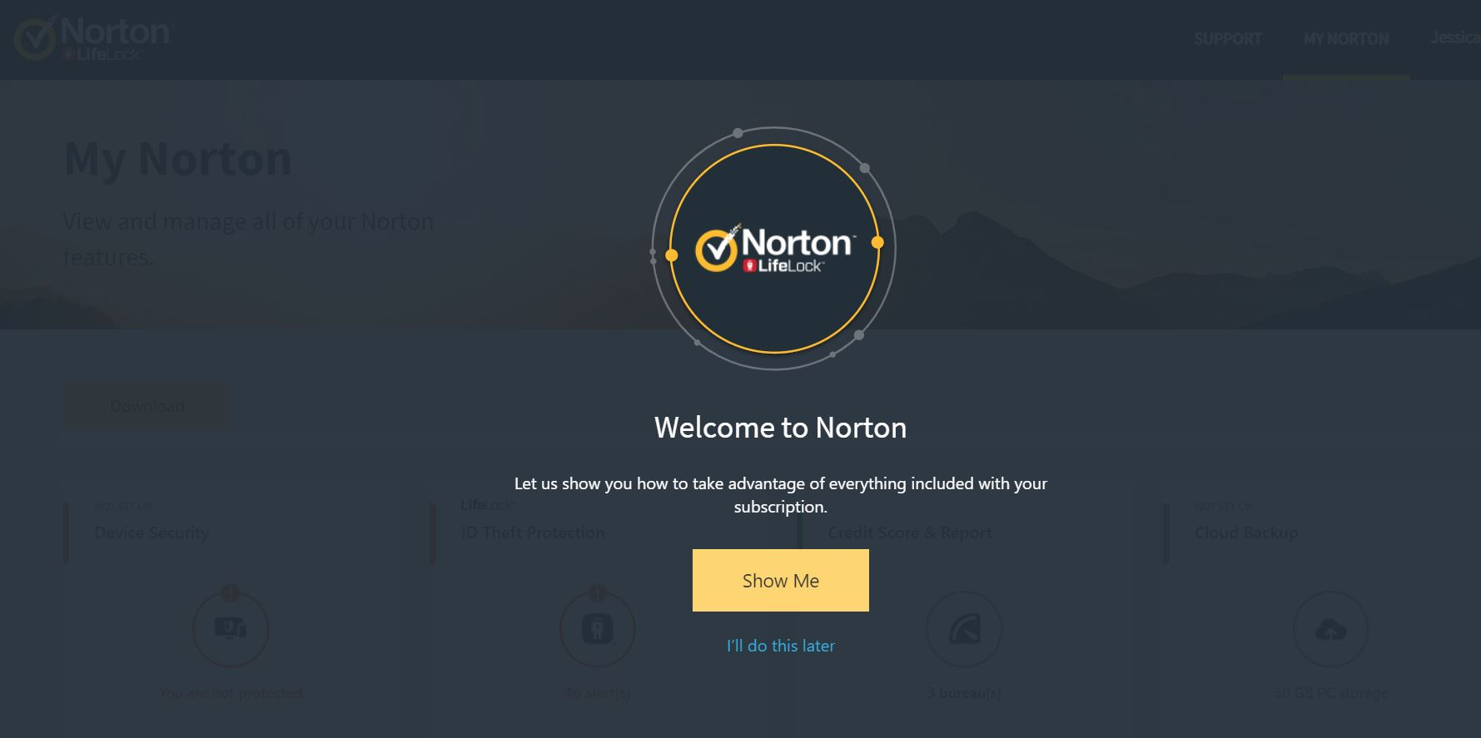
MEMBER ACCOUNT TUTORIAL
WELCOME TO YOUR LIFELOCK WITH NORTON BENEFIT PLAN

Slide 56
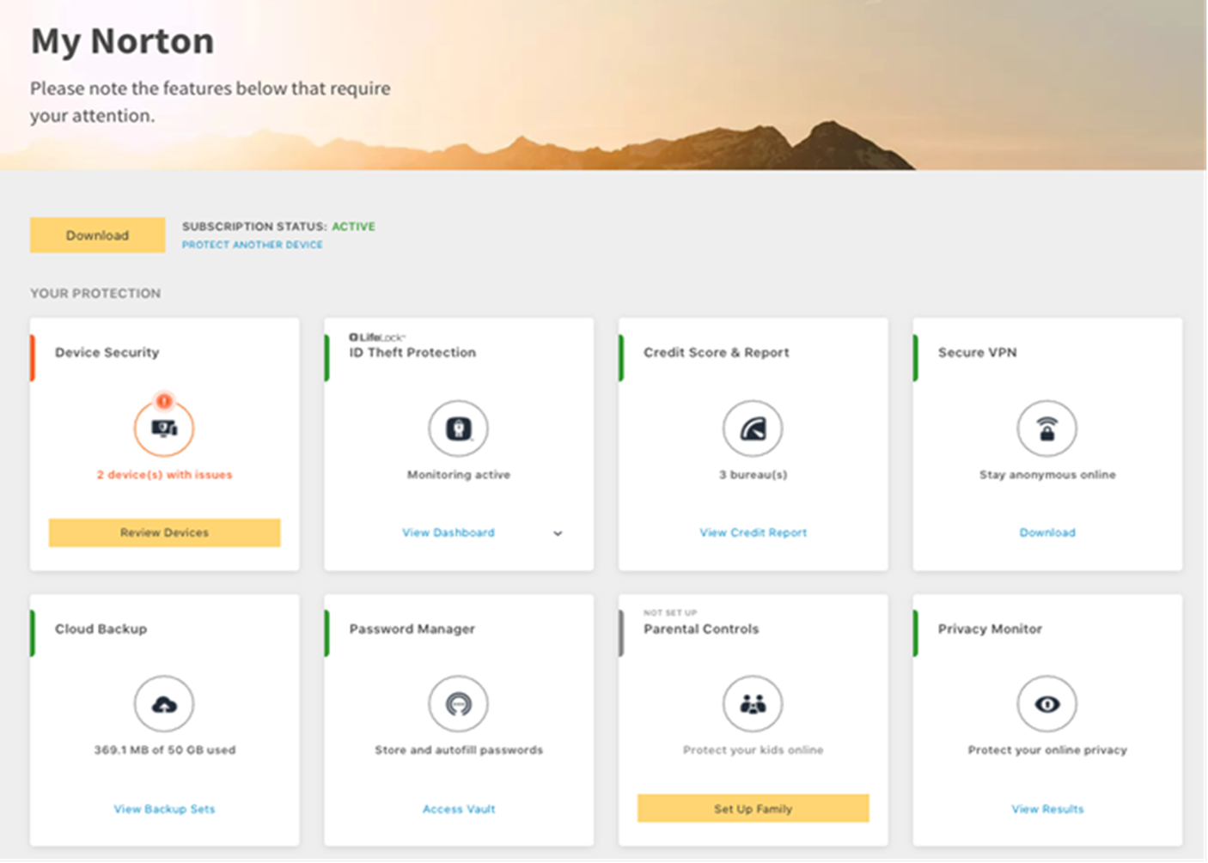
YOUR PERSONALIZED DASHBOARD
ACCESS ALL THE FEATURES OF YOUR MEMBERSHIP IN ONE PLACE
www.my.norton.com
CURRENT MEMBERS
Historical alerts remain are still visible, information added for Dark Web Monitoring remains in place, will need to reestablish transaction monitoring.
ALL-IN-ONE DASHBOARD
Your personalized dashboard gives you access to all of your membership features for both Norton and LifeLock.
ACCESS ONLINE SUPPORT
Get help online via chat, review how-to tutorials, and browse online FAQs.

Slide 57

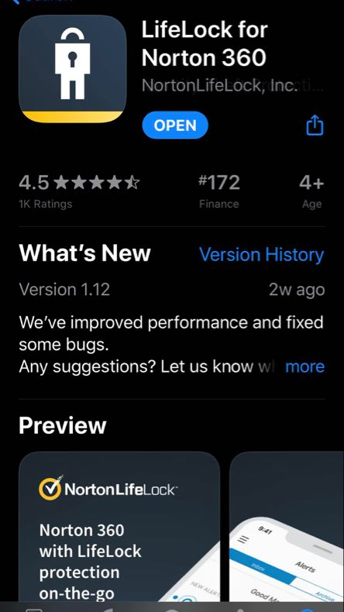
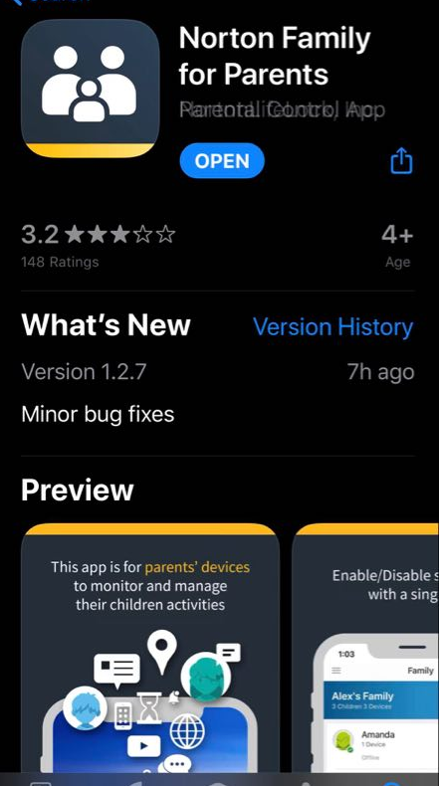
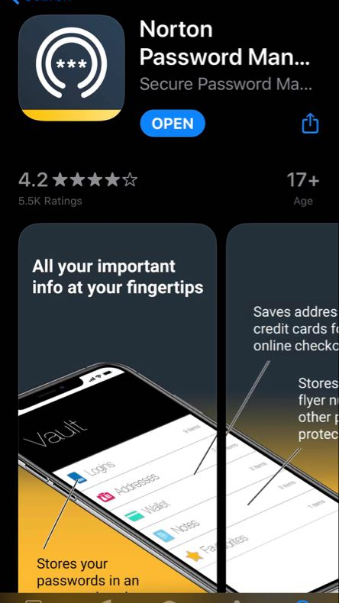
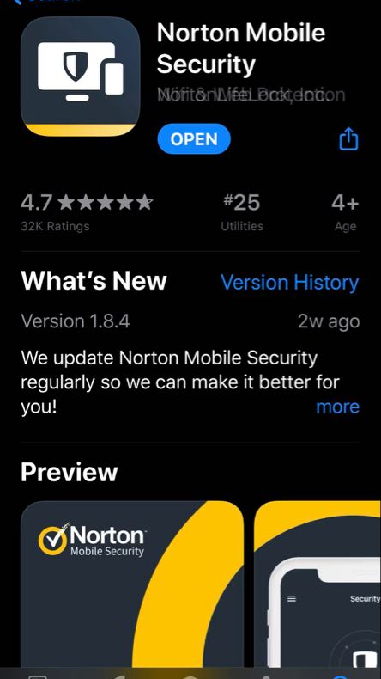
DOWNLOAD NEW MOBILE APPS
TAKE FULL ADVANTAGE OF NEW FEATURES WHEN YOU
SECURE CLOUD BACKUP
Automatically backs up your photos, financial files and other important documents of your choice on your Windows PC.

Slide 58
QUESTIONS?
Employee Benefits Member Service 800-607-9174
Dedicated EB agents between 8am-6pm

Slide 59

Employee Assistance Program (EAP)
  100% paid by The Company
  Provided through Perspectives
  Counseling on Personal Issues, such as:
  Stress, anxiety, depression
  Relationships
  Problems with your children
  Substance abuse
  EAP Services
  Assistance for you or a household family member
  Up to three (3) in-person sessions with a counselor, per year, per individual
  Unlimited toll-free phone access 24/7
  Online resources 24/7
  Work/life services for assistance with child care, elder care, financial issues, plus much more

Slide 60

HOW TO ENROLL
  Submit your form to HR by MAY 28TH, 2021
  Everyone must submit an enrollment form
  Benefits are effective July 1, 2021 through June 30, 2022

Slide 61

questions

