Slide 1
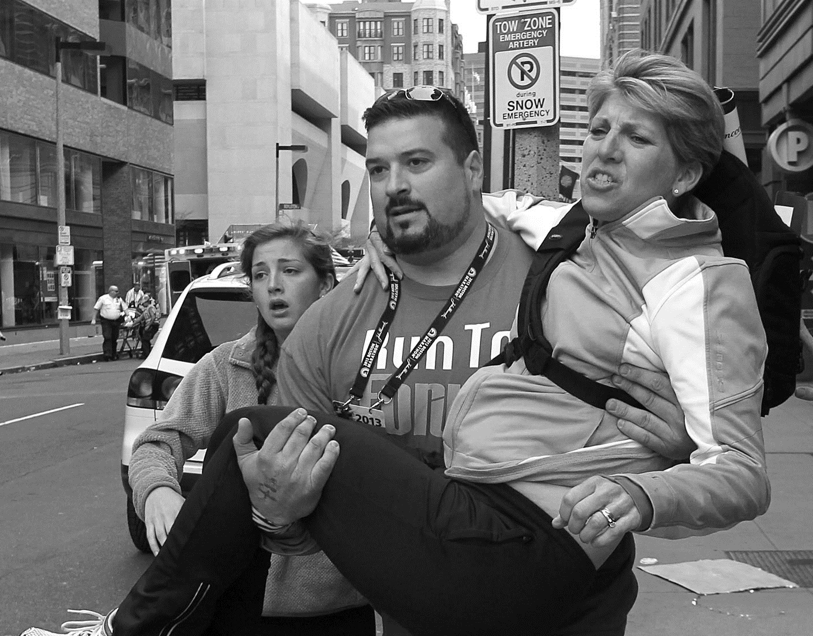




UNTIL HELP ARRIVES
v 2.0

Slide 2
WELCOME
1

Slide 3
GRAPHIC IMAGE WARNING
This course contains graphic images and audio clips from real life events that some may find disturbing.
3

Slide 4
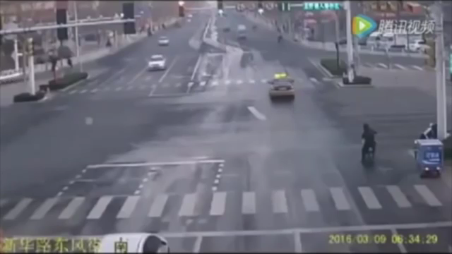
1
Video from USA: https://www.youtube.com/watch?v=LaxbadNjltc

Slide 5
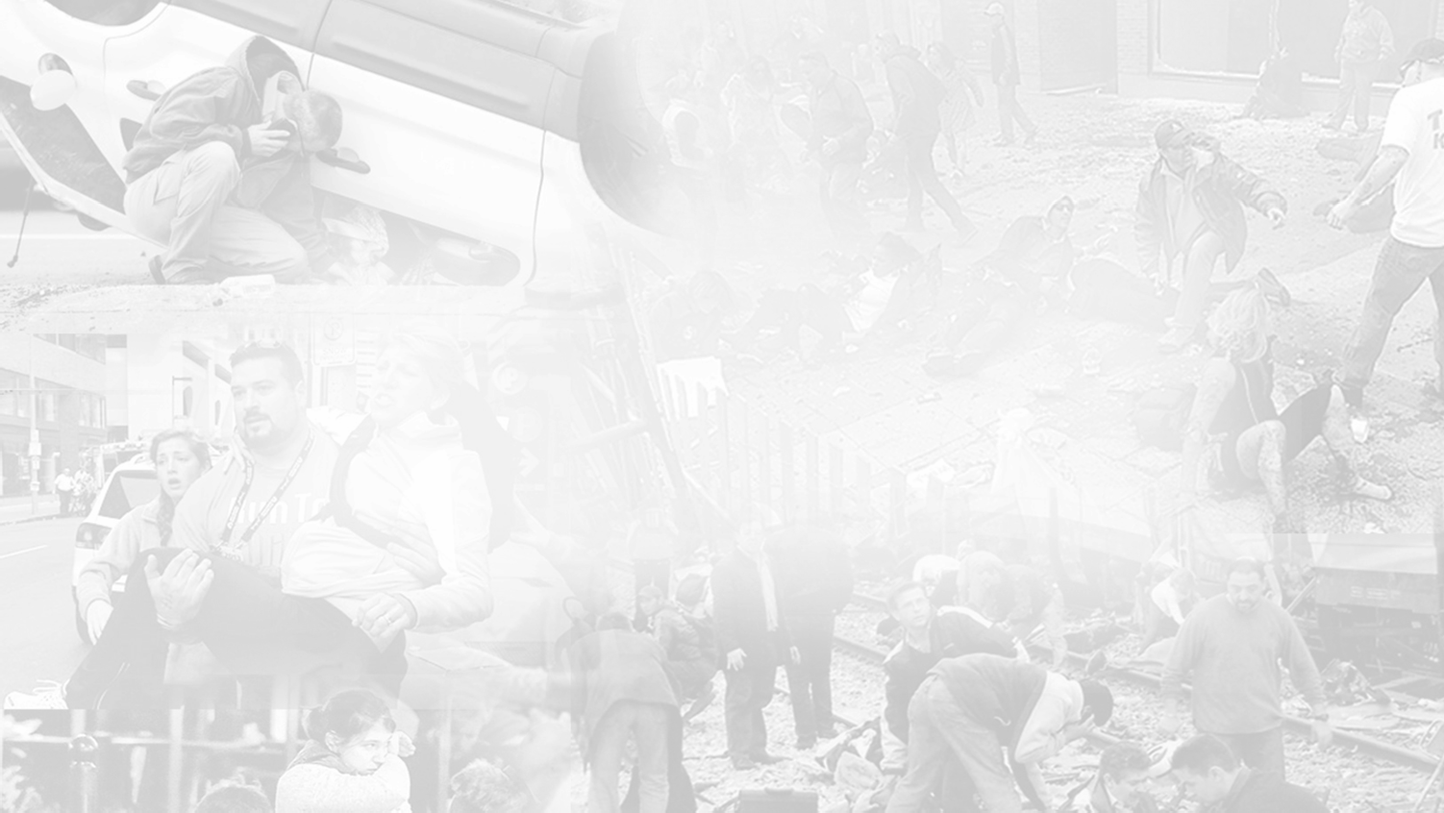

GOAL OF THE COURSE
To teach you the basic skills to keep people
with potentially life‐threatening injuries alive until professional help arrives.
4

Slide 6
COURSE OVERVIEW
Introduction: You Make a Difference
Step 1: Call 9‐1‐1
Step 2: Stay Safe
Step 3: Stop the Bleeding Step 4: Position the Injured Step 5: Provide Comfort
Before You Go: Prepare to Help
5

Slide 7





COURSE OBJECTIVES
By the end of this course, you will be able to:
Effectively communicate with 9‐1‐1 operators Stay safe
Stop life‐threatening bleeding Position the injured
Provide emotional support
6

Slide 8
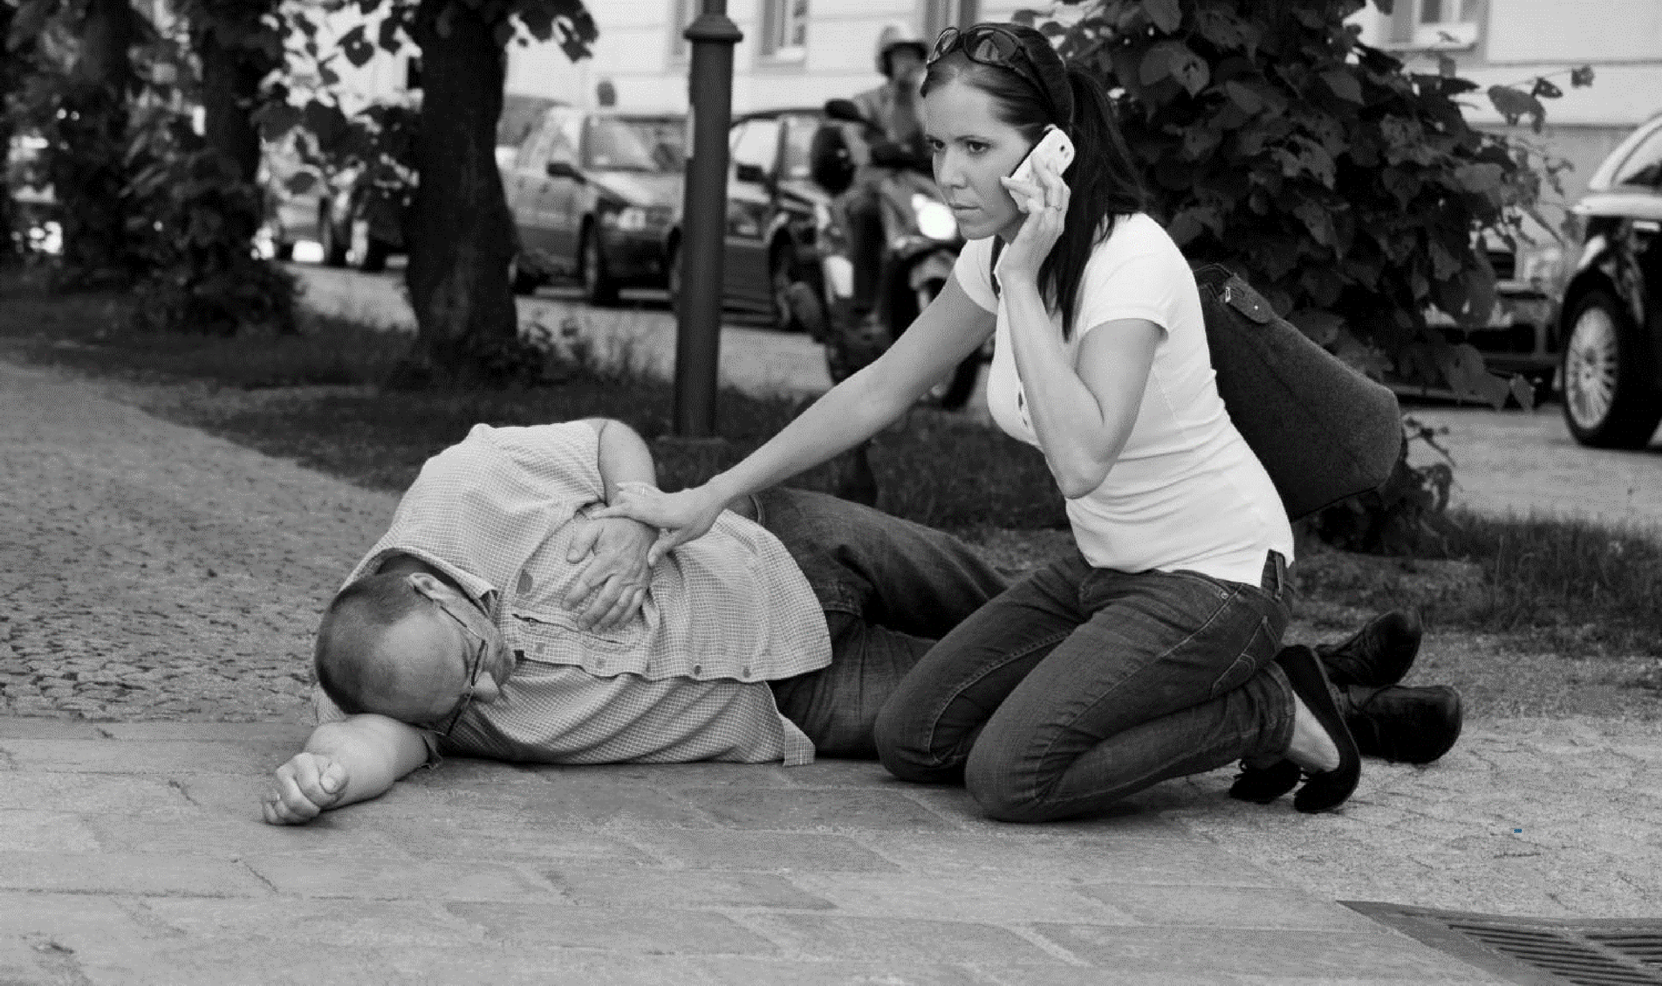

7
Photo by Corepics VOF| Noncommercial

Slide 9

A PERFECT STRANGER
INTRODUCTION: YOU MAKE A DIFFERENCE
Video can be found at: https://www.youtube.com/watch?v=qBrMU0sLoHQ

Slide 10



OBJECTIVES
INTRODUCTION: YOU MAKE A DIFFERENCE
By the end of this section, you will be able to:
State the steps you can take when responding to an emergency situation. Be familiar with different reactions you may have in a stressful event.
Understand how practice can improve your skills.

Slide 11




GROUP ACTIVITY
INTRODUCTION: YOU MAKE A DIFFERENCE
Instructions:
1
Break up into small groups.
2
Observe the following slides, which contain pictures of real emergencies.
3
Write down who you see in each picture, and what they are doing.

Slide 12
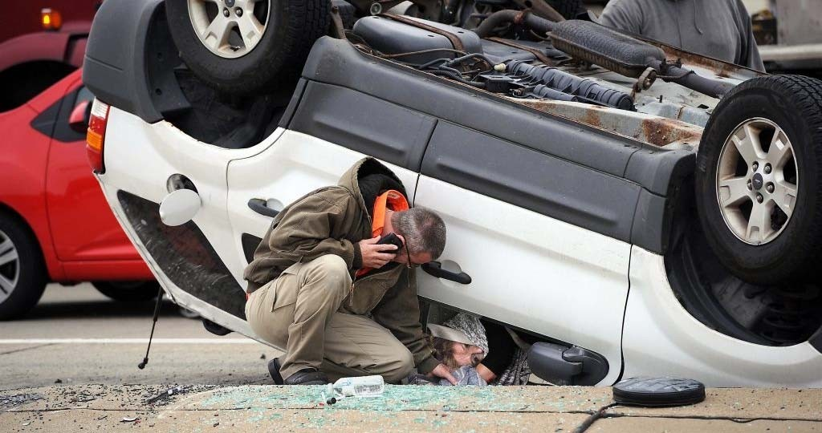
CAR CRASH
Photo by Rebecca Droke/Post‐Gazette | Noncommercial

Slide 13
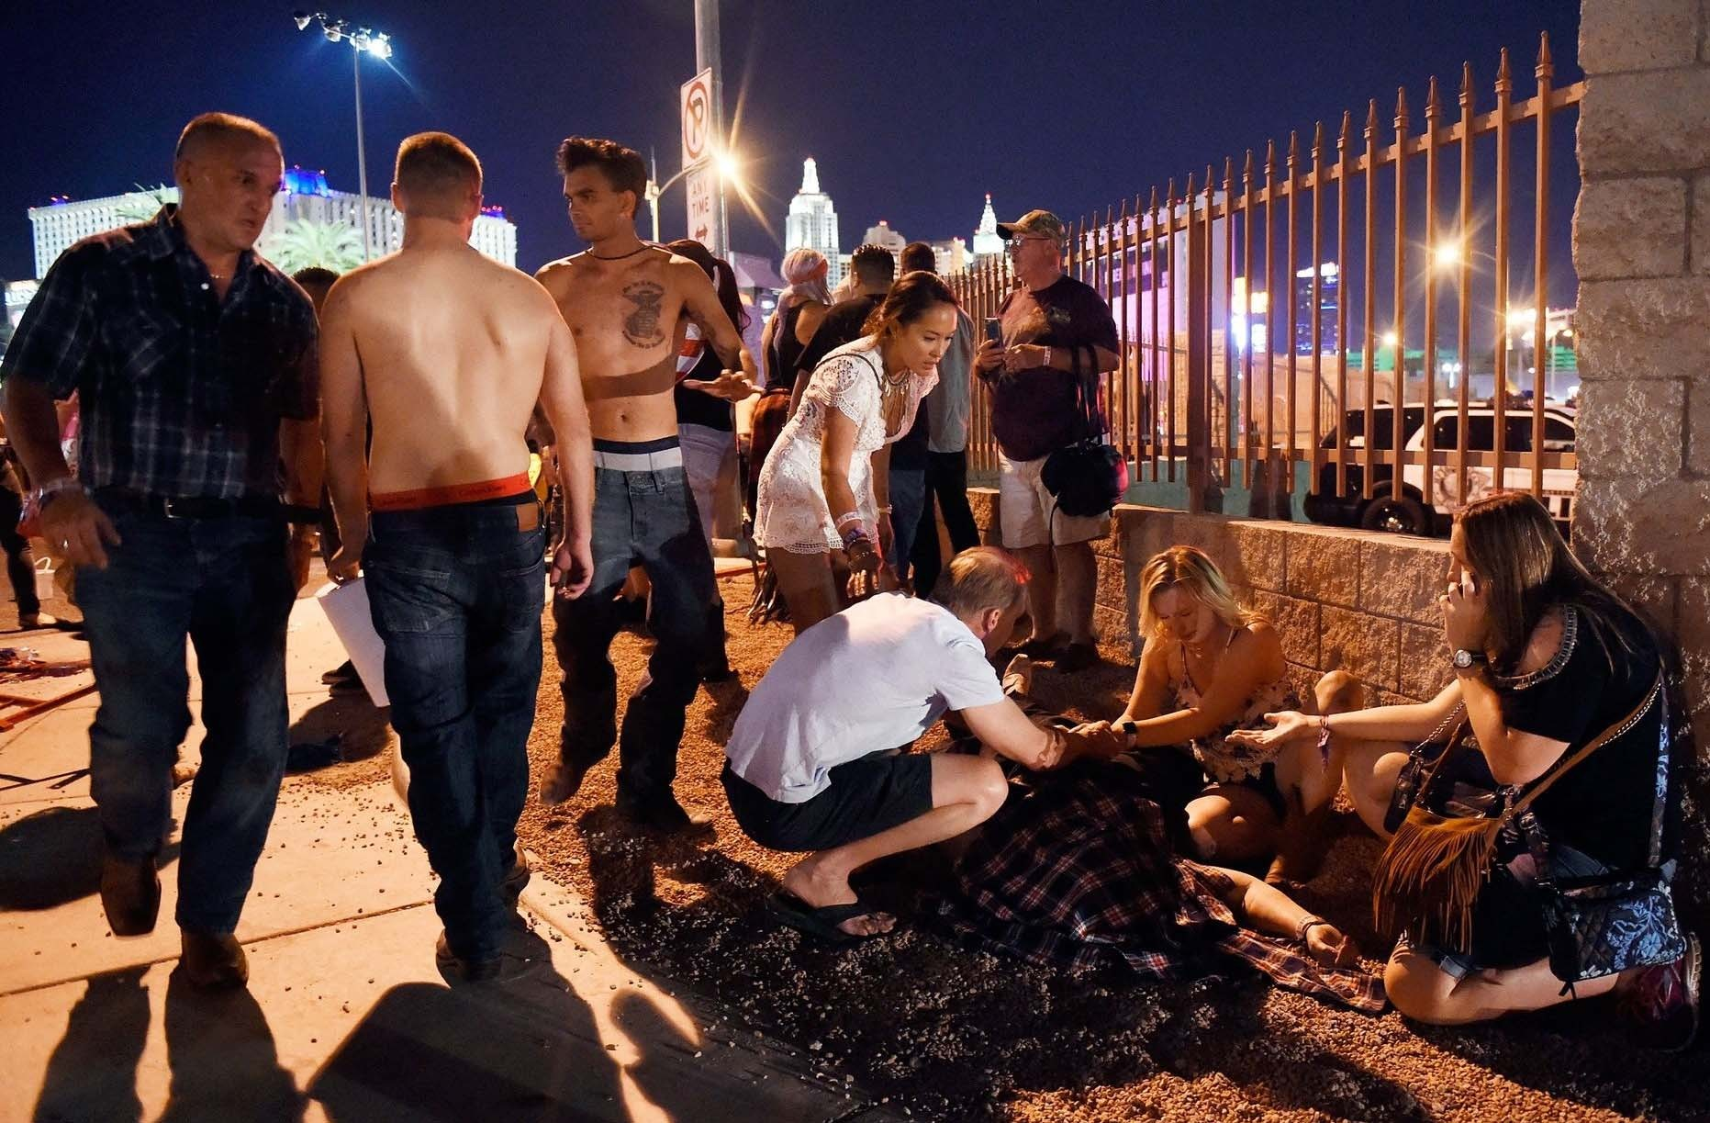
Photo by David Becker/Getty Images | Getty's Open Content Program
LAS VEGAS SHOOTING
12

Slide 14
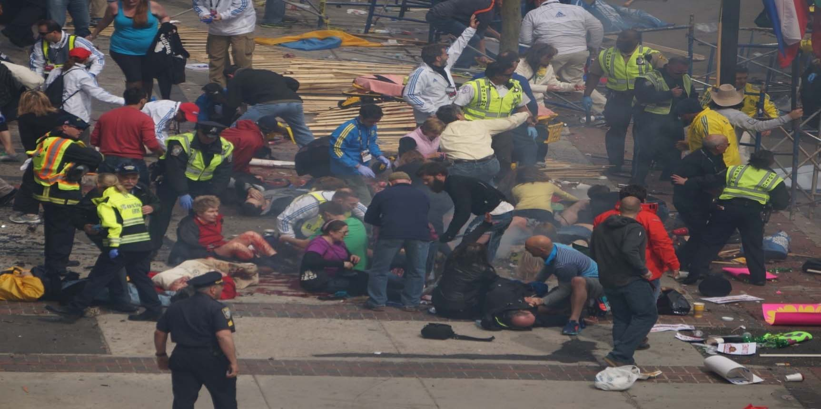
Photo by hahatango | CC BY 2.0
BOSTON MARATHON BOMBING

Slide 15



ACTIVITY DISCUSSION
INTRODUCTION: YOU MAKE A DIFFERENCE
What did you see?
People calling 9‐1‐1
People moving the injured away from danger People providing care for life‐threatening injuries People providing comfort to the wounded

Slide 16
TYPES OF INCIDENTS
INTRODUCTION: YOU MAKE A DIFFERENCE
Serious injuries can result from different types of incidents.
Common
Rare
Very Rare
Type:
Vehicle crashes and injuries at home
Type: Man-made and local weather
incidents
Type: Large-scale disasters
Examples: Car, motorcycle, bicycle, pedestrian, home repair injuries
Examples: Tornado, multi-vehicle crashes, active shooter
Examples: Acts of terrorism, bombings, large-scale transportation incidents
15

Slide 17
YOU MAKE A DIFFERENCE
INTRODUCTION: YOU MAKE A DIFFERENCE
If you act quickly and purposefully, you can save lives:
Call 9‐1‐1.
Stay safe and move the injured away from danger.
Apply pressure or a tourniquet to stop bleeding.
Help the injured breathe by allowing them to position themselves, or placing them on their side if they are unconscious.
Provide comfort.

Slide 18


RESPONSE IMPACT
INTRODUCTION: YOU MAKE A DIFFERENCE
EMS Response Time: 6‐9 minutes*
Life‐threatening injuries can kill within minutes – before medical responders arrive. Simple actions save lives: you can take relatively easy steps that may have a great impact on survival.
*Fire Department City of New York (FDNY). Citywide Ambulance Incidents & Runs. Citywide Performance Indicators. January 2017.
Please select the picture within the slide to play the video
Video can be found at: https://www.youtube.com/watch?v=i8Wc5VwksPU

Slide 19
CHAIN OF SURVIVAL
INTRODUCTION: YOU MAKE A DIFFERENCE
How the emergency medical system keeps people with serious injuries alive:
Non‐Medical First Responders
First Care: YOU
Pre‐Hospital Medical Care
Trauma Surgeons
Emergency Rooms

Slide 20

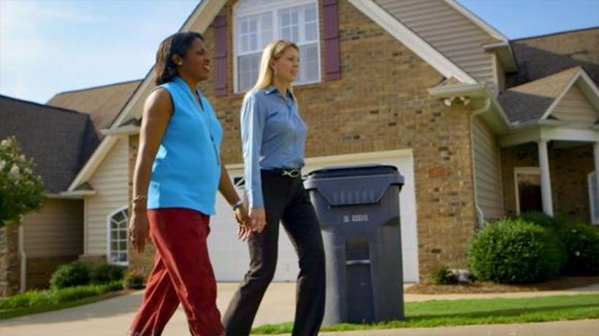


GROUP ACTIVITY
INTRODUCTION: YOU MAKE A DIFFERENCE
When a life‐threatening incident occurs, what would:
1
Boost the chances that someone will help?
2
Cause someone not to take action?
FEMA, 2015

Slide 21
WHEN PEOPLE ACT
INTRODUCTION: YOU MAKE A DIFFERENCE
TEND TO HELP
Event is unexpected, sudden
More than one person is injured
Experience the event firsthand
Believe they can help
Recognize an immediate threat to life that appears to be getting worse
Empathize with the injured
TEND NOT TO HELP
Assume professional medical responders will arrive quickly and take action
Feel they don’t know what to do
Are afraid

Slide 22

Bystander Effect
INTRODUCTION: YOU MAKE A DIFFERENCE

Slide 23
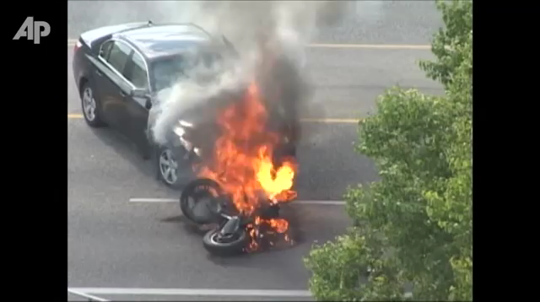
DIFFUSION OF RESPONSIBILITY
INTRODUCTION: YOU MAKE A DIFFERENCE
Video can be found at: https://www.youtube.com/watch?v=aIGTyANMFb4
Someone must be the first to act!
When multiple people witness an emergency, everyone assumes that someone else will help.
The first person to step forward often triggers a supportive response from others.

Slide 24
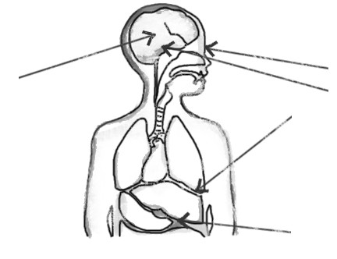
IMPACT OF STRESS
INTRODUCTION: YOU MAKE A DIFFERENCE
In an emergency, you will experience physical and psychological effects that may include:
•
Distortion of Senses:
Sight (Tunnel Vision)
Sound
Distortion of Time
Assessment Loop:
Denial
Deliberation
Action
Adrenaline (Fight/Flight Response)
Temperature change
Shaky
Loss of other functions
Nausea
22

Slide 25
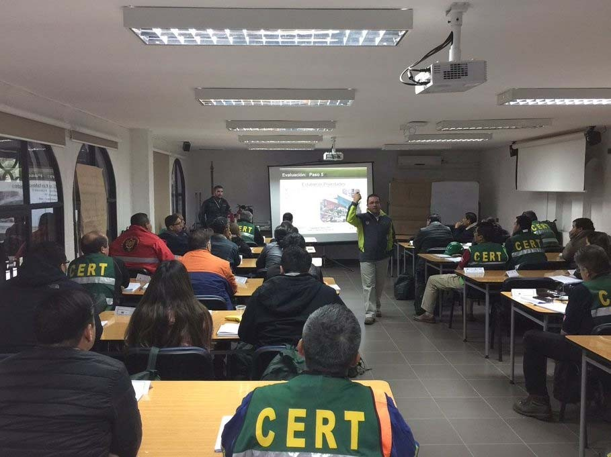
IMPROVE YOUR RESPONSE
INTRODUCTION: YOU MAKE A DIFFERENCE
Train your brain.
Talk about and practice what you would do in various emergency situations to improve the speed with which you respond.
FEMA, 2016

Slide 26




KEY POINTS
INTRODUCTION: YOU MAKE A DIFFERENCE
You are the first link in the Chain of Survival.
Stress can significantly affect how you respond.
Practice will improve your ability to act quickly and effectively.

Slide 27


25
Photo byoneinchpunch| Standard License

Slide 28


STEP ONE OBJECTIVES
STEP 1: CALL 9‐1‐1
By the end of this step, you will be able to:
Answer the 9‐1‐1 operator’s questions.
Work with them during the call to help the injured.

Slide 29


GROUP ACTIVITY
STEP 1: CALL 9‐1‐1
Instructions:
1
How many of you have ever called 9‐1‐1?
2
If you have called 9‐1‐1, rate your demeanor on the phone using your fingers, on a scale of 1 – 5. (1 = not calm and 5 = really calm)

Slide 30
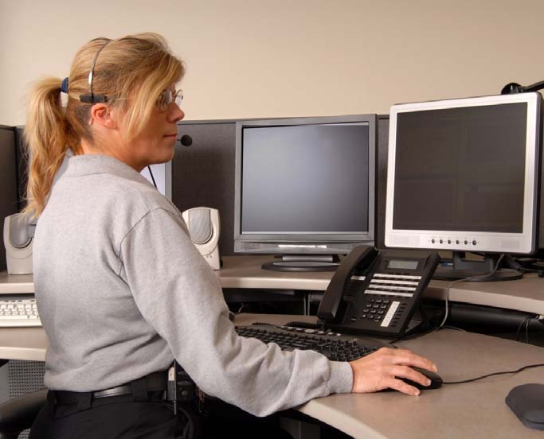



CALL 9‐1‐1
STEP 1: CALL 9‐1‐1
9‐1‐1 operators are highly trained and will help you:
Assess what is going on. Take appropriate action. Be as safe as possible.
It always helps to call – don’t assume someone else has already done so.
Photo by HHLtDave5 | Royalty‐Free

Slide 31



9‐1‐1 CALL: SHOOTING
STEP 1: CALL 9‐1‐1
9‐1‐1 call for a woman shot at an apartment complex
Please select the picture within the slide to play the audio
Photo by Manual on Uniform Traffic Control Devices | Public Domain
Audio can be found at:
Soundcloud Link

Slide 32
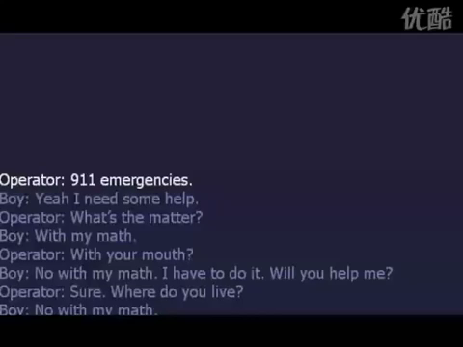
9‐1‐1 CALL: HOME INJURY
Video can be found at: https://youtu.be/YoTIaRyGzac?list=PLE8lPyHpIOnp_UBWU3 NDo7l7U1uHx_KoF
STEP 1: CALL 9‐1‐1

Slide 33


YOU AND THE 9‐1‐1 OPERATOR
STEP 1: CALL 9‐1‐1
Keep calm and follow directions:
Take a deep breath.
Let the 9‐1‐1 operator guide you.
The questions they ask help send the right resources to the right place. Depending on the situation, they will give you specific instructions – follow their lead and let them coach you through the situation.

Slide 34
COMMON QUESTIONS
STEP 1: CALL 9‐1‐1
Q
Where: Specific locations such as floor, room number, landmarks
So responders can find you easily and quickly.
Type and severity of life‐threatening situation
So the right responders and equipment are sent.
Safety concerns (obvious dangers or ongoing threats)
To help protect and aid everyone on the scene.
Q
Q

Slide 35


GROUP ACTIVITY
STEP 1: CALL 9‐1‐1
Instructions:
1
Use the scenario and role play as the witness.
2
Relay crucial information to the operator (role‐played by the instructor) using what you just learned on the previous slides.

Slide 36
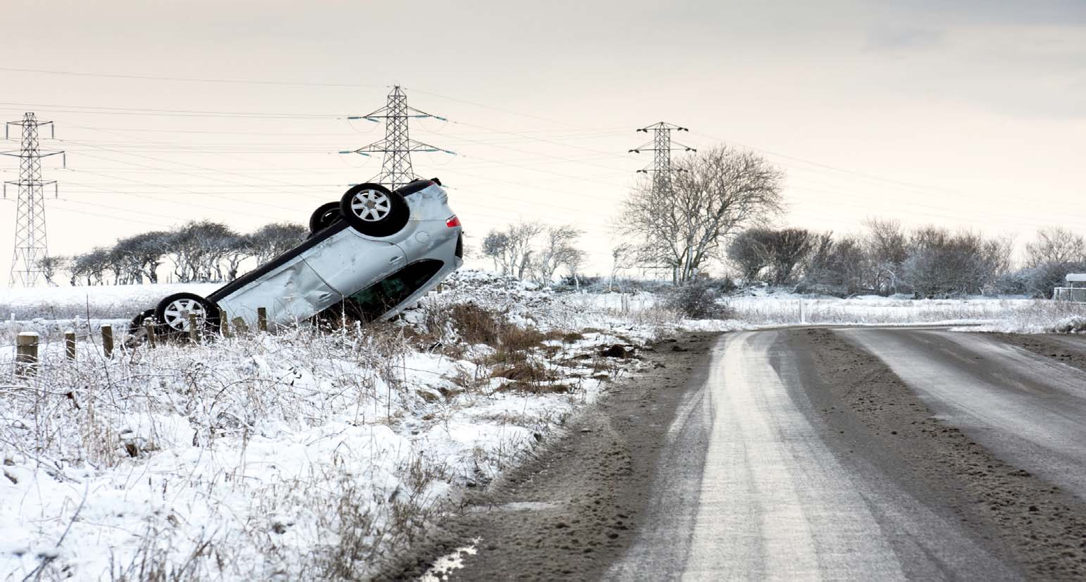
Photo by neilkendall | Standard license
SCENARIO

Slide 37




ACTIVITY DISCUSSION
STEP 1: CALL 9‐1‐1
Specific Locations: Mile markers, closest exit, nearby road sign, direction of travel
Incident Details: Car position, number of cars involved
Injuries: Awake? Talking? In pain? Breathing?
Potential Hazards: Flammable liquids, unstable ground, oncoming traffic

Slide 38




KEY POINTS
STEP 1: CALL 9‐1‐1
Always call 9‐1‐1 as soon as possible, but never delay bleeding control or moving someone away from imminent danger.
Provide as much specific information as possible including where you are, what happened, how many are injured, the severity of the injuries, and any potential hazards.
Follow the operator’s instructions and guidance.

Slide 39
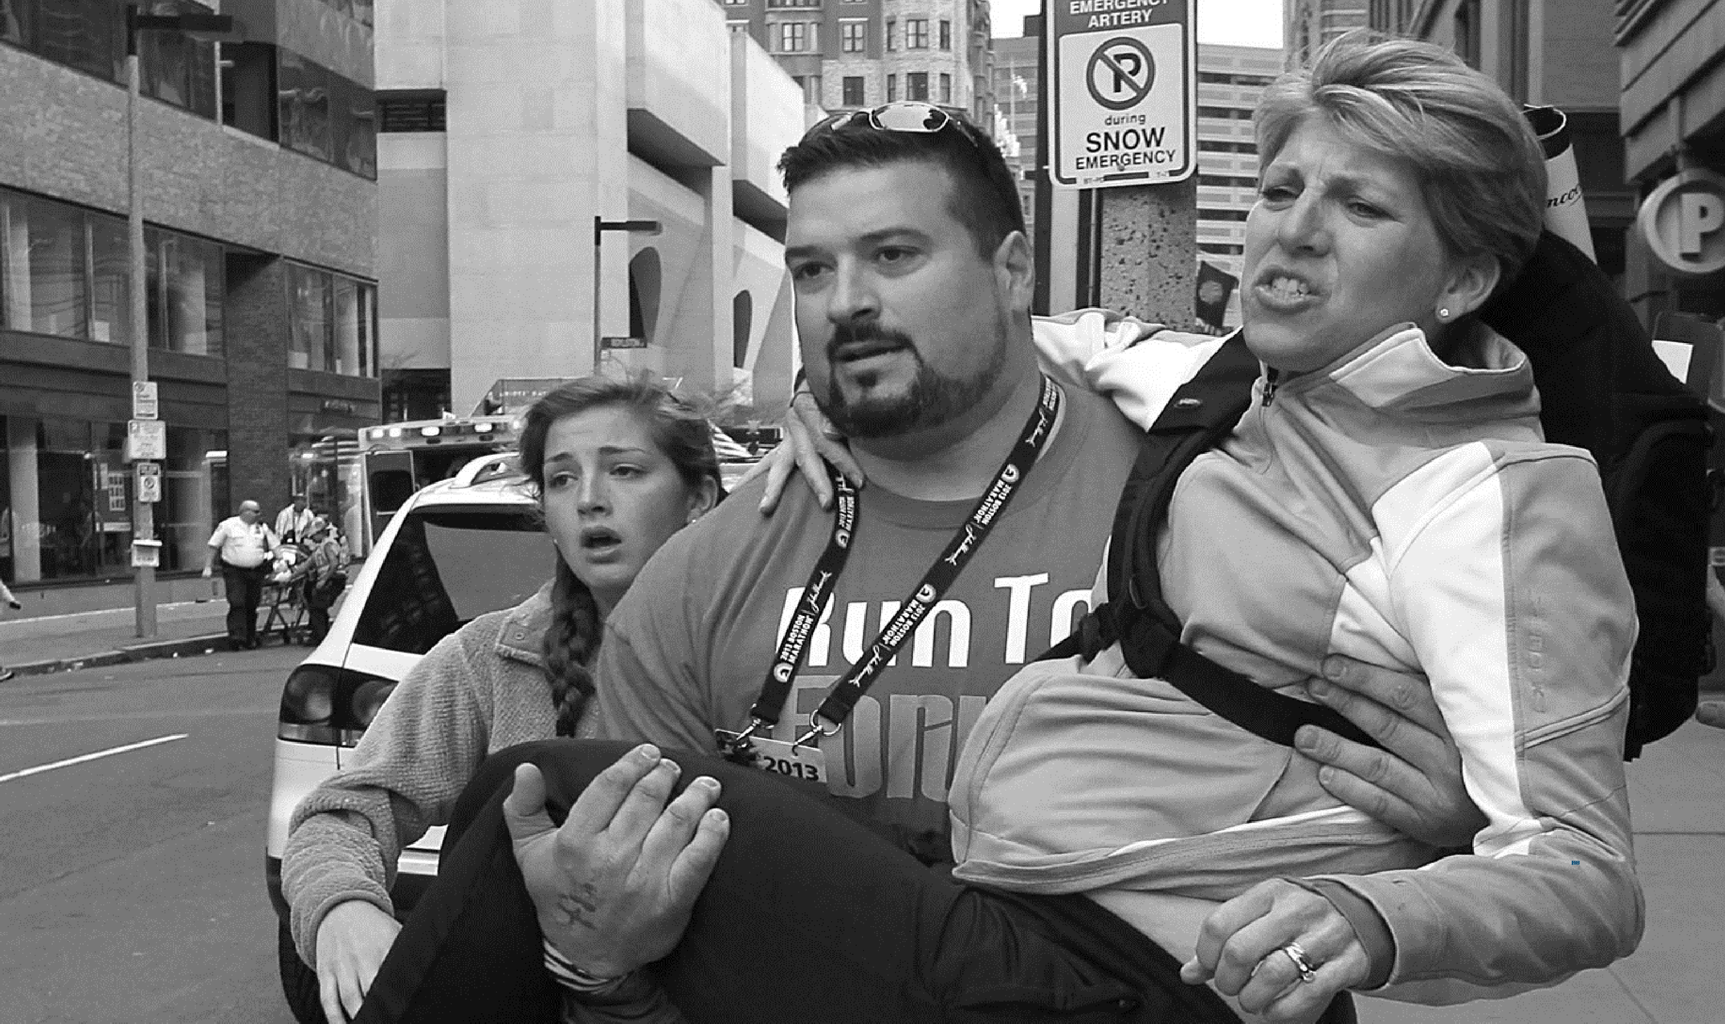

37
Photo by Bill Greene/The Boston Globe | Noncommercial

Slide 40


STEP TWO OBJECTIVES
STEP 2: STAY SAFE
By the end of this step, you will be able to:
Decide whether to stay and help, move the injured to safety, or get yourself to safety.
Demonstrate how to safely move an injured person away from further harm.

Slide 41

ASSESS THE SITUATION
STEP 2: STAY SAFE
Briefly pause. Use all your available senses:
What do you see?
Downed power lines
Smoke
Debris
Moving vehicles
People running
What do you hear?
Voices
Creaking
Hissing
Booms
Gunshots
What do you smell?
Gasoline
Smoke
Chemicals

Slide 42


GROUP ACTIVITY
STEP 2: STAY SAFE
Instructions:
1
For the following slides, write down what you may see, hear, or smell.
2
Look for hazards and resources.

Slide 43
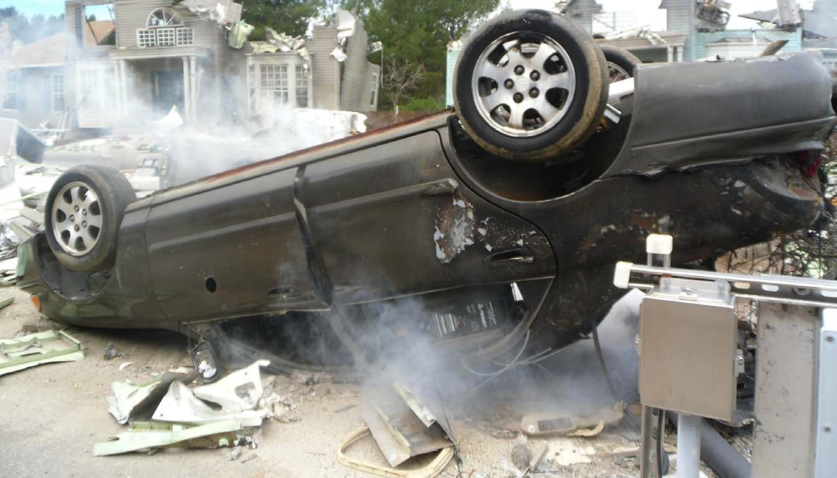
Photo by Pixabay | CC0
SCENE: CAR CRASH

Slide 44
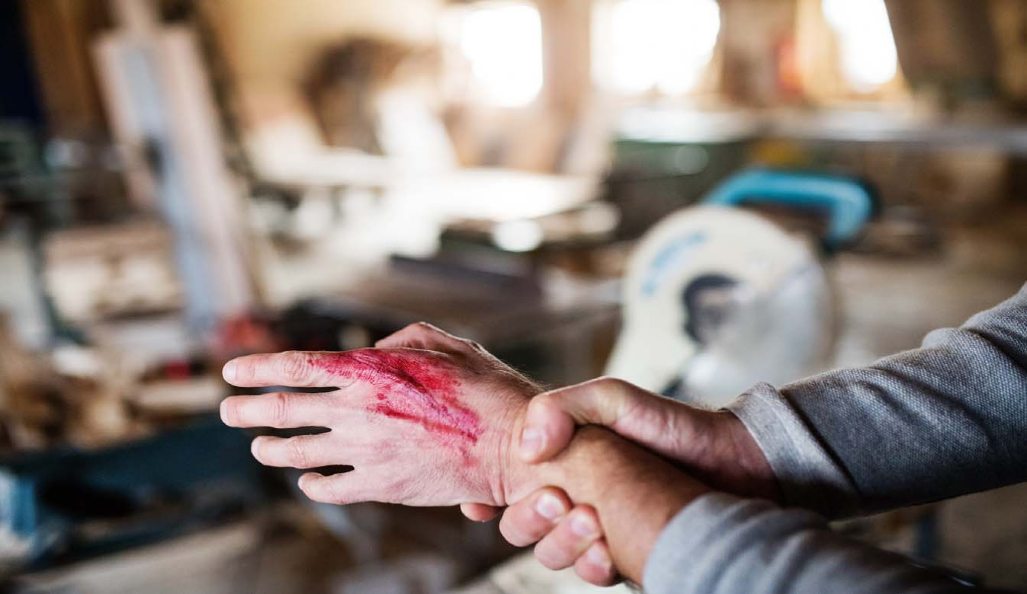
Photo by Halfpoint| Royalty‐Free
SCENE: CIRCULAR SAW INJURY
42

Slide 45
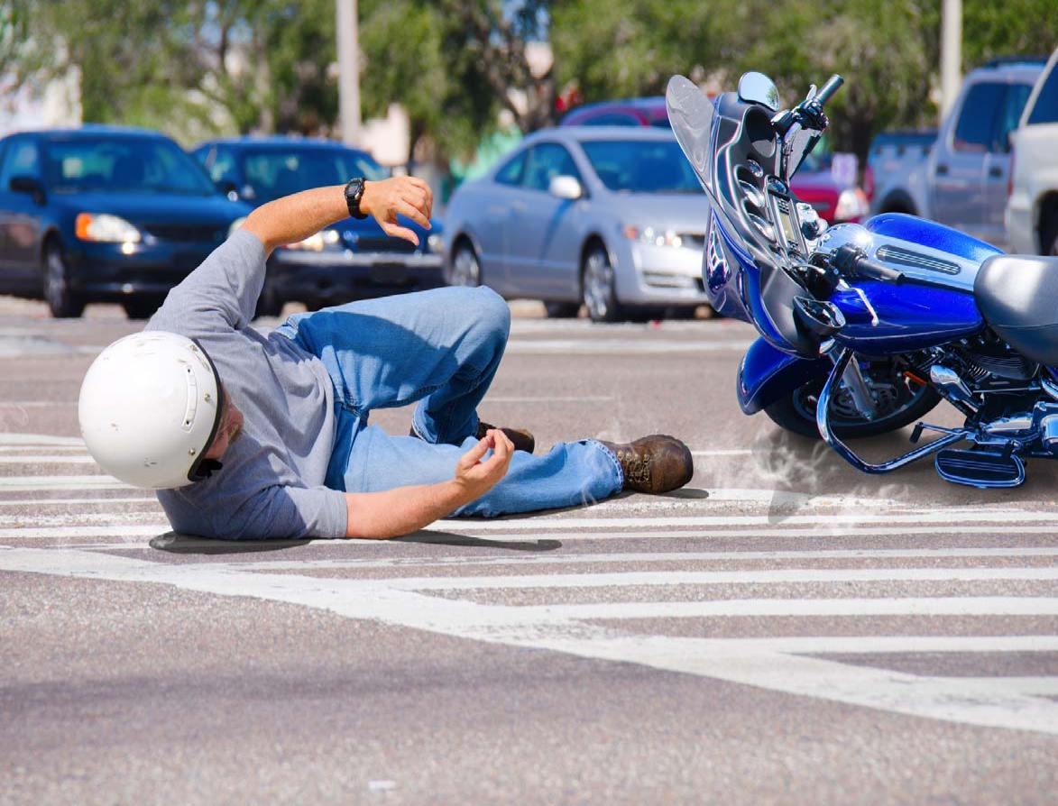
Photo by Halfpoint| Royalty‐Free
SCENE: MOTORBIKE ACCIDENT
43

Slide 46
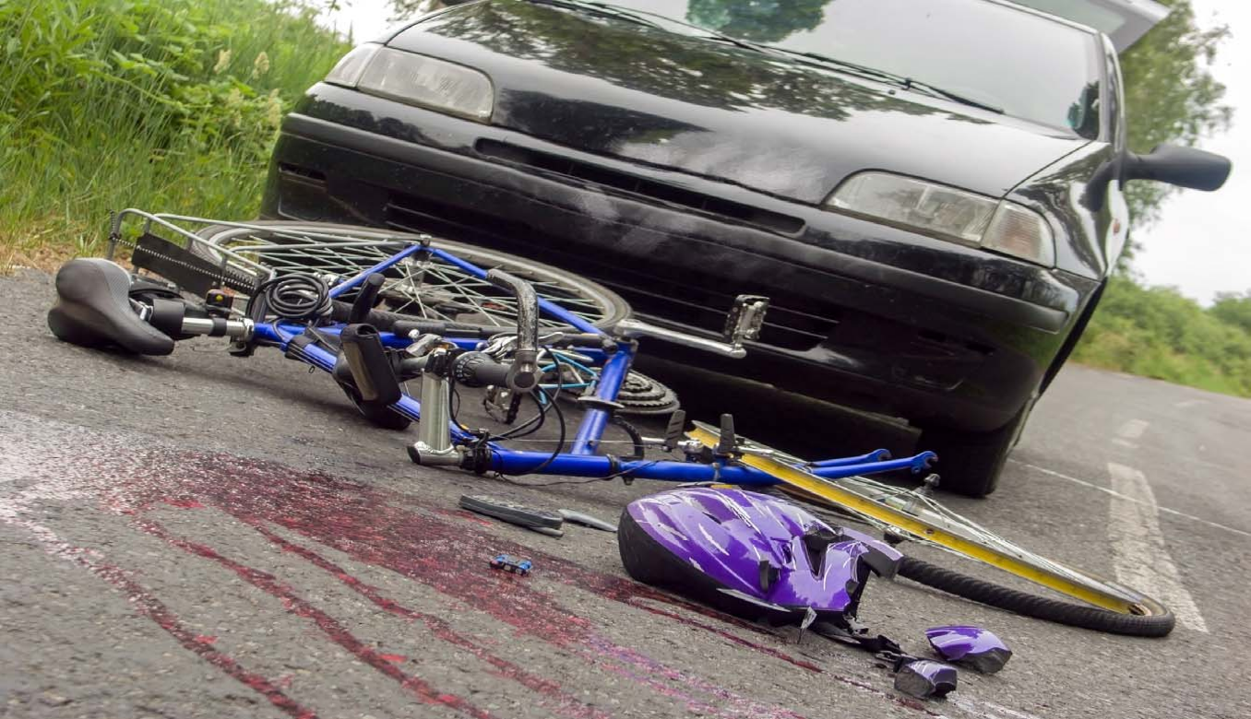
Photo byoneinchpunch| Standard License
SCENE: BICYCLE ACCIDENT

Slide 47
ACTIVITY REVIEW
STEP 2: STAY SAFE
What did you notice?
Car Crash
Circular Saw Injury
Motorbike Accident
Bicyclist Struck

Slide 48
BEFORE TAKING ACTION
STEP 2: STAY SAFE
Use your best judgment…
No
No
Do you feel safe here?
Can you move the injured person?
LEAVE
Move to a safe location
Yes
Yes
STAY
Start providing care
LEAVE
Take the injured person out of harm’s way

Slide 49
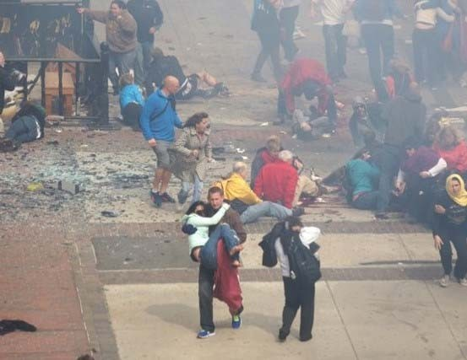
HOW TO MOVE THE INJURED
STEP 2: STAY SAFE
Move Smartly
Get help from others around you
Use things around you, such as blankets, chairs, and carts.
Moving an injured person who is in grave danger will not cause more harm than leaving them to die.
Photo by Aaron Tang | CC BY 2.0

Slide 50
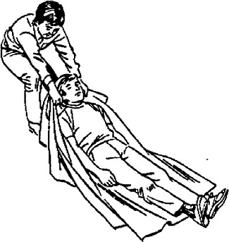
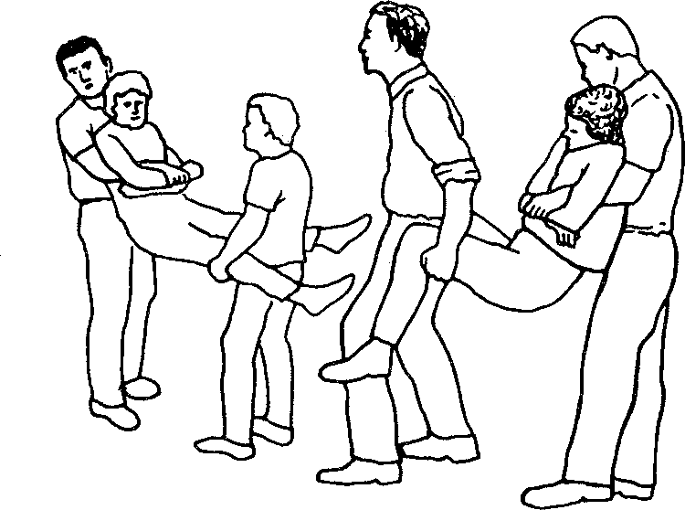
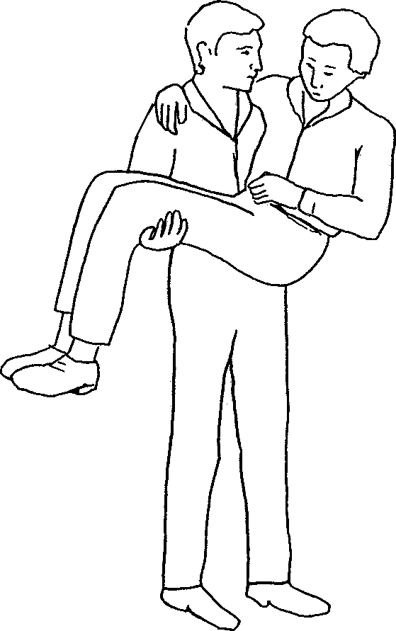
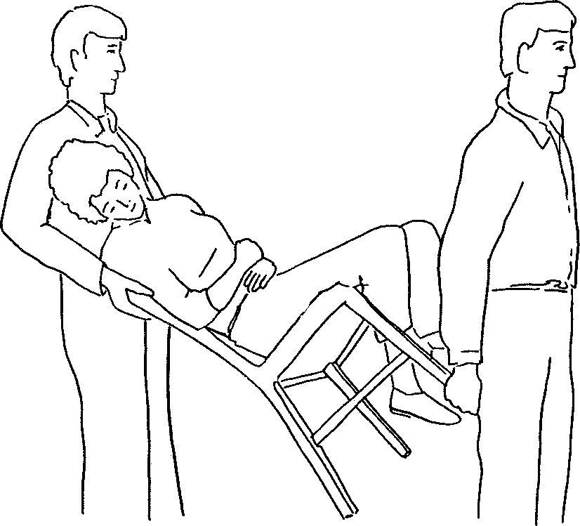
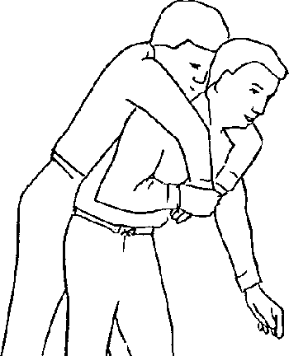
HOW TO MOVE THE INJURED
STEP 2: STAY SAFE
Drags and one‐person carries for moving injured short distances
Two‐person carries for longer distances
Boy Scouts of America, 1995
48

Slide 51



KEY POINTS
STEP 2: STAY SAFE
Use your senses to gain situational awareness.
When you can, move the injured away from harm using others to assist if possible.
Use your best judgment, you are the help until help arrives.

Slide 52
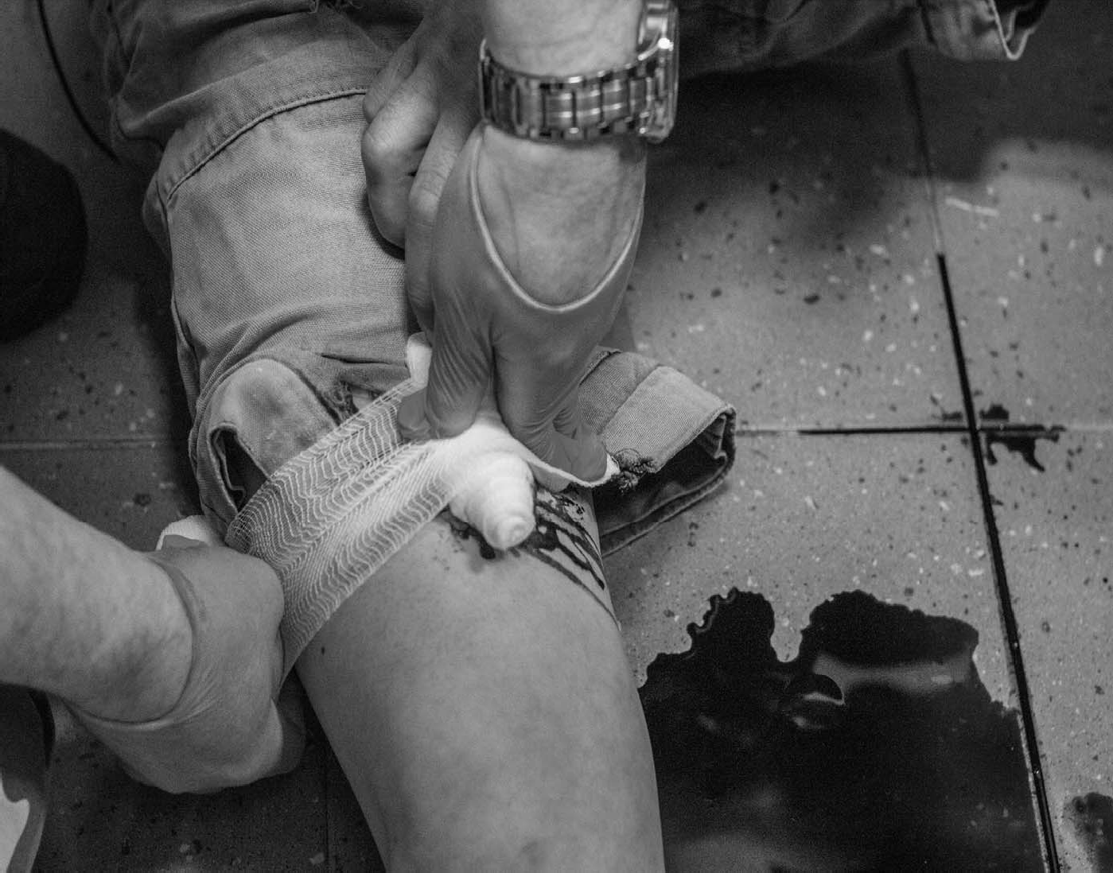


Slide 53




STEP THREE OBJECTIVES
STEP 3: STOP THE BLEEDING
By the end of this step, you will be able to:
Recognize life‐threatening bleeding.
Apply firm, steady pressure to stop bleeding. Understand when to use a tourniquet.
Optional: Apply a tourniquet.

Slide 54

WHY STOP THE BLEEDING
STEP 3: STOP THE BLEEDING
Video can be found at: https://www.youtube.com/watch?v=z331Zcmropc
Stop the Clock!
Every minute with uncontrolled bleeding decreases the chance of survival!
35% of pre‐hospital trauma deaths are due to blood loss.*
*Jones, A. R., & Frazier, S. K. (2014). Increased mortality in adult trauma patients transfused with blood components compared with whole blood. Journal of trauma nursing: the official journal of the Society of Trauma Nurses

Slide 55
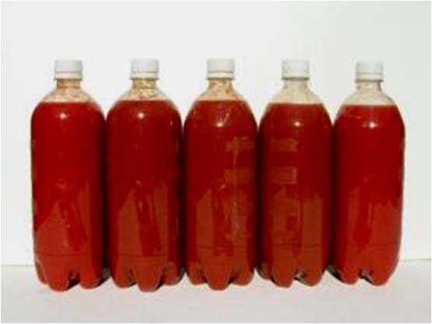
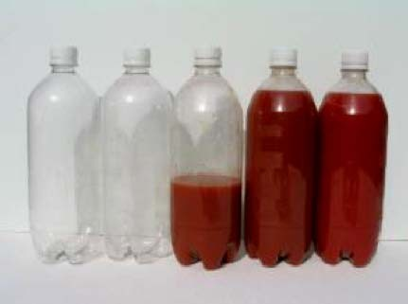
STEP 3: STOP THE BLEEDING
IRREVERSIBLE SHOCK
This is the average amount of blood in the body.
When your body loses approximately half its blood volume, it cannot survive –
regardless of the quality of medical care you eventually receive.
5 liters
You can lose that amount in just minutes!
2.5 liters

Slide 56

HOW TO STOP THE BLEEDING
STEP 3: STOP THE BLEEDING
Video can be found at: https://www.youtube.com/watch?v=e1nR5stSZn0

Slide 57


STEPS TO CONTROL BLEEDING
STEP 3: STOP THE BLEEDING
1
Find the source(s) of bleeding.
2
If you have something to put in between the blood and your hands, use it. Examples include gloves, a cloth, or a plastic bag.
3
Apply firm, steady pressure directly on the source of the bleeding. Push hard to stop or slow bleeding – even if it is painful to the injured!
4
Keep applying pressure until EMS arrives.

Slide 58
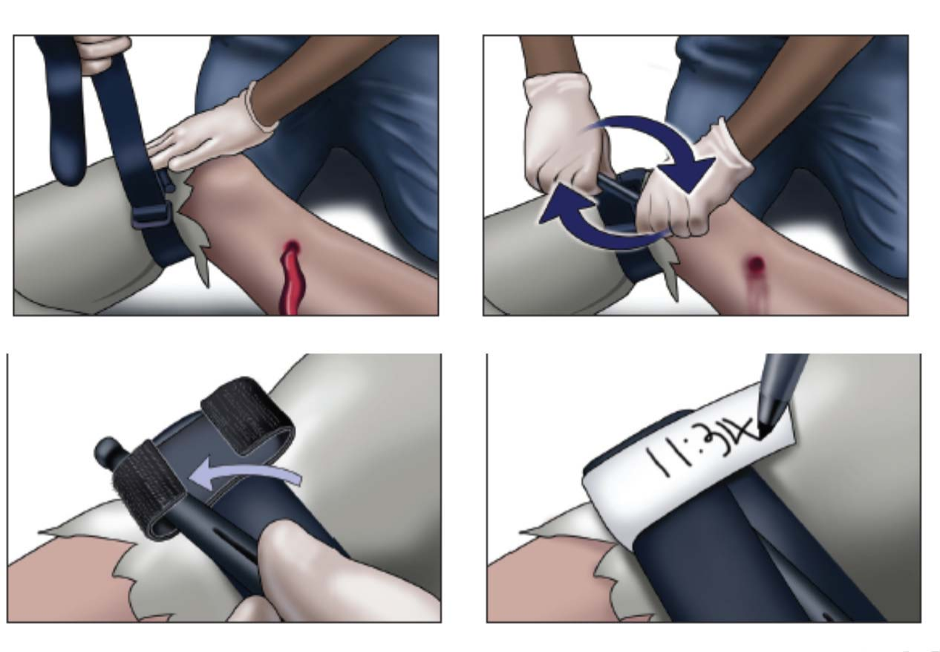
WHEN TO USE A TOURNIQUET
STEP 3: STOP THE BLEEDING
Think of a tourniquet as another way to apply firm, steady pressure when:
The injury is to an arm or leg.
The bleeding is so severe it cannot be controlled otherwise.

Slide 59
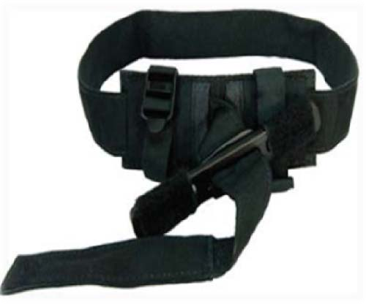



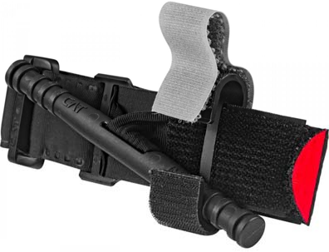
HOW TO USE A TOURNIQUET (OPTIONAL)
STEP 3: STOP THE BLEEDING
1
Place as high up as possible on the injured limb – closer to the torso. It can be placed over clothing.
2
Pull the strap through the buckle.
3
Twist the rod tightly until bleeding stops/slows significantly. This may be painful!
4
Secure the rod.
5
If bleeding doesn’t stop, place a second tourniquet.
6
Leave in place until EMS takes over care.

Slide 60




MAKESHIFT TOURNIQUETS (OPTIONAL)
STEP 3: STOP THE BLEEDING
If you don’t have a commercially available tourniquet, you can attempt to improvise one using material that is:
Broad Flexible Strong
Able to be twisted, tightened, and secured.

Slide 61


KEY POINTS
STEP 3: STOP THE BLEEDING
Apply firm, steady pressure on the source of bleeding.
If you cannot control the bleeding with manual pressure, then consider applying a tourniquet.
Continue applying pressure and do not remove a tourniquet until professional first responders arrive.

Slide 62
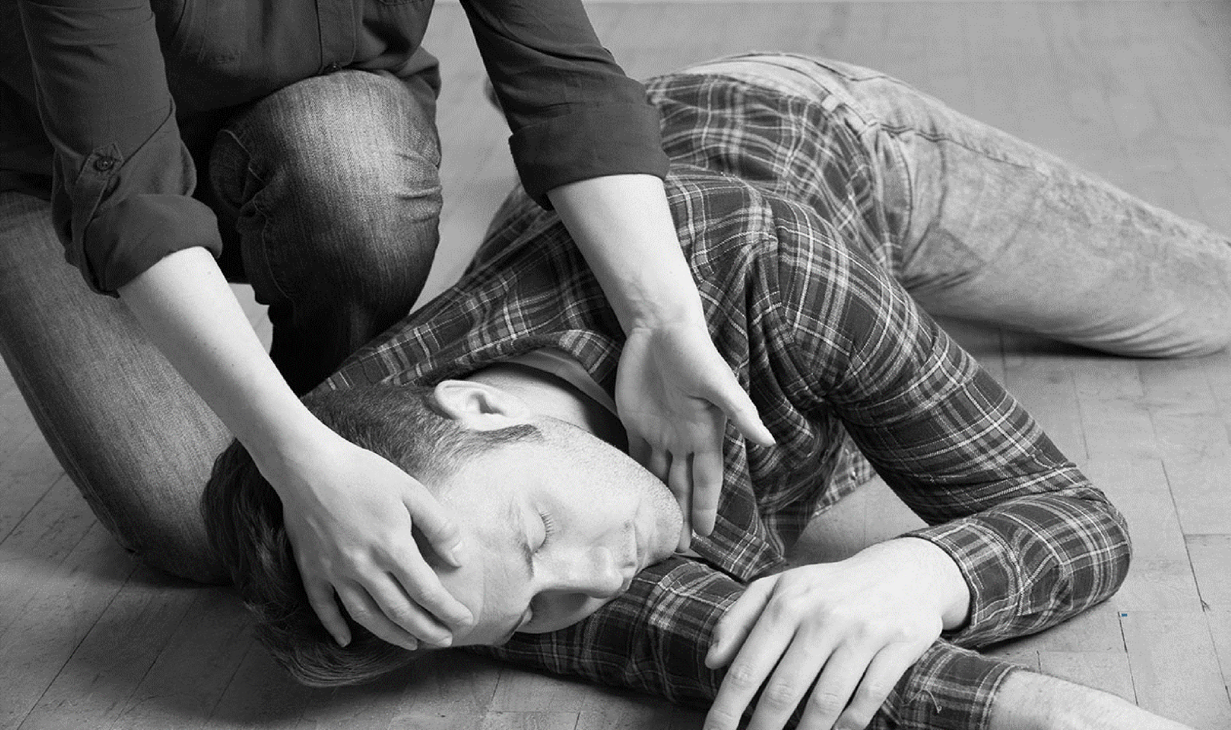

61
Photo by John Tlumacki /AP | Noncommercial

Slide 63


STEP FOUR OBJECTIVES
STEP 4: POSITION THE INJURED
By the end of this step, you will be able to:
Describe life‐preserving body positions for an injured person who is conscious.
Describe life‐preserving body positions for an injured person who is unconscious.

Slide 64
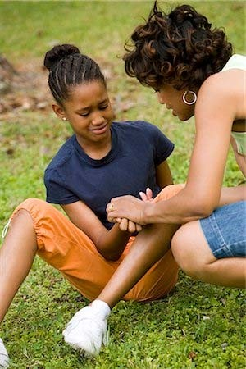
ALLOW SELF‐MANAGEMENT
STEP 4: POSITION THE INJURED
When a person is conscious and breathing, allow them to position themselves; if they are struggling to do so, assist them.
Do not force them to lie down or sit up!
Photo by Purestock | Royalty‐Free

Slide 65
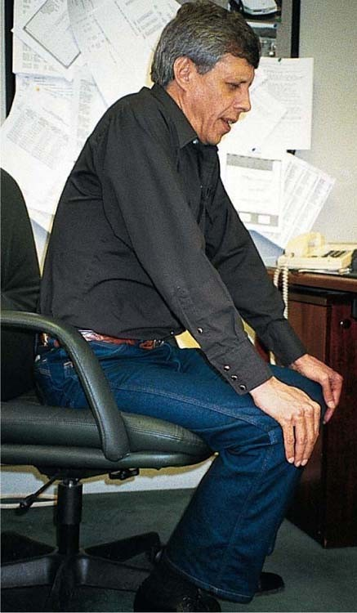
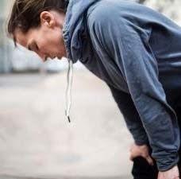
TRIPOD POSITION
STEP 4: POSITION THE INJURED
Allows the lungs and ribcage to expand as fully as possible.
Biology‐forums.com
Biology‐forums.com
When sitting on a chair or bench: Legs shoulder width apart, elbows or hands on knees, leaning slightly forward.
When standing: Legs shoulder width apart, hands on knees arms straight, leaning forward with flat back.

Slide 66
ASSESS THE UNCONSCIOUS
STEP 4: POSITION THE INJURED
Yes
Is the injured person breathing?
Move the injured person into the recovery position
No
Yes
Do you know CPR?
Open the airway and begin CPR

Slide 67
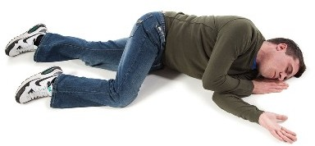
RECOVERY POSITION SETUP
STEP 4: POSITION THE INJURED
Top Arm Forearm resting on bicep of bottom arm
Mouth
Pointing downward
Legs
Bent slightly
Head
Resting on hand
Bottom Arm
Reaching outward
Imperativetraining.com | Open Source
Body
Laying on its side
Chin
Raised forward
66

Slide 68
MOVE WITH PURPOSE
STEP 4: POSITION THE INJURED
Although the risk is very small, it is possible that moving someone into the recovery position could cause harm to their spine.
Try to support the head and neck when rolling them onto their side.
Continue supporting their head if possible.
Don’t move the individual more than necessary.

Slide 69


GROUP ACTIVITY
STEP 4: POSITION THE INJURED
Demonstration:
1
Assume that the unconscious injured individual is breathing.
2
Position the individual in the recovery position using the technique you just learned.

Slide 70


KEY POINTS
STEP 4: POSITION THE INJURED
If someone is conscious and breathing, allow them to position themselves. Do not force the injured to lie down or sit up.
If someone is unconscious, move them into the recovery position. Minimize movement of the head and neck.

Slide 71
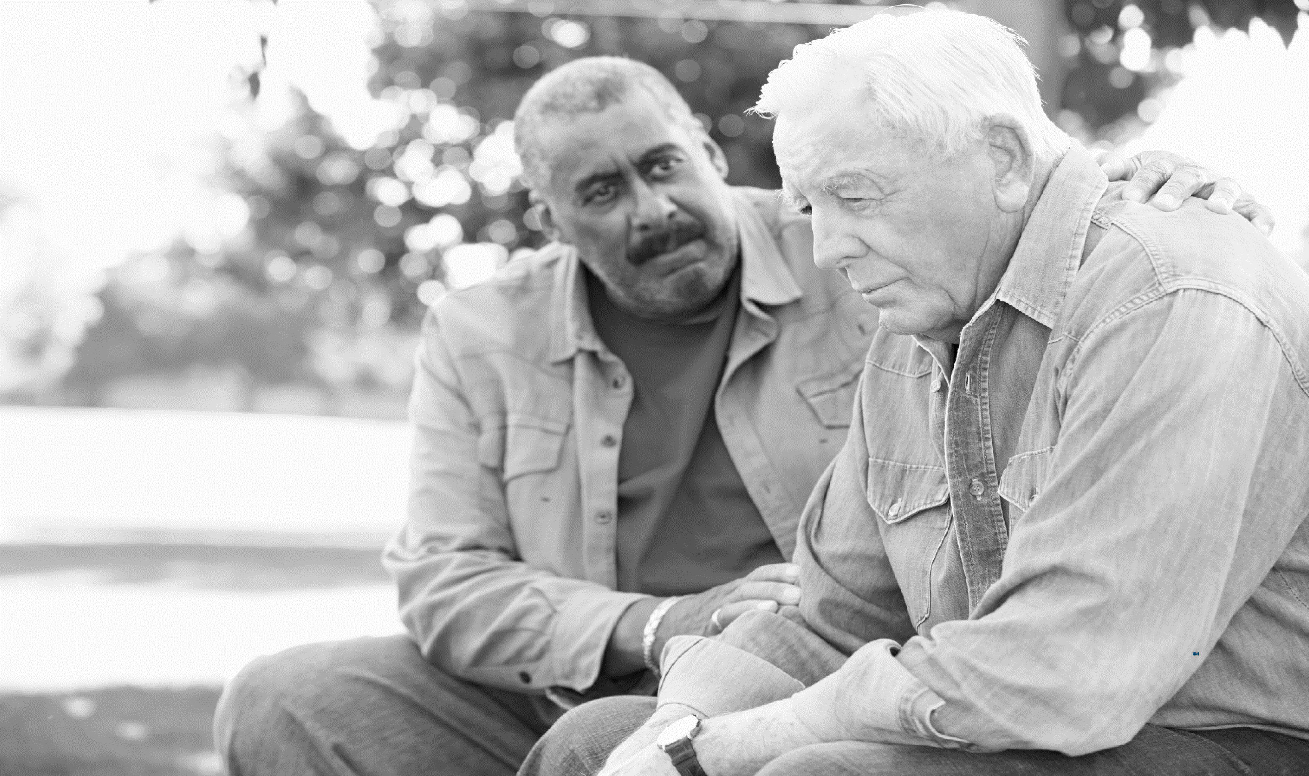

70
Photo by monkeybusinessimages | Standard License

Slide 72


STEP FIVE OBJECTIVES
STEP 5: PROVIDE COMFORT
By the end of this step, you will be able to:
Use simple words to comfort and engage with the injured.
Use simple actions to provide comfort and practical assistance.

Slide 73


GROUP ACTIVITY
STEP 5: PROVIDE COMFORT
Instructions:
Think about if…
1
You were in a position to provide comfort and assistance to someone else.
2
Someone else provided comfort and assistance to you.
3
What did you/they do? How did it affect you?
4
Write down your memories of the experience.

Slide 74
SIMPLE WORDS
STEP 5: PROVIDE COMFORT
What can you say?
Share names and ask basic Tell them: questions:
What happened, but don’t speculate.
How can I help?
What do you need?
What happened?
What is being done to assist them.
What is going to happen next.

Slide 75
SIMPLE ACTIONS
STEP 5: PROVIDE COMFORT
What can you do?
Keep them warm.
Offer a hand to hold.
Maintain eye contact.
Be patient and understanding.
If you have to move on to provide aid to another person, let them know.

Slide 76
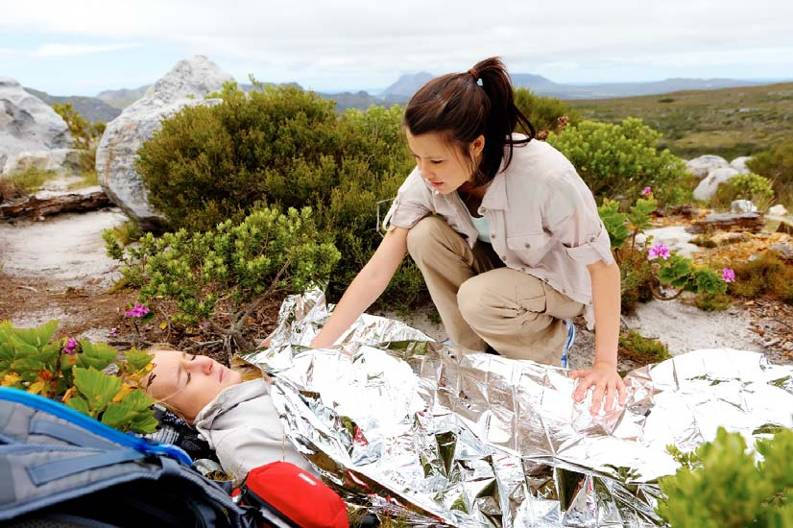
KEEPING THE INJURED WARM
STEP 5: PROVIDE COMFORT
Keeping the injured person warm will:
Improve blood clotting.
Reduce stress on the body.
Provide a level of comfort.
Photo by warrengoldswain| Standard License

Slide 77
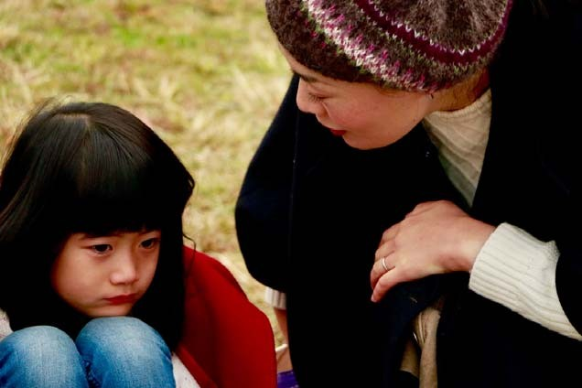
WORKING WITH CHILDREN
STEP 5: PROVIDE COMFORT
Sit or crouch at eye level.
Shield them as much as possible from the scene; create a barrier between them and the injured.
Use simple words.
Listen carefully and ask questions to make sure they understand.
Photo by Nayomiee| Standard License
Be aware that children may start
acting younger than their age.

Slide 78
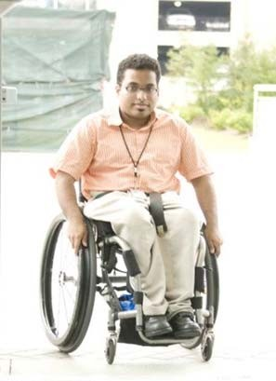
WORKING WITH THOSE WITH DISABILITIES AND ACCESS AND FUNCTIONAL NEEDS
STEP 5: PROVIDE COMFORT
Ask what you can do to help, don’t assume.
If the person has a caregiver or family member with them, keep them together.
If the person has medical equipment or a service animal with them, keep them together.
Confusion, difficulty hearing, loss of memory, and other similar issues may be the result of injuries.
Photo by Nayomiee| Standard License

Slide 79



KEY POINTS
STEP 5: PROVIDE COMFORT
Keep the injured warm.
Ask permission to provide help if the injured person is conscious. Be respectful of individual needs.

Slide 80
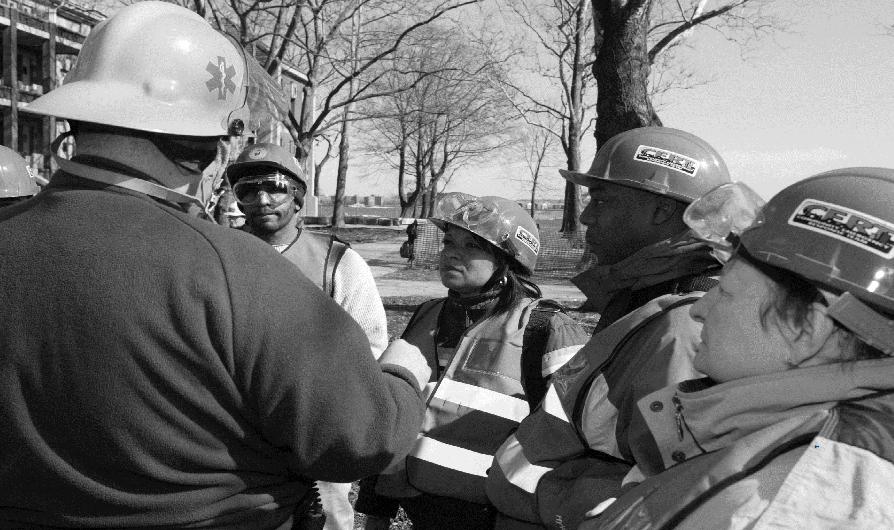

79
FEMA, 2016

Slide 81
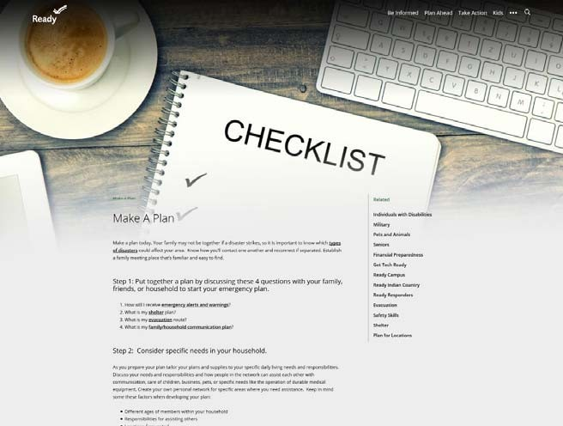




PREPARE AT HOME
BEFORE YOU GO: PREPARE TO HELP
Make a plan.
Keep supplies at home, work, and in your vehicle.
Sign up for emergency alerts and warnings. Practice.

Slide 82






EMERGENCY AID KIT
BEFORE YOU GO: PREPARE TO HELP
For life‐threatening events, have one kit for home, work, and vehicles:
Emergency trauma dressing(s) – 6‐inch S‐rolled gauze
An effective tourniquet with instructions Trauma shears
Gloves
Emergency blanket
Bag/Container to hold the equipment and dressings

Slide 83




ENHANCE YOUR SKILLS
BEFORE YOU GO: PREPARE TO HELP

Slide 84
SUPPLEMENTAL RESOURCES

Slide 85





ENHANCE YOUR SKILLS
BEFORE YOU GO: PREPARE TO HELP
Training Programs
First Aid
Heartsaver CPR/AED Babysitting and Child Care Lifeguard Swimming/Water Safety
www.redcross.org/take‐a‐class

Slide 86





ENHANCE YOUR SKILLS
BEFORE YOU GO: PREPARE TO HELP
Training Programs CPR/AED & First Aid CPR in Schools Hands‐Only CPR Workforce Training
www.cpr.heart.org

Slide 87




ENHANCE YOUR SKILLS
BEFORE YOU GO: PREPARE TO HELP
Community Emergency Response Teams (CERT)
Respond to emergencies in your neighborhood.
Learn basic disaster preparedness and response skills. Improve the resilience of your community.
www.ready.gov/CERT

Slide 88



ENHANCE YOUR SKILLS
BEFORE YOU GO: PREPARE TO HELP
Medical Reserve Corps (MRC)
As a member of an MRC unit, you can be part of an organized and trained team.
You will be ready and able to bolster local emergency planning and response capabilities.
Many MRC volunteers assist with activities to improve public health in their community.
https://mrc.hhs.gov

Slide 89
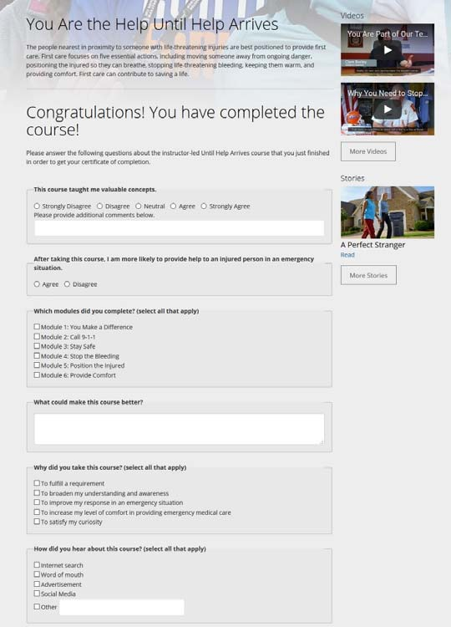
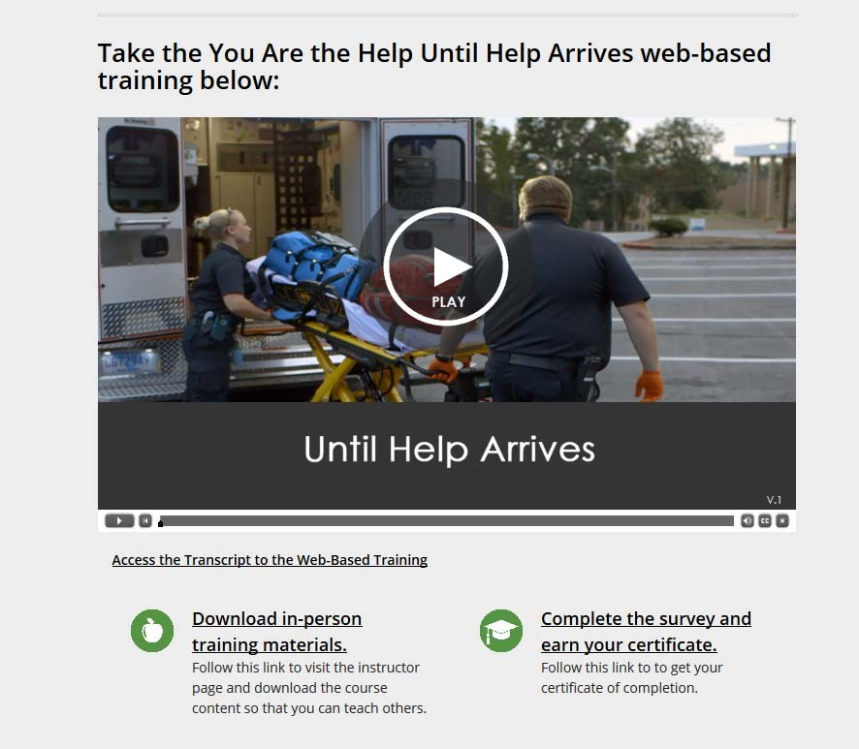
SURVEY AND CERTIFICATE
https://www.ready.gov/until‐help‐arrives
1
2

Slide 90
THANK YOU

